Slide 1


Slide 2
Contents
• Company Background
• Internship experience
• Project work
• conclusion

Slide 3

Company Background
History
Alpha IT Solution, at Addis Ababa since 2019
Founded By Mr. Dawit
Recognized in Clutch and Shortlist rankings.
Fig Company logo

Slide 4
…Company Background
Service
Website Design and Development
eCommerce Platform Design and Development
Graphic Design and Multimedia
Software and Customer Portal
Network Consulting and Installation

Slide 5
…Company Background
Some products
Jafer_Books/Online_Book_Store_with_Home_Delivery
Asbeza website
Haro_Coffee_Export_Company
And other websites

Slide 6
…Company Background
Main Customer/End User
SMEs and large corporations
Entrepreneurs and startups
Online retailers and businesses
Educational institutions
Nonprofit organizations
Government agencies
Healthcare providers
Professional service providers

Slide 7
…Company Background
Organizational Structure
Founder/Lead Developer/Mr. Dawit handles all parts of the task
Workflow:
Client Onboarding
Project Planning
Development Phase
Testing and Debugging
Client Review
Launch and Deployment
Post-Launch Support

Slide 8
Internship experience
Section we assigned
Web development
Tasks Executed
Detail understand of chosen technology
Template selection and database design
Codding
Testing

Slide 9
…Internship experience
System Development, Tools, and Techniques Used
HTML/CSS
PHP Server-Side
MySQL Database
Bootstrap Framework
JavaScript Interactivity

Slide 10
…Internship experience
Challenges and Problems
Unprepared Workspace
Technical Challenge specially to design database
Time Constraints Dilemma
Coordination Issues
Internet Block Challenge specially after finish four-month

Slide 11
…Internship experience
solutions
Understanding technologies up to preparing workspace
Theoretical Enrichment Amid Challenges
Task Prioritization for Efficiency
Collaborative Communication Strategies
Try to do offline even if tiring

Slide 12
…Internship experience
Skills and experience gained
Practical skills
HTML and CSS Proficiency ,PHP and MySQL Implementation Bootstrap
Theoretical skills
Understanding of those tools
Team playing skills
Effective Communication in Team , Cooperation in Group

Slide 13
…Internship experience
…skills and experience gained
Leadership Skill:
Initiative in Decision-making Guidance and Team Oversight
Entrepreneurship Skills:
Innovation in E-commerce Development Adaptability in Project Evolution Strategic Thinking for Scalability
Communication Skill:
Effective Communication Within and Beyond Team Technical Concepts

Slide 14
Project Work: “E-commerce website OneTech”
Problem statement
Conventional online/in person shopping especially in our country poses challenges, user fatigue, limited accessibility, limited speed, and doesn’t meet market demands for innovation.
Solution
Our strategic e-commerce website development solution aims to avoid fatigue, ensure accessibility, fast due selected technology and enhance client satisfaction, redefining the online shopping experience and meeting modern consumer expectations.

Slide 15
…E-commerce website OneTech”
Objective
Developing high speed e-commerce.
Personalizing shopping experiences and fostering client engagement for a memorable journey.
Prioritizing accessibility, security, and sustainability to create an inclusive and trustworthy e-commerce platform.

Slide 16
…E-commerce website OneTech”
Methodology
Template utilization emphasizing simplicity and uniqueness for brand identity.
Database design optimized for efficient e-commerce operations and data management.
User-centric focus through research and usability testing for a seamless shopping experience.

Slide 17
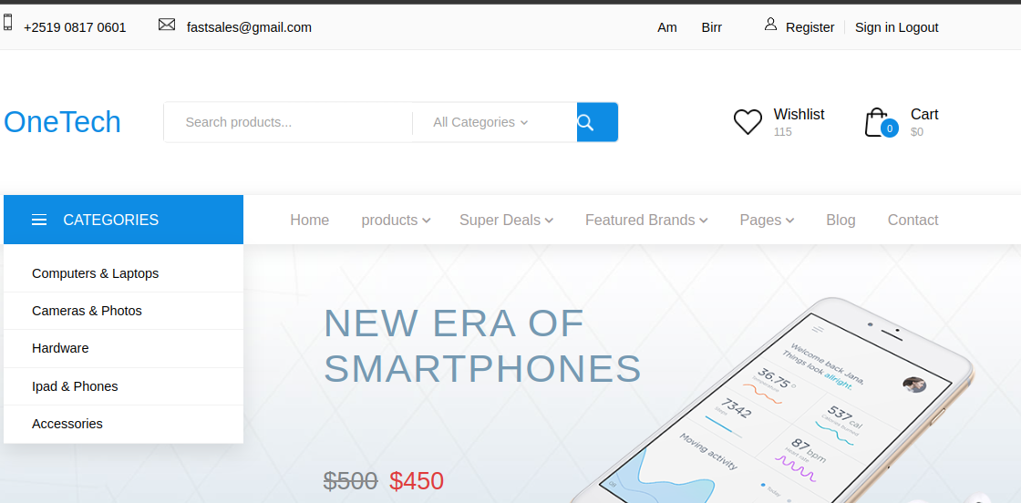
…E-commerce website OneTech” sample screenshots
Screenshot

Slide 18
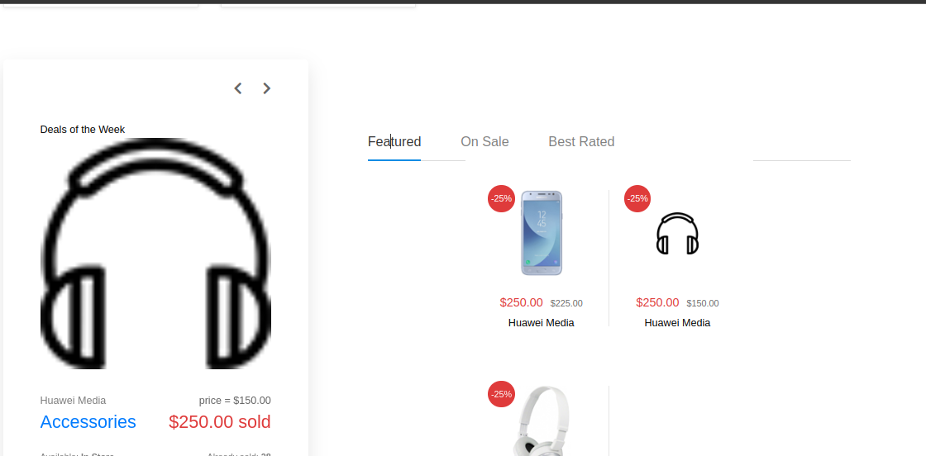
…E-commerce website OneTech” sample screenshots

Slide 19
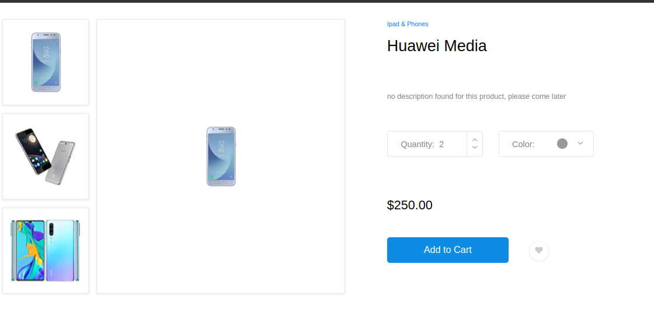
…E-commerce website OneTech” sample screenshots

Slide 20
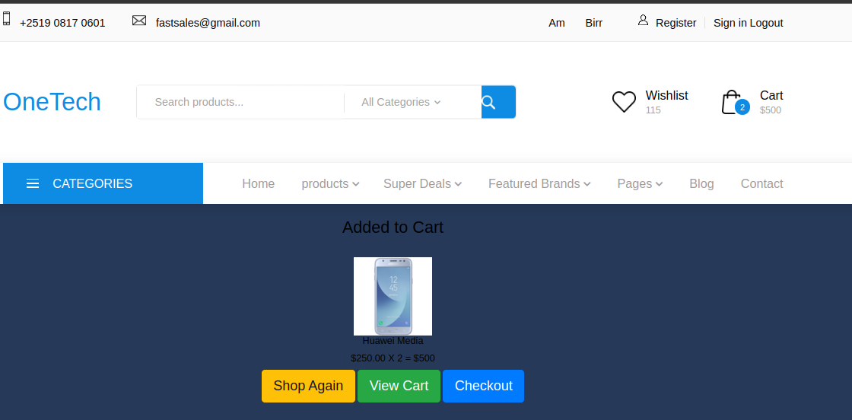
…E-commerce website OneTech” sample screenshots

Slide 21
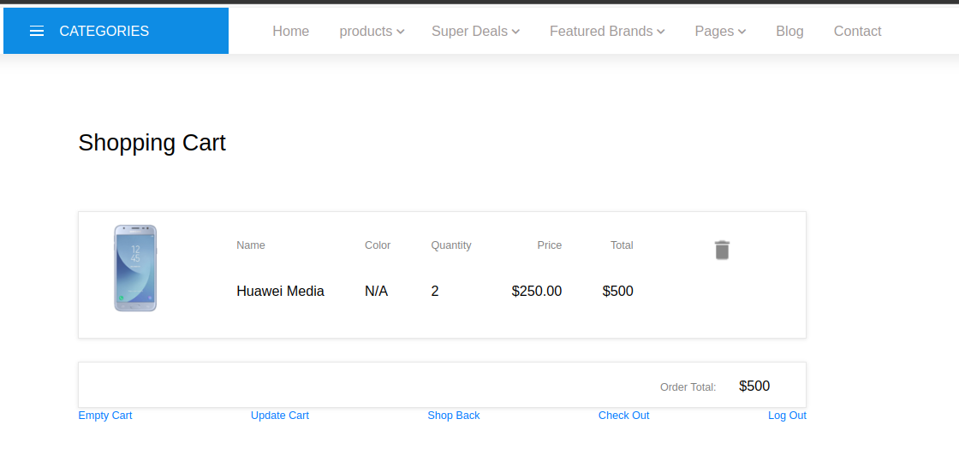
…E-commerce website OneTech” sample screenshots

Slide 22
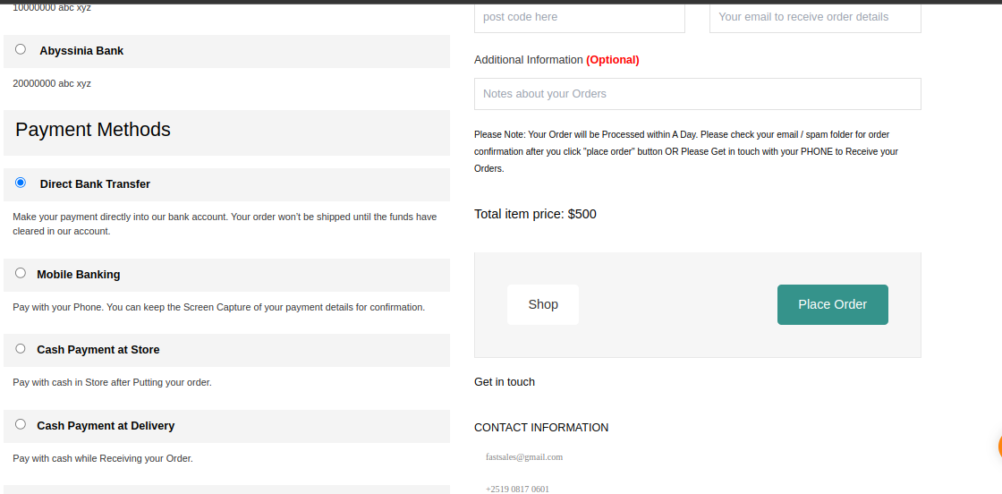
…E-commerce website OneTech” sample screenshots

Slide 23
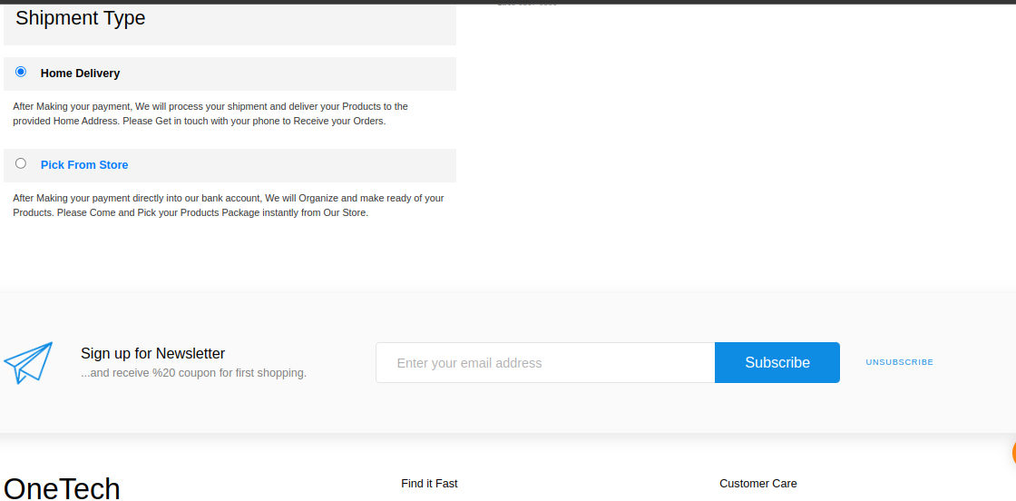
…E-commerce website OneTech” sample screenshots

Slide 24
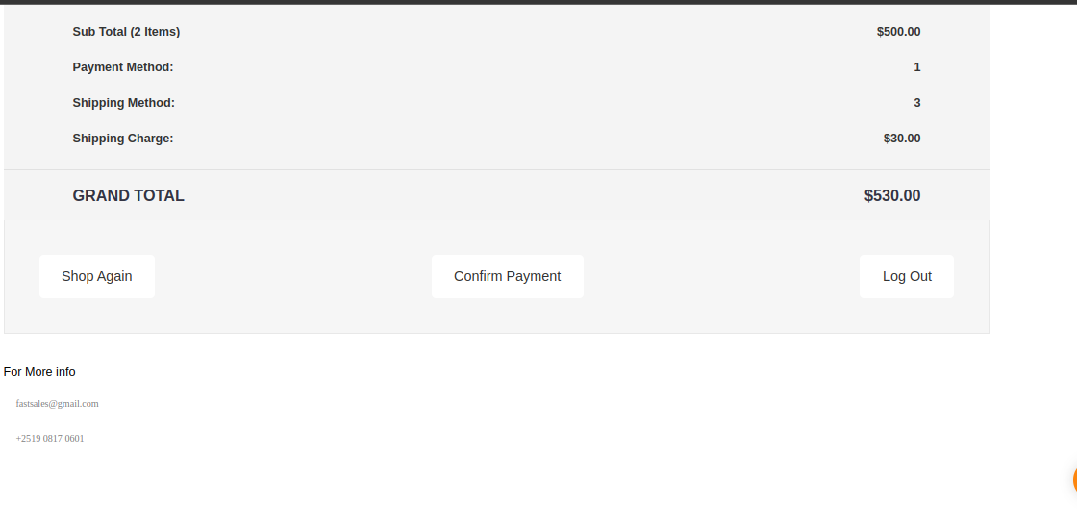
…E-commerce website OneTech” sample screenshots

Slide 25
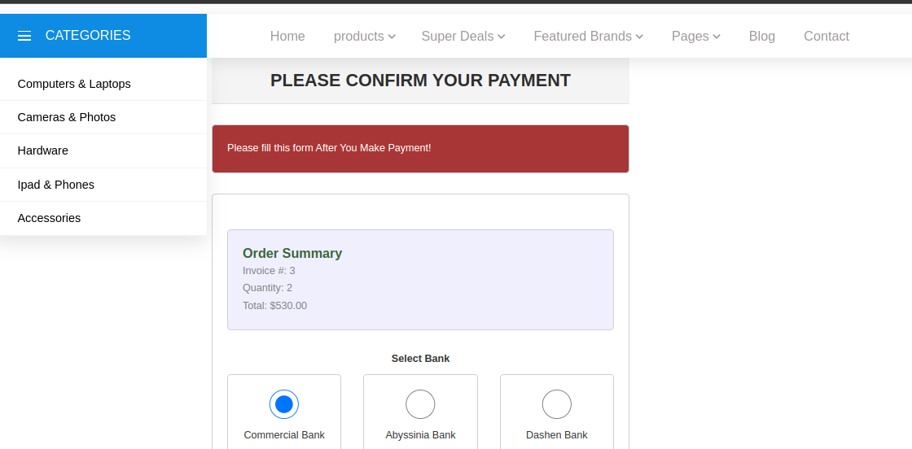
…E-commerce website OneTech” sample screenshots

Slide 26
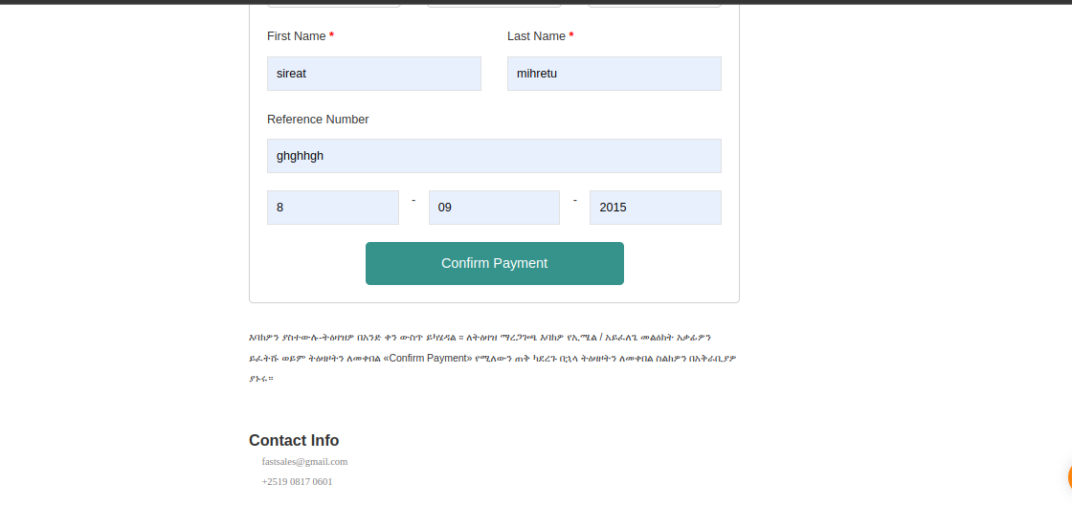
…E-commerce website OneTech” sample screenshots

Slide 27
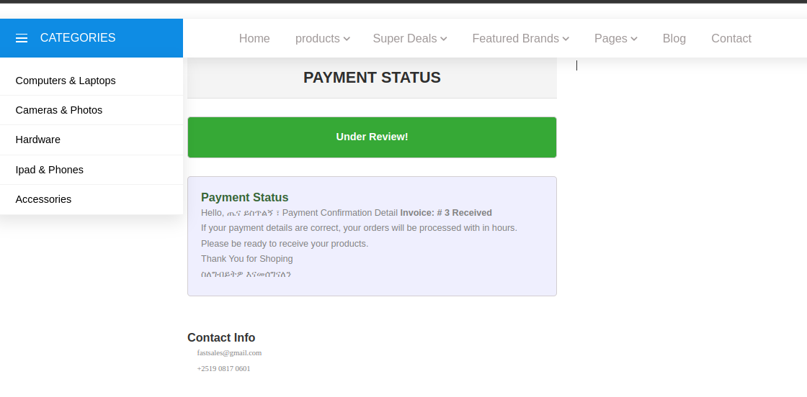
…E-commerce website OneTech” sample screenshots

Slide 28
Conclusion
Technologies i.e PHP, HTML, CSS, JavaScript, Bootstrap, and MySQL in the development of our e-commerce website not only showcases technical proficiency but also signifies a strategic integration of technologies, resulting in a dynamic and secure platform that caters comprehensively to user and customer needs, establishing a solid foundation for continuous improvement and future scalability. Basically thes technologies have high speed rather than using frameworks.

Slide 29
Thank You!

