Slide 1
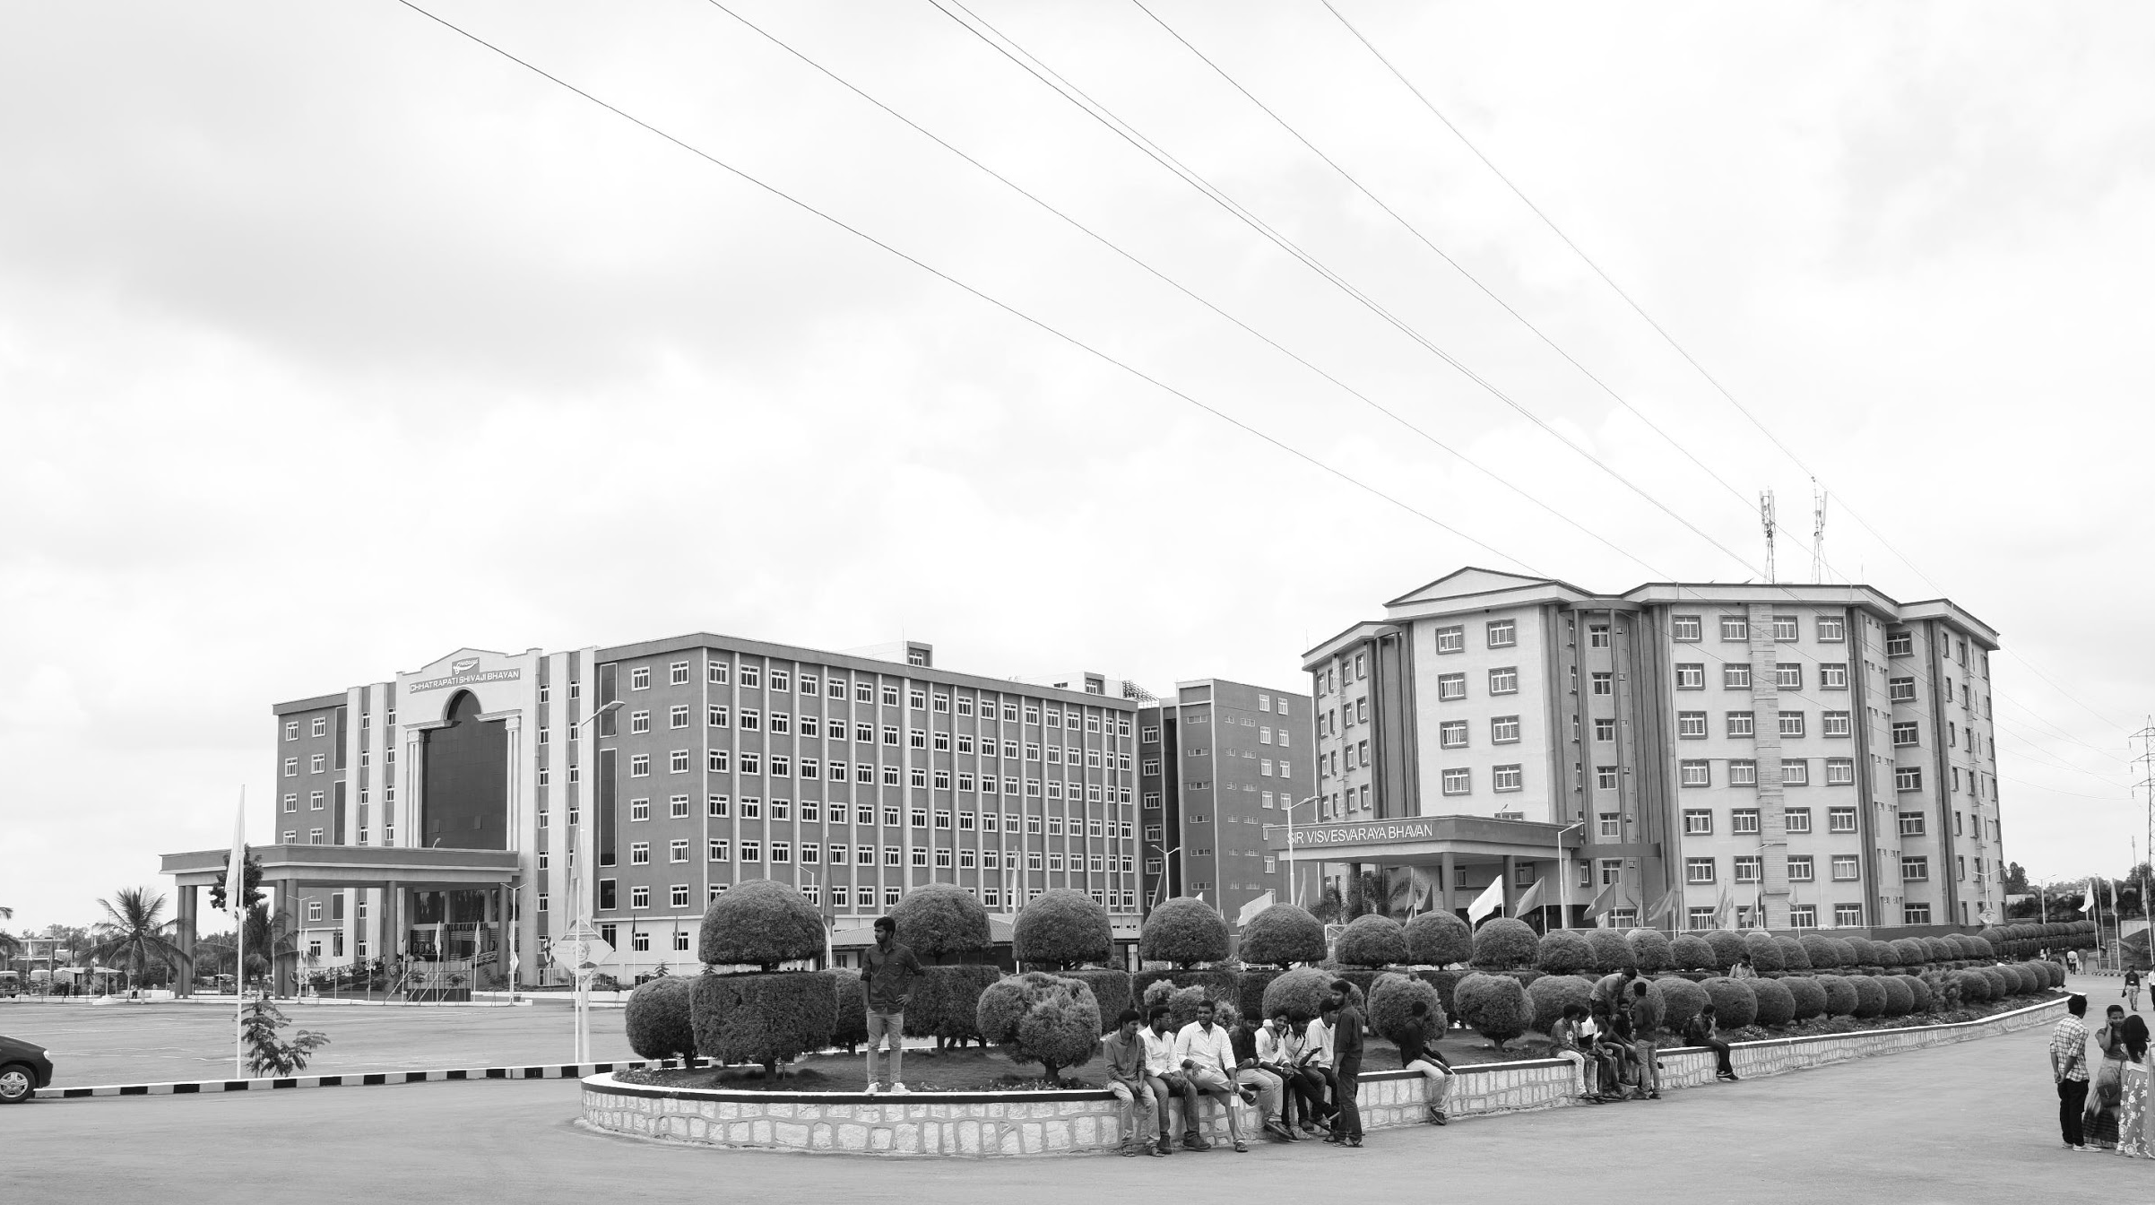

Two-Dimensional Histogram Based Bi-level Image Segmentation
Mid-Review 1/2/3
Major Project
AY 2021-25
GITAM (Deemed-to-be) University
Project Team:
SIREESHA P
CHARISMA S
SUCHITHRA C
Department of Electrical Electronics and Communication Engineering
Project Mentor:
DR.PANKAJ KANDHWAY
Project In-charge:
DR.PANKAJ KANDHWAY
www.gitam.edu

Slide 2
Objective and Goals
Abstract
Traditional Thresholding methods in image segmentation often produce poor results as they rely solely
on pixel brightness. To improve segmentation accuracy, a novel method incorporating both pixel values of the original image and Wiener based image is proposed. This approach constructs a two-dimensional histogram based on original pixel brightness and Wiener’s pixel value, which quantifies brightness differences between a pixel and smooth pixel value using Wiener values based on its neighbors. This additional contextual information helps differentiate regions with similar brightness. By plotting each pixel based on these values, the method reflects individual pixel intensities and local brightness variations. In case of one-dimensional histogram based bi-level thresholding techniques, generally used in medical imaging, but it does not produce good results for daily life images. To find the best segmented image, two-dimensional histogram is utilized and here Kapur entropy is utilized to get threshold value. This threshold value is used for bi-level image segmentation.
Keywords: Thresholding, Pixel brightness, Contextual information, and Kapur entropy

Slide 3
Objective and Goals
Objective
To improve image segmentation accuracy using a bi-level thresholding approach that integrates pixel brightness and local contextual information within a two-dimensional histogram framework.
Goals
Main Goals
Develop a two-dimensional histogram using pixel brightness and local contextual information.
Implement bi-level thresholding techniques to segment images into two distinct regions.
Test the proposed method on real-world and medical image datasets for performance evaluation.
Additional Goals
Investigate the effectiveness of bi-level segmentation on medical images.
Compare results with Wiener proposed theory.

Slide 4
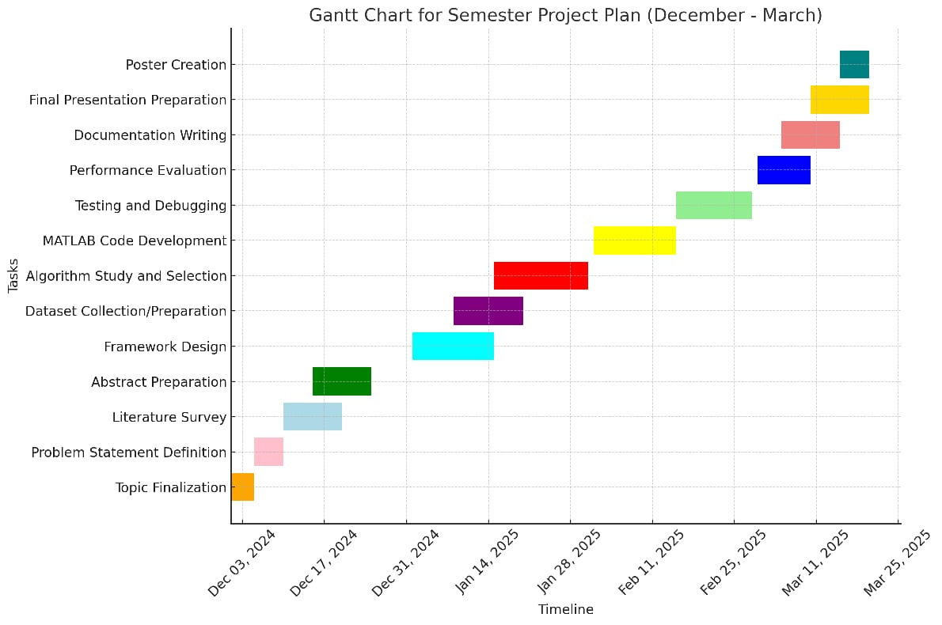
Project Plan
Gant Chart - Milestones and Activities

Slide 5
Literature Survey (Improved post minor project)
s.no | TITLE | AUTHOR | YEAR OF PUBLISHING | DRAWBACKS
1. | Two-Dimensional Histogram-Based Bi-Level Image Segmentation | Xu Ding and Jie Chen. | October 2002 | High Computational Cost Sensitivity to Image Noise Limited to Bi-Level Segmentation Memory Intensive
2. | Digital Image Processing | Rafael C. Gonzalez and Richard E. Woods | August 28, 2007 (3rd Edition) | The book covers a broad range of topics, which might be overwhelming for beginners. Some advanced topics may lack detailed explanations and might require supplementary reading.
3. | Image Segmentation and Feature Extraction | Mark Nixon | April 22, 2013 | Focuses primarily on feature extraction alongside segmentation, which might not be ideal if you are looking for in-depth coverage of segmentation techniques only. The book assumes a fair amount of prior knowledge in image processing and may not be suitable for complete beginners.

Slide 6
 | TITLE | AUTHOR | YEAR OF PUBLISHING | DRAWBACKS
4. | Image Segmentation: A Survey of Graph-Cut Methods | Yuri Boykov and Vladimir Kolmogorov | September 2003 | It does not provide in-depth explanations of each method, rather it focuses on comparing various graph-cut approaches. It doesn’t cover recent advancements since its publication.
5. | Image Processing, Analysis, and Machine Vision | Milan Sonka, Vaclav Hlavac, Roger Boyle | February 2014 (4th Edition) | Broad Scope: The book covers a wide range of topics, which may result in a more general overview rather than an in-depth exploration of bilevel image segmentation. Dated Content: The book was published in 2014, and newer methods or tools may not be included. Complexity: Like many textbooks in this field, it requires a strong background in mathematics and image processing.
6. | Image Segmentation: Advanced Concepts and Practical Applications | Vipin Tyagi | September 2018 | Advanced Level: The content is more suitable for advanced learners or professionals, which can be a barrier for beginners. Limited to Specific Techniques: The book focuses on advanced segmentation techniques, which might not include the most basic bilevel methods in sufficient detail. Complexity level is high to understand

Slide 7
Literature Survey (Improved post minor project)
s.no | TITLE | AUTHOR | YEAR OF PUBLISHING | DRAWBACKS
6. | Digital Image Restoration | H.C. Andrews and B.R. Hunt | 1977 Published by Prentice-Hall, Englewood Cliffs, NJ | Limited Computational Methods – The algorithms were designed for 1970s hardware, making them inefficient for modern computing. It does not cover GPU acceleration or advanced optimization techniques. Lack of Practical Implementation – The focus is mainly theoretical, with no coding examples or real-world applications. This makes it difficult for researchers to implement the techniques.
7. | An Optimal Threshold Scheme for Image Segmentation | S. Reddi, S. Rudin, and H. Keshavan | 1984 Journal: IEEE Transactions on Systems, Man, and Cybernetics | Limited to Bilevel Thresholding – The method mainly focuses on optimal threshold selection for bilevel segmentation. It does not generalize well to complex multi-level thresholding or adaptive segmentation techniques. 2. Sensitivity to Noise – The approach can be affected by noise and variations in lighting conditions, leading to inaccurate segmentation in real-world images. Preprocessing steps like filtering may be required to improve performance.

Slide 8
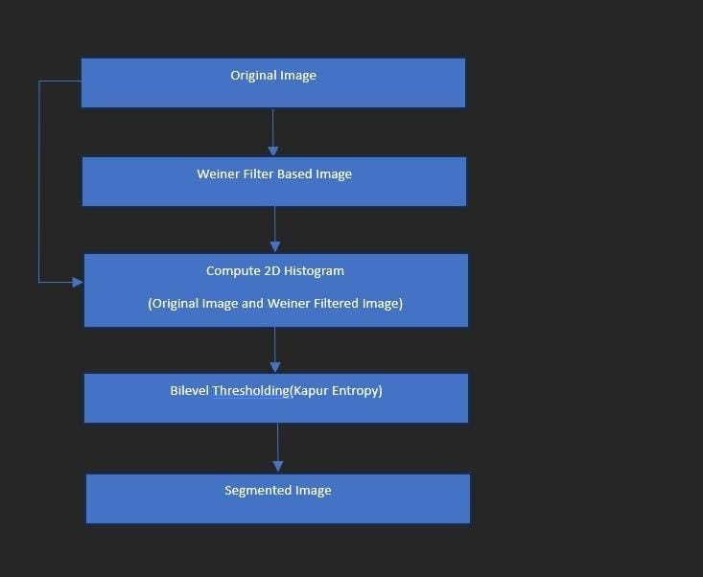
Structural Diagram

Slide 9
Use Cases & Testing
Use Cases
Medical Imaging Segment tumors and organs in MRI/CT scans by analyzing intensity and texture distributions.
Remote Sensing Classify land use (e.g., forests, water bodies) and detect changes using multi-band satellite images.
Industrial Inspection Identify defects in products by correlating features like color, texture, and intensity.
Autonomous Vehicles Detect objects and lanes for safe navigation using spatial and edge-based histograms.
Image Retrieval Enhance search accuracy in image databases by indexing color and texture features.
Test Cases
An image with high dynamic range (HDR), where both bright and dark areas are captured with variations in color, intensity, and texture (e.g., a sunset with high contrast and color gradients).
Useful for assessing feature distribution in images with extreme variances.
Real-World Image with Complex Shadows and Multiple Features real-world image containing shadows, where the shadows create variations in intensity, texture, and color (e.g., a person standing under a tree with dappled lighting).
Tests how the histogram handles overlaps between features caused by shadows and highlights.
Highly Textured Multivariate Image

Slide 10
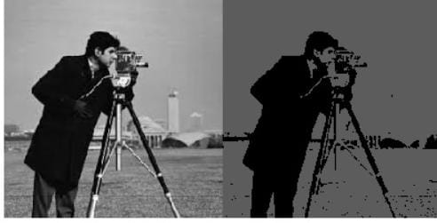
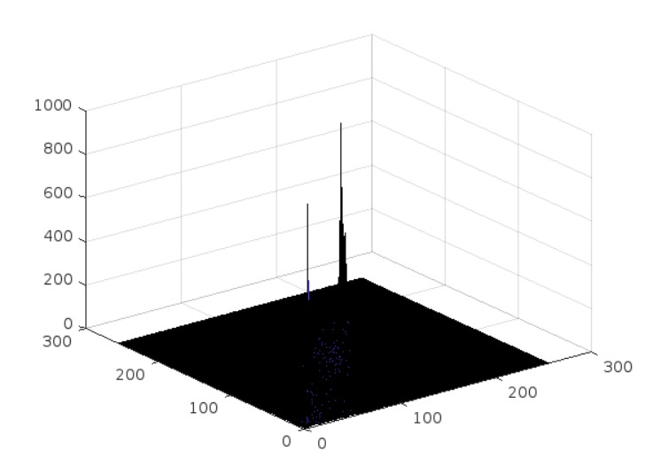
Implementation and Results
Iteration 1 :- Results:- 2D histogram
Mean based filter Wiener based filter 2D Histogram Graph

Slide 11
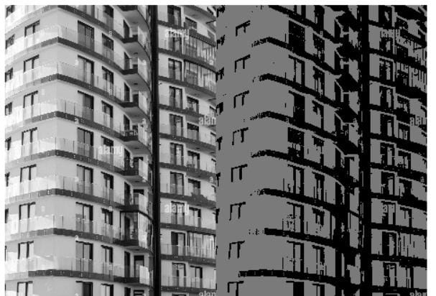
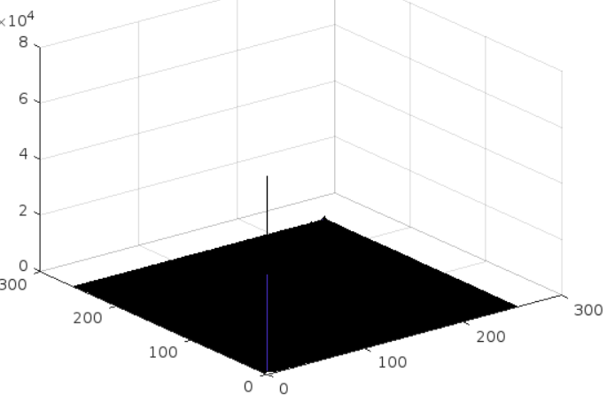
Implementation and Results
Iteration 1 :- Results:
Mean based filter Wiener based filter 2D Histogram Graph

Slide 12

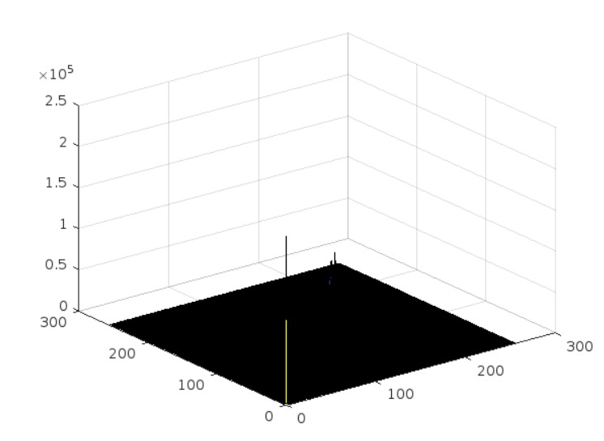
Implementation and Results
Iteration 1 :- Results:
Mean based filter Wiener based filter 2D Histogram Graph

Slide 13
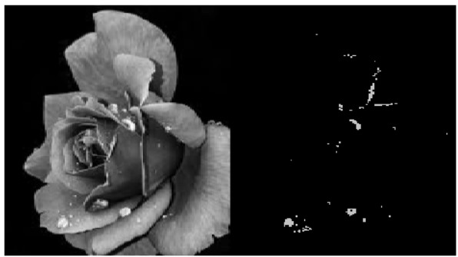
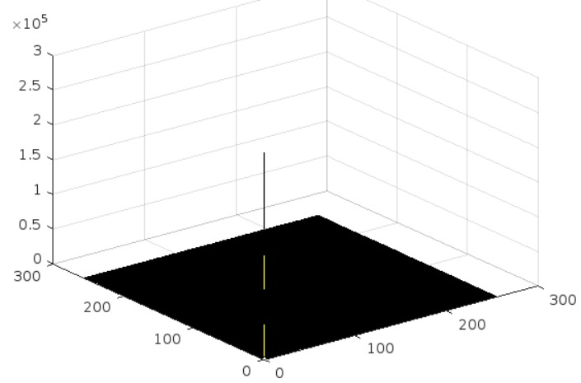
Implementation and Results
Iteration 1 :- Results:
Mean based filter Wiener based filter 2D Histogram Graph

Slide 14
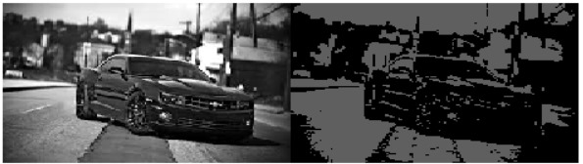
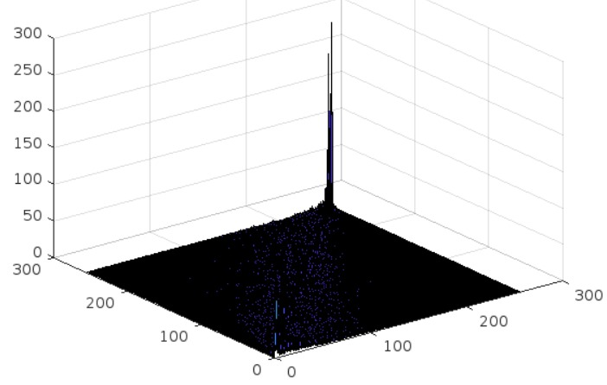
Implementation and Results
Iteration 1 :- Results:
Mean based filter Wiener based filter 2D Histogram Graph

Slide 15
Contribution
Individual Contribution
Key contributions:
Sireesha P
Algorithm Development and Implementation, Data Analysis: Developed and implemented a multidimensional histogram-based image segmentation algorithm, optimizing pixel intensity across multiple channels and computing joint entropy to enhance accuracy.
Collaborated with the team to integrate the algorithm into existing frameworks, improving segmentation across complex image datasets.
Charisma S
Testing and Research: Collected and preprocessed image datasets for algorithm evaluation.
Conducted a literature review on multidimensional histogram-based segmentation techniques, comparing their effectiveness in medical imaging, remote sensing, and computer vision.
Suchithra C
Documentation: Documented the development process of the segmentation algorithm, including design decisions, methodologies, and challenges.
Produced user manuals, technical reports, and research papers to ensure transparency, support future improvements, and enable reproducibility.

Slide 16
Conclusion & Future Work
Summary and Conclusion
The Multi-Dimensional Histogram-based segmentation project has demonstrated progress but faces unique challenges, including managing data complexity across multiple dimensions, addressing noise, and balancing computational efficiency. Strategies have shifted towards advanced binning techniques, improved thresholding methods, and robust testing across high-dimensional datasets. Early results indicate potential for practical applications in multi-dimensional data visualization and analysis
Future Work
Future efforts will explore advanced multi-dimensional algorithms, dynamic bin size optimization, and leveraging AI-driven techniques to improve segmentation precision. Expanding to applications like hyperspectral imaging, 3D modeling, and real-time analytics will be prioritized, along with integration into adaptive, scalable workflows for diverse industries.

Slide 17
THANK YOU
Have a Great Day !

