Slide 1

CROP YIELD PREDICTION AND ANALYSIS

Slide 2

Overview
To ANALYSE THE MAGNITUDE OF YIELD AND THE FEATURE IMPORTANCE OF THE PRODUCTIVITY AND PREDICT THE FUTURE PRODUCTIVITY OF THE CROPS.
CRISP Methodology has been used for the analysis and to design the model.

Slide 3
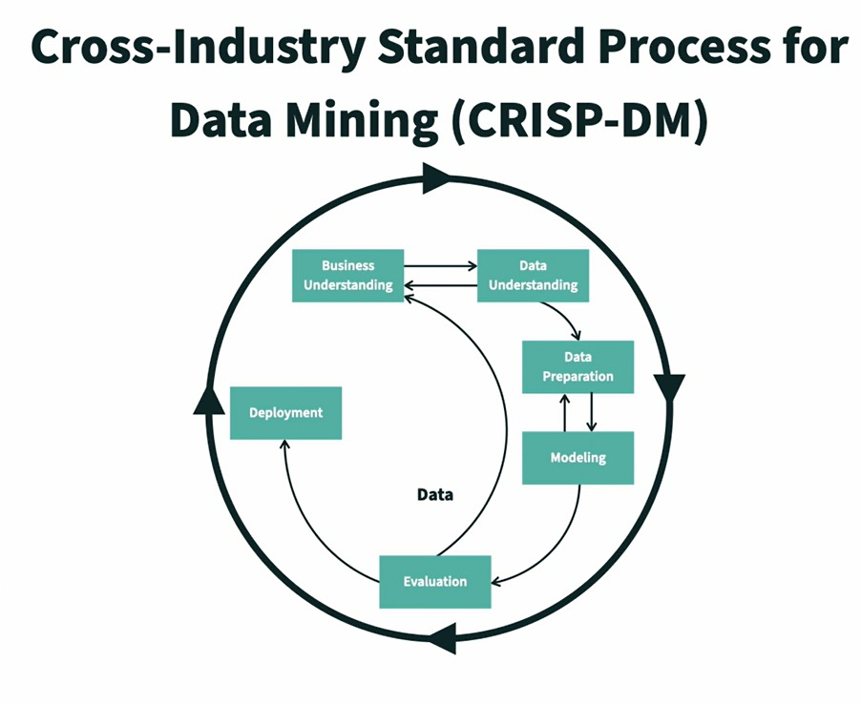
CRISP Methodology

Slide 4

PROBLEM STATEMENT
The goal is to analyze the impact of the features ( rainfall, Temp…) on the crop productivity and identify the most productive crops and predict the future productivity based on the history of data using the Regressor models like Decision tree regressor, Random Forest regressor, SVM, Gradient Boosting Regressor etc…

Slide 5
Data Understanding
Data Source
Fields in the data
The Relevant Data has been taken from the Kaggle.
The Pesticides, Yield data is collected from Food and Agriculture Organization(FAO).
Weather data like Avg. Temperature and Rainfall is collected from World Data Bank.
Some of the fields highlighted are:
Rainfall
Pesticides
Avg. Temperature
Area/Country
Type of the Crop
Target Variable:
Yield

Slide 6

Data Preparation
Some of the Pre-processing done:
Replaced Null values with the average of the values.
Transformed data in a consistent way by removing the features having less number of responses.
Worked on identifying Outliers of the features using Box plots.
Encoded the data of Categorical values to Numerical Values Using One hot encoder, Label Encoder.
Used Heat map of correlations to identify the most important features and chosen them.
Used Data Visualization to analyze the impact of the features on the productivity and the highest produced crops and predict the future productivity.
Split the data to training and testing with 75% of the training data and 25% of the data to testing data.
Scaled the data using standard scalar to improve the accuracy of the model and bringing all the features to the same level of magnitude.

Slide 7
Implementation
Amazon Sage maker is been used to do the modeling.
We have used some of the libraries of sagemaker like container, boto3, estimator, Ipython display to complete the project.
We have created S3 bucket to format and store the data in a single repository from Various Sources. and the data is then dealt with all the preprocessing.
The Data we have, contains the data of 101 countries and the Top 10 crops produced all over the world.
So, we have narrowed our project to consider Top 5 productive countries and Top 5 Crops based on the analysis through Data Visualization.

Slide 8

Modeling
We have used the Regressor models like Decision Tree Regressor, Random Forest Regressor, SVM, Gradient Boosting Regressor and found that Decision tree Regressor performs the best to predict the yield provided the trained and test data.
We have chosen Regressor Models since the prediction is based on the past data and there is variance in terms of the importance for the features considered.

Slide 9
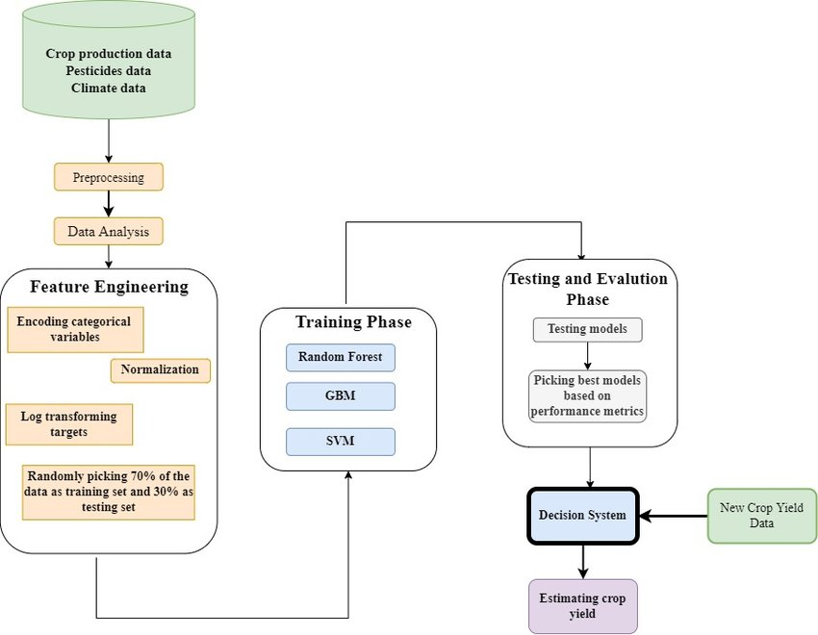
Brief Architecture of the Prediction System

Slide 10

Evaluation
For the evaluation purpose, we have used R2 Score to find the accuracy of the model and our model turned out to be 95.64% accurate.
Mean Absolute Error(MAE) is used to measure the error based on how close the predictions are to the final observed outcomes.

Slide 11

Deployment
We have dumped our model as a pickle file and built a flask app and then deployed the flask app in the EC2 instance to run on all addresses.
The Deployed model can be accessed through http://ec2-54-211-144-106.compute-1.amazonaws.com:8080/ or http://127.0.0.1:5000

Slide 12
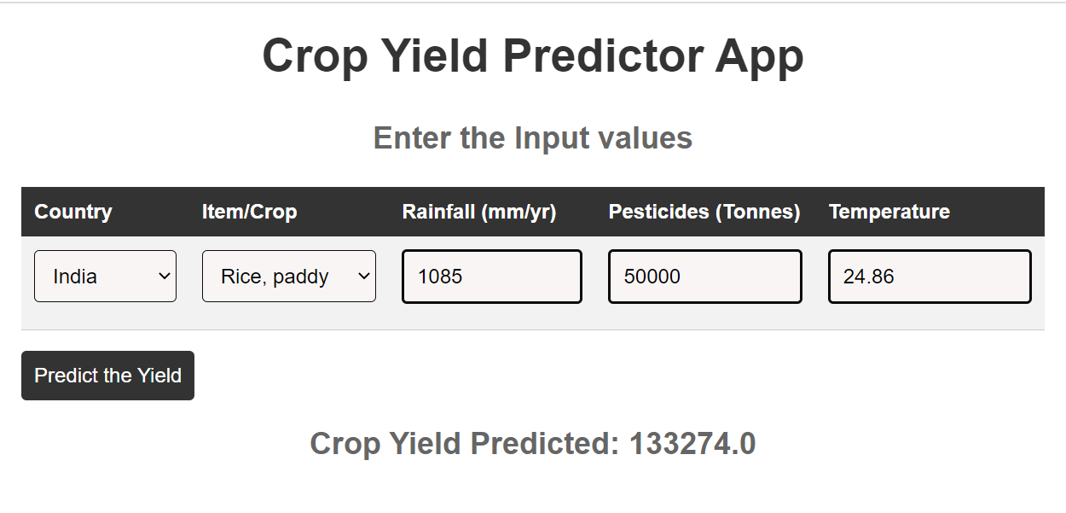
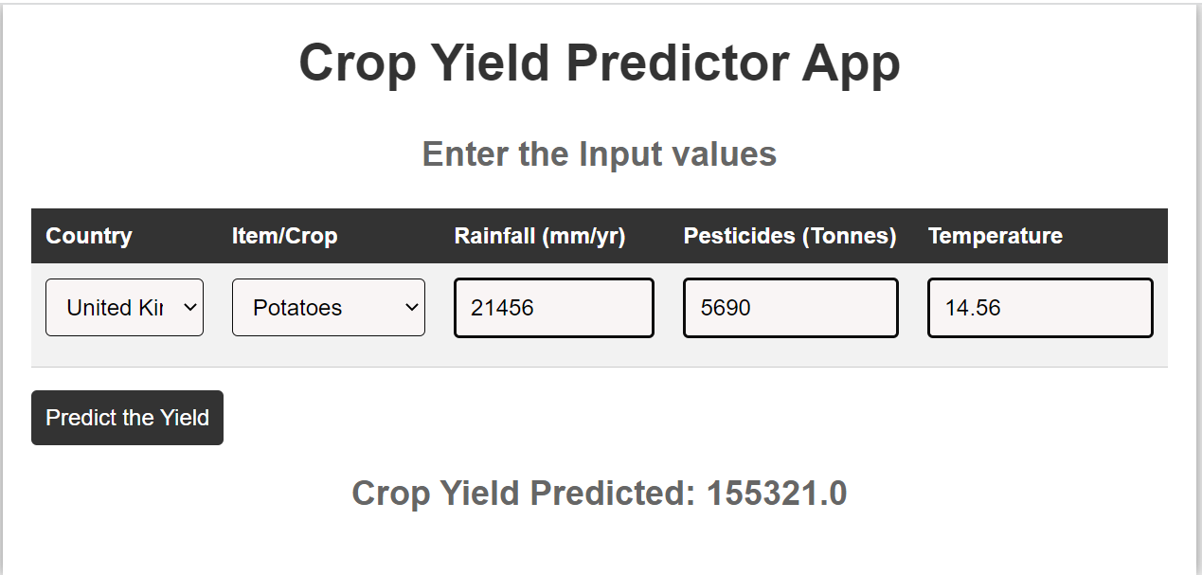
Results

Slide 13

Conclusion
Our goal was to do the Future predictions of the Crop and the Agricultural Risk Management.
A Prediction model is developed and deployed using the Past history data of the Crops yield and predicted the Future Productivity rate of different crops based on different features like Weather, Pesticides, Soil etc..
Analyzed the Most Produced Crops and the impact of Rainfall, Pesticides etc. on the Productivity.

Slide 14
THANK YOU
Team
Sireesha Chimbili – Data Scientist
Sushma Mandati – Business Analyst
Poojitha Mandapati – Data Analyst
Mustak Ahamed Yadiki – Data Architect

