Slide 1
Group – 12 The EmoTech Team
Sireesha Chimbili
Anjali Yadagiri

Slide 2

Project Topic
Comparative Analysis of Pre-trained Encoders for Emotion Recognition

Slide 3
Project Objectives
The project focuses on the task of detecting and categorizing emotions conveyed through written text using pre-trained encoders like BERT and RoBERTa to evaluate and compare the performance of the encoders.
We worked on fine-tuning the selected pre-trained encoders to adapt it’s contextual understanding to the nuances of emotion-labeled dataset.
Identified and addressed the challenges in varying textual contexts which involves different categories of emotions and verifying how well each model generalizes across diverse emotional categories.

Slide 4
Statement of Value
Improved Mental Health Support and Services.
Customer feedback Analysis.
Research Advancements.
Empowering AI Assistants.
Advancing Human-Machine Interaction.
Enhancing User Experience and Customer Satisfaction.

Slide 5
Review of the state of the art
The current landscape for Emotion Recognition in Text is characterized by a surge in deep learning methodologies, particularly with the widespread adoption of transformer-based models like BERT and GPT.
Researchers are actively addressing challenges related to contextual understanding and exploring multimodal approaches for enhanced accuracy in discerning emotions expressed in textual data.
Challenges include nuanced emotional cues like sarcasm, while innovations focus on contextual analysis and multimodal integration for improved accuracy in emotion recognition.

Slide 6
Relevant works(Citations):
Acheampong, F. A., Nunoo-Mensah, H., & Chen, W. (2021). Transformer models for text-based emotion detection: A review of BERT-based approaches. Artificial Intelligence Review, 54, 5789–5829.
Devlin, J., Chang, M.-W., Lee, K., & Toutanova, K. (2018). BERT: Pre-training of Deep Bidirectional Transformers for Language Understanding. arXiv preprint arXiv:1810.04805.
Liu, Y., Ott, M., Goyal, N., Du, J., Joshi, M., Chen, D., ... Stoyanov, V. (2019). RoBERTa: A Robustly Optimized BERT Approach. arXiv preprint arXiv:1907.11692.
Saravia, E., Liu, H. C. T., Huang, Y. H., Wu, J., & Chen, Y. S. (2018). Carer: Contextualized affect representations for emotion recognition. In Proceedings of the 2018 conference on empirical methods in natural language processing (pp. 3687-3697).

Slide 7
Dataset
Emotion-labeled Corpora:
The dataset has the features like text, labels, Comment_id(Unique) and other features in the raw data.
Labels : There are 27 labels and Neutral
( Admiration, Amusement, Anger, Annoyance, Approval, Caring, Confusion, Curiosity, Desire, Disappointment, Disapproval, embarrassment, excitement, fear, gratitude, grief, joy, love, nervousness, optimism, pride, realization, relief, remorse, sadness, surprise, neutral)
Size: 54.3K rows.
Emotion Categories: All the 28 emotions has been categorized as Anger, Disgust, Fear, Joy, Sadness, Surprise and Neutral.
https://huggingface.co/datasets/go_emotions

Slide 8
Models
Algorithms:
Fine-tuning Algorithms:
Utilized fine-tuning techniques specific to each pre-trained encoder (BERT, RoBERTa) for optimal adaptation to emotion recognition tasks.
Pre-trained Encoders:
BERT –Bidirectional Encoder Representations from Transformers.
RoBERTa– Robustly optimized BERT approach.
Tools:
Python, Pytorch, beautifulSoup, Emoji, sklearn, Hugging face Transformers.
Techniques:
Tokenization, Data Loader, Defining Custom Dataset, Autocast, Emotion Mapping, Contraction Mapping, Punctuations Handling, Misspelled words Handling, Cleaning text, Stop word removal, Lowercasing, Hyper parameter tuning, Optimization.

Slide 9

Evaluation Methodology
Accuracy Score.
F1 Score.
Precision Score.
Recall Score.
Classification Report.
ROC Curve.
AUC.

Slide 10
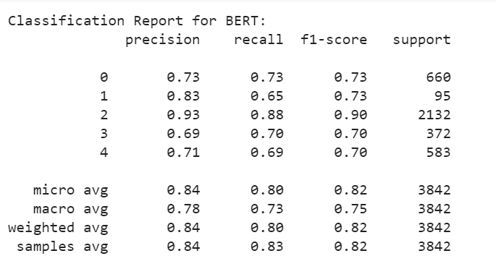
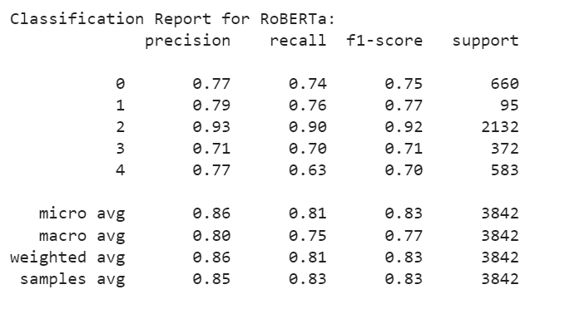
Results

Slide 11
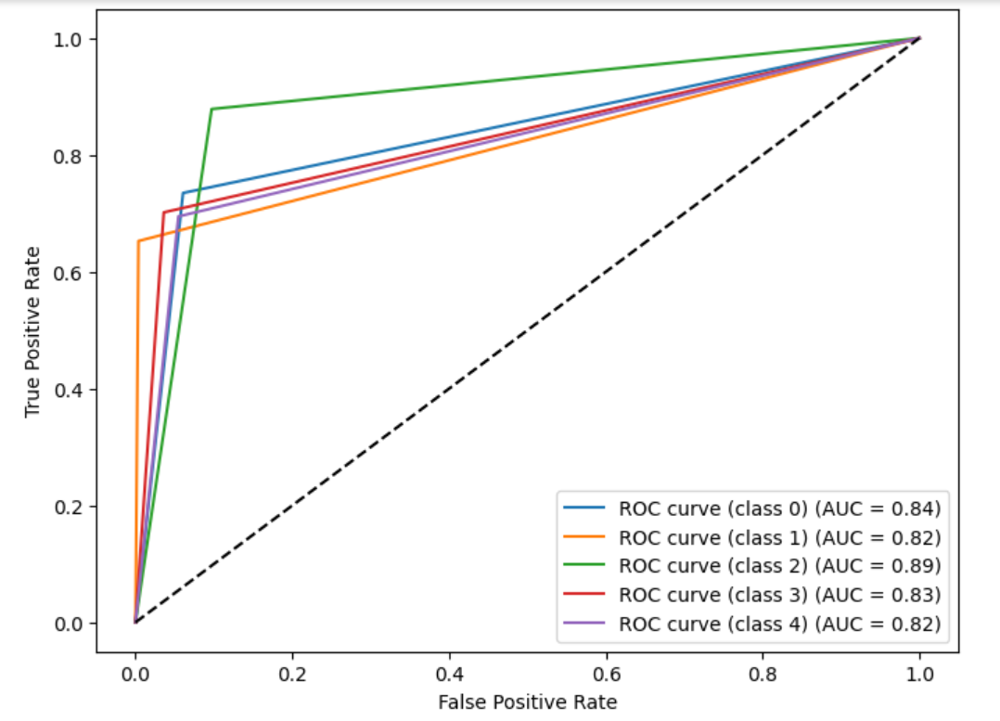
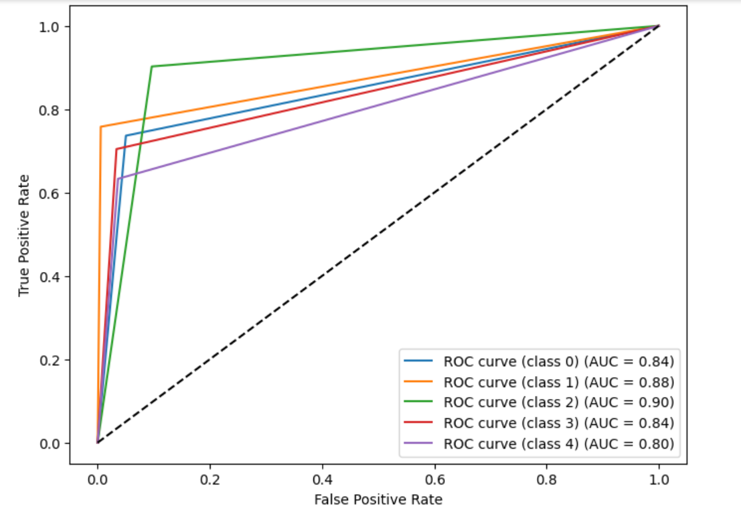
Results
BERT
RoBERTa

Slide 12
Conclusion
The project provides a comprehensive understanding of pre-trained encoders' effectiveness in emotion recognition.
Both models exhibited competitive performance in emotion classification but, RoBERTa demonstrated superior accuracy and recall compared to BERT.
Conducted a comparative analysis of pre-trained encoders (BERT and RoBERTa) for emotion recognition.
Explored fine-tuning methodologies specific to each encoder for optimal performance.
Results and insights contribute to ongoing advancements in natural language processing and sentiment analysis.

Slide 13


