Slide 1


Mental Health in Tech Industry

Slide 2
Contents
Overview
CRISP-DM Methodology
Conclusion

Slide 3

Overview
To make a model that predicts the chance of having the mental disorders of the people working in the Tech Industry based on the user inputs provided.
CRISP Methodology has been used for the analysis and to design the model.

Slide 4

PROBLEM STATEMENT
The goal is to develop a model to predict the chances of having the disorders of a person working in the Tech Industry based on their inputs by using Logistic Regression and Random Forest Classifier.

Slide 5
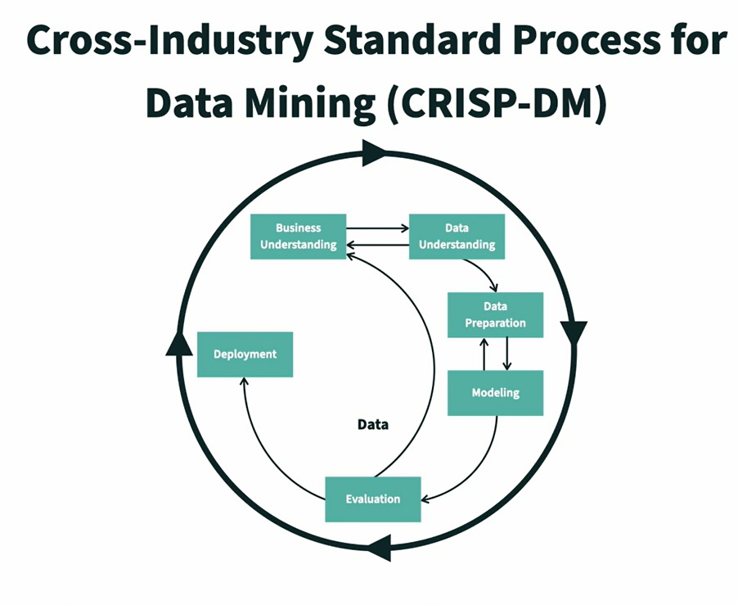
Introduction to CRISP Methodology

Slide 6
Data Understanding
Data Source
Fields in the data
Mental Health Data has been taken from the Kaggle.
The data is from Open Source Mental illness (OSMI) using survey data from years 2016.
Tech company status- “tech_comp_flag”
Medical health coverage-”mh_coverage_flag”
Any resources Provided-”mh_resources_provided”
Medical leave access-”mh_medical_leave”
Gender-”sex”
Work position-”tech_flag”
Any past Disorders-”mh_disorder_past”
Sought treatment-”mh_sought_proffes_treatm”
Impact on work-”mh_eff_treat_impact_on_work”

Slide 7
Data Preparation
Replaced Null values with the most frequent values or average of the values.
Transformed data in a consistent way by removing the features having less number of responses.
Worked on identifying Outliers of the features.
Encoded the data of Categorical values to Numerical Values Using One hot encoder, Label Encoder.
Used Heat map of correlations to identify the most important features.
Used Data Visualization to analyse the impact of the people having past disorders and the impact of the mental health on their work life.
Introduced a feature called “tech_flag” to categorize if the employee is tech/non-tech using the work position of the employee.
Split the data to training and testing with 70% of the training data and 30% of the data to testing data.
Scaled the data using standard scalar to improve the accuracy of the model.

Slide 8

Modeling
Target Variable
Input Variables
tech_comp_flag
mh_coverage_flag
mh_resources_provided
mh_medical_leave
Sex
tech_flag
mh_disorder_past
mh_sought_proffes_treatm
mh_eff_treat_impact_on_work
mh_disorder_current.
We have used Random Forest Classifier model.

Slide 9
Evaluation
For the evaluation purpose, we have used accuracy score and random state as 42 from the Random Forest Classifier.
The data has been divided into testing data sets and training data sets in which 70% of the data has been used to train the data and rest of the data set to test the model.
we have achieved an accuracy of 74.394% and we can improve the accuracy rate by collecting the new surveys to enhance the model.

Slide 10
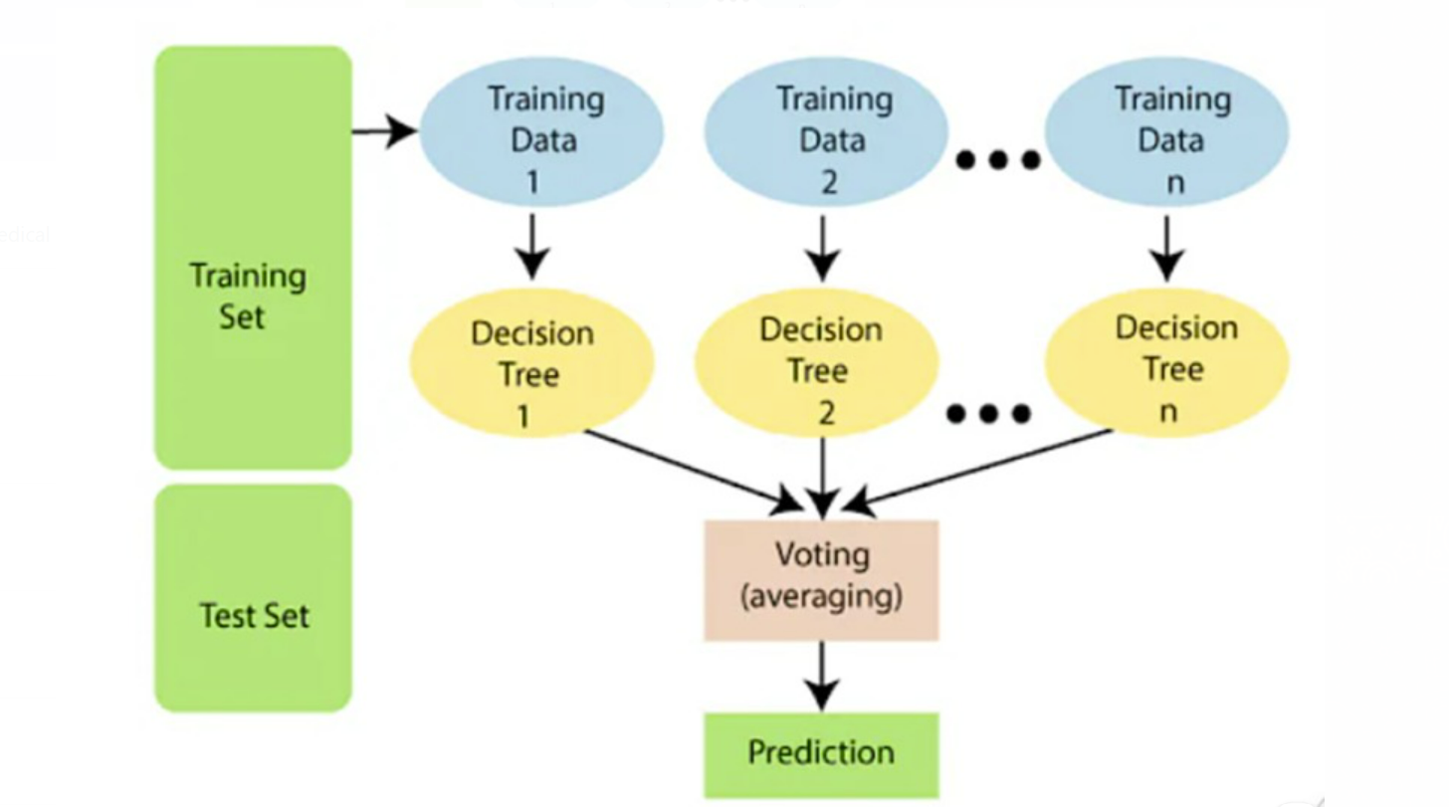
System Architecture

Slide 11
Deployment
Deployed the model in the web using Flask and the model can be access through
http://127.0.0.1:5000/disorderPredict
Status of the tech company, medical health coverage, work position , gender, medical leave access, any sources provided, any past disorders, sought treatment, impact on work are collected from the user to predict the mental disorders of their specific category.

Slide 12
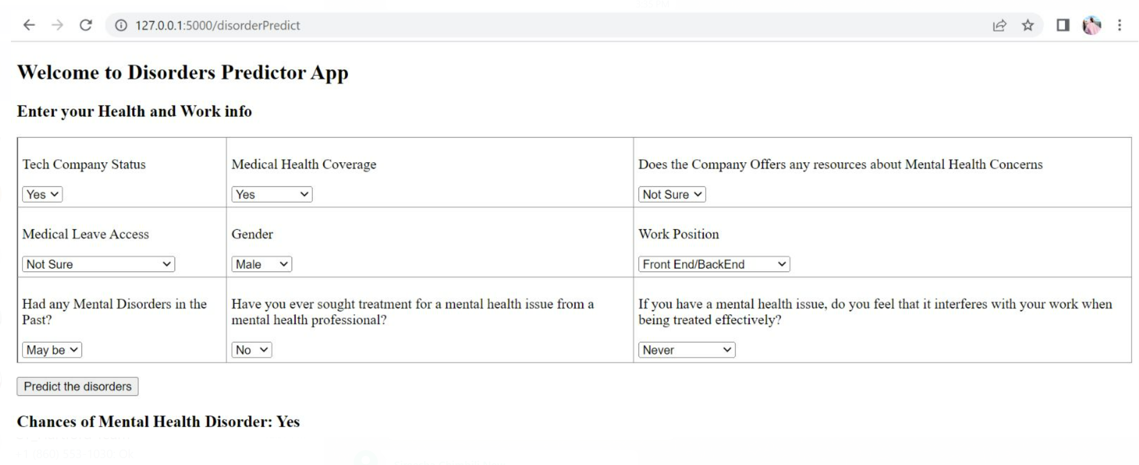
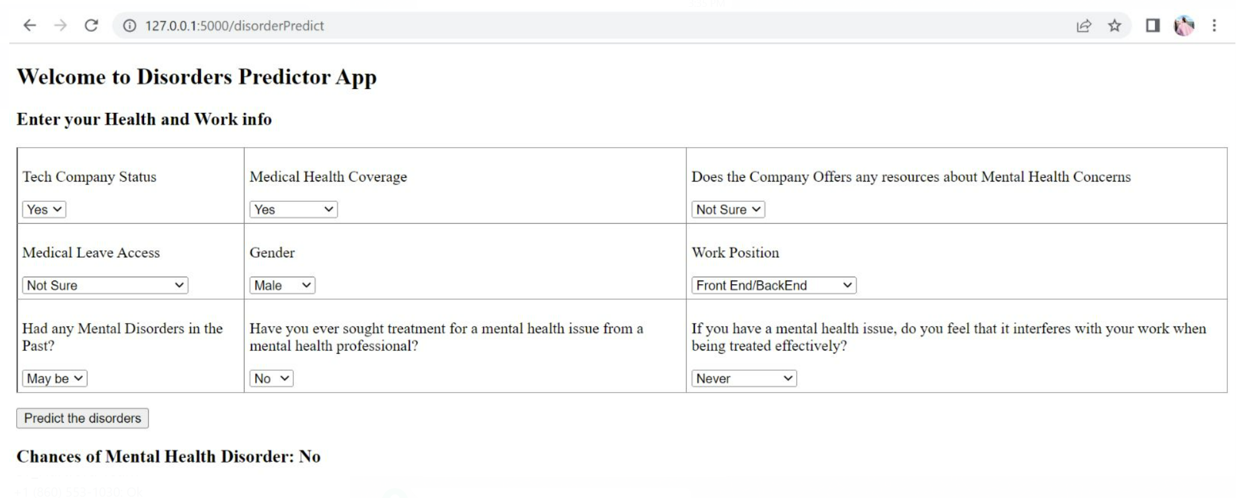
Results

Slide 13

Conclusion
A prediction model was developed to predict the chances of having the disorders of a person working in the Tech Industry based on their inputs. Using the data set, the proposed model can predict the chances of having disorders as yes or No or Maybe.

Slide 14
THANK YOU
Team Unstoppable
Sangeetha Mydam
Sireesha Chimbili
Santhoshi Reddy Raghuram
Naveen Kumar Nettem
Venkata Sri Harsha Linga

