Slide 1

Smart Mini Cafe
Under The Supervision of
Dr. P. NAGA BABU
Assistant Professor
Presented By
M.Sireesha – 22BQ1A12A0
K.Meghana – 22BQ1A1273
P.Sai Pranitha – 22BQ1A12B5
N.NagaSwapna – 23BQ5A1211
DEPARTMENT OF INFORMATION TECHNOLOGY
VASIREDDY VENKATADRI INSTITUTE OF TECHNOLOGY
PADAKAKANI MANDAL, NAMBURU, GUNTURU-522508

Slide 2
Abstract:
The Smart Mini Cafe Web Development Project aims to create an innovative, user-friendly, and tech-driven online platform for modern cafes, addressing challenges faced by small to medium-sized establishments in order management, customer engagement, and efficient operations. By integrating advanced technology like secure payment gateways, dynamic customer portals, and admin tools for inventory and analytics, the project seeks to enhance customer experiences with personalized recommendations and real-time updates while streamlining cafe operations. Unlike costly and complex systems used by larger chains, this scalable solution is tailored to smaller businesses, enabling them to compete effectively and faster growth. The outcome promises a responsive, feature-rich website that simplifies ordering, tracks orders in real-time, and rewards customer loyalty, benefiting both customers with convenience and cafe owners with operational efficiency and sustainability.

Slide 3
Introduction:
The Smart Mini Cafe Web Development Project aims to create an innovative online platform for a modern cafe that seamlessly integrates advanced technology to enhance customer experience and operational efficiency. This automated cafe caters to tech-savvy, time-conscious consumers by offering personalized service and high-quality beverages and snacks quickly. Each table is equipped with a QR code that customers can scan to browse the menu and place their orders, which are instantly sent to the cafe administration for swift processing. By leveraging automation and data-driven insights, the cafe minimizes the need for human intervention while focusing on sustainability and eco-friendly practices. This approach not only meets the evolving demands of today’s market but also sets a new standard in the food service industry, blending convenience with innovation to provide a superior cafe experience. Ultimately, the project seeks to redefine modern cafe culture through cutting-edge technology and user-friendly design.

Slide 4
Existing Solutions:
1.Generic POS Systems: While these assist with order and payment processing, they lack customization and advanced features like IoT integration or personalized recommendations.
2. Large Chain Solutions: Proprietary platforms used by big chains are often expensive and not tailored to smaller operations.
3.Limited scalability and adaptability for small business needs. High costs and complexity of implementation.

Slide 5
Proposed System:
1. Customer Portal : Develop a dynamic online ordering system with customization options, secure payments, and real-time updates.
2. Admin Portal : Provide cafe managers with tools to manage orders, update menus.
3. Feedback : Provide the genuine feedback.
4.Chef Portal: Displays incoming orders with real-time notifications.

Slide 6
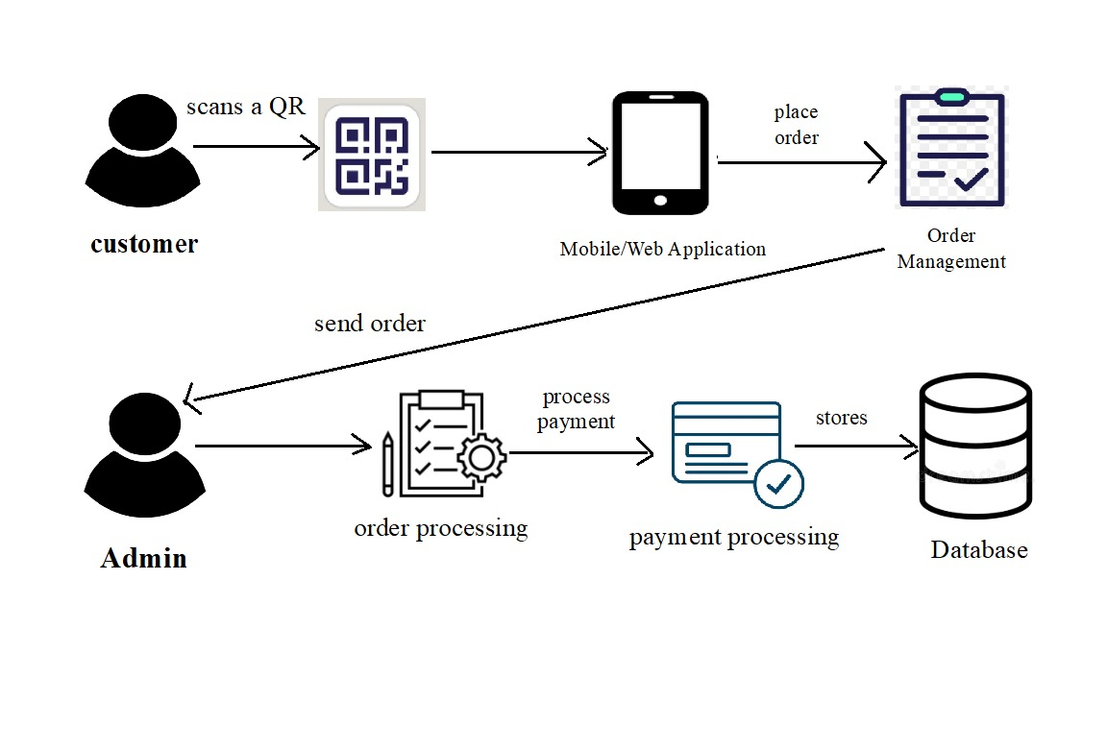
System Architecture

Slide 7
Proposed System Objectives:
1.Develop a User-Friendly Interface: Create an intuitive and responsive web interface for customers to easily place and manage their orders.
2.Implement Efficient Order Management: Build a robust backend system using Java Servlets to handle order processing, track statuses, and manage inventory.
3.Ensure Secure Payment Processing: Integrate a secure payment gateway to handle transactions safely and comply with industry standards.
4.Empower Small Cafes: Developing a platform tailored to small cafes with limited technical knowledge.
offering small cafes affordable access to features typically found in high-end establishments.

Slide 8
Modules Introduction:
1.Admin Dashboard Module : The Admin Dashboard Module enables administrators to manage café operations and access reports, menu items, orders, inventory, and analytics from a single interface.
2.Menu Management Module : Displays the cafe’s menu and allows customers to select and customize items for their orders.
3.Order Management Module : Handles order placement, tracking, updates, and status notifications.
4.Payment Processing Module : The Payment Processing Module integrates with payment gateways to securely process transactions, managing payment confirmations, receipts, and transaction records. 5.Inventory Management Module : The Inventory Management Module tracks stock levels, updates automatically, and manages supplier information and purchase orders.

Slide 9
Hardware Requirements:
1. Processor: Intel i5/i7
2. RAM: 8 GB and 1 TB
3. Storage: 256 GB SSD
4. Display: 1920x1080 resolution or higher.
5. Network: High-speed internet(1Gbps).

Slide 10
Software Requirements:
1. Operating System: Windows 10/11, or macOS.
2. IDE: Eclipse IDE for Enterprise Java Developers.
3. Back End: Java JDK 11+, Apache Tomcat 10.x, and SERVLETS/JSP.
4. Database: MySQL 8.0+ with MySQL Workbench for management.
5. Front End: HTML, CSS, JavaScript, with optional Bootstrap for responsive design.

Slide 11
Thank You…! & Any Questions…!

