Slide 1

SIGEVO Summer School, 10-12 July 2019 - Prague
Lucia Cavallaro, Kathrin Kefer, Adam Johanides, Etor Arza, Evžen Šírek supervised by Marc Schoenauer

Slide 2

Initial thoughts on the topic “Fake News”
The context:
Textual (as articles, tweets, etc.)
Images
Videos
The approaches:
Network Science
ML using classifiers
The target:
Containing the spread by the author
Identify the fake news by the contents

Slide 3
Final Problem Formulation
Main Goal: Try to discriminate Fake News from real ones
Main Focus: Contents of articles
Dataset: https://www.kaggle.com/c/fake-news/data
20k articles

Slide 4

General Classification Approach
Generate the features using the two different preprocessing approaches
Topic Classification: apply best trained model to the real problem dataset
doc2vec: transform dataset to vector representation
Apply the same 10 classifiers to the specified features
Only Topic Classification Features
Only doc2vec Features
Both, Topic Classification and doc2vec features together
Evaluate the classifiers for their accuracy

Slide 5
Topic Classification Preprocessing
Data Basis for Training: Reuters-21578 News Article Dataset
21578 instances of articles that are labelled with 135 categories (e.g. Business, Politics,..)
Train 10 different classifiers with partly different configurations [1]
LinearSVC, Decision Tree, Random Forest, kNearestNeighbour, SVM, Logistic Regression, Naive Bayes, AdaBoost, LDA
Features: each word with its number of appearances, that appears at least 3 times in the text and is no stop word like e.g. “and”, “it” etc → 26147 features in total
Choose best of the 10 classifiers and apply Hyperparameter Tuning to get the best combination of parameters
LinearSVC

Slide 6
Topic Classification - Classifier Comparison
 | Accuracy [%] | F1 [%]
LinearSVC | 81.05 | 84.04
Logistic Regression (C=1000) | 80.79 | 84.10
kNN (n=5) | 72.97 | 76.07
kNN (n=3) | 72.28 | 75.43
Logistic Regression (C=1) | 67.47 | 67.21
Random Forest (200 trees) | 65.75 | 64.36
Random Forest (50 trees) | 64.79 | 63.69
Decision Tree | 55.75 | 53.23
Naive Bayes | 43.86 | 47.98
SVM linear | 33.55 | 29.67

Slide 7
Topic Classification - Hyperparameter Tuning
Parameters to tune:
C = Penalty Parameter of the error term
[1,10,100,1000]
multi_class = determines the multi-class strategy of the LinearSVC classifier
"ovr" trains n_classes one-vs-rest classifiers
"crammer_singer" optimizes a joint objective over all classes
Accuracy: 82.15%
Best Parameters found:
C = 1
multi_class = crammer_singer

Slide 8
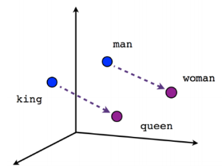


Doc2Vec based classification
using Doc2Vec (Mikilov and Le, 2014)
based on Word2Vec
training dataset - https://www.kaggle.com/c/fake-news/data
k-fold cross validation used for evaluation
(x_1, x_2,…., x_n)
doc2vec model
class. learning
classifier
dataset

Slide 9
Adapting the articles.
crisis prevention, and verifiable nuclear disarmament should be substituted for continuing counterproductive wars. Therefore, we, as signers of this petition, call for the immediate cancellation of the F-35 program as a whole, and the immediate cancellation of plans to base any such dangerous and noisy jets near populated areas.

Slide 10
Adapting the articles.
crisis prevention, and verifiable nuclear disarmament should be substituted for continuing counterproductive wars. Therefore, we, as signers of this petition, call for the immediate cancellation of the F-35 program as a whole, and the immediate cancellation of plans to base any such dangerous and noisy jets near populated areas.

Slide 11
Adapting the articles.
crisis prevention and verifiable nuclear disarmament should be substituted for continuing counterproductive wars therefore we as signers of this petition call for the immediate cancellation of the program as a whole and the immediate cancellation of plans to base any such dangerous and noisy jets near populated areas

Slide 12
Adapting the articles.
crisis prevention verifiable nuclear disarmament should be substituted continuing counterproductive wars therefore we signers petition call immediate cancellation program whole immediate cancellation plans any such dangerous and noisy jets populated areas

Slide 13
Adapting the articles.
crisis prevention verifiable nuclear disarmament should be substituted continuing counterproductive wars therefore we cancellation program whole cancellation plans any such dangerous noisy jets

Slide 14
Adapting the articles.
['crisis', 'prevention', 'verifiable', 'nuclear', 'disarmament', 'should', 'be', 'substituted', 'continuing', 'counterproductive', 'wars', 'therefore', 'we', 'cancellation', 'program', 'whole', 'cancellation', 'plans', 'any', 'such', 'dangerous', 'noisy', 'jets', 'we', 'replacing', 'any', 'basing', 'any', 'locations', 'we', 'further', 'demand', 'money', 'human', 'needs', 'us', 'customer', 'world', 'including', 'climate', 'change', 'student', 'debt', 'education', 'healthcare', 'housing', 'add', 'your', 'swanson', 'is', 'an', 'author', 'journalist', 'host', 'he', 'is', 'director', 'coordinator', 'rootsactionorg', 'books', 'war', 'is', 'lie', 'he', 'blogs', 'at', 'he', 'hosts', 'nation', 'he', 'is', 'peace', 'prize', 'follow', 'him', 'on', 'twitter', 'support', 'clicking', 'here']

Slide 15
doc2vec/preprocess - class. comparison
 | Accuracy [%] | F1 [%]
LinearSVC | 87.48 | 87.48
Logistic Regression (C=1000) | 87.67 | 87.67
kNN (n=5) | 81.60 | 81.39
kNN (n=3) | 81.99 | 81.82
Logistic Regression (C=1) | 87.72 | 87.72
Random Forest (200 trees) | 87.02 | 87.01
Random Forest (50 trees) | 87.07 | 87.06
Decision Tree | 76.19 | 76.18
SVM adjusted | 89.50 | 89.50
SVM linear | 87.62 | 87.62

Slide 16
doc2vec/no preprocess - class. comparison
 | Accuracy [%] | F1 [%]
LinearSVC | 74.93 | 74.89
Logistic Regression (C=1000) | 74.81 | 74.79
kNN (n=5) | 76.50 | 76.49
kNN (n=3) | 75.82 | 75.81
Logistic Regression (C=1) | 74.79 | 74.76
Random Forest (200 trees) | 78.35 | 78.34
Random Forest (50 trees) | 77.94 | 77.94
Decision Tree | 71.13 | 71.12
Naive Bayes | 59.45 | 57.33
SVM linear | 74.79 | 74.72

Slide 17
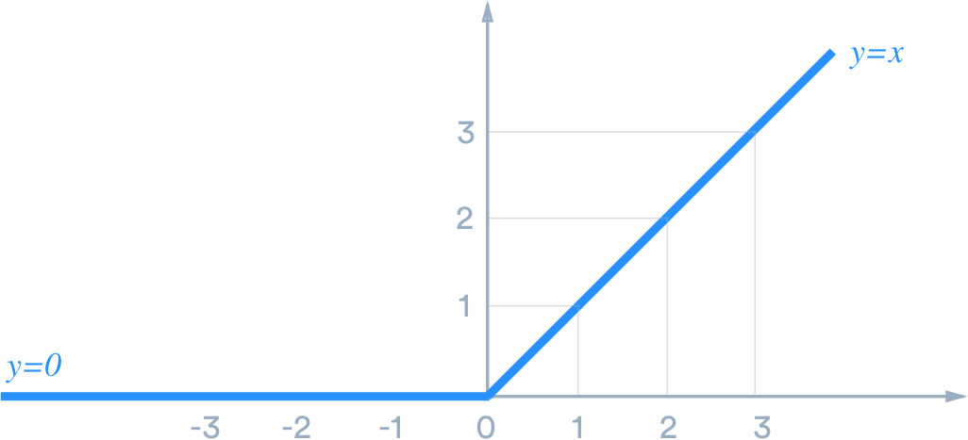
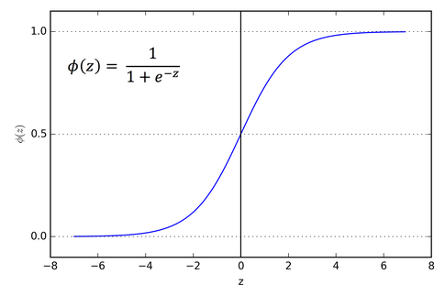
Results - doc2vec/preprocess + deep learning
Accuracy on a training set: 97.45%
Accuracy on a test set: 89.23%
Activation function: ReLU, Sigmoid
Binary classification

Slide 18
Overall Results - Preprocessing Approach Comparison
Scripts are set up & ready.. but algorithms didn’t run through so far (they take some time…)
→ So no results available for comparing the preprocessing approaches

Slide 19
Outlook
Finish the final and overall comparison of the preprocessing approaches
Set up some sort of framework to be able to continuously/regularly and automatically train the models for continuous improvement/adaptation (language is changing!)
Apply the trained models in real life e.g. on some sort of news website or similar
Take satyre into account

Slide 20
Thank you!

Slide 21
References
[1] https://martin-thoma.com/nlp-reuters/

