Slide 1

The Rise of the Ottoman Empire
Lesson 1 | Mr. Maccarello's Teaching Persona | March 27, 2026
1

Slide 2
Today's Objectives
SWBAT: Students will be able to identify and explain the key factors that contributed to the rise of the Ottoman Empire, including military organization, religious tolerance, and strategic geography, using primary source analysis and the INSPECT framework.
Standards Addressed
NYS SS 9.2 - Analyze the development of the Ottoman Empire including its military, political, and cultural achievements
NYS SS 9.3 - Examine the impact of trade routes and geography on the expansion of empires
NYS SS 9.5 - Evaluate the role of religious and cultural policies in empire building
2

Slide 3
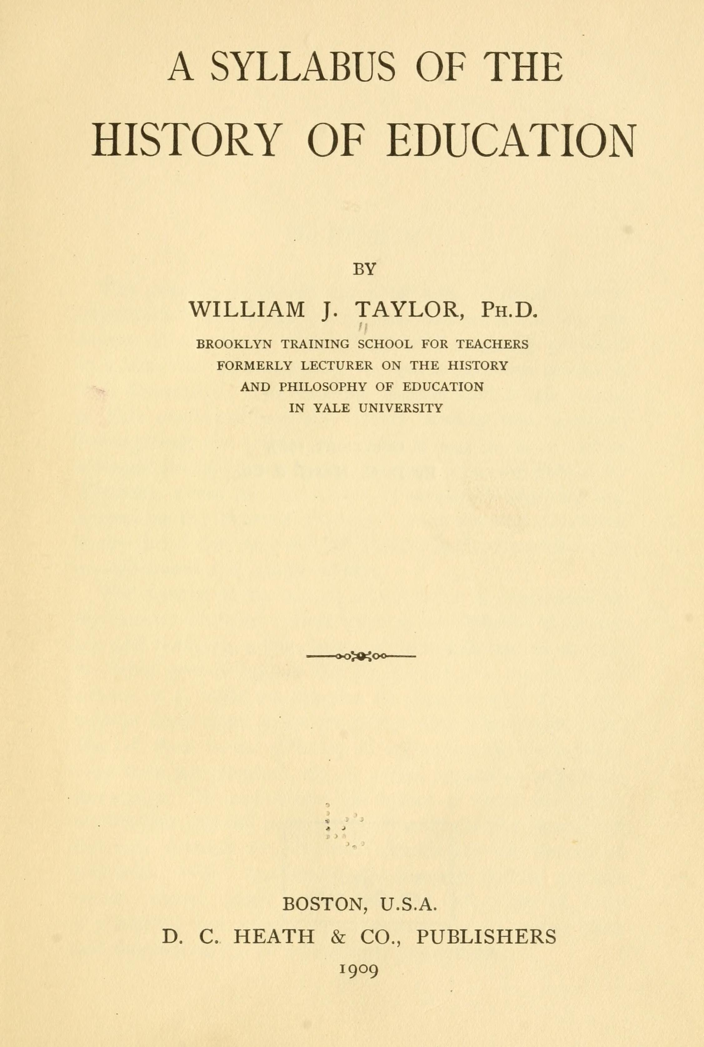
Do Now
PART 1: Examine the political cartoon titled 'The Sick Man of Europe' (1858). Describe TWO specific details you observe in the image. What symbols or characters are present? PART 2: Based on what you see in this political cartoon from 1858, what human actions or decisions might have led to the situation depicted? Explain the cause-and-effect relationship in 2-3 sentences. PART 3: Imagine you are an advisor to a powerful sultan in 1300 CE. Your job is to build an empire from a small territory in Anatolia. What THREE specific strategies would you use to grow your power quickly? Consider geography, military, alliances, and resources. Be specific and provide reasoning. (Time: 5 minutes - begin immediately when you sit down)
5 minutes
The Sick Man, The Sick Man of Europe
3

Slide 4
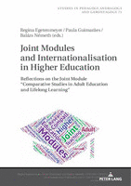
Direct Instruction
Alright historians!
Ottoman Empire, Historical Context
4
Notes:
Alright historians! Today we're diving into one of the most fascinating and powerful empires in world history - the Ottoman Empire. For the next twenty minutes, I need your full attention because we're going to build our understanding step by step.
First, let's talk about CONTEXT. Historical Context means the circumstances that existed before and during an event that help us understand why it happened. The Ottoman Empire didn't just appear out of nowhere - it emerged from very specific conditions.
Open your guided notes and let's trace this together.
Slide 1 - Map: The Anatolian Peninsula
Look at this map showing Anatolia - modern-day Turkey - in 1300 CE. What do you notice about its location? [Pause for student responses]
Exactly! Anatolia sits at a crossroads - it borders the Mediterranean Sea to the west, the Black Sea to the north, and sits right between Europe and Asia. This is called STRATEGIC GEOGRAPHY - a physical location that provides military, economic, and cultural advantages.
Slide 2 - Who Were the Ottomans?
The empire was founded by Osman I around 1299 CE. Here's what I want you to write in your notes:
Osman I - founder of the Ottoman dynasty. He was a Turkic tribal leader who united various groups under his leadership. The empire took his name - the Ottomans.
Check for Understanding: Why do you think uniting different groups was important for building an empire? Turn to your neighbor - you have 30 seconds to share your thinking.
Slide 3 - The INSPECT Framework Introduction
Here's our analytical tool for today. INSPECT helps us analyze any empire by looking at six categories:
I - Interactions with other societies
S - Social structures and hierarchies
P - Political systems and governance
E - Economic activities and trade
C - Cultural practices and beliefs
T - Technological developments
We're going to use this framework throughout the lesson. Write it in your notes right now.
Slide 4 - Factor #1: Military Organization
Listen up, because this is crucial. The Ottomans developed one of the most effective military systems in history - the DEVSHIRME system.
[Write on board]: Devshirme - 'collective selection' in Turkish - a system where Christian boys were taken from their families, converted to Islam, and trained as elite soldiers called JANISSARIES.
Why was this brilliant? Three reasons:
1. It created highly loyal soldiers - they had no family ties to betray
2. It built military strength without deplading the Muslim population
3. It created a meritocracy - these boys rose based on skill, not birth
Check for Understanding: How might the Devshirme system have created resentment among Christian populations? [Allow 30 seconds of think time]
Slide 5 - Factor #2: Religious Tolerance (The Millet System)
Here's something counterintuitive - the Ottomans were actually quite TOLERANT. They developed something called the MILLET system.
[Write on board]: Millet - 'nation' in Turkish - a system that allowed non-Muslim communities to govern themselves according to their own religious laws while paying taxes to the Ottoman state.
This was genius! By allowing Christians and Jews to practice their religions and run their own courts, schools, and communities, the Ottomans:
- Reduced rebellion
- Kept their subjects productive and happy
- Created stability across a diverse empire
Slide 6 - Factor #3: Strategic Trade Routes
Look at this map showing trade routes. Notice how Constantinople - which the Ottomans conquered in 1453 under Sultan Mehmed II - sits directly on the Silk Road and controls access between the Mediterranean and Black Seas.
When the Ottomans captured Constantinople (renaming it Istanbul), they controlled the MOST valuable trade junction in the known world. This meant:
- Massive wealth from taxes and tariffs
- Strategic military positioning
- Access to both Eastern and Western goods
Check for Understanding: How might controlling trade routes affect an empire's power? Connect this to what you learned about the Mongols and Silk Road.
Slide 7 - Primary Source Analysis
[Display excerpt from Aeneas Sylvius Piccolomini's letter, 1454]
Listen to what this European wrote just one year after Constantinople fell:
'Nothing else is talked of in Vienna but the affair of the Turks... The Barbarian is at the gates of Vienna... The Turks have taken Constantinople, have seized Greece, and threaten the rest of Europe.'
This letter reveals something important about the Ottomans - they were seen as a MAJOR threat to European powers. Why do you think European leaders were so frightened?
Slide 8 - Key Vocabulary Wrap-Up
Let's make sure you have these terms locked in your brain:
- Strategic Geography - physical location that provides advantages
- Devshirme - military conscription system using Christian boys
- Janissaries - elite Ottoman soldiers
- Millet System - religious tolerance policy
- Conquest of Constantinople - 1453, turning point moment
Your exit ticket will require you to use these terms correctly, so practice them now!
Transition: Now that we've built our foundation through direct instruction, it's time to become historians and apply what we've learned. We're going to do a jigsaw activity where you become experts on different aspects of Ottoman rise to power. Push your desks together to make islands - we're going collaborative!

Slide 5
Key Vocabulary
Osman I — founder of the Ottoman dynasty. He was a Turkic tribal leader who united various groups under his leadership. The empire took his name - the Ottomans.
5

Slide 6
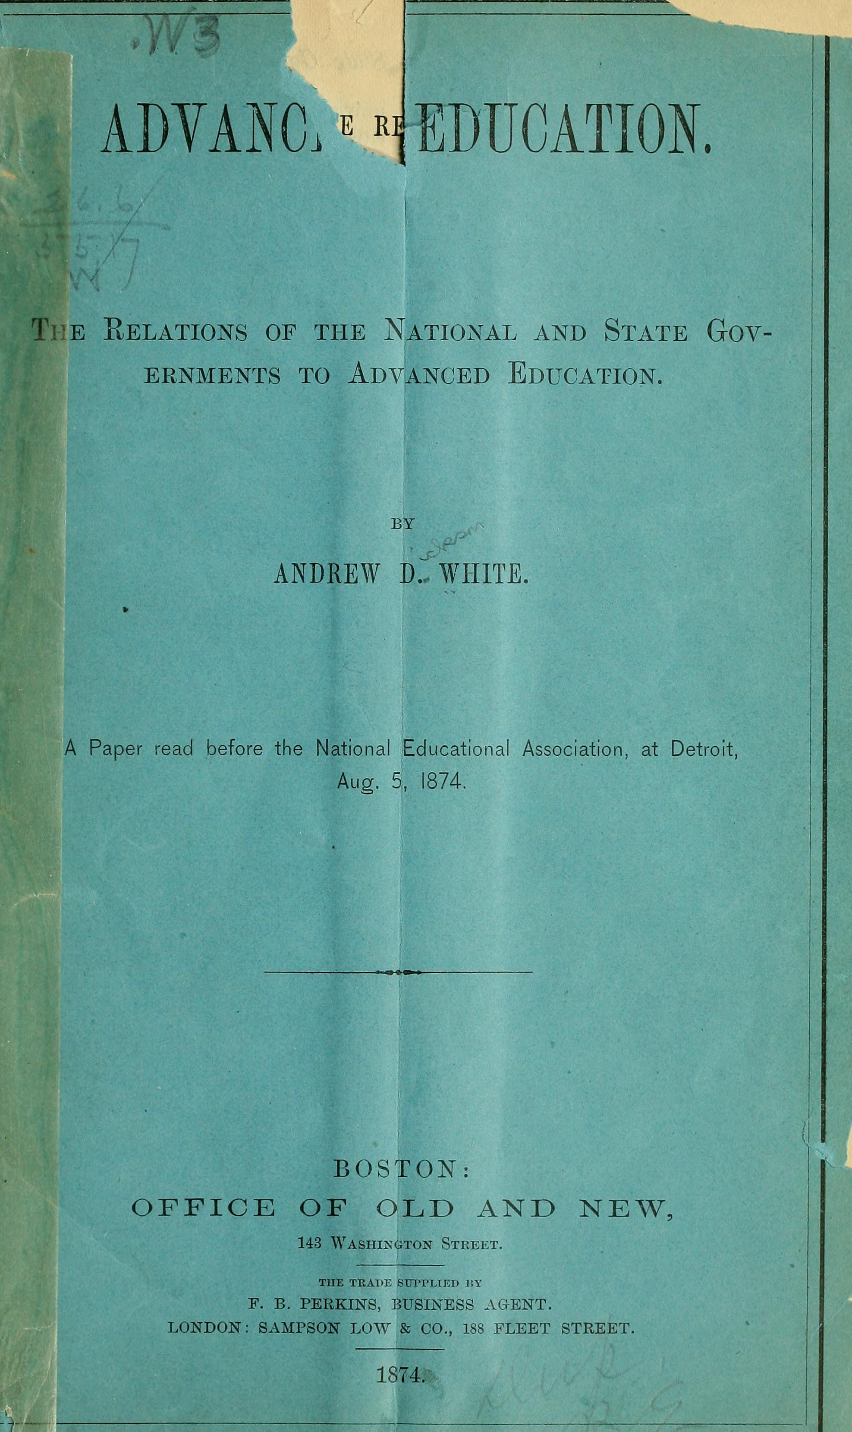
Source Excerpt
“re going to build our understanding step by step. First, let”
— it emerged from very specific conditions.
6

Slide 7
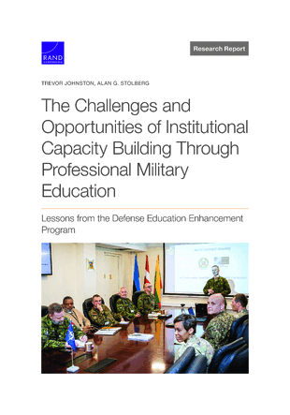
Source Excerpt
“re going to use this framework throughout the lesson. Write it in your notes right now. Slide 4 - Factor #1: Military Organization Listen up, because this is crucial. The Ottomans developed one of the most effective military systems in history - the DEVSHIRME system. [Write on board]: Devshirme -”
— a system where Christian boys were taken from their families, converted to Islam, and trained as elite soldiers called JANISSARIES.
7

Slide 8
Source Excerpt
“s something counterintuitive - the Ottomans were actually quite TOLERANT. They developed something called the MILLET system. [Write on board]: Millet -”
— a system that allowed non-Muslim communities to govern themselves according to their own religious laws while paying taxes to the Ottoman state.
8

Slide 9
Let's Practice Together
9

Slide 10
Your Turn
Expert Phase Instructions: Alright, historians! Here's how our jigsaw works today: STEP 1: Form groups of THREE and push your desks together to make an island. Number yourselves 1, 2, and 3 on your fingers - no need to write it down, just know your number. STEP 2: Each person at your island is going to become an expert on a different document set. Here's the breakdown: - NUMBER 1: Military Documents (Documents A and B) - NUMBER 2: Religious/Social Documents (Documents C and D) - NUMBER 3: Economic/Geographic Documents (Documents E and F) [Distribute Document Sets A-F to each group] STEP 3: You have 7 MINUTES to become the expert on your assigned documents. Read carefully, answer the guiding questions on the document, and be ready to teach your island partners. DOCUMENT A - The Janissary Corps: Source: Excerpt from Ottoman official records, 15th century 'The boys gathered from the Christian lands shall be instructed in the ways of Islam, trained in the arts of warfare, and bound by oath to the Sultan alone. They shall be the Sultan's right hand in battle, and his eye in peace. No greater honor can be bestowed upon these boys, for they shall rise based upon their merit alone.' Guiding Questions for Document A: 1. According to this source, what was the purpose of the Janissary system? 2. What does the phrase 'bound by oath to the Sultan alone' reveal about loyalty? DOCUMENT B - The Siege of Constantinople (1453): Source: Account by Venetian merchant, 1453 'The Sultan brought massive cannons that hurled stone balls weighing over 600 pounds. The walls of Constantinople, which had stood for a thousand years, crumbled before this terrible firepower. The city fell after 55 days of siege.' Guiding Questions for Document B: 1. What military technology allowed Constantinople to fall? 2. How long had Constantinople's walls protected the city? What does this suggest about Ottoman military power? DOCUMENT C - The Patriarch's Letter: Source: Letter from Gennadios II, Greek Orthodox Patriarch, 1454 'The Sultan has granted me authority over all Greek Orthodox Christians in his realm. We may keep our churches, our traditions, and our faith. In exchange, we must pay the taxes required and remain loyal to the state. This arrangement, though humbling, allows our people to survive.' Guiding Questions for Document C: 1. What does this source reveal about Ottoman religious policy? 2. Why might the Patriarch describe this arrangement as 'humbling' yet also as allowing his people to 'survive'? DOCUMENT D - Jewish Refugees in Ottoman Lands: Source: Account by Jewish traveler, 1488 'Many of our people fled Spain to find refuge in Ottoman lands. The Sultan welcomed us, saying that Muslim Spain had foolishly expelled skilled workers who now strengthen his realm. Here we may practice our faith freely and conduct business without persecution.' Guiding Questions for Document D: 1. What does this source reveal about Ottoman policy toward non-Muslims? 2. How might welcoming refugees benefit an empire economically? DOCUMENT E - Trade Map Analysis: Source: Map showing Ottoman trade network, 16th century [Description of map showing Istanbul at center, trade routes connecting to: Venice, Alexandria, Persia, India, North Africa, Eastern Europe] Guiding Questions for Document E: 1. What role did Istanbul play in this trade network? 2. What goods might have flowed through Ottoman territory based on this map? DOCUMENT F - Tax Records from Anatolia: Source: Ottoman tax register, 1520s 'Revenue from customs duties at Istanbul: 450,000 akçe Revenue from customs duties at Bursa: 180,000 akçe Revenue from Silk Road tariffs: 320,000 akçe Total Trade Revenue: 950,000 akçe' Guiding Questions for Document F: 1. What percentage of Ottoman revenue came from trade/tariffs (show your work!)? 2. Why do you think Istanbul generated the most revenue? Circulation during Expert Phase: Walk room, check that students are annotating, not just reading. Listen for misconceptions about Devshirme - some students may think it was purely negative. Push them to think about multiple perspectives. STEP 4: Expert Teaching Phase (6 MINUTES) Here's how you teach your partners: - Each expert has 90 SECONDS to summarize their documents to the group - After each expert shares, island partners can ask ONE clarifying question - Then move to the next expert I'll be listening for: - Are experts summarizing, not just reading? - Are listeners asking genuine clarifying questions? STEP 5: INSPECT Chart Completion (2 MINUTES) Now that you've learned from each other, complete the INSPECT chart on your worksheet. Work together at your island. INSPECT Chart for Ottoman Empire Rise: | Category | Evidence from Documents | Analysis | |----------|------------------------|----------| | Interactions | | | | Social | | | | Political | | | | Economic | | | | Cultural | | | | Technology | | | Differentiation during Guided Practice: - For Struggling Learners: Provide sentence starters for INSPECT analysis: 'Document ___ shows ___(category) because...' and 'This demonstrates that...' - For Advanced Learners: Add extension question - 'Which INSPECT category do you think was MOST important to Ottoman rise? Defend your choice with evidence.' - For ELL Students: Provide key vocabulary list with definitions, allow use of bilingual resources if available Check for Understanding during jigsaw: Call on random students using cold-call strategy: 'Number 2 at island 4 - what was the most surprising thing you learned from your expert about Ottoman religious policy?'
15 minutes
10

Slide 11
Independent Practice
Independent Synthesis Task (10 minutes): Alright, now it's your turn to demonstrate what you've learned. This is individual work - no talking, just your brain and your pen. TASK: Using your INSPECT chart and the documents we analyzed, write a well-developed paragraph answering this question: Which factor do you believe was MOST important to the rise of the Ottoman Empire - Military Organization, Religious Tolerance, or Strategic Geography? You must choose ONE and support your choice with evidence from at least TWO different documents. Writing Frame (You MAY use this sentence starter, but it's not required): The MOST important factor in the rise of the Ottoman Empire was _____________ because _____________ [reason]. For example, Document ___ states that ___________. Additionally, Document ___ demonstrates ___________. This evidence shows that ___________ was more significant than ___________ and ___________ because ___________. You have 10 minutes. Write at least 6-8 sentences. I will collect these as a formative assessment. Early Finisher Extension (for students who finish before time is called): Imagine you are an advisor to Sultan Mehmed II in 1453. Write a 30-second persuasive pitch (4-5 sentences) explaining why your chosen factor should be prioritized for future Ottoman expansion. Be ready to present if called on! Recording/Submission: - Write your paragraph on the provided half-sheet paper - Write your name and period in the top right corner - Submit to the basket at the door when finished Circulation during Independent Work: Watch for students who are summarizing instead of analyzing. If you see this, quietly approach and ask: 'WHY does that evidence matter? Don't just tell me what it says - tell me what it PROVES.'
10 minutes
11

Slide 12
Show What You Know
12

Slide 13
Exit Ticket
1
Define the Devshirme system and identify one reason why it strengthened the Ottoman military.
2
Using the Millet system as an example, explain how Ottoman religious tolerance created STABILITY in their empire. Apply this concept to a specific group (Christians, Jews, etc.).
3
CONTESTED QUESTION: A historian argues that 'Strategic Geography was the MOST important factor in Ottoman rise.' Another historian disagrees, saying 'Human decisions - like the Devshirme system and Millet policy - mattered MORE than location.' Which argument do you find more convincing, and WHY? Support your thesis with specific evidence from today's lesson. Your answer should be 3-4 sentences.
Turn in before you leave
13

Slide 14
Tonight's Homework
Homework Assignment: The Ottoman Empire extended from 1299 to 1922 CE - that's over 600 years! Tonight, I want you to complete the following tasks to prepare for our next lesson: TASK 1 - Reading & Note-Taking: Read the following primary source excerpt from Evliya Çelebi's travel diary (1660s), a famous Ottoman explorer: 'I have traveled to many lands, but never have I seen a city like Istanbul. The Sultan lives in the Topkapi Palace, surrounded by gardens and fountains that cool the air. The Hagia Sophia, once a church, now stands as a mosque with its massive dome dominating the skyline. Merchants from Venice, Persia, and Egypt all bring their goods to the Grand Bazaar, where over 4,000 shops employ thousands of workers. The empire stretches from Vienna in the west to Baghdad in the east.' TASK 2 - Prediction Question: Based on this source and what we learned today, predict THREE things we might study about the Ottoman Empire in our next lesson. Write 1-2 sentences for each prediction, explaining your reasoning. Example format: 1. I predict we will study ___________ because Çelebi mentions __________. 2. I predict we will study ___________ because ___________. 3. I predict we will study ___________ because ___________. TASK 3 - Optional Challenge (Bonus Points): Create a simple timeline of the Ottoman Empire from 1299-1922, including at least 5 major events with dates. This will be worth 5 bonus points on your next quiz! This homework is due at the beginning of class tomorrow. No late work accepted - let's keep our momentum going, historians!
Mr. Maccarello's Teaching Persona | Social Studies (Global History, Us History, Government)
Generated by Claw-ED
14

