Slide 1
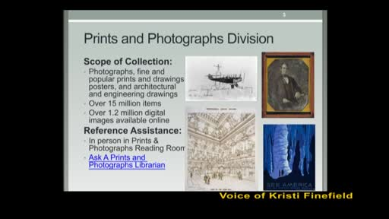
The Renaissance: Birth of a New Era
Lesson 1 | Mr. Maccarello's Teaching Persona | March 27, 2026
1

Slide 2
Today's Objectives
SWBAT: Students will be able to identify and describe the key characteristics of the Renaissance, analyzing how artistic, intellectual, and political changes distinguished this period from the medieval era using INSPECT chart analysis.
Standards Addressed
NYS Global History and Geography SS9-10ELA1
NYS SS 9-10 Era 3: Renaissance and Reformation
CCSSRH7: Integrate quantitative or technical analysis with qualitative analysis in text or spoken word
2

Slide 3
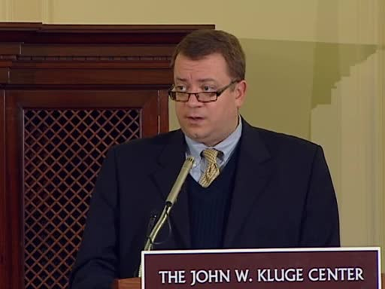
Do Now
DO NOW - Visual Analysis (5 minutes) Look at the image of Leonardo da Vinci's 'Mona Lisa' (1503-1506) and the 'Madonna and Child' by an anonymous medieval artist (c. 1250). Part 1: Describe TWO specific details from each painting that are different. How does the Mona Lisa's expression differ from the medieval Madonna? What objects or settings appear in each? Part 2: Why do you think artists began painting people this way? What human actions or changes in society might explain this shift in art? Part 3: Imagine a modern artist today chooses to paint in the medieval style instead of contemporary styles. Name TWO concrete reasons why an artist might make that choice, and TWO reasons why it would be difficult to sell such art in today's market. (Students write responses on half-sheet paper as they enter - collected after 5 minutes)
5 minutes
Visual Analysis, Mona Lisa
3

Slide 4

Direct Instruction
I DO: Teacher-Led Direct Instruction (20 minutes) Transition: 'Alright historians, you just noticed something important - artists changed how they ...
Led Direct Instruction, Opening Hook
4
Notes:
I DO: Teacher-Led Direct Instruction (20 minutes)
Transition: 'Alright historians, you just noticed something important - artists changed how they painted people. Today we're going to figure out WHY an entire era decided to look at the world differently. This is called the Renaissance.'
Opening Hook (3 minutes):
Write on the board: Renaissance = 'Rebirth' in French
Say: 'From roughly 1350 to 1600, something remarkable happened in Europe. Think of it like this - imagine everyone in your school suddenly decided that last year's fashion was boring, and everyone started wearing completely different clothes, listening to different music, and caring about different things. Now multiply that times a thousand and make it last 250 years. That's the Renaissance.'
Key Vocabulary in Context:
- Secularism: Focus on worldly (here-and-now) matters rather than only religious concerns
- Humanism: Philosophy that emphasized human potential, achievements, and individual worth
- Perspective: Artistic technique showing depth and 3D on a flat surface
Guided Notes with INSPECT Introduction (12 minutes):
Display and distribute: INSPECT Chart Template
| Category | Medieval Era | Renaissance |
|----------|-------------|-------------|
| I - Interactions | Church controlled education | Humanist scholars communicate across Europe |
| S - Social | Rigid social classes | Emerging middle class, patronage system |
| P - Political | Feudalism, Church authority | City-states, powerful merchant families |
| N - Natural/Technology | Limited innovation | Scientific inquiry, engineering advances |
| E - Economic | Agrarian, serf labor | Trade networks, banking in Italian cities |
| C - Cultural | Religious art, anonymous artists | Individual genius celebrated, classical inspiration |
| T - Trade | Local, limited | Mediterranean trade, global connections |
Model filling in the first row together:
Say: 'Look at the Interactions row. During the Medieval period, who controlled most learning and communication? The Church. But during the Renaissance, humanist scholars began writing letters to each other across different cities and countries. They shared ideas about art, science, and philosophy. This is a change in how people INTERACTED with each other intellectually.'
Primary Source Analysis (5 minutes):
Display: Excerpt from Petrarch's letter (1374):
'My fate is to live among varied and confusing storms. But for you perhaps, if as I hope and wish you will follow me, I can look forward to being able to die in the of my own beloved Florence...'
Ask: 'What does Petrarch value here? Is this focused on religious salvation or worldly life?' (Answer: He loves Florence as his home - secular, worldly attachment)
CHECK FOR UNDERSTANDING (Minute 12):
Cold call: 'On the count of three, tell me one word that describes medieval art, and one word for Renaissance art. One...two...three!' (Take 3-4 responses)
Transition: 'Now you're going to practice applying this INSPECT framework yourselves with real primary sources.'

Slide 5
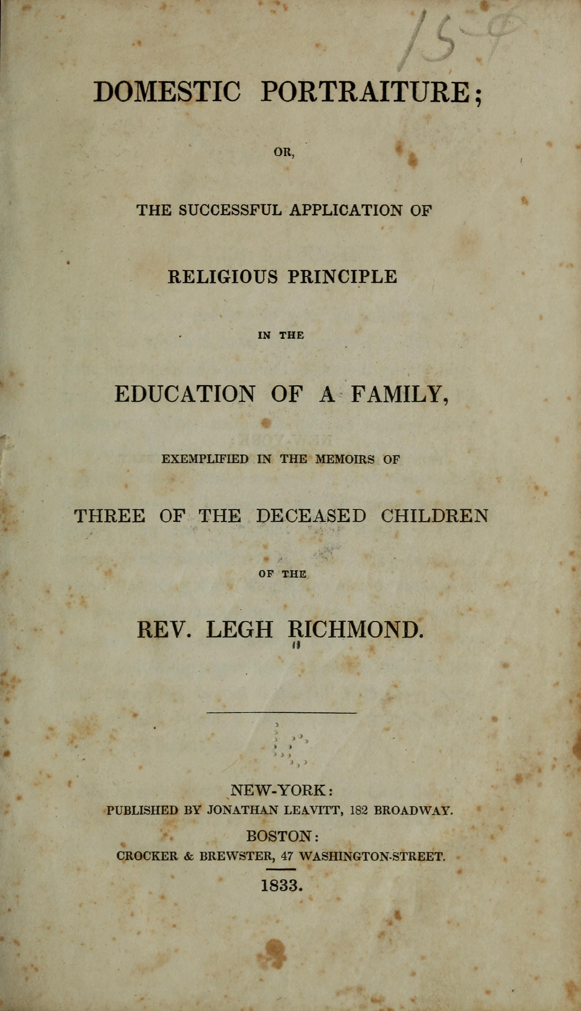
Source Excerpt
“What does Petrarch value here? Is this focused on religious salvation or worldly life?”
— secular, worldly attachment)
5

Slide 6
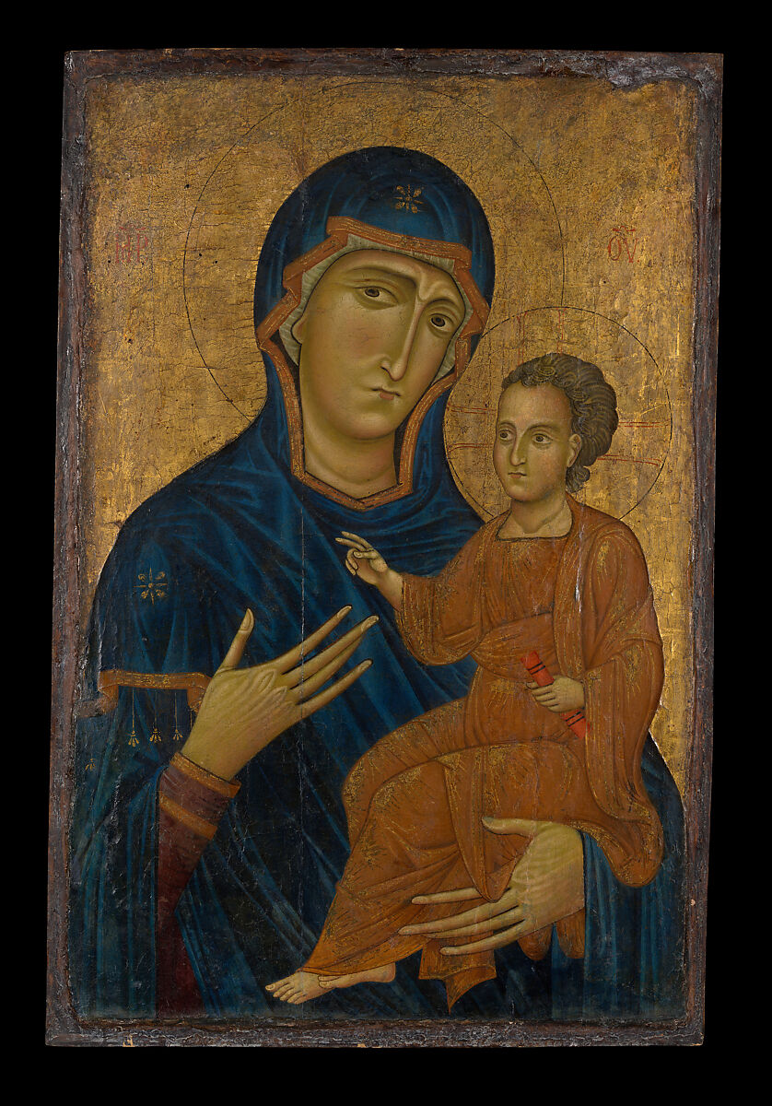
Source Excerpt
“On the count of three, tell me one word that describes medieval art, and one word for Renaissance art. One...two...three!”
— 4 responses)
6

Slide 7
Let's Practice Together
7

Slide 8
Your Turn
WE DO: Jigsaw Expert Groups with INSPECT Analysis (15 minutes) Transition: 'Here's how we're going to work today. Push your desks together to make an island with your table group. You will become experts on one aspect of Renaissance change, then teach your island partners.' Jigsaw Formation (2 minutes): Form groups of three. Push desks together to make an island. Number yourselves 1-2-3. Each group member will analyze a different document set: - Set 1 (Student 1): Political cartoons and images - Lorenzo de' Medici patronage, city-state politics - Set 2 (Student 2): Art reproductions - Masaccio's 'The Tribute Money' (perspective), Michelangelo's David (human form) - Set 3 (Student 3): Historical maps and data - Italian trade routes, population growth in Florence Expert Phase (5 minutes): Each student studies their document set with guiding questions: Set 1 Guiding Questions: 1. How did powerful families like the Medici gain and maintain political power? 2. What role did art patronage play in Renaissance politics? 3. In what ways did this represent a change from feudal medieval politics? Set 2 Guiding Questions: 1. How does this art show the human body differently than medieval art? 2. What does the artist value - religious devotion or human achievement? 3. How does the use of perspective change the viewer's experience? Set 3 Guiding Questions: 1. Why did Italian city-states become wealthy during this period? 2. How did trade networks support Renaissance cultural development? 3. What natural/geographic advantages did Italy have? Teaching Phase (6 minutes): Students return to their islands and teach sequentially: - Student 1 shares first (2 minutes) - others take notes - Student 2 shares (2 minutes) - others take notes - Student 3 shares (2 minutes) - others take notes Each expert must include: at least ONE quote from sources, ONE specific example, and ask ONE clarifying question of each presenter. INSPECT Completion (2 minutes): Groups collaboratively complete their INSPECT charts using information from all three expert presentations. Fill in at least THREE rows completely. Circulation Checklist: - Look for: Groups filling in actual details, not just copying - Listen for: Academic vocabulary usage (secularism, humanism, perspective) - Support: Provide sentence starters for struggling groups: 'During the Renaissance, there was a change in ___ because...' Transition: 'Experts, nice work! Now we're going to see if you can apply what you learned about Renaissance changes to a real historical debate.'
15 minutes
8

Slide 9
Independent Practice
YOU DO: Role-Play Debate - 'Gold, God, or Glory?' (10 minutes) Role-Play Setup (2 minutes): Reconfigure desks so competing groups face each other. Teacher puts on crown briefly and transforms voice: 'I, Advisor to King Ferdinand and Queen Isabella of Spain, have observed the remarkable changes occurring in the Italian city-states. Our Majesties wish to understand: What was the PRIMARY cause of the Renaissance? Was it wealth from trade (GOLD), the questioning of Church authority (GOD), or the desire for fame and achievement (GLORY)?' 'Your table groups will have 8 minutes to prepare your argument and 30 SECONDS to convince me to fund your theory. The winning group shall receive period coins, and one student will have the chance to win a reproduction artifact!' Debate Instructions (8 minutes): Step 1 (3 minutes): With your table group, decide: - Which cause was MOST important to the Renaissance? - Find specific evidence from your INSPECT chart to support your position - Appoint a spokesperson for your 30-second pitch Step 2 (5 minutes): Round-by-round debate: - Group 1 spokesperson: 30-second pitch + ONE piece of evidence - Teacher cold-calls another group to respond (15 seconds) - Repeat with different groups until all have presented Sentence Starter Scaffolding for debate: 'I argue that GOLD was most important because [evidence from INSPECT chart]...' 'While Group X makes a valid point about GOD, I would counter that...' Early Finisher Extension: Write a thesis statement answering: 'Which Renaissance change had the greatest impact on modern society? Support with evidence.' (1-2 sentences) Collect INSPECT charts from each table before proceeding to exit ticket.
10 minutes
9

Slide 10
Show What You Know
10

Slide 11
Exit Ticket
1
Identify TWO specific changes that occurred during the Renaissance that were NOT present during the medieval period, using evidence from today's INSPECT chart analysis.
2
How did the wealth from Italian city-state trade networks (GOLD) help spread Renaissance ideas? Apply concepts from today's lesson to explain this cause-and-effect relationship.
3
Imagine you're a Renaissance humanist writer writing a letter to a medieval peasant explaining why people should care more about worldly achievements than religious salvation. Write a thesis statement (1-2 sentences) arguing for this humanist perspective, using academic vocabulary learned today.
Turn in before you leave
11

Slide 12
Tonight's Homework
Renaissance Reflection Journal Entry (Due Next Class) Your assignment: Choose ONE piece of media from modern life (a movie, song, advertisement, video game, or artwork) and analyze it using the INSPECT framework. Your journal entry must include: 1. A brief description of the media piece (title, creator, date, medium) - 2-3 sentences 2. An INSPECT chart completed with at least FOUR categories filled in (describe what you see in the media through each lens: Interactions, Social, Political, Economic, Cultural, or Technology) 3. A thesis statement answering: 'Is this modern work more like medieval or Renaissance art/ideas? Support with evidence.' - 1-2 sentences 4. One question you still have about the Renaissance after today's lesson Example Thesis Starter: 'This modern [movie/song/ad] reflects Renaissance values because...' Example Question Starter: 'I'm still confused about how...' This will be collected at the door next class. Be ready to share your analysis with a partner.
Mr. Maccarello's Teaching Persona | Social Studies (Global History, Us History, Government)
Generated by Claw-ED
12

