Slide 1
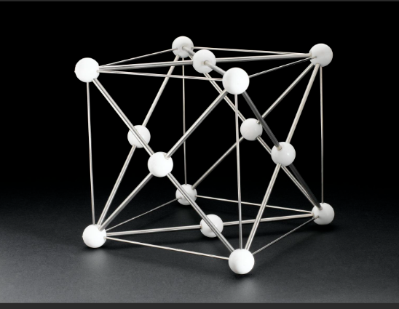
CRYSTALGEN
AI-Driven Crystal Structure Prediction
Presented by: Sirichandana Roll No: 23BD1A0556 | Team No: G450

Slide 2
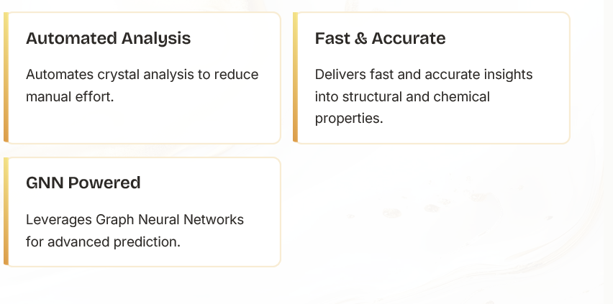
Project Overview: CrystalGen
CrystalGen is an AI-driven platform that predicts and analyzes crystal structures from CIF data using Graph Neural Networks (GNNs).

Slide 3
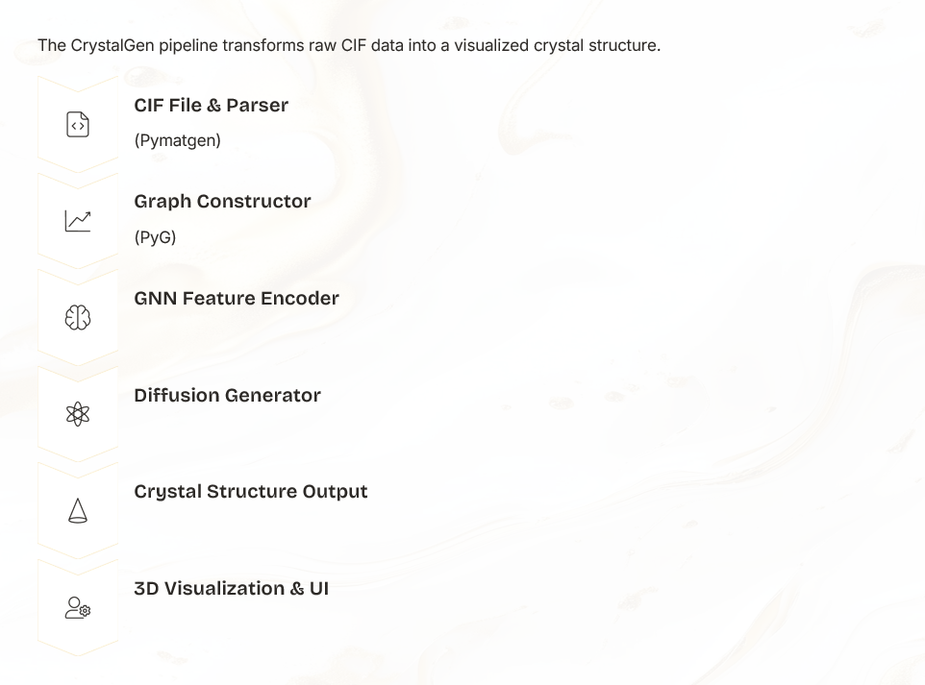
System Architecture Flow

Slide 4
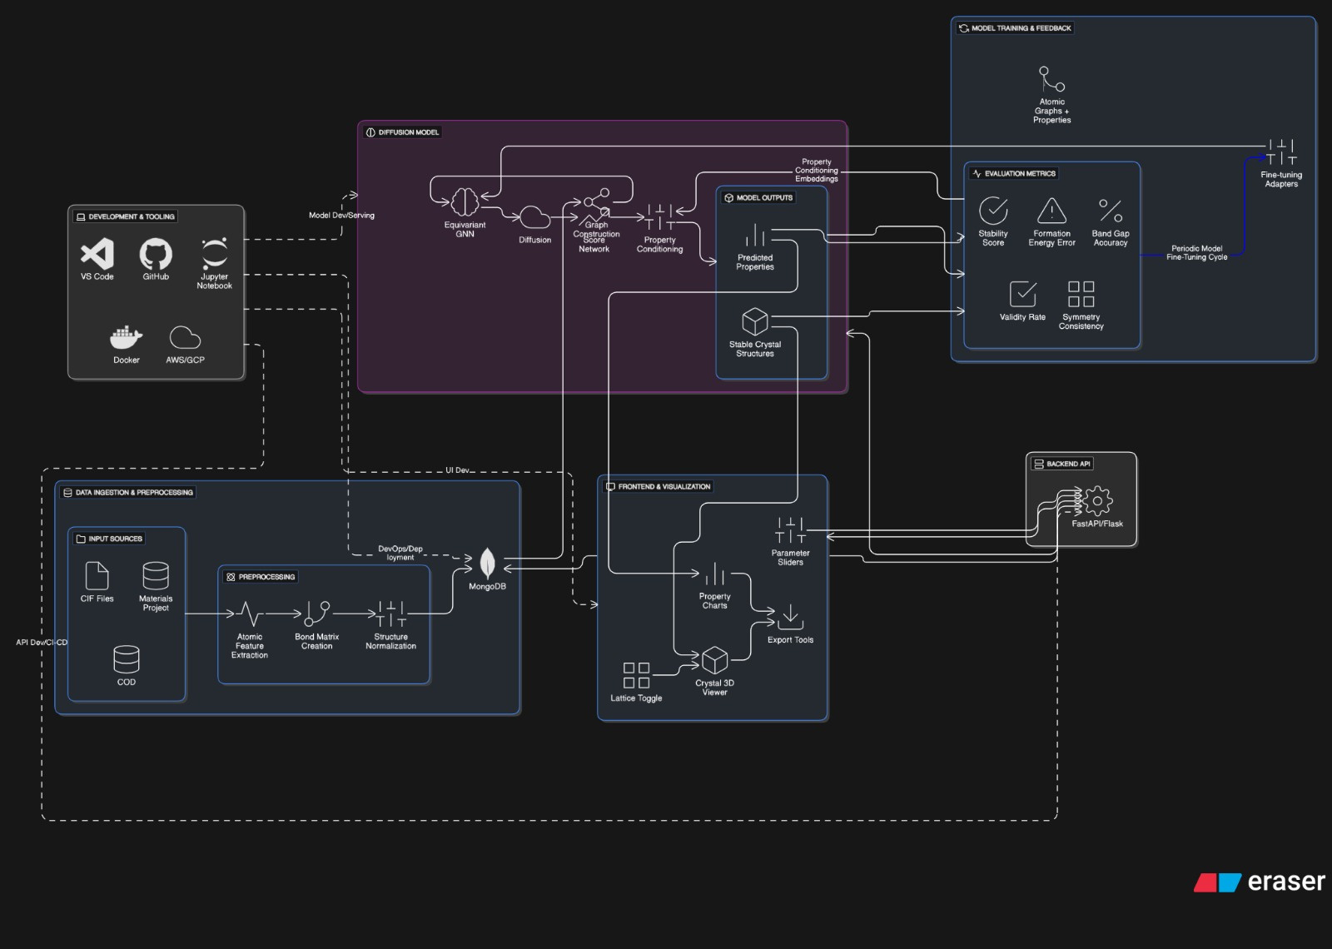

Slide 5
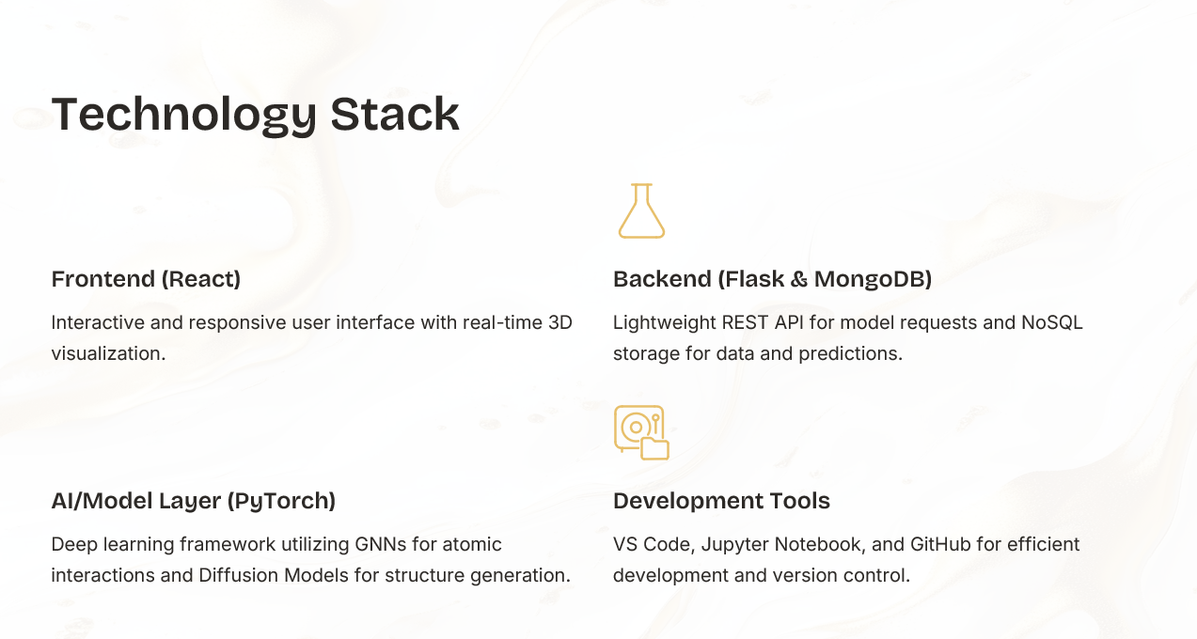

Slide 6
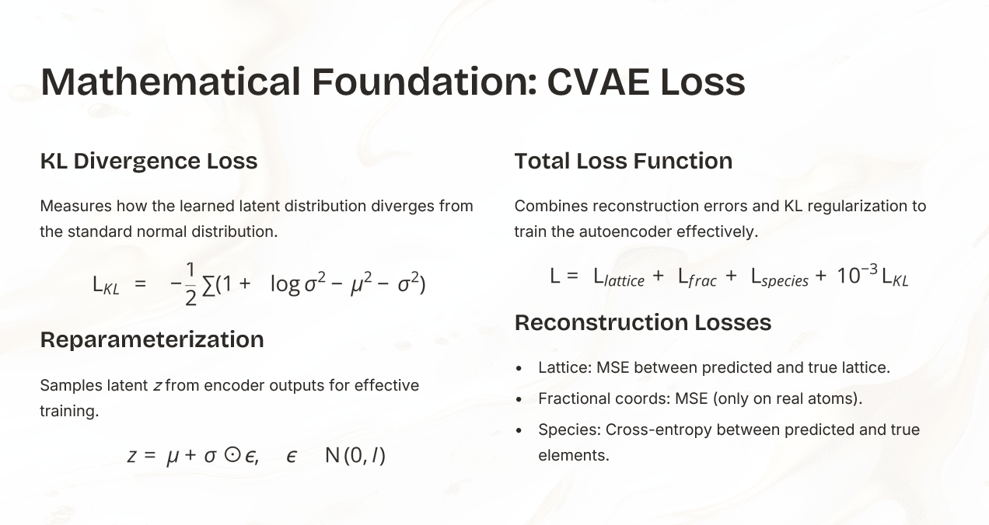

Slide 7
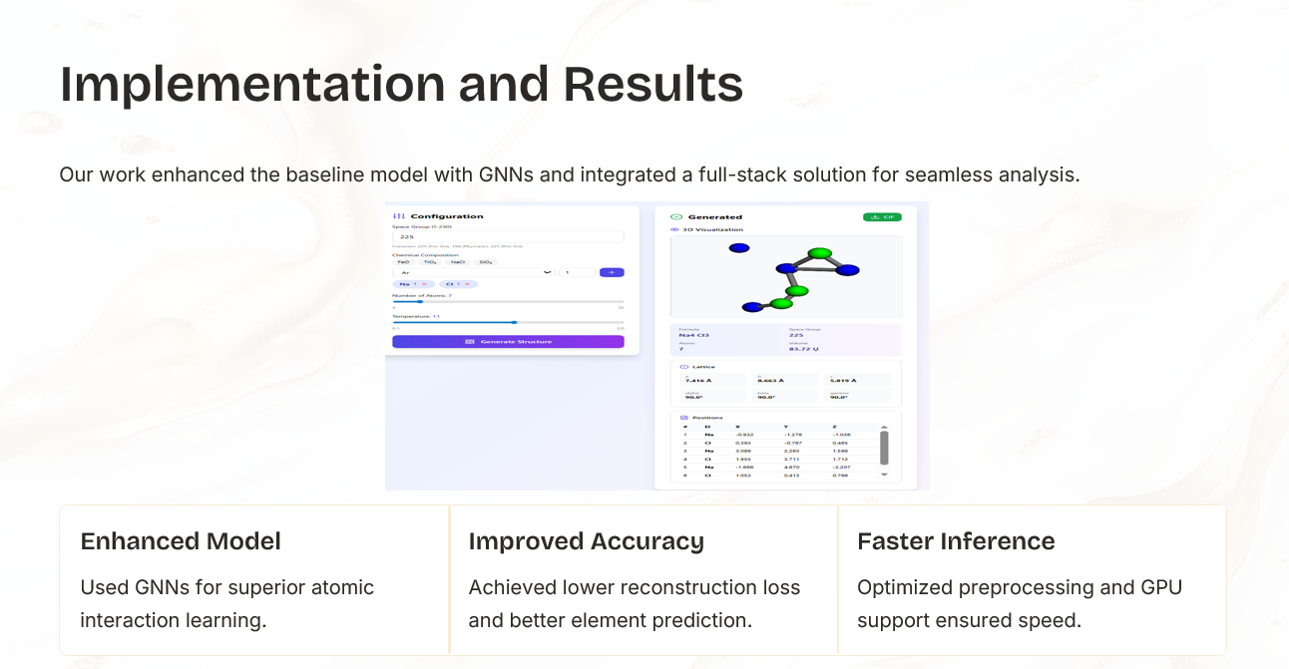

Slide 8
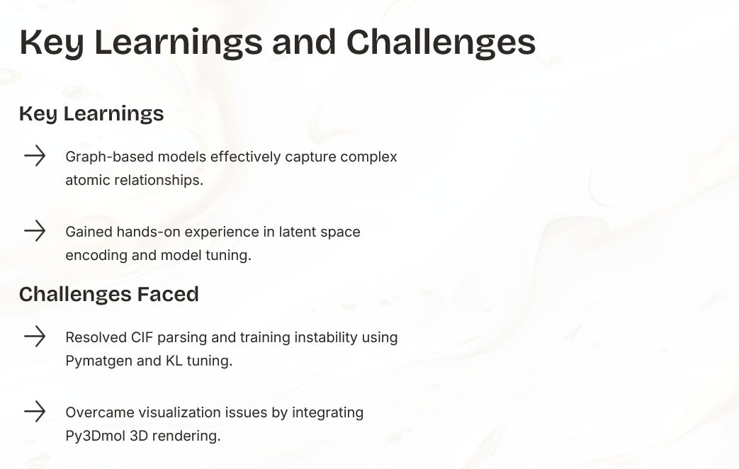

Slide 9
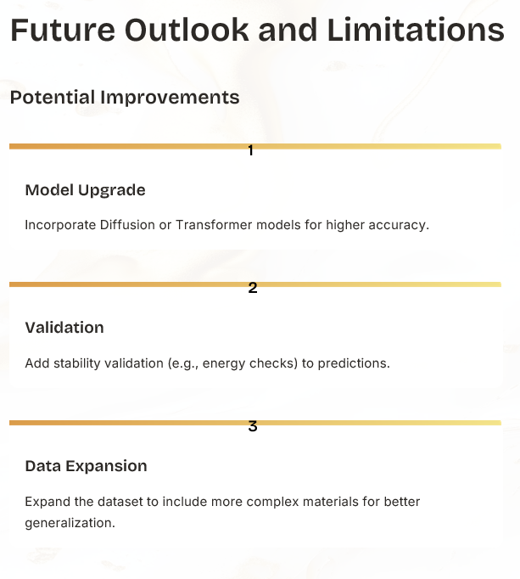

Slide 10
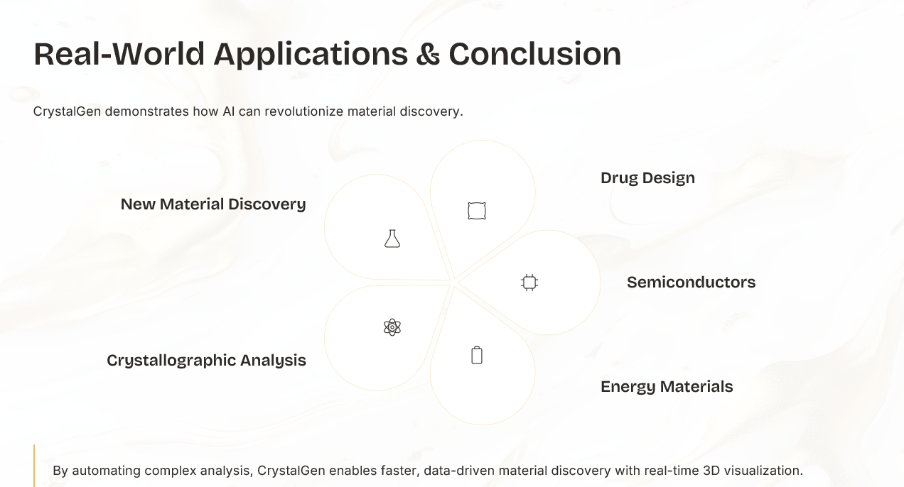

Slide 11

Thank You

