Slide 1
Databases

Slide 2
ToC
SQLite
SQLite Basic commands
JOINS
Redis
Data types supported by Redis
Writing and Reading data
Elasticsearch
ELK Stack
Elasticsearch REST API
Neo4j

Slide 3
SQLite
SQLite is a software library that implements a self-contained, serverless, zero-configuration, transactional SQL database engine.
SQLite engine is not a standalone process, you can link it statically or dynamically as per your requirement with your application. SQLite accesses its storage files directly.

Slide 4
SQLite Commands
CREATE, ALTER and DROP.
Data Definition Language:
CREATE: Creates a new table, a view of a table, or other object in database.
ALTER: Modifies an existing database object, such as a table.
DROP: Deletes an entire table, a view of a table or other object in the database.

Slide 5
SQLite Commands
INSERT, UPDATE, and DELETE
Data Manipulation Language:
INSERT: Creates a record
UPDATE: Modifies records
DELETE: Deletes records

Slide 6
SQLite Commands
SELECT
Data Query Language:
SELECT: Retrieves certain records from one or more tables

Slide 7
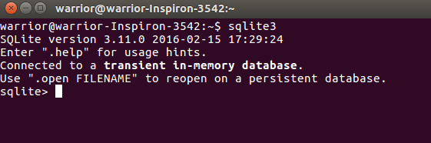
SQLite
Open sqlite command prompt with the command: sqlite3
Now, you have SQLite command prompt where you can issue SQLite commands for your exercises.

Slide 8
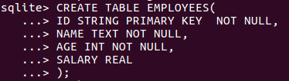
Create table
Let’s create a table with name “EMPLOYEES”.
Fields: ID, NAME, AGE, SALARY
Query:

Slide 9
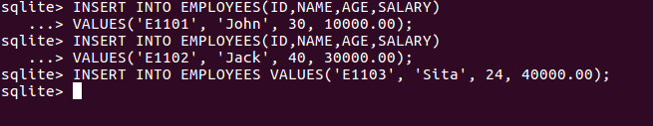
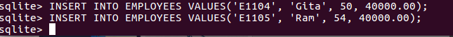
Insert rows
Let’s write query to add new rows of data into the table “EMPLOYEES”
Query: INSERT INTO TABLE_NAME [(column1, column2, column3,...columnN)] VALUES (value1, value2, value3,...valueN);
or INSERT INTO TABLE_NAME VALUES (value1,value2,value3,...valueN);

Slide 10
Formatting Output
By default, .header configuration will be in OFF mode which doesn’t show headers.
Type .header ON command to turn display of headers on and .mode column to get left aligned columns.
Similarly, SQLite will have multiple commands to configure or display different information.

Slide 11
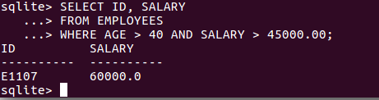
Fetch the data
SELECT statement is used to fetch the data from a SQLite database table which returns data in the form of a result table.
Query to get ID and SALARY from EMPLOYEES with the conditions AGE > 40 and SALARY > 45000.00:

Slide 12
ALTER
SQLite ALTER TABLE command modifies an existing table without performing a full dump and reload of the data.
Renaming the table and adding a column in existing table operations can be done by ALTER.
Let’s rename our EMPLOYEES table with BEST_EMPLOYEES.
Query: ALTER TABLE database_name.table_name RENAME TO new_table_name;

Slide 13
JOINS
SQLite Joins clause is used to combine records from two or more tables in a database. A JOIN is a means for combining fields from two tables by using values common to each.
Let’s create a new table to perform JOIN operation.

Slide 14
Foreign Key
A foreign key is a column or group of columns in a relational database table that provides a link between data in two tables. It acts as a cross-reference between tables because it references the primary key of another table, thereby establishing a link between them.
Before using foreign key, don’t forget to type “pragma FOREIGN_KEYS=’ON’” to enable foreign key constraint.

Slide 15
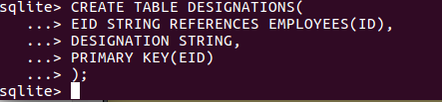
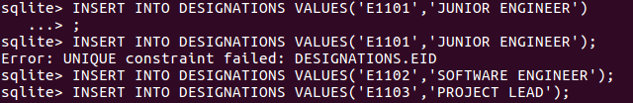
DESIGNATIONS Table
Table name: DESIGNATIONS
Fields: EID, DESIGNATION
Query to create table:
Query to insert rows:

Slide 16
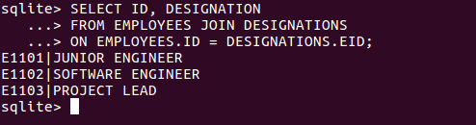
JOINS
A query to get designations of employees who get salary more than 30000.00:

Slide 17

DROP
To delete the table completely, query: DROP TABLE <table_name>

Slide 18
Redis

Slide 19
Redis
Redis is an open source (BSD licensed), in-memory data structure store, used as a database, cache and message broker.
It supports data structures such as strings, hashes, lists, sets, sorted sets with range queries, bitmaps, hyperloglogs and geospatial indexes with radius queries.
It’s an advanced key-value store and an apt solution for building high performance, scalable web applications.

Slide 20
Redis
Redis has three main peculiarities that sets it apart.
Redis holds its database entirely in the memory, using the disk only for persistence.
Redis has a relatively rich set of data types when compared to many key-value data stores.
Redis can replicate data to any number of slaves.

Slide 21
Data types supported by Redis
Redis supports 5 types of data types.
Strings
Hashes
Lists
Sets
Sorted Sets

Slide 22
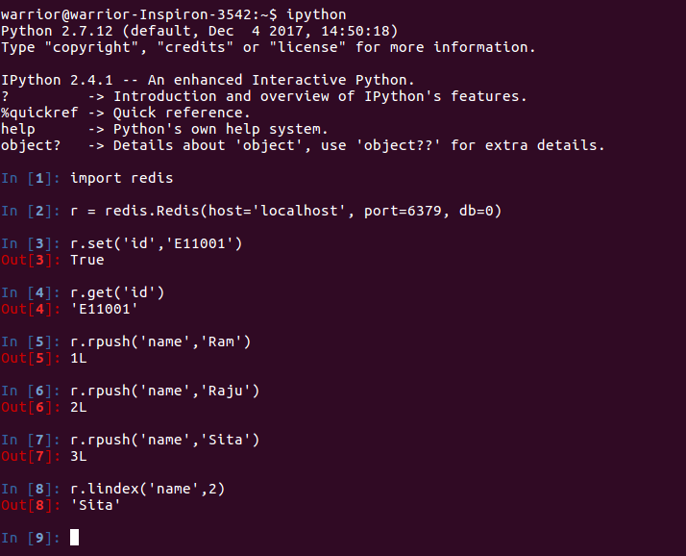
Redis with Python
Open python or ipython terminal using “python” or “ipython” commands respectively.
Once you get the shell, set connection to redis.

Slide 23
Redis with Python
Step 1: Create a connection to Redis
a. To create a connection to Redis using redis-py, import redis with the command: import redis
b. Run the command: r = redis.Redis(host=’localhost’, port=6379, db=0)
The port=6379 and db=0 are default values.

Slide 24
Redis String Commands
Basic Redis String commands are:
SET key value: This command sets the value at the specified key.
GET key: Gets the value of a key

Slide 25
Writing data
Now that we are connected to Redis, we can start reading and writing data.
The following code snippet writes the value ‘E11001’ to the Redis key ‘id’.
The set key to hold the string value. If key already holds a value, it is overwritten, regardless of its type. Any previous time to live associated with the key is discarded on successful SET operation.

Slide 26
Reading data
To read the data, use: r.get(‘id’)

Slide 27
Redis List Commands
Basic commands related to List are:
RPUSH key value1 [value2]: Appends one or multiple values to a list
LRANGE key start stop: Gets a range of elements from a list
LINDEX key index: Gets an element from a list by its index

Slide 28
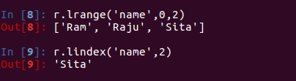
Redis List Commands
Examples for RPUSH, LRANGE, LINDEX

Slide 29
Elasticsearch

Slide 30
ELK Stack
The ELK Stack is a collection of three open-source products — Elasticsearch,Logstash, and Kibana — all developed, managed and maintained by Elastic.
Elasticsearch is a NoSQL database that is based on the Lucene search engine.
Logstash is a log pipeline tool that accepts inputs from various sources, executes different transformations, and exports the data to various targets.
Kibana is a visualization layer that works on top of Elasticsearch.

Slide 31
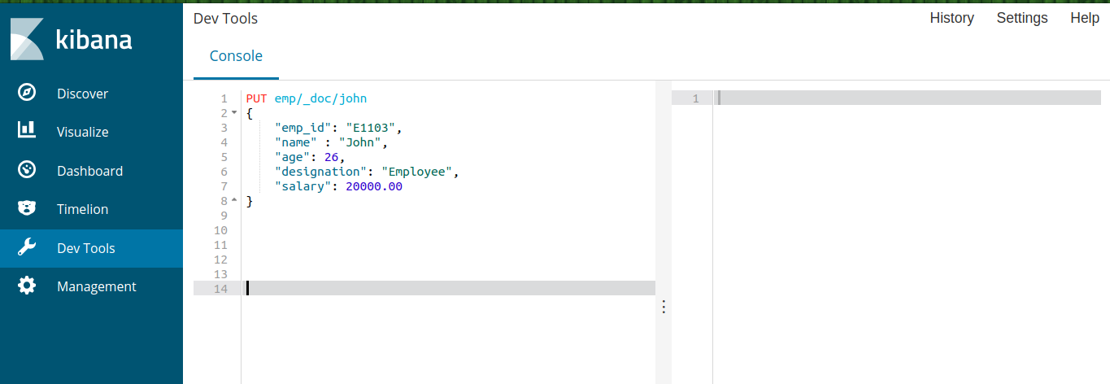
Elasticsearch REST API
One of the great things about Elasticsearch is its extensive REST API which allows you to integrate, manage and query the indexed data in countless different ways.
Interacting with the API is easy — you can use any HTTP client but Kibana comes with a built-in tool called Console which can be used for this purpose.

Slide 32
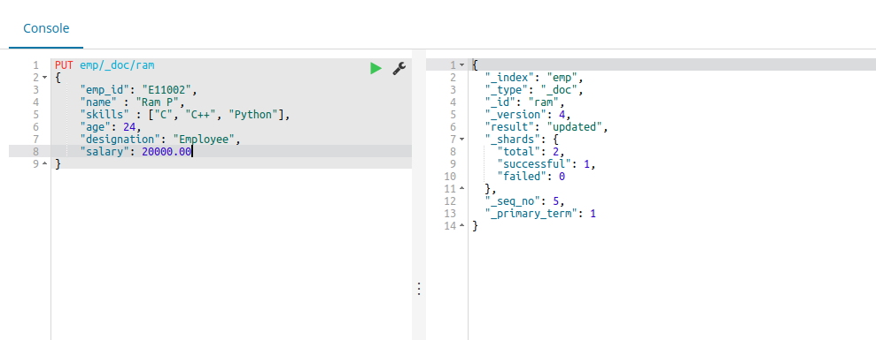
Elasticsearch REST API
In the left side console, we will type our request and when we click on “play” button, it will display response on right side.

Slide 33
Adding a JSON document
The index API adds or updates a typed JSON document in a specific index, making it searchable.
The following example inserts the JSON document into the "emp" index, under a type called "_doc" with an id of “sita”.

Slide 34
Result
The result of the above index operation is:
The _shards header provides information about the replication process of the index operation.
total - Indicates to how many shard copies (primary and replica shards) the index operation should be executed on.

Slide 35
Result
The result of the above index operation is:
successful- Indicates the number of shard copies the index operation succeeded on.
failed - An array that contains replication related errors in the case an index operation failed on a replica shard.

Slide 36
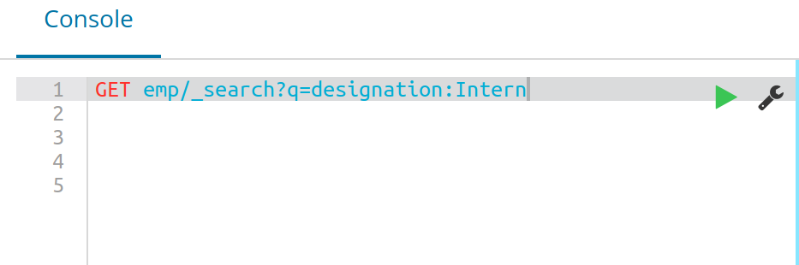
Search request
Request to search based on designation: Intern.
GET emp/_search?q=designation:Intern

Slide 37
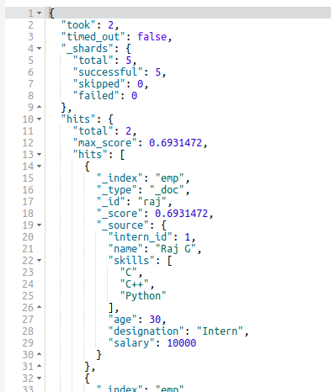
Response
Response for the request that we have made:
Designation: Intern

Slide 38
Query DSL
Elasticsearch provides a full Query DSL based on JSON to define queries.
The query DSL is a flexible, expressive search language that Elasticsearch uses to expose most of the power of Lucene through a simple JSON interface.
It is what you should be using to write your queries in production. It makes your queries more flexible, more precise, easier to read, and easier to debug.

Slide 39
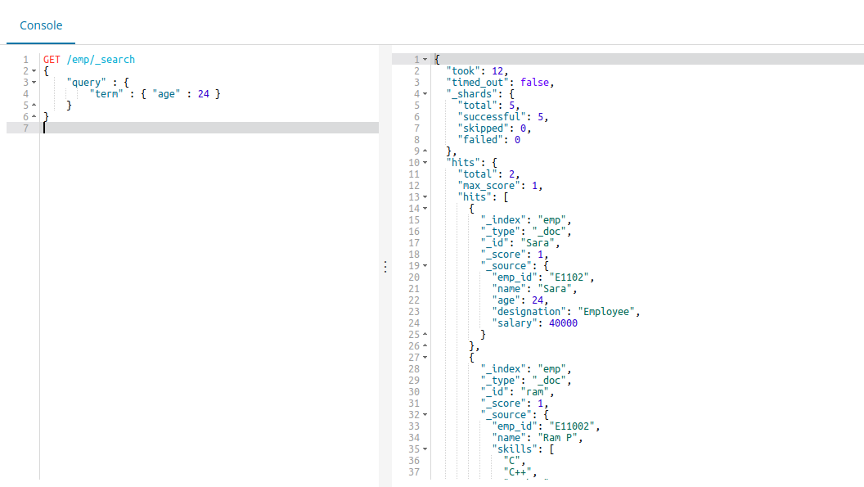
Request Body Search
The search request can be executed with a search DSL, which includes the Query DSL, within its body. Here is an example:

Slide 40
Response
The response for request that we made:
Employees with age 24

Slide 41
Neo4j

Slide 42
Neo4j
Neo4j is a graph database management system developed by Neo4j, Inc.
Described by its developers as an ACID-compliant transactional database with native graph storage and processing, Neo4j is the most popular graph database according to DB-Engines ranking.

Slide 43
Graph Database
A graph database is a database designed to treat the relationships between data as a first-class citizen in the data model.
While other databases compute relationships at query time through expensive JOIN operations, a graph database stores connections as first class citizens.

Slide 44
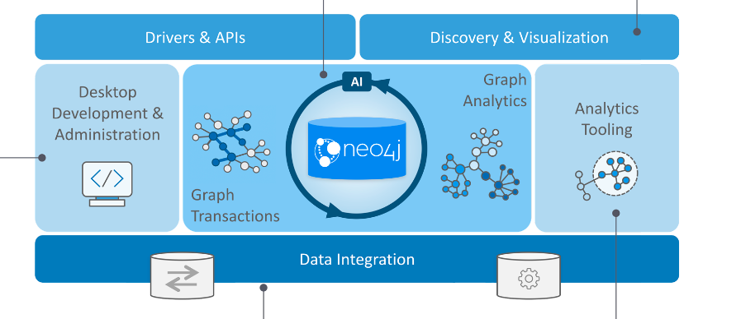
Neo4j

Slide 45
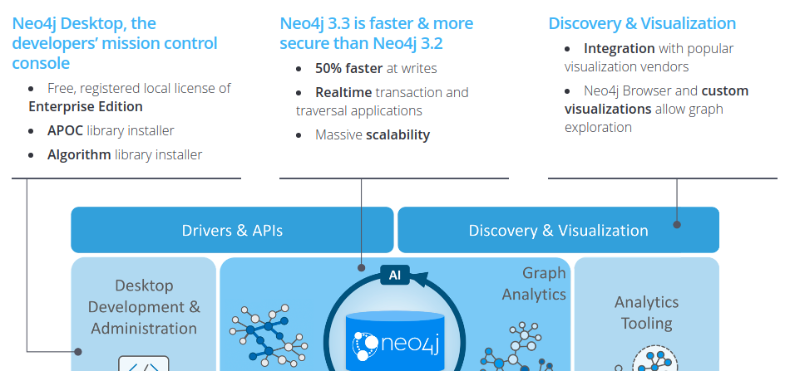
Neo4j

Slide 46
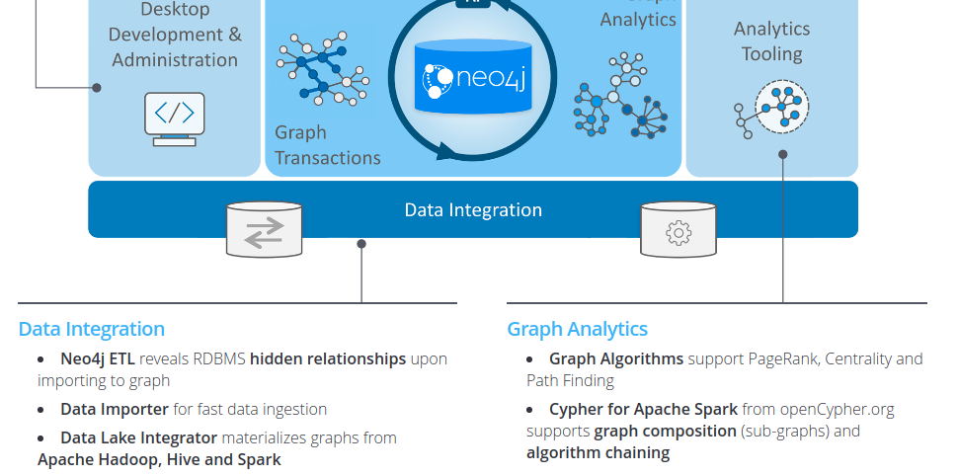
Neo4j

Slide 47
Graph Visualization with Neo4j
Graph Visualization Democratizes Your Connected Data.
The Neo4j graph database unlocks value from your data relationships – and graph data visualization unlocks the accessibility and human understanding of your connected dataset.

Slide 48
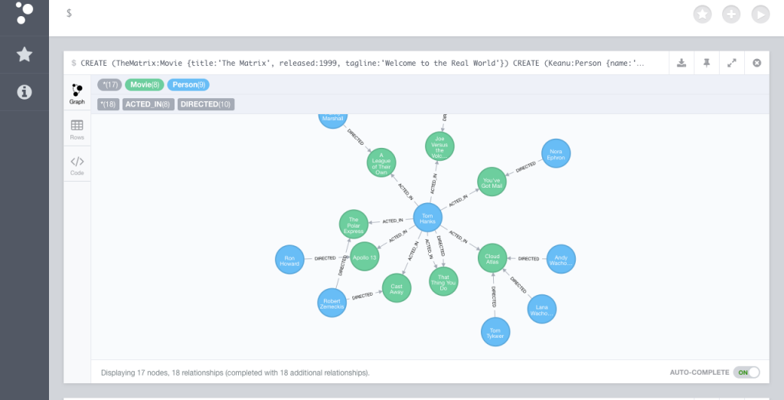
The Neo4j Browser
The Neo4j browser is itself a great visualization tool to help with application and database development.
Notes:
https://neo4j.com/graph-visualization-neo4j/

Slide 49
Fundamentals
Neo4j Graph Database has the following building blocks −
Nodes
Properties
Relationships
Labels

Slide 50
Node
empno: 1234
ename: “Neo”
salary: 35000
deptno: 10
Employee Node
Node is a fundamental unit of a Graph. It contains properties with key-value pairs as shown in the following image.
Here, Node Name = "Employee" and it contains a set of properties as key-value pairs.

Slide 51
Properties
Property is a key-value pair to describe Graph Nodes and Relationships.
Key = Value
Where Key is a String and Value may be represented using any Neo4j Data types.

Slide 52
Relationships
Relationships are another major building block of a Graph Database. It connects two nodes as depicted in the following figure.
Here, Emp and Dept are two different nodes. "WORKS_FOR" is a relationship between Emp and Dept nodes.
Emp
Dept
Works_For
Id = 123

Slide 53
Relationships
As it denotes, the arrow mark from Emp to Dept, this relationship describes −
Emp WORKS_FOR Dept
Here, "WORKS_FOR" relationship has one property as key-value pair.
Id = 123

Slide 54
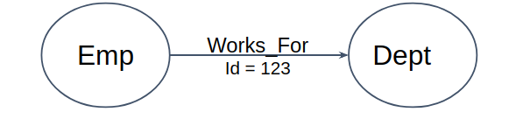
Labels
Label associates a common name to a set of nodes or relationships. A node or relationship can contain one or more labels.
From the previous diagram, we can observe that there are two nodes.
Left side node has a Label: "Emp" and the right side node has a Label: "Dept".
Relationship between those two nodes also has a Label: "WORKS_FOR".

Slide 55
CQL(Cypher Query Language)
Cypher is a declarative graph query language that allows for expressive and efficient querying and updating of a property graph.
Cypher is a relatively simple but still very powerful language.
Very complicated database queries can easily be expressed through Cypher.

Slide 56
Read clauses of Neo4j CQL
Read Clauses | Usage
MATCH | This clause is used to search the data with a specified pattern.
OPTIONAL MATCH | This is the same as match, the only difference being it can use nulls in case of missing parts of the pattern.
WHERE | This clause id is used to add contents to the CQL queries.
START | This clause is used to find the starting points through the legacy indexes.
LOAD CSV | This clause is used to import data from CSV files.

Slide 57
Write clauses of Neo4j CQL
Write Clauses | Usage
CREATE | This clause is used to create nodes, relationships, and properties.
MERGE | This clause verifies whether the specified pattern exists in the graph. If not, it creates the pattern.
SET | This clause is used to update labels on nodes, properties on nodes and relationships.
DELETE | This clause is used to delete nodes and relationships or paths etc. from the graph.
REMOVE | This clause is used to remove properties and elements from nodes and relationships.
FOREACH | This class is used to update the data within a list.
CREATE UNIQUE | Using the clauses CREATE and MATCH, you can get a unique pattern by matching the existing pattern and creating the missing one.

Slide 58
Some Neo4j CQL Functions
CQL Functions | Usage
String | They are used to work with String literals.
Aggregation | They are used to perform some aggregation operations on CQL Query results.
Relationship | They are used to get details of relationships such as startnode, endnode, etc.

Slide 59

Creating a Single node
You can create a node in Neo4j by simply specifying the name of the node that is to be created along with the CREATE clause.
Cypher Query: CREATE (sample)

Slide 60
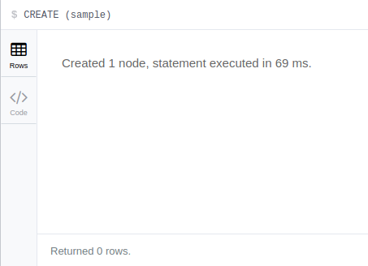
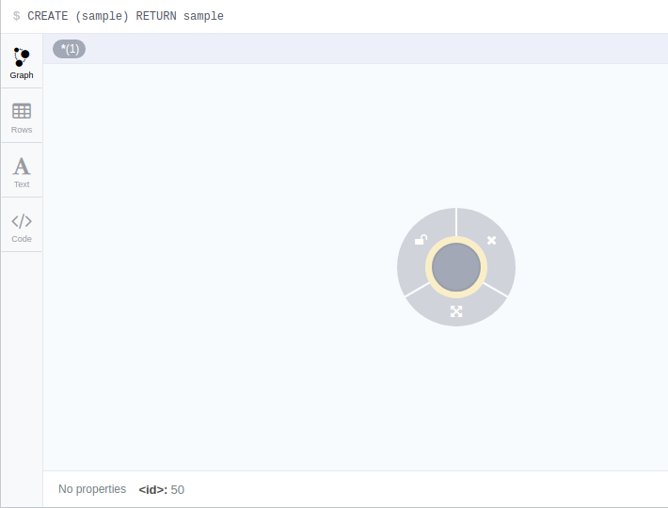
Node
On executing, this query shows the created node as shown in the following screenshot.

Slide 61
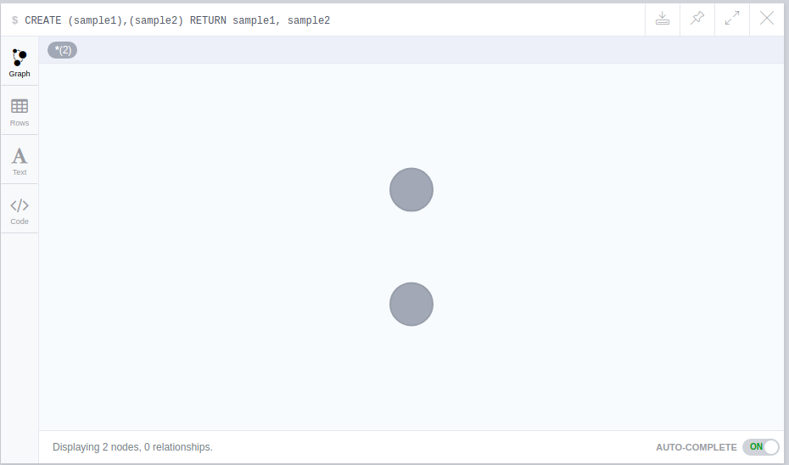
Creating Multiple Nodes
Cypher Query: CREATE (sample1),(sample2)

Slide 62
Creating Multiple Nodes
Cypher Query: CREATE (sample1),(sample2)

Slide 63
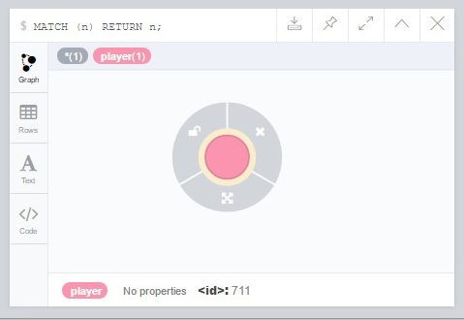
Creating Node with a Label
A label in Neo4j is used to group (classify) the nodes using labels. You can create a label for a node in Neo4j using the CREATE clause.
CREATE (node_name:label1:label2:. . . . )
Cypher Query: CREATE (Dhoni:player)

Slide 64
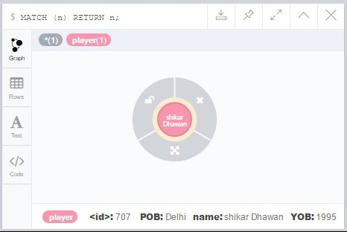
Creating Node with Properties
Syntax to create a node with properties: CREATE (node:label { key1: value, key2: value,....})
Example: CREATE (Dhawan:player{name: "Shikar Dhawan", YOB: 1985, POB: "Delhi"})

Slide 65
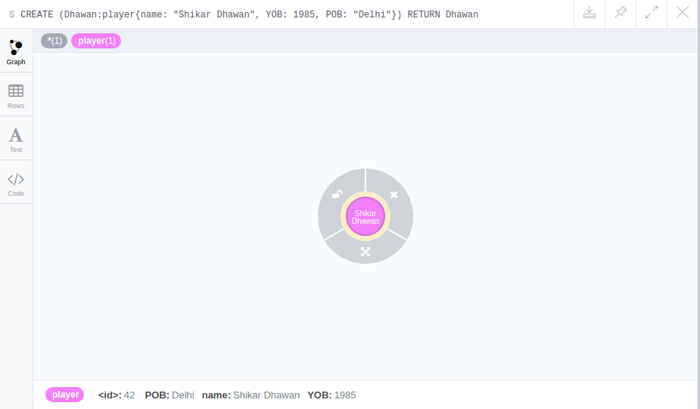
Returning the Created Node
we can use the RETURN clause with CREATE to view the newly created node.
Syntax: CREATE (Node:Label{properties. . . . }) RETURN Node
Query: CREATE (Dhawan:player{name: "Shikar Dhawan", YOB: 1985, POB: "Delhi"}) RETURN Dhawan

Slide 66
Creating Relationship
We can create a relationship using the CREATE clause.
We will specify relationship within the square braces “[ ]” depending on the direction of the relationship it is placed between hyphen “ - ” and arrow “ → ” as shown in the following syntax:
CREATE (node1)-[:RelationshipType]->(node2)

Slide 67
Creating Relationship - Example
Let’s create two nodes Ind and Dhawan, as shown below.
CREATE (Dhawan:player{name: "Shikar Dhawan", YOB: 1985, POB: "Delhi"})
CREATE (Ind:Country {name: "India"})

Slide 68
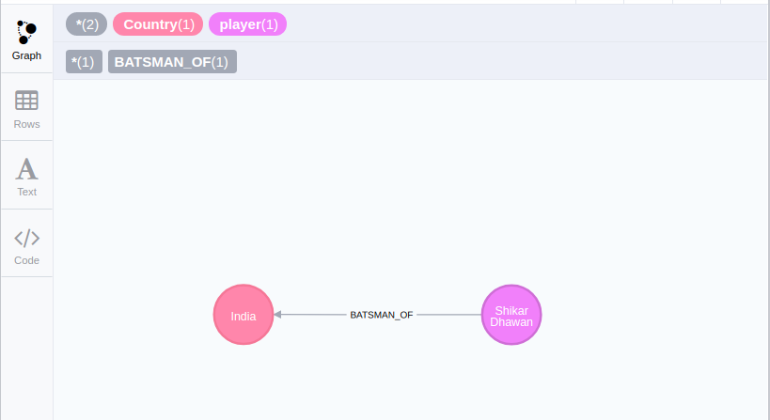
Creating Relationship - Example
Now, create a relationship named BATSMAN_OF between these two nodes and return both nodes to see relationship:
CREATE (Dhawan)-[r:BATSMAN_OF]->(Ind)
RETURN Dhawan, Ind

Slide 69
Match clause
Before proceeding, let’s create 3 more nodes with label player.
CREATE (Dhoni:player {name: "MahendraSingh Dhoni", YOB: 1981, POB: "Ranchi"})
CREATE (Dhawan:player{name: "shikar Dhawan", YOB: 1995, POB: "Delhi"})
CREATE (Jadeja:player {name: "Ravindra Jadeja", YOB: 1988, POB: "NavagamGhed"})

Slide 70
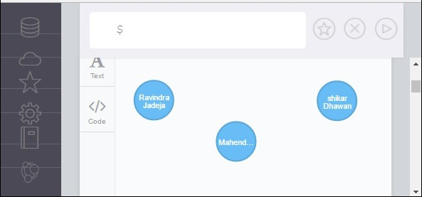
Match clause
This clause is used to search the data with a specified pattern.
Let’s write query to get All Nodes Under a Specific Label.
MATCH (n:player)
RETURN n
To retrieve all nodes in database:
MATCH (n) RETURN n

Slide 71
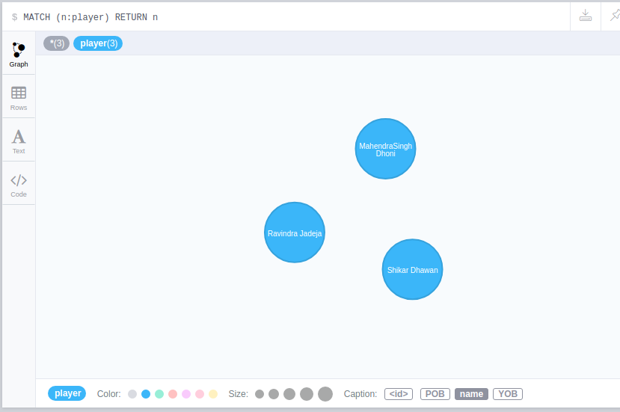
Node
If we click on any label or relationship above the graph visualization, we can then choose its styling in the area below the graph.
Colors, sizes, and captions are selectable from there.

Slide 72
Example
Getting friend of friend of a person
Let’s write a Cypher Query that creates 3 nodes for 3 persons(Nikil, Aaditya, Surya) with
label: Person and properties: name, YOB(Year of Birth), and POB(PlaceOfBirth).
CREATE (Nikil:Person{name: "Nikil R", YOB: 1996, POB: "Delhi"})
CREATE (Aaditya:Person{name: "Aaditya Gupta", YOB: 1995, POB: "Mumbai"})
CREATE (Surya:Person{name: "Surya Teja", YOB: 1994, POB: "Hyderabad"})

Slide 73
Example
After creating 3 persons, let’s add relations as Aaditya is friend of Nikil and Surya is friend of Aaditya.
CREATE (Nikil:Person{name: "Nikil R", YOB: 1996, POB: "Delhi"})
CREATE (Aaditya:Person{name: "Aaditya Gupta", YOB: 1995, POB: "Mumbai"})
CREATE (Surya:Person{name: "Surya Teja", YOB: 1994, POB: "Hyderabad"})
CREATE (Aaditya)-[r:FRIEND_OF]->(Nikil)
CREATE (Surya)-[r1:FRIEND_OF]->(Aaditya)
RETURN Nikil, Aaditya, Surya

Slide 74
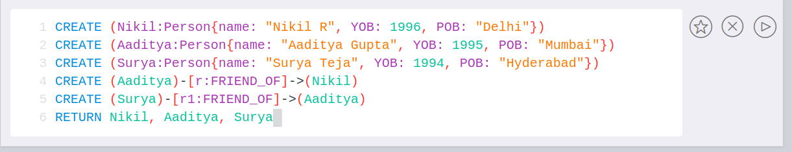
Example
Click Play Button

Slide 75
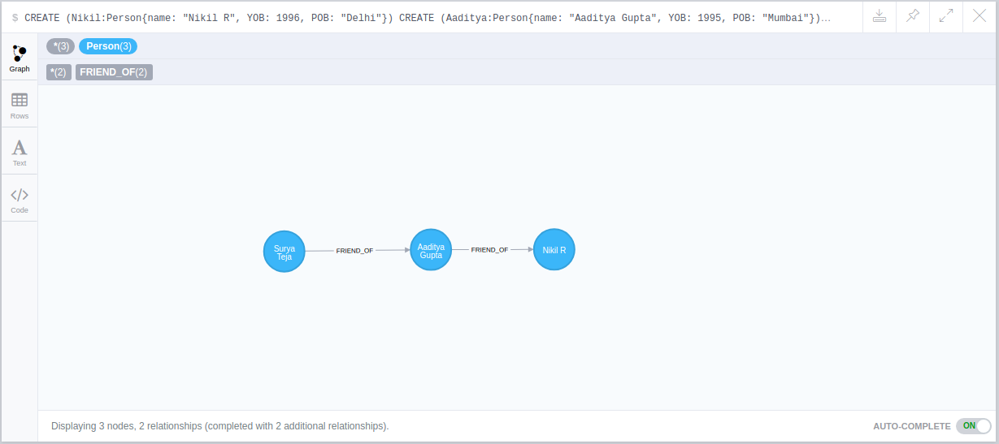
Result
Getting friend of friend of a person
Let’s write a Cypher Query that creates 3 nodes for 3 persons with data
CREATE (Nikil:Person{name: "Nikil R", YOB: 1996, POB: "Delhi"})
CREATE (Aaditya:Person{name: "Aaditya Gupta", YOB: 1995, POB: "Mumbai"})
CREATE (Surya:Person{name: "Surya Teja", YOB: 1994, POB: "Hyderabad"})
CREATE (Aaditya)-[r:FRIEND_OF]->(Nikil)
CREATE (Surya)-[r1:FRIEND_OF]->(Aaditya)
RETURN Nikil, Aaditya, Surya

Slide 76
Query
Getting friend of friend of a person
Let’s write a Cypher Query that returns friend of friend of Nikil ie., Surya Teja.
Cypher Query:
MATCH (a:Person {name:'Nikil R'})-[r:FRIEND_OF]-()-[r1:FRIEND_OF]-(friend_of_a_friend) WHERE friend_of_a_friend.POB='Hyderabad'
RETURN friend_of_a_friend.name AS fofName

Slide 77
Query
Enter the query in Neo4j browser and click play button.

Slide 78
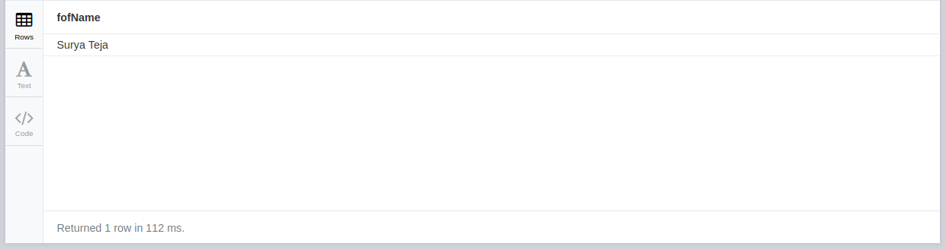
Example
Here, we can see that Friend of friend of Nikil is: Surya Teja

Slide 79
END

Slide 80
ToC
SQLite: tutorialpoint
Redis:
https://redislabs.com/lp/python-redis/
https://pypi.org/project/redis/
http://www.bogotobogo.com/python/python_redis_with_python.php
https://www.tutorialspoint.com/redis/redis_quick_guide.htm
ELK:
https://www.elastic.co/guide/en/elasticsearch/reference/current/search-request-body.html
https://www.elastic.co/guide/en/elasticsearch/reference/5.5/search-request-body.html
https://www.elastic.co/guide/en/elasticsearch/reference/current/search-request-post-filter.html

Slide 81
ToC
Neo4j
https://www.tutorialspoint.com/neo4j/neo4j_cql_create_label.htm
https://www.tutorialspoint.com/neo4j/neo4j_cql_relationship_functions.htm
https://neo4j.com/docs/developer-manual/current/cypher/clauses/set/
https://graphaware.com/neo4j/2015/01/16/neo4j-graph-model-design-labels-versus-indexed-properties.html - Example
https://gist.github.com/DaniSancas/1d5265fc159a95ff457b940fc5046887 - Example
https://neo4j.com/blog/rdbms-graphs-basics-for-relational-developer/
https://neo4j.com/developer/graph-db-vs-rdbms/

