Slide 1
Logging

Slide 2

Agenda
Logging
What is Logging?
Why Logging?
When to use Logging?
Severity Levels
Logging in the industry.
Python Logging Module
Third Party Tools
Using ELK stack to Manage Logs.

Slide 3
Logging

Slide 4
What is Logging?
Logging is a means of tracking events that happen when some software runs.
The software’s developer adds logging calls to their code to indicate that certain events have occurred.
An event is described by a descriptive message which can optionally contain variable data (i.e. data that is potentially different for each occurrence of the event).
Events also have an importance which the developer ascribes to the event; the importance can also be called the level or severity.

Slide 5
Why Logging?
Logging serves two purposes:
Diagnostic logging
records events related to the application’s operation.
If a user calls in to report an error, for example, the logs can be searched for context.
Audit logging
records events for business analysis.
A user’s transactions can be extracted and combined with other user details for reports or to optimize a business goal.

Slide 6
When to use logging
In Ppython, Logging provides a set of convenience functions for simple logging usage.
debug(),
info(),
warning(),
error() and
critical().
To determine when to use logging, see the table in the next slide, which states, for each of a set of common tasks, the best tool to use for it.

Slide 7
When to use logging
Task you want to perform | The best tool for the task
Display console output for ordinary usage of a command line script or program | print()
Report events that occur during normal operation of a program (e.g. for status monitoring or fault investigation) | logging.info() (or logging.debug() for very detailed output for diagnostic purposes)
Issue a warning regarding a particular runtime event | warnings.warn() in library code if the issue is avoidable and the client application should be modified to eliminate the warning logging.warning() if there is nothing the client application can do about the situation, but the event should still be noted
Report an error regarding a particular runtime event | Raise an exception
Report suppression of an error without raising an exception (e.g. error handler in a long-running server process) | logging.error(), logging.exception() or logging.critical() as appropriate for the specific error and application domain

Slide 8
Severity Levels
Level | When it’s used
DEBUG | Detailed information, typically of interest only when diagnosing problems.
INFO | Confirmation that things are working as expected.
WARNING | An indication that something unexpected happened, or indicative of some problem in the near future (e.g. ‘disk space low’). The software is still working as expected.
ERROR | Due to a more serious problem, the software has not been able to perform some function.
CRITICAL | A serious error, indicating that the program itself may be unable to continue running.
The logging functions are named after the level or severity of the events they are used to track.
The standard levels and their applicability are described (in increasing order of severity).

Slide 9
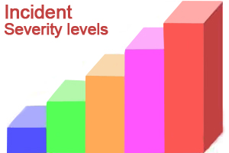
Severity Levels
The default level is WARNING, which means that only events of this level and above will be tracked, unless the logging package is configured to do otherwise.
Events that are tracked can be handled in different ways.
The simplest way of handling tracked events is to print them to the console. Another common way is to write them to a disk file.

Slide 10
Logging vs Printing
The only time that print is a better option than logging is when the goal is to display a help statement for a command line application. Other reasons why logging is better than print:
• The log record, which is created with every logging event, contains readily available diagnostic information such as the file name, full path, function, and line number of the logging event.
• Events logged in included modules are automatically accessible via the root logger to your application’s logging stream, unless you filter them out.
• Logging can be selectively silenced by using the method logging.Logger.setLevel() or disabled by setting the attribute logging.Logger.disabled to True.

Slide 11
Logging in the industry

Slide 12




Logging in the Industry
There are a plethora of log management tools and software.
The logging module in Python.
Third Party tools like:
Logentries,
Loggly,
ELK stack
Here, we’ll address the ELK stack only.

Slide 13
Python: Logging Module

Slide 14

Logging Module in Python
The logging module has been a part of Python’s Standard Library since version 2.3. It is succinctly described in PEP 282.
The documentation is notoriously hard to read, except for the basic logging tutorial. Let’s look at a simple example:
import logging
logging.warning('Watch out!') # will print a message to the console
logging.info('I told you so') # will not print anything

Slide 15
Logging Module in Python
The INFO message doesn’t appear because the default level is WARNING.
The printed message includes the indication of the level and the description of the event provided in the logging call, i.e. ‘Watch out!’.

Slide 16

Logging to a file
A very common situation is that of recording logging events in a file, so let’s look at that next.
import logging logging.basicConfig(filename='example.log',level=logging.DEBUG) logging.debug('This message should go to the log file') logging.info('So should this') logging.warning('And this, too')
You would not see an output in the commandline.
Open the file created and you should find the log messages

Slide 17
Logging from multiple modules
If your program consists of multiple modules, here’s an example of how you could organize logging in it:
# myapp.py import logging import mylib def main(): logging.basicConfig(filename='myapp.log', level=logging.INFO) logging.info('Started') mylib.do_something() logging.info('Finished') if __name__ == '__main__': main()
# mylib.py import logging def do_something(): logging.info('Doing something')
Save both the codes in different files.

Slide 18

Logging from multiple modules
If you run myapp.py, you should see this in “myapp.log” file which was created:
You can generalize this to multiple modules, using the pattern in mylib.py.
Note that for this simple usage pattern, you won’t know, by looking in the log file, where in your application your messages came from, apart from looking at the event description.

Slide 19
Logging variable data
To log variable data, use a format string for the event description message and append the variable data as arguments. For example:
import logging logging.warning('%s before you %s', 'Look', 'leap!')

Slide 20

Changing the format of displayed messages
To change the format which is used to display messages, you need to specify the format you want to use:
import logging logging.basicConfig(format='%(levelname)s:%(message)s', level=logging.DEBUG) logging.debug('This message should appear on the console') logging.info('So should this') logging.warning('And this, too')

Slide 21
Displaying the date/time in messages
To display the date and time of an event, you would place ‘%(asctime)s’ in your format string:
import logging logging.basicConfig(format='%(asctime)s %(message)s') logging.warning('is when this event was logged.')
The default format for date/time display (shown above) is ISO8601.

Slide 22
Displaying the date/time in messages
If you need more control over the formatting of the date/time, provide a datefmt argument to basicConfig, as in this example:
import logging logging.basicConfig(format='%(asctime)s %(message)s', datefmt='%m/%d/%Y %I:%M:%S %p') logging.warning('is when this event was logged.')
Observe that we can specify the format using the datefmt argument.
The format of the datefmt argument is the same as supported by time.strftime().

Slide 23
Bottomline
There’s a lot more that the logging package offers, but to get the best out of it, you’ll need to invest a little more of your time in reading and exploring further.

Slide 24
Third Party Logging Solutions - ELK Stack

Slide 25
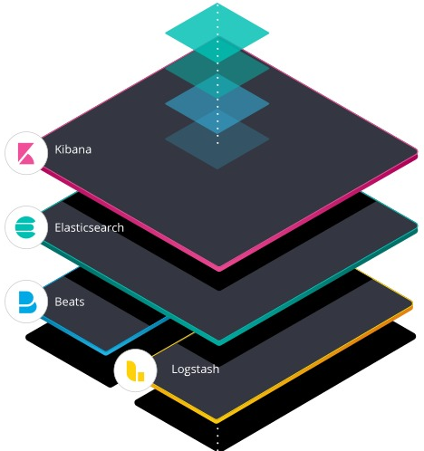
ELK Stack
"ELK" is the acronym for three open source projects: Elasticsearch, Logstash, and Kibana.
Elasticsearch is a search and analytics engine.
Logstash is a server‑side data processing pipeline that ingests data from multiple sources simultaneously, transforms it, and then sends it to a "stash" like Elasticsearch.
Kibana lets users visualize data with charts and graphs in Elasticsearch.
The Elastic Stack is the next evolution of the ELK Stack.

Slide 26
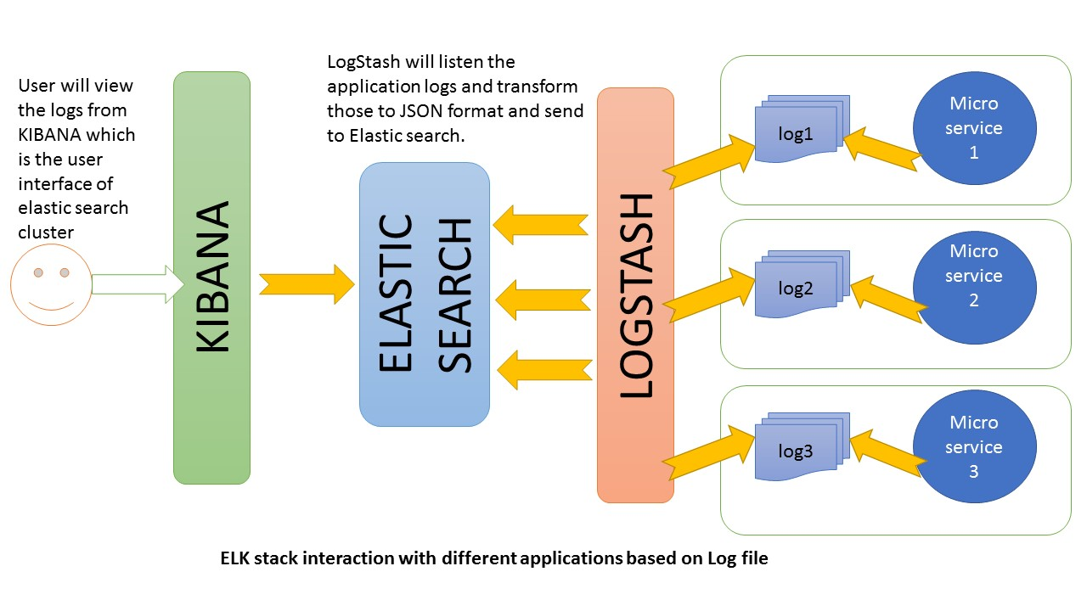
ELK Stack Architecture

Slide 27
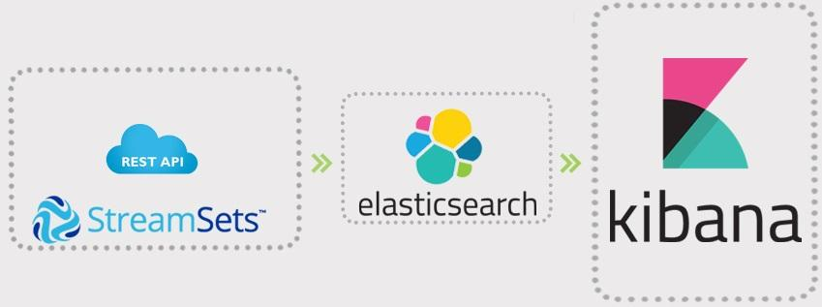
REST API
REST stands for Representational State Transfer. It relies on a stateless, client-server, cacheable communications. In most cases it is used with the HTTP protocol.
RESTful applications use HTTP requests to POST (create), PUT (create and/or update), GET (e.g., make queries), and DELETE data.
REST uses HTTP for all four CRUD (Create/Read/Update/Delete) operations.

Slide 28
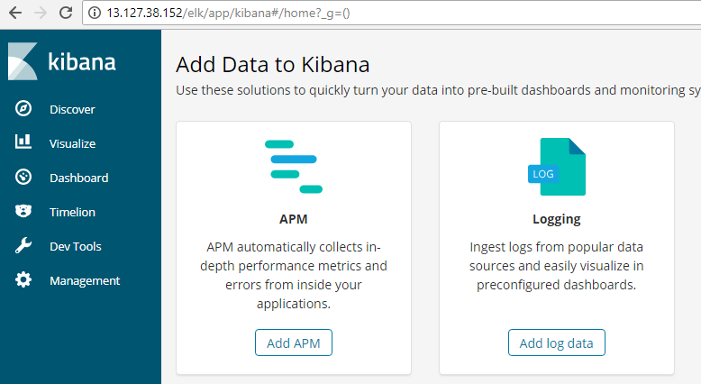
Kibana Dashboard
Kibana is a window into the Elastic Stack. It enables visual exploration and real-time analysis of your data in Elasticsearch.
Log in into the kibana dashboard on http://13.127.38.152/elk/app/kibana

Slide 29
Creating a New Document
Remember that the combination of _index, _type, and _id uniquely identifies a document.
So the easiest way to ensure that our document is new is by letting Elasticsearch auto generate a new unique _id, using the POST version of the index request.
POST /_index/_type/_id
{ ... }
However, if we already have an _id that we want to use, then we have to tell Elasticsearch that it should accept our index request only if a document with the same _index, _type, and _id doesn’t exist already.

Slide 30
Creating a New Document
Let’s say you’re creating an api for maintaining a book list. The corresponding request would look somewhat like this:
POST /booklist/Books/Game_of_Thrones/
{
"api_name":"/bookList/Books/Game_of_Thrones/book1 ",
"request":{
"author": "George R. R. Martin",
"id": 9,
"book_name":"A Clash of Kings"
},
"response":{
"_response":"A Clash of Kings added to the list of books"
},
"status": 503
}

Slide 31
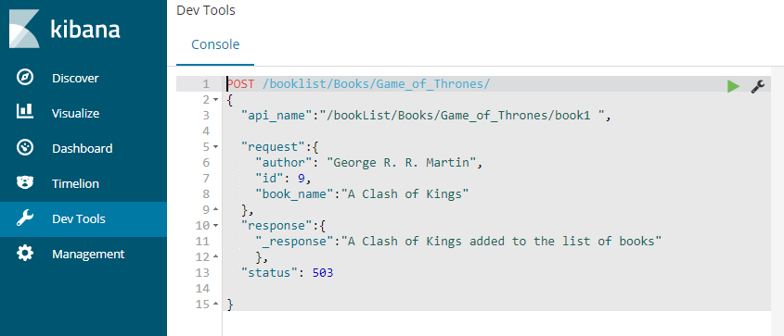
Creating a New Document
In your Kibana Dashboard, you should see the view similar to the one shown in the image.
To run the JSON script, press the Green Play icon.
Similarly, create 7-10 requests with different statuses.

Slide 32
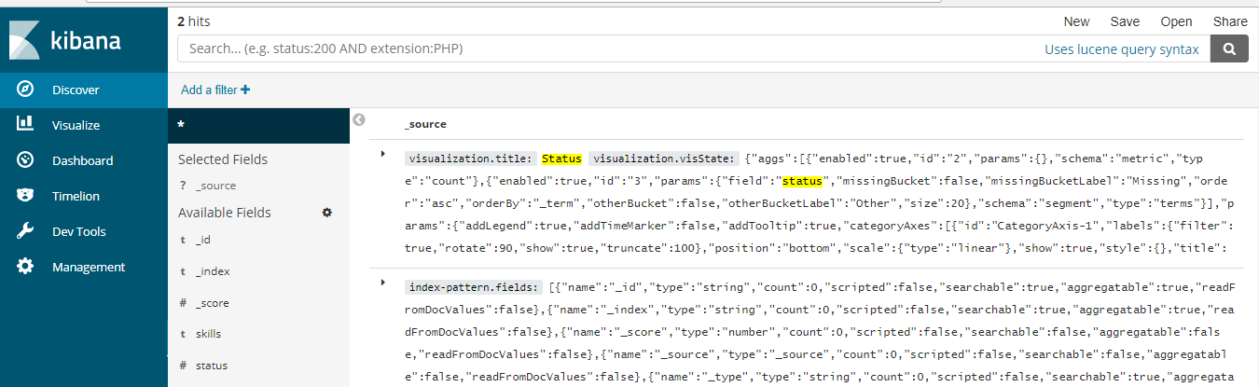
Discovering Your Data
Using the Discover application, you can enter an Elasticsearch query to search your data and filter the results.
Open Discover. The shakes* pattern is the current index pattern.
From the list of filters, select “status”

Slide 33
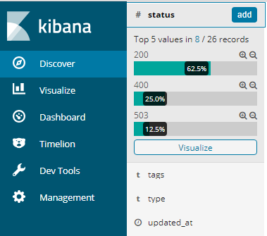
Visualizing Your Data
In the Visualize application, you can shape your data using a variety of charts, tables, and maps, and more.
You can create four visualizations: a pie chart, bar chart, coordinate map, and Markdown widget.
Click on the “Visualize” button below the status field and you will be redirected to another page.

Slide 34
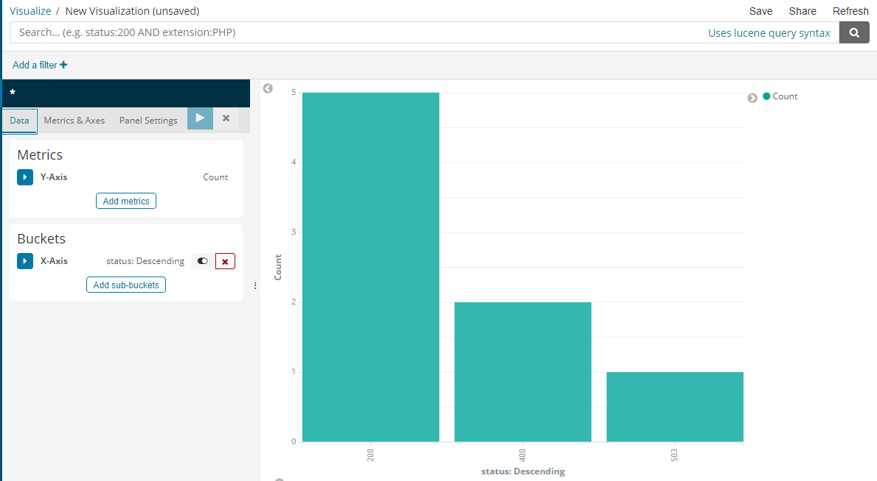

Slide 35
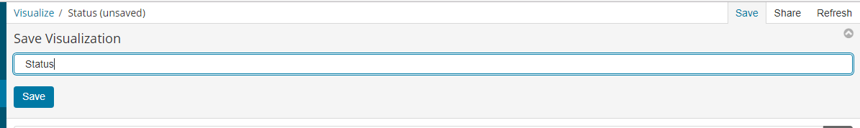
Visualizing Your Data
You also have an option to “Save” the visualization for use in a dashboard.
Click on the “Save” button on the top right corner.
Fill up the name for the visualization, in this case “Status”
Click on Save.

Slide 36
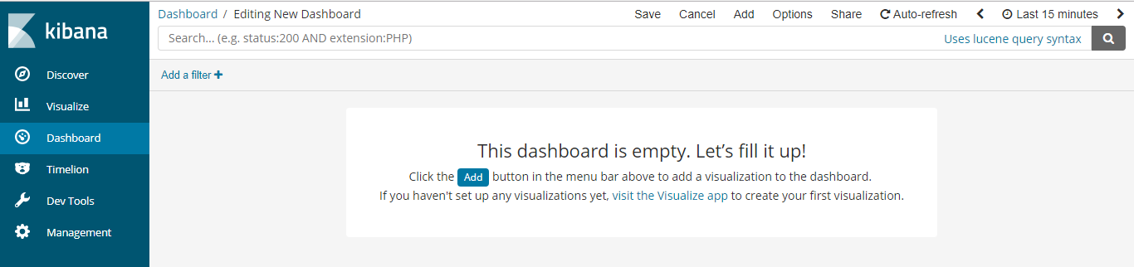
Putting it Together in a Dashboard
A dashboard is a collection of visualizations that you can arrange and share.
Here you’ll build a dashboard that contains the visualizations you saved .
Open Dashboard.
Click Create new dashboard.
Click Add.
Select the Saved Visualization.

Slide 37
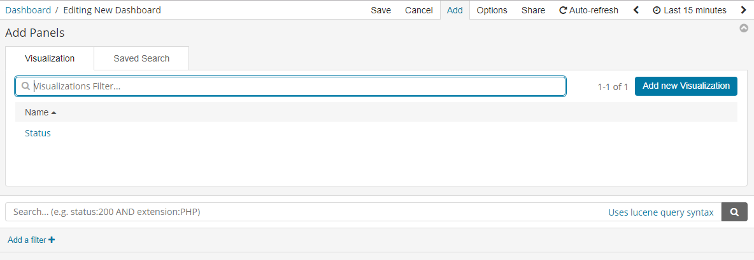
Putting it Together in a Dashboard

Slide 38
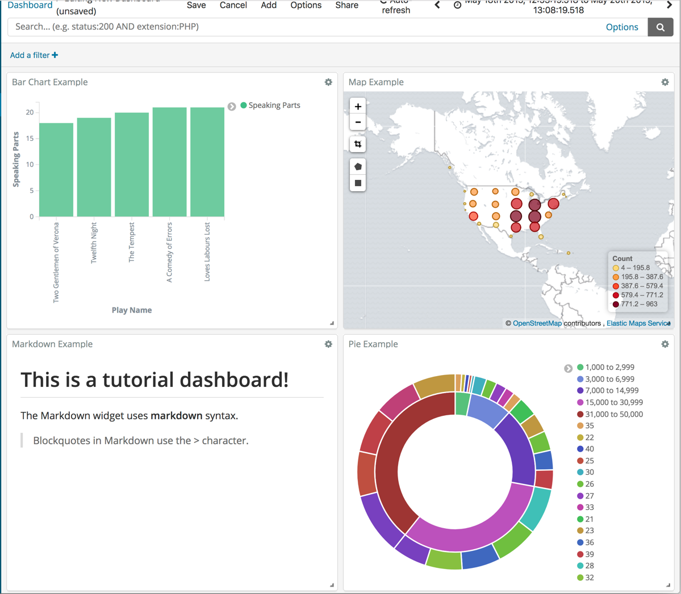
Putting it Together in a Dashboard
A sample dashboard should look like as shown.
You can rearrange the visualizations by clicking a the header of a visualization and dragging.
The gear icon in the top right of a visualization displays controls for editing and deleting the visualization.
A resize control is on the lower right.

Slide 39
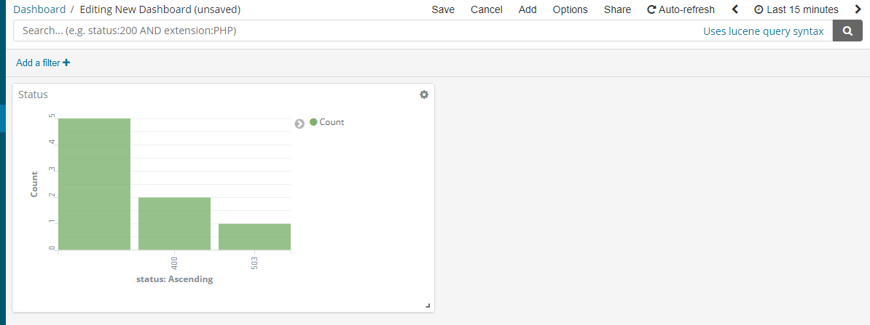
Putting it Together in a Dashboard
Your dashboard should look like as shown.

Slide 40
END

