Slide 1
Documentation

Slide 2
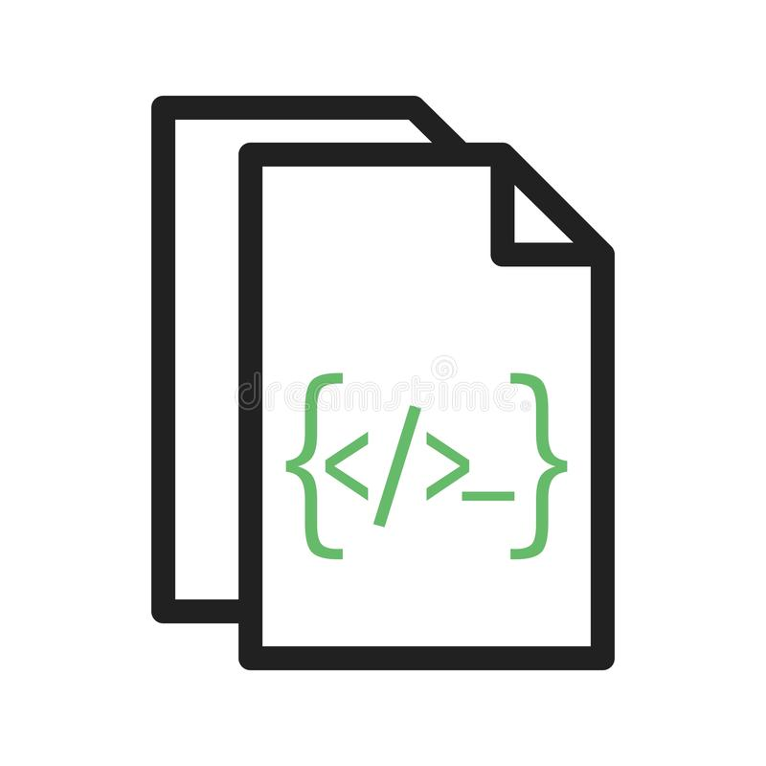
Agenda
Documentation
Why Documentation?
Project Documentation
Code Documentation
Python Docstrings
reStructuredText Primer
Getting Started with Sphinx

Slide 3
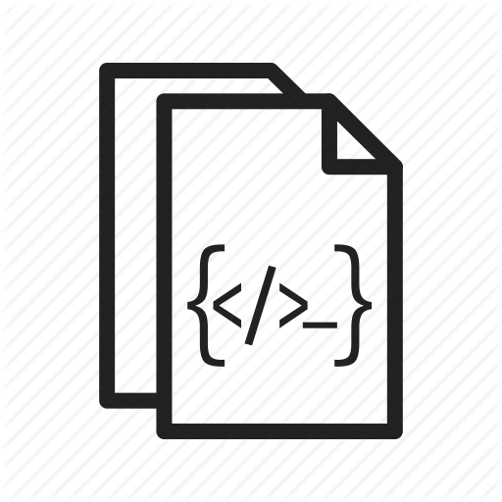
Documentation
In computer hardware and software product development, documentation is the information that describes the product to its users.
It consists of the product technical manuals and online information (including online versions of the technical manuals and help facility descriptions).

Slide 4
Why Documentation?
Documentation is all about making your code as usable as possible. The benefits of good documentation are many. Good documentation means it’s easier to…
Onboard new developers to a project
Track the status of ongoing development
Continue work when a developer gets sick or leaves the company
Share your work with a client’s development team

Slide 5
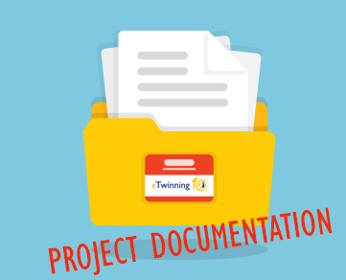
Project Documentation
A README file at the root directory should give general information to both users and maintainers of a project.
It should be raw text or written in some very easy to read markup, such as reStructuredText or Markdown.
It should contain a few lines explaining:
the purpose of the project or library (without assuming the user knows anything about the project),
the URL of the main source for the software, and some basic credit information.
This file is the main entry point for readers of the code.

Slide 6
Project Documentation - Elements
An INSTALL file is less necessary with Python.
The installation instructions are often reduced to one command, such as
pip install module or python setup.py install and added to the README file.
A LICENSE file should always be present and specify the license under which the software is made available to the public.
A TODO file or a TODO section in README should list the planned development for the code.
A CHANGELOG file or section in README should compile a short overview of the changes in the code base for the latest versions.

Slide 7
Documentation Tools
Tools that support auto-documentation of code can be broadly classified into tools that:
import the code to generate documentation based on runtime introspection
parse and analyze the code statically (without running it)
Tools that generate documentation from user-provided input typically use plain text markup formats such as reStructuredText (reST, the markup used for writing the official Python documentation) or Markdown.

Slide 8
Documentation Tools
Docstrings, the default python module documentation.
Automatic Python API documentation generation tools:
autodoc, a Sphinx-based processor that processes/allows reST doc strings,
PyDoc, http://pydoc.org/ documentation browser (in HTML) and/or an off-line reference manual. Also in the standard library as pydoc
Documentation processing tools
DocUtils, http://docutils.sourceforge.net/ reStructuredText processing engine
Sphinx, http://sphinx.pocoo.org/ - converts reStructuredText documentation into various formats

Slide 9
Code Documentation

Slide 10
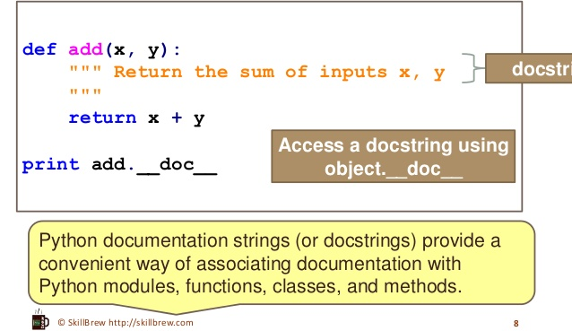
Python Docstrings
Python Docstrings are specified in source code that is used, like a comment, to document a specific segment of code. Unlike conventional source code comments, the docstring should describe what the function does, not how.

Slide 11
What should a docstring look like?
The doc string line should begin with a capital letter and end with a period.
The first line should be a short description.
If there are more lines in the documentation string, the second line should be blank, visually separating the summary from the rest of the description.
The following lines should be one or more paragraphs describing the object’s calling conventions, its side effects, etc.

Slide 12
Declaring and Accessing Docstrings
Declaring Docstrings:
The docstrings are declared using “””triple double quotes””” just below the class, method or function declaration.
All functions should have a docstring.
Accessing Docstrings:
The docstrings can be accessed using the __doc__ method of the object or using the help function.

Slide 13
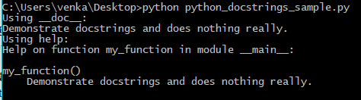
Declaring and Accessing Docstrings
The below example demonstrates how to declare and access a docstring:
def my_function():
"""Demonstrate docstrings and does nothing really."""
return None
print "Using __doc__:"
print my_function.__doc__
print "Using help:"
help(my_function)

Slide 14

One Line Docstrings
As the name suggests, one line docstrings fit in one line. They are used in obvious cases.
The closing quotes are on the same line as the opening quotes. This looks better for one-liners. For Example:
def power(a, b):
"""Returns arg1 raised to power arg2."""
return a**b
print power.__doc__

Slide 15
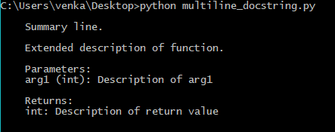
Multi-line Docstrings
Multi-line docstrings consist of a summary line just like a one-line docstring, followed by a blank line, followed by a more elaborate description. The summary line may be on the same line as the opening quotes or on the next line.
The example below shows a multi-line docstring.
def my_function(arg1):
"""
Summary line.
Extended description of function.
Parameters:
arg1 (int): Description of arg1
Returns:
int: Description of return value
"""
return arg1
print my_function.__doc__

Slide 16
Indentations in Docstrings
The entire docstring is indented the same as the quotes at its first line.
Docstring processing tools will strip a uniform amount of indentation from the second and further lines of the docstring, equal to the minimum indentation of all non-blank lines after the first line.
Any indentation in the first line of the docstring (i.e., up to the first newline) is insignificant and removed.
Relative indentation of later lines in the docstring is retained.

Slide 17
Docstrings in Classes
Let us take an example to show how to write docstrings for a class and its methods. help is used to access the docstring.
class ComplexNumber:
"""
This is a class for mathematical operations on complex numbers.
Attributes:
real (int): The real part of complex number.
imag (int): The imaginary part of complex number.
"""
def __init__(self, real, imag):
"""
The constructor for ComplexNumber class.
Parameters:
real (int): The real part of complex number.
imag (int): The imaginary part of complex number.
"""

Slide 18
Docstrings in Classes
def add(self, num):
"""
The function to add two Complex Numbers.
Parameters:
num (ComplexNumber): The complex number to be added.
Returns:
ComplexNumber: A complex number which contains the sum.
"""
re = self.real + num.real
im = self.imag + num.imag
return ComplexNumber(re, im)
help(ComplexNumber) # to access Class docstring
help(ComplexNumber.add) # to access method's docstring

Slide 19
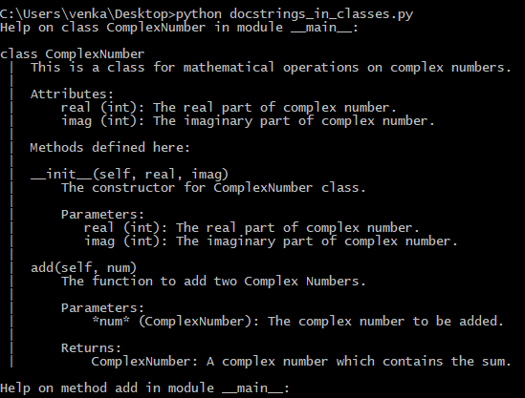
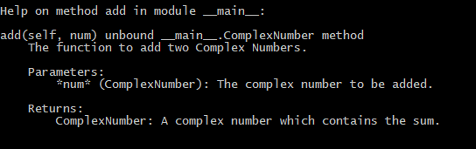
Docstrings in Classes

Slide 20
reStructuredText Primer

Slide 21
reStructured Text
The markup used for the Python documentation is reStructuredText, developed by the docutils project, amended by custom directives and using a toolset named Sphinx to post-process the HTML output.
An easy-to-read, what-you-see-is-what-you-get plaintext markup syntax and parser system.
Useful for inline program documentation (such as Python docstrings), for quickly creating simple web pages, and for standalone documents.

Slide 22
Inline Markup
Plain text | Typical result | Notes
*emphasis* | emphasis | Normally rendered as italics.
**strong emphasis** | strong emphasis | Normally rendered as boldface.
`interpreted text` | (see note at right) | The rendering and meaning of interpreted text is domain- or application-dependent. It can be used for things like index entries or explicit descriptive markup (like program identifiers).
``inline literal`` | inline literal | Normally rendered as monospaced text. Spaces should be preserved, but line breaks will not be.
reference_ | reference | A simple, one-word hyperlink reference. See Hyperlink Targets.
Inline markup allows words and phrases within text to have character styles (like italics and boldface) and functionality (like hyperlinks).

Slide 23
Inline Markup
Plain text | Typical result | Notes
`phrase reference`_ | phrase reference | A hyperlink reference with spaces or punctuation needs to be quoted with backquotes. See Hyperlink Targets.
anonymous__ | anonymous | With two underscores instead of one, both simple and phrase references may be anonymous . See Hyperlink Targets.
_`inline internal target` | inline internal target | A crossreference target within text. See Hyperlink Targets.
|substitution reference| | (see note at right) | The result is substituted in from the substitution definition. It could be text, an image, a hyperlink, or a combination of these and others.
footnote reference [1]_ | footnote reference ¹ | See Footnotes.
Inline markup allows words and phrases within text to have character styles (like italics and boldface) and functionality (like hyperlinks).

Slide 24
Inline Markup
Plain text | Typical result | Notes
citation reference [CIT2002]_ | citation reference [CIT2002] | See Citations.
http://docutils.sf.net/ | http://docutils.sf.net/ | A standalone hyperlink.
Asterisk, backquote, vertical bar, and underscore are inline delimiter characters.
If you want to use inline delimiter characters literally, escape (with backslash) or quote them (with double backquotes; i.e. use inline literals).
Also remember that inline markup may not be nested (well, except that inline literals can contain any of the other inline markup delimiter characters, but that doesn't count because nothing is processed).

Slide 25
Escaping with Backslashes
reStructuredText uses backslashes ("\") to override the special meaning given to markup characters and get the literal characters themselves.
To get a literal backslash, use an escaped backslash ("\\").
Raw reStructuredText | Typical result
*escape* ``with`` "\" | escape with ""
\*escape* \``with`` "\\" | *escape* ``with`` "\"

Slide 26
Escaping with Backslashes
In Python strings it will, of course, be necessary to escape any backslash characters so that they actually reach reStructuredText.
The simplest way to do this is to use raw strings.
Python string | Typical result
r"""\*escape* \`with` "\\"""" | *escape* `with` "\"
"""\\*escape* \\`with` "\\\\"""" | *escape* `with` "\"
"""\*escape* \`with` "\\"""" | escape with ""

Slide 27
Section Structure
Plain text | Typical result
===== Title ===== Subtitle -------- Titles are underlined (or over-and underlined) with a printing nonalphanumeric 7-bit ASCII character. Recommended choices are "``= - ` : ' " ~ ^ _ * + # < >``". The underline/overline must be at least as long as the title text. A lone top-level (sub)section is lifted up to be the document's (sub)title. | Title Subtitle Titles are underlined (or over- and underlined) with a printing nonalphanumeric 7-bit ASCII character. Recommended choices are "= - ` : ' " ~ ^ _ * + # < >". The underline/overline must be at least as long as the title text. A lone top-level (sub)section is lifted up to be the document's (sub)title.

Slide 28
Bullet Lists
Plain text | Typical result
Bullet lists: - This is item 1 - This is item 2 - Bullets are "-", "*" or "+". Continuing text must be aligned after the bullet and whitespace. Note that a blank line is required before the first item and after the last, but is optional between items. | Bullet lists: This is item 1 This is item 2 Bullets are "-", "*" or "+". Continuing text must be aligned after the bullet and whitespace. Note that a blank line is required before the first item and after the last, but is optional between items.

Slide 29
Enumerated Lists
Plain text | Typical result
Enumerated lists: 3. This is the first item 4. This is the second item 5. Enumerators are arabic numbers, single letters, or roman numerals 6. List items should be sequentially numbered, but need not start at 1 (although not all formatters will honour the first index). #. This item is auto-enumerated | Enumerated lists: This is the first item This is the second item Enumerators are arabic numbers, single letters, or roman numerals List items should be sequentially numbered, but need not start at 1 (although not all formatters will honour the first index). This item is auto-enumerated

Slide 30
Definition Lists
Plain text | Typical result
Definition lists: what Definition lists associate a term with a definition. how The term is a one-line phrase, and the definition is one or more paragraphs or body elements, indented relative to the term. Blank lines are not allowed between term and definition. | Definition lists: what Definition lists associate a term with a definition. how The term is a one-line phrase, and the definition is one or more paragraphs or body elements, indented relative to the term. Blank lines are not allowed between term and definition.

Slide 31
Doctest Blocks
Plain text | Typical result
Doctest blocks are interactive Python sessions. They begin with "``>>>``" and end with a blank line. >>> print "This is a doctest block." This is a doctest block. | Doctest blocks are interactive Python sessions. They begin with ">>>" and end with a blank line. >>> print "This is a doctest block." This is a doctest block.

Slide 32
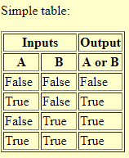
Tables
Plain text | Typical result
Simple table: ===== ===== ====== Inputs Output ------------ ------ A B A or B ===== ===== ====== False False False True False True False True True True True True ===== ===== ======
There are two syntaxes for tables in reStructuredText. Grid tables are complete but cumbersome to create. Simple tables are easy to create but limited (no row spans, etc.).

Slide 33
Bottomline
There are many such markup options available in the reStructuredText page.
http://docutils.sourceforge.net/rst.html

Slide 34
Getting Started with Sphinx

Slide 35

Sphinx
Just like setting up a good infrastructure for writing your unit tests, setting up a good infrastructure for your documentation is important to starting off a python project correctly.
Sphinx is a tool that translates a set of reStructuredText source files into various output formats, automatically producing cross-references, indices, etc.
That is, if you have a directory containing a bunch of reST-formatted documents (and possibly subdirectories of docs in there as well), Sphinx can generate a nicely-organized arrangement of HTML files (in some other directory) for easy browsing and navigation

Slide 36
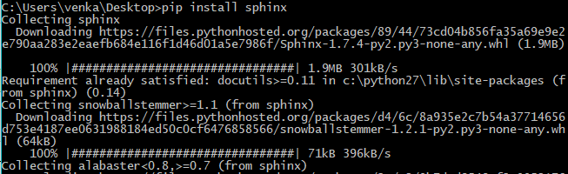
Installing Sphinx
First, you will need to install Sphinx:
pip install sphinx

Slide 37
Setting up the environment
Create a ‘docs’ folder in your project, so that you overall project structure looks similar to:
project_name
project_name
__init__.py
source_file_1.py
source_file_2.py
docs
run.py

Slide 38
Setting up the environment
We have a top-level docs directory in the main project directory. Inside of this is:
index.rst:
This is the index file for the documentation, or what lives at /. It normally contains a Table of Contents that will link to all other pages of the documentation.
conf.py:
which allows for customization of the output.
For the most part this shouldn’t need to be changed.
Makefile:
This ships with sphinx, and is the main interface for local development, but shouldn’t be changed.
Other *.rst files for specific subsections of documentation.

Slide 39

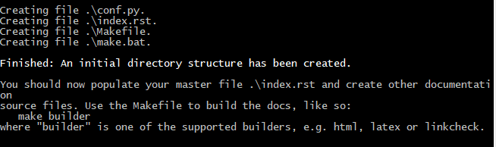
Sphinx Quickstart
Sphinx comes with a script called sphinx-quickstart that sets up a source directory and creates a default conf.py with the most useful configuration values from a few questions it asks you.
Within the ‘docs’ folder, run the ‘sphinx-quickstart’ script to perform the necessary setup Just run the following command and answer its questions. (Be sure to say yes to the “autodoc” extension.):
sphinx-quickstart

Slide 40
Sphinx Quickstart
Prompt | Choice
> Root path for the documentation [.]: | <ENTER>
> Separate source and build directories (y/N) [n]: | n
> Name prefix for templates and static dir [_]: | <ENTER>
> Project name: | homework
> Author name(s): | None
> Project release [0.0.1]: | <ENTER>
> Project Languaga | <ENTER>
> Source file suffix [.rst]: | <ENTER>
> Name of your master document (without suffix) [index]: | <ENTER>
> autodoc: automatically insert docstrings from modules (y/N) [n]: | y
> doctest: automatically test code snippets in doctest blocks (y/N) [n]: | n

Slide 41
Sphinx Quickstart
Prompt | Choice
> intersphinx: link between Sphinx documentation of different projects (y/N) [n]: | y
> todo: write “todo” entries that can be shown or hidden on build (y/N) [n]: | n
> coverage: checks for documentation coverage (y/N) [n]: | n
> pngmath: include math, rendered as PNG images (y/N) [n]: | n
> jsmath: include math, rendered in the browser by JSMath (y/N) [n]: | n
> ifconfig: conditional inclusion of content based on config values (y/N) [n]: | y
> Create Makefile? (Y/n) [y]: | n
> Create Windows command file? (Y/n) [y]: | n

Slide 42
Defining document structure
Let’s assume you’ve run sphinx-quickstart.
It created a source directory with conf.py and a master document, index.rst (if you accepted the defaults).
The main function of the master document is to serve as a welcome page, and to contain the root of the “table of contents tree” (or toctree).
The toctree directive initially is empty, and looks like this:
.. toctree:: :maxdepth: 2

Slide 43
Defining document structure
The documents to include are given as document names, which in short means that you leave off the file name extension and use slashes as directory separators.
You can now create the files you listed in the toctree and add content, and their section titles will be inserted (up to the “maxdepth” level) at the place where the toctree directive is placed.

Slide 44
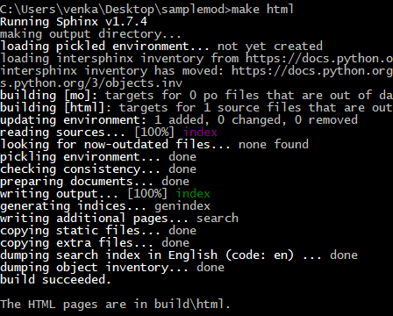
Running the build
Now that you have added some files and content, let’s make a first build of the docs.
sphinx-quickstart script creates a Makefile and a make.bat which make life even easier for you: with them you only need to run the following:
make html
Execute make without an argument to see which targets are available.

Slide 45
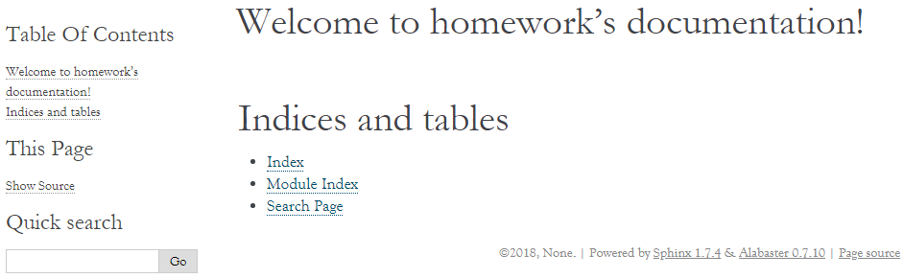
Running the build
Once the build finishes, open the index.html file in the _build folder.
The index.html is generally available on the following path:
C:\Path\to\source\folder\_build\html

Slide 46
The index.rst file
This is the index file for the documentation, or what lives at /.
It normally contains a Table of Contents that will link to all other pages of the documentation.
You can update the index file with all the references in the Project folder.
For example, you can add documents listing them in the content of the directive:
.. toctree:: :maxdepth: 2
project
tutorial
code …
Note that the list of files added above are yet to be created by us. Also, note the newline gap.
Newline Gap.

Slide 47
Creating the required documents - Project
Once you update the index.rst file, it’s time to create the corresponding files.
Create a file called “project.rst” in the same folder as index.rst.
Include the following as the text inside the project.rst file and save it.
Project Summary
===============
Goals Achieved
--------------
Goal 1: Successfully installed Sphinx
Goal 2: Successfully ran the make html code.
Lessons Learned
---------------
Things are much simpler with Sphinx to document projects.

Slide 48
Creating the required documents - Tutorial
Create a file called “tutorial.rst” in the same folder as index.rst.
Include the following as the text inside the file and save it.
Homework Tutorial
=================
Just some sample text to show.

Slide 49
Creating the required documents - Code
Create a file called “Code.rst” in the same folder as index.rst.
Include the following as the text inside the file and save it.
Auto Generated Documentation
============================
.. automodule:: docstrings_in_classes
:members:
NOTE:
This is the page that will contain all the auto generated documentation of the project.
Mention the python file for which you want to create the documentation for.
For example, instead of docstrings_in_classes, you can put the respective filenames without the extension.
Copy the docstrings_in_classes file that we worked on earlier, into the same folder.

Slide 50
Configuring Sphinx
Now that the lone source code file is properly commented, we need to edit the Sphinx configuration file
(‘../source/conf.py’) to be able to find out source code.
Uncomment the following lines from ‘../source/conf.py’ and make it point to the top-level directory in your project:
import os
import sys
sys.path.insert(0, os.path.abspath('.'))
Once done, build the html files again with the command:
make html

Slide 51
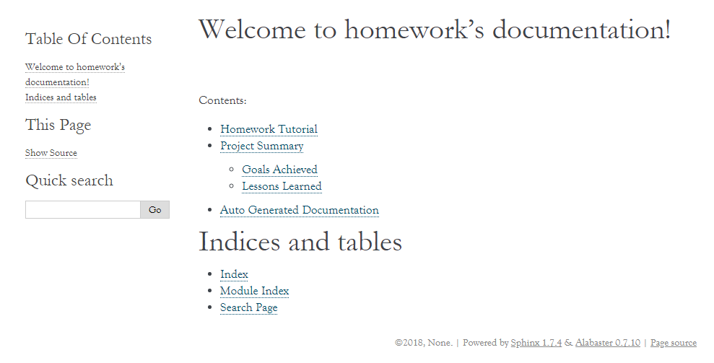
Final view

Slide 52
END

