Slide 1
Integrated Development Environment (IDE)

Slide 2
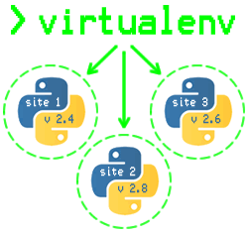
Agenda
What is an IDE?
Why do you need an IDE?
Requirements for a Good Python Coding Environment
General Editors and IDEs With Python Support : An Overview
Eclipse + PyDev
Sublime Text
Atom
Visual Studio Code
Python Specific Editors and IDEs
PyCharm
Why PyCharm?
PyCharm Setup

Slide 3
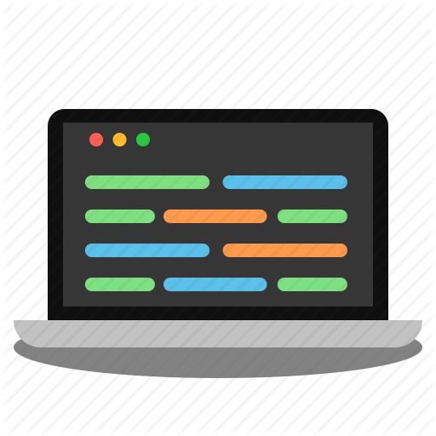
What is an IDE?
A program dedicated to software development.
IDEs integrate several tools specifically designed for software development.
These tools usually include:
an editor tailored to handling code (for example, syntax highlighting and auto-completion);
build, execution, and debugging tools; and
some form of source control.

Slide 4
Why do we need an IDE?
A development environment is a combination of a text editor and the Python interpreter.
Python code needs to be written, executed and tested to build applications.
The text editor provides a way to write the code.
The interpreter allows it to be executed.
Testing to see if the code does what you want can either be done manually or by unit and functional tests.

Slide 5
Requirements for a Good Coding Environment
Feature lists vary from app to app, but there are a core set of features which makes coding easier:
Save and reload code files
If an IDE or editor won’t let you save your work and reopen everything later, in the same state it was in when you left, it’s not much of an IDE.
Run code from within the environment
Similarly, if you have to drop out of the editor to run your Python code, then it’s not much more than a simple text editor.

Slide 6
Requirements for a Good Coding Environment
Debugging support
Being able to step through your code as it runs is a core feature of all IDEs and most good code editors.
Syntax highlighting
Being able to quickly spot keywords, variables, and symbols on your code makes reading and understanding code much easier.
Automatic code formatting
Any editor or IDE worth it’s salt will recognize the colon at the end of a while or for statement, and know the next line should be indented.

Slide 7
General Editors and IDEs With Python Support : An Overview

Slide 8


Eclipse + PyDev
Category: IDE
Website: www.eclipse.org
Python tools: PyDev, www.pydev.org
Eclipse is the de-facto open-source IDE for Java development. It has a rich marketplace of extensions and add-ons, which makes Eclipse useful for a wide range of development activities.
One such extension is PyDev, which enables Python debugging, code completion, and an interactive Python console.

Slide 9
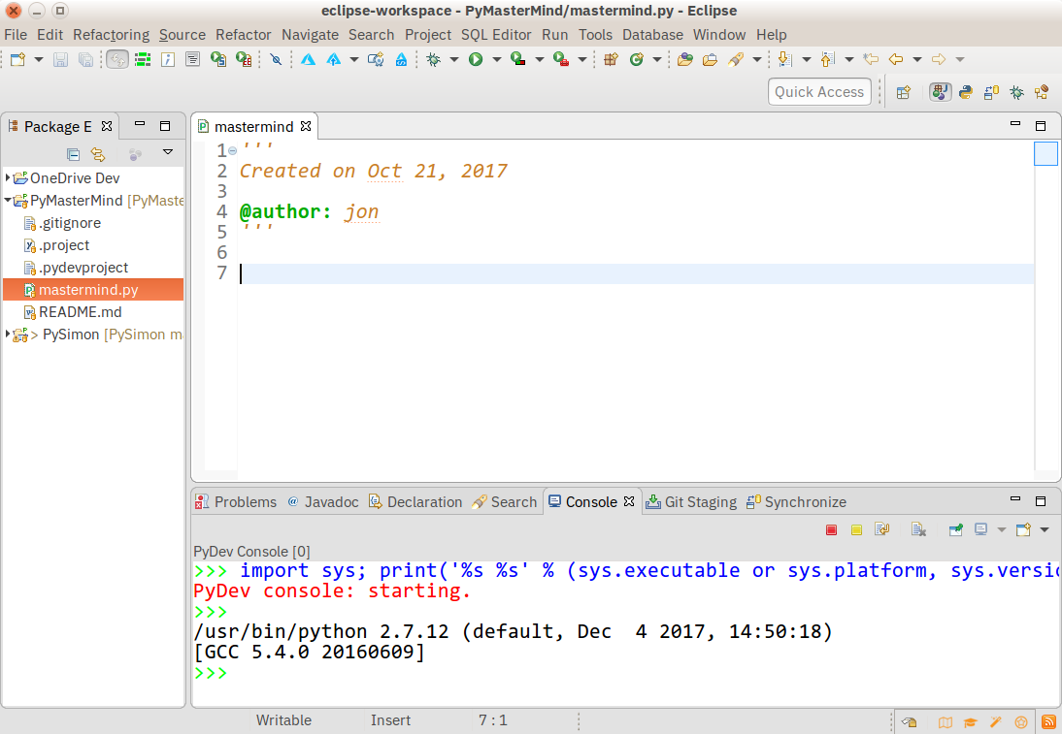
Eclipse + PyDev

Slide 10
Eclipse + PyDev
Pros:
If you’ve already got Eclipse installed, adding PyDev is quick and easy.
The learning curve for PyDev is non-existent for the experienced Eclipse developer.
Cons:
If you’re just starting out with Python, or with software development in general, Eclipse can be a lot to handle.
IDEs are larger and need more knowledge to use properly. Eclipse is all that and a bag of (micro)chips.

Slide 11
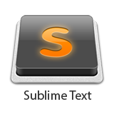
Sublime Text
Category: Code Editor
Website: http://www.sublimetext.com
Sublime Text is an extremely popular code editor.
Supported on all platforms, Sublime Text has built in support for Python code editing, and a rich set of extensions (called packages) which extend the syntax and editing features.
Installing additional Python packages can be tricky - all Sublime Text packages are written in Python itself, and installing community packages often require you to execute Python scripts directly in Sublime Text.

Slide 12
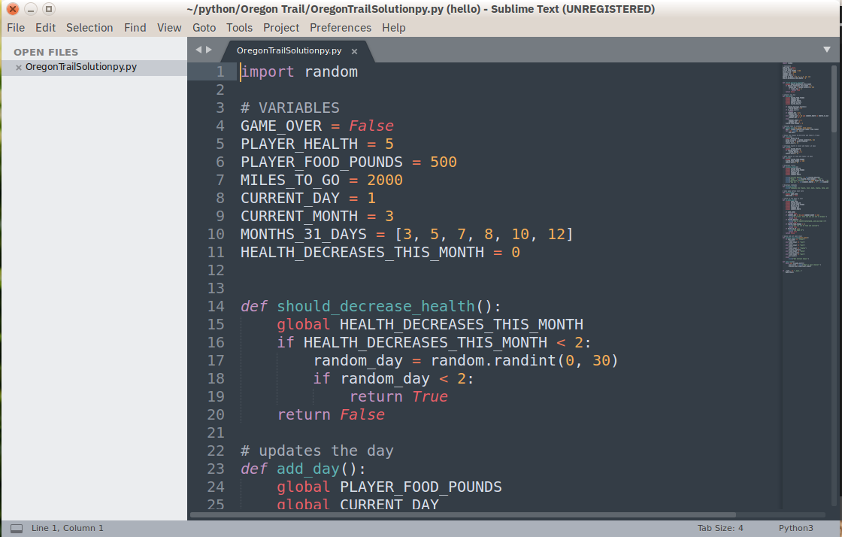
Sublime Text

Slide 13
Sublime Text
Pros:
Sublime Text has a great following in the community.
As a code editor, alone, Sublime Text is fast, small, and well supported.
Cons:
Sublime Text is not free, although you can use the evaluation version for an indefinite period of time.
Installing extensions can be tricky, and there’s no direct support for executing or debugging code from within the editor.

Slide 14

Atom
Category: Code Editor
Website: https://atom.io/
Available on all platforms, Atom is billed as the “hackable text editor for the 21st Century”.
With a sleek interface, file system browser, and marketplace for extensions, open-source Atom is built using Electron, a framework for creating desktop applications using JavaScript, HTML, and CSS.
Python language support is provided by an extension which can installed when Atom is running.

Slide 15
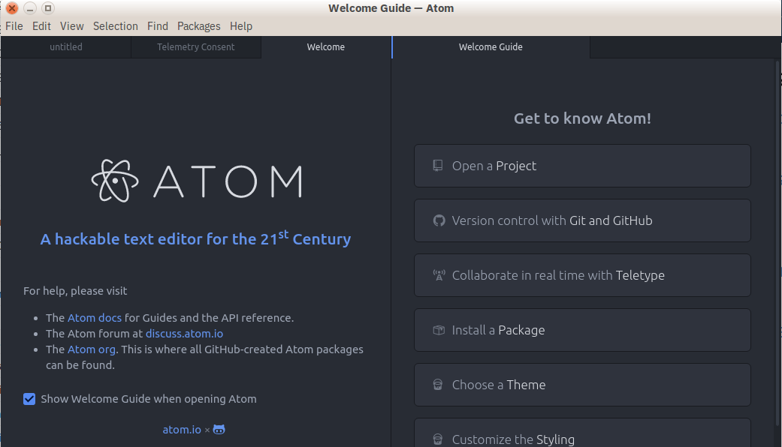
Atom

Slide 16
Atom
Pros:
Broad support on all platforms, thanks to Electron.
Atom is small, and downloads and loads fast.
Cons:
Build and debugging support aren’t built-in, but are community provided add-ons.
Because Atom is built on Electron, it’s always running in a JavaScript process, and not as a native application.

Slide 17
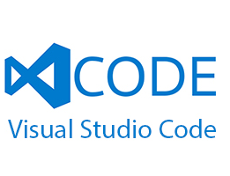
Visual Studio Code
Category: Code Editor
Website: https://code.visualstudio.com/
Python tools: https://marketplace.visualstudio.com/items?itemName=ms-python.python
A full-featured code editor available for Linux, Mac OS X, and Windows platforms.
Small and light-weight, but full-featured, VS Code is open-source, extensible, and configurable for almost any task.
Like Atom, VS Code is built on Electron, so it has the same advantages and disadvantages that brings.

Slide 18
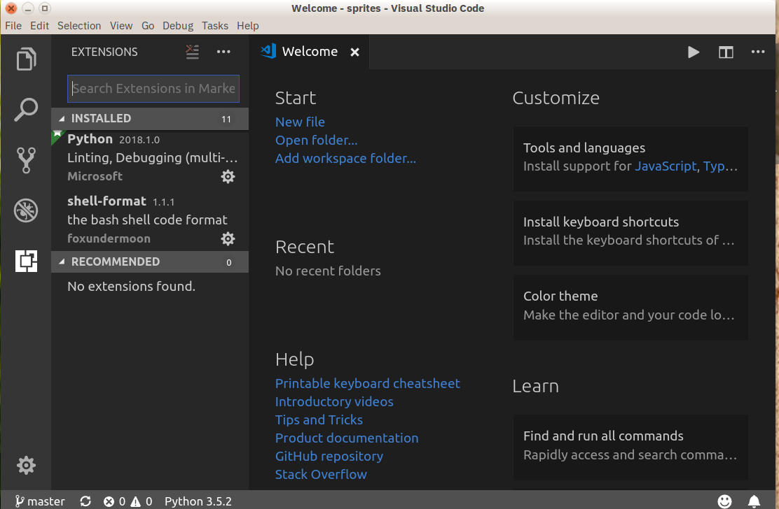
Visual Studio Code

Slide 19
Visual Studio Code
Pros:
Installing Python support in VS Code is very easy - the Marketplace is a quick button click away. Search for Python, click Install, and restart if necessary. VS Code will recognize your Python installation and libraries automatically.
VS Code is available on every platform, surprisingly full-featured despite having a small footprint, and open-source.
Cons:
Electron means VS Code is not a native app. Plus, some people may have principled reasons to not use Microsoft resources.

Slide 20
Python Specific Editors and IDE - PyCharm

Slide 21

PyCharm
Category: IDE
Website: https://www.jetbrains.com/pycharm/
One of the best (and only) full-featured, dedicated IDEs for Python is PyCharm.
Available in both paid (Professional) and free open-source (Community) editions, PyCharm installs quickly and easily on Windows, Mac OS X, and Linux platforms.
Out of the box, PyCharm supports Python development directly - open a new file and start writing code.
You can run and debug Python directly inside PyCharm, and it has support for source control and projects.

Slide 22
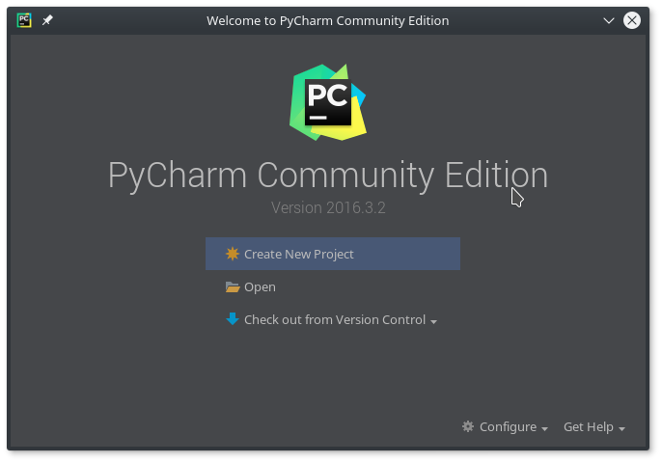
PyCharm

Slide 23
PyCharm
Pros:
It’s the de facto Python IDE environment, with tons of support and a supportive community. It edits, runs, and debugs Python out of the box.
Cons:
PyCharm can be slow to load, and the default settings may need tweaking for existing projects.

Slide 24
Why PyCharm?
PyCharm is big. It comes tons of features out of the box.
PyCharm comes with an integrated debugger.
Autocomplete, autoimport and other code intel and refactoring tools work better in PyCharm.
PyCharm does background spell checking of written text and Python docstrings. It’s very handy if you want to write high quality software with meaningful comments and API descriptions.

Slide 25
Why PyCharm?
With PyCharm you need to spend little time to tune up your programming environment or hunt plugins for your basic development needs (Python, JavaScript, HTML, CSS).
PyCharm has more robust integrated version control support (Git, SVN)
Power save mode. It disables background tasks like code intel which are CPU drainage for large projects.
PyCharm has integrated terminal and run window and unit test runner.

Slide 26
Setting up PyCharm

Slide 27
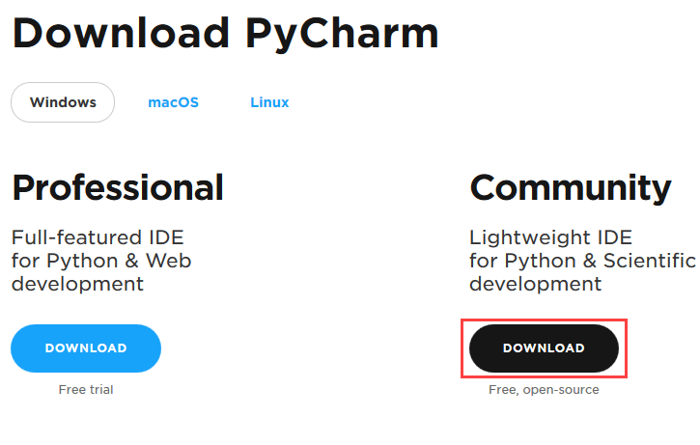
Step 1
To download PyCharm visit the website https://www.jetbrains.com/pycharm/download/
Click the "DOWNLOAD" link under the Community Section.

Slide 28
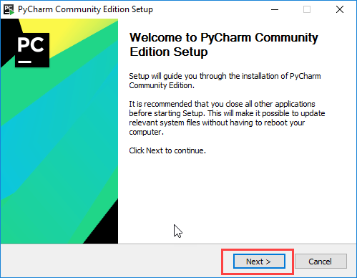
Step 2
Once the download is complete, run the exe for install PyCharm.
The setup wizard should have started. Click “Next”.

Slide 29
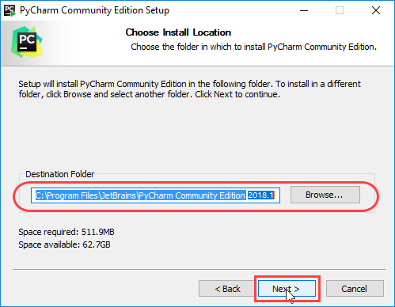
Step 3
On the next screen, Change the installation path if required. Click “Next”.

Slide 30
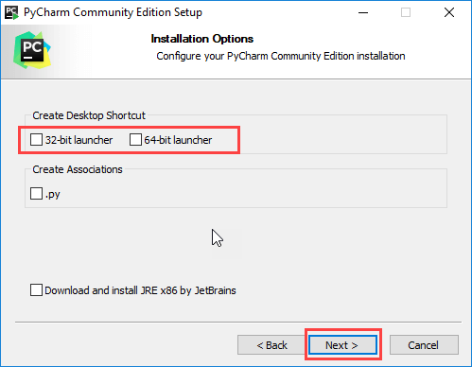
Step 4
On the next screen, you can create a desktop shortcut if you want and click on “Next”.

Slide 31
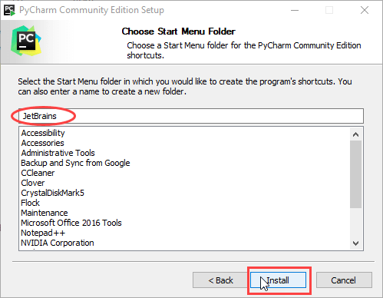
Step 5
Choose the start menu folder. Keep selected JetBrains and click on “Install”.

Slide 32
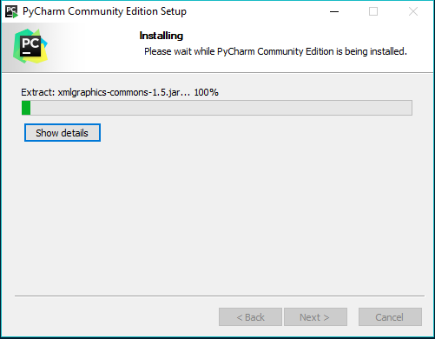
Step 6
Wait for the installation to finish.

Slide 33
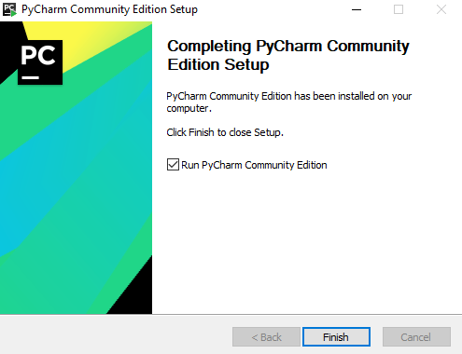
Step 7
Once installation finished, you should receive a message screen that PyCharm is installed. I
f you want to go ahead and run it, click the “Run PyCharm Community Edition” box first and click “Finish”.

Slide 34
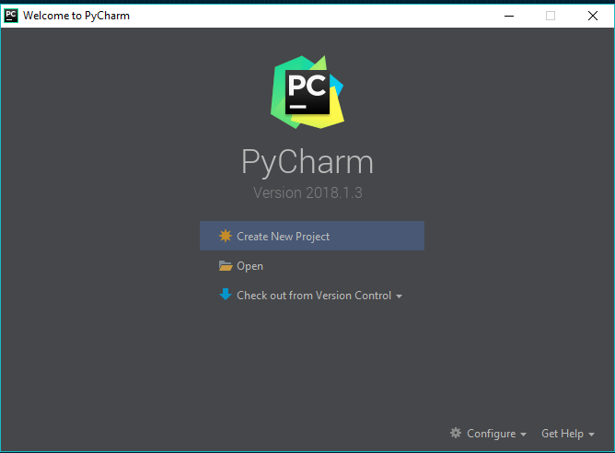
Step 8
After you click on "Finish," the screen will appear as shown.

Slide 35
END

