Slide 1
Testing

Slide 2
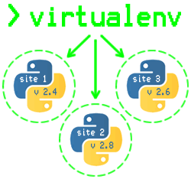
Agenda
Testing In Python
Test Driven Development
Why write test cases
Getting started with unit testing in python
Types of test methods
Unittest
DocTest
Tools available.
Unittest2

Slide 3

Testing in Python
One frequent source of confusion for novice developers is the subject of testing.
They are vaguely aware that "unit testing" is something that's good and that they should do, but don't understand what the term actually means.

Slide 4
Unit Testing
Unit Testing in Python is done to identify bugs early in the development stage of the application when bugs are less recurrent and less expensive to fix.
A unit test is a scripted code level test designed in Python to verify a small "unit" of functionality.
Unit test is an object oriented framework based around test fixtures.

Slide 5
Python Unit Testing Techniques
Test-Driven Development TDD:
Unit Testing should be done along with the Python, and for that developers use Test-Driven Development method.
In TDD method, you first design Python Unit tests and only then you carry on writing the code that will implement this feature.
Stubs and Mocks:
They are two main techniques that simulate fake methods that are being tested.
A Stub is used to fill in some dependency required for unit test to run correctly.
A Mock on the other hand is a fake object which runs the tests where we put assert.
The intentions of both methods are same to eliminate testing all the dependencies of a class or function.

Slide 6
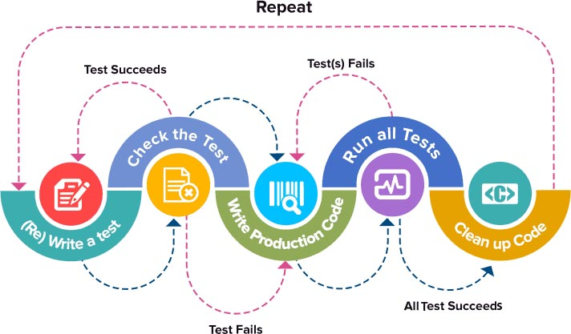
Test Driven Development
TDD recommends writing tests that would check the functionality of your code prior to your writing the actual code.
Only when you are happy with your tests and the features it tests, do you begin to write the actual code in order to satisfy the conditions imposed by the test that would allow them to pass.

Slide 7

Why Testing?
Testing makes sure your code works properly under a given set of conditions
Syntax errors will almost certainly be caught by running tests, and the basic logic of a unit of code can be tested to ensure correctness under certain conditions.
Testing allows one to ensure that changes to the code did not break existing functionality
If you want to be able to change or rewrite your code and know you didn't break anything, proper unit testing is imperative.
Good testing requires modular, decoupled code, which is a hallmark of good system design.

Slide 8
Why write test cases?
Test cases have a great impact on the testing phase.
The value of having test cases long-term is that anyone can go in and retest using the test case. In short, test cases provide the following value:
Ensures good test coverage (key functionality isn’t missed in the testing process).
Allows the tester to think thoroughly through different ways of validating features.
Negative test cases are also documented, which can often be overlooked.
They are reusable for the future – anyone can reference them and execute the test.

Slide 9
Getting started with unit testing in python

Slide 10
Unit Testing in Python
The unittest module provides classes that make it easy to support these qualities for a set of tests.
To achieve this, unittest supports some important concepts:
test fixture
A test fixture represents the preparation needed to perform one or more tests, and any associate cleanup actions. This may involve, for example, creating temporary or proxy databases, directories, or starting a server process.
test case
A test case is the smallest unit of testing. It checks for a specific response to a particular set of inputs. unittest provides a base class, TestCase, which may be used to create new test cases.

Slide 11
Unit Testing in Python
test suite
A test suite is a collection of test cases, test suites, or both. It is used to aggregate tests that should be executed together.
test runner
A test runner is a component which orchestrates the execution of tests and provides the outcome to the user. The runner may use a graphical interface, a textual interface, or return a special value to indicate the results of executing the tests.

Slide 12
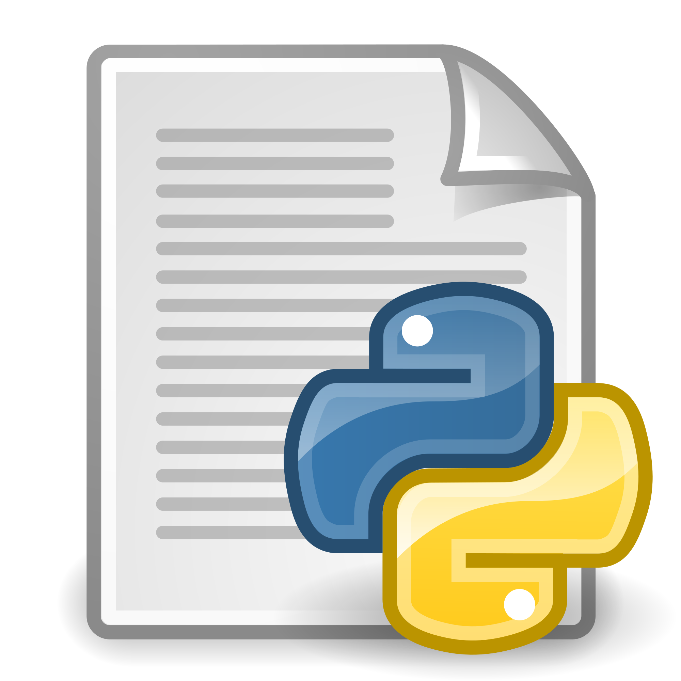
Basic Test Structure
Tests, as defined by unittest, have two parts: code to manage test “fixtures”, and the test itself.
Individual tests are created by subclassing TestCase and overriding or adding appropriate methods. For example:
import unittest class SimplisticTest(unittest.TestCase): def test(self): self.failUnless(True) if __name__ == '__main__': unittest.main()
In this case, the SimplisticTest has a single test() method, which would fail if True is ever False.

Slide 13
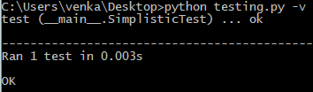
Running Tests
The easiest way to run unittest tests is to include:
if __name__ == '__main__':
unittest.main()
At the bottom of each test file, then simply run the script directly from the command line.
Save the code in a file called testing.py and run the following command:
python testing.py -v

Slide 14
Test Outcomes
Tests have 3 possible outcomes:
ok
The test passes.
FAIL
The test does not pass, and raises an AssertionError exception.
ERROR
The test raises an exception other than AssertionError.
There is no explicit way to cause a test to “pass”, so a test’s status depends on the presence (or absence) of an exception.

Slide 15
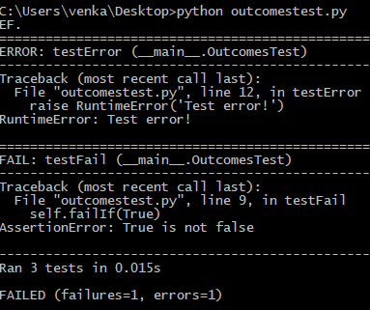
Test Outcomes
For example:
import unittest class OutcomesTest(unittest.TestCase): def testPass(self): return def testFail(self): self.failIf(True) def testError(self): raise RuntimeError('Test error!') if __name__ == '__main__': unittest.main()
When a test fails or generates an error, the traceback is included in the output.

Slide 16
Test Outcomes
In the example, testFail() fails and the traceback shows the line with the failure code.
To make it easier to understand the nature of a test failure, the fail*() and assert*() methods all accept an argument msg, which can be used to produce a more detailed error message. For example:
import unittest class FailureMessageTest(unittest.TestCase): def testFail(self): self.failIf(True, 'failure message goes here') if __name__ == '__main__': unittest.main()
understand

Slide 17
Test Outcomes
In the example, testFail() fails and the traceback shows the line with the failure code.
To make it easier to understand the nature of a test failure, the fail*() and assert*() methods all accept an argument msg, which can be used to produce a more detailed error message.

Slide 18
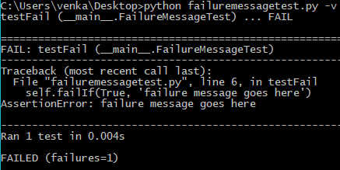
Test Outcomes
For example:
import unittest class FailureMessageTest(unittest.TestCase): def testFail(self): self.failIf(True, 'failure message goes here') if __name__ == '__main__': unittest.main()

Slide 19
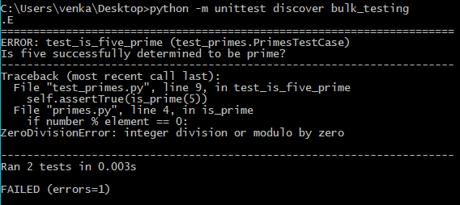
Test discovery
Let’s say that you’ve got a bunch of test files. It would be annoying to have to run each test file separately. That’s where test discovery comes in handy. Test discovery runs all the unittests in a single iteration.
Let’s move all the code we’ve tried till now into a single file “bulk_testing.py” and run the test discovery for all the unittests:
python -m unittest discover bulk_testing

Slide 20
Asserting Truth
Most tests assert the truth of some condition.
There are a few different ways to write truth-checking tests, depending on the perspective of the test author and the desired outcome of the code being tested.
If the code produces a value which can be evaluated as true, the methods failUnless() and assertTrue() should be used.
If the code produces a false value, the methods failIf() and assertFalse() make more sense.

Slide 21
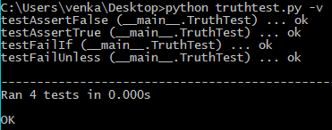
Asserting Truth
For example:
import unittest class TruthTest(unittest.TestCase): def testFailUnless(self): self.failUnless(True) def testAssertTrue(self): self.assertTrue(True) def testFailIf(self): self.failIf(False) def testAssertFalse(self): self.assertFalse(False) if __name__ == '__main__': unittest.main()

Slide 22
Testing Equality
As a special case, unittest includes methods for testing the equality of two values.
Example code:
import unittest class EqualityTest(unittest.TestCase): def testEqual(self): self.failUnlessEqual(1, 3-2) def testNotEqual(self): self.failIfEqual(2, 3-2) if __name__ == '__main__': unittest.main()

Slide 23
Testing for Exceptions
If a test raises an exception other than AssertionError it is treated as an error.
This is very useful for uncovering mistakes while you are modifying code which has existing test coverage.
There are circumstances, however, in which you want the test to verify that some code does produce an exception.
For example, if an invalid value is given to an attribute of an object. In such cases, failUnlessRaises() makes the code more clear than trapping the exception yourself.

Slide 24
Testing for Exceptions
import unittest def raises_error(*args, **kwds): print args, kwds raise ValueError('Invalid value: ' + str(args) + str(kwds)) class ExceptionTest(unittest.TestCase): def testTrapLocally(self): try: raises_error('a', b='c') except ValueError: pass else: self.fail('Did not see ValueError') def testFailUnlessRaises(self): self.failUnlessRaises(ValueError, raises_error, 'a', b='c') if __name__ == '__main__': unittest.main()

Slide 25
Test Fixtures
Fixtures are resources needed by a test.
For example, if you are writing several tests for the same class, those tests all need an instance of that class to use for testing.
Other test fixtures include database connections and temporary files (many people would argue that using external resources makes such tests not “unit” tests, but they are still tests and still useful).
TestCase includes a special hook to configure and clean up any fixtures needed by your tests.
To configure the fixtures, override setUp().
To clean up, override tearDown().

Slide 26
Testing for Exceptions
Example code:
import unittest class FixturesTest(unittest.TestCase): def setUp(self): print 'In setUp()' self.fixture = range(1, 10) def tearDown(self): print 'In tearDown()' del self.fixture def test(self): print 'in test()' self.failUnlessEqual(self.fixture, range(1, 10)) if __name__ == '__main__': unittest.main()

Slide 27
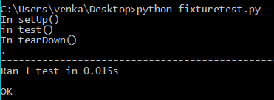
Testing for Exceptions
When this sample test is run, you can see the order of execution of the fixture and test methods:

Slide 28
END

