Slide 1
Week 2_ Day 12
Mentor Review
Mentor Name: Vamsikrishna
Student Name: Ettigowni Siri
OCC VIDEO MESSAGE DECODING

Slide 2
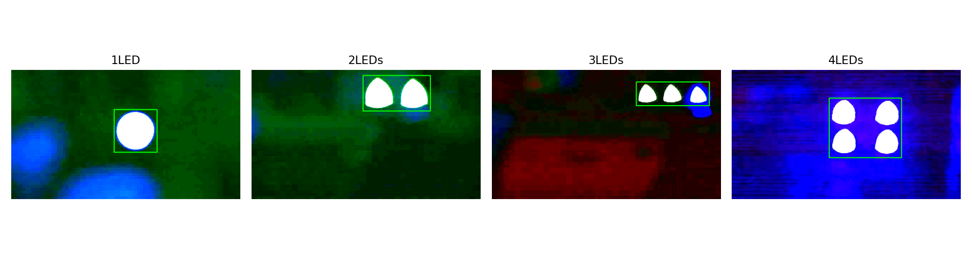
Signal Pipeline Review
METHOD:
ROI Detection & Extraction — Recap
Fixed ROI per video
Candidate blobs filtered by minimum area to reject the non-transmitter artifact found Day 8
Sub-5px drift (Day 8) justifies not re-detecting per frame
Full active window processed per video (64,870 frames total), not a sample
File | ROI Box | Size | Motion | Frames
1LED | (287,110)-(407,229) | 120x119 | 0.31px | 27,820
2LEDs | (311,15)-(499,114) | 188x99 | 0.33px | 17,160
3LEDs | (403,33)-(607,99) | 204x66 | 2.08px | 11,440
4LEDs | (272,78)-(474,244) | 202x166 | 4.01px | 8,450
OCC Video Message Decoding |
2

Slide 3
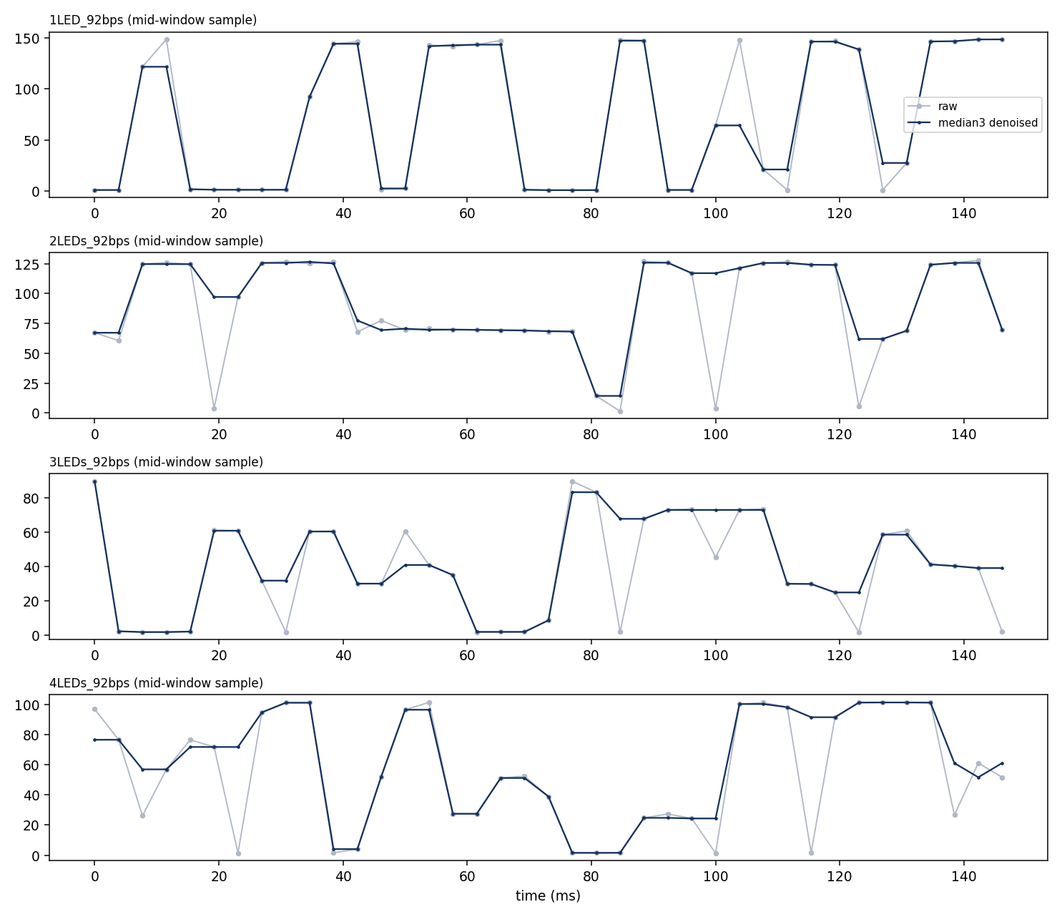
Preprocessing
Preprocessing — Why Denoising Is Minimal
The extracted OCC signal already has a strong separation between ON and OFF intensity levels. Therefore, preprocessing should remove isolated noise without changing the actual signal transitions.
Why a 3-Sample Median Filter?
The camera operates at 260 fps, while the transmission rate is 92 bps.
This gives approximately 2.826 frames per bit.
Since only a few frames represent each bit, a large smoothing window could shift or blur genuine ON/OFF transitions.
A 3-sample median filter is therefore used as a lightweight denoising method.
What the Filter Corrects
It is mainly intended to remove isolated single-frame intensity dropouts.
For example, the 2-LED signal showed short disturbances around 20 ms, 85 ms and 100 ms.
The filter corrects these short abnormalities while preserving the overall plateau shape of the signal.
Why Not Use Stronger Smoothing?
The measured SNR is already very high, approximately 57×–318×.
Therefore, aggressive denoising is not required to improve signal quality.
The purpose of the median filter is specifically to handle rare large frame-level disturbances, rather than broadly smooth the entire signal.
File | Frames Altered | Median Δ
1LED | 51.0% | 0.55
2LEDs | 49.2% | 1.15
3LEDs | 48.7% | 0.75
4LEDs | 46.0% | 1.50
OCC Video Message Decoding |
3

Slide 4
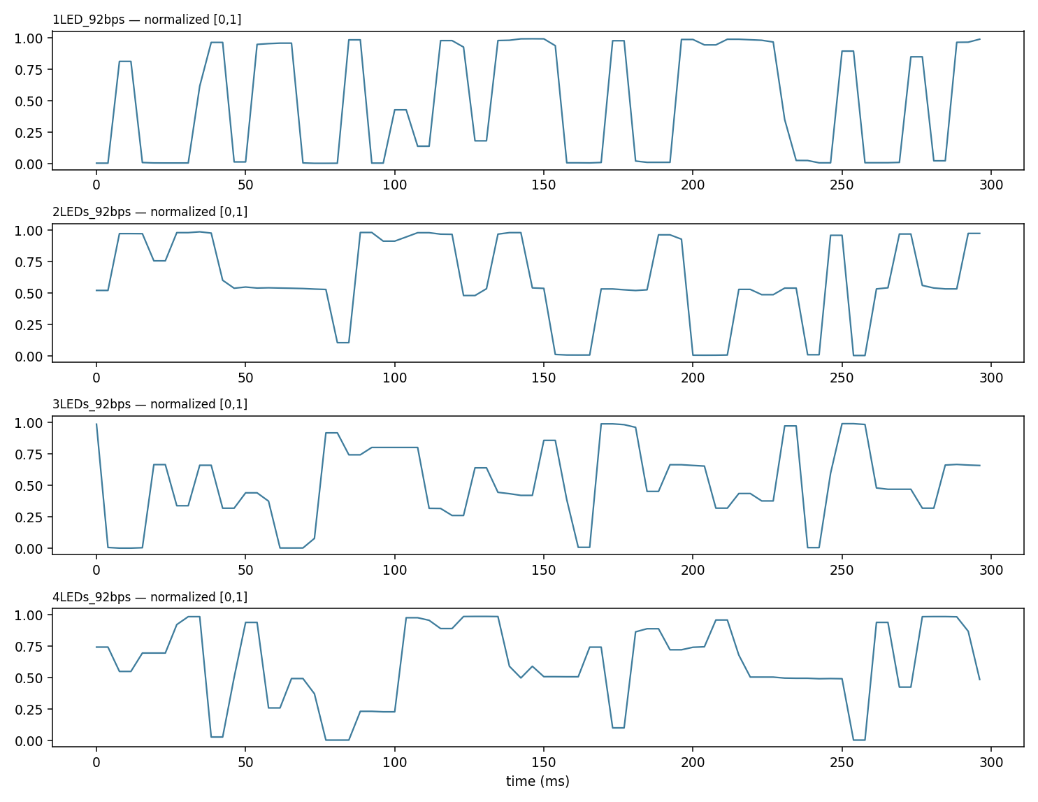
Why Use Per-Video Min-Max Normalization?
The raw ROI intensity ranges are different for different LED-count conditions.
For example, the observed range is approximately 150 for the 1-LED video and 92 for the 3-LED video.
These differences can result from LED count, distance and recording conditions, rather than representing different signal quality.
Using raw intensity values would therefore require different absolute thresholds for different videos.
Normalization Method
Apply min-max normalization to [0,1] independently for each video.
The minimum and maximum are calculated only over the active transmission window.
The dead-time region is excluded from this calculation, following the Day 7 preprocessing decision.
Why This Helps
Places all videos on a common intensity scale.
Makes downstream thresholding less dependent on absolute brightness.
Avoids creating separate hard-coded intensity thresholds for every LED-count condition.
Provides a more consistent input for the synchronization and decoding stages.
NEW FINDING — Ramp-Up at Window Start
Analysis of the active-window boundary revealed that the signal does not immediately reach its full amplitude.
In the 1-LED video, the first approximately 150 ms of the active window has an average intensity of 38.3, compared with 75.3 in the middle of the window.
This indicates a real ramp-up transient at the beginning of the active window.
It does not invalidate the saved signal, but it is important for the upcoming synchronization stage.
Day 13 synchronization should therefore avoid assuming that the entire active window has uniform signal quality.
DEFENDING THE NORMALIZATION CHOICE
Normalization & a New Finding
OCC Video Message Decoding |
4

Slide 5
Freeze Signal V1
What Signal V1 Consists Of
1. Fixed ROI
One fixed, area-filtered ROI per video.
Based on the Day 9 ROI decision.
Avoids unnecessary frame-by-frame detection.
2. Minimal Denoising
3-sample median filter.
Specifically designed to remove isolated frame-level disturbances.
Large smoothing windows are avoided because the signal is already under sampled.
3. Per-Video Normalization
Min-max normalization to [0,1].
Calculated over the active transmission window.
Dead-time is excluded.
4. Reproducibility
All preprocessing parameters are stored in preprocessing_config.json.
The same configuration can therefore reproduce the processed signal without manually changing parameters.
Current Deliverables
preprocess.py
processed_signals.csv
preprocessing_config.json
64,870 processed signal rows/frames across the four videos.
ASKING TO FREEZE TODAY
Proposed Signal V1 pipeline:
Fixed ROI → 3-Sample Median Denoising → Active-Window Min-Max Normalization → Signal V1
No further preprocessing changes unless a new change is supported by experimental evidence.
This prevents continuously changing the preprocessing pipeline while synchronization and decoding are being developed.
Notes:
Mentor Review 4 — record actual corrections here immediately after the review. If Signal V1 is approved as-is, note that explicitly; if changes are required, log them here and update preprocess.py accordingly before Day 13.

