Slide 1
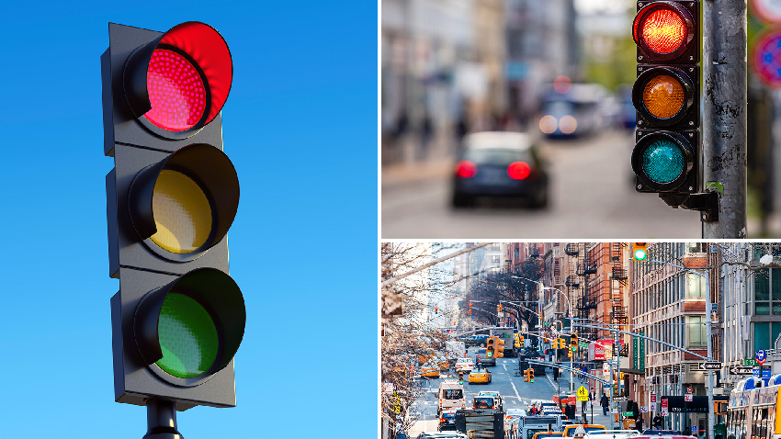
ADVANCED TRAFFIC VOLUME ESTIMATION WITH MACHINE LEARNING
Presented by
➳ Siri chintapalli
➳ P.Surya teja
➳ Madhu sudhan
➳ S.Uma avinash
Team ID : LTVIP2025TMID40335

Slide 2
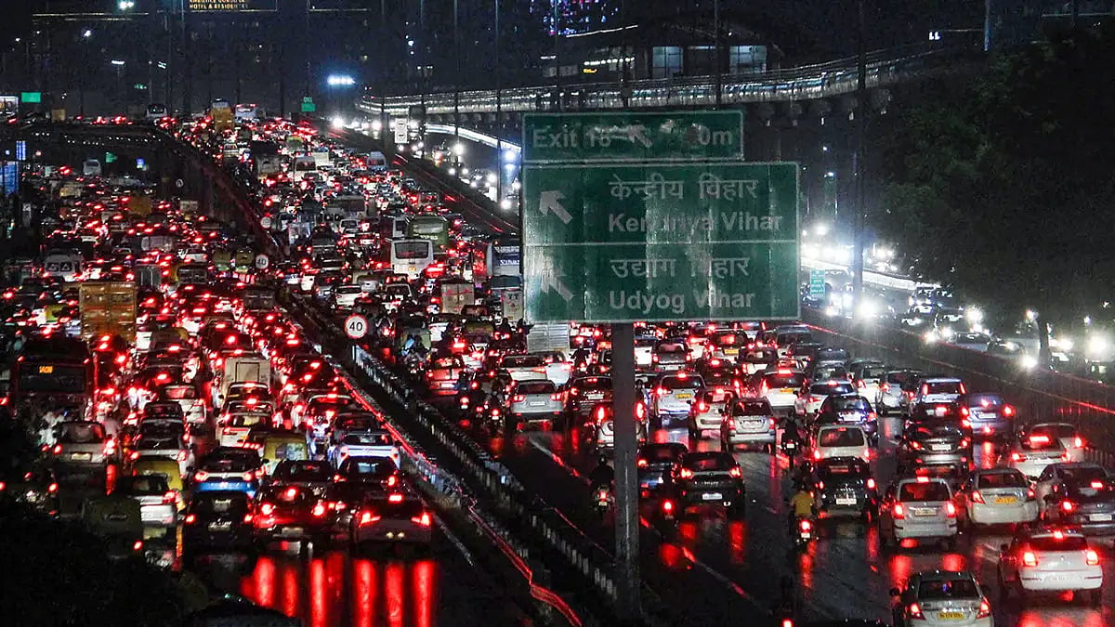
Introduction to Traffic Volume Estimation
Introduction to Traffic Volume Estimation Traffic volume estimation is a crucial aspect of transportation engineering, involving the calculation of the number of vehicles passing through a specific point or section of a road network.
Accurate traffic volume estimation enables effective traffic management, infrastructure planning, and optimization of traffic flow. It helps reduce congestion, improve safety, and enhance the overall efficiency of transportation systems
. With the increasing complexity of urban road networks, traffic volume estimation has become a vital tool for transportation professionals to make informed decisions and create more sustainable and efficient transportation systems. I

Slide 3
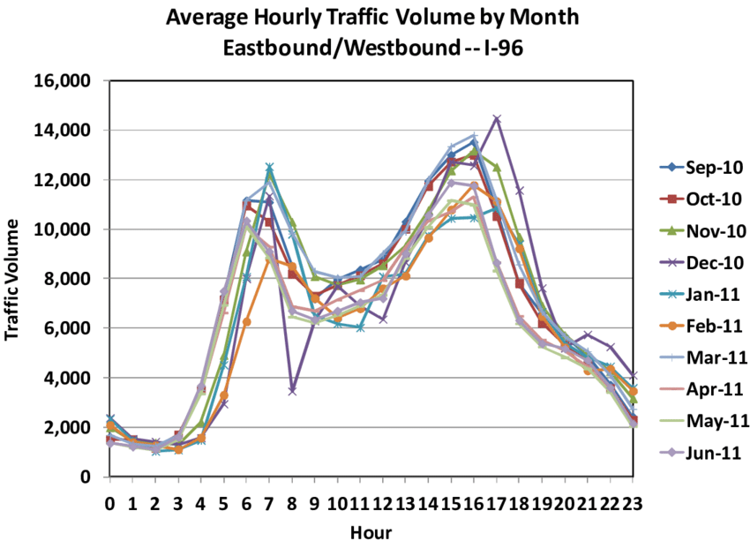
*Pre-requisites for Traffic Volume Estimation: 1. Machine Learning Fundamentals: Understanding of supervised learning, regression models, and algorithms. 2. Programming Skills: Proficiency in Python programming language and relevant libraries. 3. Data Preprocessing:Knowledge of data cleaning, handling missing values, normalization, and feature scaling. 4. Traffic Domain Knowledge: Understanding of traffic volume estimation challenges, data sources, and collection methods. 5. Statistical Analysis: Familiarity with statistical modeling, hypothesis testing, and confidence intervals. 6. Data Visualization: Understanding of data visualization tools and techniques for effective communication.

Slide 4

Challenges in Traffic Volume Estimation
1. Data Quality Issues: Inaccurate or missing data from sensors or cameras. 2. Variability: Traffic patterns change due to events, weather, or construction. 3. Complexity: Interactions between traffic signals, pedestrian flow, and vehicle types. 4. Scalability: Estimating traffic volume for large networks or cities. 5. Real-time Processing: Need for accurate and timely estimates. 6. Seasonal Fluctuations: Changes in traffic patterns due to holidays or special events. 7. Model Maintenance: Regular updates to models to ensure accuracy.

Slide 5
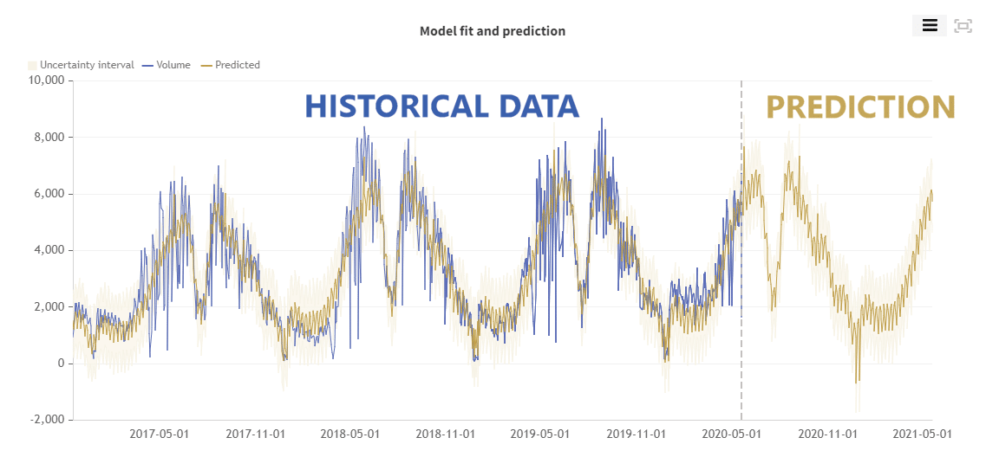
Machine Learning in Traffic Forecasting
Machine learning models can learn complex patterns from historical traffic data.
Techniques like regression, time series analysis, and neural networks are commonly used.
These models enable real-time traffic volume estimation with higher precision.

Slide 6
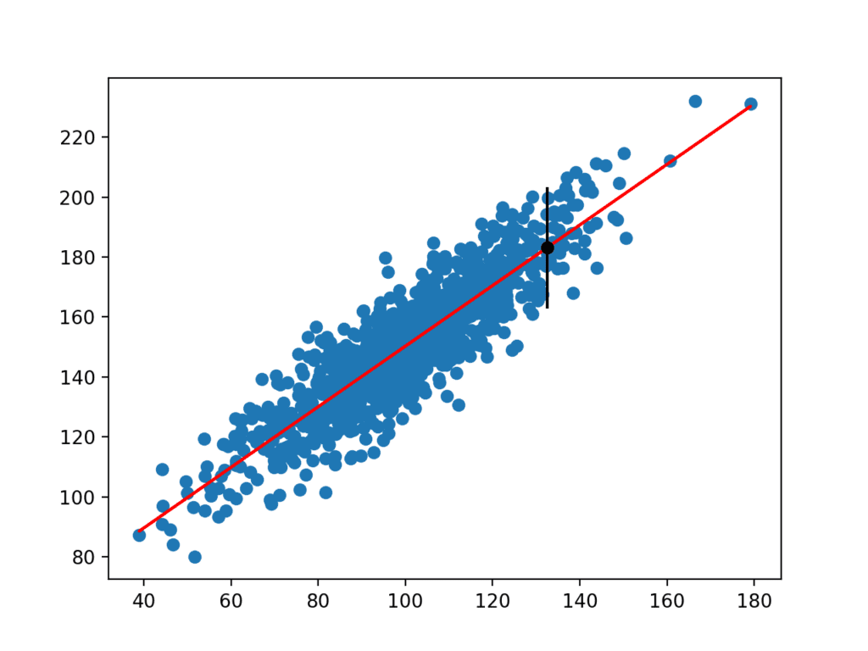
Data Sources for Advanced Estimation
Traffic sensors, cameras, and GPS data provide detailed vehicle movement information.
External data such as weather, holidays, and social events enhance model accuracy.
Data preprocessing and feature engineering are critical steps for effective modeling.

Slide 7
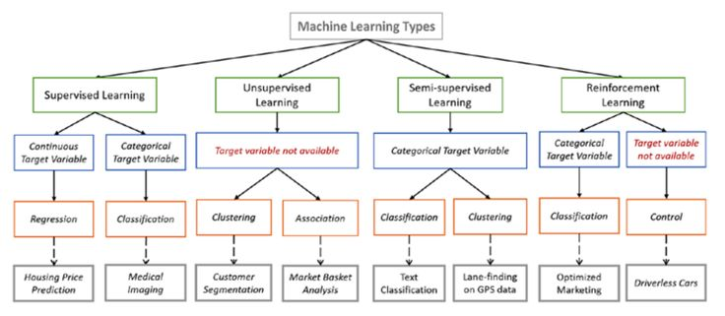
Machine Learning Models for Traffic Volume
Supervised learning algorithms like Random Forests and Gradient Boosting are popular choices.
Deep learning models, particularly LSTM networks, excel at capturing temporal dependencies.
Ensemble methods combine multiple models to improve robustness and accuracy.

Slide 8

A simple program on advanced traffic volume estimation
import pandas as pd from sklearn.model_selection import train_test_split from sklearn.linear_model import LinearRegression from sklearn.metrics import mean_squared_error data = { 'hour': [7, 8, 9, 10, 11, 12, 13, 14, 15, 16, 17, 18], 'traffic_volume': [500, 700, 1000, 1200, 1500, 1800, 2000, 2200, 2500, 2800, 3000, 3200] } df = pd.DataFrame(data) X = df[['hour']] y = df['traffic_volume'] X_train, X_test, y_train, y_test = train_test_split(X, y, test_size=0.2, random_state=42) model = LinearRegression() model.fit(X_train, y_train) y_pred = model.predict(X_test) mse = mean_squared_error(y_test, y_pred) print(f'Mean Squared Error: {mse}') new_hour = [[9.5]] estimated_traffic_volume = model.predict(new_hour) print(f'Estimated traffic volume at {new_hour[0][0]} hour: {estimated_traffic_volume[0]}')

Slide 9
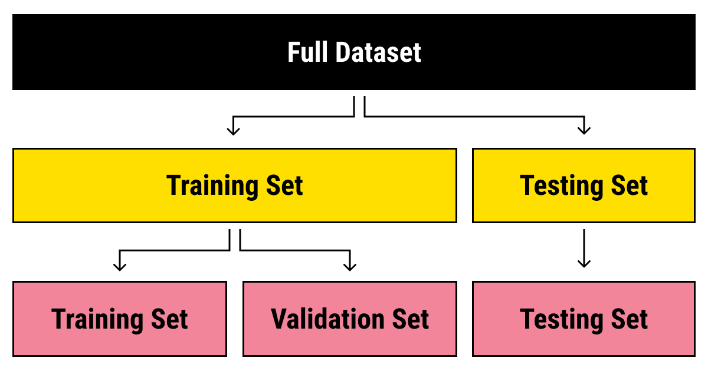
Model Training and Validation
Splitting data into training, validation, and test sets ensures unbiased evaluation.
Hyperparameter tuning optimizes model performance for specific datasets.
Cross-validation techniques help assess the model's generalization ability.

Slide 10
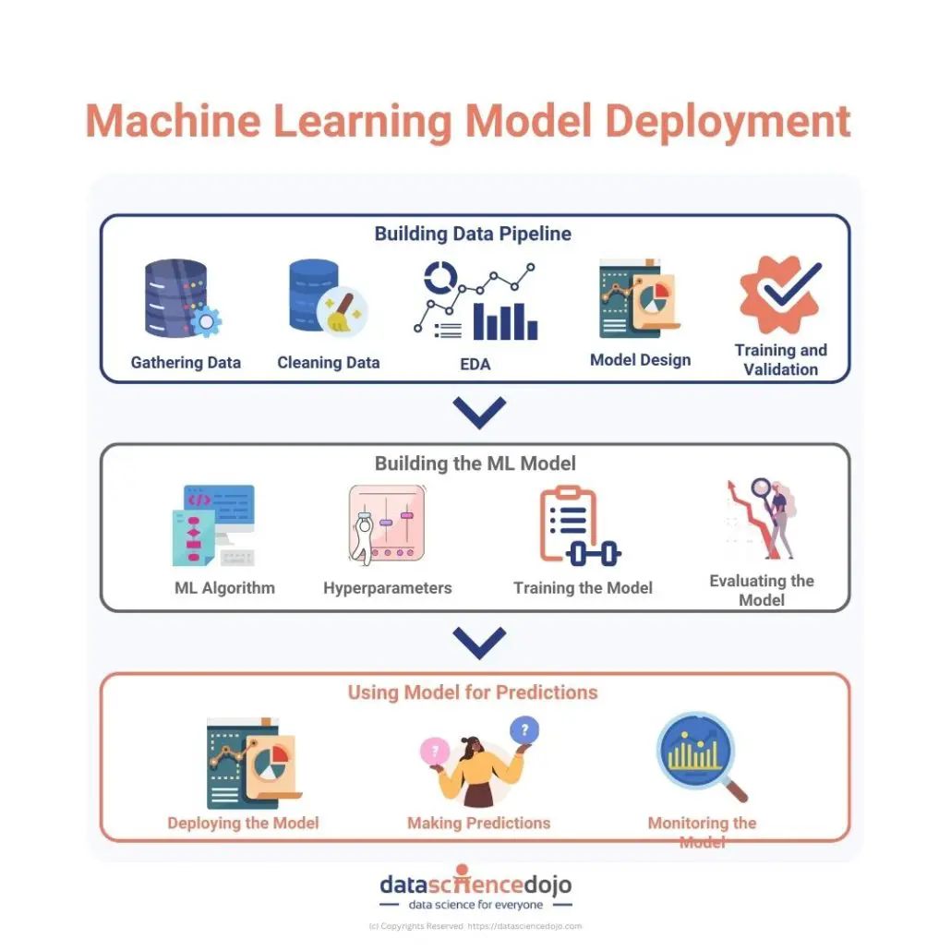
Deployment and Real-Time Estimation
Models are integrated into traffic management systems for real-time predictions.
Continuous data streaming allows for adaptive learning and model updates.
Visualization dashboards facilitate decision-making for traffic control and infrastructure planning.

Slide 11

Case Studies and Applications
Cities like New York and London have implemented ML-based traffic estimation systems successfully.
Applications include congestion management, route optimization, and emergency response planning.
Improved accuracy leads to better resource allocation and reduced congestion.

Slide 12
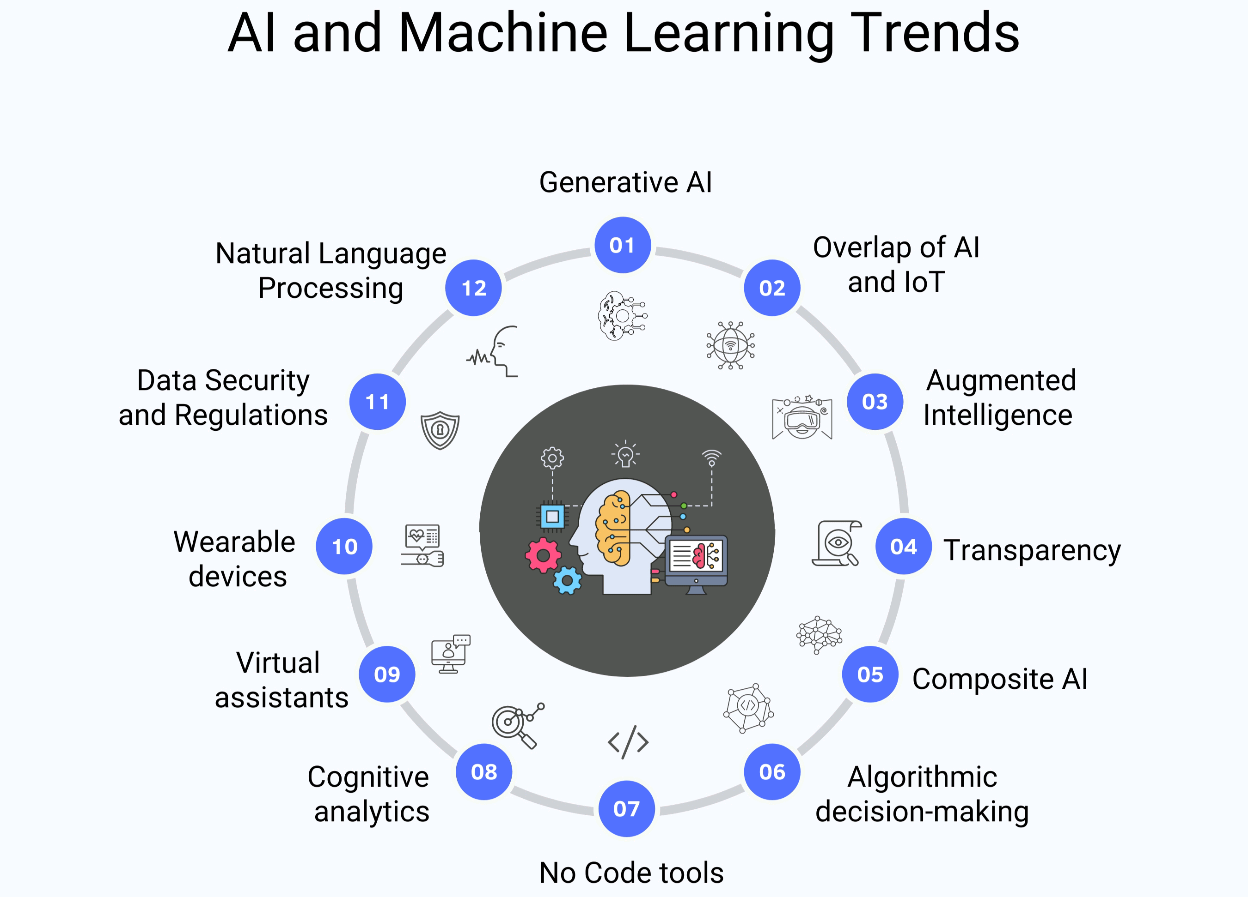
Future Trends and Research Directions
Integration of IoT devices and 5G connectivity will enhance data collection.
Multi-modal traffic estimation considering pedestrians, bicycles, and public transit is emerging.
Developing explainable AI models will increase trust and transparency in traffic predictions.

Slide 13

Conclusion
Advanced machine learning techniques significantly improve traffic volume estimation accuracy.
They enable smarter urban mobility solutions and better traffic management strategies.
Ongoing research and technological advancements promise even more effective traffic forecasting tools.

Slide 14


