Slide 1

Presented by: Varre . Siri Chandana 4/4 it reg no:20B91A12I3 department of information technology

Slide 2
contents
Title of the project
Abstract
methodology
architecture
Implementation
conclusion

Slide 3
Building an Architecture for Application and Database Deployment
Abstract: This Project presents an architecture for creating a Virtual Private Cloud (VPC) with interconnected public and private subnets, using an Internet Gateway (IGW) and Network Address Translation (NAT). The architecture enables secure connectivity and efficient communication between resources within the VPC and the internet.

Slide 4
Methodology:
The steps involved in Building an Architecture for Application and Database Deployment are:
Step 1: Create VPC along with public and private subnets
Step 2: Create an Internet gateway and attach it to our created VPC
Step 3: Create Route Tables(Public, Private) with VPC
Step 4: Enable the destination route of the public route table and connect it to the IG
Step 5: Attach the route table to the subnets and change public subnet settings to enable auto-assign IP Settings
Step 6: Create an EC2 instance and For using a private IP Address NAT instance with aws-NAT ami
Step 7: Change the Private route table settings and attach it to the NAT instance
Step 8: Now we can access our architecture by the Private IP address and then cleanup

Slide 5
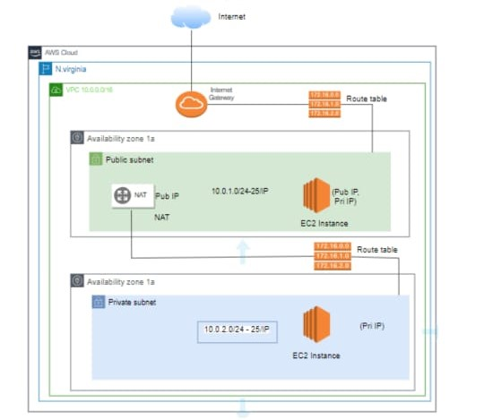
Architecture

Slide 6
Implementation:
Hard ware and soft ware used :
EC2 : Amazon Elastic Compute Cloud (Amazon EC2) provides on-demand, scalable computing capacity in the Amazon Web Services (AWS) Cloud. Using Amazon EC2 reduces hardware costs so you can develop and deploy applications faster. You can use Amazon EC2 to launch as many or as few virtual servers as you need, configure security and networking, and manage storage.
VPC : With Amazon Virtual Private Cloud (Amazon VPC), you can launch AWS resources in a logically isolated virtual network that you've defined. This virtual network closely resembles a traditional network that you'd operate in your own data center, with the benefits of using the scalable infrastructure of AWS.
Gitbash : Git Bash is an application for Microsoft Windows environments which provides an emulation layer for a Git command line experience. Bash is an acronym for Bourne Again Shell. A shell is a terminal application used to interface with an operating system through written commands.

Slide 7
Conclusion
In conclusion, By implementing the proposed architecture, organizations can separate resources based on connectivity requirements, with the public subnet allowing public access through the IGW and the private subnet enabling outbound internet connectivity via the NAT gateway or instance. Routing and security measures ensure controlled traffic flow and enforce security policies, enhancing data privacy and mitigating external threats. By following this architecture, organizations can confidently deploy their applications in the cloud, achieving a well-designed VPC setup that meets their connectivity and security needs while leveraging the advantages of cloud infrastructure

