Slide 1
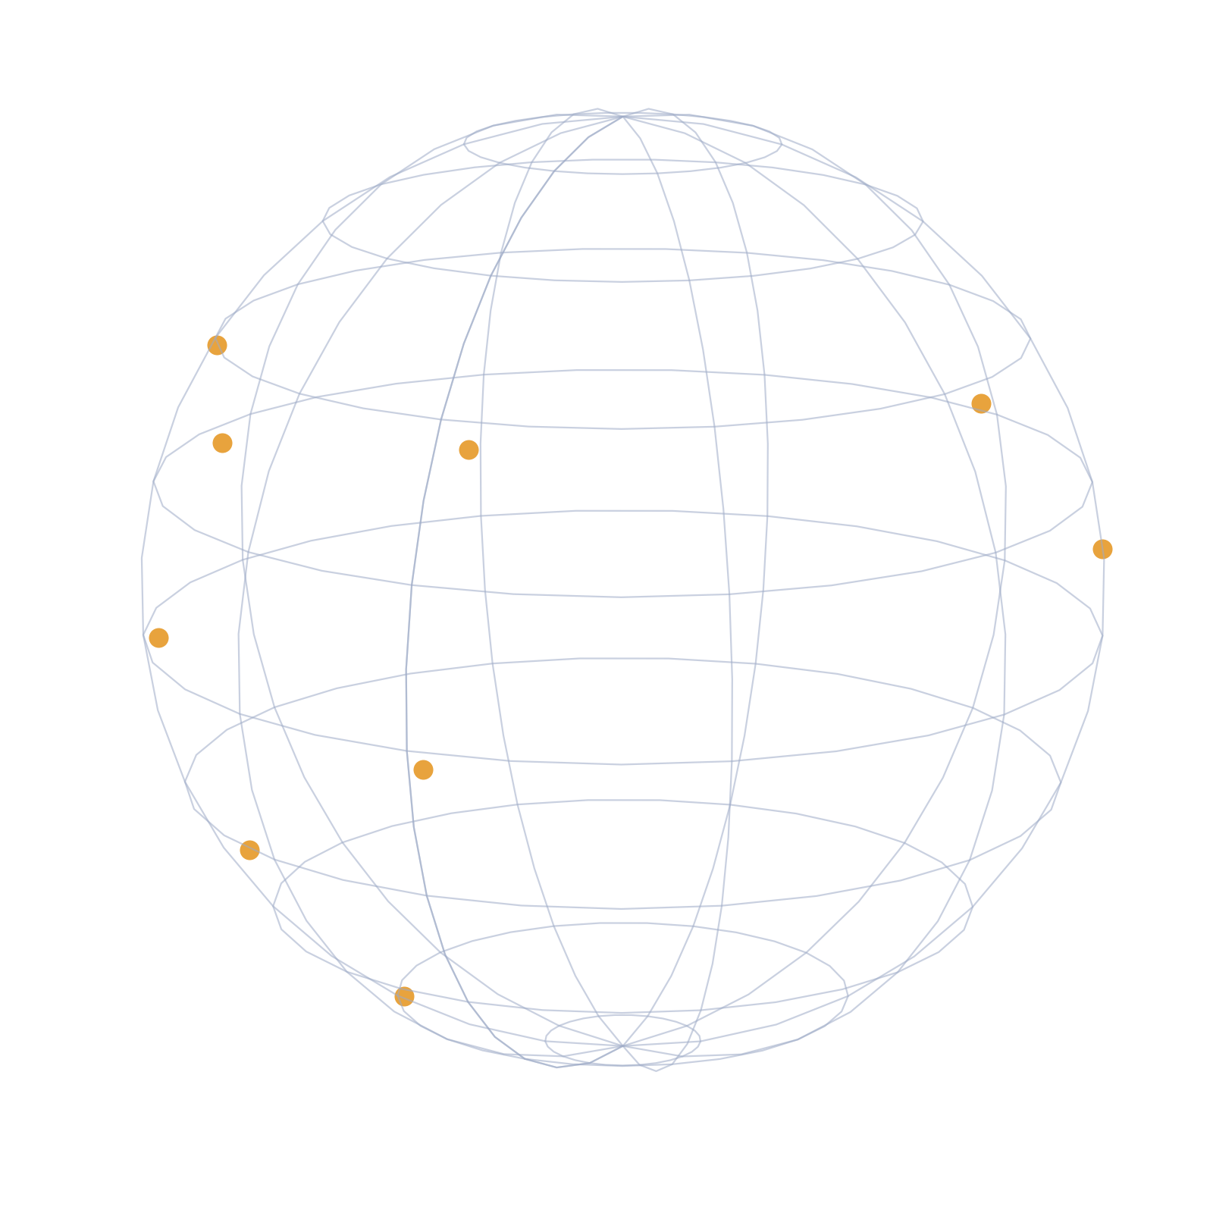
Global Economic Indicators
An Exploratory Data Analysis of World Bank & IMF Country Indicators
200+ countries • 81 indicators • 2000–2025
“Where you’re born still predicts how you’ll live”
Group No : 14
MINDFORGE
P . Siri
U . Harini
P . Kiranmayi
G . Sumithra
Training Project | EDA Submission

Slide 2
Project Overview
1
Objective
To explore and analyze global economic and demographic indicators — including poverty, GDP, and life expectancy — across 200+ countries, in order to identify patterns and relationships between income levels, regions, and quality-of-life outcomes.
2
Scope
This project covers country-level data from the World Bank and IMF, spanning the years 2000 to 2025 (with some indicators projected through 2031). It focuses primarily on indicators from the Economy, Demographics, and Social categories — including poverty rate, GDP per capita, and life expectancy — analyzed across 200+ countries, grouped by region and income level.
3
Approach
Three source datasets — an indicator dictionary , a country reference table, and the core indicator dataset — were profiled, cleaned, and merged into a single unified table. Missing values were handled deliberately (filled rather than dropped, to preserve full country coverage), and merge keys were validated before combining. The resulting dataset was then explored through multiple visualization types — including bar charts, box plots, choropleth maps, line charts, and scatter plots — to uncover patterns across regions, income levels, and time.

Slide 3
Data Sources
Dataset : Global Country Economic Indicators (2000–2031)
Kaggle — kaggle.com/code/metricshour/global-country-economic-indicators-starter-eda
dictionary
country_reference
global_economic
81
250
317K+
indicators
countries
data rows
dictionary — 81 indicators across 12 categories (Economy, Demographics, Social, Fiscal, and more), describing what each indicator measures, its unit, and coverage
country_reference — 250 countries and territories, with attributes like region, income level, and group memberships (G7, G20, EU, etc.)
global_economic — the core dataset: over 317,000 rows combining country, indicator, year, and value, from 2000 to 2025 (some indicators extend to 2031)
Metadata: category, unit, source, coverage
Region, income level, memberships, ratings
Country × indicator × year, 2000–2031
Why we chose it:
Authoritative sources — World Bank and IMF, trusted globally for economic data
Broad coverage — 200+ countries, 81 indicators across 12 categories
Sufficient time range — 2000 to 2025+, enabling real trend analysis
Well-structured — three related tables suited to practicing real-world data cleaning and merging
Relevant, meaningful topics — poverty, GDP, and life expectancy are globally significant and easy to communicate to any audience
Sources: World Bank (majority of indicators) and IMF World Economic Outlook (projections through 2031)

Slide 4
Data Cleaning & Preparation
Null handling
Checked all three tables for missing values. Nine columns in country_reference were completely empty and were dropped. Remaining gaps were filled with meaningful placeholders instead of deleting rows — preserving all 250 countries for analysis.
Merge validation
Before combining tables, verified that every country code in the indicator dataset had a matching entry in the reference table. Result: 0 missing matches — safe to merge without losing any data
Datetime conversion
Converted period_date from plain text to a proper datetime format. Verified 0 parsing failures across all 317,055 rows before converting — enabling time-based operations like grouping by year and plotting trends.
Final merged table
Combined dictionary (81 indicators), country_reference (250 countries), and global_economic (317K+ rows) into one table. Final result: 37 columns, 317,055 rows — same row count as the original, confirming no data was lost or duplicated. Duplicate columns from the merge (e.g. two versions of "region") were removed to keep the table clean.

Slide 5
Methodology
Our data mixes very different units — percentages, dollars, ratios — all in one column. So before analyzing anything, we always filter down to a single indicator first, otherwise we'd be comparing things that can't actually be compared."
1
Use each country's latest available year for snapshot charts (bar charts, maps, box plots) — ensuring a fair, current comparison across countries.
2
Use the full time series for trend charts — showing how values change year by year (line charts, animated maps)
3
We matched each chart type to the question we were asking — box plots for distribution, line charts for trends, scatter plots for relationships, and maps for geography — rather than using one chart style for everything
4

Slide 6
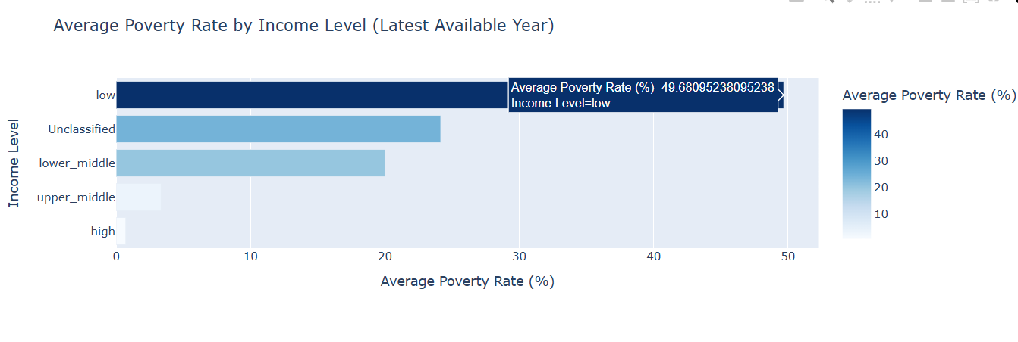
Poverty Rate by Income Level
Average poverty rate, latest available year per country
This bar chart shows the average poverty rate for countries in each income classification — low, lower-middle, upper-middle, and high income — using each country's most recent available data
Data source: global_economic merged with country_reference on country_code3
Poverty drops sharply as income level rises — from nearly 50% in low-income countries to under 1% in high-income countries, a ~70x difference.
The steepest gap is between low and lower-middle income — poverty is heavily concentrated in the poorest bracket rather than declining gradually.
Key takeaway

Slide 7
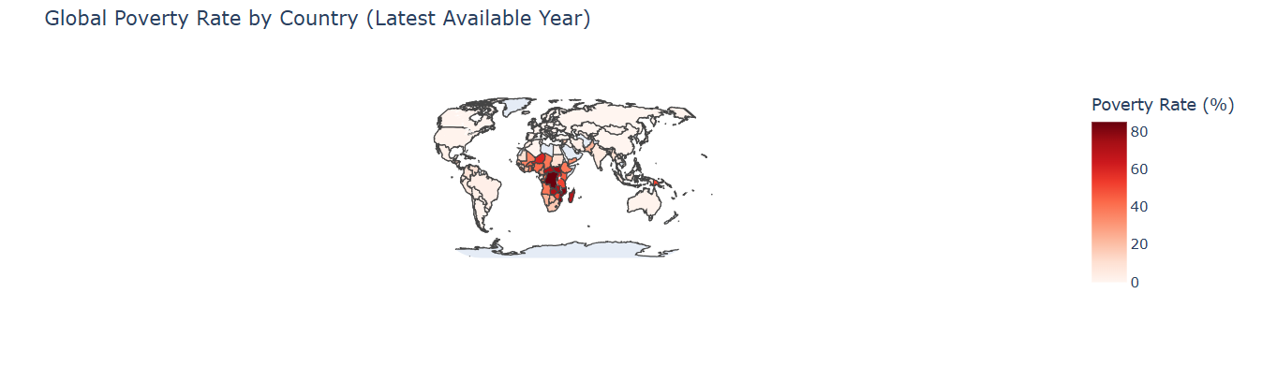
Global Poverty Rate by Country
Choropleth map, latest available year per country
Each country is shaded by its poverty rate — darker shades indicate higher poverty. Hover over any country to see its exact value, year, and income classification
[ World map: poverty_rate_pct, color scale Reds ]
Data source: global_economic merged with country_reference on country_code3
Key takeaway
Geography makes the pattern immediate: poverty is visually concentrated in specific regions, particularly Sub-Saharan Africa and parts of South Asia, rather than spread evenly worldwide.

Slide 8
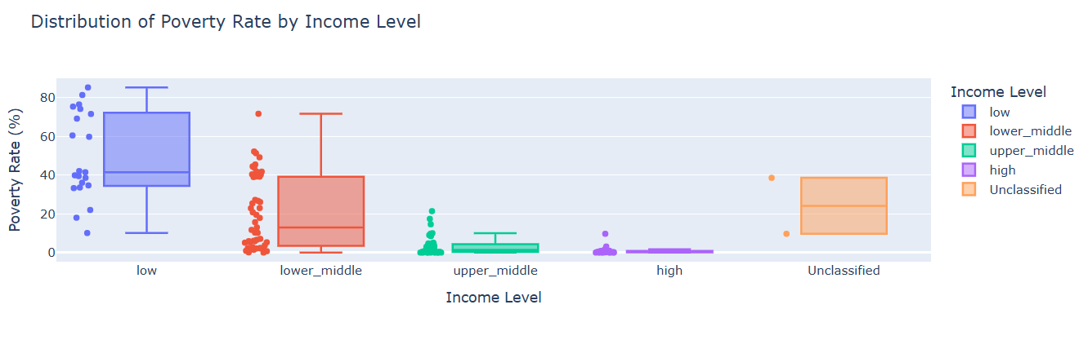
Distribution Within Income Groups
Box plot of poverty rate by income level
Data source: global_economic merged with country_reference on country_code3
Each box shows where most countries in that group fall; the line inside marks the median, and dots show individual countries, including outliers.
[ Box plot: poverty_rate_pct by income_level, points='all' ]
Key takeaway
Averages can hide a lot. This box plot shows the full range of poverty rates within each income group — not just the average — plus every country as a point, revealing which groups are consistent and which have big outliers.

Slide 9
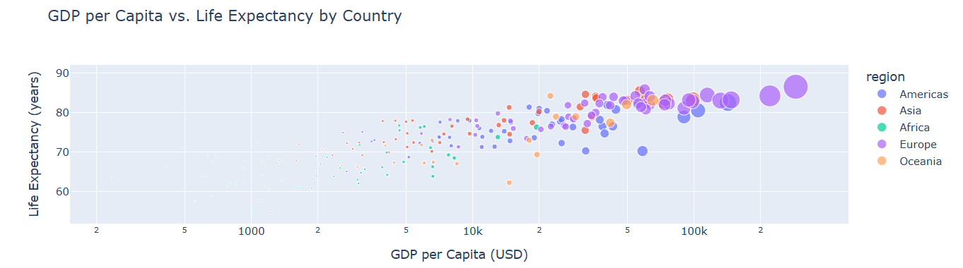
GDP per Capita vs. Life Expectancy
Scatter plot, log-scaled GDP per capita, colored by region
Data source: global_economic merged with country_reference and dictionary
Each dot represents one country. Position along the x-axis shows GDP per capita (log scale), and position along the y-axis shows life expectancy. Color indicates region, and dot size reflects GDP per capita.
[ Scatter: gdp_per_capita_usd (log) vs life_expectancy ]
Key takeaway
A classic diminishing-returns pattern: life expectancy rises steeply with GDP at lower income levels, then flattens — wealthier countries gain far less additional life expectancy per added dollar.

Slide 10
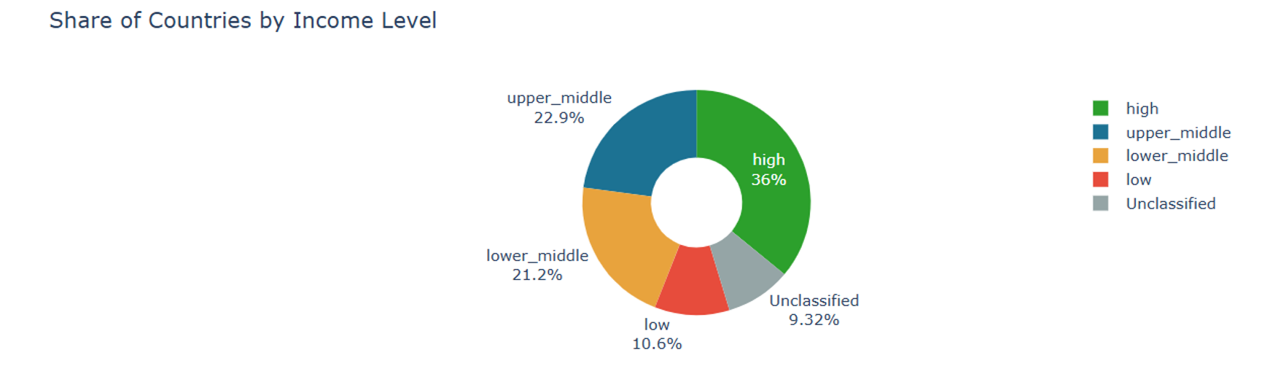
Share of Countries by Income Level
Proportion of all countries by income classification
Data source: country_reference merged with global_economic on country_code3
This chart provides context for the poverty findings shown earlier — knowing how many countries fall into each income bracket helps clarify whether those patterns are driven by a large or small group of countries..
[ Scatter: gdp_per_capita_usd (log) vs life_expectancy ]
Key takeaway
High-income countries make up the largest share of the dataset (36%), while low-income countries are the smallest well-defined group (10.6%). This is useful context for the poverty findings — the ~50% average poverty rate in low-income countries reflects a relatively small group of countries, while the near-0% rate in high-income countries reflects the largest group

Slide 11
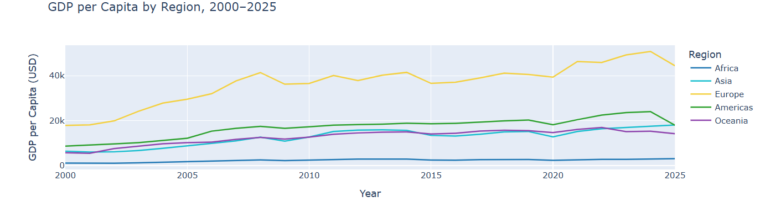
GDP per Capita by Region, 2000–2024
Regional trend lines, average GDP per capita per year
Data source: global_economic merged with country_reference on country_code3
Each line represents one region, tracked from 2000 to 2024. The vertical position shows average GDP per capita that year — lines further apart indicate a larger wealth gap between regions.
[ Line chart: gdp_per_capita_usd by region, 2000–2024 ]
Key takeaway
Regional GDP gaps are large and persistent — the gap between wealthier and poorer regions has not meaningfully narrowed across the 24-year period, suggesting that global economic growth has not been evenly shared..

Slide 12
Key Findings
1. Poverty and Income Classification
Poverty rate rises steeply from high-income (0.71%) to low-income (49.68%) countries. The gap isn't gradual — the biggest jump is between low and lower-middle income specifically. This suggests income classification alone can roughly predict poverty severity.
2. Wealth vs. Poverty Isn't a Perfect Relationship
The GDP vs. poverty scatter plot confirms the same pattern at the individual country level, not just group averages. Some countries sit far from the general trend — unexpectedly low or high poverty for their GDP. These outliers are worth investigating further, as they may reflect strong social policy, conflict, inequality, or data quality issues.
3. Persistent Regional GDP Gaps
Some regions have consistently lower GDP per capita than others across the entire 24-year window. This gap has not meaningfully closed despite global economic growth overall — raising the question of whether growth is being shared evenly across the globe. It doesn't appear to be.
4. GDP and Life Expectancy — Diminishing Returns
Early GDP increases (very poor to lower-middle income) produce large gains in life expectancy. Beyond a certain GDP threshold, additional wealth adds progressively less. This is a well-documented pattern in global development economics, not unique to this dataset.
5. Geographic Concentration of Poverty
Poverty is not spread evenly — it's visually clustered on the world map in specific regions, particularly Sub-Saharan Africa and parts of South Asia. Geography and economic history are clearly intertwined in this pattern.

Slide 13
Limitations & Conclusion
Limitations
Next Steps
• Some indicators (e.g. tourism) end at 2020, limiting recent-year analysis
• Extend analysis to Governance, Environment, and Innovation indicators
• A few indicators blend multiple sources, which may vary in methodology
• Investigate specific outlier countries flagged in the scatter plots
• Some reference values were filled with placeholders rather than dropped, to preserve full country coverage
• Explore a simple predictive model for poverty rate using related indicators
Conclusion
This project explored global economic and demographic indicators across200+ countries (World Bank, IMF data, 2000–2025+). After cleaning andmerging three source tables, key patterns emerged:
Poverty is strongly tied to income classification — average poverty rate drops from ~50% in low-income countries to under 1% in high-income countries.
GDP and life expectancy show diminishing returns — life expectancy rises sharply with GDP at lower income levels, then flattens at higher incomes.
Regional GDP gaps are persistent, not converging over 2000–2024.
Geographic patterns are clear in the poverty choropleth, concentrated in specific regions.
Thank you..

