Slide 1
SOUVENIR SHOP MONTHLY SALES FORECASTING
RUTGERS BUSINESS SCHOOL - BUSINESS FORECASTING
ABHYANK
AESHA
AKSHADA
PETER
SIHENG YU
SIRI

Slide 2




CONTENT
Dataset Description
Exploratory Data Analysis (Approach)
Forecasting/Prediction
Conclusion

Slide 3
DATASET
Monthly sales for a souvenir shop at a beach resort town in Queensland, Australia, for January 1987-December 1993.
The original data from Wheelwright and Hyndman, 1998.
http://robjhyndman.com/tsdldata/data/fancy.dat
http://robjhyndman.com/tsdldata/data/fancy.dat

Slide 4
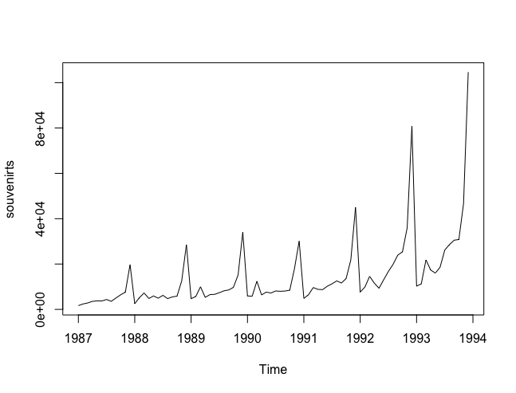
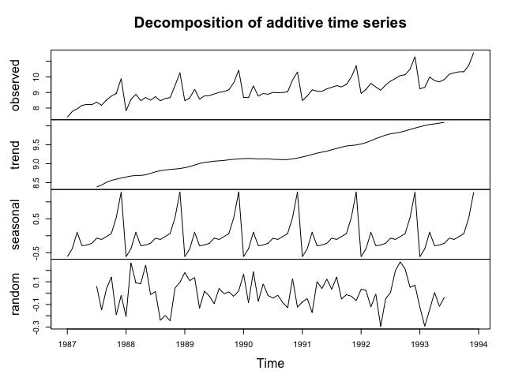
LOOKING AT THE DATA
Size of the seasonal fluctuations seem to increase with the level of the time series.
Transformation using log

Slide 5
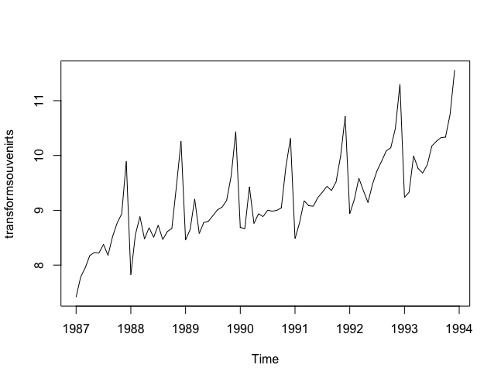
LOG TRANSFORMATION
Roughly constant over time, and do not depend on the level of the time series.
Can probably be described using an additive model.

Slide 6
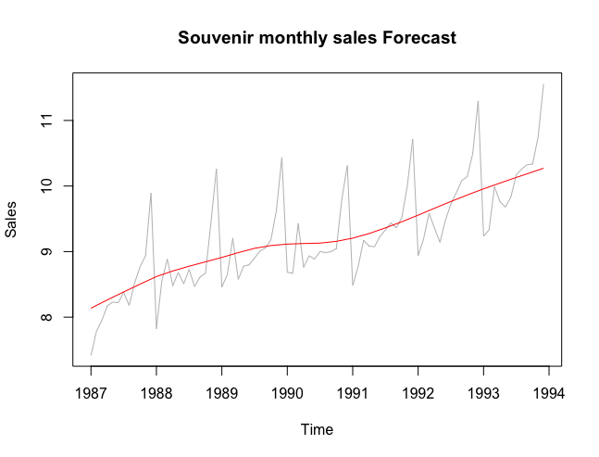
Trend on the Monthly forecasting
The red line shows the trend

Slide 7
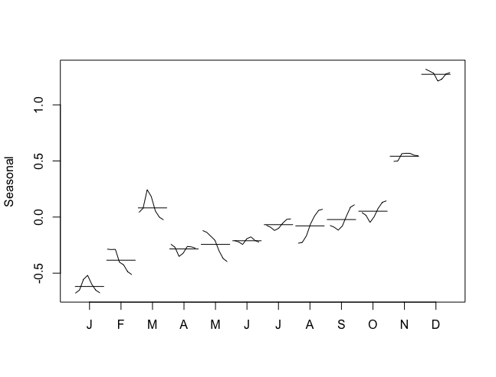
MONTHLY SEASONALITY
It has varying seasonality we can have seasonal subseries plots of the seasonal component
Helps to visualize the variation in the seasonal component over time

Slide 8
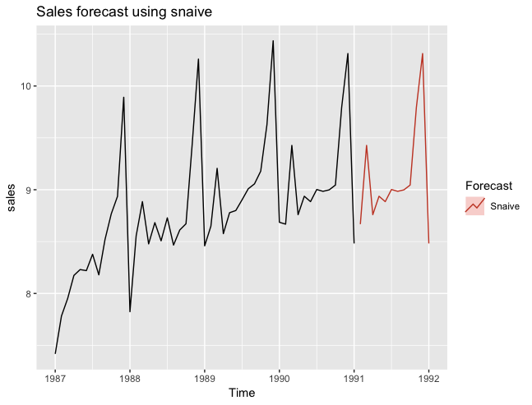
SEASONAL NAIVE

Slide 9
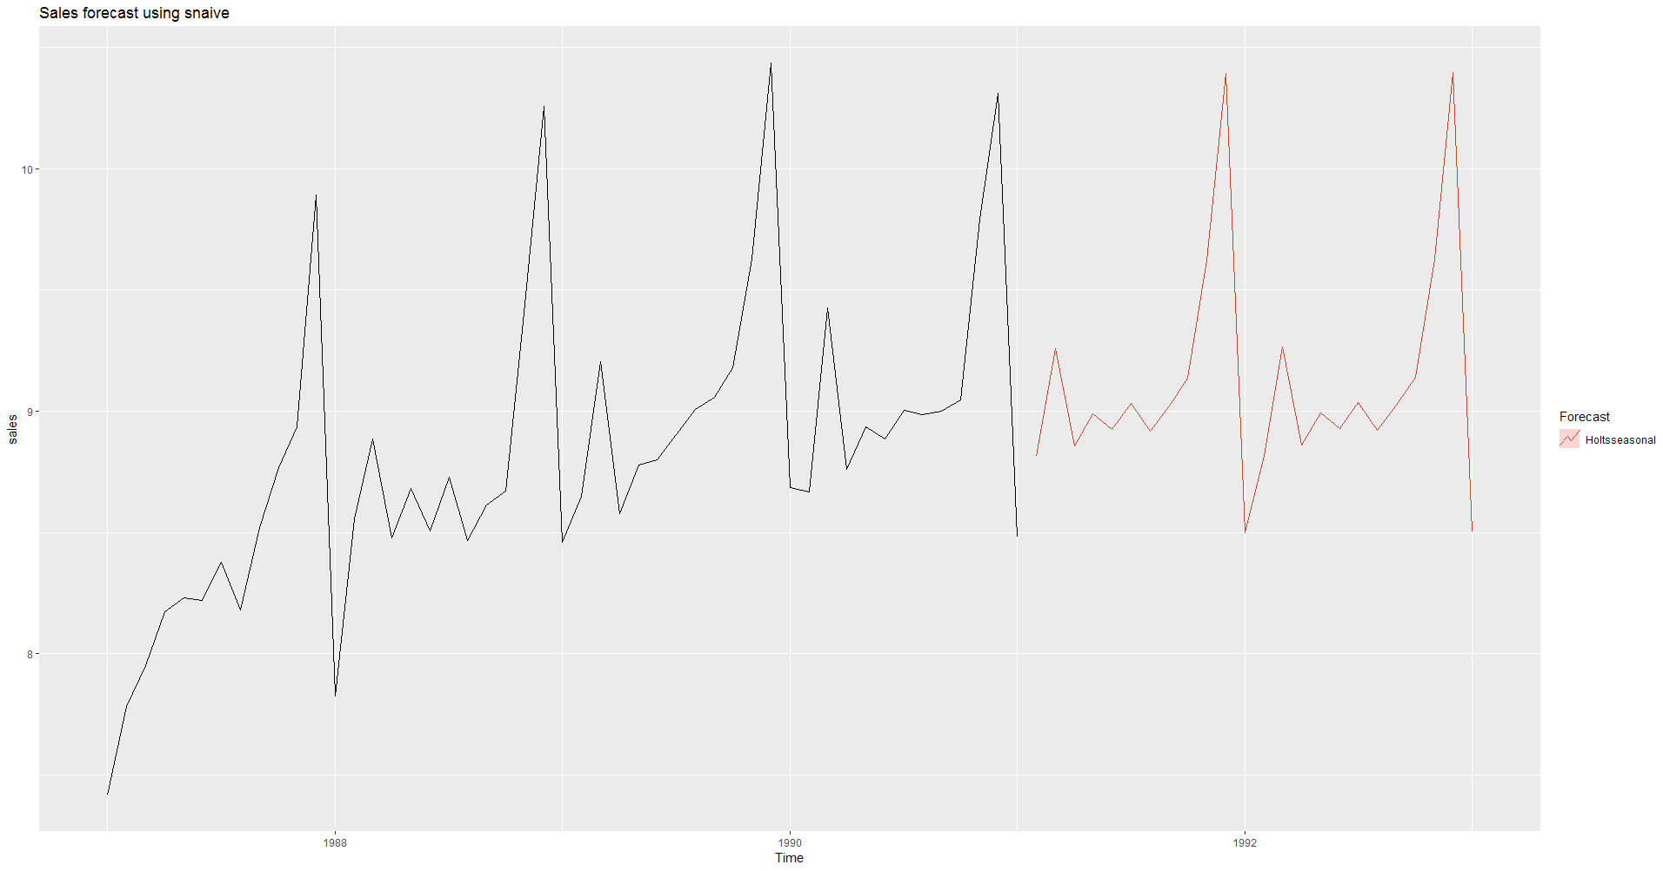
Holts-Winters’ Seasonal Method

Slide 10
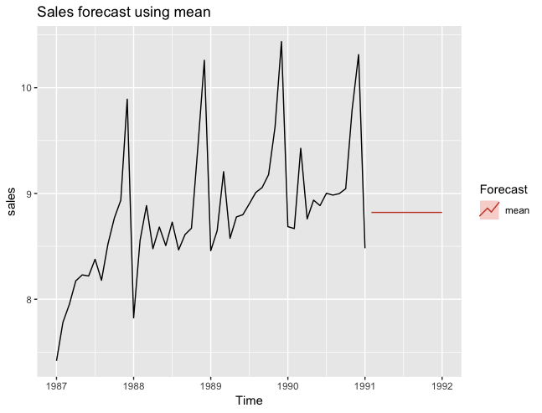
Mean model to predict the values

Slide 11
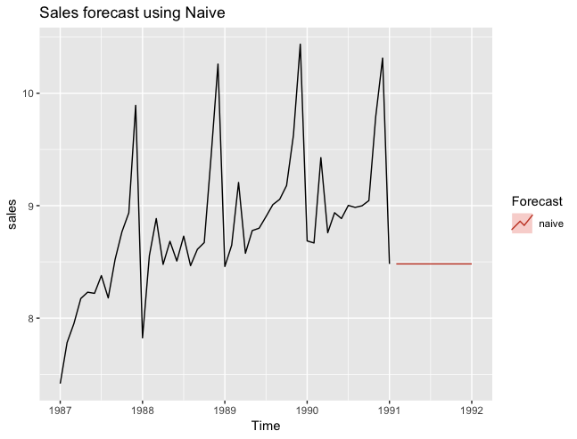
Naive model to predict the values

Slide 12
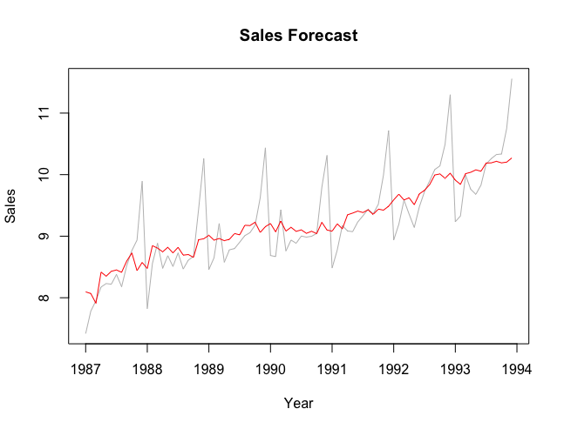
Seasonally adjusted
Seasonally adjusted data when we remove the seasonality from the original data

Slide 13
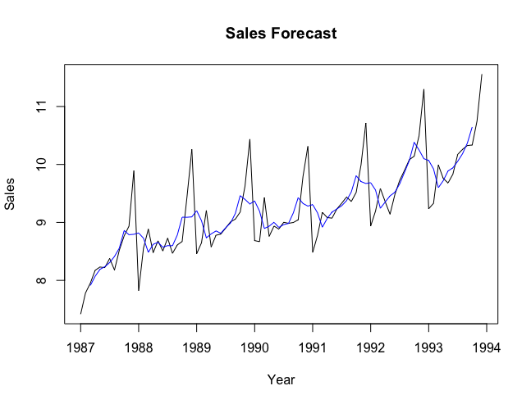
Moving average
Estimating trend using moving average

Slide 14
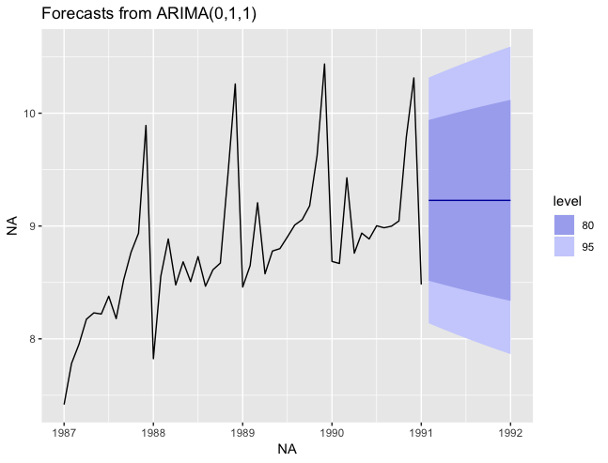
ARIMA model

Slide 15
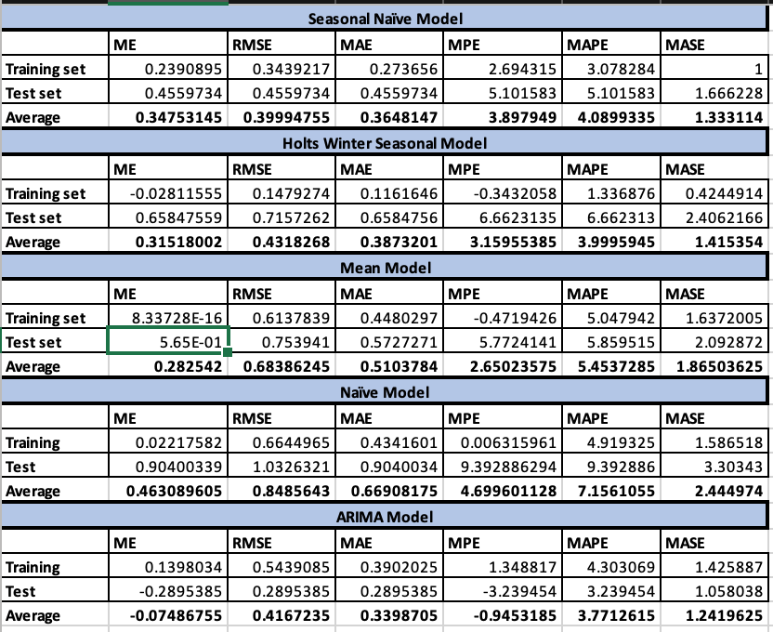
Conclusion

Slide 16


Slide 17


