Slide 1

4 bit Binary-to-decimal
Conversion and Display System Using Logic Gates
Presented by:
Siri - 2620030002
Bruhathi – 2620030025
Varshitha - 2620030033
Kruthika - 2620030037

Slide 2

WHAT IS A 4 BIT BINARY CONVERSION?
A 4-bit binary number consists of 4 bits, where each bit is either 0 or 1.
It has 16 possible combinations, from 0000 to 1111.
These represent decimal values from 0 to 15.
The four bit positions have values 8, 4, 2, and 1.
Example:
1010₂ = (1×8) + (0×4) + (1×2) + (0×1) = 10₁₀

Slide 3
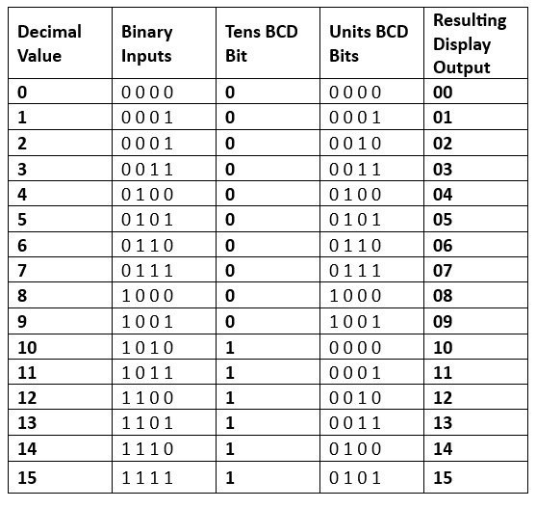
4 – BIT BINARY - TO - DECIMAL CONVERSION
A 4-bit binary-to-decimal conversion system using logic gates is a digital circuit that takes a 4-bit binary input and produces the corresponding decimal value on a display.

Slide 4
ADVANTAGES
Can be built using basic logic gates such as AND, OR, and NOT gates.
Helps students understand binary numbers, decimal representation, truth tables, and logic circuits.
The system works using hardware logic, without requiring programming or a microcontroller.

Slide 5
DISADVANTAGES
A 4-bit input can represent only 0 to 15.
Increasing the number of bits requires additional logic gates and circuits
Using multiple ICs and a display increases power usage.
Changing the circuit for additional digits or functions may require redesigning part of the logic.

Slide 6
THANK YOU

