Slide 1

SMART INDIA HACKATHON 2026
TITLE PAGE
Problem Statement ID – SIH26001
Problem Statement Title- AI-Based early warning and landslide Risk Monitoring System in NER
Theme- Disaster Management
PS Category - Software
Team ID-
Team Name (Registered on portal) - 6g’s

Slide 2
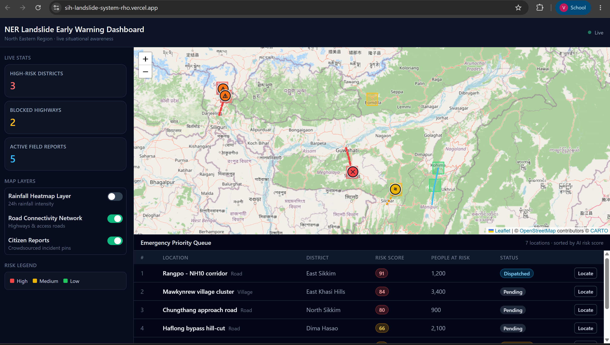
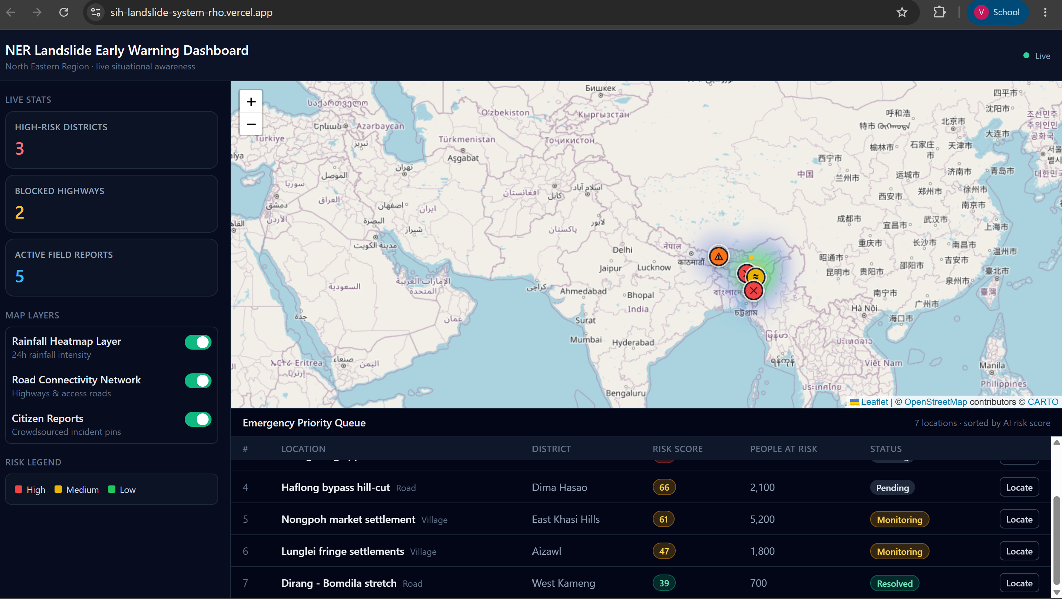
IDEA TITLE
6g’s
      Proposed Solution: GeoAlert-NER
Zero-Human-Delay Hazard Verification: Replaces slow physical inspections by using YOLOv8 Computer Vision to instantly quantify road blockages and severity directly from uploaded photo evidence.
Objective Resource Allocation: Eliminates manual emergency dispatch guesswork with an automated priority matrix that sorts rescue operations by real-time risk scores and population vulnerability.
Multi-Layer Spatial Analytics: Seamless GIS integration merging live 24h rainfall heatmaps, terrain geometry, soil saturation, and lithology stability directly into a single risk index.
Instant Auto-Flyto Spatial Targeting: One-click spatial navigation that automatically zooms command center viewports directly to affected geographical coordinates and critical highway sectors.
Bandwidth-Resilient Closed-Loop Platform: Bridges citizen reporting, AI prediction, and NDRF/SDMA dispatch into a unified, lightweight React/FastAPI interface engineered specifically for 2G/3G disaster zones.

Slide 3
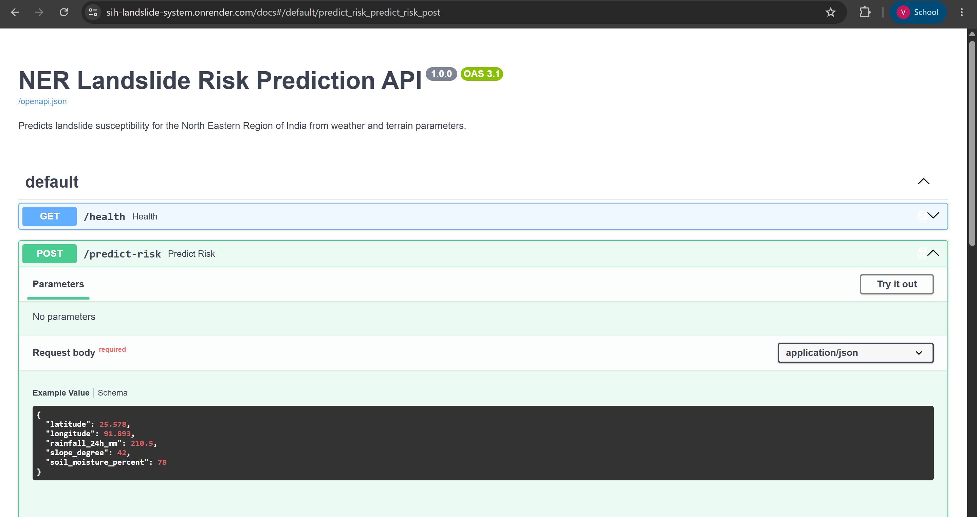
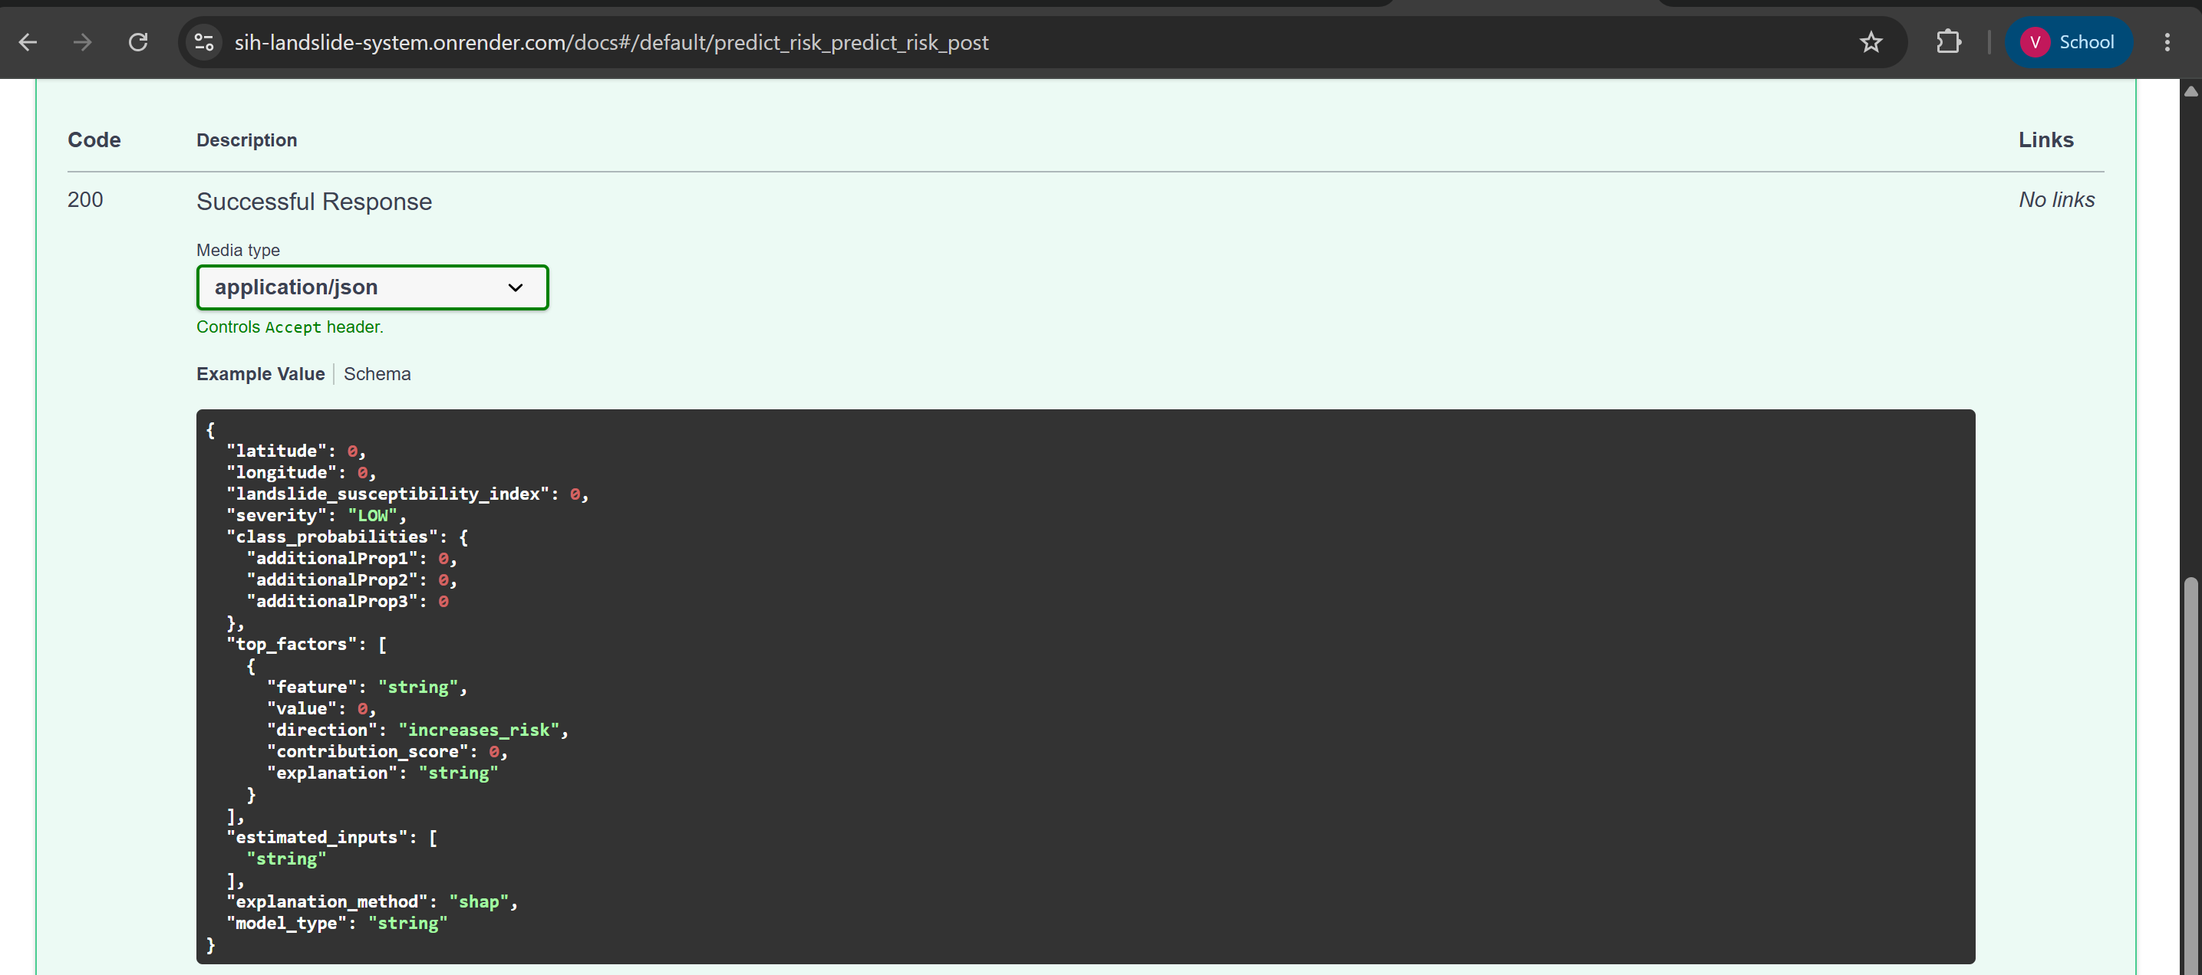
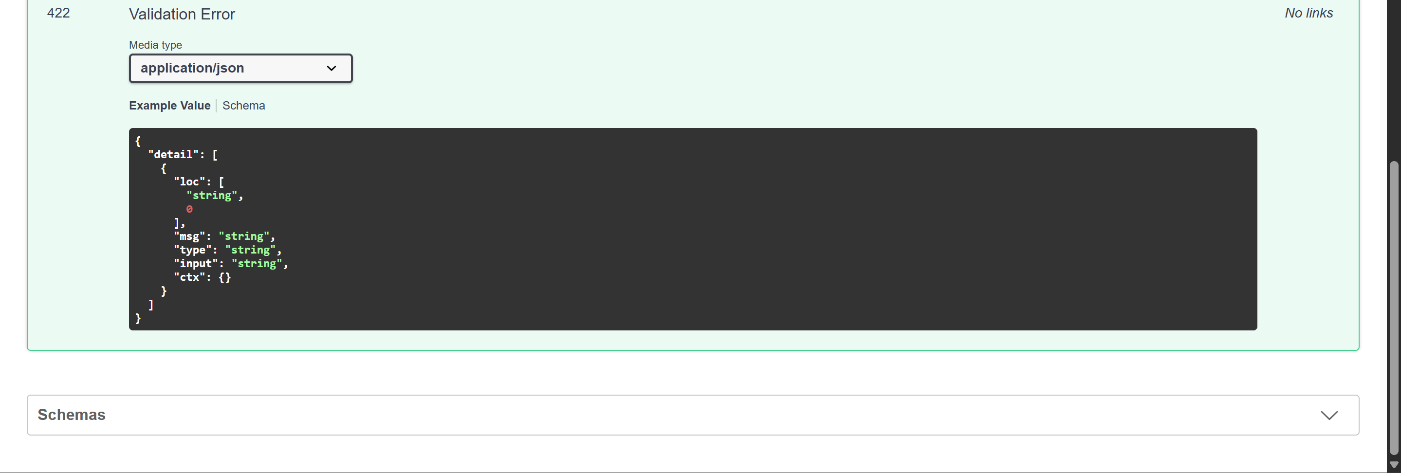
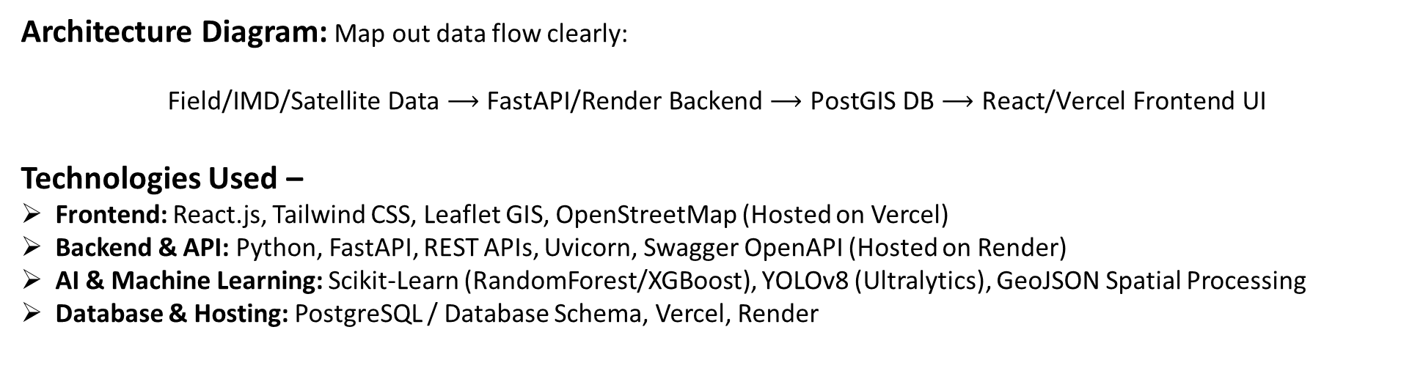
TECHNICAL APPROACH
6g’s
Architecture Diagram: Map out data flow clearly:
$$\text{Field/IMD/Satellite Data}⟶\text{FastAPI/Render Backend}⟶\text{PostGIS DB}⟶\text{React/Vercel Frontend UI}$$
Technologies Used –
Frontend: React.js, Tailwind CSS, Leaflet GIS, OpenStreetMap (Hosted on Vercel)
Backend & API: Python, FastAPI, REST APIs, Uvicorn, Swagger OpenAPI (Hosted on Render)
AI & Machine Learning: Scikit-Learn (RandomForest/XGBoost), YOLOv8 (Ultralytics), GeoJSON Spatial Processing
Database & Hosting: PostgreSQL / Database Schema, Vercel, Render

Slide 4
FEASIBILITY AND VIABILITY
6g’s
Feasibility
Risks and Mitigation
Viability
Lightweight Architecture: Asynchronous FastAPI backend + Leaflet GIS ensures microsecond API response times and ultra-fast tile rendering.
Low-Bandwidth Optimization: GeoJSON payload compression allows smooth operation on weak 2G/3G mobile networks in remote hilly terrains.
Zero-Cost Deployment Footprint: Scalable cloud deployment on Vercel and Render demonstrates immediate operational viability without expensive initial infrastructure.
Risk 1: Network Blackouts in Remote Districts
  Mitigation: Progressive Web App (PWA) offline data caching + automated SMS/USSD fallback alerts for field teams.
Risk 2: False Citizen Reports & Spam Uploads
  Mitigation: Dual-layer verification requiring YOLOv8 vision AI confidence score (>80%) + one-click local authority validation.
Risk 3: Dynamic Weather Sensor Disruption
  Mitigation: Fallback to IMD grid interpolation algorithms when local ground sensors lose power.
Modular Scale: Plug-and-play architecture allows seamless extension beyond NER to other landslide-prone regions (e.g., Western Ghats, Uttarakhand).
Government Integration Ready: Designed for direct API integration into existing SDMA (State Disaster Management Authority) and NDRF dispatch workflows.
High ROI / Low Maintenance: Open-source core stack (React, Python, OpenStreetMap) eliminates recurring software licensing fees for state disaster agencies.

Slide 5
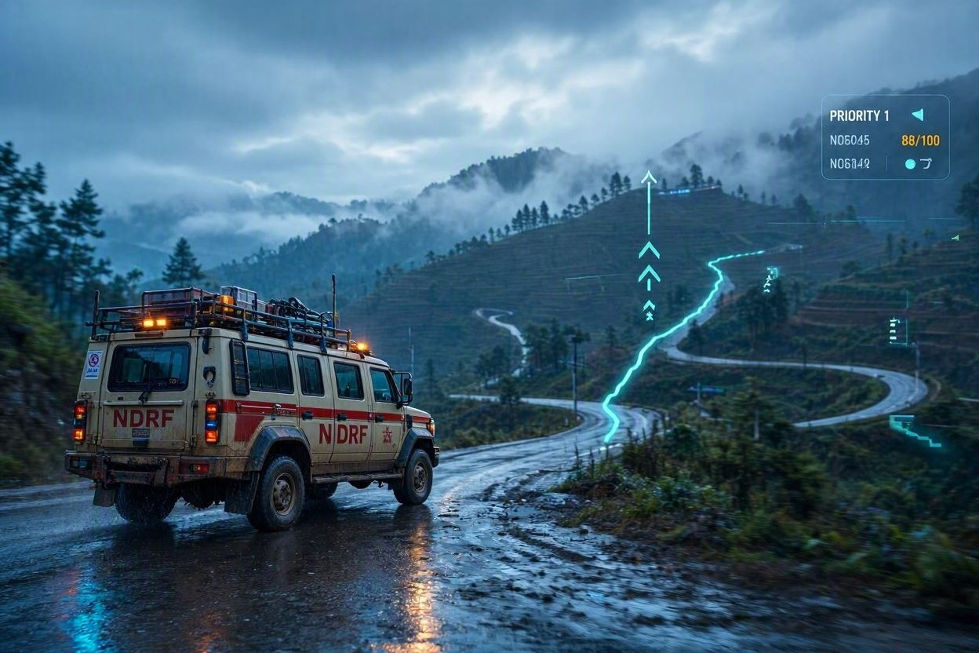
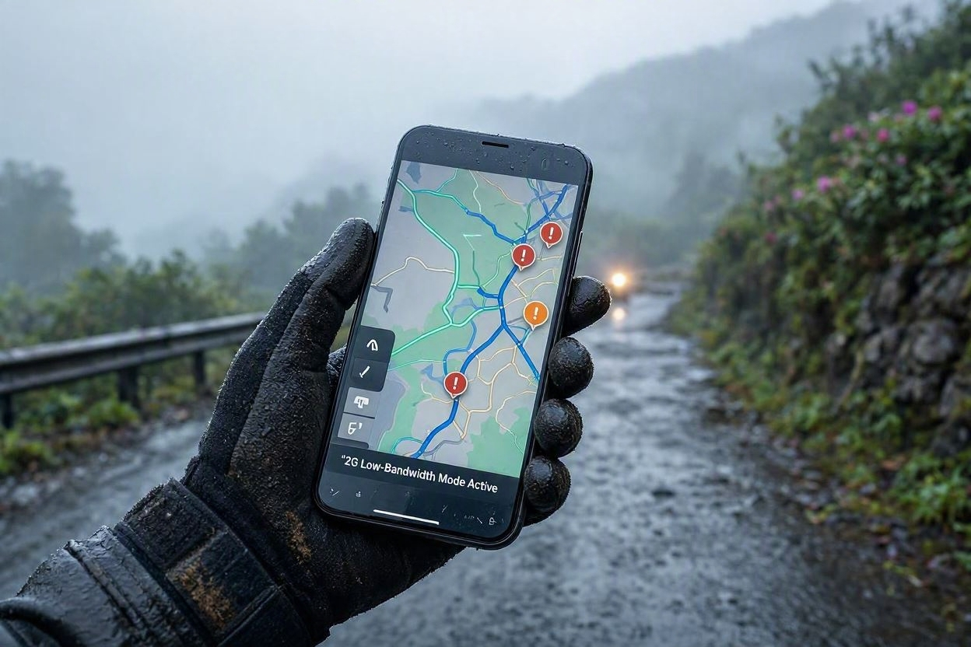
IMPACT AND BENEFITS
6g’s
1. Direct Human & Operational Impact
Reduced Emergency Response Latency
Proactive Evacuation Window
Elimination of Field Verification Bottlenecks
2. Socio-Economic Value
Protection of Strategic Lifelines
Casualty Rate Reduction
Zero Software Licensing Overhead
3. Technical Performance Impact
Bandwidth-Resilient Field Delivery
Unified Emergency Ecosystem

Slide 6
RESEARCH AND REFERENCES
6g’s
References & Research Framework
GSI NLSM Guidelines: Defined geological parameters (slope, elevation, lithology) used to weight our ML risk model.
NDMA Guidelines: Guided our automated priority queueing, warning thresholds, and emergency evacuation protocols.
IMD Rainfall Datasets: Provided the baseline precipitation framework for dynamic 24h rainfall heatmaps in NER.
OpenStreetMap & Leaflet.js: Enabled lightweight, interactive GIS map rendering on our React frontend (hosted on Vercel: https://sih-landslide-system-rho.vercel.app/).
Ultralytics YOLOv8: Used to construct our vision AI pipeline for real-time blockage detection and severity scoring.
FastAPI & OpenAPI 3.1: Provided high-concurrency microservices and live interactive documentation (hosted on Render: https://sih-landslide-system.onrender.com/docs).

Slide 7
IMPORTANT INSTRUCTIONS
Please ensure below pointers are met while submitting the Idea PPT:
Kindly keep the maximum slides limit up to six (6). ( Including the title slide)
Try to avoid paragraphs and post your idea in points /diagrams / Infographics /pictures
Keep your explanation precise and easy to understand
Idea should be unique and novel.
You can only use provided template for making the PPT without changing the idea details pointers (mentioned in previous slides).
You need to save the file in PDF and upload the same on portal. No PPT, Word Doc or any other format will be supported.
Note - You can delete this slide (Important Pointers) when you upload the details of your idea on SIH portal.

