Slide 1
Deep Learning-Based Skin Cancer Detection
Authors:
Yellu Siri
syellu@students.kennesaw.edu
001165833
Akshay Krishna Varma Buddharaju
abuddhar@students.kennesaw.edu
001172165
Andrew Bala Abhilash Polisetty apoliset@students.kennesaw.edu
001138913
Notes:
Hello everyone, we are Yellu Siri, Akshay Krishna Varma Buddharaju, and Andrew Bala Abhilash Polisetty. Today we’re excited to present our project titled "Deep Learning-Based Skin Cancer Detection."

Slide 2
Abstract
Skin cancer is an increasingly critical global health concern, where early detection significantly improves survival rates. However, conventional diagnostic methods primarily depend on visual assessments by dermatologists, which can be subjective and time-consuming. This project aims to automate skin cancer detection through deep learning models trained on the HAM10000 dermoscopic image dataset.
To achieve this, five convolutional neural network architectures—ResNet150, DenseNet, Inception V3, MobileNet V2, and EfficientNet B0—were trained and evaluated. Data augmentation techniques were employed to mitigate class imbalance and enhance model generalization. Among these, MobileNet V2, EfficientNet B0, and DenseNet were further combined using a weighted majority voting ensemble with weights of 0.3, 0.5, and 0.2, respectively, to improve overall classification performance.
The study demonstrates the potential of deep learning in enhancing diagnostic accuracy and efficiency. Future directions include further refinement of ensemble strategies and the integration of attention U-Net architectures for improved lesion segmentation and model interpretability.
Notes:
Skin cancer is a major global health issue where early detection can save lives. Traditional diagnosis relies on dermatologists' visual inspections, which can be subjective. We address this using deep learning, training CNN models on the HAM10000 dermoscopic image dataset to automatically classify skin lesions.

Slide 3
Dataset and Features
The HAM10000 dataset was selected for this study due to its diversity and size, consisting of 10,015 dermoscopic images across seven distinct skin cancer classes: Actinic Keratoses (AKIEC), Basal Cell Carcinoma (BCC), Dermatofibroma (DF), Melanoma (MEL), Melanocytic Nevi (NV), Vascular Lesions (VASC), and Benign Keratosis-like Lesions (BKL).
This dataset serves as a robust benchmark for training deep learning models due to its high variability in lesion appearance and clinical relevance.
To enhance model performance and address class imbalance, data preprocessing was performed using image resizing (224×224) and augmentation techniques such as flipping, rotation, and cropping. These methods increased dataset diversity, ensured balanced training, and helped improve generalization on unseen data. Each image was standardized for optimal input into CNN architectures, ensuring better training efficiency and feature extraction.
Notes:
We used the HAM10000 dataset with over 10,000 images across 7 skin lesion classes. Preprocessing included resizing images to 224x224 and applying augmentation techniques like flipping and rotation to tackle class imbalance and improve generalization.

Slide 4
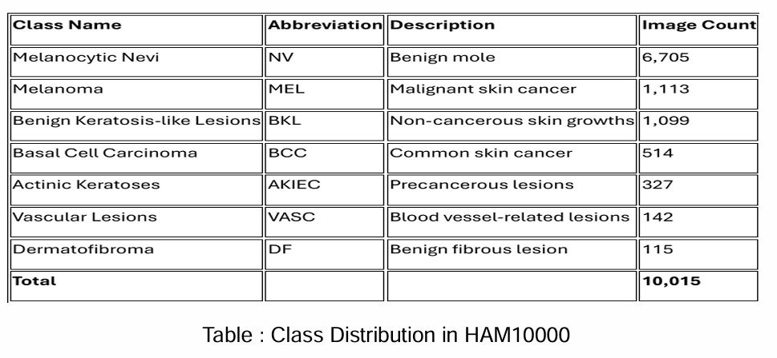

Slide 5
Methodology
1. Dataset Preparation
Dataset Used: HAM10000 (10,015 dermoscopic images, 7 skin lesion classes)
CSV Metadata: Labels and image names stored in GroundTruth.csv
Preprocessing: • Resized all images to 224×224 pixels. • Normalized pixel values using ImageNet mean and std. • Converted segmentation masks to binary for lesion detection.
2. Data Augmentation
Applied to classification dataset to reduce class imbalance: • Rotation, flipping, zooming, shifting, color jitter.
3. Model Architectures
Multiclass Classification Models (7-class):
Efficient Net B0
DenseNet121
MobileNet V2
4. Ensemble Learning
Combined predictions from MobileNetV2, EfficientNet B0, and DenseNet121 using majority voting.
Ensemble achieved improved accuracy and F1-score over individual models.
Notes:
We trained three CNN models: EfficientNetB0, MobileNetV2, and DenseNet121. Data augmentation and normalization were used to enhance performance. We also built an ensemble using weighted majority voting for better prediction accuracy.

Slide 6
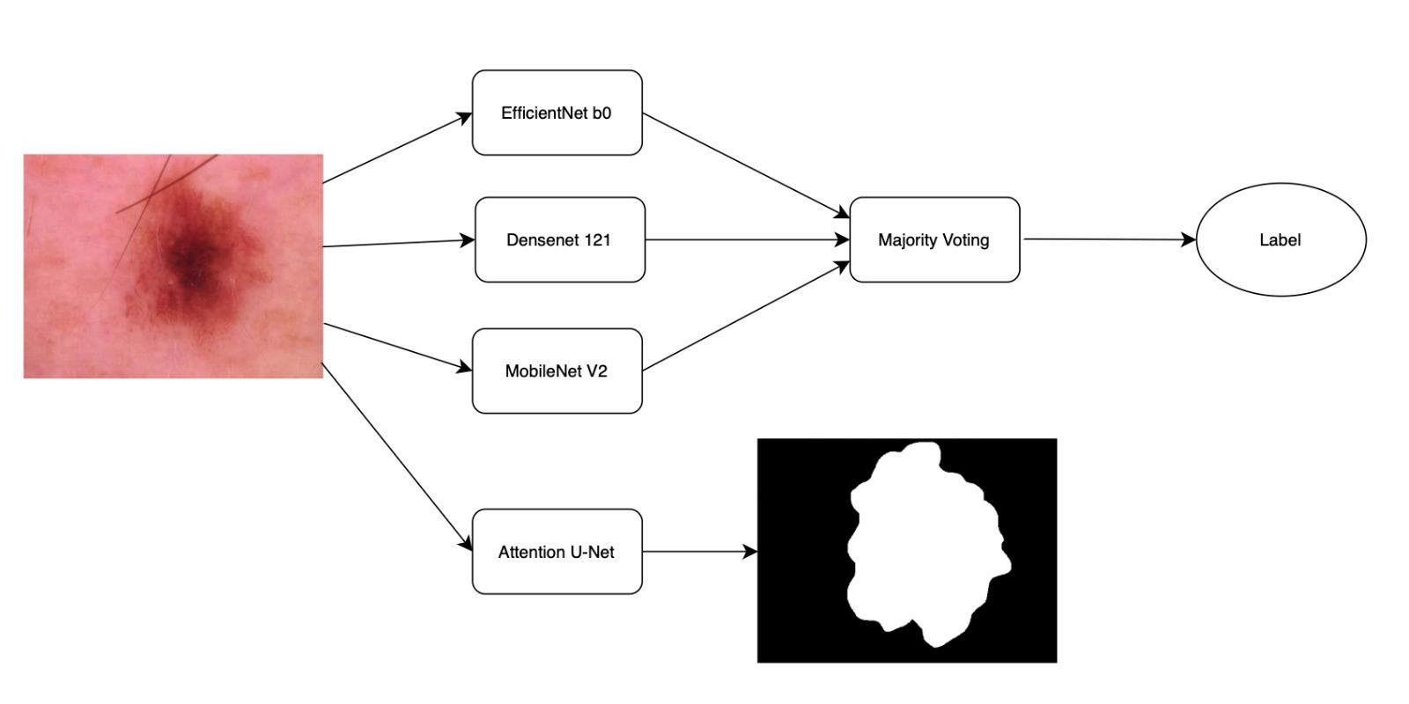
Fig 1: Model architecture combining classification (ensemble of ResNet152, DenseNet121, and VGG19) and segmentation (Attention U-Net) for skin cancer detection.

Slide 7
Mobile Net V2
Inverted Residuals and Linear Bottlenecks: MobileNet V2 introduces inverted residual blocks where the input and output are thin bottleneck layers, and the intermediate expansion layer uses depthwise separable convolutions, reducing computation while preserving accuracy.
Lightweight and Efficient: Designed for mobile and embedded vision applications, MobileNet V2 offers a good trade-off between latency and accuracy, making it ideal for real-time tasks with limited computational resources.
Improved Performance Over MobileNet V1: Compared to its predecessor, MobileNet V2 provides better accuracy and speed by optimizing layer connections and reducing information loss during dimensionality reduction.
Notes:
MobileNetV2 is lightweight and fast, ideal for real-time mobile deployment.

Slide 8
EfficientNet B0
Compound Scaling Method: EfficientNet B0 introduces a compound scaling technique that uniformly scales depth, width, and resolution using a fixed set of scaling coefficients, optimizing both model performance and efficiency.
Baseline Model of the EfficientNet Family: It serves as the foundational architecture in the EfficientNet family, built on a mobile inverted bottleneck convolution (MBConv) with squeeze-and-excitation optimization, balancing accuracy and speed.
State-of-the-Art Accuracy with Fewer Parameters: Despite being lightweight, EfficientNet B0 achieves high accuracy on image classification tasks while using significantly fewer parameters and FLOPs compared to traditional CNNs like ResNet or Inception.
Notes:
EfficientNetB0 scales model size efficiently with excellent accuracy.

Slide 9
DenseNet121
Dense Connectivity: DenseNet121 connects each layer to every other layer in a feed-forward manner—i.e., each layer receives the feature maps of all preceding layers as input, promoting feature reuse and efficient gradient flow.
Parameter Efficiency: Despite its deep architecture, DenseNet121 uses fewer parameters than traditional CNNs by avoiding redundant feature learning and using narrow layers, making it both accurate and computationally efficient.
Improved Feature Propagation: The dense connections help alleviate the vanishing gradient problem, strengthen feature propagation, and encourage the network to learn compact and highly discriminative features, which enhances performance in classification tasks.
Notes:
DenseNet121 uses dense connections for efficient feature reuse and strong performance.

Slide 10
Attention U-Net
Integration of Attention Gates: Attention U-Net enhances the traditional U-Net architecture by incorporating attention gates in the skip connections, allowing the model to focus on relevant regions of the input image while suppressing irrelevant background noise.
Improved Segmentation Accuracy: By selectively emphasizing important spatial features, Attention U-Net improves performance in medical image segmentation tasks—especially when lesions or structures are small or vary in shape.
No Additional Computational Overhead at Inference: Attention mechanisms are lightweight and only active during training, so the model retains the inference efficiency of standard U-Net while achieving better interpretability and precision.
Notes:
For lesion segmentation, we used Attention U-Net, which enhances traditional U-Net by focusing on relevant regions. It improves segmentation accuracy without increasing inference time.

Slide 11
Weighted Ensemble Learning Approach
Concept: Majority voting is an ensemble technique where multiple models make predictions, and the final output is determined by the majority class selected across the models. It helps reduce variance and improve generalization.
Weighted Majority Voting: Unlike simple majority voting where each model has equal influence, weighted majority voting assigns different importance (weights) to each model based on their performance, reliability, or confidence. The final prediction is the class with the highest weighted vote.
Application in Our Project: In our skin cancer classification task, we ensembled MobileNet V2, EfficientNet B0, and DenseNet121 using weighted majority voting. The weights were assigned based on individual model performance:
EfficientNet B0: 0.5 (highest accuracy, strongest performer)
MobileNet V2: 0.3 (lightweight and consistent)
DenseNet121: 0.2 (diverse feature representation)
Notes:
We ensembled the three classifiers using weighted majority voting—EfficientNet had the highest weight due to best performance. This approach improved overall classification metrics by leveraging each model's strengths.

Slide 12
Evaluation Metrics
Evaluation Metrics For Classification Models
Precision
Definition: Measures the proportion of correctly predicted positive instances out of all predicted positives.
Formula: Precision = TP / (TP + FP)
Interpretation: High precision indicates a low rate of false positives.
Recall (Sensitivity)
Definition: Measures the proportion of correctly predicted positive instances out of all actual positives.
Formula: Recall = TP / (TP + FN)
Interpretation: High recall indicates a low rate of false negatives.
F1-Score
Definition: Harmonic mean of Precision and Recall.
Formula: F1-Score = 2 × (Precision × Recall) / (Precision + Recall)
Interpretation: Balances precision and recall; useful when classes are imbalanced.
Accuracy
Definition: Measures the proportion of correctly predicted instances out of all instances.
Formula: Accuracy = (TP + TN) / (TP + TN + FP + FN)
Interpretation: Overall effectiveness of the model.
Notes:
We used precision, recall, F1-score, and accuracy for classification. For segmentation, Dice Coefficient and IoU were used.

Slide 13
Evaluation Metrics
Evaluation Metrics For SegmentationModels
Dice Coefficient:
Definition: Measures the overlap between predicted and ground truth lesion masks.
Formula:
Dice=2×∣A∩B∣∣A∣+∣B∣\text{Dice} = \frac{2 \times |A \cap B|}{|A| + |B|}Dice=∣A∣+∣B∣2×∣A∩B∣​
Interpretation: Higher Dice score means better lesion overlap prediction.
2. IoU – Intersection over Union (Jaccard Index)
Definition: Measures the ratio of intersection to the union of predicted and ground truth areas.
Formula:
IoU=∣A∩B∣∣A∪B∣\text{IoU} = \frac{|A \cap B|}{|A \cup B|}IoU=∣A∪B∣∣A∩B∣​
Interpretation: High IoU reflects precise segmentation, with minimal over-segmentation or under-segmentation.
Notes:
These helped us comprehensively measure the model’s performance across both tasks.

Slide 14
Results Summary
1. Segmentation Results
The segmentation performance was evaluated using Dice Coefficient and Intersection over Union (IoU):
Attention U-Net:
Loss: 0.0699
Dice: 0.9462
IoU: 0.8982
Model saved as attention_unet_final.pth
U-Net:
Loss: 0.0997
Dice: 0.9252
IoU: 0.8619
Model saved as unet_final.pth
Conclusion: Attention U-Net outperformed standard U-Net in both Dice and IoU scores, demonstrating better lesion segmentation accuracy.

Slide 15
2. Classification Results (Accuracy)
Model | Accuracy | F1 score | Precision | Recall
EfficientNet b0 | 0.9767 | 0.9759 | 0.9773 | 0.9767
MobileNet V2 | 0.9479 | 0.9466 | 0.9486 | 0.9479
DenseNet121 | 0.8750 | 0.8840 | 0.9177 | 0.8750
ResNet 150 | 0.8301 | 0.8174 | 0.8217 | 0.8301
InceptionV3 | 0.8088 | 0.8029 | 0.8444 | 0.8088
Ensemble model | 0.9887 | 0.9885 | 0.9889 | 0.9887

Slide 16
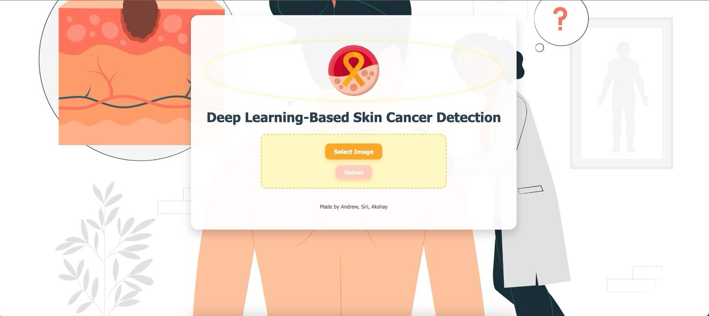
Website :
Notes:
We also developed a responsive website where users can upload lesion images and get predictions with confidence scores and segmentation masks.

Slide 17
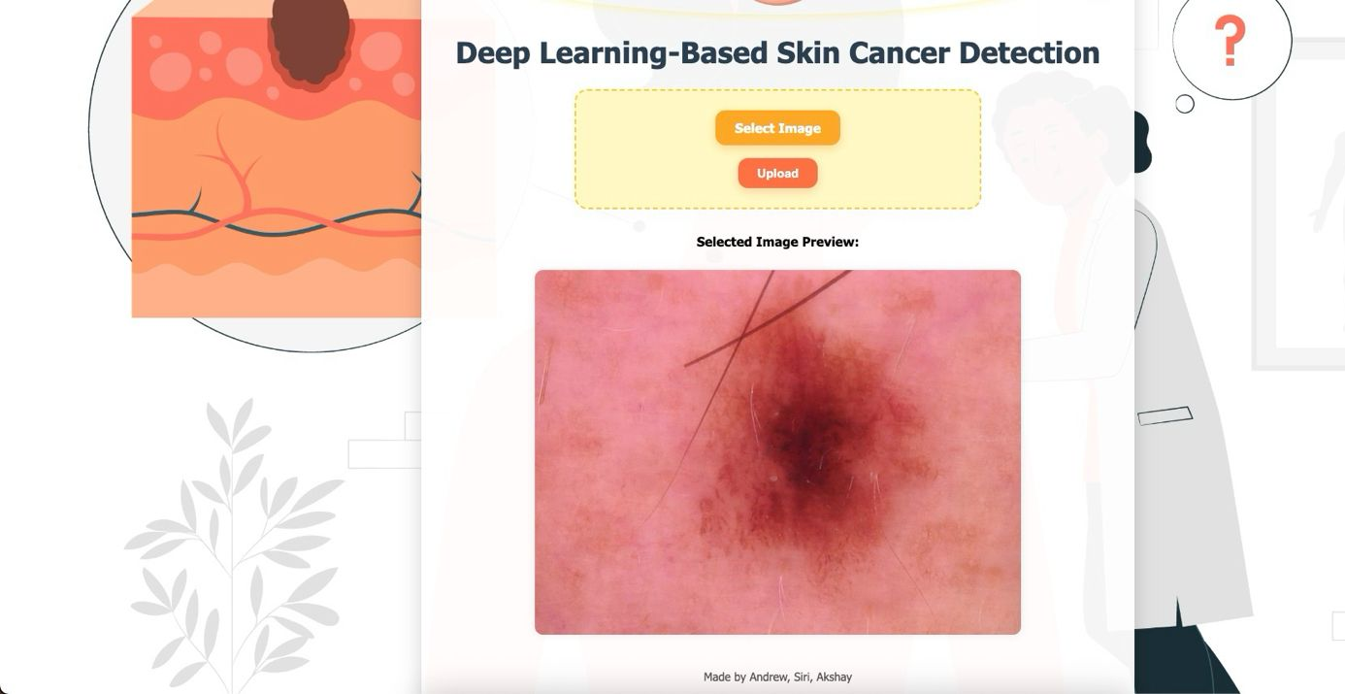

Slide 18
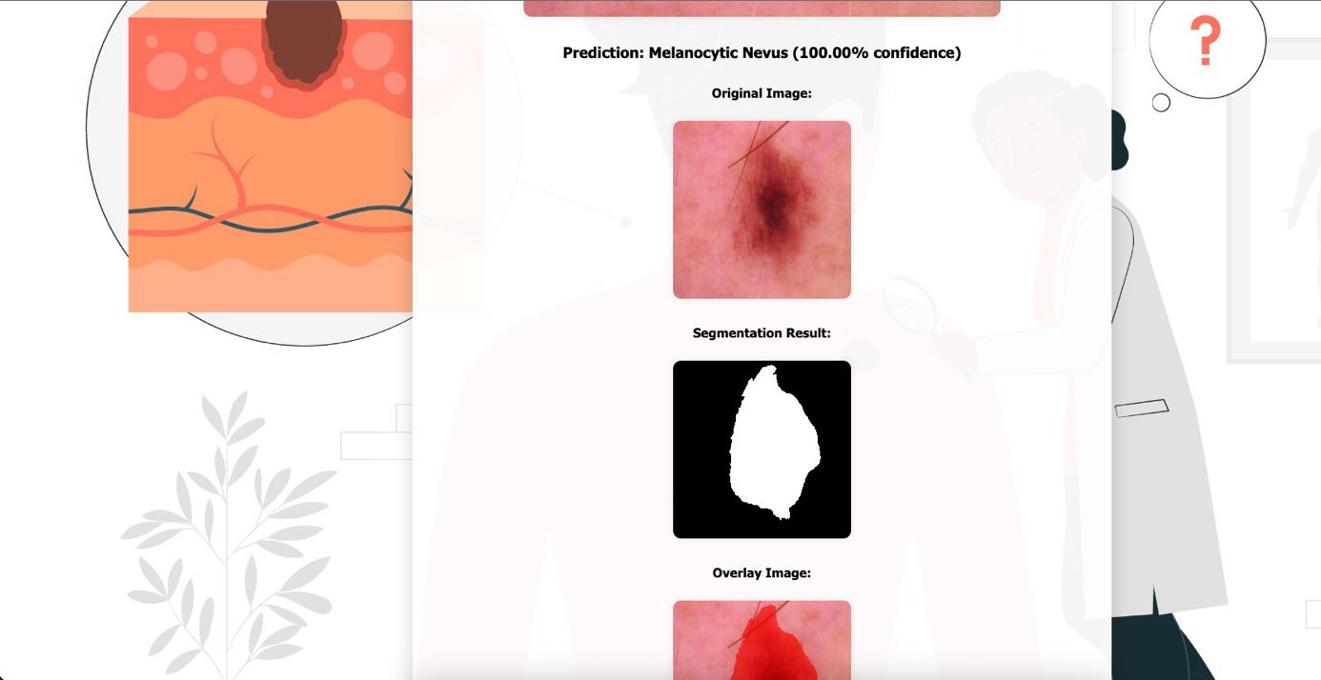

Slide 19
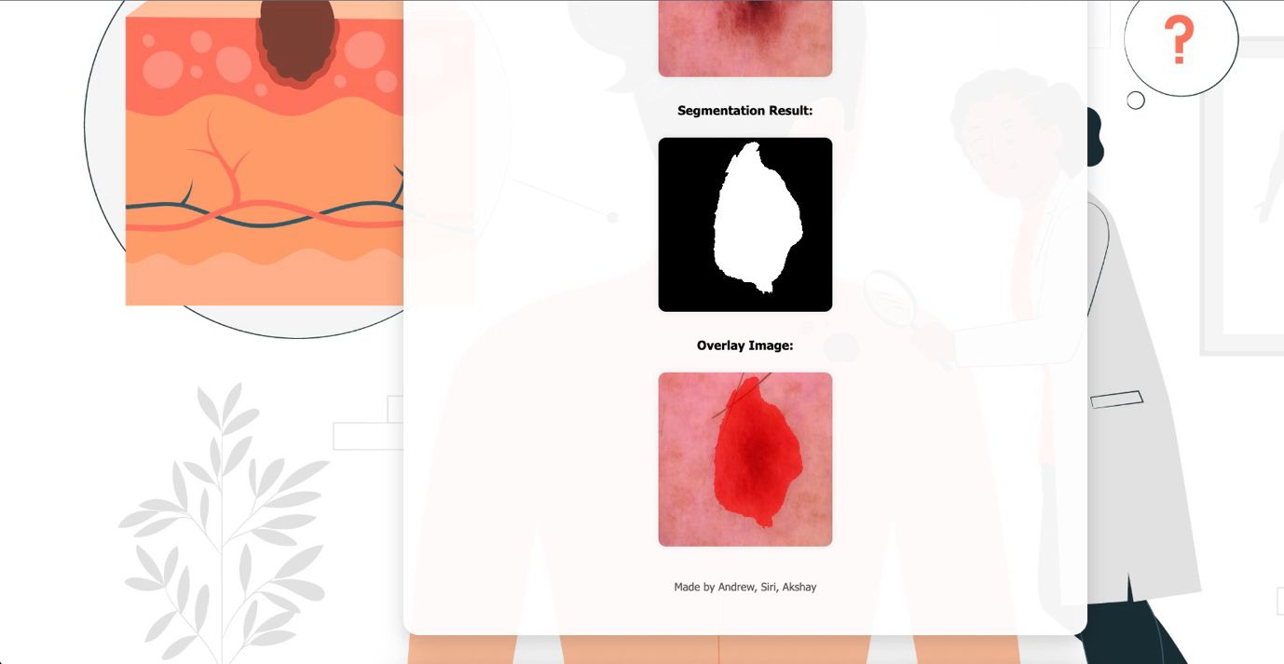

Slide 20
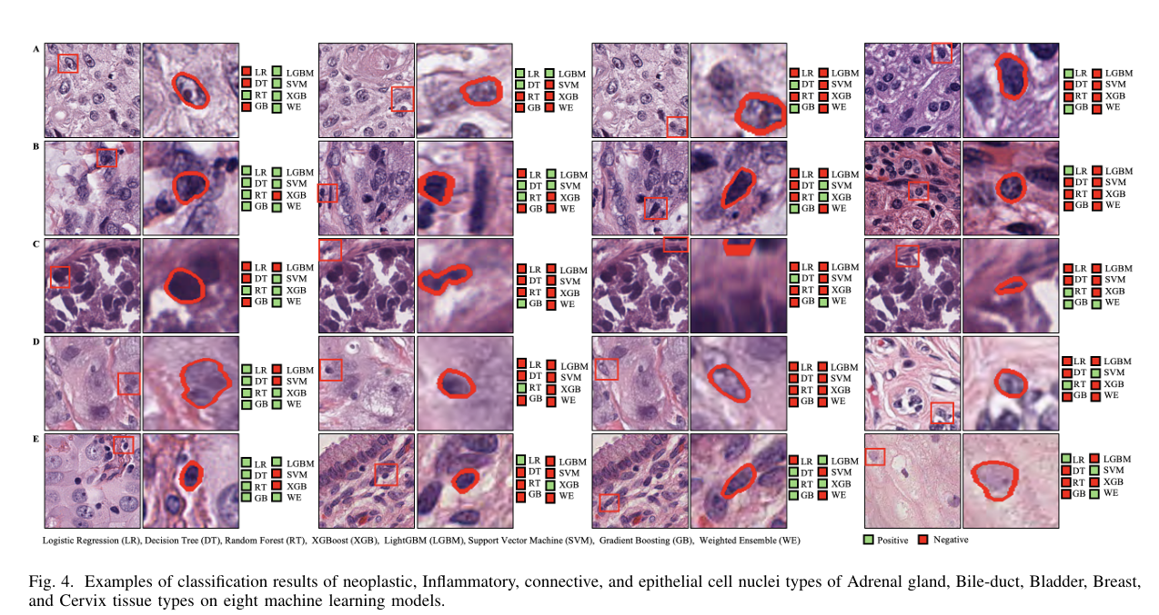
Conclusions
The proposed system demonstrated excellent performance in both classification and segmentation of skin lesions. The weighted ensemble of EfficientNet B0, MobileNet V2, and DenseNet121 achieved the highest classification metrics, with an accuracy of 98.87% and an F1 score of 98.85%, significantly outperforming all individual models. For segmentation, the Attention U-Net model surpassed the standard U-Net by achieving a Dice Coefficient of 0.9462 and an IoU of 0.8982, indicating more precise lesion boundary detection. These results highlight the effectiveness of ensemble learning and attention mechanisms in enhancing diagnostic accuracy and lesion interpretability.
Notes:
Our system showed strong performance in classifying and segmenting skin lesions. Ensemble learning and attention mechanisms significantly improved model accuracy and interpretability.

Slide 21
Future Work
Multi-modal Learning: Combine clinical metadata (e.g., patient history, lesion location) with image data for more robust predictions.
Mobile Deployment: Optimize trained models for real-time mobile or edge device deployment to support early diagnosis in remote or underserved areas.
Data Expansion: Extend the dataset by integrating other public repositories (e.g., ISIC) and using synthetic data generation (GANs) to enhance minority class representation.
Notes:
Moving forward, we plan to:
Integrate clinical metadata for more robust predictions,
Optimize models for mobile deployment,
Expand the dataset using synthetic data generation.

Slide 22
References
[1] J. Ferlay, M. Ervik, F. Lam, et al., “Cancer statistics for the year 2020: An overview,” International Journal of Cancer, vol. 149, no. 4, pp. 778–789, 2021.
[2] G. Argenziano and H. P. Soyer, “Dermoscopy of pigmented skin lesions—a valuable tool for early diagnosis,” The Lancet Oncology, vol.
2, no. 7, pp. 443 449, 2001.
[3] Y. LeCun, Y. Bengio, and G. Hinton, “Deep learning,” Nature, vol. 521, no. 7553, pp. 436–444, 2015.
[4] G. Litjens, T. Kooi, B. E. Bejnordi, et al., “A survey on deep learning in medical image analysis,” Medical Image Analysis, vol. 42, pp. 60–88, 2017.
[5] A. Esteva, B. Kuprel, R. A. Novoa, et al., “Dermatologist-level classifi cation of skin cancer with deep neural networks,” Nature, vol. 542, no. 7639, pp. 115 118, 2017.
[6] T. J. Brinker, et al., “Skin cancer classification using convolutional neural networks: systematic review,” Journal of Medical Internet Research, vol. 20, no. 10, p. e11936, 2018
Notes:
These some of the referneces

Slide 23
THANK YOU!!
Notes:
hank you for listening! We happy to take any questions.

