Slide 1
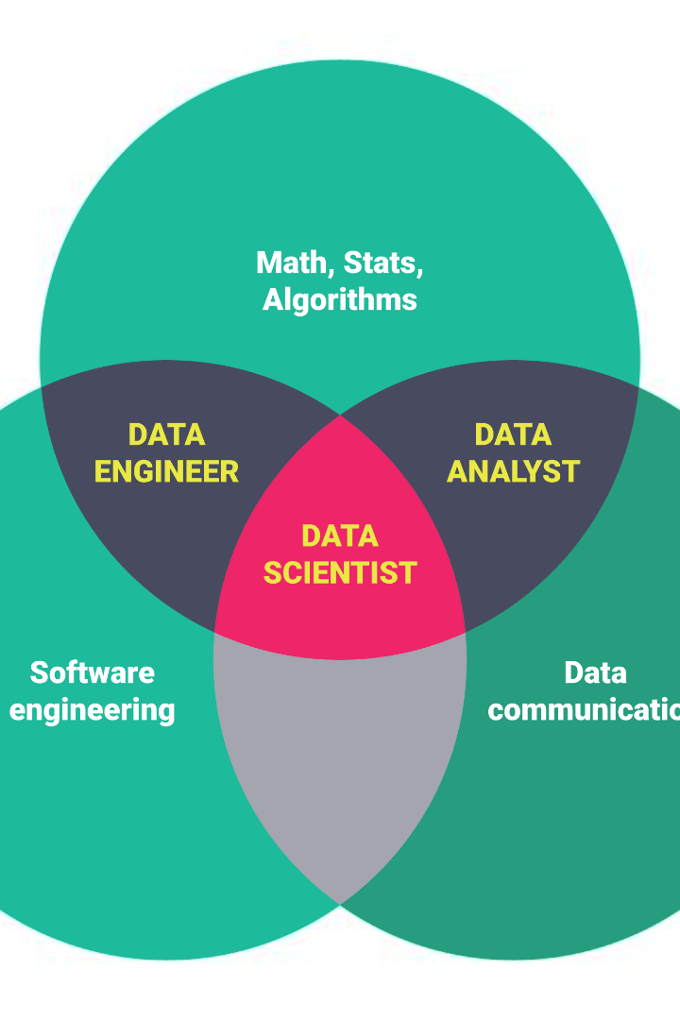


The Three Pillars of Data Science
Data science is built upon three fundamental pillars: linear algebra, statistics, and optimization. These pillars form the foundation for understanding and solving complex problems in the field.
by Siri Chandana

Slide 2

Linear Algebra: Unlocking the Power of Matrices
Definition and Principles
Applications in Data Science
Visualizing Complex Relationships
Learn how linear algebra provides the tools to analyze and manipulate vectors and matrices, enabling efficient computations and transformations.
Explore real-world applications of linear algebra in data science, including dimensionality reduction, regression, and machine learning algorithms.
See how visualizing data using linear algebra concepts such as eigenvectors and eigenvalues can uncover hidden patterns and relationships.

Slide 3

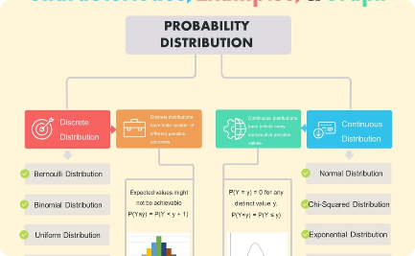

Statistics: Unleashing the Power of Data
Importance of Statistics
Key Concepts and Techniques
Visualizing and Exploring Data
Discover why statistics is crucial in data science for making informed decisions, drawing meaningful insights, and addressing uncertainty.
Delve into essential statistical concepts and techniques such as probability distributions, hypothesis testing, and statistical modeling.
Learn how to effectively visualize and explore data using statistical methods like histograms, scatter plots, and correlation analysis.

Slide 4
Optimization: Maximizing Performance and Efficiency
1
Introduction to Optimization
Get an introduction to optimization in data science, understanding how it maximizes performance and efficiency in various algorithms and models.
2
Different Types of Optimization Methods
Explore different optimization methods, including gradient descent, evolutionary algorithms, and mathematical programming techniques.
3
Optimizing Machine Learning Models
Discover how optimization plays a critical role in training and fine-tuning machine learning models for optimal predictive performance.

Slide 5
Conclusion: Mastering the Three Pillars
1
Recap of the Three Pillars
2
Empowering Data Scientists
3
Continued Learning and Growth
Summarize the key concepts of linear algebra, statistics, and optimization, highlighting their importance in data science.
Emphasize the significance and value of mastering these three pillars for data scientists in tackling complex problems and driving innovation.
Encourage continuous learning and further exploration of each pillar to unlock greater possibilities and become a well-rounded data scientist.

