Slide 1
Computational Analysis of Developmental Disorders in Children
By
Siri Chandana S, MS Computer Science
SUID- 829955672
Notes:
Good morning! My name is Siri Chandana. My thesis topic is Computational Analysis of Developmental Disorders in Children

Slide 2
Contents
Problem Statement
Background
Implementation
Results
Conclusion & Future Work
Notes:
In this presentation, I will be covering the following topics

Slide 3
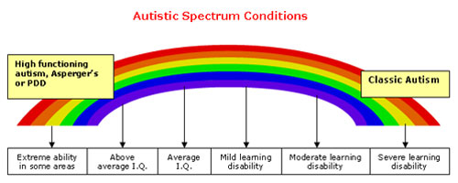
Problem Statement
The objective of our research is to assist in early intervention of developmental disorders using feature selection and supervised learning techniques.
The main focus of our research lies in the disorders:
Autism Spectrum Disorder (ASD
Attention-Deficit/Hyperactivity Disorder (ADHD
Deletion syndrome (VCFS)
Our research uses three different parent-oriented reviews:
Autism Diagnostic Interview-Revised
Behavioral Assessment Schedule for Children
Vineland Adaptive Behavior Scales
Notes:
Developmental disorders effect the growth of child and medications or treatments can be used to aid the child and family during the developmental phrase.
The main objective of this research is to assist in early diagnosis of developmental disorders. The average wait to diagnose a child with developmental disorder is 13 months and double this time if a child were to suffer with more then one disorder. The disorders focused on in our research are ….. And their comorbidity…
Our feature set consists of responses by parents for the three parent oriented reviews. For the purpose of analysis different feature selection and supervised learning techniques are explored.
This image shows the six different Autism conditions. When there is difference in the IQ and learning abilities
Second point make bulltets and acroymns for reviews

Slide 4
Key Contributions
Identifying important features for developmental disorders ASD, VCFS and ADHD, along with the comorbid disorders.
Assessing the impact of the three different parent-oriented reviews on these developmental disorders and their comorbidity.
Designing models to distinguish these different developmental disorders present in the data
Formulating hypothesis using the relationships between features found in our models to predict the developmental disorders
Notes:
These are the key contributors of our research.

Slide 5
Background
Notes:
Before talking about the implementation, we discuss more details of our disorders and feature set to understand it in better details.

Slide 6
Definitions
Autism
Spectrum Disorder
Characterized by social interaction difficulties and communication challenges
1 out of 68 in US
Attention Deficit/ Hyperactivity Disorder
(ADHD)
Difficulty in staying focused and paying attention, and difficulties with controlling behavior
One-third children carry it into adulthood
Deletion Syndrome
(VCFS)
Delays growth and speech development, while effecting learning abilities
2,000 to 5,000 born each year
Notes:
Both ASD and ADHD are more common in males than females 4.5 times more
The genetic causes for ASD and ADHD are not known, it could be due to various environmental factors
VCFS is a genetic syndrome, due to deletion of 30 to 40 genes in the middle of chromosome 22

Slide 7
Comorbid Disorders
Comorbid disorders are when two or more developmental disorders exist in an individual
In 2013, American Psychiatric Association stated ASD and ADHD could co-occur
VCFS
ADHD
15-20%
20-50%
30-80%
ASD
ASD
Notes:
figures for percentages
VCFS co-occurs with disorders like Schizophrenia, ASD. VCFS leads to Schizophrenia research shows that 15-20% VCFS meets criteria for ASD
In 2013, the APA declared that these two disorders can co-occur. ASD and ADHD are also comorbid disorders whose relations are not known.

Slide 8
Parent-oriented Reviews
Autism Diagnostic Interview-Revised
(ADI-R)
Scores range from 0 to 2
Behavioral Assessment Schedule for Children
(BASC)
T- scores with a mean of 50
Assess Hyperactivity, Aggression, Atypicality, Withdrawal, and Attention problems
Vineland Adaptive Behavior Scales
(VINE)
Standard scores with a mean of 100
Measures adaptive behaviors, daily living and communication
Assess Social Interactions, Language, Behaviors and Early Development
Notes:
The mean value is 100 for IQ measures
2 indicates high severity. It meets the DSM-IV criteria.
. BASC has also shown that children diagnosed with ADHD are rated lower on adaptive skills when compared to children with no diagnosis[38]. However, when trying to diagnose children with ASD, atypical behavior, attention and adaptive functions were complicated. It was also observed that the parent-rated social withdrawal was higher for children with ASD[39].
BASC mean is 50 and 70 and above is considered critical
Vine mean is 100

Slide 9
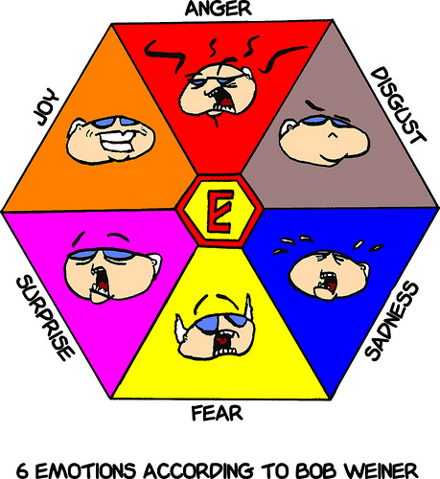
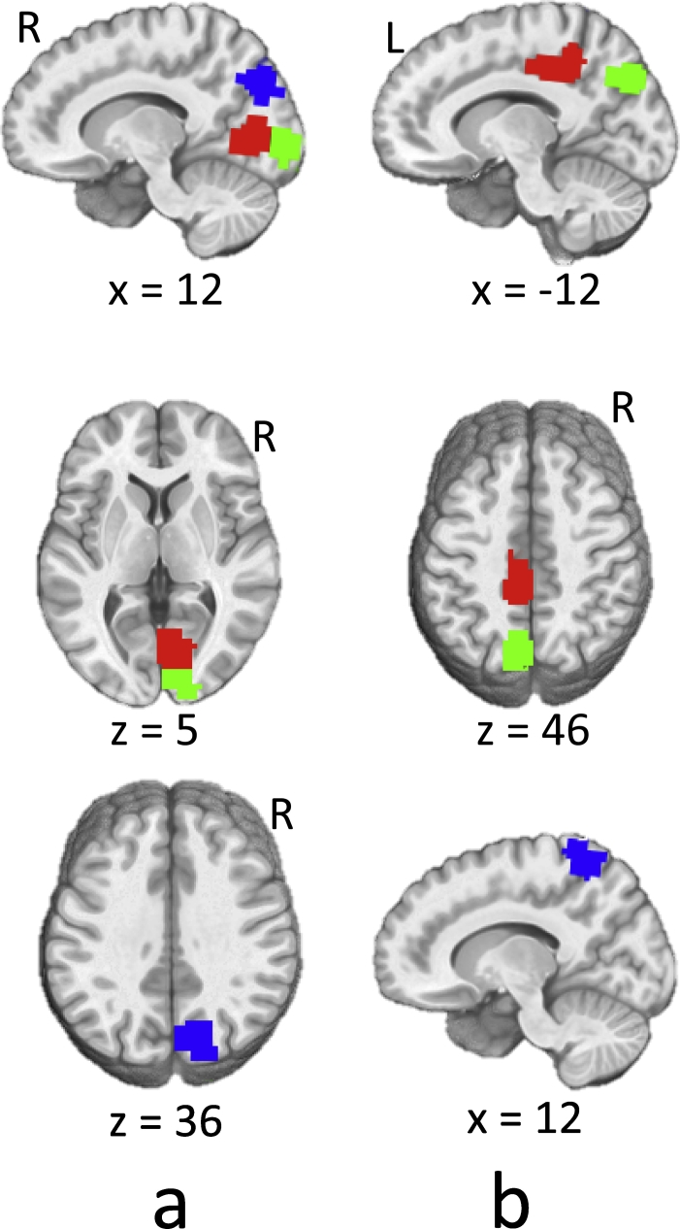
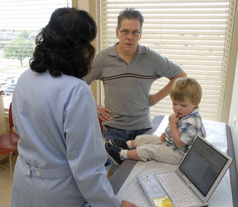
Existing Models
1. Emotion-based
2. fMRI-based
3. Review-based
Emotion-based

Slide 10
1. Emotions-based Model
Differentiate ASD from ADHD using reaction times of individuals to assess emotions
Data consists of children understanding and responding to various emotions
Applied ReliefF feature selection algorithm and the machine learning algorithms applied are Decision Tree, Random Forest, Support Vector Machine, K-Nearest Neighbors and AdaBoost.
Results show that ASD children could be differentiated from ADHD and control group with 80% accuracy
Reference- Uluyagmur-Ozturk, M., Arman, A. R., Yilmaz, S. S., Findik, O. T. P., Genc, H. A., Carkaxhiu-Bulut, G., ... & Cataltepe, Z. (2016, December). ADHD and ASD Classification Based on Emotion Recognition Data. In Machine Learning and Applications (ICMLA), 2016 15th IEEE International Conference on (pp. 810-813). IEEE.
Notes:
slide before with all three models
The application of machine learning to this field of clinical psychology has been done in the past 5 years. Researcher trained models based on the emotional status of autistic children. Children were shown pictures of various emotions and the reaction time of each child was noted. These reactions of the children were analyzed. For this they used these machine learning techniques.
Our research delays with more features, the underlying features examined here are communication, attention and eye contact

Slide 11
2. fMRI-based models
The functional magnetic resonance imaging (fMRI) of two datasets available online ABIDE and ADHD-200
In 2016 [Ghiassian, S.], (f)MRI HOG-feature-based patient classification (MHPC) technique was developed using the Histogram of oriented gradients (HOG)
Model had an accuracy of 69.6% for distinguishing ADHD and accuracy of 65% for distinguishing ASD from the control groups
In 2017 [Heinsfeld, A. S], deep learning techniques increased the accuracy for ASD to 70%.
Reference- Ghiassian, S., Greiner, R., Jin, P., & Brown, M. R. (2016). Using functional or structural magnetic resonance images and personal characteristic data to identify ADHD and autism. PloS one, 11(12), e0166934.
Heinsfeld, A. S., Franco, A. R., Craddock, R. C., Buchweitz, A., & Meneguzzi, F. (2018). Identification of autism spectrum disorder using deep learning and the ABIDE dataset. NeuroImage: Clinical, 17, 16-23.
Notes:
These are the state of the art models and along with this researcher found that there is a pattern in brain that identifies these disorders
fMRI’s are not always available

Slide 12
3. Reviews-based models
[Duda, M.] Social Responsiveness Scale (SRS) score sheets of individuals who either had ASD or ADHD
Using minimal-redundancy-maximal-relevance (mRMR) criterion, they selected top 6 features
Machine Learning techniques- Support Vector Machine, Linear Discriminant Analysis, Categorical Lasso and Logistic Regression
Models had average accuracies of comparable accuracy of 96%
[Bone, D., ] ADTree machine learning algorithm on the Autism Diagnostic Observation Schedule-Generic(ADOS)
8 of the 29 questions in module 1 are relevant, trained models achieved 99.7% sensitivity and 94% specificity
Reference- Duda, M., Ma, R., Haber, N., & Wall, D. P. (2017). Use of machine learning for behavioral distinction of autism and ADHD. Translational psychiatry, 6(2), e732.
Bone, D., Goodwin, M. S., Black, M. P., Lee, C. C., Audhkhasi, K., & Narayanan, S. (2015). Applying machine learning to facilitate autism diagnostics: pitfalls and promises. Journal of autism and developmental disorders, 45(5), 1121-1136.
Notes:
- based
65 questions in the SRS
ADOS has 4 modules and each module takes 30-60 mins
and also plotted the ROC for each models
Our research is similar to this. Except our data consists of more developmental disorders and a combination of reviews

Slide 13
Implementation

Slide 14
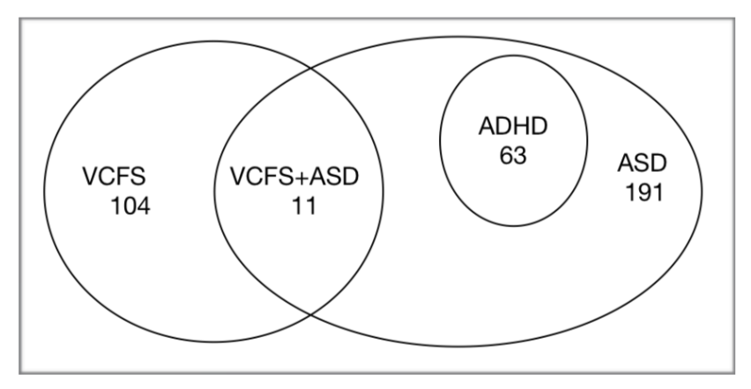
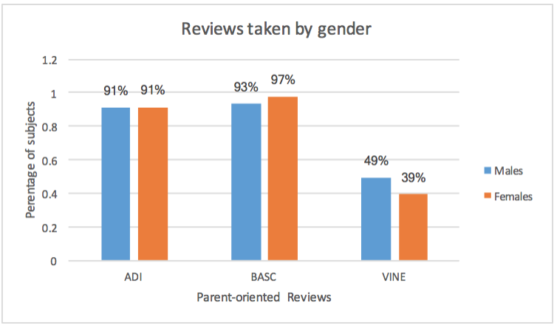
Data Exploration
369 children’s data collected by Dr. Russo, Dr. Antshel and Dr. Kates between the ages 3 to 18.
92% of subjects have taken ADI-R, 96% have taken BASC and only 48% have taken VINE
The average feature values missing are:
ADI-R- 10%, mostly the 3rd domain
BASC- Adaptability feature has 20%
VINE- no missing feature values
Notes:
almost terms of males and females balance dataset in
group missing features
This data took these professors around 10 years to collect.

Slide 15
Data Preprocessing
Data Transformation- conversion of categorical features, creation of target labels
Data Reduction- eliminating unique identifiers and redundant columns, reduced the feature set to 73 columns
Data Cleaning- handling the missing values
IQ feature set- mean 100
ADI-R feature set- 0 as that indicates less severity
BASC feature set- mean 50
VINE feature set- 0 indicating the absence of feature values
Notes:
unique identifiers and redundant features
Data transformation- setting the target labels depending on research needs
Data reduction- removing adiaustim column which is the key criteria , IDs and labs and other non essential columns like totals

Slide 16
Feature Selection
LASSO
selects subset of variables that are highly correlated predictors in the data
ReliefF
noise tolerant and robust algorithm which is independent of variable dependencies
RFE
elimination process to select a subset of features recursively from our data
Notes:
change the graphics
LASSO regression method selects subset of variables when there are highly correlated predictors in the data, as in our dataset
ReliefF is a noise tolerant and robust algorithm which is independent of variable dependencies
RFE uses an elimination process to select a subset of features recursively from our data
For the subgroup diagnosis, LASSO selected features from the BASC and VINE parent- oriented reviews
RFE selected features from the ADI-R parent-oriented reviews
The convergent features for ASD and ADHD comorbidity are ‘Vineland socialization’, ‘Quality of social overtures’, ‘Inappropriate questions or statements’ and ‘Attention problems’
Performance IQ is the only common feature in the case of ASD and VCFS comorbidity
No convergent features for individual diagnosis of disorders ASD, ADHD and VCFS

Slide 17
Approach used for Analysis
Horizontal partitioning- for analyzing comorbid disorders
306 children with ASD and VCFS
254 subjects with ASD and ADHD
Vertical partitioning- dividing the features to understand the effect of it on disorders
IQ feature set
ADI-R feature set
BASC feature set
VINE feature set
Naive Bayes, Logistic Regression, Random Forest, Support Vector Machines and K-Nearest Neighbors
Notes:
why?
machine learning are not sensitive models and to assess the learning bias

Slide 18
Distinguishing the different disorders that occur
Notes:
Among the different diagnosis conditions present in our data, we try to distinguish one diagnostic condition from the other and the results obtained are discussed in the next fes slides

Slide 19
Effect of Parent-oriented Reviews
LASSO models with BASC and VINE features has an accuracy of 73%
RFE models with ADI-R has an accuracy of 83%
The most important features are:
Criteria for Repetitive behaviors and stereotyped patterns (ADI-R)
Criteria for Qualitative impairments in reciprocal social interaction (ADI-R)
Inappropriate questions and statements (ADI-R)
Vineland Socialization (VINE)
Social Skills (BASC)

Slide 20
Predicting disorders
Random forest models performed the best for distinguishing disorders
ADI-R parent-oriented review is better than other reviews
IQ features are not sufficient enough for prediction
Feature Set | Accuracy | ROC Area | F-measure
All | 94.85% | 0.994 | 95.7%
IQ | 66.32% | 0.802 | 61.2%
ADI-R | 96.47% | 0.976 | 96.4%
BASC | 75.06% | 0.879 | 71.2%
VINE | 70% | 0.787 | 68%
Notes:
prediction performance
change subgroup diagnosis name
remove unsupervised learning

Slide 21
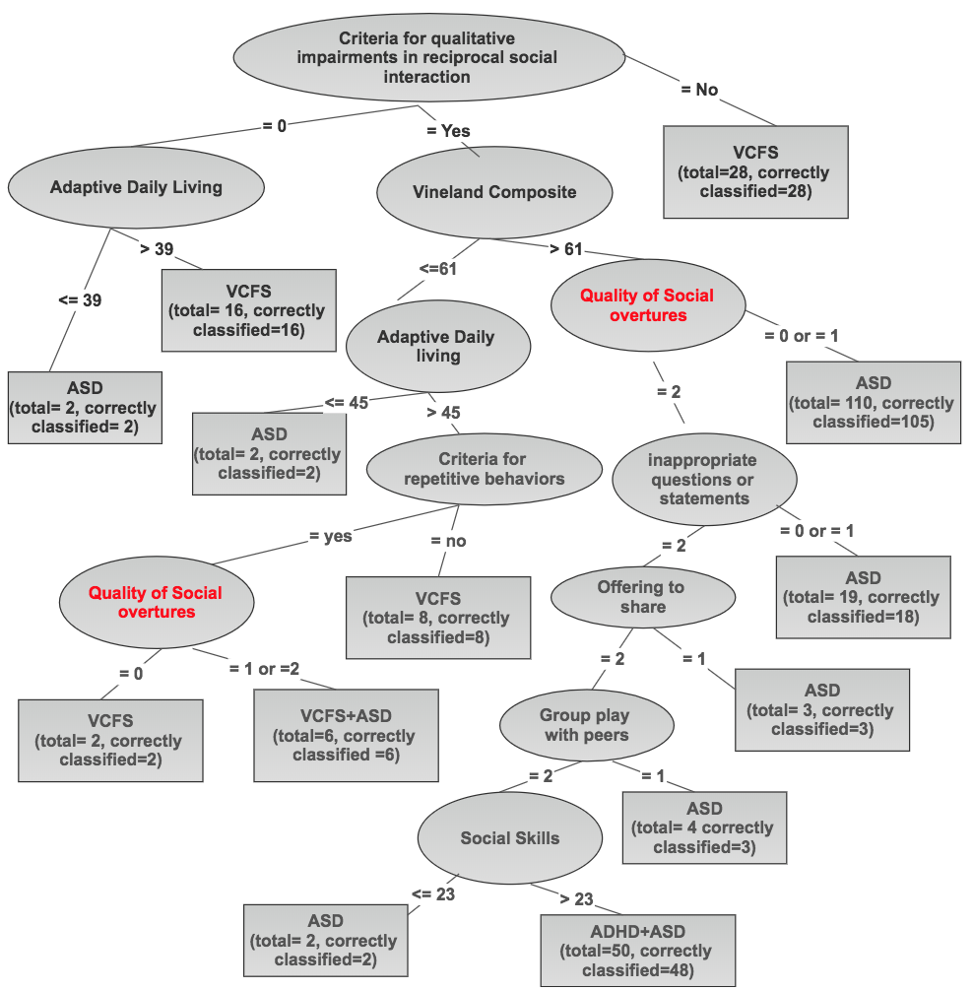
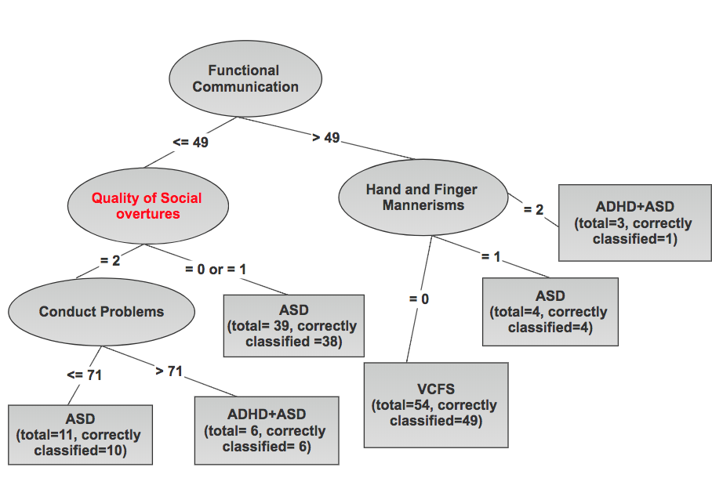
Impact of Gender
252 male children
Accuracy of J48 is 90%
Accuracy of Random Forest is 94%
117 female children
Accuracy of J48 is 78%
Accuracy of Random Forest is 87%
Notes:
is model biased based on gender
align the images

Slide 22
Analyzing Comorbid Disorders
Notes:
Analyzinf comorbid disorders

Slide 23
ASD + VCFS comorbidity
306 children are present, out of which 11 have both these disorders
When using features selected by feature selection algorithms, performance of these models was comparable
Most important features are:
Criteria for Repetitive behavior and stereotyped patterns (ADI-R)
Repetitive use of objects or interest in parts of objects (ADI-R)
Spontaneous imitation of actions (ADI-R)
Functional Communication (BASC)
Criteria for Communication (ADI-R)
Adaptive Daily Living (BASC)
Feature Set | Accuracy | ROC Area | F-measure
All | 97% | 0.976 | 97%
IQ | 63% | 0.518 | 60%
ADI-R | 93% | 0.936 | 92%
BASC | 84% | 0.874 | 84%
VINE | 80% | 0.825 | 79%
Notes:
and to + change 10 to 11
table changed to align currently
- to :
SVM is best
2 belong to BASC and 4 belong to ADI-R

Slide 24
Ensemble Techniques
Logit Boost
Accuracy- 95.7%
ROC Area- 0.988
ASD, precision- 97%, recall- 97%
VCFS, precision- 95%, recall- 99%
ASD+VCFS, precision- 100%, recall- 55%
Selected 13 features from entire feature set
AdaBoost
Accuracy- 92.15%
ROC Area- 0.978
ASD, precision- 93%, recall- 97%
VCFS, precision- 95%, recall- 94%
ASD+VCFS, precision- 100%, recall- 40%
Selected 5 features from the entire feature set
Notes:
AdaBoost
False positives are present

Slide 25
ASD + ADHD comorbidity
254 subjects who have ASD or both these disorders
The most important features are-
Quality of social overtures (ADI-R)
Inappropriate questions or statements (ADI-R)
Attention Problems (BASC)
Conventional/Instrumental Gestures (ADI-R)
Using LASSO and RFE features, the accuracy of Random Forest model is 95%
Feature Set | Accuracy | ROC Area | F-measure
All | 95% | 0.978 | 96%
IQ | 66% | 0.588 | 64%
ADI-R | 96% | 0.966 | 96%
BASC | 76% | 0.727 | 74%
VINE | 74% | 0.557 | 64%
Notes:
Random forest is best
But more consistent models through RFE

Slide 26
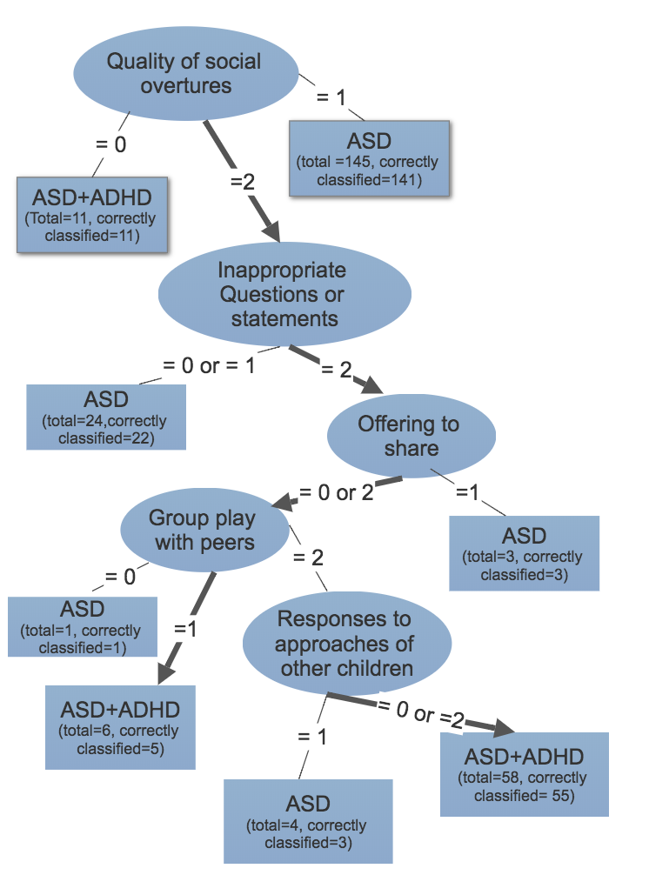
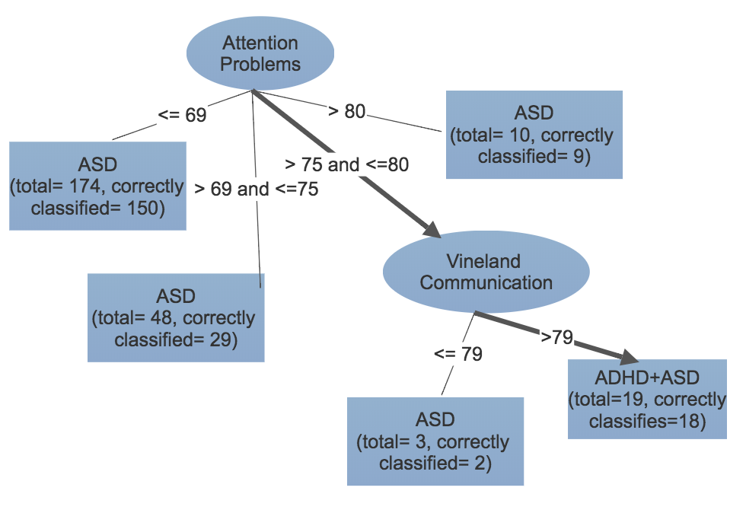
Decision Trees for ASD+ADHD
Notes:
95% accuracy and 80%
align images

Slide 27
Ensemble Techniques
Logit Boost
Accuracy- 92%
ROC Area- 0.949
ASD+ADHD group, precision and recall is 94%
ASD group, precision and recall is 84%
Selected 5 features from the entire feature set
AdaBoost
Accuracy- 90.5%
ROC Area- 0.951
ASD+ADHD group, precision is 76% and recall is 92%
ASD group, precision is 97% and recall is 90%
Selected 4 features from the entire feature set
Notes:
considerable decent performance indicates that parent-orient reviews are good
Except for Attention Problems all other features are selected from ADI parent oriented review
3 of these features are same.

Slide 28
Investigating Individual
Developmental Disorders

Slide 29
Autism Spectrum Disorder
265 children are diagnosed with ASD
Models trained with RFE and ReliefF have 94% and 90% accuracy
Each of the feature sets are doing well for diagnosis
Feature Set | Accuracy | ROC Area | F-measure
All | 98% | 0.991 | 99%
IQ | 88% | 0.930 | 87.8%
ADI-R | 97% | 0.960 | 96.8%
BASC | 91% | 0.965 | 91%
VINE | 88% | 0.941 | 88.2%

Slide 30
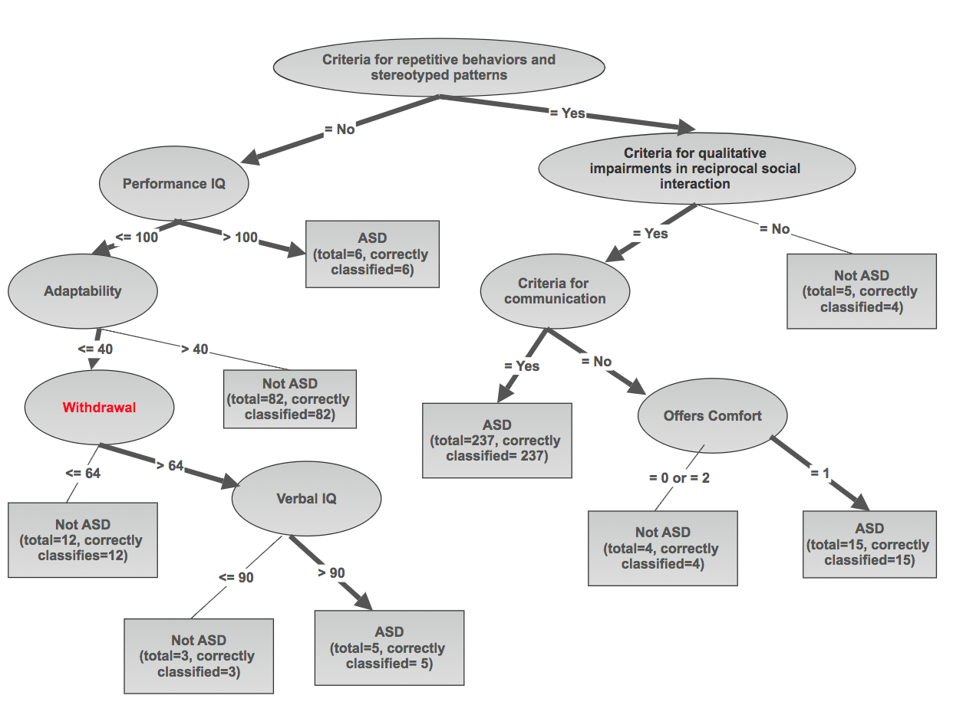
Decision Tree Model for ASD
Notes:
J48 algorithm provides a good model approximation (Accuracy-96%)
Researchers talking about withdrawal

Slide 31
Attention Deficit/Hyperactivity Disorder
63 children out of 369 have ADHD
Model with RFE features had accuracy of 96%
ADI-R parent-oriented review is better than other reviews
Feature Set | Accuracy | ROC Area | F-measure
All | 95% | 0.906 | 89%
IQ | 80% | 0.714 | 78%
ADI-R | 98% | 0.996 | 98%
BASC | 83% | 0.768 | 79%
VINE | 81% | 0.689 | 74%

Slide 32
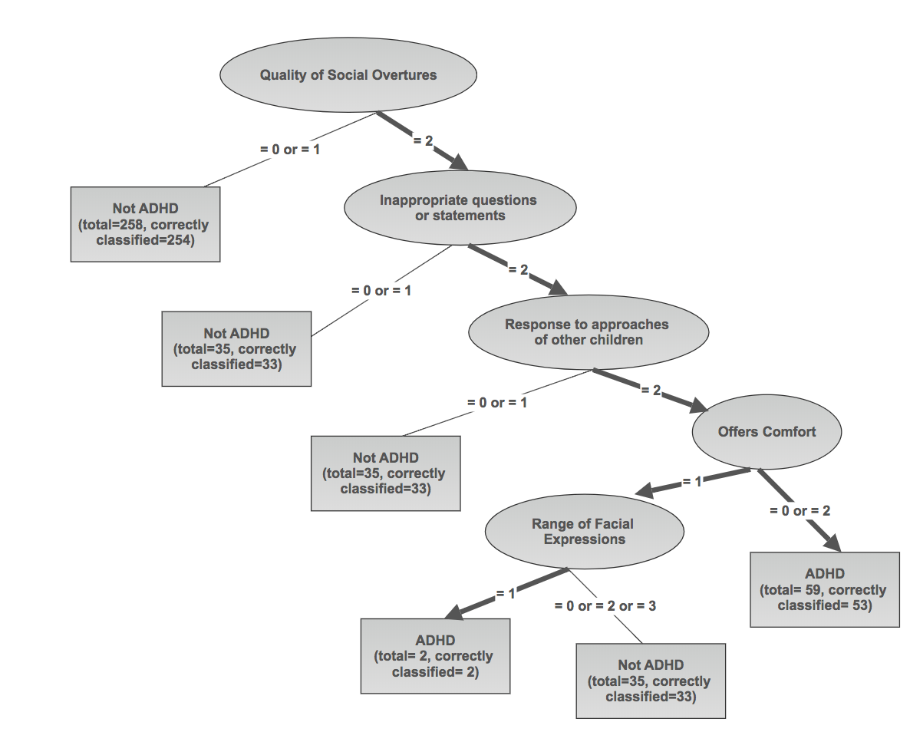
Decision Tree Model for ADHD
Notes:
J48 algorithm provides a good model approximation (Accuracy-94%)

Slide 33
Deletion Syndrome(22q)
115 subjects out of 369 have VCFS
Model with LASSO features (accuracy of 92%), RFE features (accuracy of 90%)
BASC and ADI-R parent oriented reviews are doing a good job for diagnosis
Feature Set | Accuracy | ROC Area | F-measure
All | 98% | 0.990 | 97%
IQ | 88% | 0.948 | 88%
ADI-R | 94% | 0.981 | 94%
BASC | 95% | 0.983 | 95%
VINE | 89% | 0.961 | 88%

Slide 34
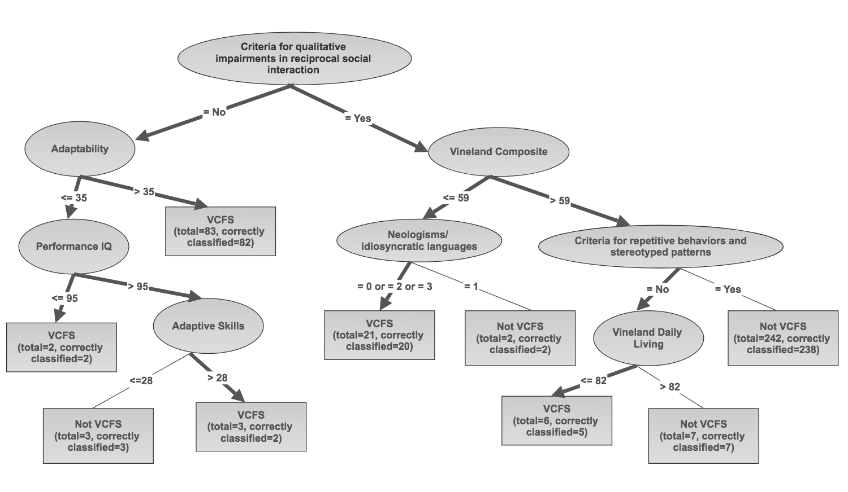
Decision Tree Model for VCFS
Notes:
93%

Slide 35
Conclusion
Supervised techniques predict with accuracy of 80%- 97%
Tree- based learning algorithms perform best
Models predict for male children with 7% better accuracy
Important features selected by feature selection algorithms are
Attention Problems (BASC)
Vineland Communication (VINE)
Repetitive or stereotyped behaviors (ADI-R)
Models built with ADI-R have an accuracy of 7-12% better accuracy over BASC and VINE
Models were consistent to predict ADHD+ASD with 95% accuracy and VCFS+ASD with 90% accuracy
Future Work
Specific parent-oriented reviews for disorders with feature relevance
Models specific to each diagnostic conditions like ASD, ASD+ADHD etc.
Notes:
summary
you can use parent oriented reviews
distinguish between the disorders

