Slide 1
Computational Analysis of Developmental Disorders in Children
By
Siri Chandana S, MS Computer Science
SUID- 829955672
Notes:
Good morning! My name is Siri Chandana. My thesis topic is Computational Analysis of Developmental Disorders in Children

Slide 2
Contents
Problem Statement
Background
Implementation
Results
Conclusion & Future Work
Notes:
In this presentation, I will be covering the following topics

Slide 3
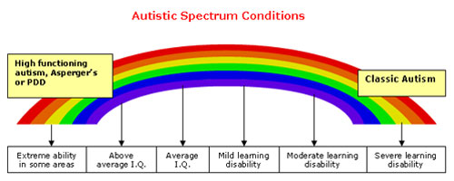
Problem Statement
The objective of our research is to assist in early intervention of developmental disorders using feature selection and supervised learning techniques.
The main focus of our research lies in the disorders ‘Autism Spectrum Disorder(ASD)’, ‘Attention-Deficit/Hyperactivity Disorder(ADHD)’, ‘Deletion syndrome (VCFS)’ and their co-occurrences
Our research uses three different parent-oriented reviews, which are ‘Autism Diagnostic Interview-Revised’, ‘Behavioral Assessment Schedule for Children’, and ‘Vineland Adaptive Behavior Scales’
Notes:
Developmental disorders effect the growth of child and medications or treatments can be used to aid the child and family during the developmental phrase.
The main objective of this research is to assist in early diagnosis of developmental disorders. The average wait to diagnose a child with developmental disorder is 13 months and double this time if a child were to suffer with more then one disorder. The disorders focused on in our research are ….. And their comorbidity…
Our feature set consists of responses by parents for the three parent oriented reviews. For the purpose of analysis different feature selection and supervised learning techniques are explored.

Slide 4
Key Contributions
Identifying important features for developmental disorders ASD, VCFS and ADHD, along with the comorbid disorders.
Assessing the impact of the three different parent-oriented reviews on these developmental disorders and their comorbidity.
Designing models to diagnose these different subgroups of developmental disorders present in the data
Formulating hypothesis using the relationships between features found in our models to assess the developmental disorders
Notes:
These are the key contributors of our research.

Slide 5
Background
Notes:
Before talking about the implementation, we discuss more details of our disorders and feature set to understand it in better details.

Slide 6
Definitions
Autism Spectrum Disorder
Characterized by social interaction difficulties and communication challenges
1 out of 68 in US
Attention Deficit/Hyperactivity Disorder
Difficulty in staying focused and paying attention, and difficulties with controlling behavior
One-third children carry it into adulthood
Deletion Syndrome
Delays growth and speech development, while effecting learning abilities
2,000 to 5,000 born each year
Notes:
Both ASD and ADHD are more common in males than females 4.5 times more
The genetic causes for ASD and ADHD are not known, it could be due to various environmental factors
VCFS is a genetic syndrome, due to deletion of 30 to 40 genes in the middle of chromosome 22

Slide 7
Comorbid Disorders
Comorbid disorders are when two or more developmental disorders exist in an individual
15-20% patients diagnosed with VCFS meet the behavioral criteria for a diagnosis of ASD
In 2013, American Psychiatric Association stated ASD and ADHD could co-occur
20-50% of the individuals diagnosed with ADHD had shown symptoms of ASD
30-80% of the individuals diagnosed with ASD meet the criteria for ADHD
Notes:
VCFS co-occurs with disorders like Schizophrenia, ASD. VCFS leads to Schizophrenia research shows that 15-20% VCFS meets criteria for ASD
In 2013, the APA declared that these two disorders can co-occur. ASD and ADHD are also comorbid disorders whose relations are not known.

Slide 8
Parent-oriented Reviews
Autism Diagnostic Interview-Revised
(ADI-R)
Scores range from 0 to 2
Behavioral Assessment Schedule for Children
(BASC)
T- scores with a mean of 50
Assess Hyperactivity, Aggression, Atypicality, Withdrawal, and Attention problems
Vineland Adaptive Behavior Scales
(VINE)
Standard scores with a mean of 100
Measures adaptive behaviors, daily living and communication
Assess Social Interactions, Language, Behaviors and Early Development
Notes:
The mean value is 100 for IQ measures
2 indicates high severity. It meets the DSM-IV criteria.
. BASC has also shown that children diagnosed with ADHD are rated lower on adaptive skills when compared to children with no diagnosis[38]. However, when trying to diagnose children with ASD, atypical behavior, attention and adaptive functions were complicated. It was also observed that the parent-rated social withdrawal was higher for children with ASD[39].
BASC mean is 50 and 70 and above is considered critical
Vine mean is 100

Slide 9
Emotional Analysis Model
Differentiate ASD from ADHD using reaction times of individuals to assess emotions
Data consists of children understanding and responding to various emotions
Applied ReliefF feature selection algorithm and the machine learning algorithms applied are Decision Tree, Random Forest, Support Vector Machine, K-Nearest Neighbors and Ada Boost.
Results show that ASD children could be differentiated from ADHD and control group with 80% accuracy
Notes:
The application of machine learning to this field of clinical psychology has been done in the past 5 years. Researcher trained models based on the emotional status of autistic children. Children were shown pictures of various emotions and the reaction time of each child was noted. These reactions of the children were analyzed. For this they used these machine learning techniques.
Our research delays with more features, the underlying features examined here are communication, attention and eye contact

Slide 10
fMRI based models
The functional magnetic resonance imaging (fMRI) of two datasets available online ABIDE and ADHD-200
In 2016, (f)MRI HOG-feature-based patient classification (MHPC) technique developed using the Histogram of oriented gradients (HOG)
Model had an accuracy of 69.6% for distinguishing ADHD and accuracy of 65% for distinguishing ASD from the control groups
In 2017, deep learning techniques applied increased the accuracy for ASD to 70%.
Notes:
These are the state of the art models and along with this researcher found that there is a pattern in brain that identifies these disorders
fMRI’s are not always available

Slide 11
Reviews based models
Social Responsiveness Scale (SRS) score sheets of individuals who either had ASD or ADHD
Using minimal-redundancy-maximal-relevance (mRMR) criterion, they selected top 6 features
Machine Learning techniques- Support Vector Machine, Linear Discriminant Analysis, Categorical Lasso and Logistic Regression
Models had average accuracies of comparable accuracy of 96%
ADTree machine learning algorithm on the Autism Diagnostic Observation Schedule-Generic(ADOS)
8 of the 29 questions in module 1 are relevant, trained models achieved 99.7% sensitivity and 94% specificity
Notes:
65 questions in the SRS
ADOS has 4 modules and each module takes 30-60 mins
and also plotted the ROC for each models
Our research is similar to this. Except our data consists of more developmental disorders and a combination of reviews

Slide 12
Implementation

Slide 13
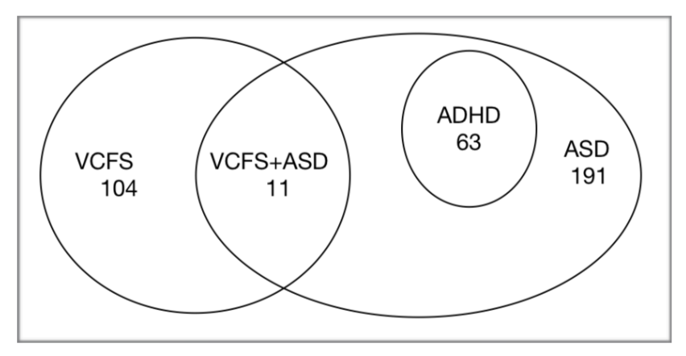
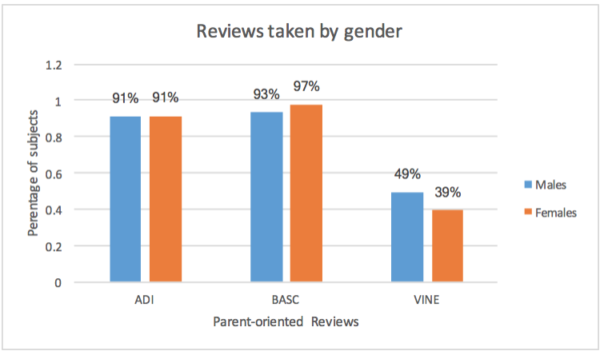
Data Exploration
369 children’s data collected by Dr. Russo, Dr. Antshel and Dr. Kates between the ages 3 to 18.
92% of subjects have taken ADI-R, 96% have taken BASC and only 48% have taken VINE
On an average the missing feature values for ADI-R are 10% (majority of third domain missing)
Incase of BASC, Adaptability feature has 20% missing values
VINE has no feature values missing
Notes:
This data took these professors around 10 years to collect.

Slide 14
Data Preprocessing
Data Transformation- conversion of categorical features, creation of target labels
Data Reduction- eliminating unique and redundant columns, reduced the feature set to 73 columns
Data Cleaning- handling the missing values
IQ feature set- mean 100
ADI-R feature set- 0 as that indicates less severity
BASC feature set- mean 50
VINE feature set- 0 indicating the absence of feature values
Notes:
Data transformation- setting the target labels depending on research needs
Data reduction- removing adiaustim column which is the key criteria , IDs and labs and other non essential columns like totals

Slide 15
Feature Selection
LASSO
selects subset of variables when there are highly correlated predictors in the data
ReliefF
noise tolerant and robust algorithm which is independent of variable dependencies
RFE
elimination process to select a subset of features recursively from our data
Notes:
LASSO regression method selects subset of variables when there are highly correlated predictors in the data, as in our dataset
ReliefF is a noise tolerant and robust algorithm which is independent of variable dependencies
RFE uses an elimination process to select a subset of features recursively from our data
For the subgroup diagnosis, LASSO selected features from the BASC and VINE parent- oriented reviews
RFE selected features from the ADI-R parent-oriented reviews
The convergent features for ASD and ADHD comorbidity are ‘Vineland socialization’, ‘Quality of social overtures’, ‘Inappropriate questions or statements’ and ‘Attention problems’
Performance IQ is the only common feature in the case of ASD and VCFS comorbidity
No convergent features for individual diagnosis of disorders ASD, ADHD and VCFS

Slide 16
Approach used for Analysis
Horizontal partitioning- for analyzing comorbid disorders
306 children with ASD and VCFS
254 subjects with ASD and ADHD
Vertical partitioning- dividing the features to understand the effect of it on disorders
IQ feature set
ADI-R feature set
BASC feature set
VINE feature set
Naive Bayes, Logistic Regression, Random Forest, Support Vector Machines and K-Nearest Neighbors

Slide 17
Results of Subgroup Diagnosis

Slide 18
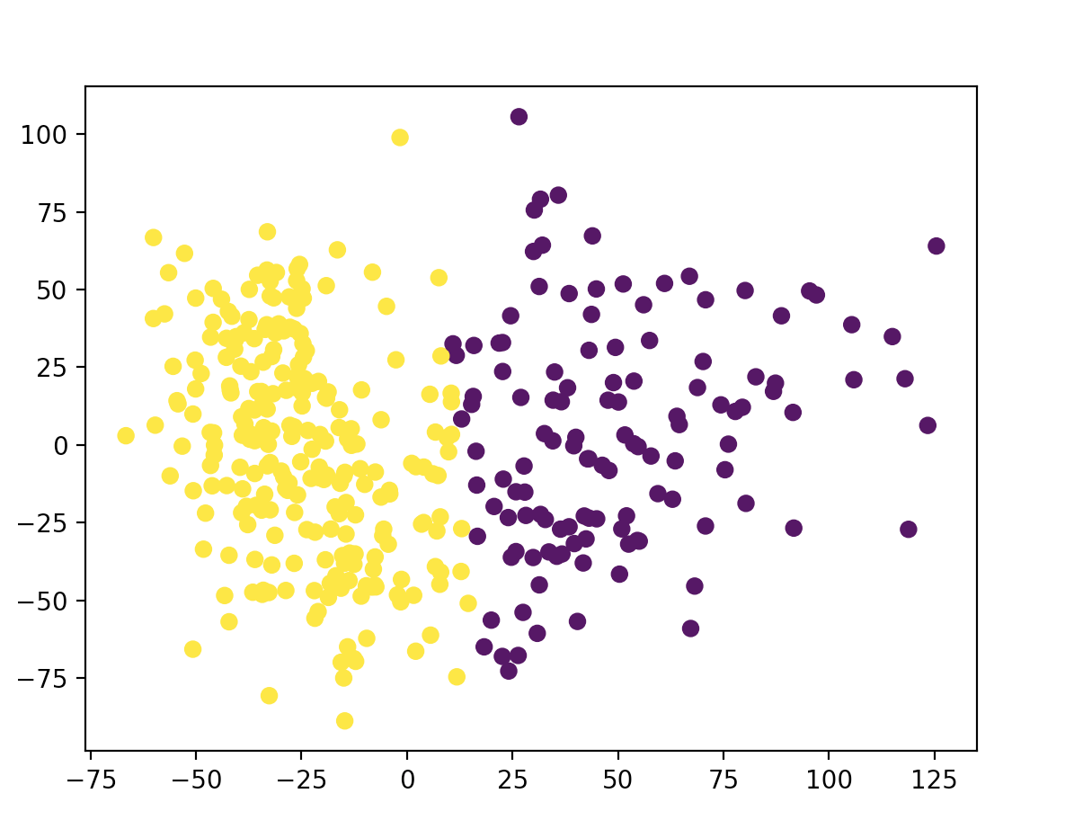
Unsupervised Learning
K-means Clustering to partition the data into distinguishable clusters.
Before clustering, Principal Component Analysis to reduce 73 features to 2 dimensions.
Varied the value of k from 2 to 5
Children diagnosed to VCFS were closely clustered and more specifically children diagnosed with both VCFS+ASD belonged to came cluster.
Agglomerative clustering was also applied to the data
Notes:
Also, agglomerative clustering was applied on our data. This should similar results, however, they could find any relation between ADHD and ASD.

Slide 19
Supervised Learning
Random forest models performed the best for diagnosing subgroups
ADI-R parent-oriented review is better than other reviews
IQ features are not sufficient enough
Feature Set | Accuracy | ROC Area | F-measure
All | 94.85% | 0.994 | 95.7%
IQ | 66.32% | 0.802 | 61.2%
ADI-R | 96.47% | 0.976 | 96.4%
BASC | 75.06% | 0.879 | 71.2%
VINE | 70% | 0.787 | 68%

Slide 20
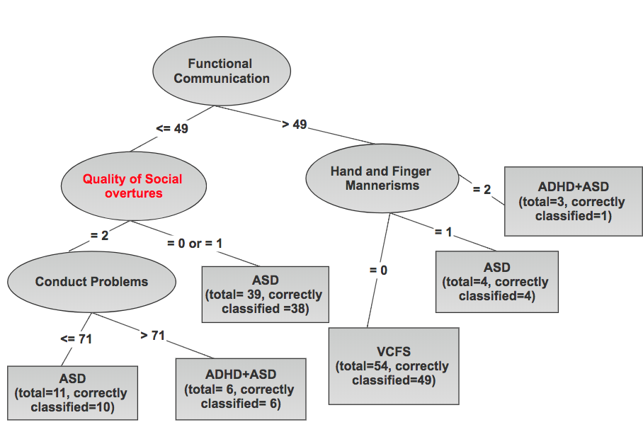
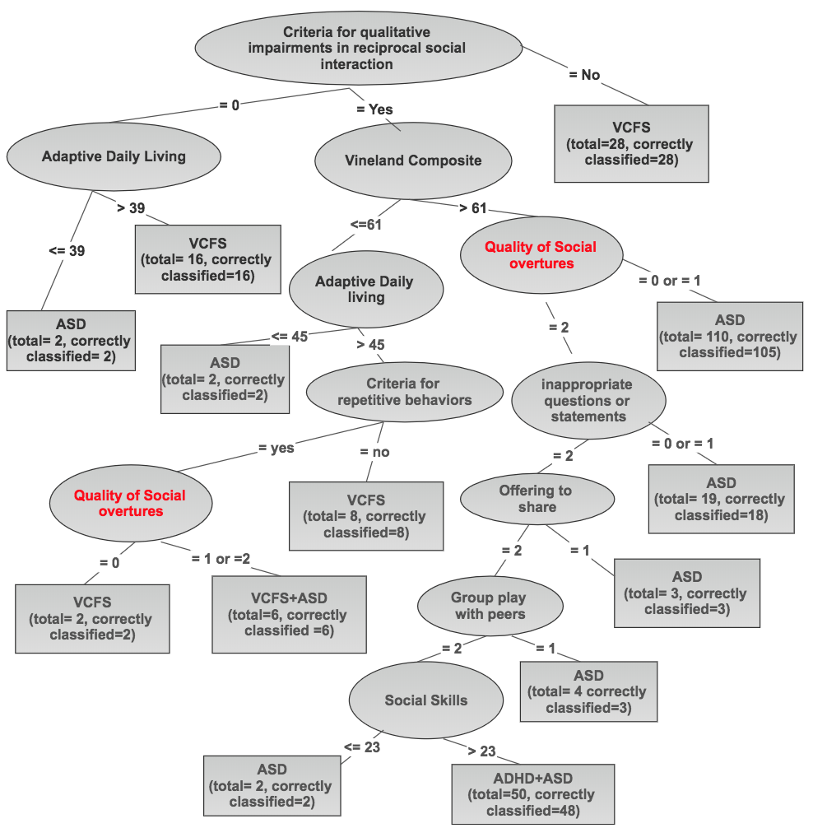
Model Bias
252 male children
Accuracy of J48 is 90%
Accuracy of Random Forest is 94%
117 female children
Accuracy of J48 is 78%
Accuracy of Random Forest is 87%

Slide 21
Results of Comorbid Disorders

Slide 22
ASD and VCFS comorbidity
306 children are present, out of which 10 have both these disorders
When using features selected by feature selection algorithms, performance of these models was not comparable
Most important features are-
Criteria for Repetitive behavior and stereotyped patterns (ADI-R)
Repetitive use of objects or interest in parts of objects (ADI-R)
Spontaneous imitation of actions (ADI-R)
Functional Communication (BASC)
Criteria for Communication (ADI-R)
Adaptive Daily Living (BASC)
Feature Set | Accuracy | ROC Area | F-measure
All | 97% | 0.976 | 97%
IQ | 63% | 0.518 | 60%
ADI-R | 93% | 0.936 | 92%
BASC | 84% | 0.874 | 84%
VINE | 80% | 0.825 | 79%
Notes:
SVM is best
2 belong to BASC and 4 belong to ADI-R

Slide 23
Ensemble Techniques
Logit Boost
Accuracy- 95.7%
ROC Area- 0.988
ASD, precision- 97%, recall- 97%
VCFS, precision- 95%, recall- 99%
ASD+VCFS, precision- 100%, recall- 55%
Selected 13 features from entire feature set
Ada Boost
Accuracy- 92.15%
ROC Area- 0.978
ASD, precision- 93%, recall- 97%
VCFS, precision- 95%, recall- 94%
ASD+VCFS, precision- 100%, recall- 40%
Selected 5 features from the entire feature set
Notes:
False positives are present

Slide 24
ASD and ADHD comorbidity
254 subjects who have ASD or both these disorders
The most important features are-
Quality of social overtures (ADI-R)
Inappropriate questions or statements (ADI-R)
Attention Problems (BASC)
Conventional/Instrumental Gestures (ADI-R)
Using LASSO and RFE features, the accuracy of Random Forest model is 95%
Feature Set | Accuracy | ROC Area | F-measure
All | 95% | 0.978 | 96%
IQ | 66% | 0.588 | 64%
ADI-R | 96% | 0.966 | 96%
BASC | 76% | 0.727 | 74%
VINE | 74% | 0.557 | 64%
Notes:
Random forest is best
But more consistent models through RFE

Slide 25
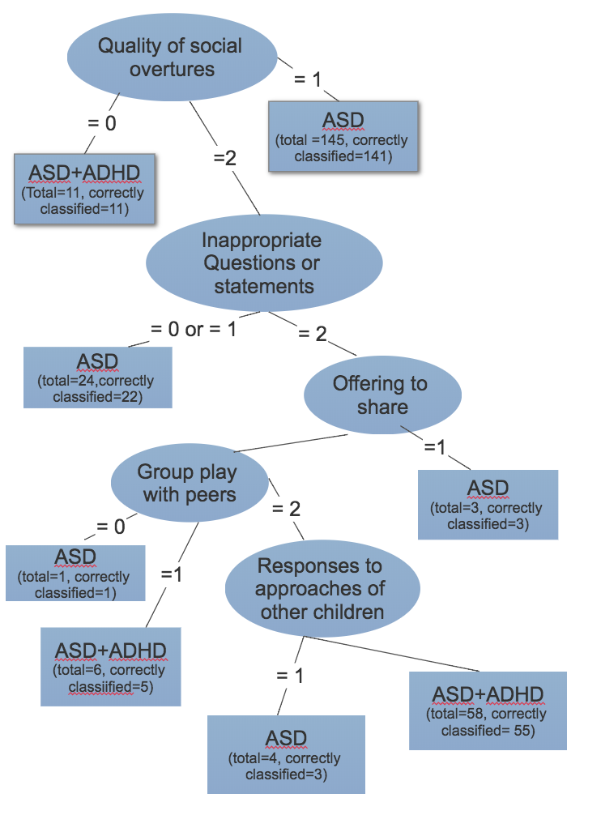
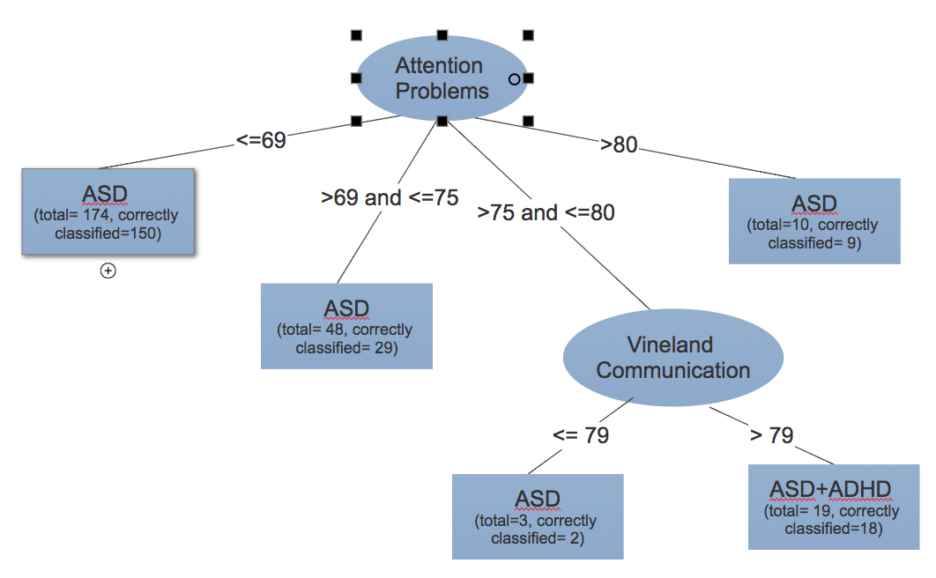
Decision Trees for ASD+ADHD
Notes:
95% accuracy and 80%

Slide 26
Ensemble Techniques
Logit Boost
Accuracy- 92%
ROC Area- 0.949
ASD+ADHD group, precision and recall is 94%
ASD group, precision and recall is 84%
Selected 5 features from the entire feature set
Ada Boost
Accuracy- 90.5%
ROC Area- 0.951
ASD+ADHD group, precision is 76% and recall is 92%
ASD group, precision is 97% and recall is 90%
Selected 4 features from the entire feature set
Notes:
Except for Attention Problems all other features are selected from ADI parent oriented review
3 of these features are same.

Slide 27
Results of Individual
Developmental Disorders

Slide 28
Autism Spectrum Disorder
265 children are diagnosed with ASD
Models trained with RFE and ReliefF have 94% and 90% accuracy
Each of the feature sets are doing well for diagnosis
Feature Set | Accuracy | ROC Area | F-measure
All | 98% | 0.991 | 99%
IQ | 88% | 0.930 | 87.8%
ADI-R | 97% | 0.960 | 96.8%
BASC | 91% | 0.965 | 91%
VINE | 88% | 0.941 | 88.2%

Slide 29
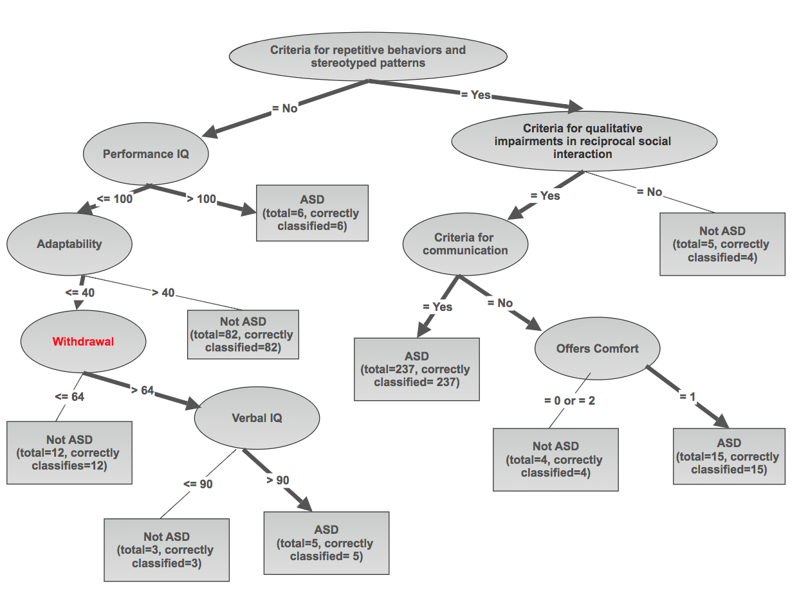
Decision Tree Model for ASD
Notes:
J48 algorithm provides a good model approximation (Accuracy-96%)
Researchers talking about withdrawal

Slide 30
Attention Deficit/Hyperactivity Disorder
63 children out of 369 have ADHD
Model with RFE features had accuracy of 96%
ADI-R parent-oriented review is better than other reviews
Feature Set | Accuracy | ROC Area | F-measure
All | 95% | 0.906 | 89%
IQ | 80% | 0.714 | 78%
ADI-R | 98% | 0.996 | 98%
BASC | 83% | 0.768 | 79%
VINE | 81% | 0.689 | 74%

Slide 31
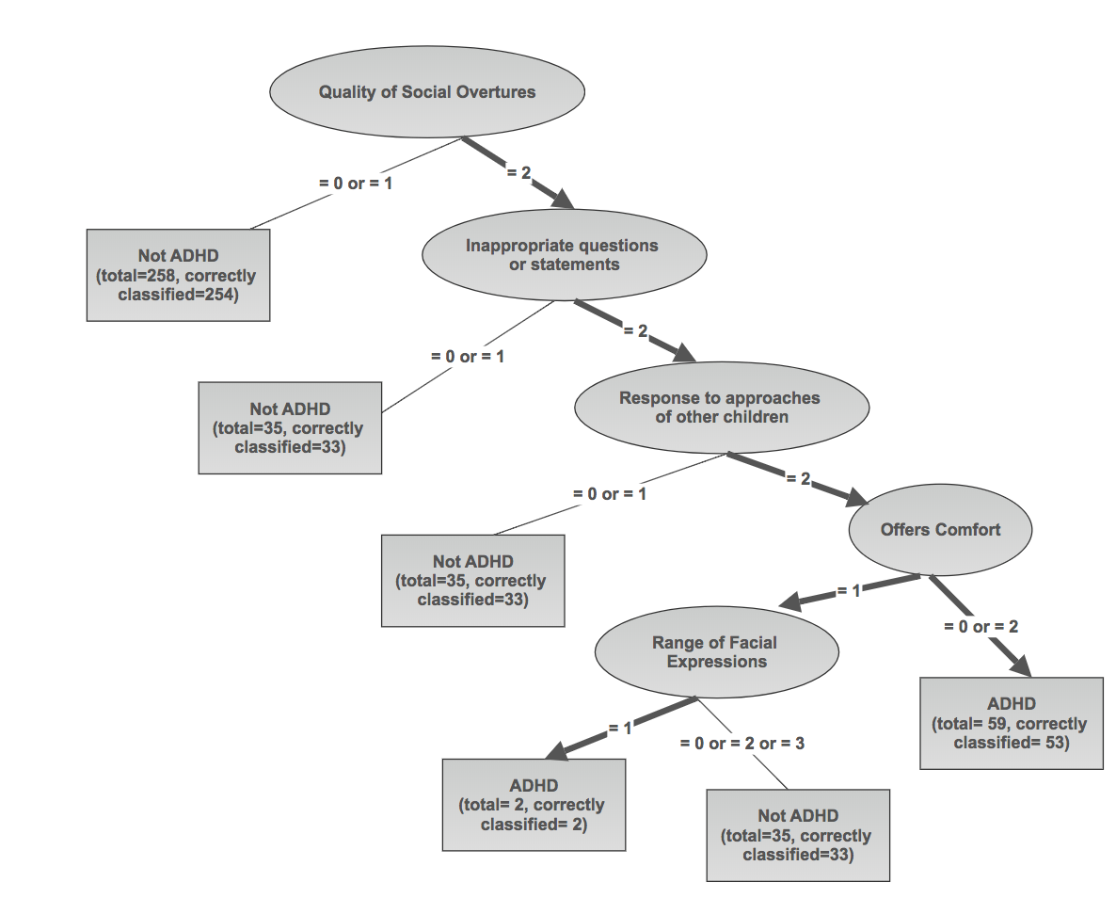
Decision Tree Model for ADHD
Notes:
J48 algorithm provides a good model approximation (Accuracy-94%)

Slide 32
Deletion Syndrome(22q)
115 subjects out of 369 have VCFS
Model with LASSO features (accuracy of 92%), RFE features (accuracy of 90%)
BASC and ADI-R parent oriented reviews are doing a good job for diagnosis
Feature Set | Accuracy | ROC Area | F-measure
All | 98% | 0.990 | 97%
IQ | 88% | 0.948 | 88%
ADI-R | 94% | 0.981 | 94%
BASC | 95% | 0.983 | 95%
VINE | 89% | 0.961 | 88%

Slide 33
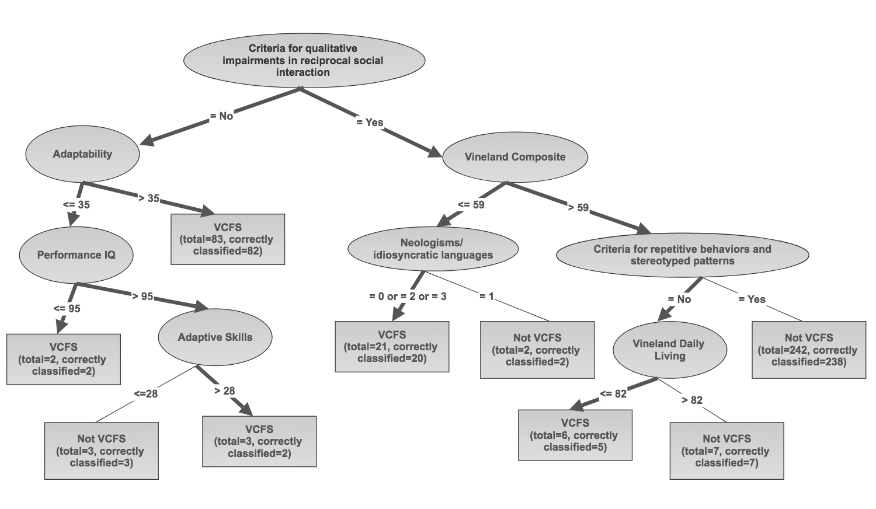
Decision Tree Model for VCFS
Notes:
93%

Slide 34
Conclusion
Our models predict with a better accuracy of 7% for male children
Tree- based learning algorithms for building models
LASSO and Recursive Feature Elimination algorithms identified suitable features
ADI parent oriented review is better than other two
Models were better in diagnosing ASD and VCFS children over ADHD
Future Work
Generalization of parent-oriented reviews
Models specific to each diagnostic conditions

