Slide 1
Computational Analysis of Developmental Disorders in Children
By
Siri Chandana S, MS Computer Science
SUID- 829955672

Slide 2
Contents
Introduction
Related Work
Data Exploration
Data Preprocessing
Feature Selection
Subgroup diagnosis
Comorbidity
Individual Developmental Disorders
Conclusion

Slide 3
Problem Statement
Early developmental disorders are common in children between the ages of 3 through 17
The main focus of our research lies in the disorders ‘Autism Spectrum Disorder’, ‘Attention-Deficit/Hyperactivity Disorder’, ‘Deletion syndrome (22q)’ and their co-occurrences
Our research uses three different parent-oriented reviews, which are ‘Autism Diagnostic Interview’, ‘Behavioral Assessment Schedule for Children’, and ‘Vineland Adaptive Behavior Scales’
The objective of our research is to assist in early intervention of developmental disorders using feature selection and supervised learning techniques.
Notes:
The average wait to diagnose a child with developmental disorder is 13 months

Slide 4
Introduction
Identifying important features for developmental disorders ASD, VCFS and ADHD, along with the comorbid disorders.
Assessing the impact of the three different parent-oriented reviews on these developmental disorders and their comorbidity.
Designing models to diagnose these different subgroups of developmental disorders present in the data
Formulating hypothesis using the features relation found in our models to assess the developmental disorders

Slide 5
Related Work
ASD occurs in 1 out of 68 children in the United States
ASD is characterized by social interaction difficulties and communication challenges
ADHD is difficulty in staying focused and paying attention, and difficulties with controlling behavior
Almost one-third of children diagnosed with ADHD retain it even in adulthood
VCFS is a genetic syndrome, due to deletion of 30 to 40 genes in the middle of chromosome 22
VCFS delays growth and speech development, and also effects learning disabilities
Notes:
Both ASD and ADHD are more common in males than females 4.5 times more
VCFS co-occurs with disorders like Schizophrenia, ASD. VCFS leads to Schizophrenia research shows that 15-20% VCFS meets criteris for ASD
ASD and ADHD are also comorbid disorders whose relations are not known.

Slide 6
Comorbid Disorders
Comorbid disorders are when two or more developmental disorders exist in individual
15-20% patients diagnosed with VCFS meet the behavioral criteria for a diagnosis of ASD
In 2013, APA stated ASD and ADHD could co-occur
20-50% of the individuals diagnosed with ADHD had shown symptoms of ASD
30-80% of the individuals diagnosed with ASD meet the criteria for ADHD

Slide 7
Parent-oriented Reviews
Autism Diagnostic Interview (ADI)- The scores range from 0 to 2. The four domains analyzed are
Reciprocal Social Interaction
Language/Communication
Restricted, Repetitive, and Stereotyped Behaviors
Abnormality Present in early development (before age 3)
Behavioral Assessment Schedule for Children (BASC)- These are T-scores that assess Hyperactivity, Aggression, Atypicality, Withdrawal, and Attention problems
Vineland Adaptive Behavior Scales (VINE)- It uses standard scores to measure adaptive behaviors, including the ability to cope with environmental changes, to learn new everyday skills
Notes:
2 indicates high severity. It meets the DSM-IV criteria.
. BASC has also shown that children diagnosed with ADHD are rated lower on adaptive skills when compared to children with no diagnosis[38]. However, when trying to diagnose children with ASD, atypical behavior, attention and adaptive functions were complicated. It was also observed that the parent-rated social withdrawal was higher for children with ASD[39].

Slide 8
Existing Model 1
Differentiate ASD from ADHD using reaction times of individuals to assess emotions
Assumption- Children with ASD have shorter reaction times when compared to those that do not have ASD
Data consists of children understanding various emotions
Applied ReliefF feature selection algorithm and the machine learning algorithms applied are Decision Tree, Random Forest, Support Vector Machine, K-Nearest Neighbors and Ada Boost.
Results show that ASD children could be differentiated from ADHD and control group with 80% accuracy

Slide 9
Existing Model 2
The functional magnetic resonance imaging (fMRI) of two datasets available online ABIDE and ADHD-200
In 2016, (f)MRI HOG-feature-based patient classification (MHPC) technique developed using the Histogram of oriented gradients (HOG)
Model had an accuracy of 69.6% for distinguishing ADHD and accuracy of 65% for distinguishing ASD from the control groups
In 2017, deep learning techniques applied increased the accuracy for ASD to 70%.
Also, these researchers found patterns/ signals in the brain images to identify these disorders.
Notes:
These are the state of the art models

Slide 10
Existing Model 3
Social Responsiveness Scale (SRS) score sheets of individuals who either had ASD or ADHD
Using minimal-redundancy-maximal-relevance (mRMR) criterion, they selected top 6 features
Machine Learning techniques- SVC, LDA, Categorical Lasso and Logistic Regression
Models had average accuracies of comparable accuracy of 96%
ADTree machine learning algorithm on the Autism Diagnostic Observation Schedule-Generic(ADOS)
8 of the 29 questions in module 1 are relevant, trained models achieved 99.7% sensitivity and 94% specificity
Notes:
65 questions in the SRS
ADOS has 4 modules and each module takes 30-60 mins
and also plotted the ROC for each models

Slide 11
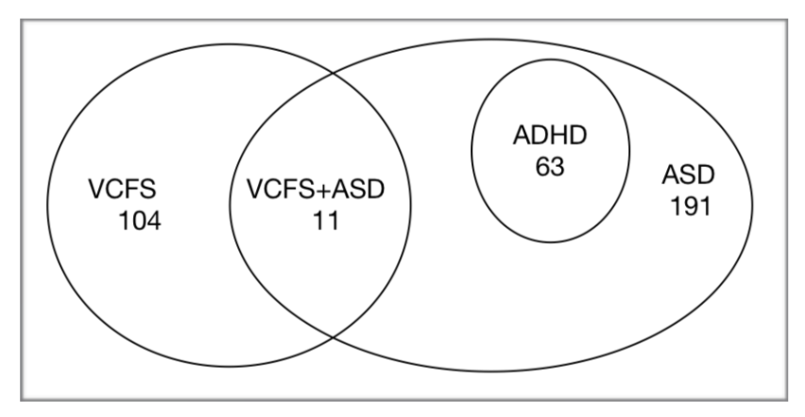
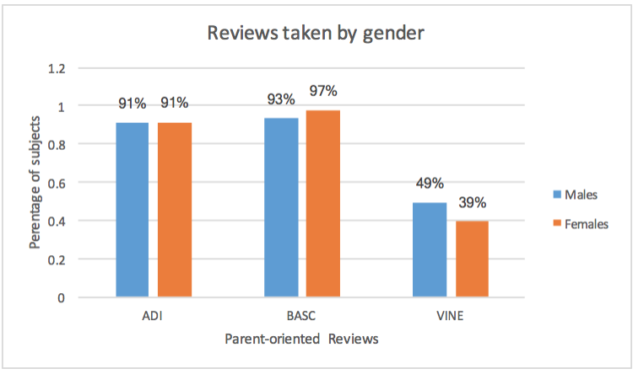
Data Exploration
369 children collected from three different labs ‘Russo’, ‘Antshel’ and ‘Kates’
92% of subjects have taken ADI, 96% have taken BASC and only 48% have taken VINE
On an average the missing feature values for ADI are 10% (majority of third domain missing)
Incase of BASC, Adaptability feature has 20% missing values
VINE has no feature values missing

Slide 12
Data Preprocessing
Data Transformation- conversion of categorical features, creation of target labels
Data Reduction- eliminating unique and redundant columns, reduced the feature set to 73 columns
Data Cleaning- handling the missing values
IQ feature set- mean 100
ADI feature set- 0 as that indicates less severity
BASC feature set- mean 50
VINE feature set- 0 indicating the absence of feature values
Notes:
Data transformation- setting the target labels depending on research needs
Data reduction- removing adiaustim column which is the key criteria , IDs and labs and other non essential columns like totals

Slide 13
Approach used for Analysis
Horizontal partitioning- dividing children to understand each of the disorders and their comorbidity
Partitioned the data for understanding comorbidity
Modified the target labels for each developmental disorder ‘ASD’, ‘ADHD’ and ‘VCFS’
Vertical partitioning- dividing the features to understand the effect of it on disorders
IQ feature set
ADI feature set
BASC feature set
VINE feature set

Slide 14
Feature Selection
LASSO regression method that selects subset of variable when there is highly correlated predictors in the data, as in our dataset
ReliefF is a noise tolerant and robust algorithm which is independent of variable dependencies
RFE uses an elimination process to select a subset of features recursively from our data
The most common features selected are-
Performance IQ
Vineland Daily living
Vineland Communication
Criteria for Repetitive behaviors and stereotyped patterns
Criteria for Qualitative impairments in reciprocal social interaction

Slide 15
For the subgroup diagnosis, LASSO selected features from the BASC and VINE parent- oriented reviews
RFE selected features from the ADI parent-oriented reviews
The convergent features for ASD and ADHD comorbidity are ‘Vineland socialization’, ‘Quality of social overtures’, ‘Inappropriate questions or statements’ and ‘Attention problems’
Performance IQ is the only common feature in the case of ASD and VCFS comorbidity
No convergent features for individual diagnosis of disorders ASD, ADHD and VCFS

Slide 16
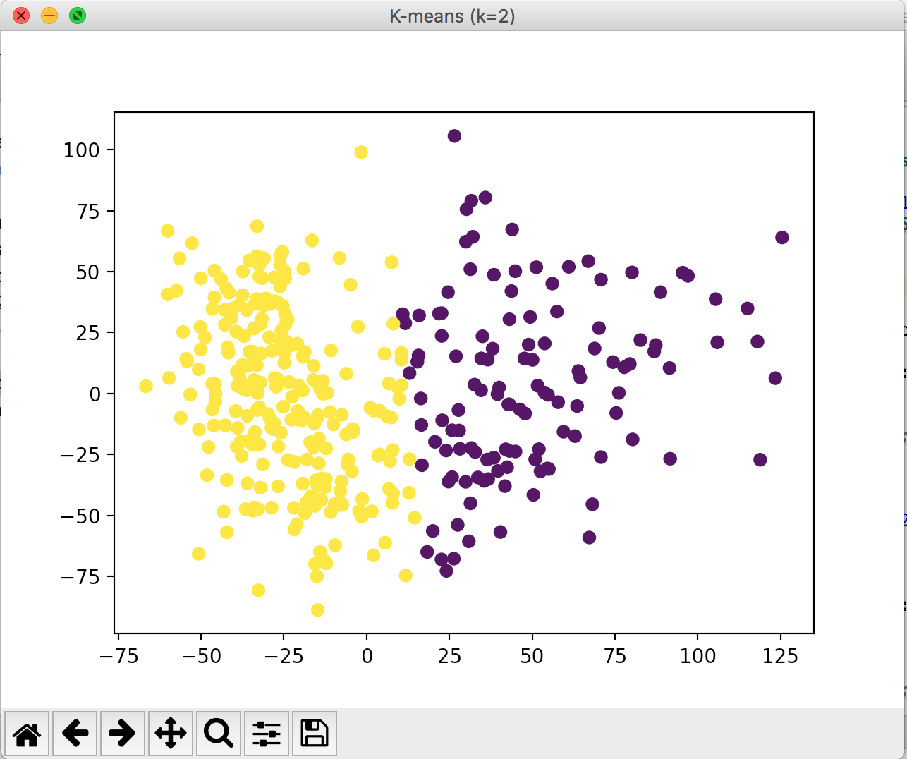
Subgroup Diagnosis
K-means Clustering to partition the data into distinguishable clusters.
Before clustering, Principal Component Analysis to reduce 73 features to 2 dimensions.
Varied the value of k from 2 to 5
Children diagnosed to VCFS were closely clustered and more specifically children diagnosed with both VCFS+ASD belonged to came cluster.
Agglomerative clustering was also applied to on our data

Slide 17
Supervised Learning Techniques
Classifiers used are- Naive Bayes, Logistic Regression, Multi-class classifier and Random Forest
Random forest models were best for diagnosing subgroups
ADI parent-oriented review is better than other reviews
IQ features are not sufficient enough
Feature Set | Accuracy | ROC Area | F-measure
All | 94.85% | 0.994 | 95.7%
IQ | 66.32% | 0.802 | 61.2%
ADI | 96.47% | 0.976 | 96.4%
BASC | 75.06% | 0.879 | 71.2%
VINE | 70% | 0.787 | 68%

Slide 18
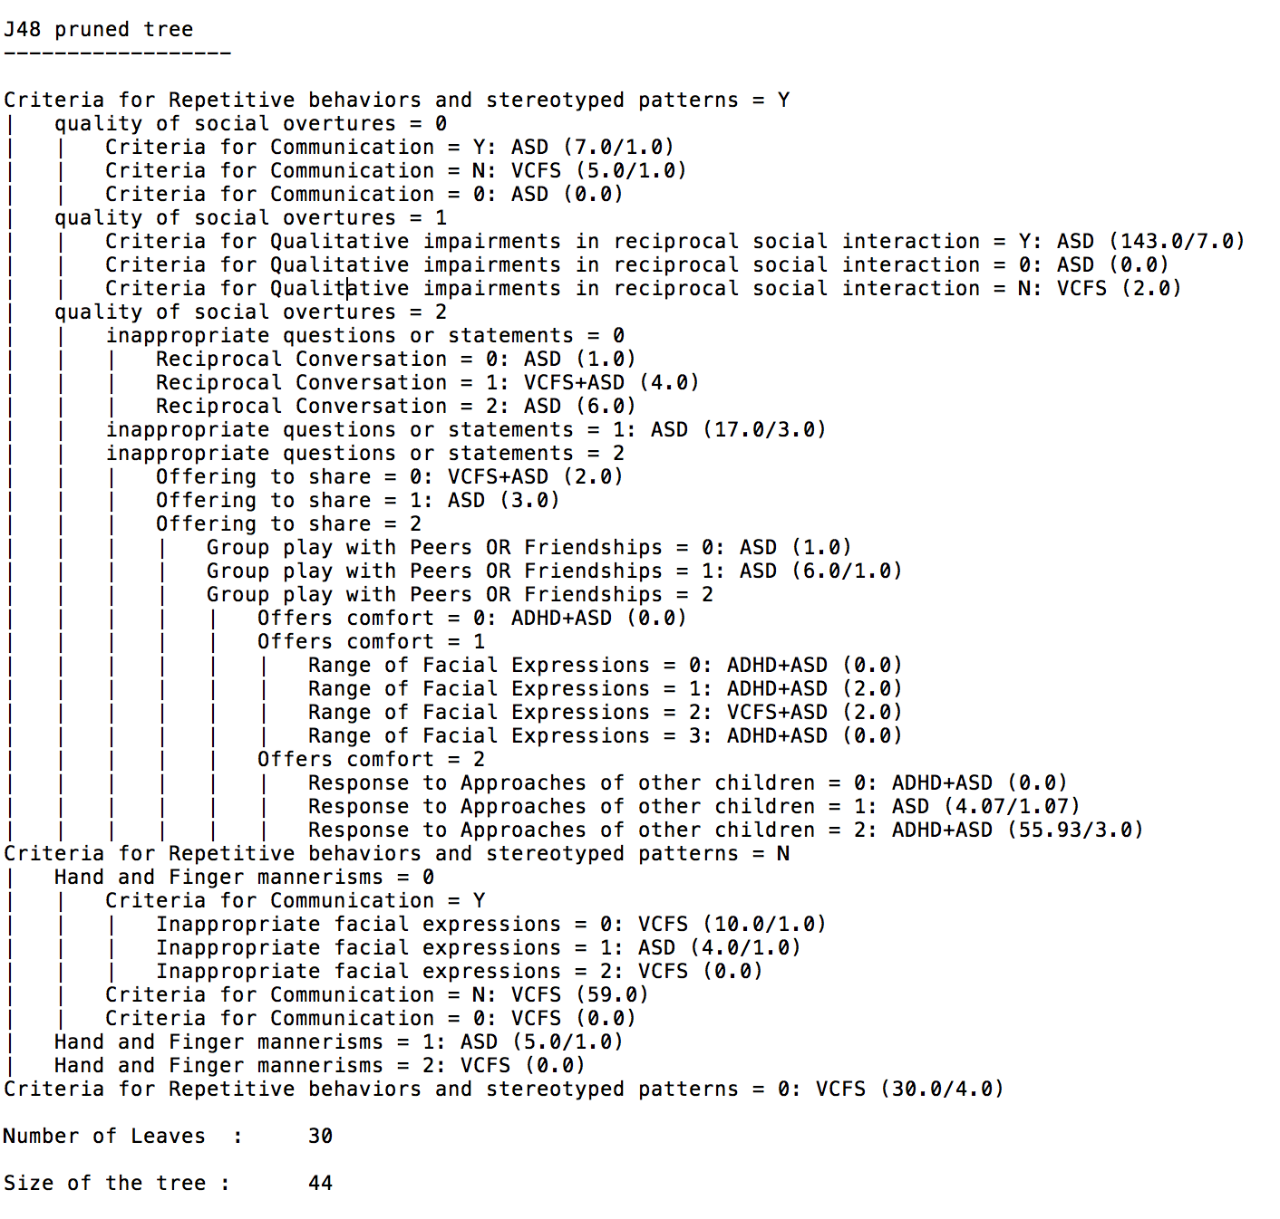
J48 model approximation

Slide 19
Important Features
Criteria for Repetitive behaviors and stereotyped patterns
Criteria for Qualitative impairments in reciprocal social interaction
Inappropriate questions and statements
Offers Comfort
Quality of social overtures
Offering Comfort
Range of Facial Expressions
Hand and finger mannerisms
Response to approaches of other children
Reciprocal Conversation

Slide 20
ASD and VCFS comorbidity
306 children are present, out of which 10 have both these disorders
Techniques used are- Naive Bayes, Logistic Regression, Random Forest, Support Vector Machines and K-Nearest Neighbors
When using features selected by feature selection algorithms, performance of these models was not comparable
Most important features are-
Functional Communication
Criteria for Communication
Spontaneous imitation of actions
Adaptive Daily Living
Criteria for Repetitive behaviors and stereotyped patterns
Repetitive use of objects or interest in parts of objects
Feature Set | Accuracy | ROC Area | F-measure
All | 97% | 0.976 | 97%
IQ | 63% | 0.518 | 60%
ADI | 93% | 0.936 | 92%
BASC | 84% | 0.874 | 84%
VINE | 80% | 0.825 | 79%
Notes:
SVM is best

Slide 21
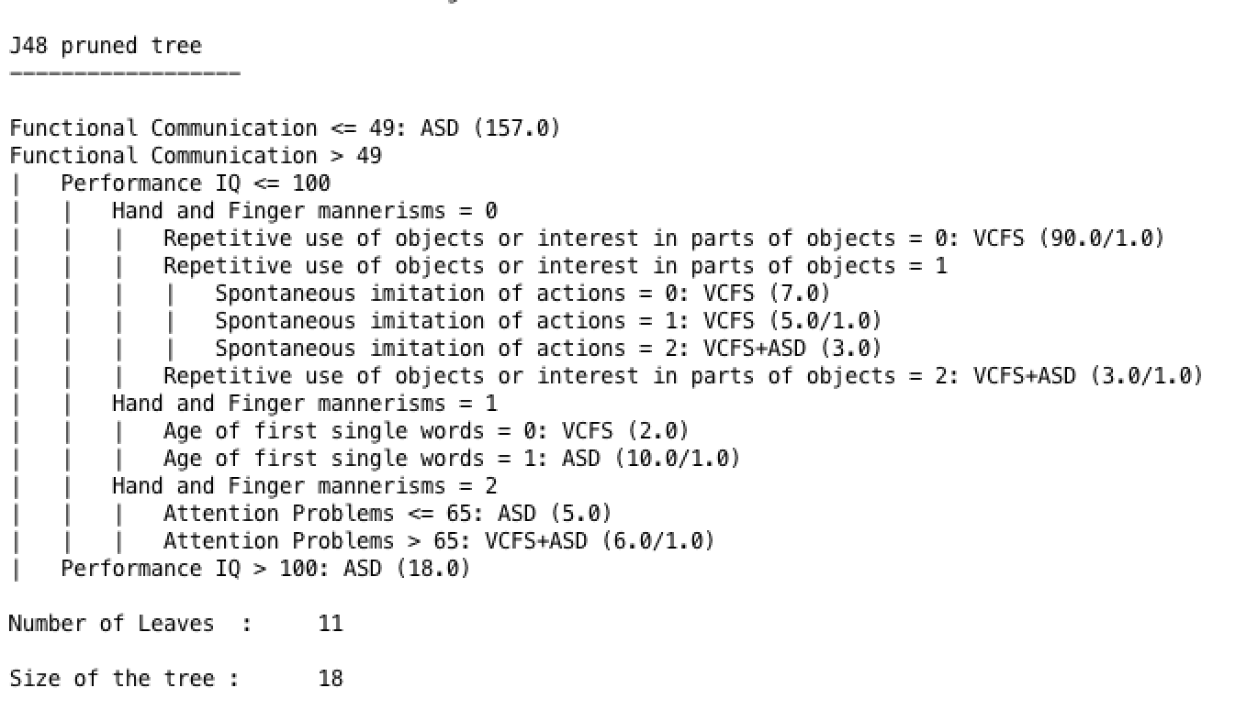
J48 model approximation

Slide 22
Ensemble Techniques
Logit Boosting
Accuracy- 95.7%
ROC Area- 0.988
ASD, precision- 97%, recall- 97%
VCFS, precision- 95%, recall- 99%
ASD+VCFS, precision- 100%, recall- 55%
Selected 13 features from entire feature set
Ada Boosting
Accuracy- 92.15%
ROC Area- 0.978
ASD, precision- 93%, recall- 97%
VCFS, precision- 95%, recall- 94%
ASD+VCFS, precision- 100%, recall- 40%
Selected 5 features from the entire feature set
Notes:
False positives are present

Slide 23
ASD and ADHD comorbidity
254 subjects who have ASD or both these disorders
Techniques used- Naive Bayes, Logistic Regression, Random Forest, Support Vector Machines and K-Nearest Neighbors
The most important features are-
Quality of social overtures
Inappropriate questions or statements
Attention Problems
Conventional/Instrumental Gestures
Using LASSO and RFE features, the accuracy of Random Forest model is 95%
Feature Set | Accuracy | ROC Area | F-measure
All | 95% | 0.978 | 96%
IQ | 66% | 0.588 | 64%
ADI | 96% | 0.966 | 96%
BASC | 76% | 0.727 | 74%
VINE | 74% | 0.557 | 64%
Notes:
Random forest is best
But more consistent models through RFE

Slide 24
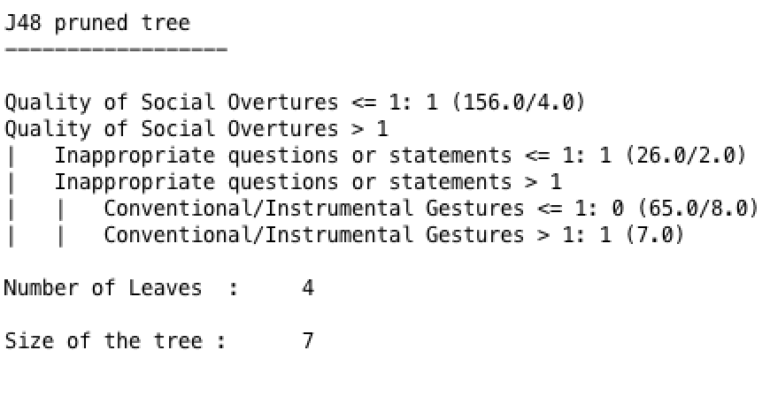
J48 model approximation

Slide 25
Ensemble Techniques
Logit Boosting
Accuracy- 92%
ROC Area- 0.949
ASD+ADHD group, precision and recall is 94%
ASD group, precision and recall is 84%
Selected 5 features from the entire feature set
Ada Boosting
Accuracy- 90.5%
ROC Area- 0.951
ASD+ADHD group, precision is 76% and recall is 92%
ASD group, precision is 97% and recall is 90%
Selected 4 features from the entire feature set
Notes:
Except for Attention Problems all other featurese are selected from ADI parent oriented review
3 of these features are same.

Slide 26
Autism Spectrum Disorder
265 children are diagnosed with ASD
Techniques used- Logistic Regression, Decision Trees, K-Nearest Neighbors and Random Forest
Models trained with RFE and ReliefF have 94% and 90%
J48 algorithm provides a good model approximation (Accuracy-96%)
Each of the feature sets are doing well for diagnosis
Feature Set | Accuracy | ROC Area | F-measure
All | 98% | 0.991 | 99%
IQ | 88% | 0.930 | 87.8%
ADI | 97% | 0.960 | 96.8%
BASC | 91% | 0.965 | 91%
VINE | 88% | 0.941 | 88.2%

Slide 27
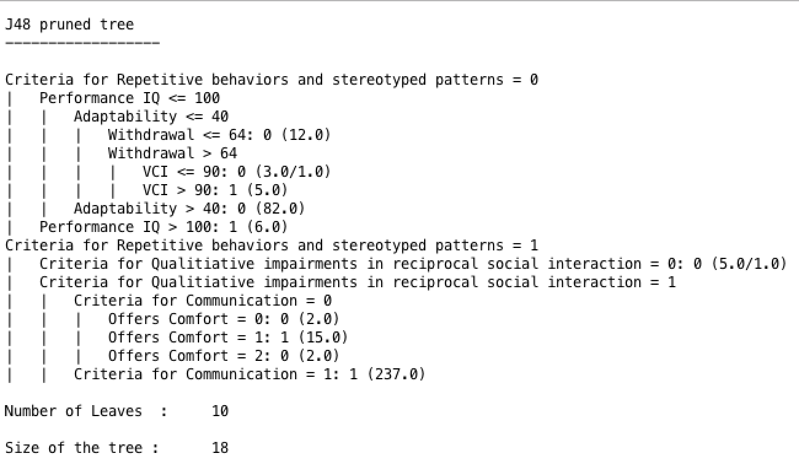
J48 model approximation

Slide 28
Important Features for ASD
Offers Comfort
Criteria for Qualitative impairments in reciprocal social interaction
Criteria for Communication
Criteria for repetitive behaviors and stereotyped patterns
Adaptability
Withdrawal
Performance IQ

Slide 29
Attention Deficit/Hyperactivity Disorder
63 children out of 369 have ADHD
Techniques used- Logistic Regression, Decision Trees, Naive Bayes and Random Forest
Model with RFE features has accuracy of 96%
J48 algorithm provides a good model approximation (Accuracy-94%)
ADI parent-oriented review is better than other reviews
Feature Set | Accuracy | ROC Area | F-measure
All | 95% | 0.906 | 89%
IQ | 80% | 0.714 | 78%
ADI | 98% | 0.996 | 98%
BASC | 83% | 0.768 | 79%
VINE | 81% | 0.689 | 74%

Slide 30
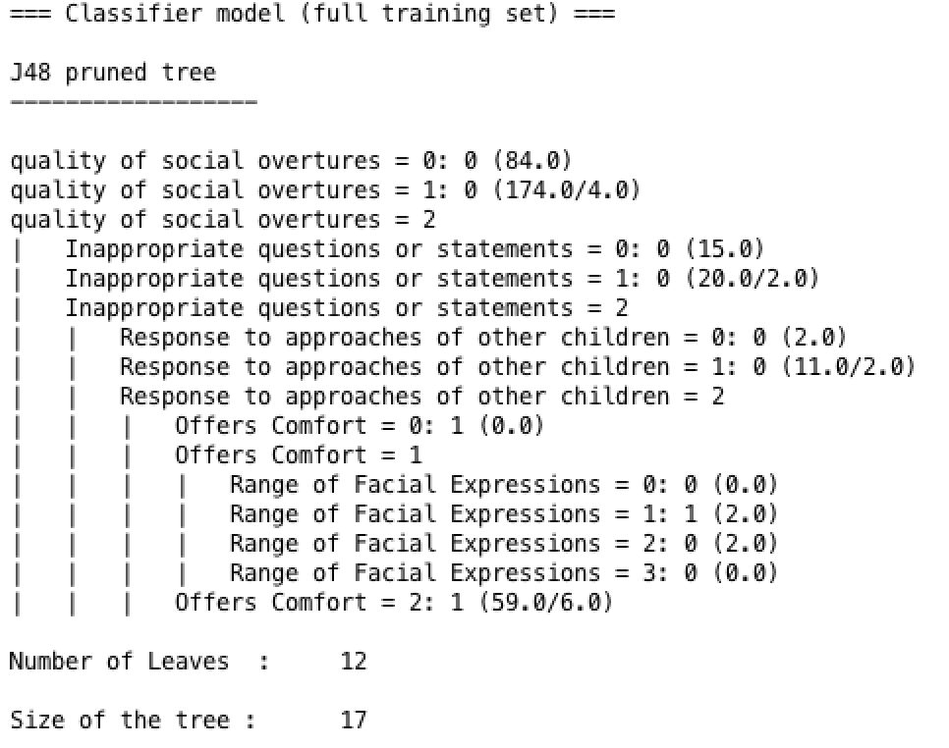
J48 model approximation

Slide 31
Important Features for ADHD
Quality of social overtures
Inappropriate statements or questions
Group play with peers or friendships
Offers comfort
Response of approaches to other children
Range of facial expressions

Slide 32
Deletion Syndrome(22q)
115 subjects out of 369 have VCFS
Techniques used- Logistic Regression, Decision Trees, Naive Bayes and Random Forest
Model with LASSO features (accuracy of 92%), RFE features (accuracy of 90%)
BASC and ADI parent oriented reviews are doing a good job for diagnosis
Feature Set | Accuracy | ROC Area | F-measure
All | 98% | 0.990 | 97%
IQ | 88% | 0.948 | 88%
ADI | 94% | 0.981 | 94%
BASC | 95% | 0.983 | 95%
VINE | 89% | 0.961 | 88%

Slide 33
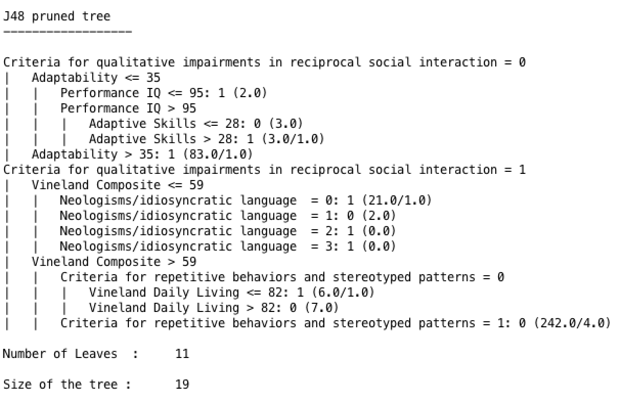
J48 model approximation

Slide 34
Important Features for VCFS
Adaptability
Criteria for qualitative impairments in reciprocal social interaction
Performance IQ
Adaptive skills
Vineland Composite
Neologisms/idiosyncratic language
Criteria for Repetitive behaviors and stereotyped patterns
Vineland Daily Living

Slide 35
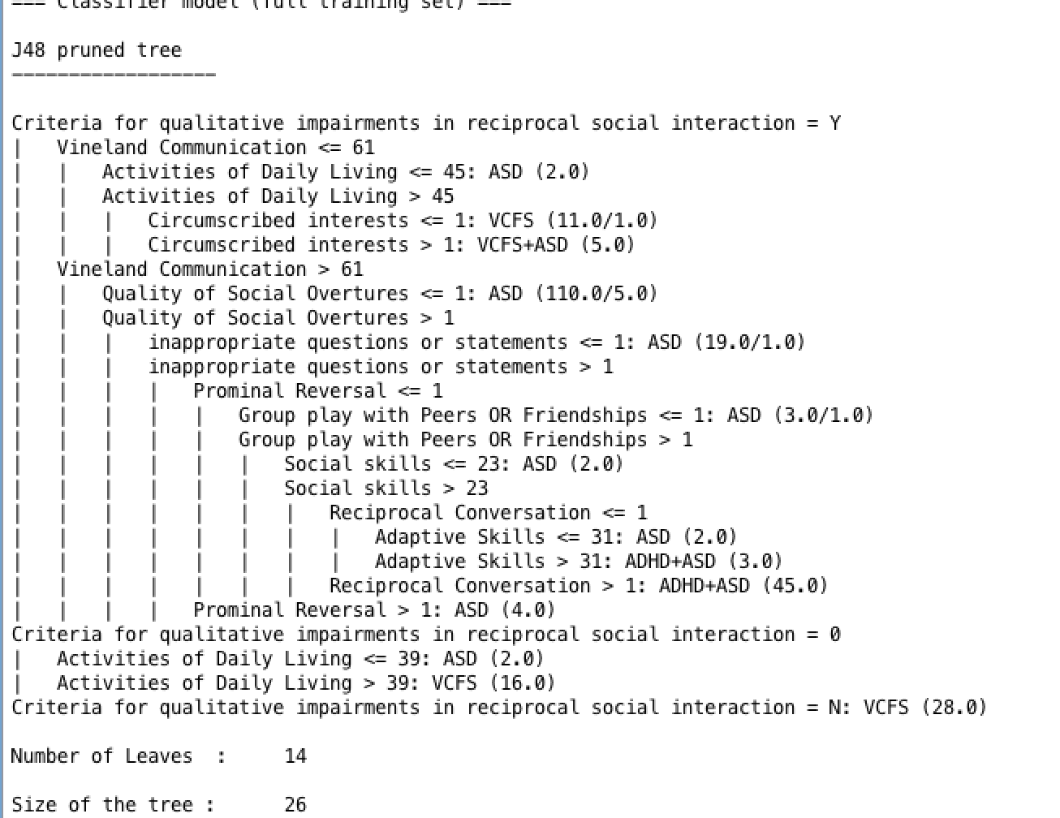
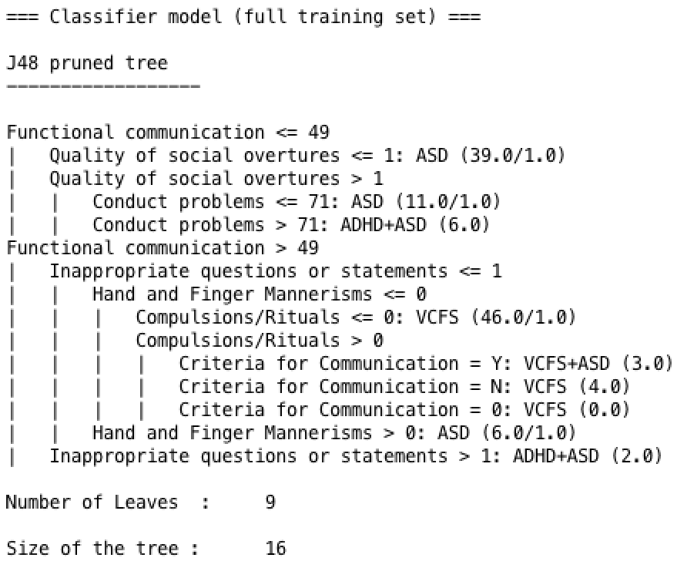
Model Bais
252 males children
Accuracy of j48 is 78%
Accuracy of Random Forest is 87%
117 females children
Accuracy of J48 90%
Accuracy of Random Forest is 94%

Slide 36
Conclusion
Our models predict with a better accuracy of 7% for male children
IQ features cannot be used to predict diagnosis labels
ADI parent-oriented review is better than other two
ASD and VCFS disorders models are more precise over ADHD
ASD and ADHD could be identified with ADI parent oriented reviews and models achieved an average accuracy of 94%
Models could identify ASD and VCFS individually, but identifying their co-occurrence was more complex
Notes:
ASD and VCFs have 90% accuracy on average

Slide 37
Future Work
Models could be tested with other diagnostic labels
Generalization of parent-oriented reviews
Models specific to each diagnostic conditions

Slide 38
Thank You!

