Slide 1
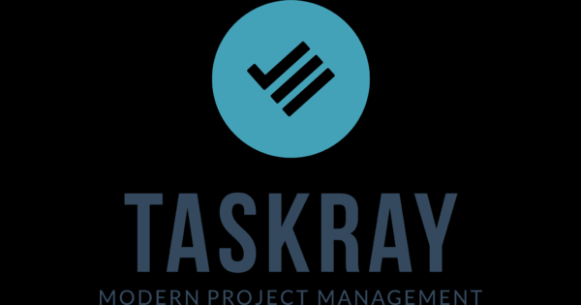
L. Siri Chandana

Slide 2
Contents
TaskRay
Objective
Features
Target Audience
Target Verticles
Business Stories
User Stories
Tech Approach

Slide 3
What is TASKRAY ?
TaskRay is the Leader in Customer Onboarding in Salesforce.
Drives post-sale automation in Salesforce where teams are already closing deals.
Allows teams to collaborate internally and with external customers/clients.
Provides seamless data integration with Salesforce and other solutions such as Quip.

Slide 4
Objective

Slide 5
Features
Views
    My work
    Calender
    Projects
    Row
    kanban
Projects
Tasks
Collanoration
Users
Customizations

Slide 6
Key Features
100% native Salesforce application
3 different ways to work - Column, Deadline or Plan view
Agile project management workflow
Color-coded project filters
Column view - organize work by priority
Communication - built on Salesforce Chatter
Deadline view - track date-driven commitments
Document sharing
Each license includes a free native iOS ap
Easily customizable
Multi-project view
Plan view - high-level project progress
Project hierarchy

Slide 7
Target Audiences

Slide 8
Target Verticles

Slide 9
Data Model

Slide 10
Business Stories

Slide 11
User Stories

