Slide 1
Fake News Detection Using Machine Learning
M. Mounika, Siri chandana

Slide 2
Problem Statement
Manual fact-checking is slow and inefficient.
Need for automated system to detect fake news.
Solution: ML-based text classification model.

Slide 3
Objectives
Automate fake news detection.
Apply NLP & ML techniques.
User-friendly web interface using Streamlit.

Slide 4
Technologies Used
Python, Pandas, Numpy
Scikit-learn (Logistic Regression)
TF-IDF Vectorizer
Streamlit for UI

Slide 5
Dataset Description
Source: Kaggle Fake and Real News datasets
Total Records: 44,898
Fake: 21,417 | Real: 23,481
Merged into single file: news.csv

Slide 6
Data Preprocessing
Merged True.csv and Fake.csv
Labeled: Real = 1, Fake = 0
Selected columns: title, text, label
Used TF-IDF for text vectorization

Slide 7
Model Training
TF-IDF Vectorizer used to extract features
Trained with Logistic Regression
80% Train | 20% Test split
Accuracy: 95%+

Slide 8
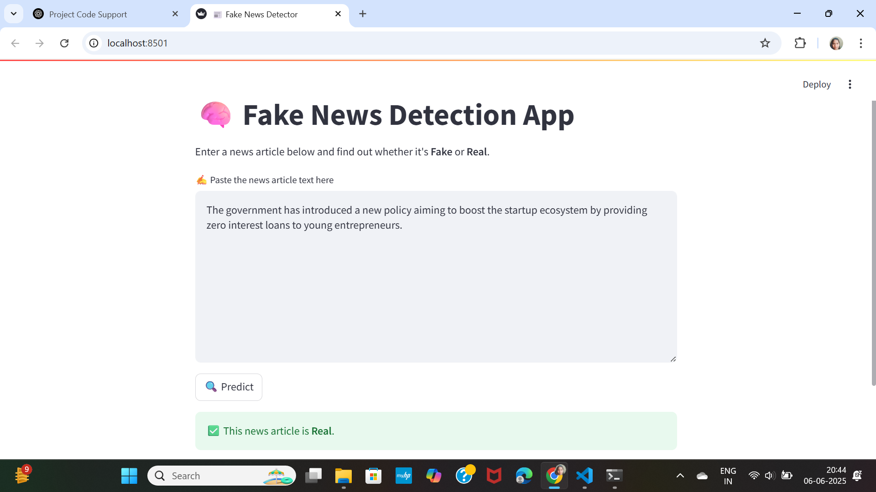
Streamlit Web App Interface

Slide 9
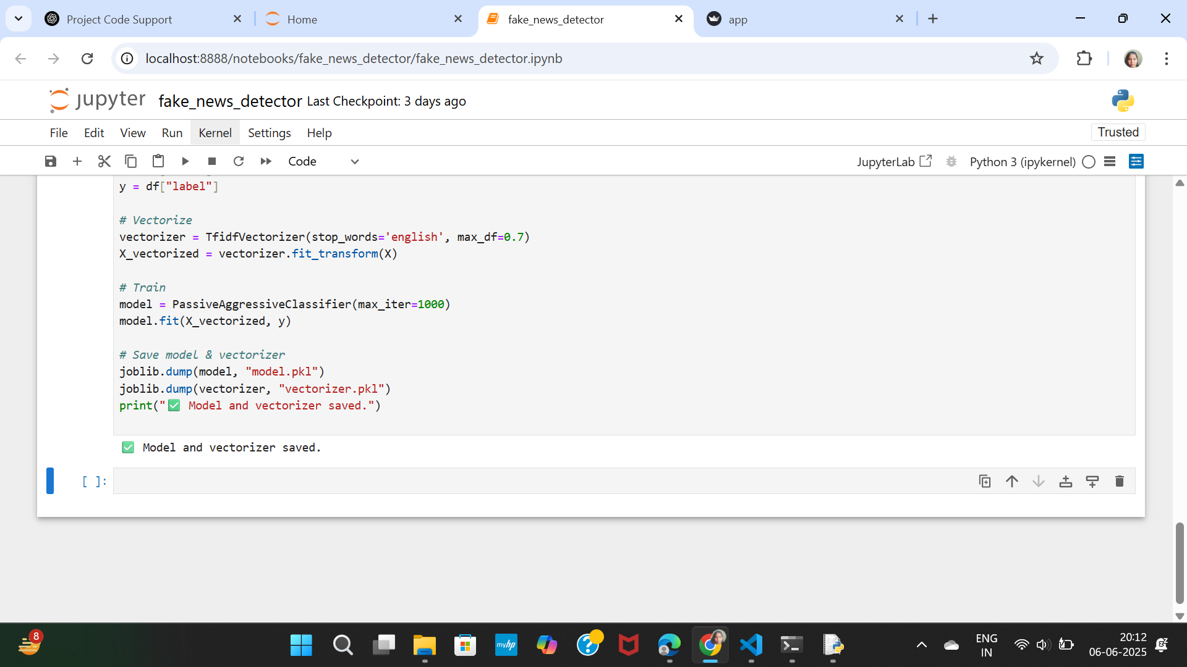
Prediction Screenshot

Slide 10
Challenges & Solutions
Imbalanced dataset → Used proper merge & label
Model tuning → Tried multiple classifiers
Deployment issues → Used Streamlit locally

Slide 11
Conclusion
Functional fake news classifier built
Useful for journalists and readers
Can be extended for real-time usage

Slide 12
Thank You

