Slide 1


2025 International Conference on Computing Technologies (ICOCT)
Title : DDoS Attack - Traffic Stage Identification using Random Forest Algorithm
Paper ID: 4852
B.V.Raju Institute of Technology
Narsapur, Medak Dist,Telangana
By:
Student1: DIVYA SAI
Student2: RUTHVIK
Student3: SAI GANESH
Student4: SIRI HARINI
Guided By:
MR.J.MANIKANDAN.,M.E
ASSISTANT PROFESSOR

Slide 2

Index
Abstract
Research Gaps & Motivation
Introduction
Proposed Architecture
Proposed Frameworks
Dataset Used
Results
Conclusion & Future Work
References

Slide 3
Abstract
The overall performance and availability of online services is particularly threatened by Distributed Denial of Service (DDoS) attacks where systems are flooded with massive traffic with an intention of failing them. During a DDoS attack, it becomes necessary to tell if the traffic coming to the system will result in a DDoS attack. The project investigates to tell which stage the attack is taking place. Stage-1 is Early attack, Stage-2 is ongoing attack and Stage-3 is intense attack. Classifying the attack into stages like this will help in the early detection of the attack and we can mitigate the attack in early stages, significantly reducing the severity of the attack. To achieve this, the project uses the Random Forest algorithm to classify the traffic based on key features, allowing for efficient identification and response during each stage of the attack

Slide 4
Research Gaps and Motivation
Research Gaps:
Lack of Stage-wise Detection: Most models detect DDoS attacks in binary (attack vs normal) form, not in progressive stages like early, ongoing, or intense.
Limited Real-time Classification: Existing methods are often slow or not suitable for real-time response.
Underuse of Ensemble Methods: Random Forest is rarely applied for multi-stage DDoS classification.
Poor Feature Selection: Many features in datasets are irrelevant or redundant, reducing model performance.
Weak Early-stage Detection: Early attack stages are often misclassified or missed.
Data Imbalance Issues: Fewer samples in early stages lead to biased model performance

Slide 5
Research Gaps and Motivation
Motivation:
Early Detection Saves Resources: Identifying attacks early helps prevent damage and reduces server load.
Improved Response Strategy: Classifying attack stages allows for better prioritization of defense actions.
Effective and Interpretable Models: Random Forest offers both high accuracy and insight into key features.
Real-world Relevance: This approach supports scalable, adaptive protection for online services.
Research Advancement: Shifting from binary to stage-wise classification enhances DDoS defense systems

Slide 6
Introduction
In today’s digital era, Distributed Denial of Service (DDoS) attacks pose a significant threat to the availability and reliability of online services. These attacks aim to overwhelm a network or server with excessive traffic, rendering it inaccessible to legitimate users. Early and accurate detection of DDoS traffic is critical to maintaining cybersecurity and preventing service disruption.
This presentation explores an effective machine learning approach to identifying in which stage the DDoS attack is in using the Random Forest algorithm. Early detection and classification of attack stages are important to minimize damage and maintain service availability.
This project focuses on classifying DDoS traffic into three stages: Stage-1: Early Attack
Stage-2: Ongoing Attack
Stage-3: Intense Attack.
A Random Forest algorithm is employed to accurately detect and classify the traffic based on its characteristics, enabling proactive mitigation strategies.

Slide 7
Literature Review
S.No | Paper Title | Author | Methodology | Challenges | Future Enhancements
1 | Analysis and detection of DDoS machine lerning techniqued | Saman Sarraf | Experimental; various machine learning classifiers were applied to network traffic data for DDoS detection. | Effectiveness of ML models (like SVM, Decision Tree) in detecting DDoS attacks. | Explore ensemble methods or real-time detection systems to improve scalability and speed.
2 | Efficient DDoS Detection and Mitigation in SDN | Yang, H., and Zhao, F. | Implementation-based; a DDoS detection mechanism integrated into an SDN controller was tested. | Implementation-based; a DDoS detection mechanism integrated into an SDN controller was tested. | Improve scalability of detection mechanisms and integrate with AI-driven analytics for smarter mitigation.

Slide 8
Literature Review
S.No | Paper Title | Author | Methodology | Challenges | Future Enhancements
3 | A Survey of DDoS Attack Detection and Mitigation Techniques | Anjaneyulu, G. U. S. S. R. | Literature review; comprehensive survey of existing methods and tools. | Overview of existing strategies, highlighting trends and challenges in DDoS defense. | Develop unified frameworks integrating detection and mitigation with AI and SDN for better adaptability.
4 | Classification of DDoS Attack Traffic on SDN Network Environment Using Deep Learning | Deepa, N. | Experimental; deep learning models (like CNN or LSTM) applied to SDN traffic datasets. | High accuracy of deep learning models in identifying attack patterns in SDN-managed networks. | Expand the dataset variety, test models in real-time SDN setups, and reduce false positives.

Slide 9
Proposed Architecture
Key Components:
1. data_preprocessing
2. feature_engineering
3. model_training
4. visualization
Goal:
By analyzing data set to successfully distinguish between Stage-1,2 or 3 aiding in early detection and prevention of DDoS activities.

Slide 10
Architecture of the Proposed Model
Random Forest Classifier
Stage Attack Traffic Identification
Dataset
Normal Traffic
Scanning Traffic
DDoS Attack Traffic
Label Stages
1 – Early Attack
2 – Ongoing Attack
3 – Intense Attack
Feature Extraction

Slide 11
Methods: Data and Pre-Processing
1. data_preprocessing:
Loading the dataset (CSV file reading).
Cleaning the data (replacing 'Infinity', 'NaN', and converting types).
Handling missing values and dropping incomplete rows.
Selecting important features for the model.
Encoding the labels (BENIGN and DDoS) into numeric values.
Splitting the dataset into training and testing sets.
2. feature_engineering
Defining and applying the attack stage classification (Stage 1, Stage 2, Stage 3) based on Flow Bytes/s.
Creating a new feature called 'Attack Stage'.
Preparing the data to predict attack stages instead of basic labels.

Slide 12
Methods: Data and Pre-Processing
3. model_training
Training the Random Forest Classifier on both the attack label and attack stage.
Making predictions on the test set.
Evaluating model performance using:
Accuracy score
Confusion matrix
Classification report
4. visualization
Creating a bar plot showing the distribution of attack stages (Stage 1, Stage 2, Stage 3).
Displaying charts for better understanding of traffic behavior and attack intensity.

Slide 13
Performance Evaluation
 | Precision | Recall | F1 - score | Support
Stage -1 | 1.00 | 1.00 | 1.00 | 55576
Stage -2 | 1.00 | 1.00 | 1.00 | 7882
Stage -3 | 1.00 | 1.00 | 1.00 | 4256

Slide 14
Performance Evaluation
Attack Stage:
Stage 1: 185065
Stage 2: 26257
Stage 3: 14389
Name: count, dtype: int64
Accuracy: 1.0
Confusion Matrix: [ [55576 0 0]
[ 0 7882 0]
[ 0 0 4256 ] ]

Slide 15
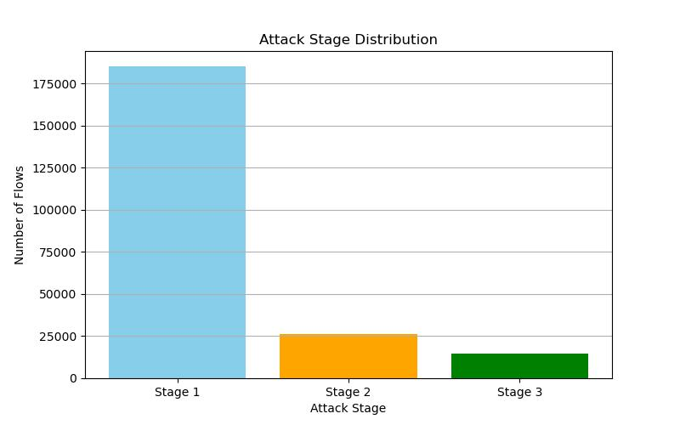
Results and Discussion

Slide 16
Conclusion and Future Work
Conclusion:
1.The Random Forest algorithm has proven to be an effective method for identifying DDoS attack traffic due to its robustness, accuracy, and ability to handle large datasets.
2.By analyzing data set ,the model successfully distinguishes between Stage-1,2 or 3 aiding in early detection and prevention of DDoS activities.
Future Work:
1.Advanced Models: Try XGBoost, LightGBM, CatBoost for better accuracy.
2.Deep Learning: Use MLP or LSTM for smarter detection.
3.Feature Engineering: Create new features (e.g., packet variance) and use feature selection (RFE).
4.Hyperparameter Tuning: Optimize models using GridSearchCV or RandomizedSearchCV

Slide 17
References
[1]Saman saraff.,”Analysis and detection of DDoS Attacks Using Machine learning techniques”,American Scientific Research Journal for engineering, Technology, and Sciences, vol.66, No 1,pp 95-104, March.2020.
[2]Yang, H., and Zhao, F., ”Efficient DDoS detection and mitigation in SDN,” IEEE Trans. Netw. Serv. Manage.vol. 15, no. 4, pp. 1001-1010, Dec. 2018
[3]Deepa, N., ”Classification of DDoS attack traffic on SDN network environment using deep learning,”Cybersecurity 2, 4, pp. 1-15, Oct. 2021
[4]Hu, W., ”A hybrid approach for DDoS attack detection in SDN,” J. Netw. Comput. Appl., vol. 124, pp. 42-56,Mar. 2021
[5]Anjaneyulu, G. U. S. S. R., ”A Survey of DDoS Attack Detection and Mitigation Techniques,” International Journal of Computer Science and Engineering, vol. 9, no. 5, pp. 512-526, May 2022

Slide 18
References
[6]Gokhale, A. S., Shukla, B. K., and Gupta, R. K., ”DDoS Detection using Machine Learning Techniques,” Journal of Network and Computer Applications, vol. 45, no. 3, pp. 78-92, Aug. 2020.
[7]Shuja, H. A., Alam, F. A., and Al-Dubai, A. M., ”DDoS Attack Detection Using Flow Data: A Review,” IEEE Access, vol. 9, pp. 1450 1461, Feb. 2021.
[8]Ahmed, H. F., and Al-Ameen, A. M. G. N., ”Distributed Denial of Service (DDoS) Attack Detection and Mitigation Techniques,” in Handbook of Computer Networks and Cyber Security, Springer, 2021, pp. 763-781.
[9]Abadi, B., and Chang, F., ”DDoS Attacks: From Detection to Miti gation,” Computer Security Journal, vol. 33, no. 4, pp. 218-230, Dec. 2022.
[10]Ibrahim, Z. A., Rahman, R. R. A., and Islam, M. M., ”Analysis and Detection of DDoS Attacks in SDN Networks,” Journal of Cyber Security Technology, vol. 4, no. 1, pp. 34-48, Nov. 2019.

Slide 19
References
[11]Komar, M., et al. Deep Neural Network for Detection of Cyber At tacks. in 2018 IEEE First International Conference on System Analysis and Intelligent Computing (SAIC). 2018. IEEE.
[12]Sarraf, S., 5G Emerging Technology and Affected Industries: Quick Survey. American Scientific Research Journal for Engineering, Technol ogy, and Sciences (ASRJETS), 2019. 55(1): p. 75-82.
[13]M Devendra Prasad, P.B.V., C Amarnath, Machine Learning DDoS Detection Using Stochastic Gradient Boosting. International Journal of Computer Sciences and Engineering, 2019. 7(4): p. 157-16

Slide 20


