Slide 1
EMPLOYEE SALARY PREDICTION
IBM-SKILLBUILD PROJECT
Presented By:
Name: Kanderi Shree Siri
College: St. Vincent Pallotti College Of Engineering And Technology
Dept: Computer Science and business Systems

Slide 2
OUTLINE
Problem Statement (Should not include solution)
System Development Approach (Technology Used)
Algorithm & Deployment (Step by Step Procedure)
Result
Conclusion
Future Scope(Optonal)
References

Slide 3
Problem Statement
This project aims to develop a machine learning model that predicts employee salaries based on key factors such as age, gender, education level, years of experience, and job title. The goal is to support fair compensation practices and data-driven HR decisions by accurately estimating salaries and reducing bias. A key challenge addressed is the effective handling of diverse job titles by ranking them based on salary levels to improve model accuracy.

Slide 4
System Approach
This project follows a machine learning-based approach to predict employee salaries using structured data. The process includes data cleaning, handling missing values, and encoding categorical variables like gender and education. Job titles are ranked based on median salary to improve prediction accuracy and reduce feature complexity. The dataset is split into training and testing sets, and models such as Linear Regression, Decision Tree, and Random Forest are trained. Hyperparameter tuning is performed using GridSearchCV to optimize model performance. The system is implemented in Python using libraries like pandas, numpy, scikit-learn, and matplotlib.

Slide 5
System requirements
Operating System: Windows 10/11 or Linux
Processor: Intel i5 or higher / AMD Ryzen
RAM: Minimum 8 GB (Recommended: 16 GB
Python Version: 3.8 or above
Development Environment: Jupyter Notebook or VS Code
Library required to build the model
Pandas—Data manipulation
Numpy– numerical Computations
Matplotlib, seaborn—Data Visualization
Scikit-learn –Model Building, training and Evaluation
Joblib– Saving the model

Slide 6
Algorithm & Deployment
Data Collection Imported a structured employee salary dataset containing features like age, gender, education, job title, experience,
and salary.
Data Preprocessing Cleaned the dataset by handling missing values and standardizing categorical values (e.g., normalizing education levels).
Feature Engineering Ranked job titles based on their median salaries to reduce randomness and improve model learning. Encoded other
Categorical features using one-hot encoding.
Model Building Split the data into training and testing sets. Trained multiple regression models including Linear Regression, Decision
Tree, and Random Forest.
Hyperparameter Tuning Applied GridSearchCV to find the best model configuration for optimized accuracy.
Model Evaluation Evaluated models using metrics like Mean Absolute Error (MAE), Mean Squared Error (MSE), and R² Score.
Prediction Used the final model to predict salaries for new employee profiles by matching input features with the trained model’s
structure.
Model Saving Saved the best-performing model using joblib for future use and easy reuse without retraining.

Slide 7
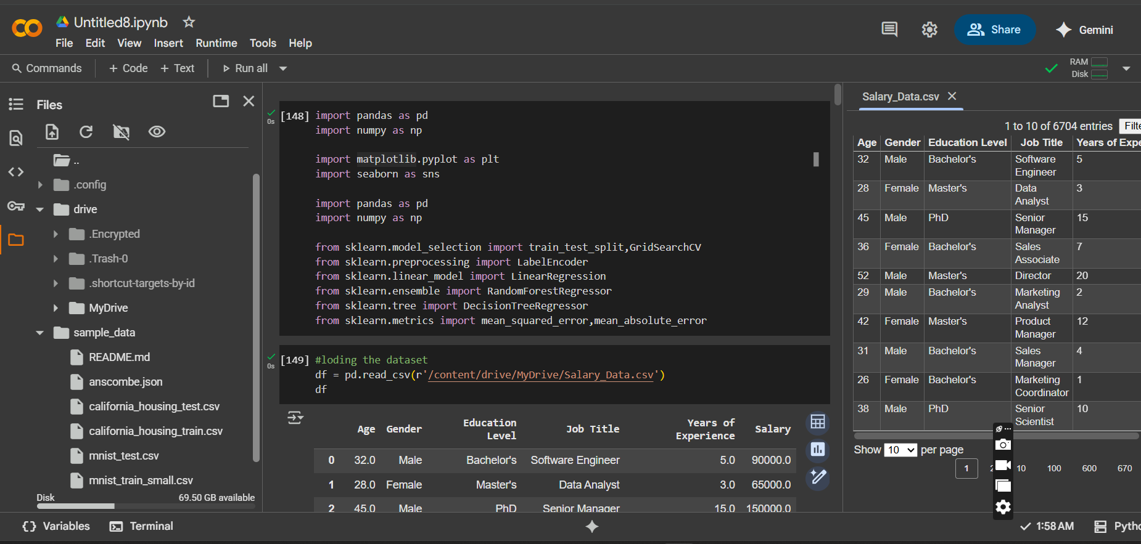
Result
Screenshot 1

Slide 8
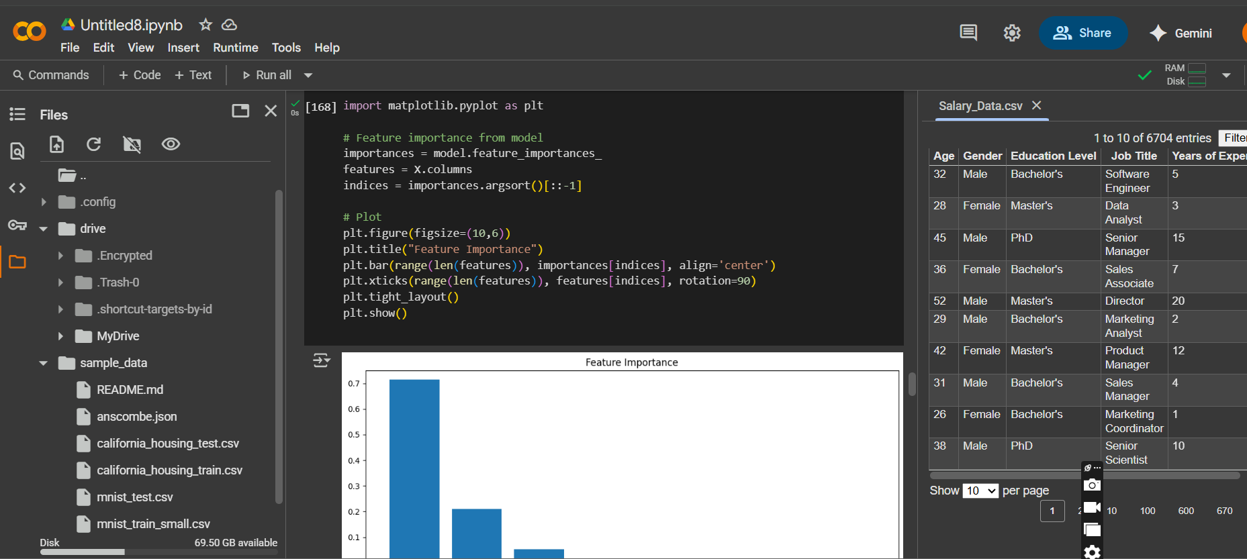
Result
Screenshot 2

Slide 9
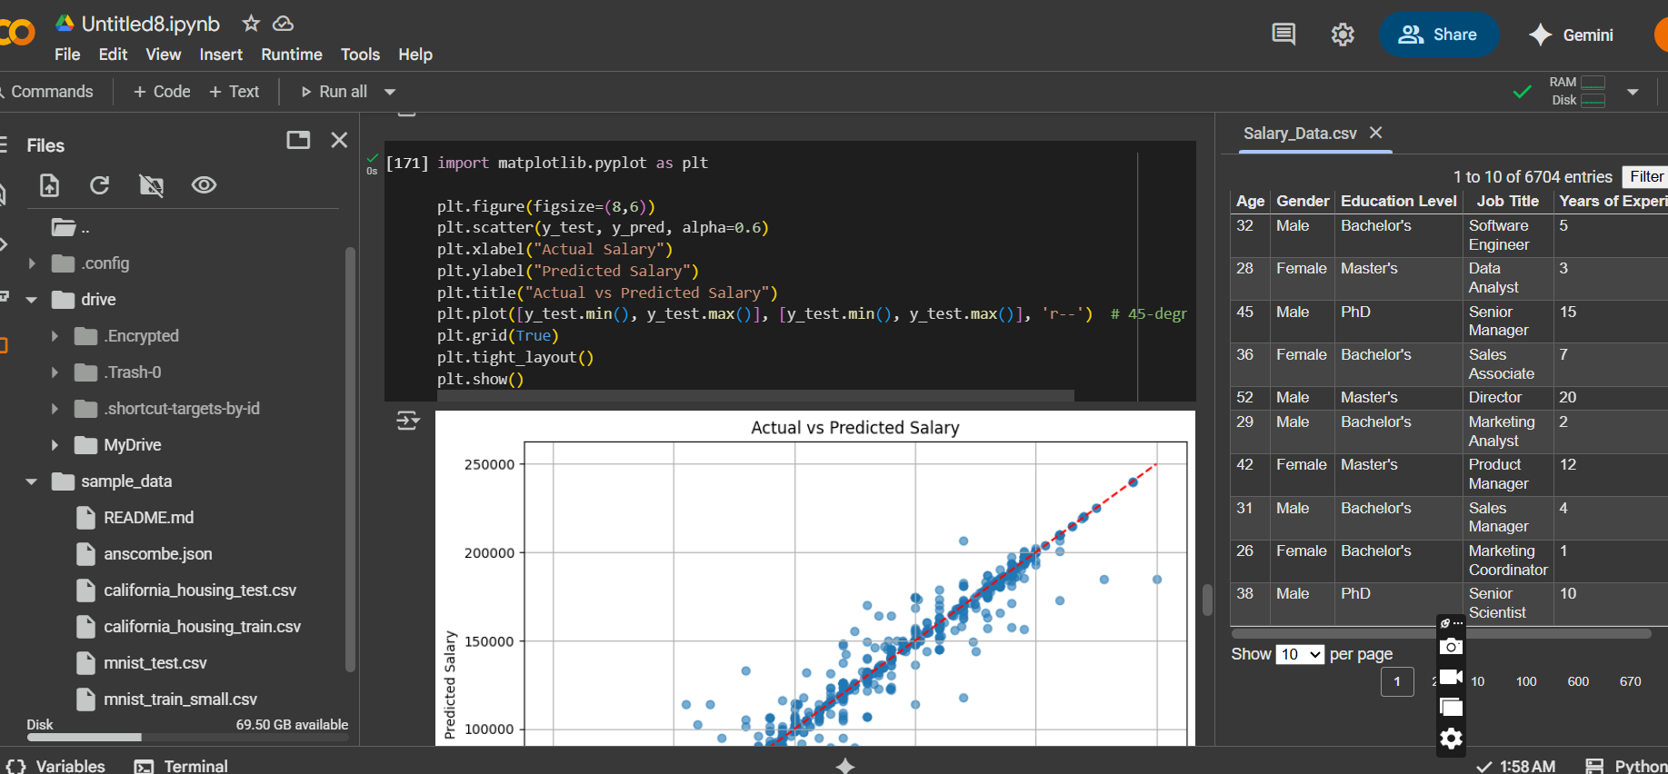
Result
Screenshot 3

Slide 10
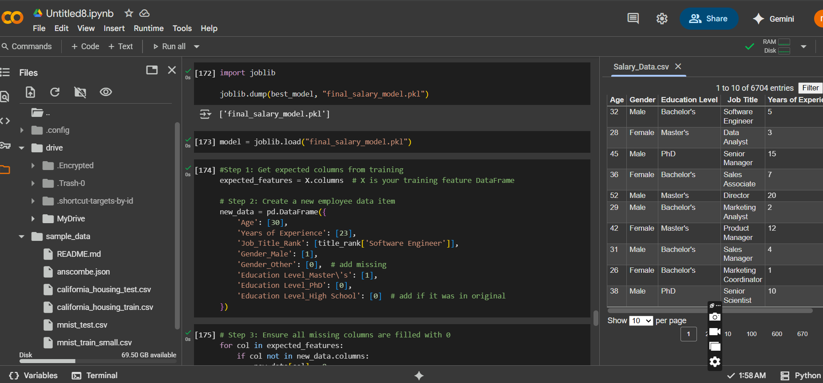
Result
Screenshot 4

Slide 11
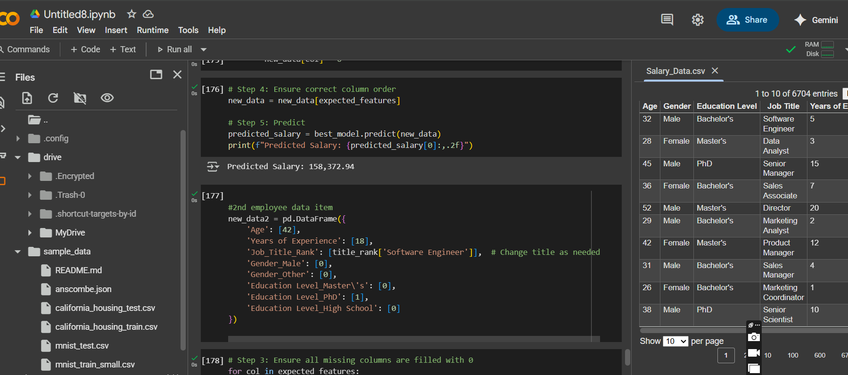
Result
Screenshot 5
Github Project Repository:
https://github.com/Sirikanderi/Salary_Prediction.git

Slide 12
Conclusion
In conclusion, the Random Forest model demonstrated the best predictive capability for salary estimation in this dataset. Its feature importance analysis revealed the most influential factors.This salary prediction model can be used to make informed salary estimates based on individual characteristics, making it a valuable tool for HR analytics and compensation planning.In conclusion, our salary prediction model, trained on a well-preprocessed dataset, successfully predicts salaries based on various factors. This project demonstrates the importance of data preprocessing, feature engineering, and model selection in creating an accurate predictive model.

Slide 13
Future scope(Optional)
The system can be enhanced by incorporating larger and more diverse datasets to improve accuracy and reliability. Adding real-time learning capabilities will allow the model to adapt quickly to new data. Expanding the application to other industries or domains can increase its impact. Future improvements can also focus on strengthening privacy protections and integrating advanced explainability tools to make AI decisions clearer and more transparent.

Slide 14
References
.
Goodfellow, I., Bengio, Y., & Courville, A. (2016). Deep Learning. MIT Press. https://www.deeplearningbook.org/
Dwork, C. (2008). Differential Privacy: A Survey of Results. Theory and Applications of Models
of Computation.
https://link.springer.com/chapter/10.1007/978-3-540-79228-4_1
IBM AI Fairness 360 Toolkit. (2020). IBM. https://aif360.mybluemix.net/
Google AI Blog (2021). Explainable AI: Interpretability Techniques. https://ai.googleblog.com/2021/05/explainable-ai-interpretability.html

Slide 15
THANK YOU

