Slide 1
TP-DATE
Travelling pair flow matching
2026.10.20
Junda Ying (应骏达)
Beijing International Center for Mathematical Research (BICMR)
Peking University

Slide 2
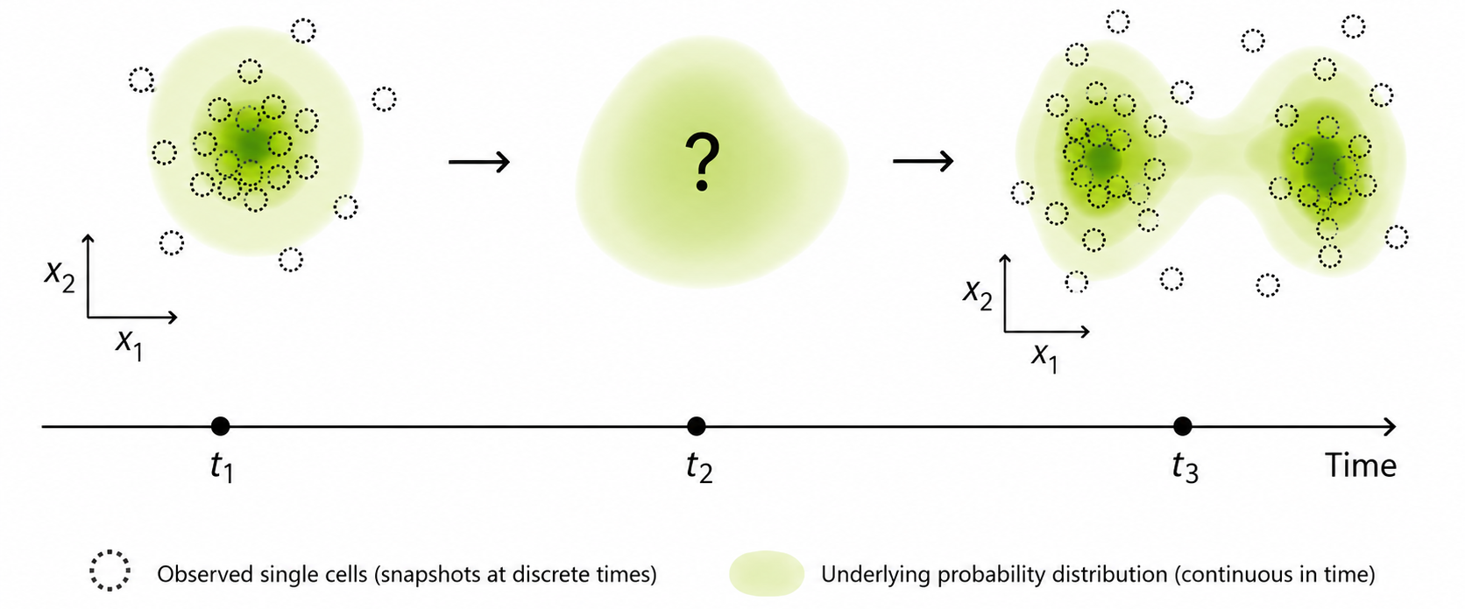
Snapshots → Continuous interpolation

Slide 3
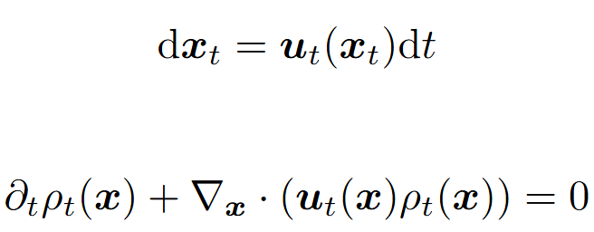
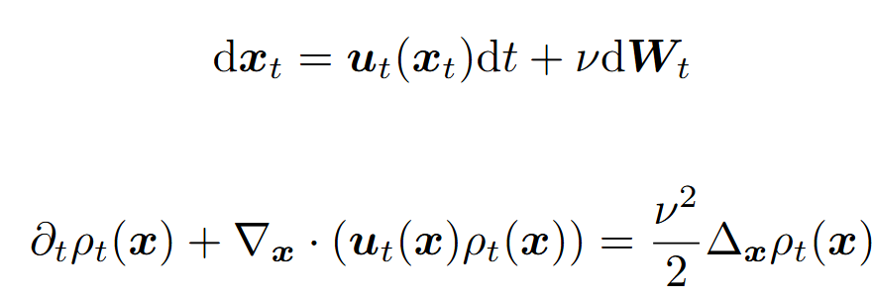
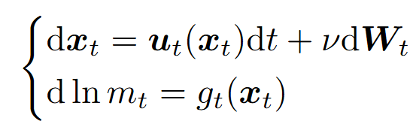
Weighted Particles
Particle dynamics
Measure dynamics
ODE
Continuity equation
SDE
Fokker-Planck equation
Fokker-Planck equation with source
Weighted SDE

Slide 4
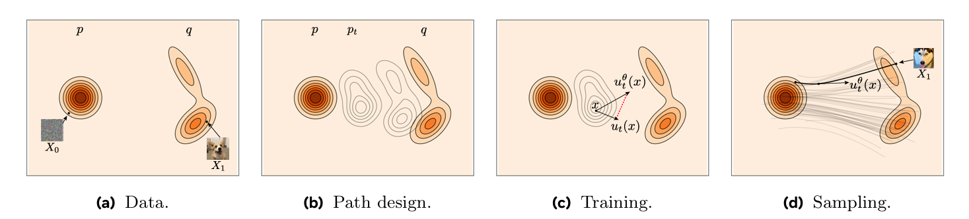
Flow Matching (FM)
Y. Lipman et. al, Flow Matching Guide and Code
Difficulty: the true velocity field u is intractable
Notes:
Figure from Y. Lipman et. al, Flow Matching Guide and Code, https://arxiv.org/abs/2412.06264

Slide 5
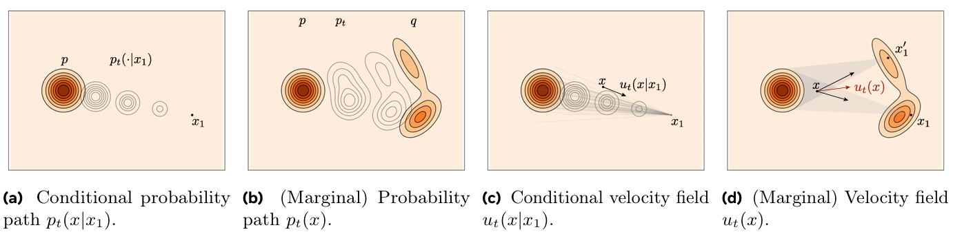
Conditional Flow Matching (CFM)
As a tractable alternative, one can also regress the conditional velocity
Figure from Flow Matching Guide and Code
Notes:
Figure from Y. Lipman et. al, Flow Matching Guide and Code, https://arxiv.org/abs/2412.06264

Slide 6
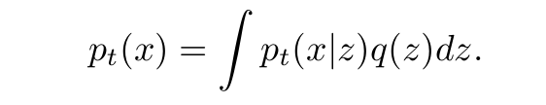
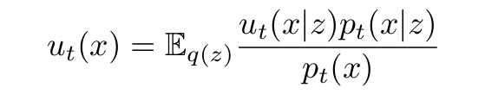


Learning marginal by conditions
Marginalization trick
Equivalence between FM loss and CFM loss
Notes:
这里下面x1就是上面的z

Slide 7
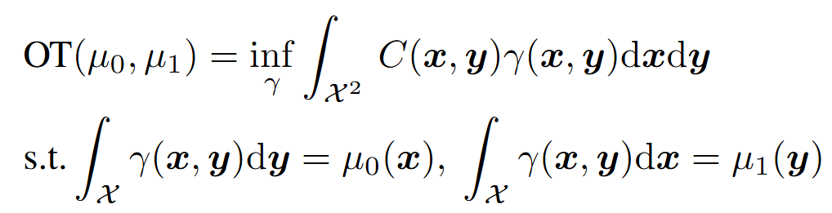
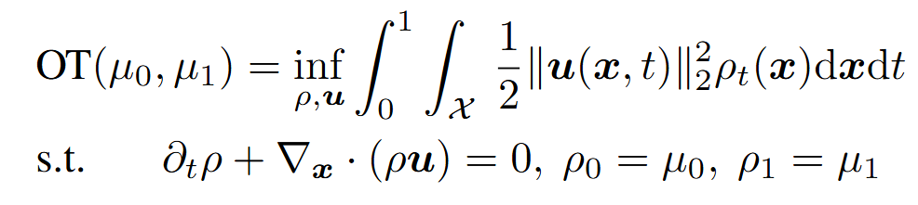
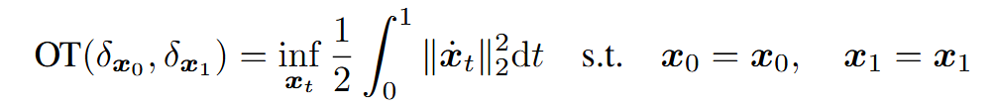
Optimal Transport (OT)
Static form (Kantorovich)
Dynamic form (Benamou, Brenier)
Observation: dynamics = static coupling + conditional path
transport plan
how to transport
Notes:
即存在一种调整，使得全局测地和子结构测地都得到满足

Slide 8
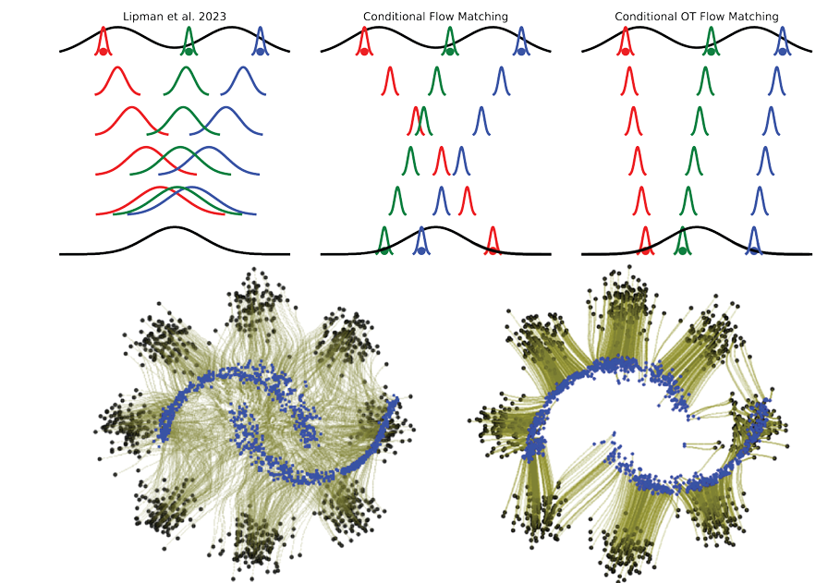
OT-CFM
Solve dynamic OT by flow matching.
PINN loss automatically satisfied
OT loss automatically minimized
Reconstruction loss automatically matched
A.Tong et. al, Improving and generalizing flow-based generative models with minibatch optimal transport.
Notes:
将整个数值求解过程变成了一个数值积分

Slide 9
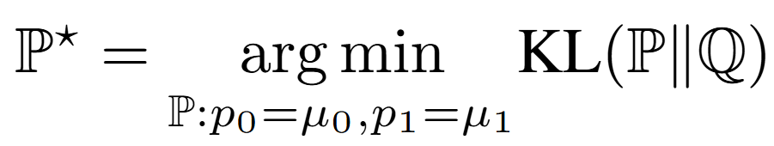
Schrödinger bridge
Deterministic version: What is the optimal transport between two distributions?
Stochastic version: What is the most likely stochastic process bridging two distributions?
Notes:
大偏差理论Sanov定理：在参考过程Q下，N个粒子的经验分布P，服从一概率分布Prob(P)≈exp(-N*KL(P||Q))，因此所谓薛定谔桥，就是最可能的那个随机过程。

Slide 10
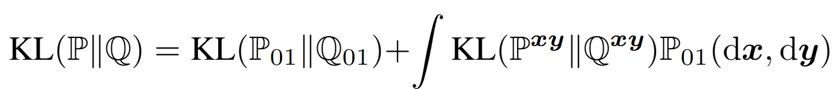
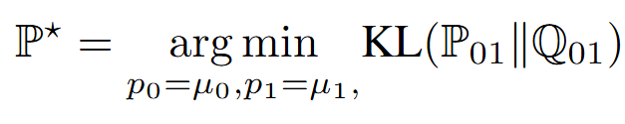
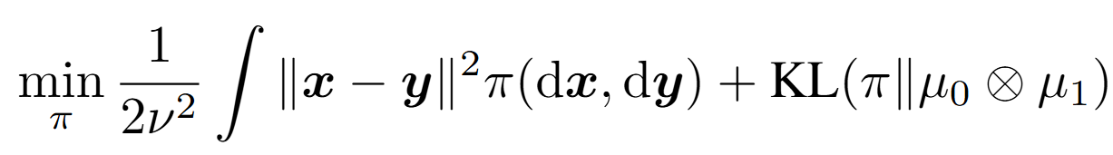
KL disintegration
Disintegration
Static Schrödinger bridge
can be minimized to 0
Regularized OT
Notes:
大偏差理论Sanov定理：在参考过程Q下，N个粒子的经验分布P，服从一概率分布Prob(P)≈exp(-N*KL(P||Q))，因此所谓薛定谔桥，就是最可能的那个随机过程。

Slide 11
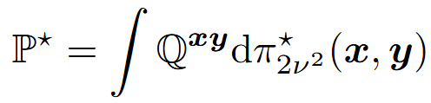
KL disintegration
Regularized OT + Brownian bridge
Observation: dynamics = static coupling + conditional path
Conditional path
Coupling
Notes:
大偏差理论Sanov定理：在参考过程Q下，N个粒子的经验分布P，服从一概率分布Prob(P)≈exp(-N*KL(P||Q))，因此所谓薛定谔桥，就是最可能的那个随机过程。

Slide 12
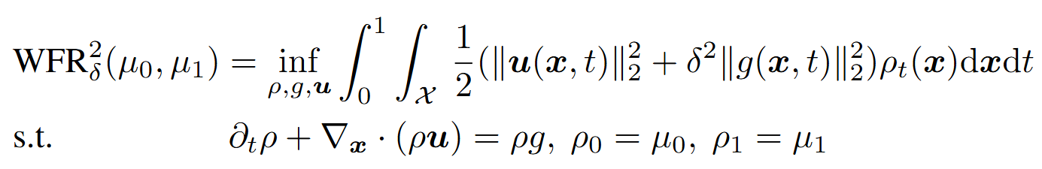
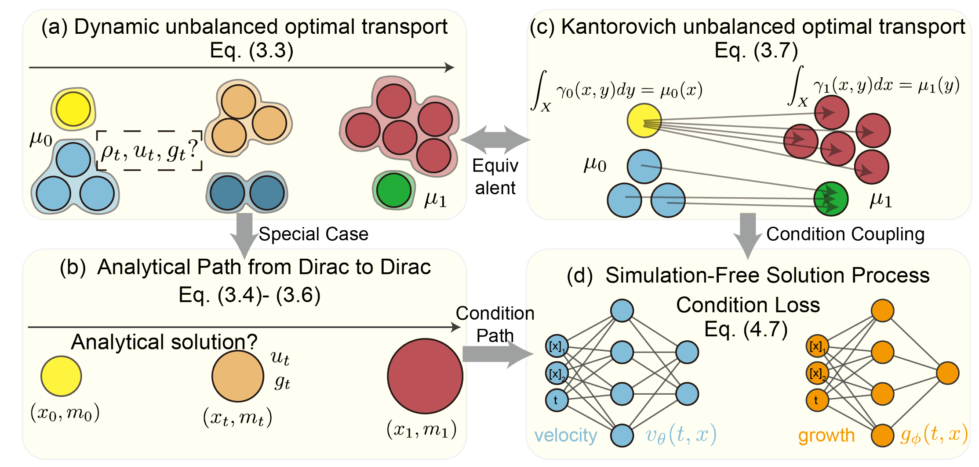
Unbalanced OT
static coupling
conditional path
Joint work with Peng et. al, WFR-FM: Simulation-free dynamic unbalanced optimal transport
Notes:
WFR在理论上被证明的确是个度量，并且有静态形式，能够转化为OET问题高效求解

Slide 13
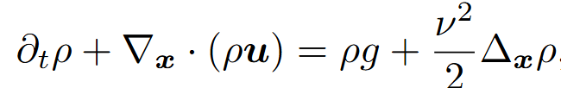
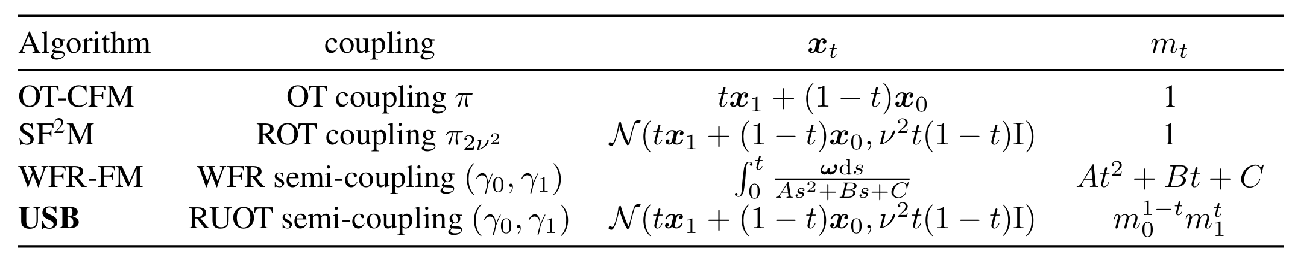
Key observation
Dynamics = coupling + conditional path
Stochastic
Unbalanced
Ying et. al, Beyond Continuity: Simulation-free Reconstruction of Discrete Branching Dynamics from Single-cell Snapshots

Slide 14
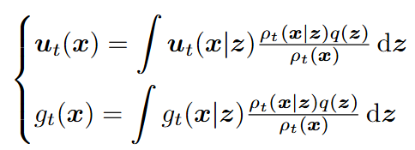
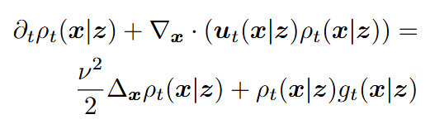

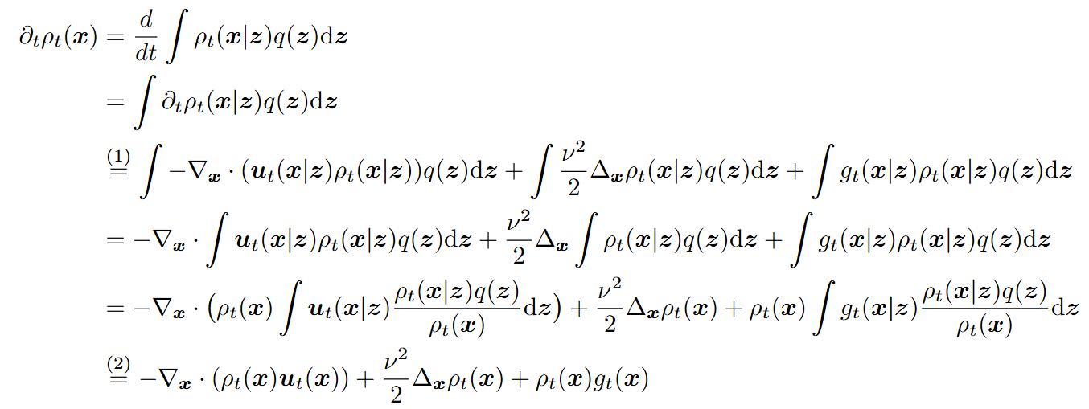
Marginalization trick
Linear & local

Slide 15
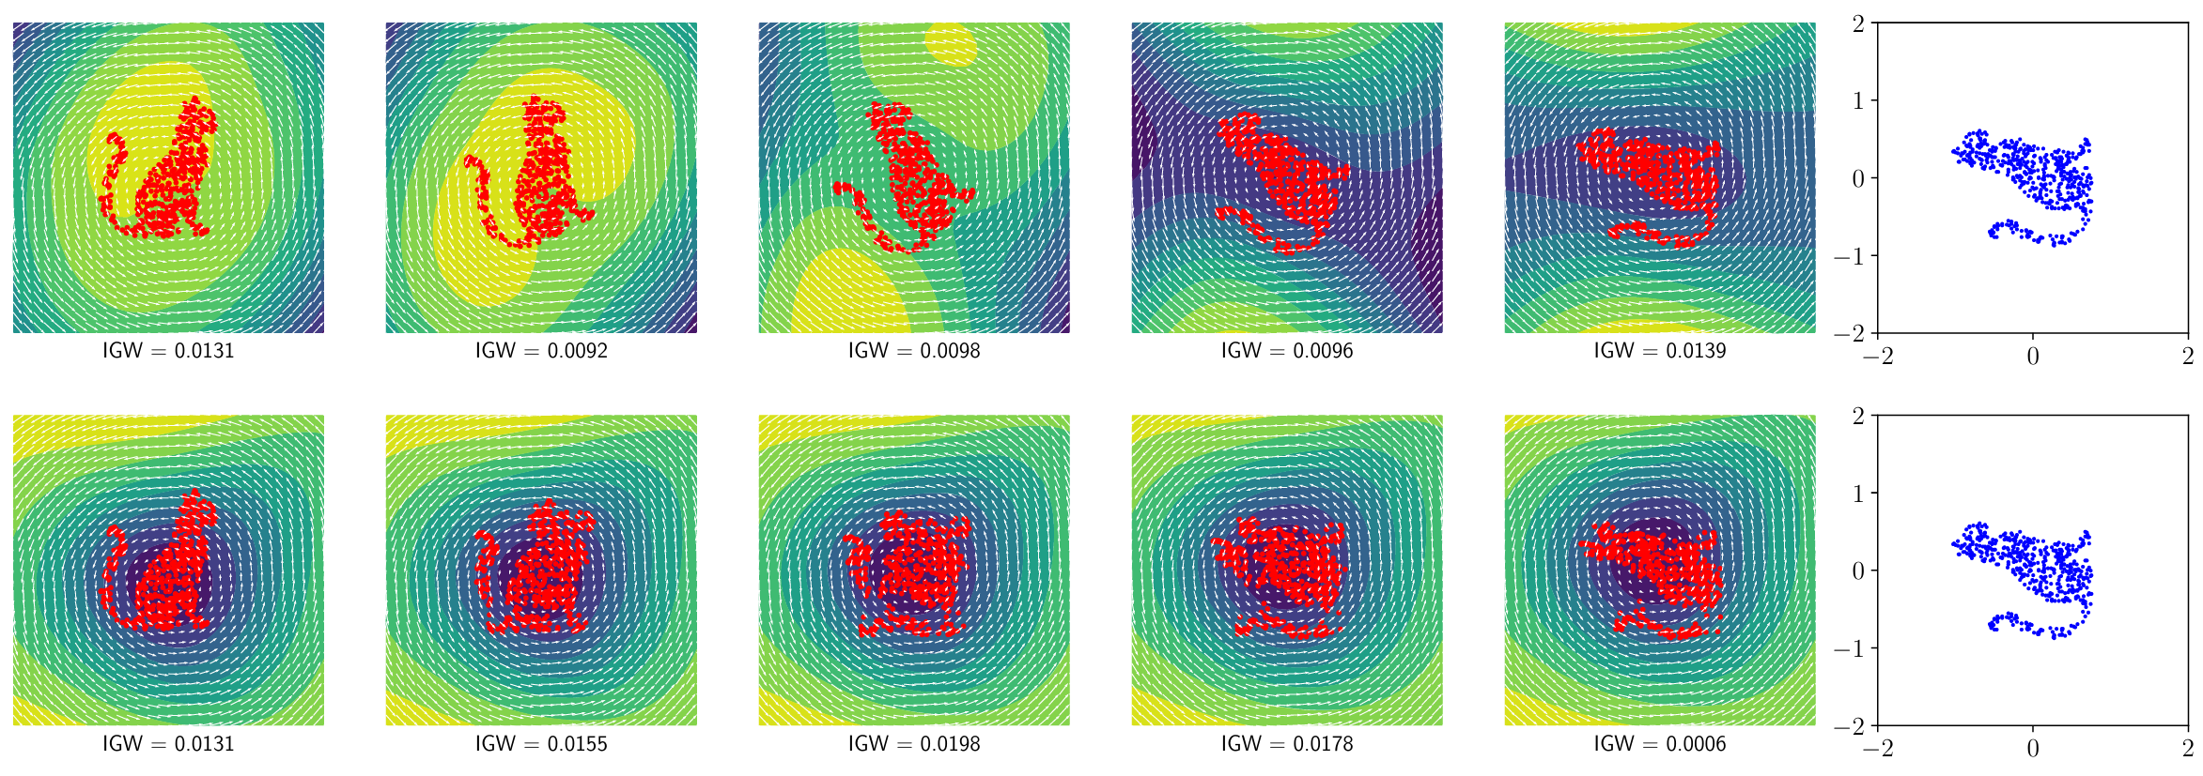
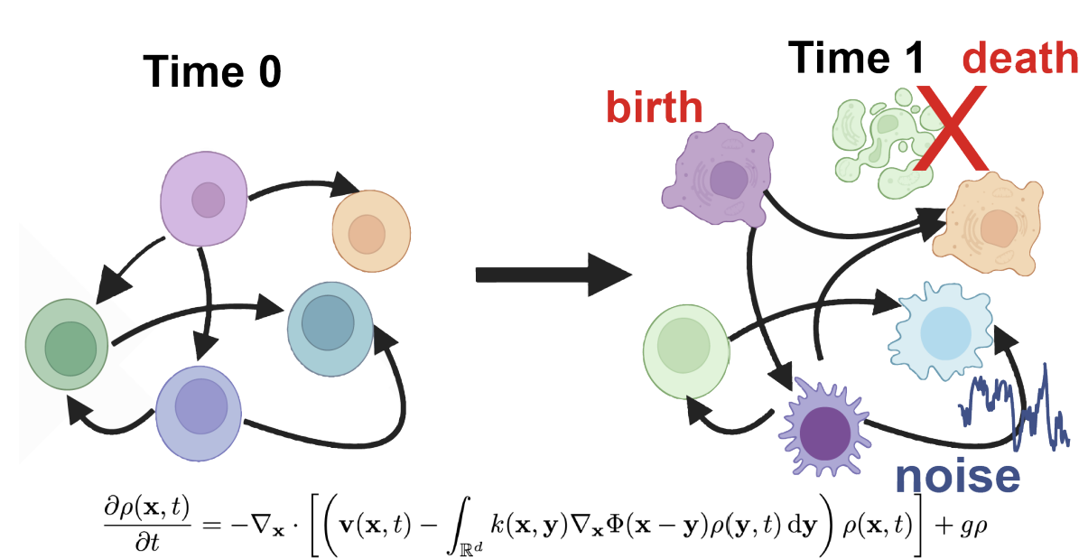
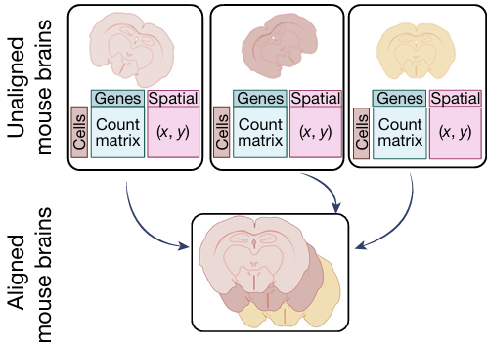
Nonlocal effects
Cell-cell interaction
Structural alignment
Zhenyi Zhang et. al, Modeling Cell Dynamics and Interactions with Unbalanced Mean Field Schrödinger Bridge.
Zhengxin Zhang et. al, Gradient Flows and Riemannian Structure in the Gromov-Wasserstein Geometr
The conditional paths have to interact
Klein et. al, Mapping cells through time and space with moscot

Slide 16
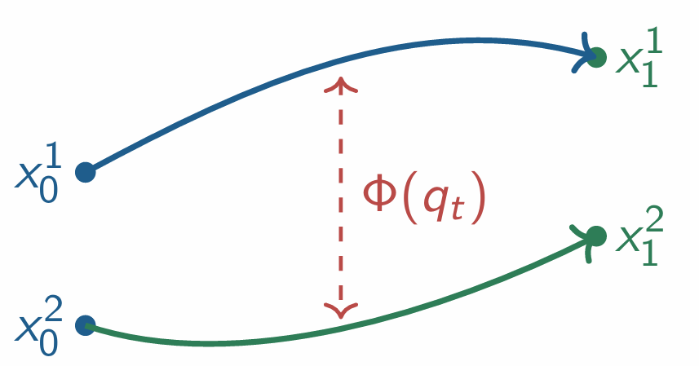
Challenges
Conditional paths only condition on endpoint pair, hence are independent.
Interacting dynamics introduces nonlocal term into the continuity equation. The marginalization trick fails.
To address these challenges, we consider how a pair of particles travel instead of how one particle travels. (Travelling pairs)

Slide 17
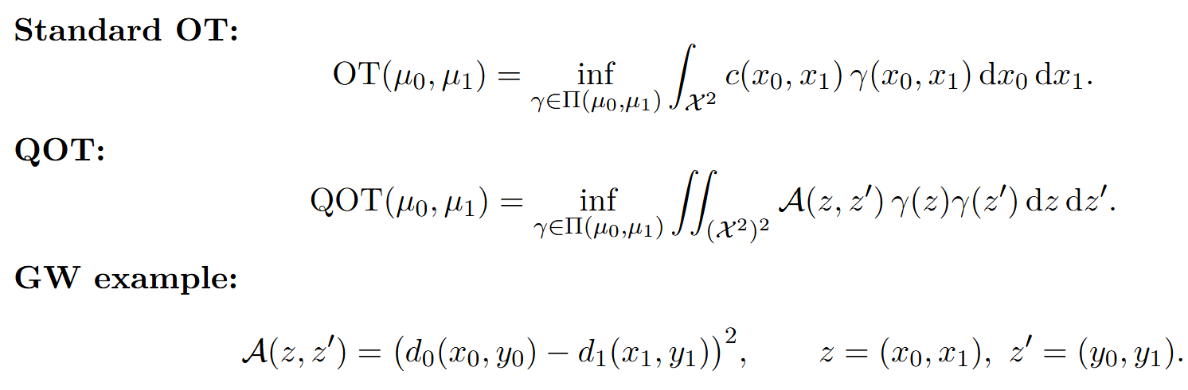
Quadratic-form OT (QOT)

Slide 18
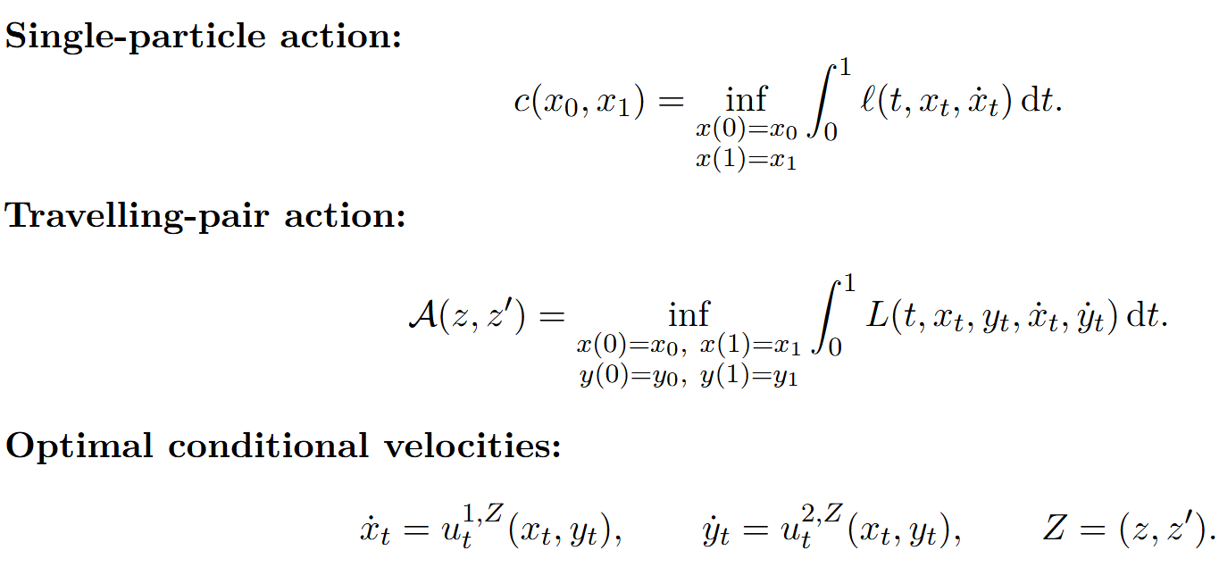
Travelling pair
Eg.
Interaction term

Slide 19
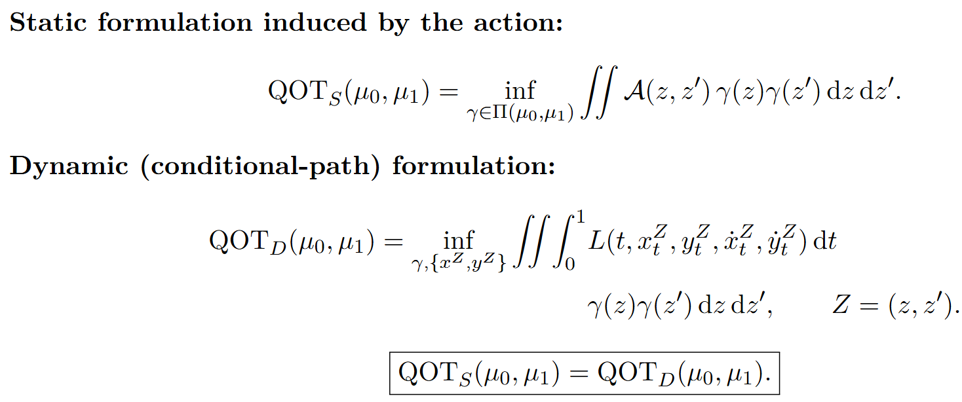
Dynamic QOT realization

Slide 20
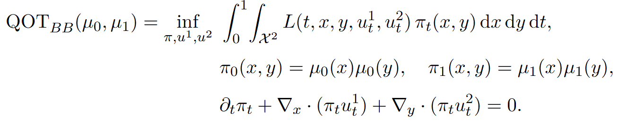

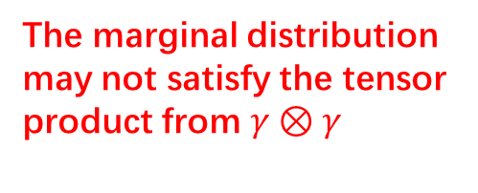
The BB-form
The marginal distribution may not satisfy the tensor product from $γ⊗γ$
An analog to the BB-form in OT
In this case, the static QOT is no longer equivalent to the BB-form. Only

Slide 21
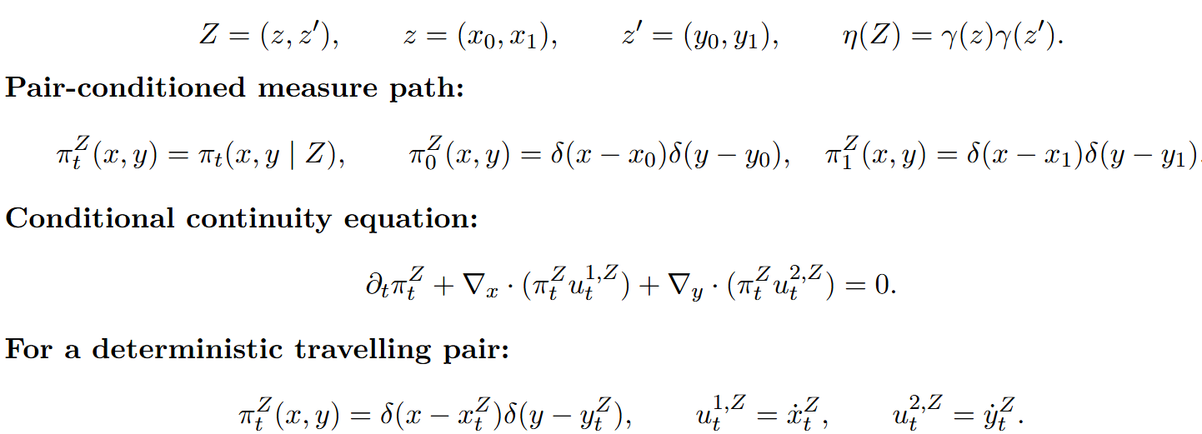
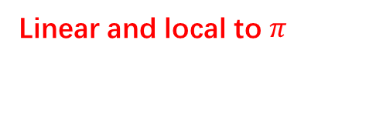
Conditional pair dynamics
Linear and local to $π$

Slide 22
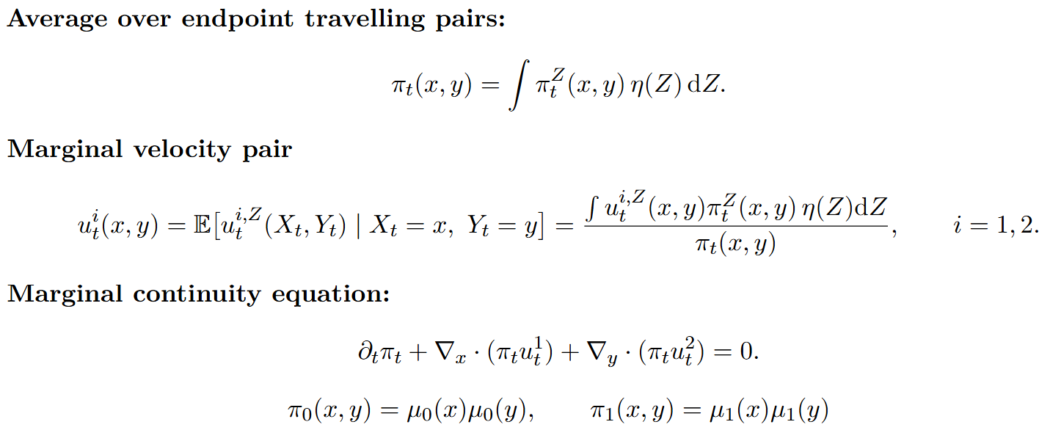
Pair marginalization
Can be learned by flow matching

Slide 23
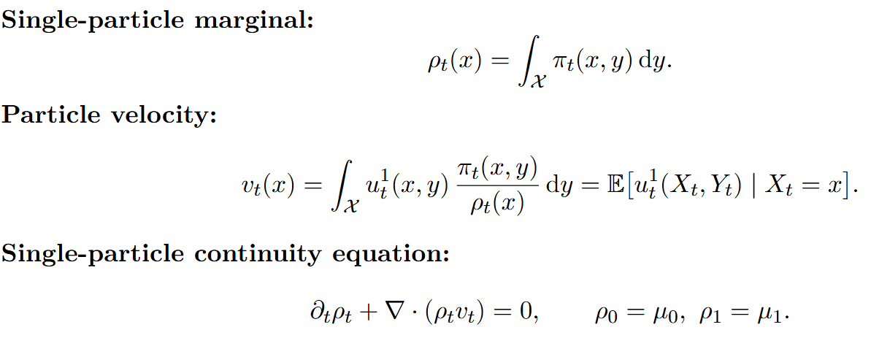
Particle marginalization
Intuitively, the particle velocity of X marginalizes the interaction effect over all possible partners Y
We start at a travelling pair setting, and travel back to the single particle transport setting by marginalization.

Slide 24
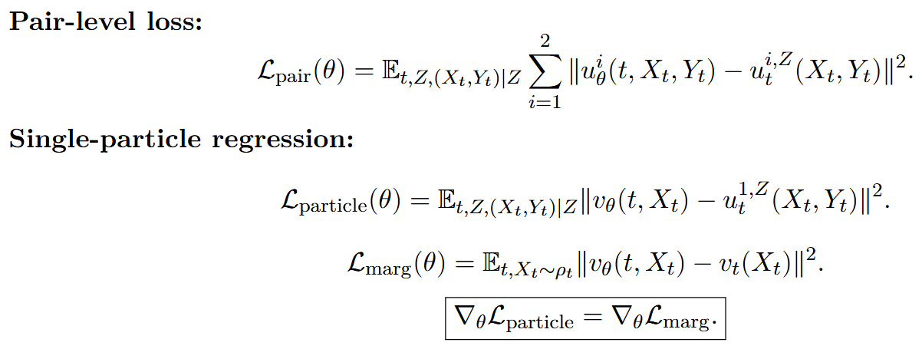
Travelling pair flow matching

Slide 25





Velocity decomposition
Suppose we have some velocity decomposition
Self-driven
Interaction-driven
Single-particle marginalization
The marginal dynamics can be viewed as an approximation to the mean-field dynamics

Slide 26
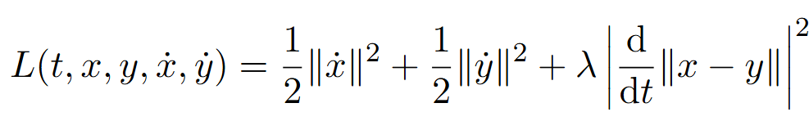
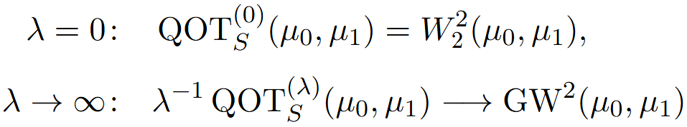
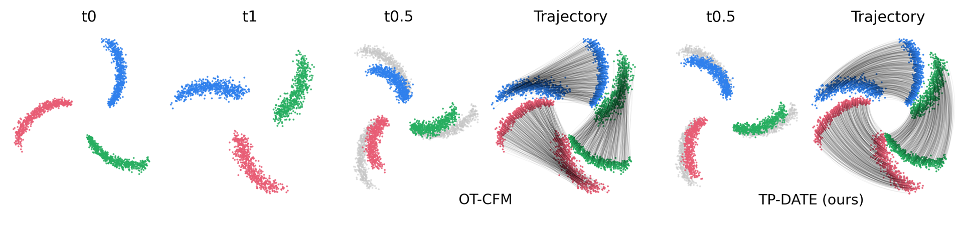
An example – GW-OT as a limit case
Kinetic energy
Geometric distortion term for structure preservation

Slide 27
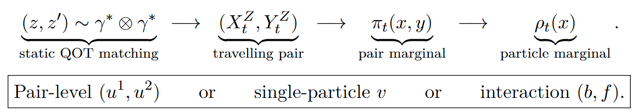
Summary
Flow matching with interacting conditional paths
Dynamic realization for QOT
Given velocity decomposition gauges, the marginal dynamics can be viewed as an approximation to the mean-field dynamics. Here are potentials of simulation-free interaction dynamics modeling.
Original optimizer
The transport of interest
For further interpretability

Slide 28
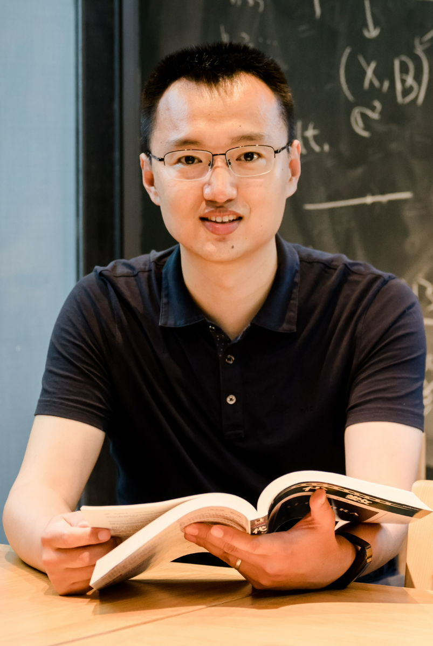

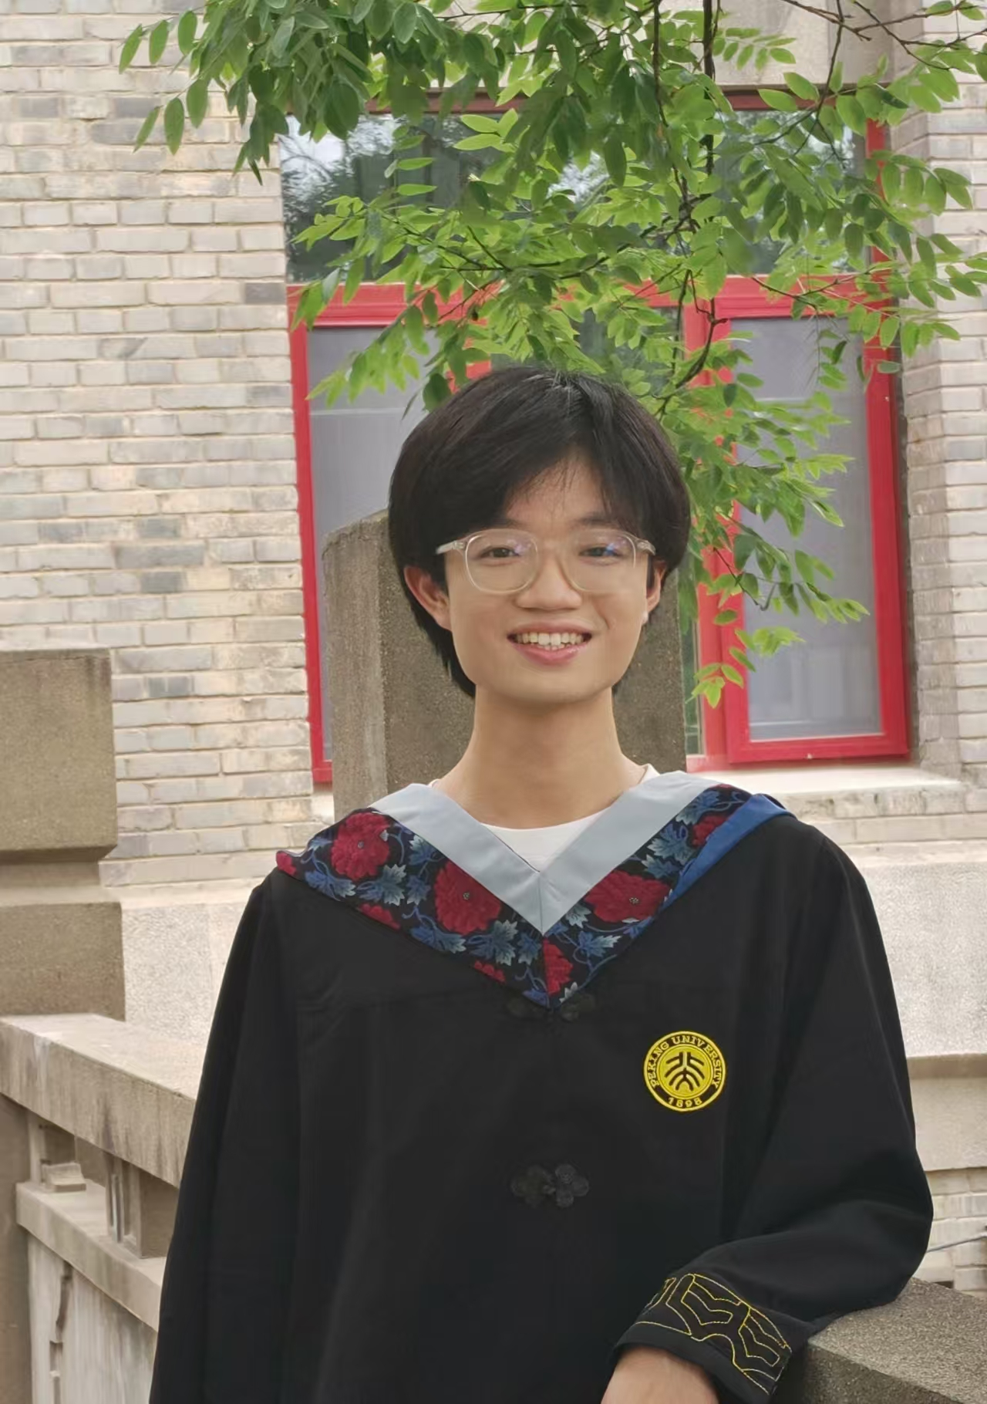
Acknowledgement
Lei Zhang
Peijie Zhou
Zhiwei Zeng

