Slide 1
ACROBA Platform Workshop
- Skills tutorial

Slide 2
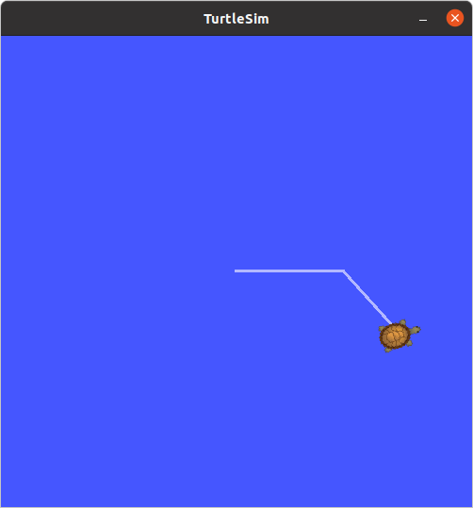
Turtle Sim
A tool made for teaching ROS and ROS packages.
Installation and Getting started :
http://wiki.ros.org/turtlesim
Move the turtle with keyboard inputs:
rosrun turtlesim turtle_teleop_key
Move the turtle by publishing on the /turtle1/cmd_vel topic:
  rostopic pub /turtle1/cmd_vel
Move the turtle with python scripts:
Readme: Step 1 - Write a basic python code to move the turtle in a straight line
Also see 10 - Practicing Python with Turtlesim at:
http://wiki.ros.org/turtlesim/Tutorials#Tutorials_Using_Turtlesim

Slide 3

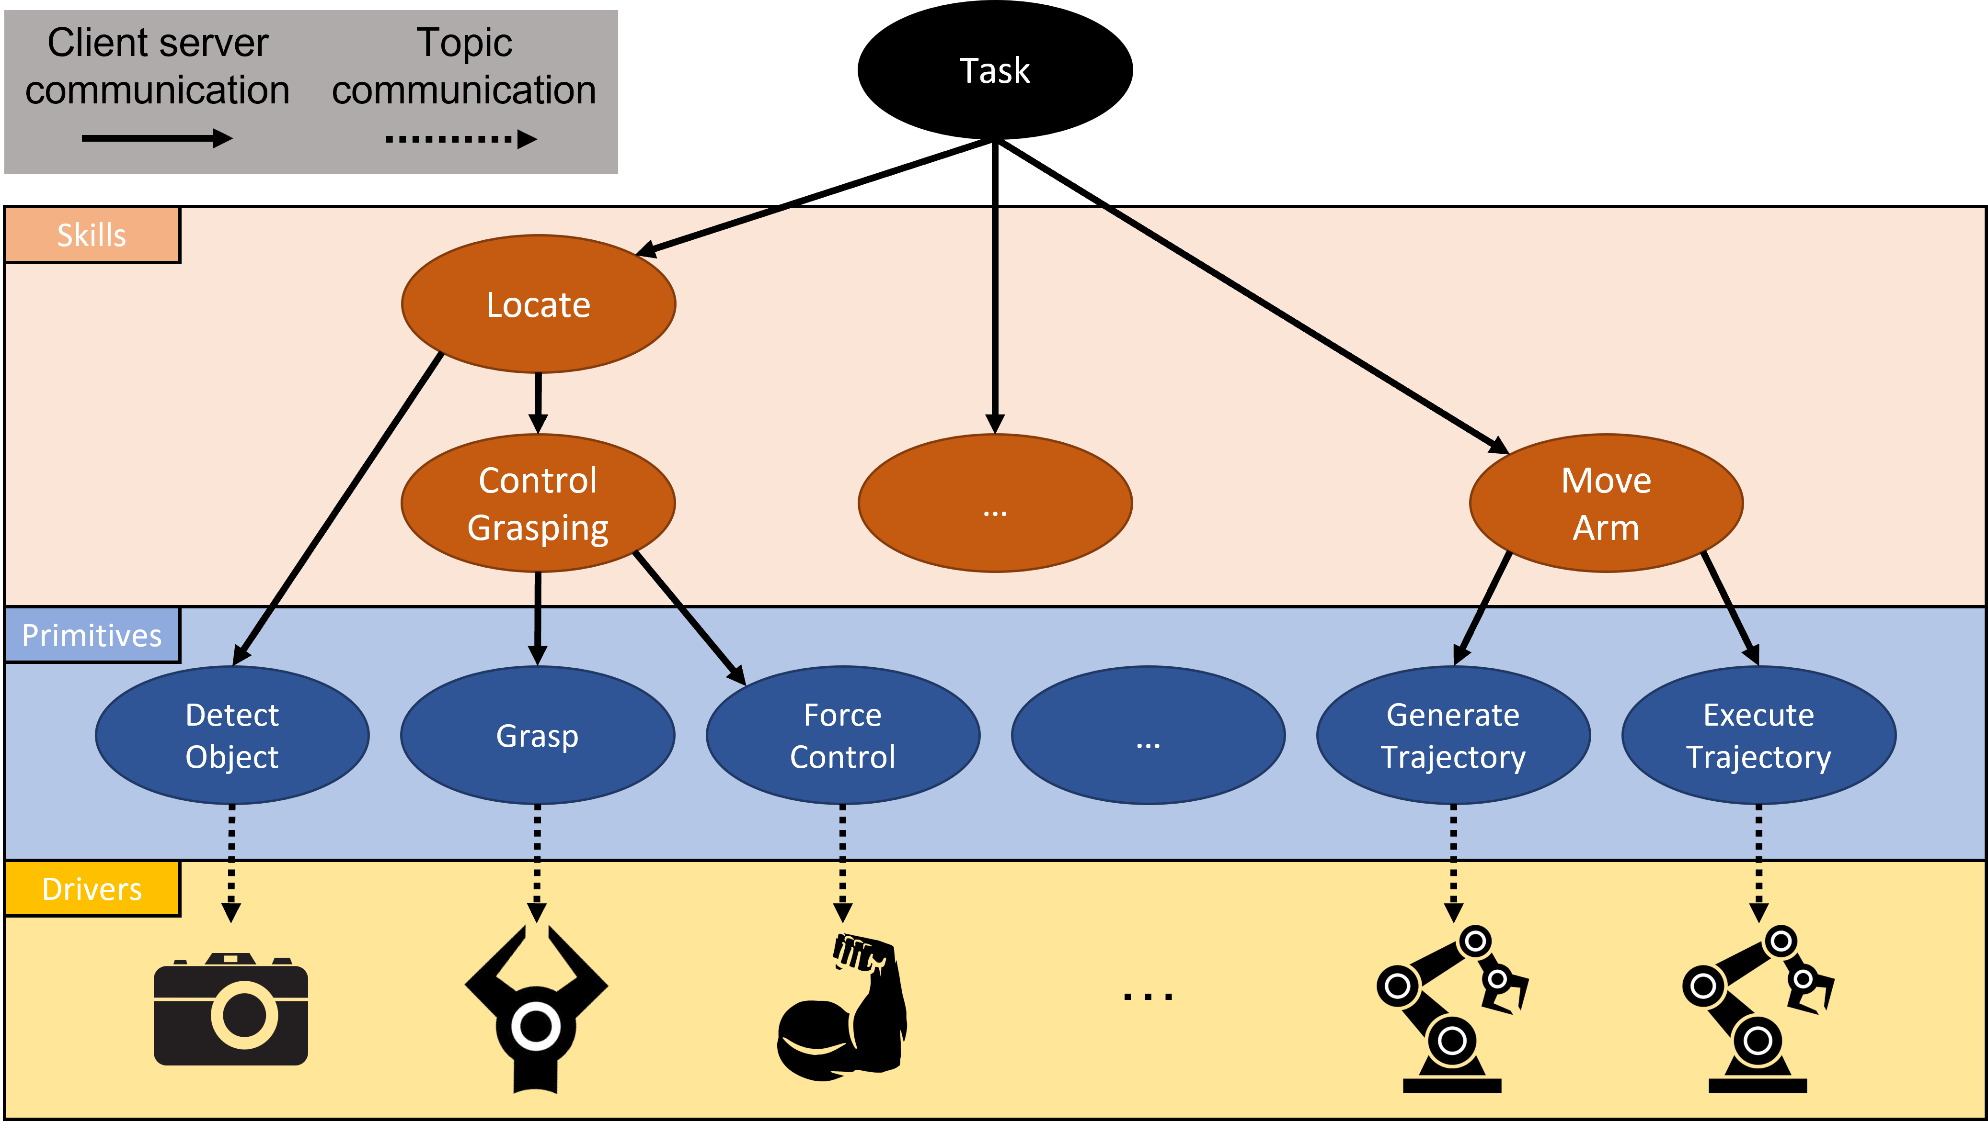

Overview of Skills – Primitives Architecture
This project has received funding from the European Union’s Horizon 2020 research and innovation programme under grant agreement No 1017284

Slide 4
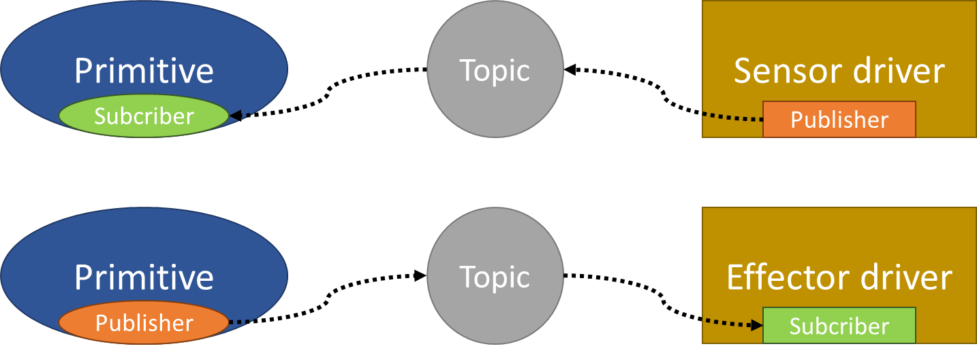
Overview of Skills – Primitives
Primitive/drivers interaction
This project has received funding from the European Union’s Horizon 2020 research and innovation programme under grant agreement No 1017284

Slide 5
Overview of Skills – Primitives
Primitive/skills interaction – ROS action
Actionlib : http://wiki.ros.org/actionlib
Goal
Feedback
Skill
Result
Primitive
Status
Cancel
This project has received funding from the European Union’s Horizon 2020 research and innovation programme under grant agreement No 1017284

Slide 6
Today’s goal :
Write a skill that will make the turtle Patrol
Skill : sk_patrol.py
→ primitives :
  pr_move.py :
  move ina straight line
    Inputs :
        Speed (float32)
        Distance (float32)
        Forward / backward (bool)
  pr_rotate.py :
  rotate around vertical axis z
    Inputs :
        Speed (float32)
        Angle (float32)
        clockwise / counter-clockwise (bool)
Topic communication :
  /turtle1/cmd_vel
linear:
x: ... (float32)
y: ... (float32)
z: ... (float32)
angular:
x: ... (float32)
y: ... (float32)
z: ... (float32)
  /turtle1/pose
x: ... (float32)
y: ... (float32)
theta: ... (float32)
linear_velocity: ... (float32)
angular_velocity: ... (float32)

Slide 7
Needs :
For each primitive / skill
1 - .action file containing the goal, result and feedback messages definition
2 - Add the .action file into the CmakeLists.txt and build the package
3 - Python file following pr_template.py or sk_template.py
4 - Create a test client following test_template.py or send the goal manually by publishing topic from terminal

Slide 8
Turtle Sim
A tool made for teaching ROS and ROS packages.
Readme: Step 2 - Write a basic primitive (with its .action and test files)

Slide 9
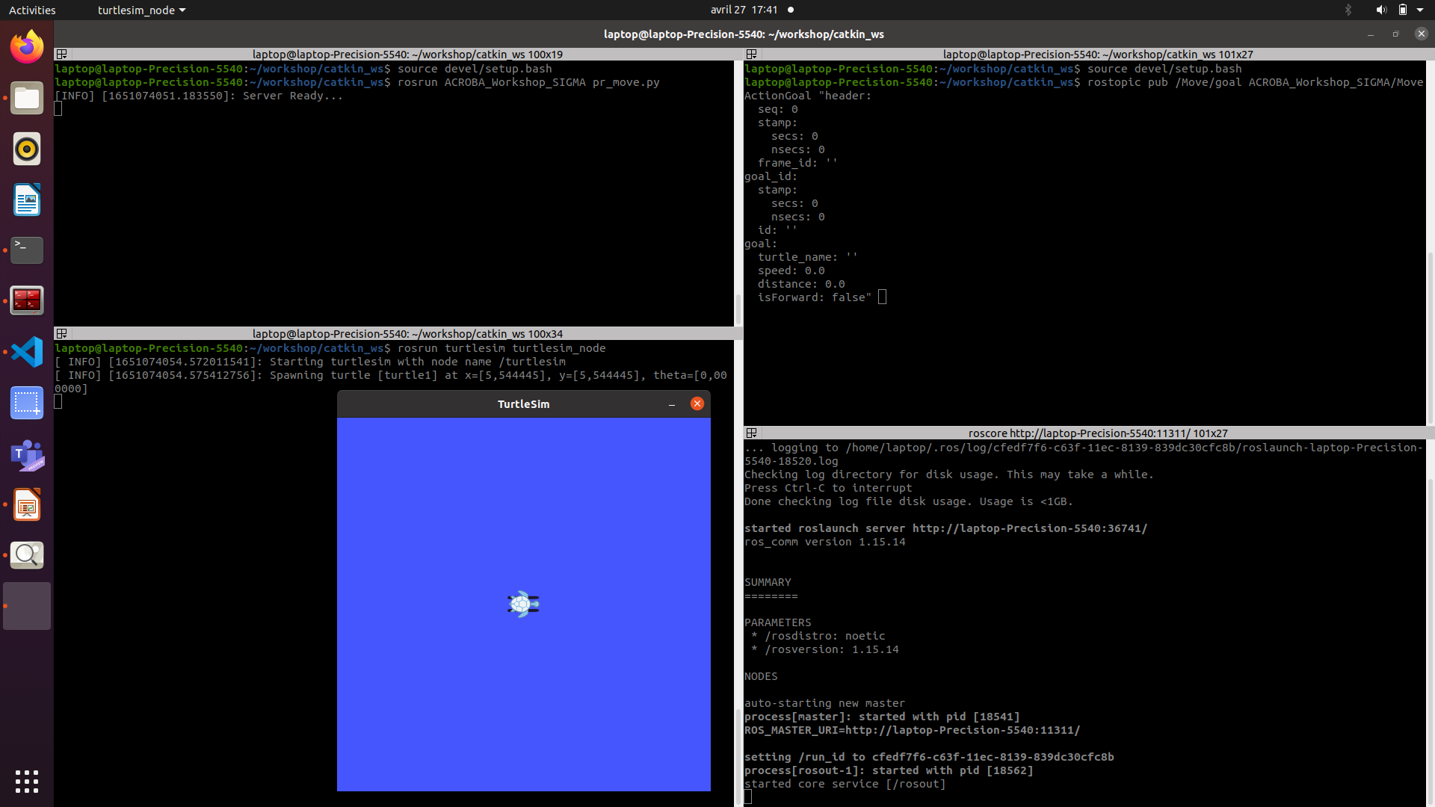

Slide 10
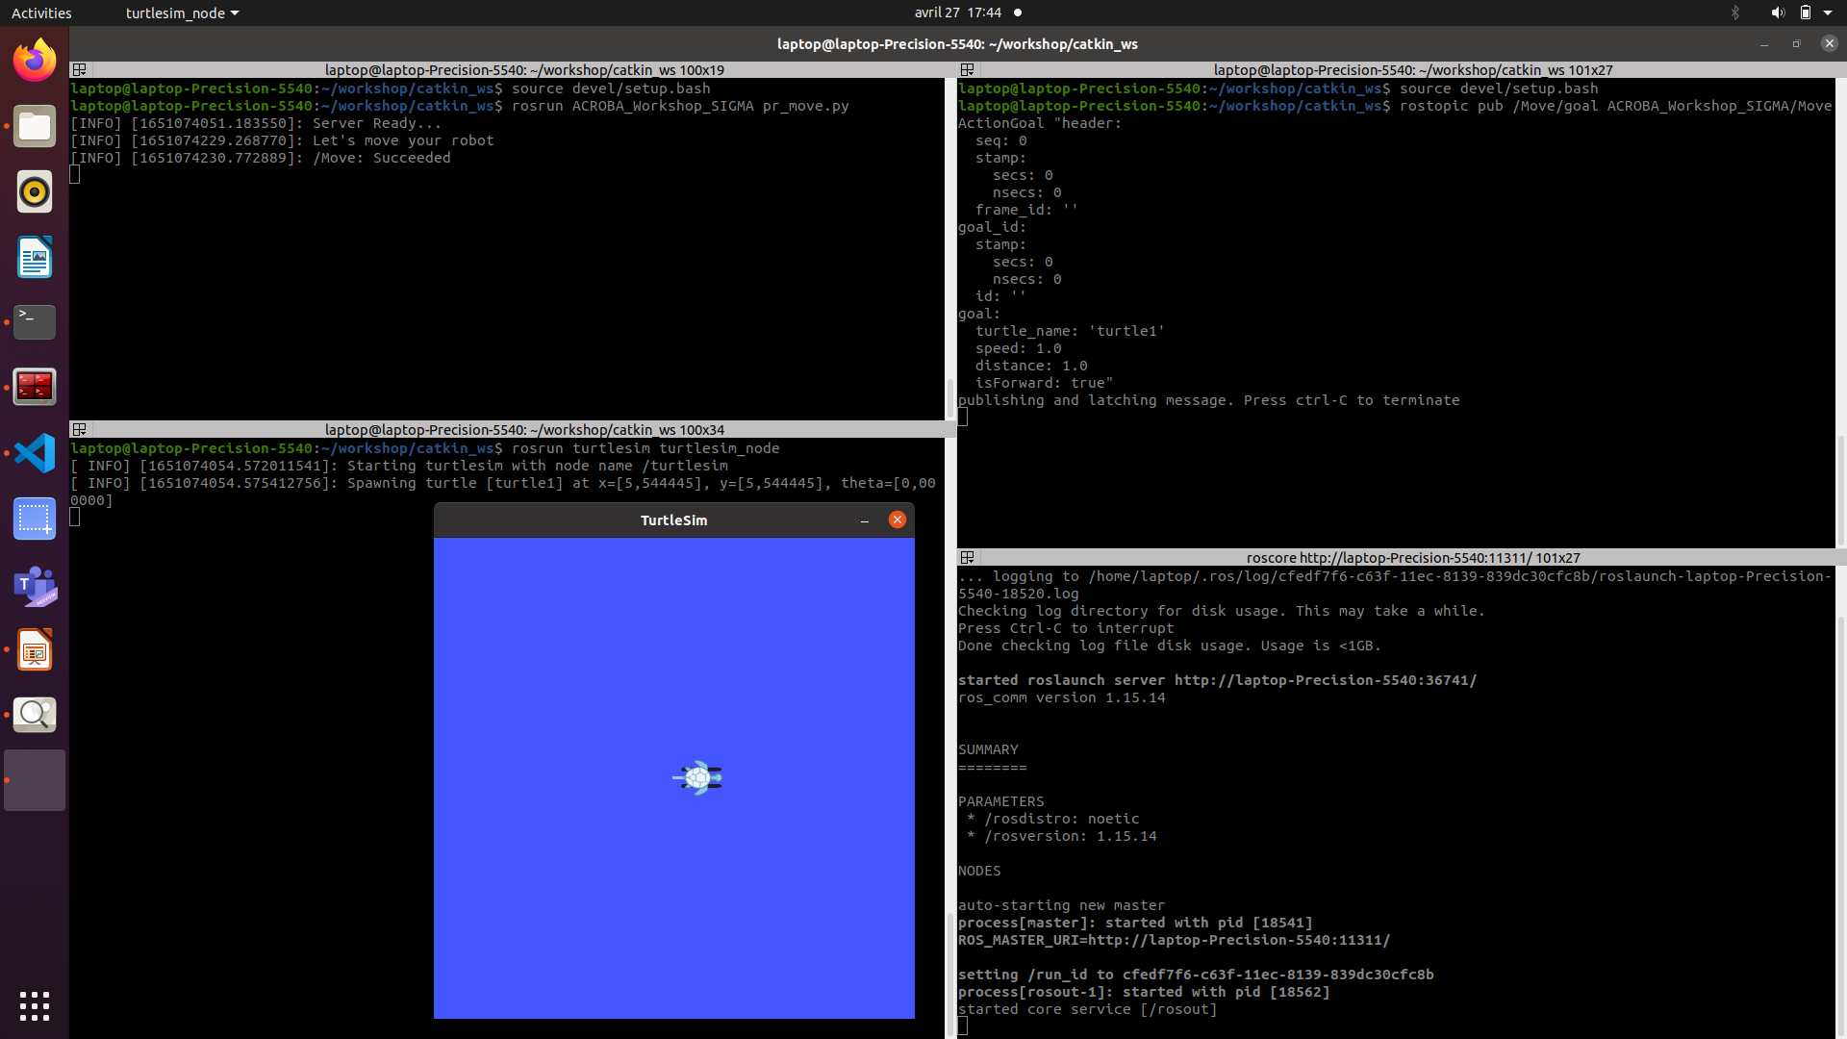

Slide 11
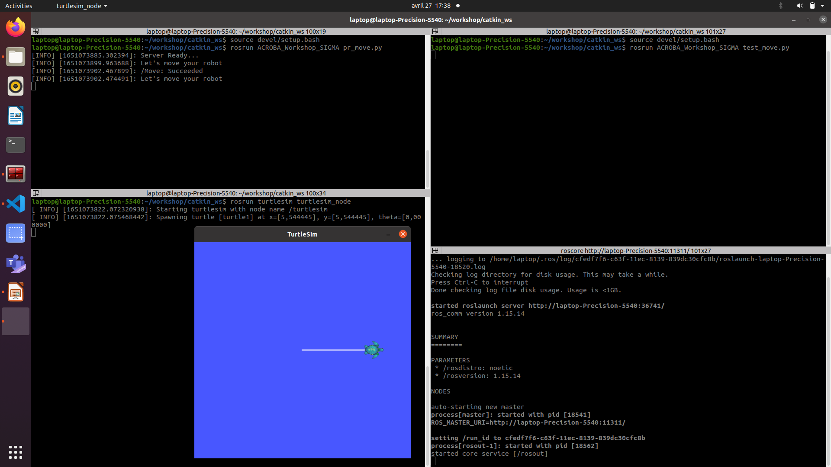

Slide 12
Turtle Sim
A tool made for teaching ROS and ROS packages.
Readme:
Step 3 - Improve the primitive
Step 4 - Write a primitive to rotate the turtle
Step 5 - Write a skill using both primitives

Slide 13
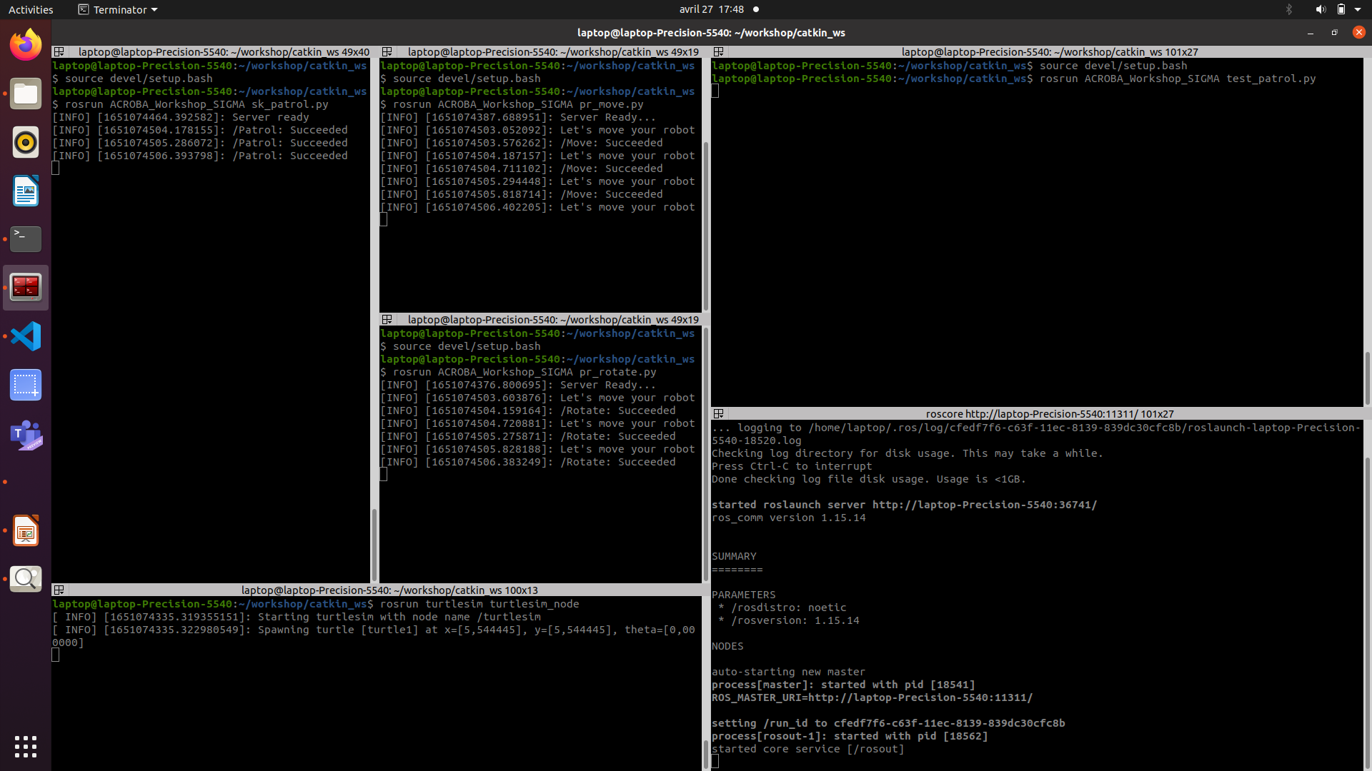

Slide 14
