Slide 1
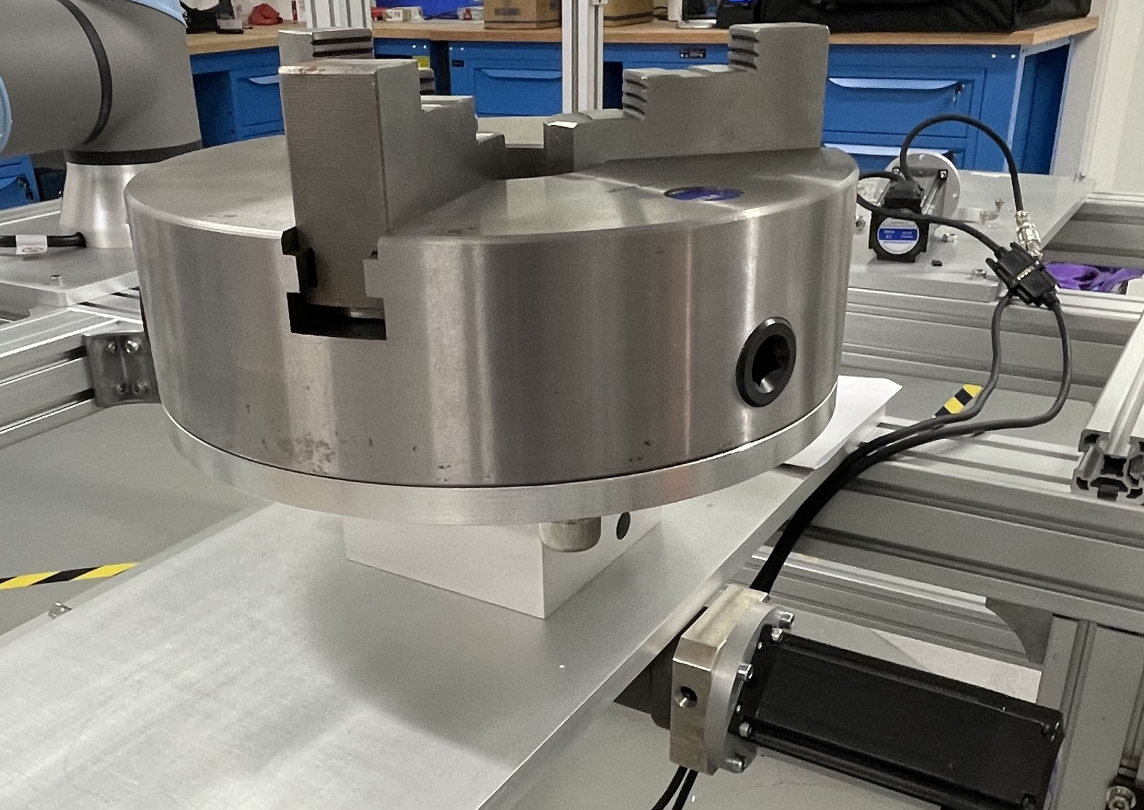
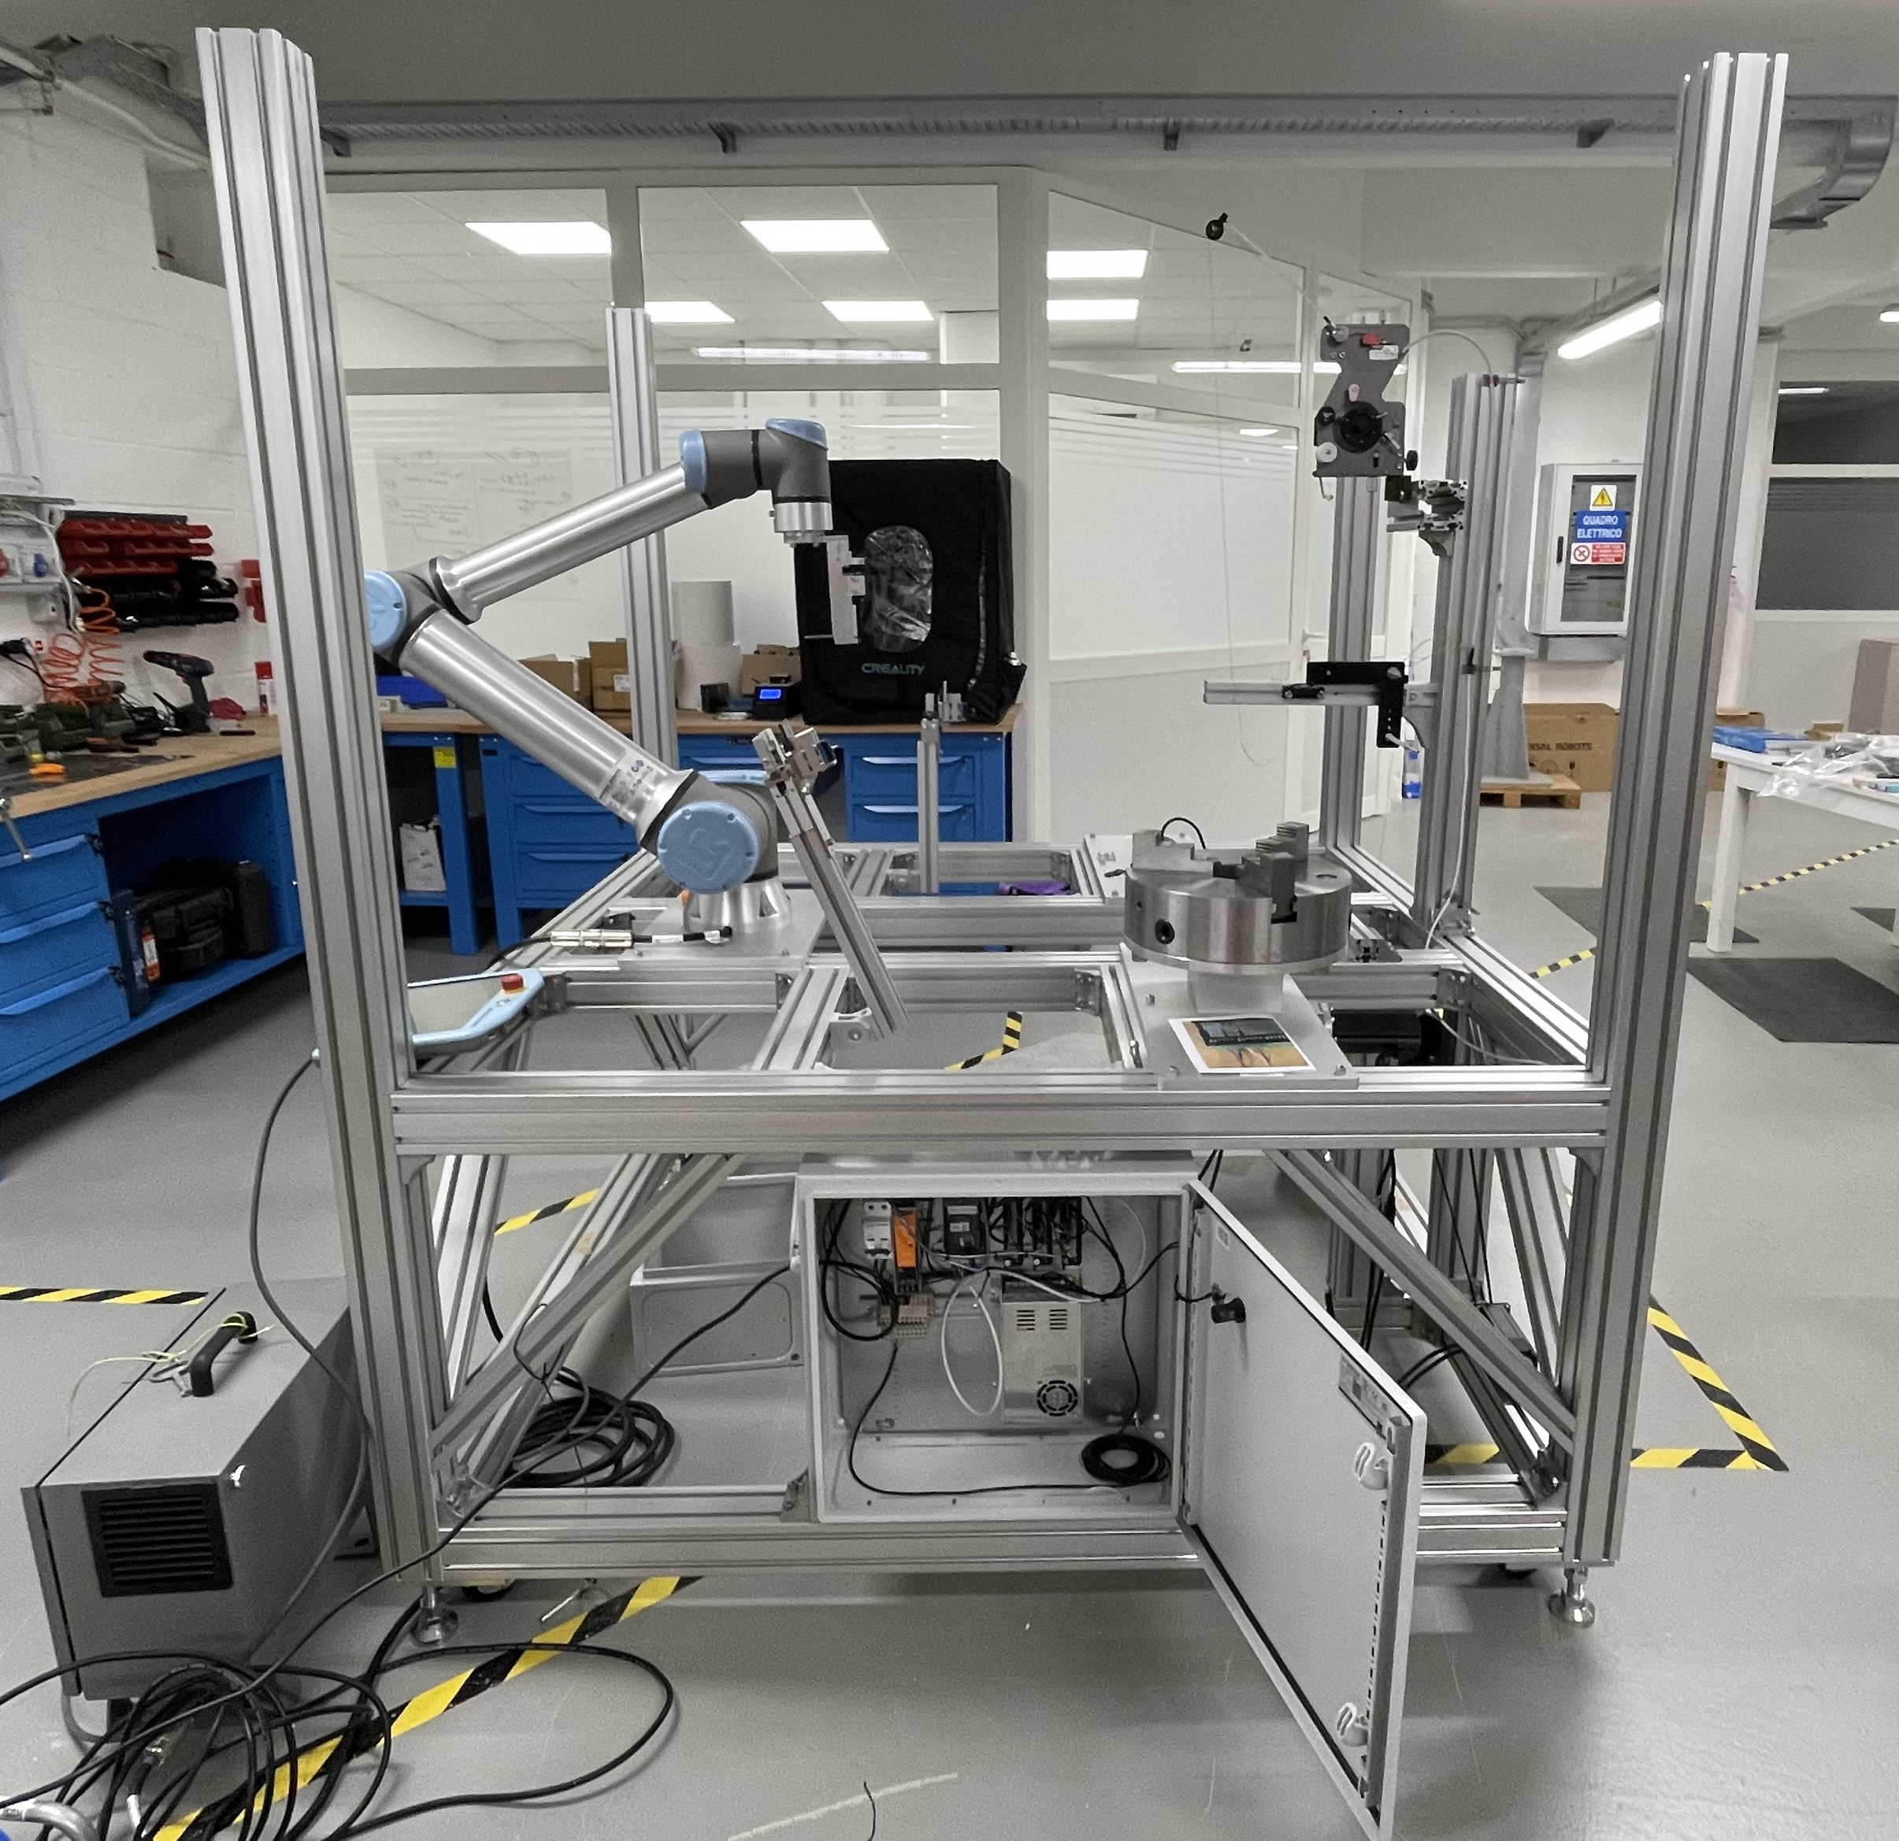
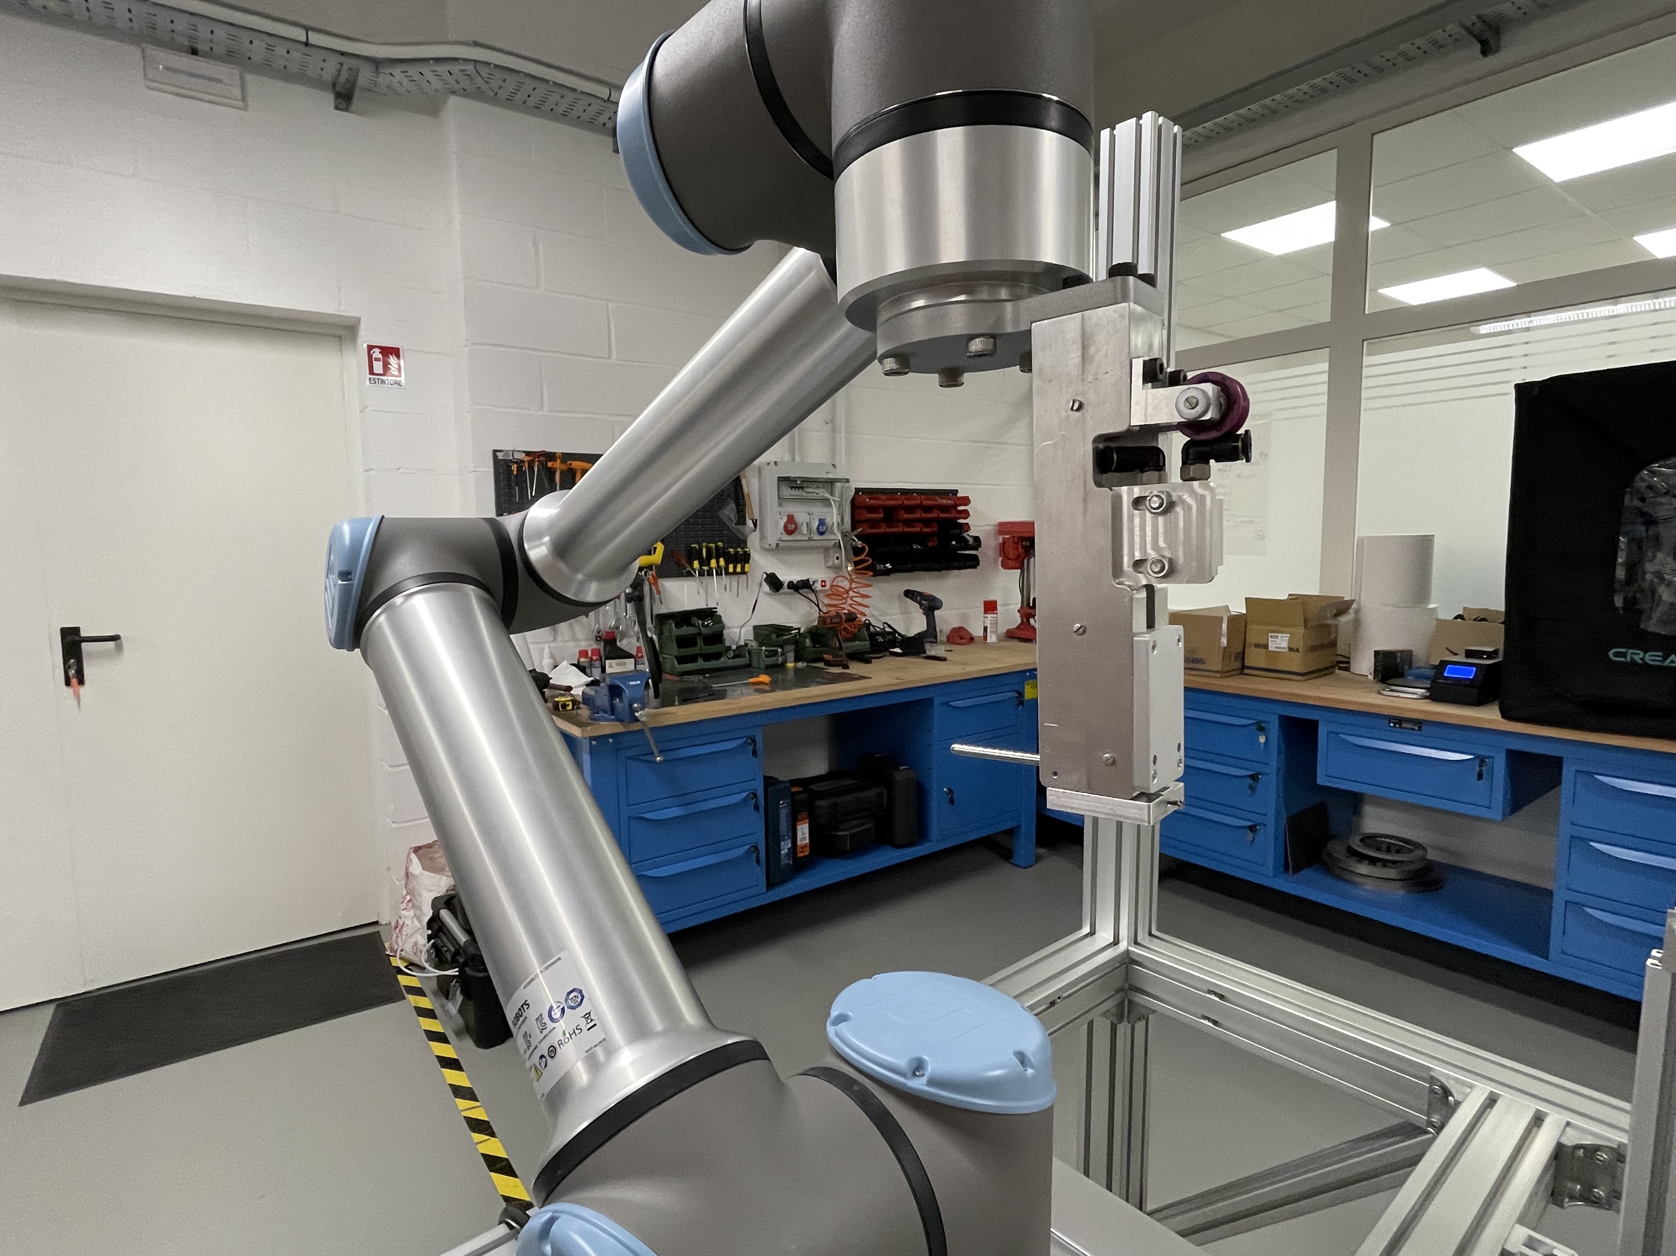
Acroba hackathon challenges

Slide 2
Winding

Slide 3
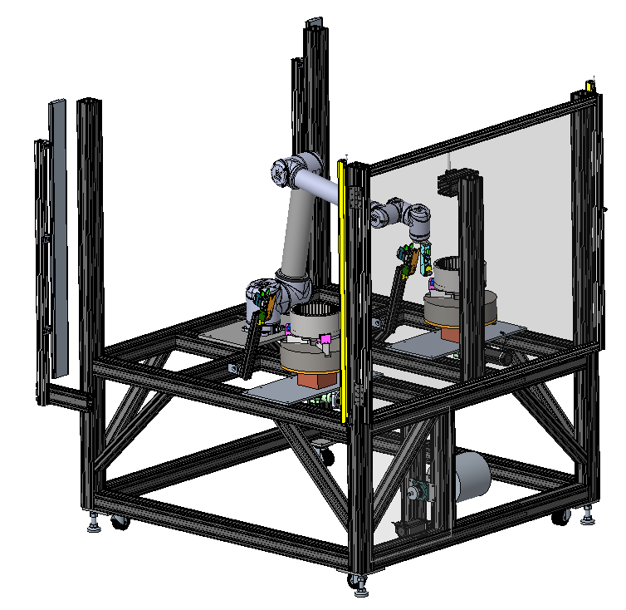
Winding cell
Main components of the winding cell:
UR10 robot.
Custom end-effector.
Wire tensioner.
Two self-centering chucks for the stator handling.
Nema 23 stepper motors with high precision. orthogonal gearboxes for the stator rotation.
Pneumatic grippers for wire handling.
Pneumatic cutters for wire cutting.
KEYENCE Light curtains.
KEYENCE laser sensor to detect the zero position of the stator.

Slide 4
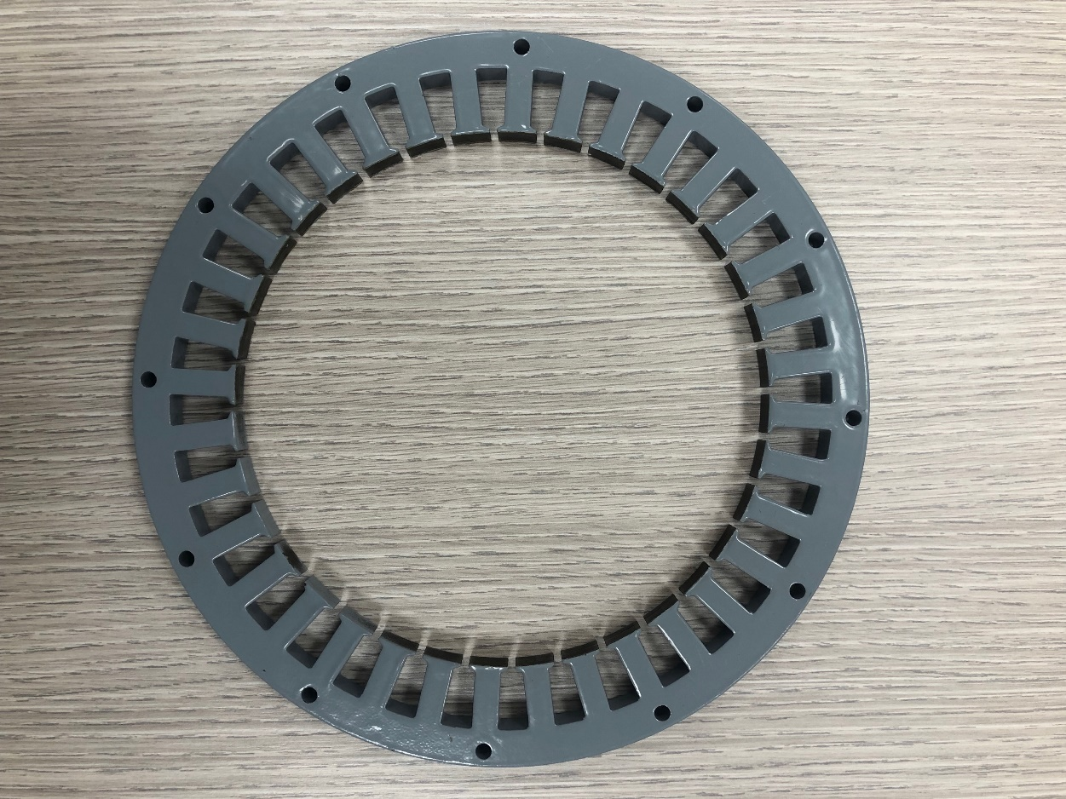
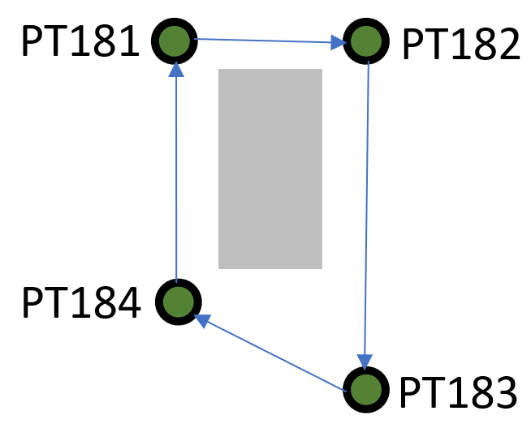
z
Tooth_ext diameter
Stator diameter
Tooth_int diameter
x
Stator center position
3 diameters
Tooth thickness
Tooth width
Number of turn
clockwise/anti-

Slide 5
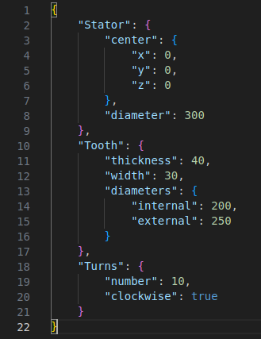
winding.json

Slide 6
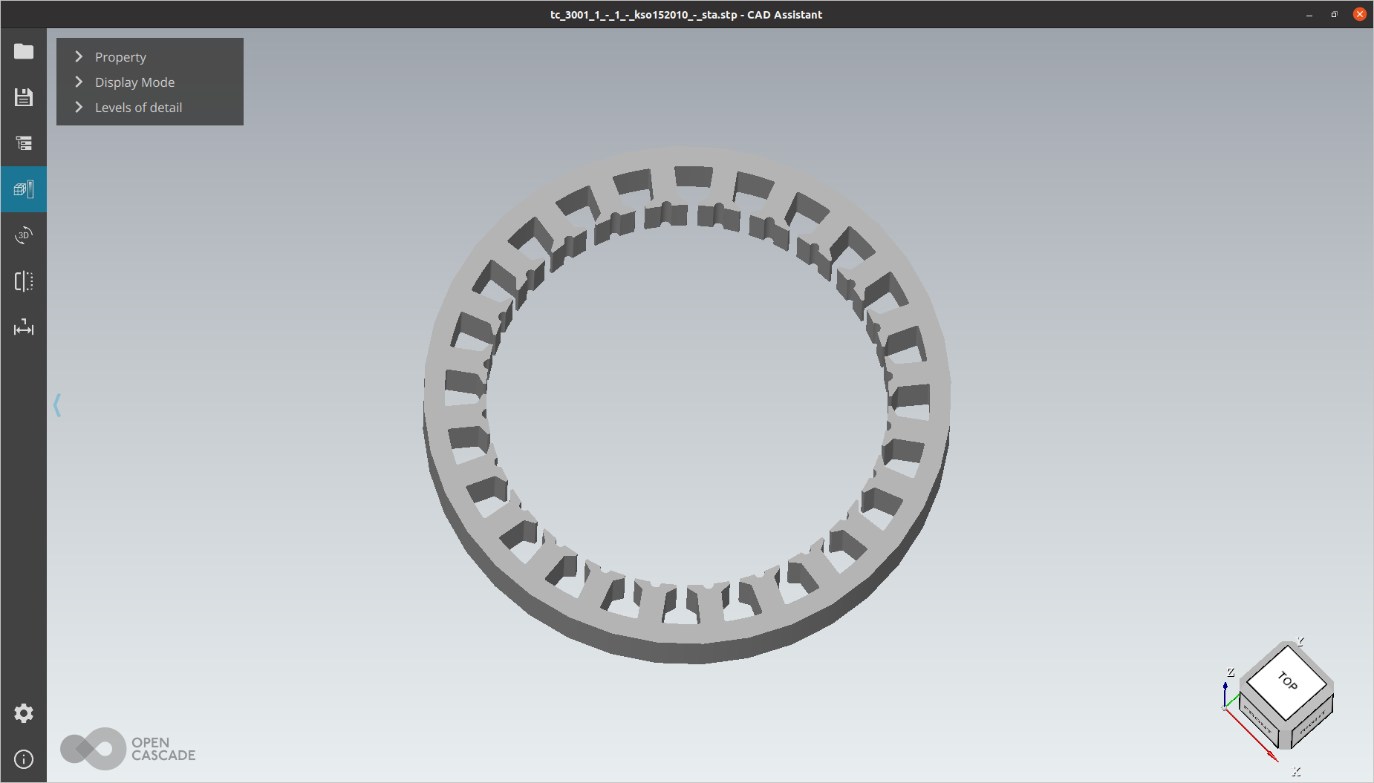

Slide 7
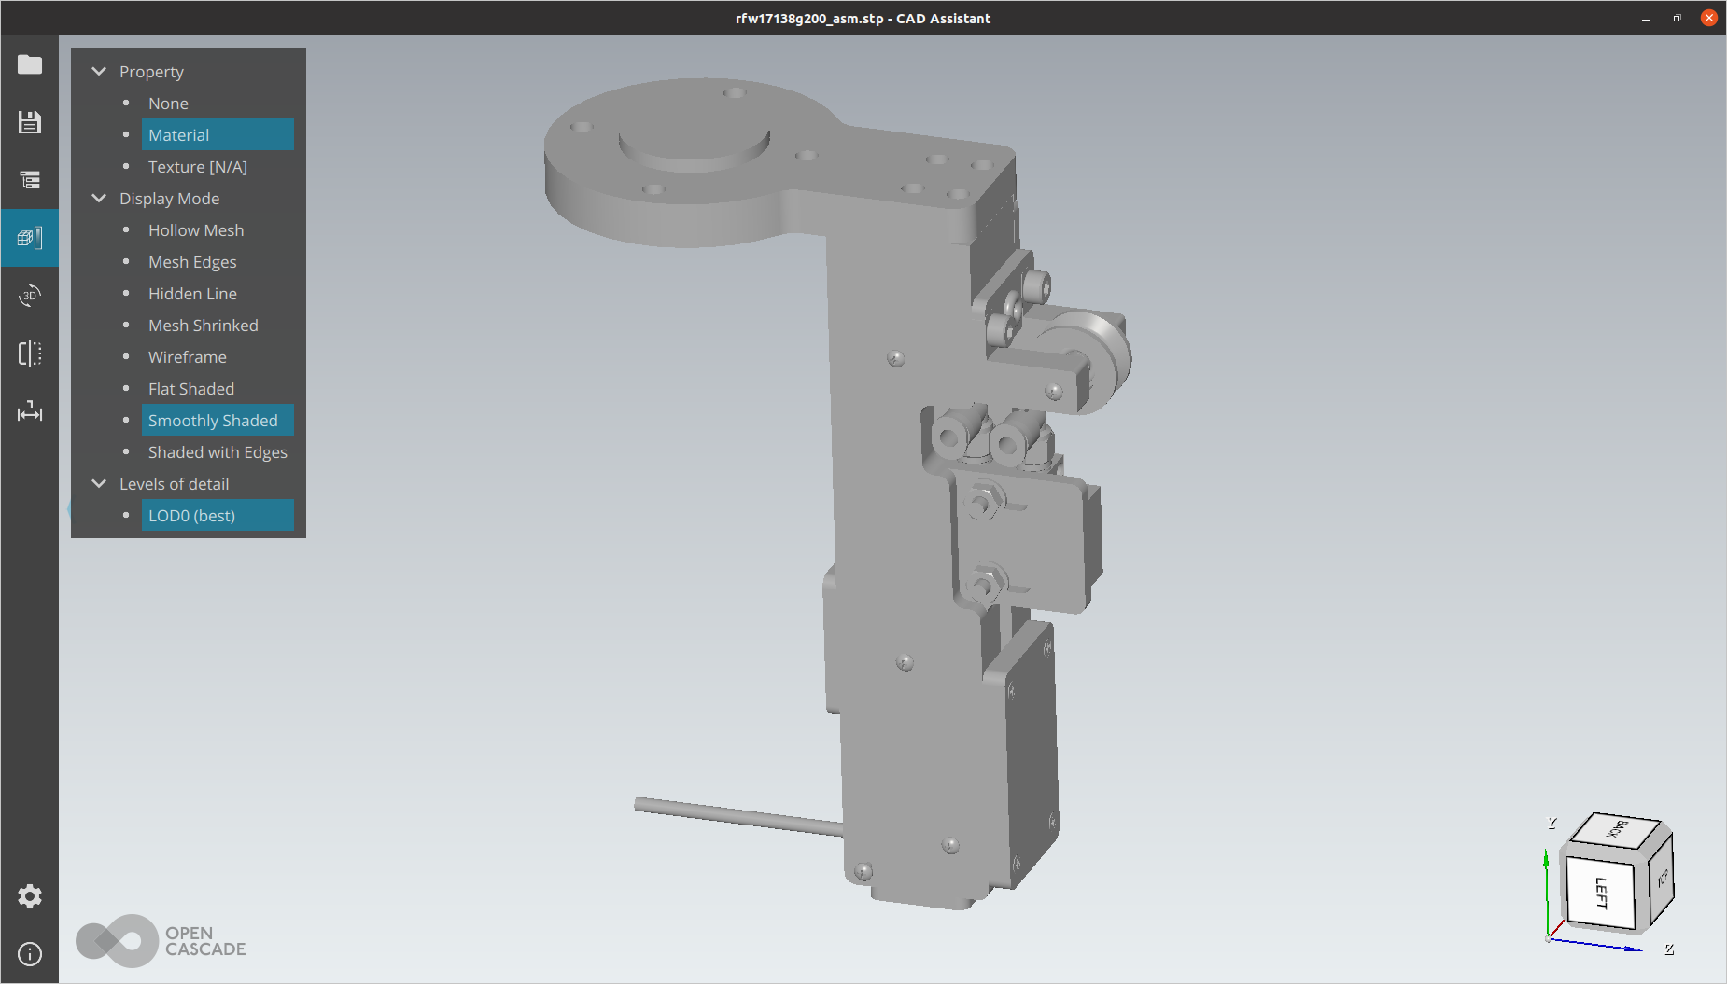

Slide 8
Magnet picking

Slide 9
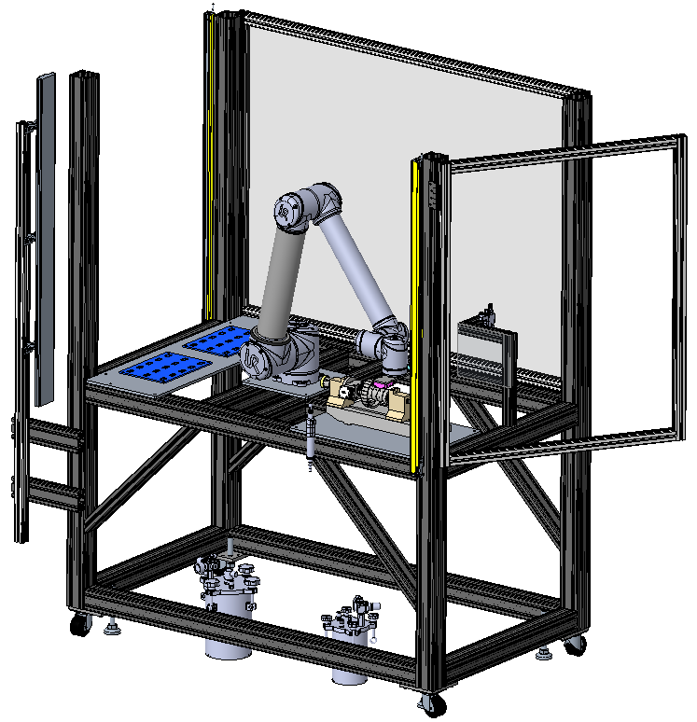
Bonding cell
Main components of the Bonding cell:
UR10 robot.
Custom end-effector with vacuum pads.
Electric spindle.
Spray valve for activator deposition.
Volumetric pump for manual glue dispenser.
Controller for PCP pumps
Pressurized tanks for glue and activator.
KEYENCE Light curtains
3D printed magnets trays

Slide 10
Picking station
Placing station
Position of the upper left corner of the 1st magnet (upper left on the rack)
Magnet length/width/thickness
Spacing between magnet horizontally and vertically
Number magnet per row
Number of rows
Position of placing station (x and y)

Slide 11
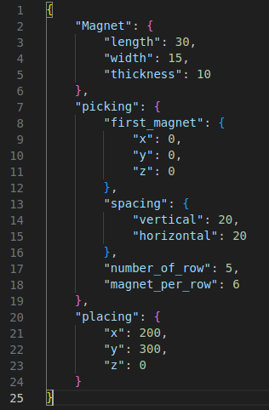
bonding.json

