Slide 1
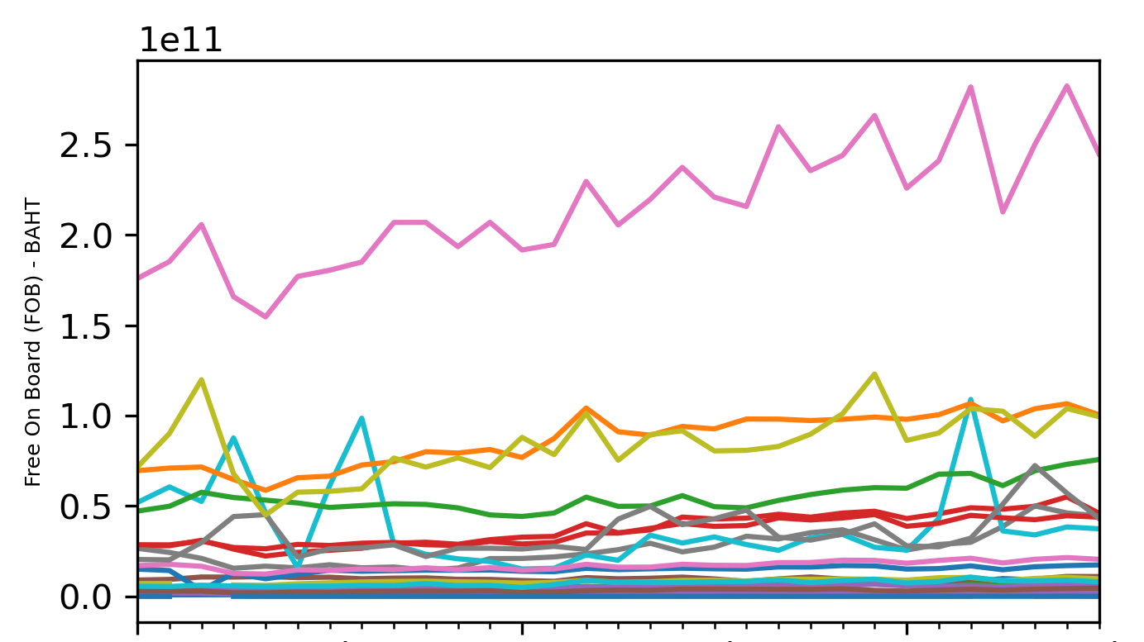
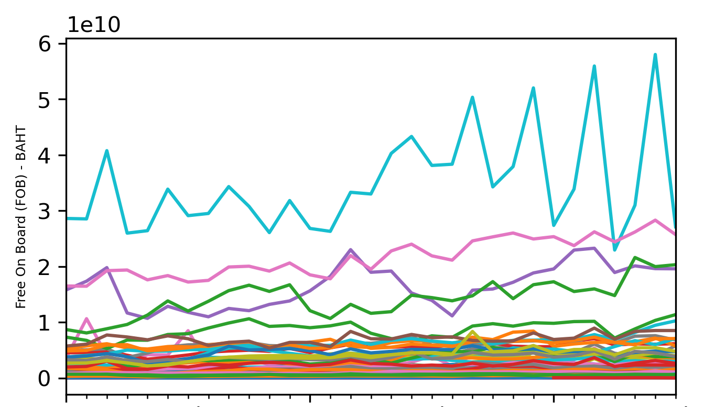
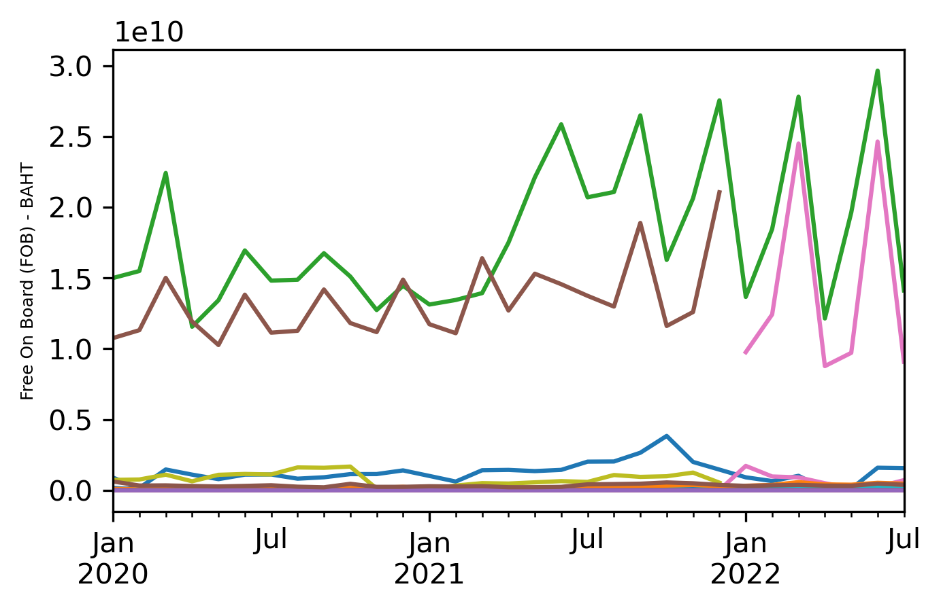
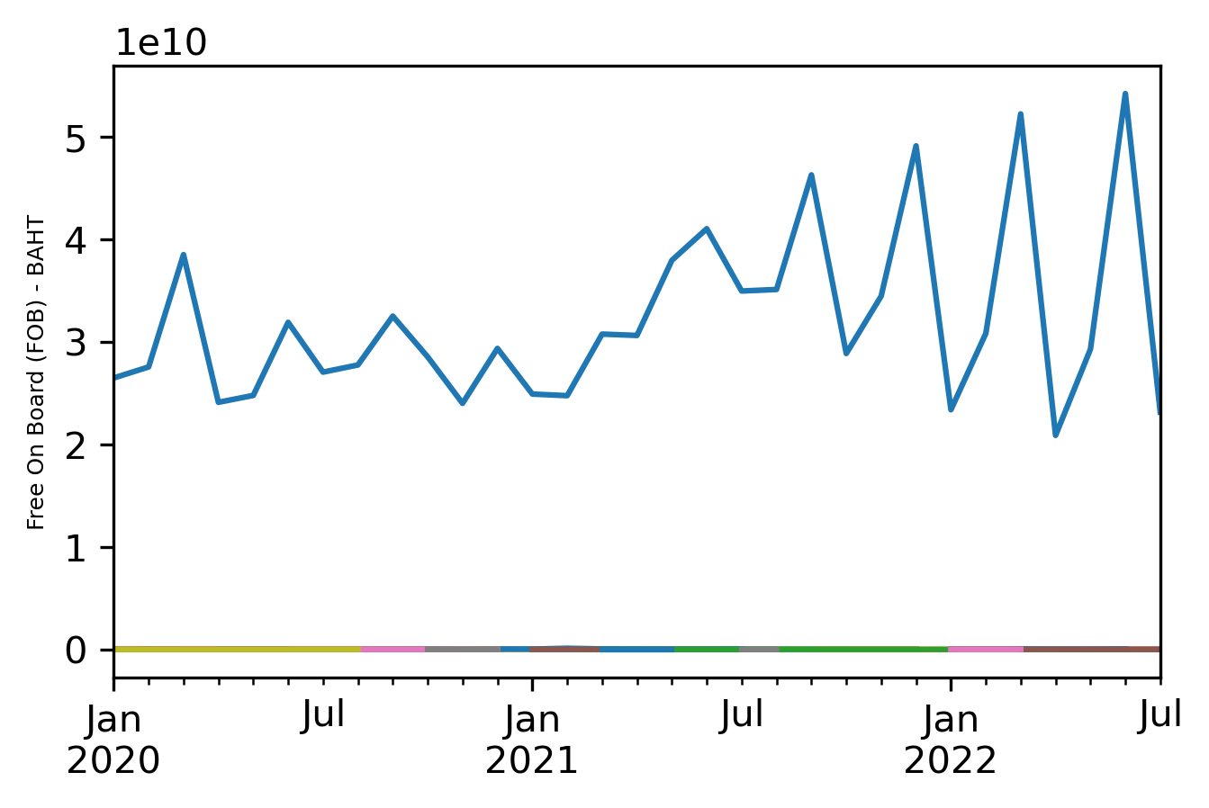
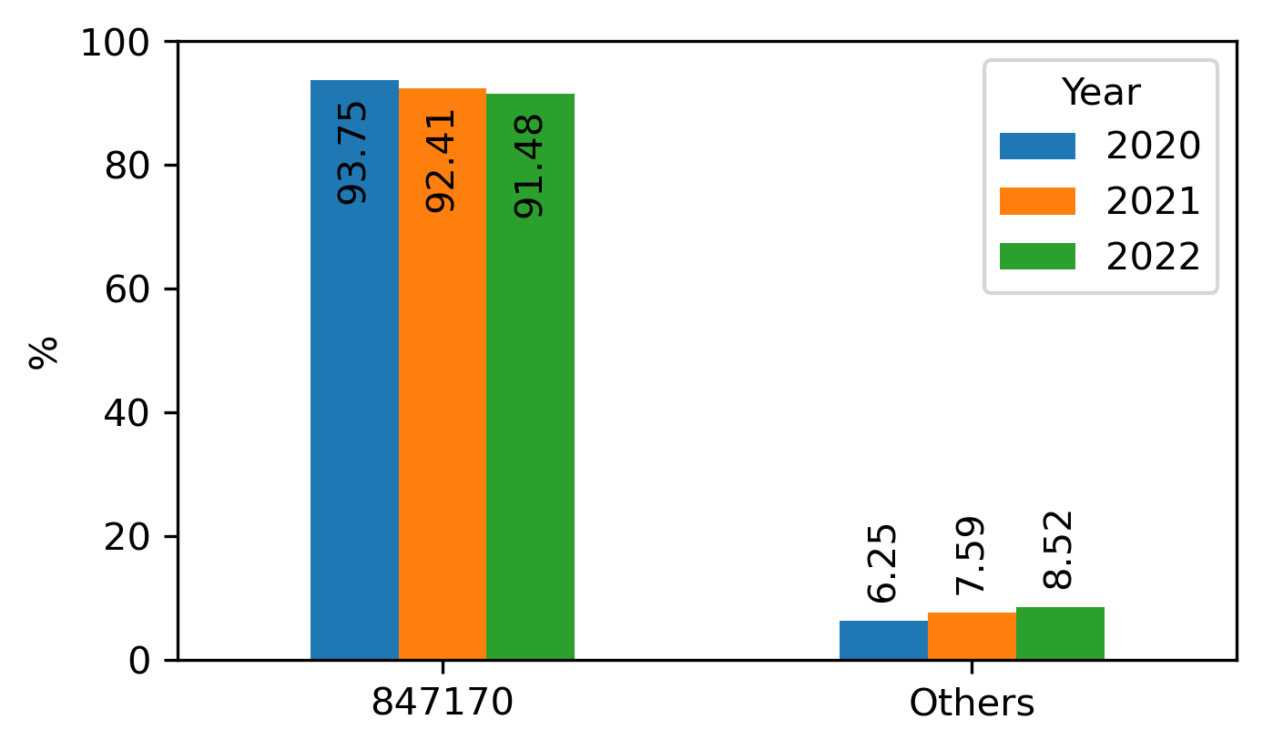
Thailand Export Trends (Jan2020 - Jul2022)
By Sections
Top Section - By Chapter>Heading
21 Sections
Top Section
Top by Chapter>Heading
Machinery and Mechanical Appliances; Electrical Equipment; Parts thereof; etc.
8471 : Automatic data processing machines and units thereof; magnetic or optical readers, machines for transcribing data onto data media in coded form and machines for processing such data, not elsewhere specified or included.
Grouped into
HS Code
30.15% in 2022
84717020
8471 – HS Code
847170 – By Country
Top HS Code
847170
84717020
84717050
84717090
Top Export by Country
Classified as
UNITED ARAB EMIRATES (AE)
847170 :
Storage units
From 21 Countries
84 : Chapter
71 : Heading
70 : Sub –Heading (HS Code)
Export percent of 847170 vs Others
Q1: Which product type that Thailand exported the most?
A1: Electrical Equipment
20 : Sub –Heading (Determine Duty)
%
Q&A
Q2: Which product that Thailand exported the most?
A2: An electronic storage unit (mostly HDD)
Q3: Which country that Thailand exported the top exported good to?
A3: United Arab Emirates (Y2020:99.94%, Y2021:99.90%, Y2022:99.88%)
Data from: https://www.customs.go.th/statistic_report.php?
Notes:
Harmonized System (HS) Codes
HS is a standard commodity classification
84717020 Hard disk drives
84717050 Proprietary format storage devices including media therefor for automatic data processing machines, with or without removable media and whether magnetic, optical or other technology
84717090 Storage units > OTHERS

