Slide 1

ZOMATO ANALYSIS PROJECT REPORT
Presented By:
Ramidi Siri
Uditi Agrawal
Dipak Ghanshyam
Ashwini Sopan Verulkar

Slide 2
AGENDA
Company Introduction
Vision, Mission & Business Model
Introduction
Objectives
Importance
Tool Used and its role
KPI & Data Analysis
Insights & Findings

Slide 3
Introduction of Zomato
Started In: July 2008, Delhi NCR,
Founded By: Deepinder Goyal and Pankaj Chaddah
Initially Named as: “Foodiebay”
In November 2010 it was named as “ZOMATO”
Parent Company: Info Edge
Category: Mobile Application Based
Sector: Food and Restaurant guide
Tagline/ Slogan: Discover great places to eat around you
Segment: Young population, working professionals looking for information of restaurants
Target Group: All Smartphone Users

Slide 4
Mission
Our mission is to ensure nobody has a bad meal
They do this by
Helping people discover great places around them
Building amazing experiences around dining
Enabling restaurants to create amazing experiences
Vision
Zomato is used by millions every day to decide where to eat in over 10,000 cities across 23 countries.
In a few years, we should be able to help point you to a great place to eat no matter what part of the world you are in
Business Model
Restaurants pays Zomato for being featured
User views restaurant
More customer footfall for the restaurants

Slide 5
Introduction
The P722 Zomato Analysis project aims to provide in-depth insights into Zomato’s business model, user engagement, and market performance.
Zomato, one of the leading online food delivery and restaurant discovery platforms, operates across multiple cities and countries, connecting customers, restaurants, and delivery partners.
This analysis focuses on exploring Zomato’s operational data to uncover trends in customer behaviour, restaurant ratings, delivery times, and overall service efficiency.
The project leverages a comprehensive dataset, including key metrics such as restaurant ratings, user reviews, location-based performance, and order details.
By analysing these factors, the project highlights Zomato’s role in shaping the food delivery industry and improving customer experience. Additionally, the study aims to identify areas of growth, potential challenges, and optimization opportunities to enhance operational strategies.
Through data-driven insights, this analysis will assist stakeholders in understanding Zomato’s strengths, weaknesses, and market dynamics, offering recommendations for future improvements and competitive positioning.

Slide 6
Objectives
Understanding User Behaviour:
Analyzing user preferences, ordering patterns, and reviews to understand customer behavior across different demographics, locations, and restaurant categories.
Restaurant Performance Analysis:
These attributes help evaluate restaurant services, such as whether they offer table booking or online delivery options, and analyze their impact on restaurant ratings and customer satisfaction.
Market Trends and Insights:
Identify trends in the food delivery market, including popular cuisines and customer demands, to provide a clear picture of market dynamics.
Revenue and Growth Opportunities:
Exploring revenue-generating trends and pricing strategies to help Zomato maintain its competitive edge in the food delivery industry.

Slide 7
Importance
The P722 Zomato Analysis is crucial for understanding Zomato’s operations and its impact on the food delivery ecosystem.
It helps identify customer preferences, restaurant performance, and delivery efficiency, enabling data-driven decision-making.
By analyzing factors like table booking, online delivery options, and user feedback, the analysis uncovers areas for service improvement and operational optimization.
It provides insights into market trends, customer satisfaction, and competitive positioning, helping Zomato enhance its services and retain its market leadership.
Additionally, the analysis supports strategic growth by identifying revenue opportunities and addressing challenges in the evolving food delivery industry.

Slide 8




Tool Used and its role
Excel:
Excel played a foundational role in the project, particularly in the initial stages of data exploration and analysis. Its versatility and widespread use made it an ideal tool for handling smaller datasets and performing preliminary analysis.
PowerBi:
Power BI was a key tool in this project for advanced data visualization, providing a dynamic and interactive platform .The primary goal was to create comprehensive visual representations of key metrics and trends, enabling stakeholders to make informed decisions quickly.
Tableau:
Tableau was another critical tool used in the project, primarily for its advanced data visualization capabilities and user-friendly interface
MYSQL:
SQL was the backbone of the data extraction and manipulation process in this project. It was used to query the databases, retrieve relevant data, and perform complex data transformations that laid the foundation for subsequent analysis in Excel, Tableau, and Power BI.

Slide 9
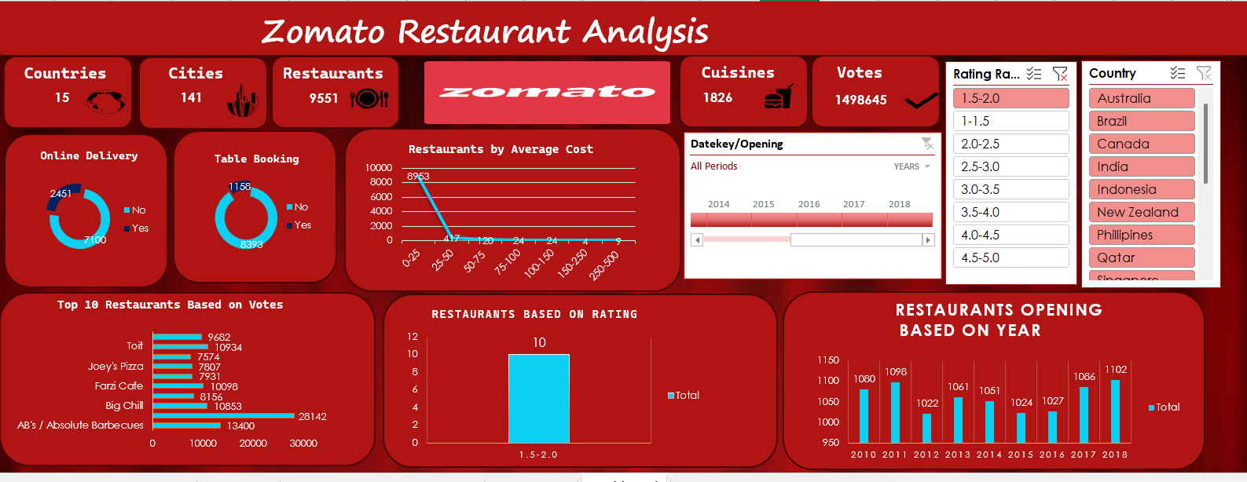
KPI Observations- Excel

Slide 10
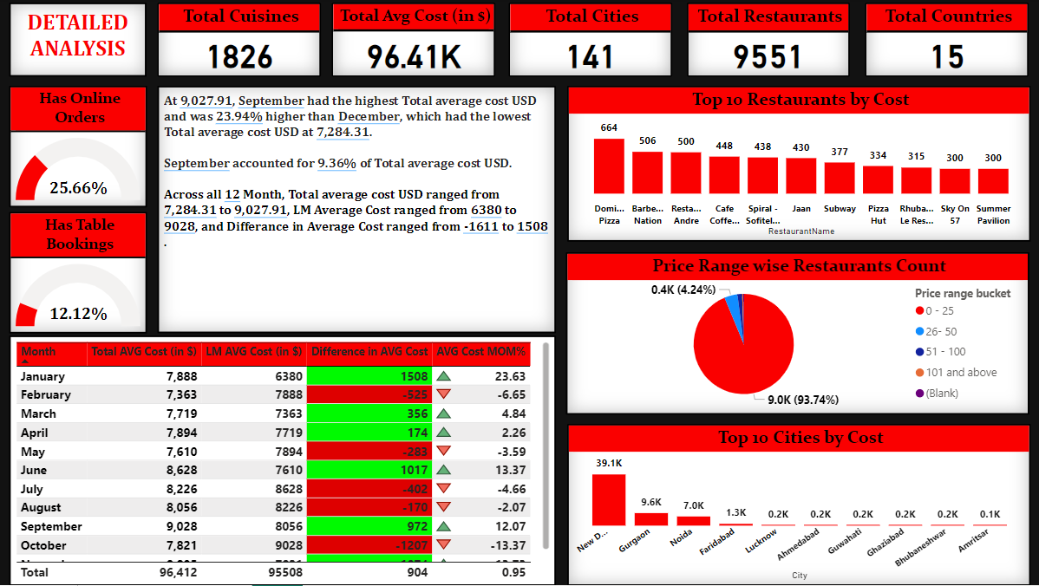
KPI Observations- Power BI

Slide 11
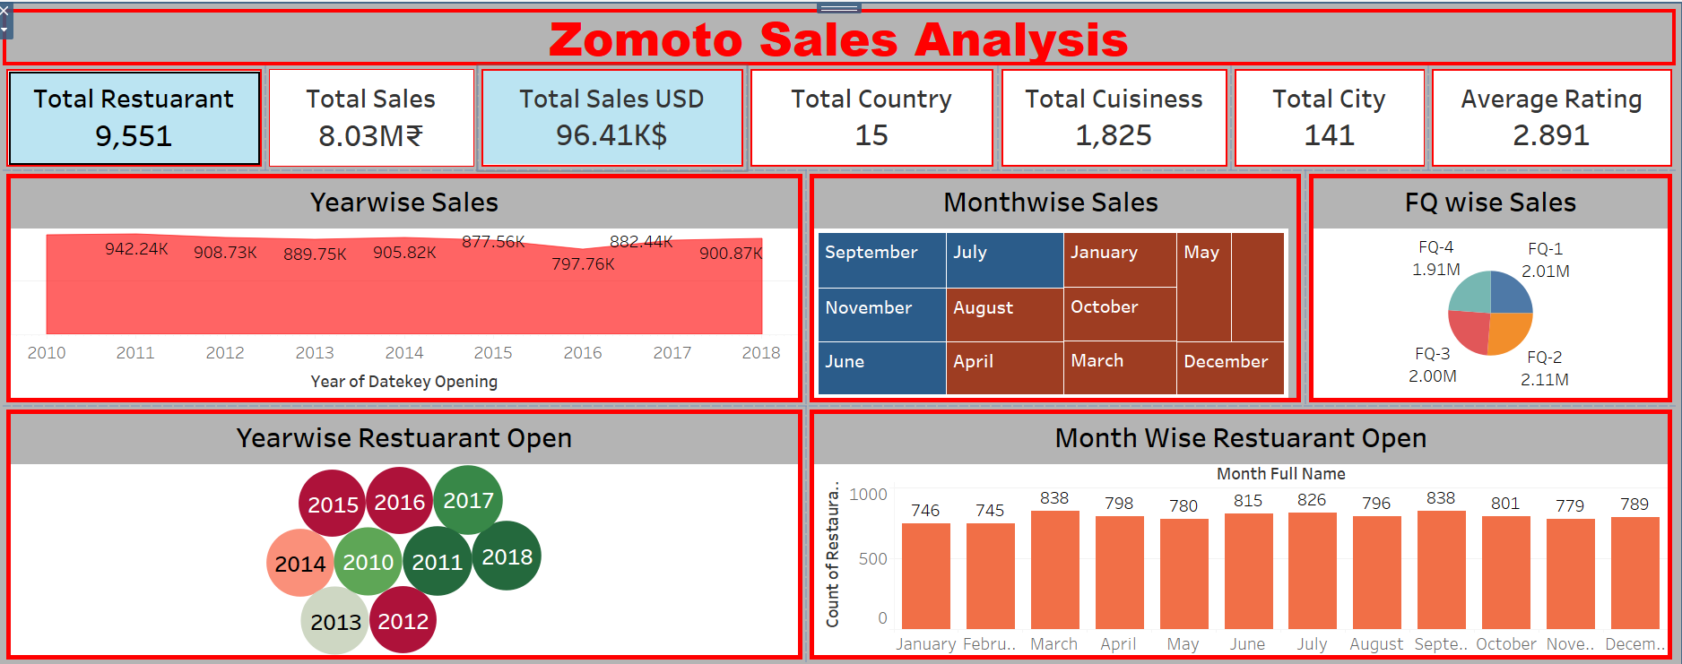
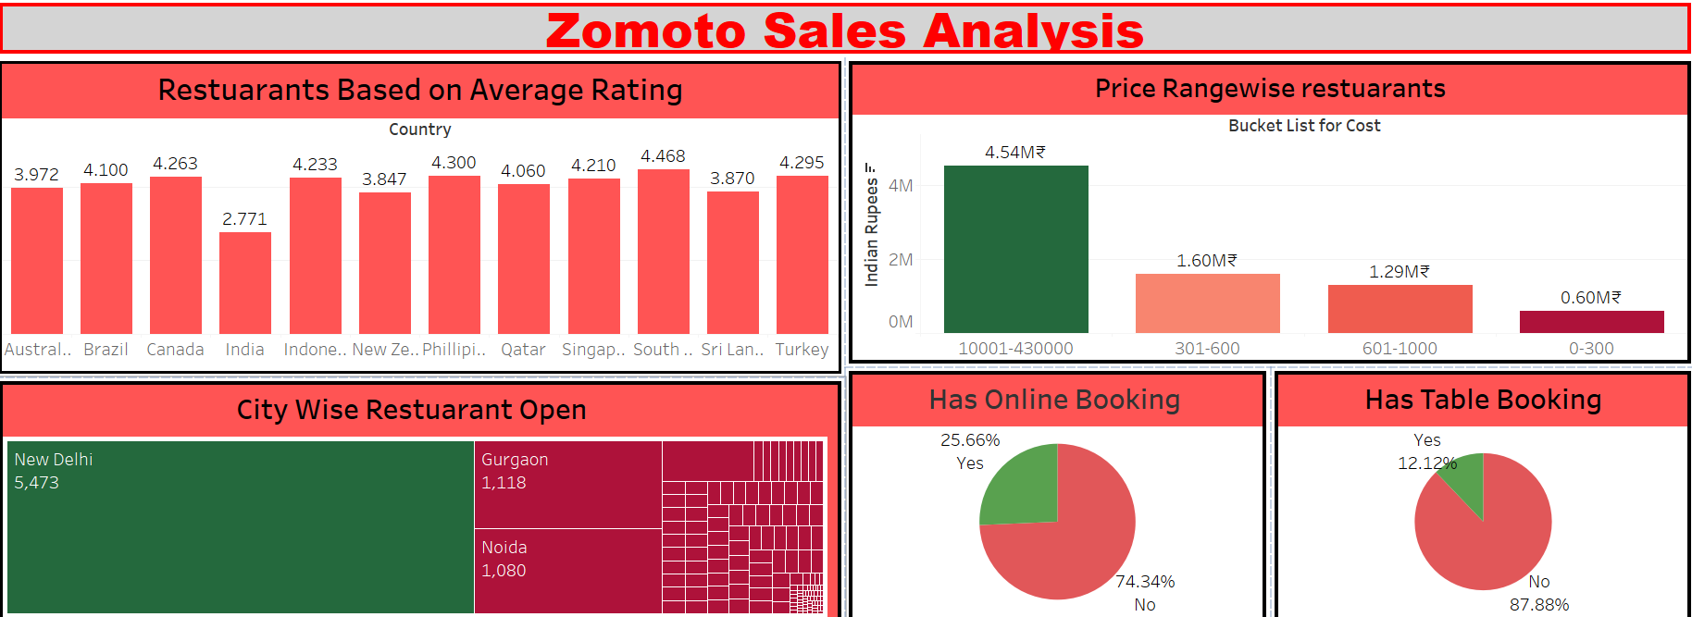
KPI Observations- Tableau

Slide 12
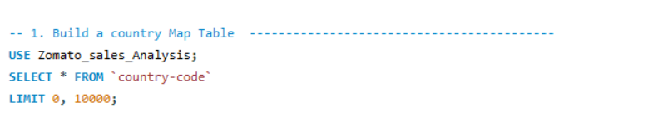
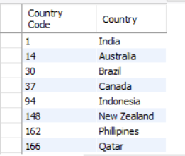
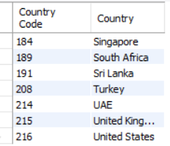
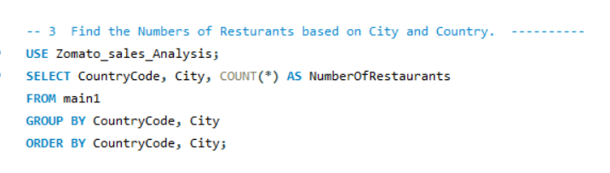
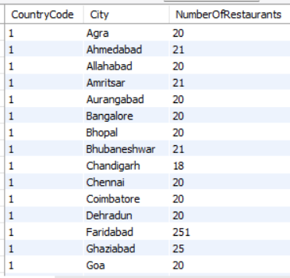
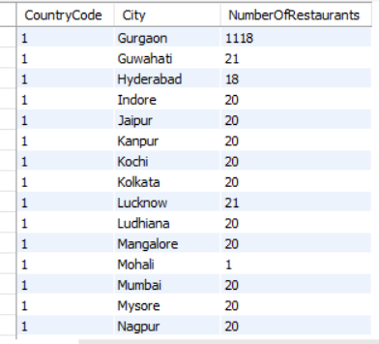
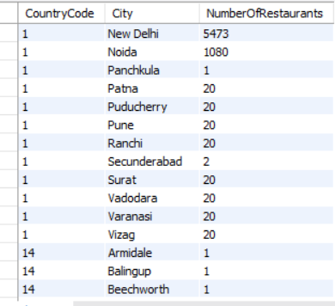
KPI Observations- MYSQL

Slide 13
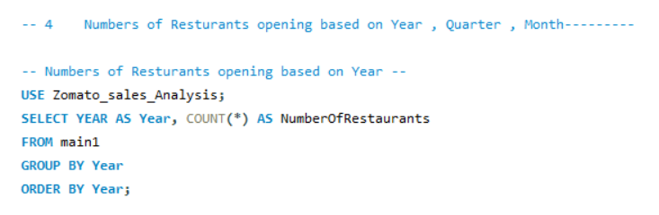
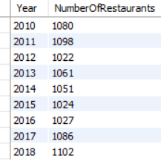
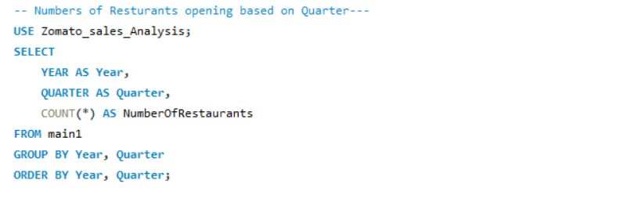
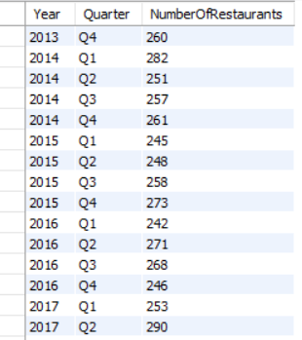
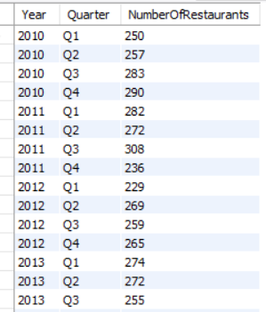
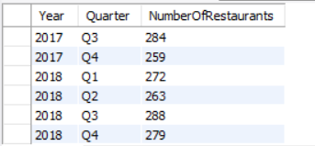
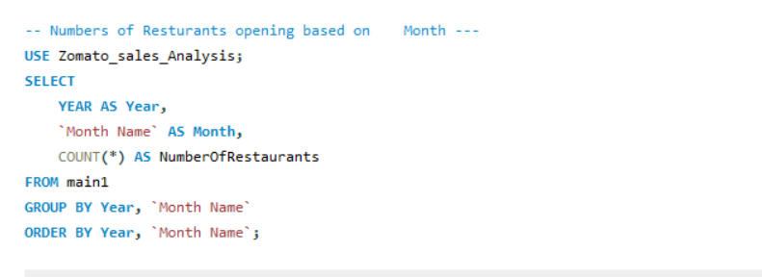
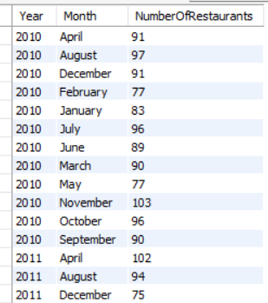
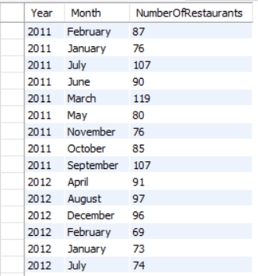
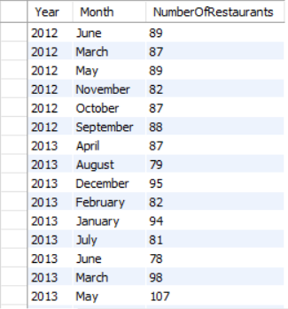

Slide 14
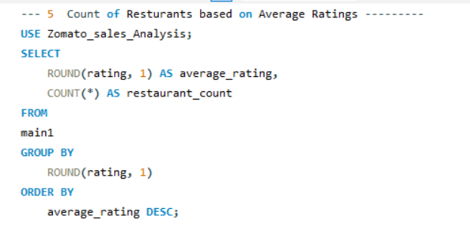
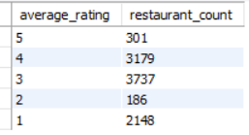
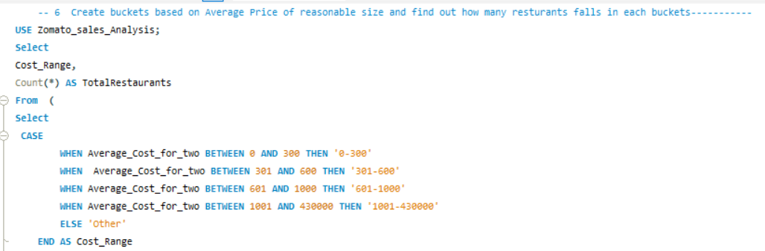
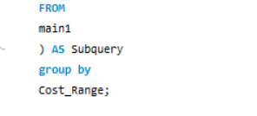
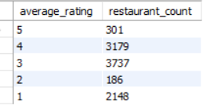
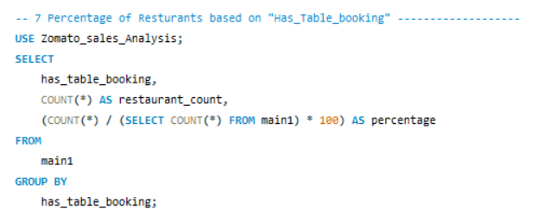


Slide 15
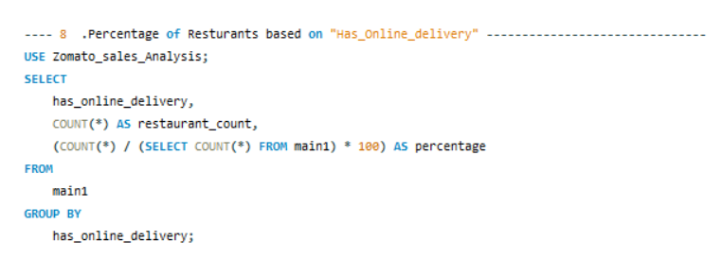

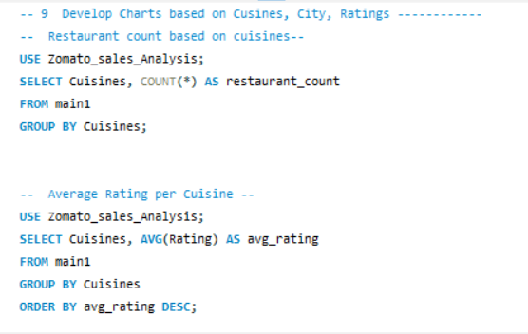
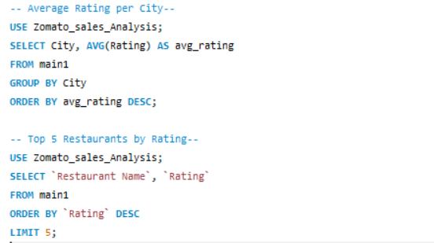

Slide 16
Findings of Zomato Analysis Project
User base: India is Zomato's top user, followed by the US and the UK.
Ratings: US customers rate more frequently and consistently than Indian customers. USA restaurants have higher ratings compared with Indian restaurants, this could indicate a better service in the US. A major of Indian restaurant ratings are zero.
Popular cuisines: North Indian is popular in India, while Americana is popular in the US.
Food prices: India and the US have moderate food prices compared to other countries.
Online delivery: Most restaurants do not offer online delivery, and it is limited to India and the United Arab Emirates.
Table booking: Only a small percentage of restaurants offer table booking.
Average cost: The average cost for two people across all countries is around $10.10.
Year with Maximum Openings: The year 2018 witnessed the highest number of restaurant openings, totaling 1102

Slide 17

THANK YOU

