Slide 1
Image Read, Write and Basic Geometrical Transforms
Experiment - 1
Image Processing Laboratory (EC 69502)

Slide 2
What is an Image
y
Gray level
x
pixel
Original picture
Digital image
f(x, y)
I[x, y]

Slide 3
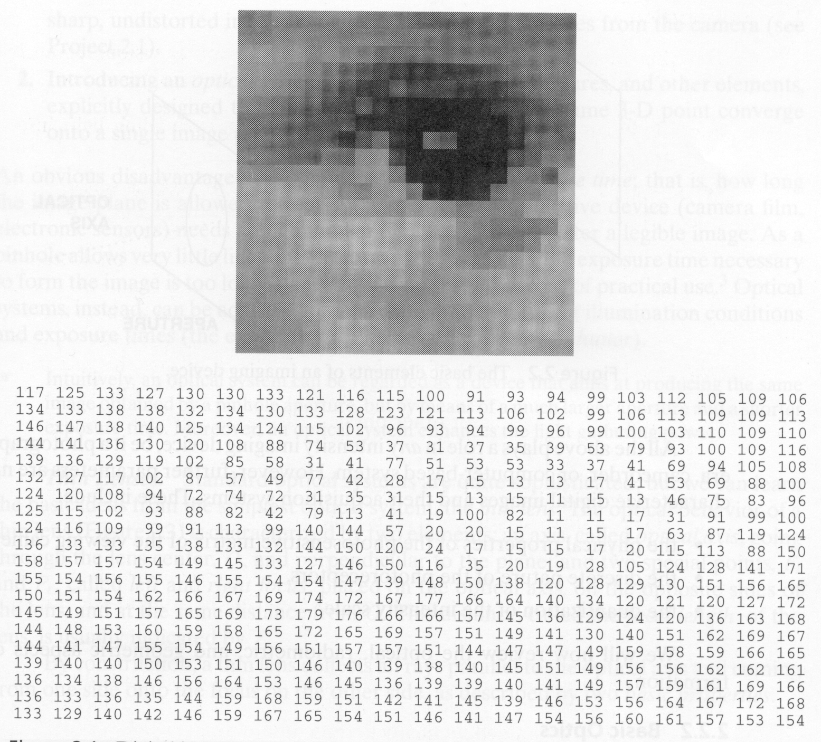
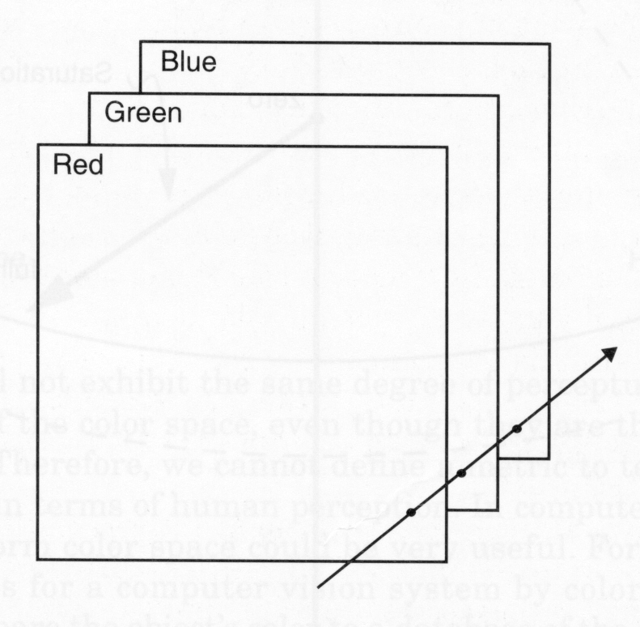
What is an Image

Slide 4
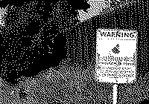
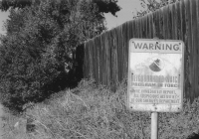
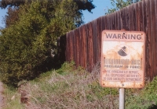
Color Depth
Number of bits for a single pixel
1-bit color: black and white
8-bit color: gray-scale
24-bit color: true color
Black-White Gray-Scale Color

Slide 5
Reading and Writing an Image

Slide 6
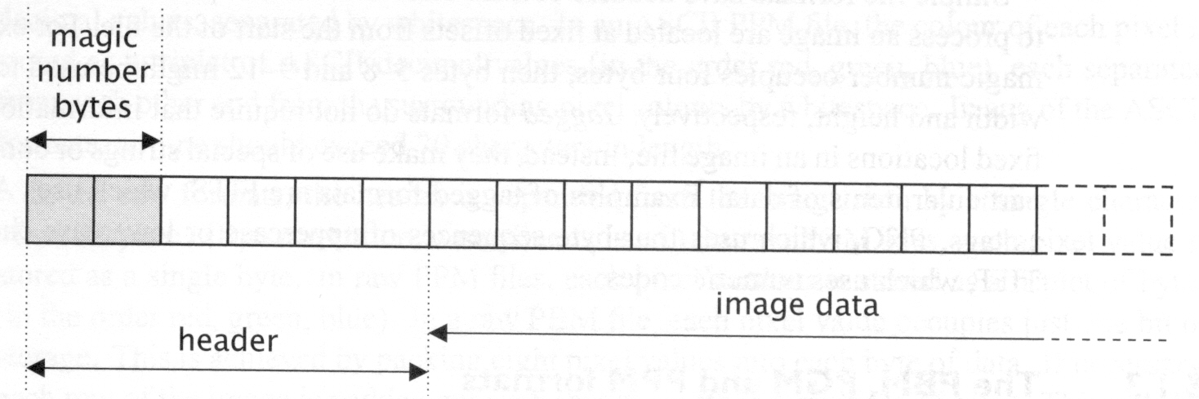
Image File Format
Most headers begin with a signature or magic number - a short sequence of bytes for identifying the file format.
Header: characteristics of the image: Size, color map, compression method, etc.
Data value: Pixel values, index values.
Common formats: BMP, GIF, PNG, JPEG, TIFF, etc.

Slide 7
BMP File Format
The BMP file format, also known as bitmap image file
device independent bitmap (DIB) file format or simply a bitmap, is a image file format used to store bitmap digital images.
independently of the display device (such as a graphics adapter), especially on Microsoft Windows and OS/2 operating systems
BMP file is an uncompressed raster image comprised of a rectangular grid of pixels.
It contains a
file header (bitmap identifier, file size, width, height, color options, and bitmap data starting point)
bitmap pixels, each with a different color.

Slide 8
BMP File Format
Structure | Corresponding Bytes | Description
Header | 0x00 - 0x0D | contains information about the type, size, and layout of a device-independent bitmap file
Info Header | 0x0E - 0x35 | specifies the dimensions, compression type, and color format for the bitmap
Color Table | 0x36 - variable | contains as many elements as there are colors in the bitmap, but is not present for bitmaps with 24 color bits because each pixel is represented by 24-bit red-green-blue (RGB) values in the actual bitmap data area
Pixel Data | variable | an array of bytes that defines the bitmap bits. These are the actual image data, represented by consecutive rows, or scan lines, of the bitmap. Each scan line consists of consecutive bytes representing the pixels in the scan line, in left-to-right order. The system maps pixels beginning with the bottom scan line of the rectangular region and ending with the top scan line.

Slide 9
BMP File Header
Name |  | Size | Description
Header |  | 14 bytes | Windows Structure: BITMAPFILEHEADER
 | Signature | 2 bytes | ‘BM’
 | File Size | 4 bytes | File size in bytes
 | reserved | 4 bytes | Unused (=0) Application Specific
 | Data Offset | 4 bytes | Offset from beginning of file to the beginning of the bitmap data

Slide 10
BMP Info Header
Name |  | Size | Description
Info Header |  | 40 bytes | Windows Structure: BITMAPINFOHEADER
 | Size | 4 bytes | Size of InfoHeader =40
 | Width | 4 bytes | Horizontal width of bitmap in pixels
 | Height | 4 bytes | Vertical height of bitmap in pixels
 | Planes | 2 bytes | Number of Planes (=1)
 | Bits Per Pixel | 2 bytes | Bits per Pixel used to store palette information.
 | Compression | 4 bytes | Type of Compression
 | ImageSize | 4 bytes | (compressed) Size of Image
 | XpixelsPerM | 4 bytes | horizontal resolution
 | YpixelsPerM | 4 bytes | vertical resolution
 | Colors Used | 4 bytes | Number of actually used colors
 | Important Colors | 4 bytes | Number of important colors

Slide 11
Color Table and Pixel Data
ColorTable |  | 4 * NumColors bytes | present only if Info.BitsPerPixel less than 8
 | Red | 1 byte | Red intensity
 | Green | 1 byte | Green intensity
 | Blue | 1 byte | Blue intensity
 | reserved | 1 byte | unused (=0)
Pixel Data | InfoHeader.ImageSize bytes |  | The image data

Slide 12
Geometric Transformation

Slide 13
What is Geometric Transformation
A set of image transformations where the geometry of image is changed without altering its actual pixel values are commonly referred to as Geometric transformation.
In general, multiple operations are applied on it, pixel values are not changed, the positions of pixel values are changed.
There are two basic steps in geometric transformations:
Spatial transformation of the physical re-arrangement of pixels in the image
Interpolation, which assigns pixel intensity to the missing pixels of transformed image
Such transformations are frequently used as pre-processing steps in different applications such as
document understanding, where the scanned image may be mis-aligned.
Basic Geometric Image Transformations:
Translation, Scaling, Shear, Rotation

Slide 14
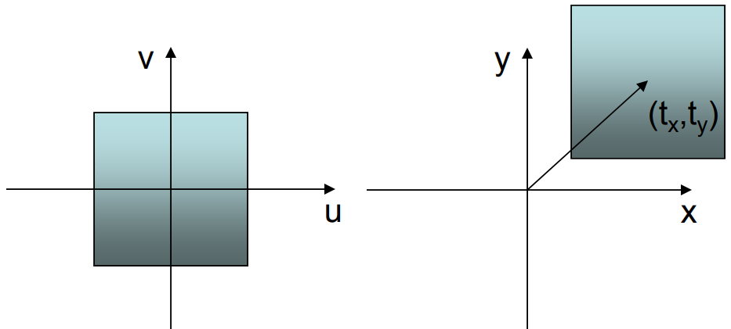
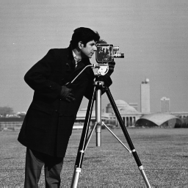
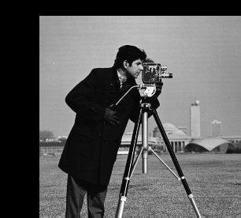


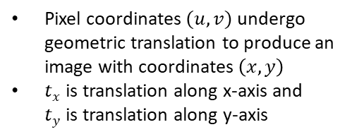
Translation
Pixel coordinates $(u,v)$ undergo geometric translation to produce an image with coordinates $\left(x,y\right)$
$t_{x}$is translation along x-axis and $t_{y}$is translation along y-axis
Translation mapping function:
$$x=u+t_{x} \\ y=v+t_{y}$$
Matrix notation:
$$\left[\begin{matrix}x \\ y\end{matrix}\right]=\left[\begin{matrix}u \\ v\end{matrix}\right]+\left[\begin{matrix}t_{x} \\ t_{y}\end{matrix}\right]$$
Input
Translated Image

Slide 15
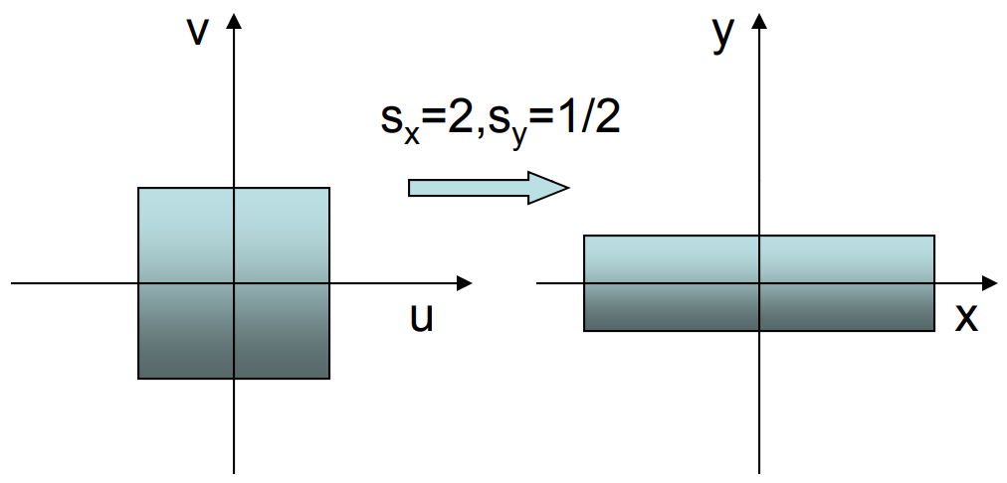
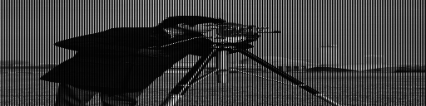
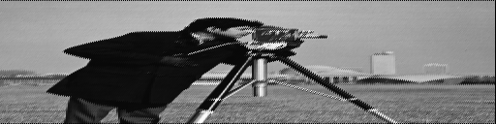


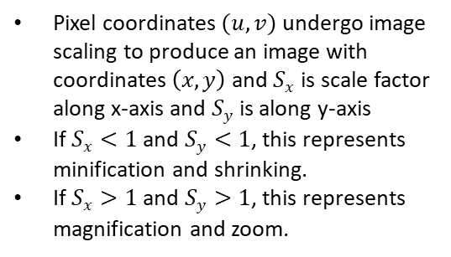
Scaling
Pixel coordinates $(u,v)$ undergo image scaling to produce an image with coordinates $\left(x,y\right)$ and${ S}_{x}$ is scale factor along x-axis and$S_{y}$ is along y-axis
If $S_{x}<1$ and $S_{y}<1$, this represents minification and shrinking.
If $S_{x}>1$ and $S_{y}>1$, this represents magnification and zoom.
Scaling function:
$$x=S_{x}u \\ y=S_{y}v$$
Matrix notation:
$$\left[\begin{matrix}x \\ y\end{matrix}\right]=\left[\begin{matrix}S_{x} & 0 \\ 0 & S_{y}\end{matrix}\right]\left[\begin{matrix}u \\ v\end{matrix}\right]$$
Input
Scaled Image

Slide 16
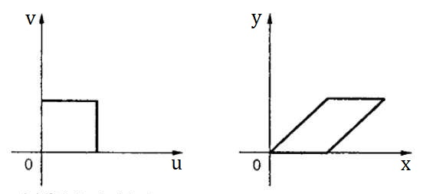
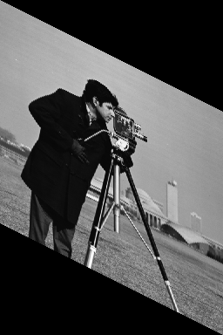
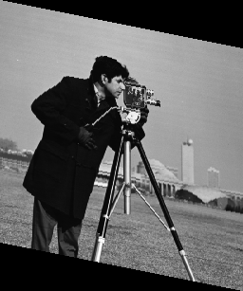

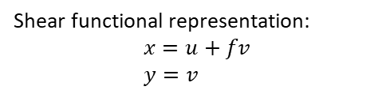
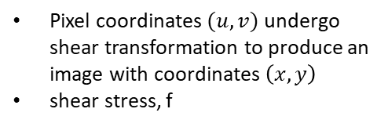
Shear
Pixel coordinates $(u,v)$ undergo shear transformation to produce an image with coordinates $\left(x,y\right)$
shear stress, f
Shear functional representation:
$$x=u+fv \\ y=v$$
Matrix notation:
$$\left[\begin{matrix}x \\ y\end{matrix}\right]=\left[\begin{matrix}u \\ v\end{matrix}\right]+f\left[\begin{matrix}v \\ 0\end{matrix}\right]$$
Input
Shear with different factor

Slide 17
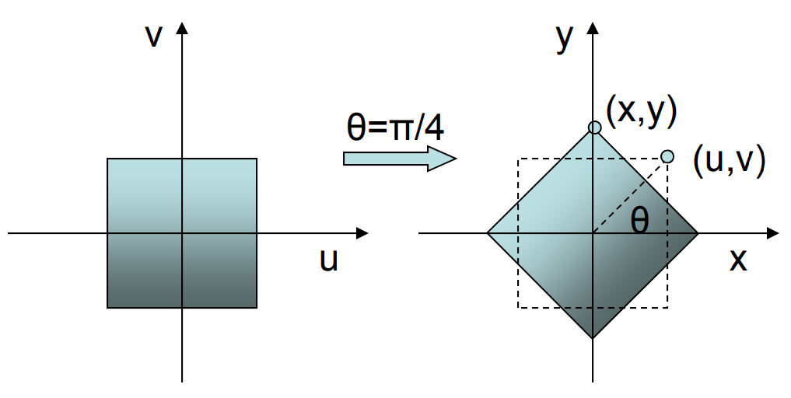
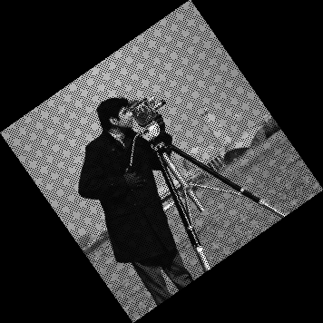
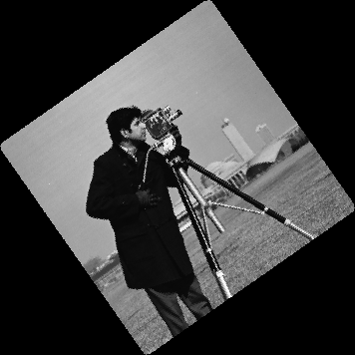
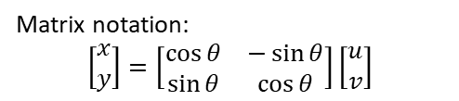

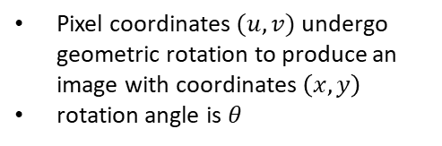
Rotation
Pixel coordinates $(u,v)$ undergo geometric rotation to produce an image with coordinates $\left(x,y\right)$
rotation angle is $θ$
Rotation function:
$$x=u\cos{θ}−v\sin{θ} \\ y=u\sin{θ+v\cos{θ}}$$
Matrix notation:
$$\left[\begin{matrix}x \\ y\end{matrix}\right]=\left[\begin{matrix}\cos{θ} & −\sin{θ} \\ \sin{θ} & \cos{θ}\end{matrix}\right]\left[\begin{matrix}u \\ v\end{matrix}\right]$$
Input
Rotation without Interpolation
Rotation after Interpolation

Slide 18
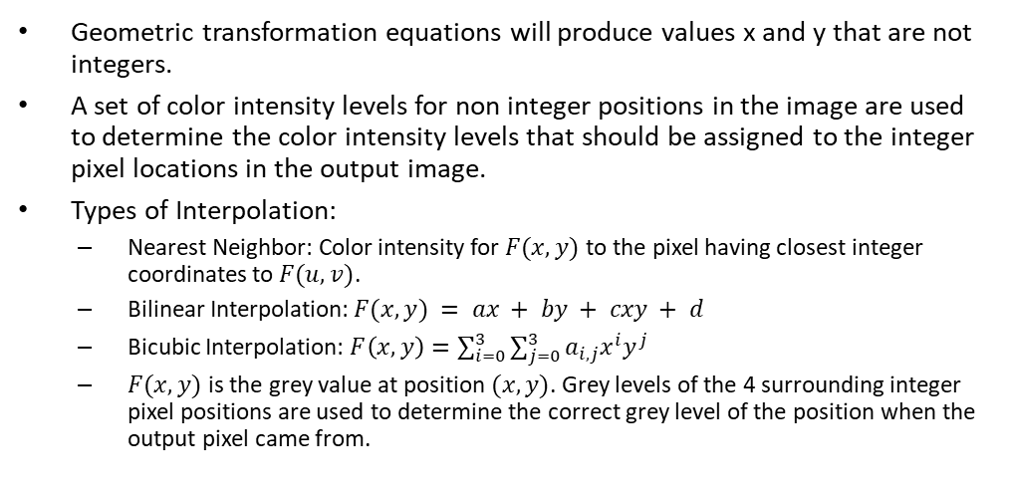
Interpolation
Geometric transformation equations will produce values x and y that are not integers.
A set of color intensity levels for non integer positions in the image are used to determine the color intensity levels that should be assigned to the integer pixel locations in the output image.
Types of Interpolation:
Nearest Neighbor: Color intensity for $F(x, y)$ to the pixel having closest integer coordinates to $F(u, v)$.
Bilinear Interpolation: $F(x, y) = ax + by + cxy + d$
Bicubic Interpolation: $F\left(x,y\right)=\sum_{i=0}^{3}{\sum_{j=0}^{3}{a_{i, j}x^{i}y^{j}}}$
$F(x, y)$ is the grey value at position $(x, y)$. Grey levels of the 4 surrounding integer pixel positions are used to determine the correct grey level of the position when the output pixel came from.

Slide 19
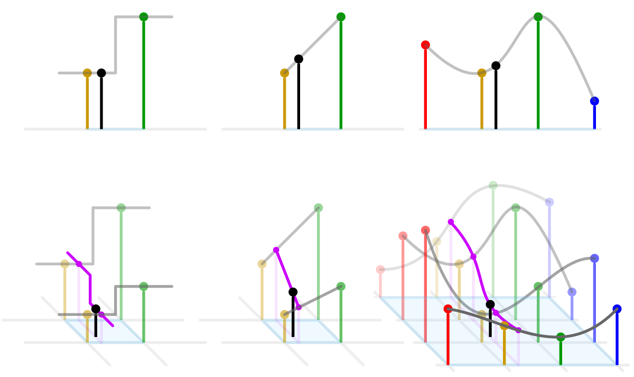
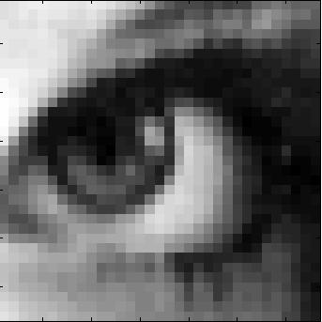
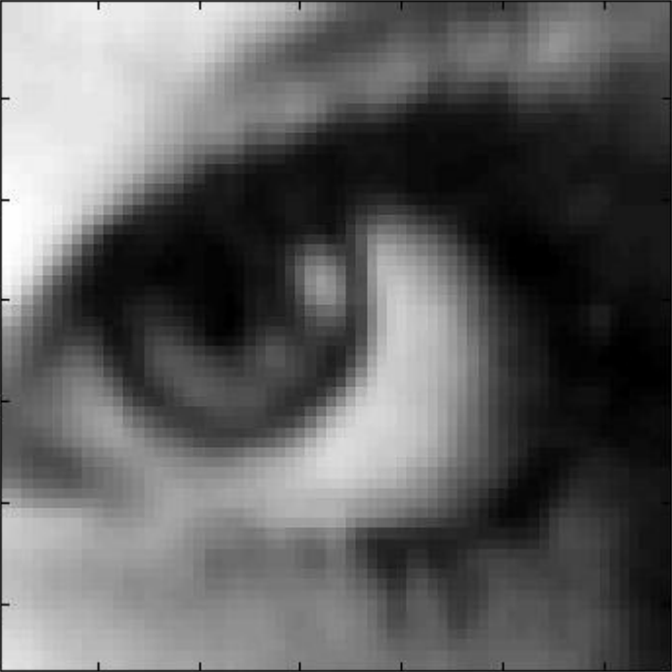
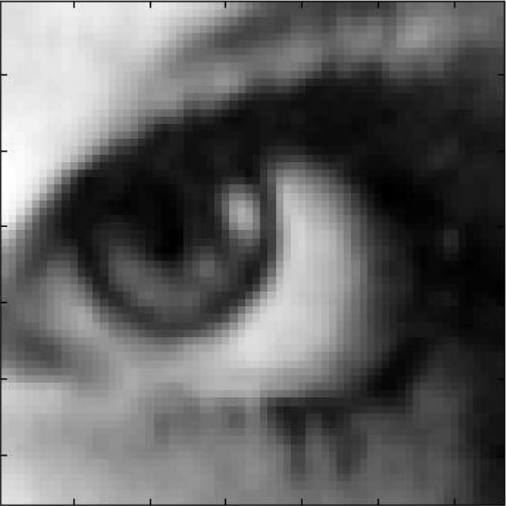

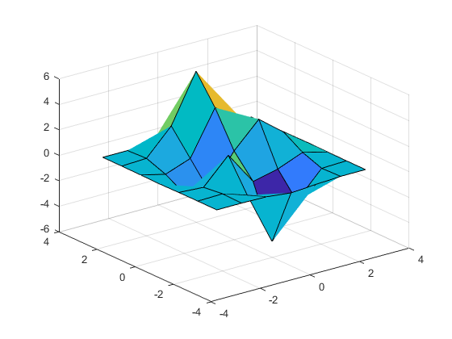
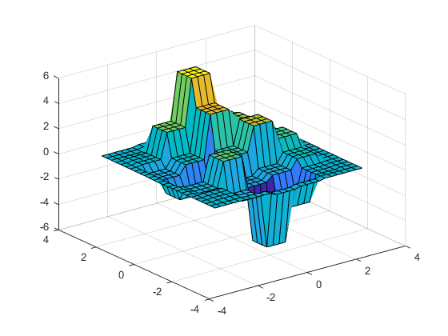
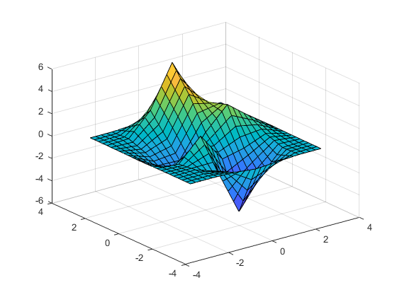
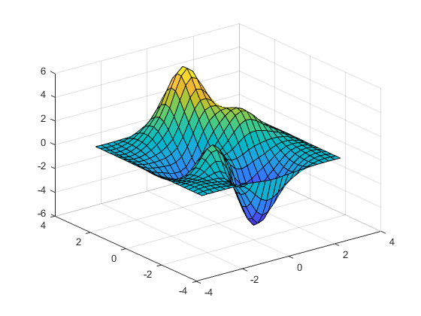
Interpolation
1-D
2-D
Nearest
Bilinear
Bicubic
Nearest
Bilinear
Bicubic
Input
Nearest
Bilinear
Bicubic

Slide 20
Thank You

