Slide 1

Autism Spectrum Disorder Screening Tool
G.SHIRISHA – 19071D5804
GUIDE -Dr. M. RAJA SEKAR
(Professor)

Slide 2
Abstract
ASD is a condition of neurodevelopment related to high healthcare costs, and early diagnosis will minimize them. However, waiting times for an ASD diagnosis are lengthy, with no cost-effective treatments. The rapid growth in the number of ASD cases worldwide includes behaviour-related datasets. However, these datasets are uncommon, making it difficult to conduct detailed analyses to enhance the ASD screening process's performance, responsiveness, and predictive accuracy. We are therefore proposing a new adult autism screening dataset containing 20 features to be used for further study, especially in identifying autistic features and improving the classification.

Slide 3
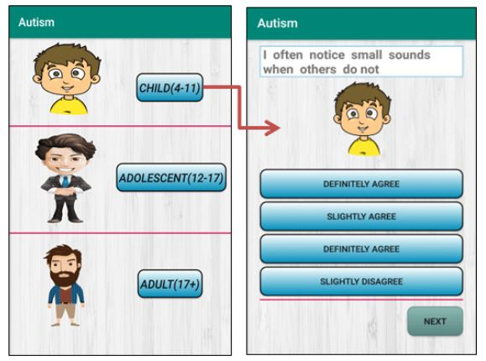

Slide 4
Introduction
Autism spectrum disorder starts in early childhood and eventually creates societally functioning difficulties — for example, socially, at school, and at work. During the first year, children also show signs of autism . This study aimed to examine the long-term risk of ASD individuals using both observational tools and parental reports. With further understanding of the relationships between maternal tension, needs, healthcare practitioners can coordinate treatment best within their area of practice, collect key resources, and provide referrals for external support services. This is condition related to brain development that affects how a person perceives and socializes with others, causing social interaction and communication problems.

Slide 5
Literature review
01 | The Genetic-Evolutionary Random Support Vector Machine Cluster Analysis in ASD | It combines with feature selection method and SVM to distinguish between ASD subjects and normal controls. Problem: Drawbacks of single SVM cluster to overcome we use random SVM and GERSVMC(Genetic SVM cluster)
02 | Diagnosis of Autism Spectrum Disorder Based on Eigenvalues of Brain Networks | Problem: Due to the lack of differences between neuroimages of healthy persons and ASD patients, there has been no powerful diagnosis approach. Excessive features overfit ML algorithms by introducing noise into the feature set.

Slide 6
Literature review
03 | Analysis and Detection of Autism Spectrum Disorder Using Machine Learning Techniques | Main aim of this paper was to detect the autism problem and the levels of autism. In this Neural Network, SVM and Fuzzy techniques with WEKA tools are used to analyse the student’s behaviour and their social interaction. These results strongly suggest that a CNN based model can be implemented for detection of autism

Slide 7
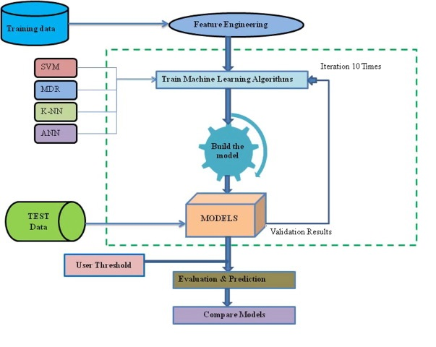

Slide 8
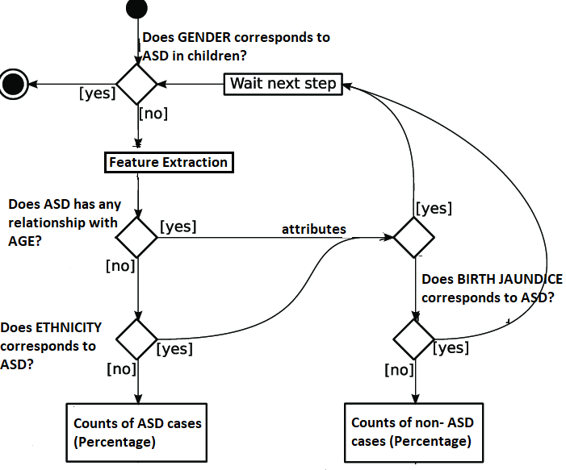
flowchart

Slide 9

tools
Installation: (Software)
Anaconda Navigator
Jupyter Notebook
Coding: Programming language – Python
Version – 3.6
Hardware Requirements:
Pentium IV or higher, (PIV-300GHz recommended)
12 GB RAM
1 TB hard free drive space

Slide 10
Concepts
MODELLING : (Supervised Learning)
Train the machine using data which is well labelled
Produces a correct outcome from labelled data.
Why Classification is used:
Content is clearly defined
Regression output is continuous quantity where as in classification we have categorical quantity
Automatically create accurate predictive models
Main aim is to compute but in regression it is forecast

Slide 11
Algorithms
Logistic Regression:
Transforms data about the binary dependent variable into an unbounded continuous variable and estimates a regular model
Tests the statistical significance of each coefficient
Find the best fitting model to describe the relationship
Why Decision Tree is used:
Tree structure to represent a number of possible decision paths and an outcome for each path.
Handles both categorical and numerical data, and graphically allow you to interpret the data.

Slide 12
Algorithms
Random Forest:
One way of avoiding overfitting that Decision Trees are prone to, is to apply a technique called.
Built multiple decision trees and let them vote on how to classify their inputs which is an ensemble technique
Why k-Nearest Neighbours is used:
Based on mainly two ideas: the notion of a distance metric and that points that are close to one another are similar.
Result of majority voting
Use a Euclidean distance metric.

Slide 13
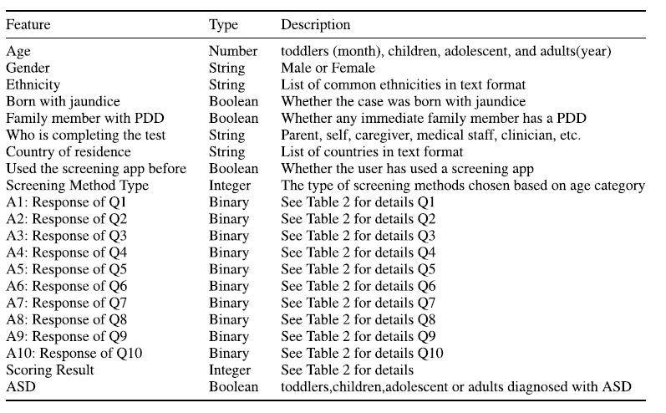
Screenshots

Slide 14
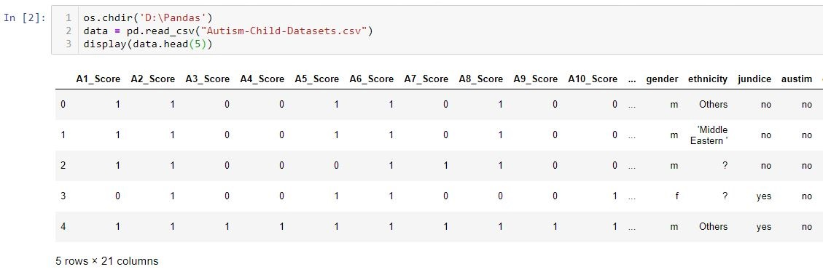
We have the following list and some additional features for autism data stored in a CSV file. We use Pandas library to import data
Imported data using pd.read_csv and later displayed the first 5 columns of data out of 300 sets
First 5 columns are displayed using head()

Slide 15
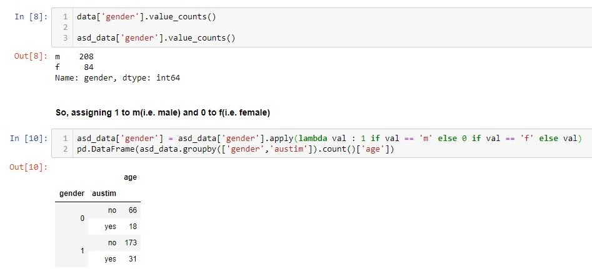
Feature Extraction - Many machine learning algorithms cannot operate on label data directly as they require variables to be numeric.
Later cleaning data is done methods like MinMaxScalar function and One Hot Encoding which creates dummy variable and later works with target labels which is used as step of pre-process

Slide 16
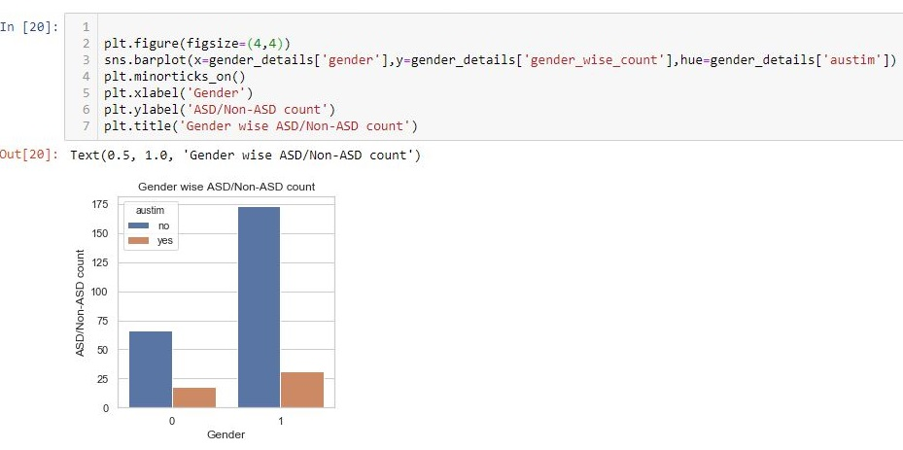
With the help of data visualization, we can see how the data looks like and what kind of correlation is held by the attributes of data.
Fastest way to see if the features correspond to the output.
Bar plot for autistic individuals compared with gender

Slide 17



We applied few machine learning models to 300 individuals with and without autism diagnosis to test the ability to reliably detect autism on mobile platforms
Used to construct new machine learning models that may have higher accuracy for autism detection using more features
More accurate model has good outcomes result in better decisions

Slide 18
Comparisons
Algorithms | Cross_Val Score | Accuracy Score
Decision Tree | 0.89 | 88%
Random Forest | 0.99 | 96%
Logistic Regression | 0.99 | 95%
K-Nearest-Neighbours | 0.95 | 87%
Naive Bayes | 0.86 | 77%

Slide 19
Result & Discussions
This work yields triple results: first, a prediction model was developed to predict autism traits. Using the AQ-10 data collection, the proposed model can predict autism with 97.10% accuracy, respectively, for infants, teenagers, and adults. Further new idea is going to establish as input will be video data and later they will analyse the behaviour of child or adult and from that features run through various classifiers and later we look for accuracy and sensitivity, which is known as Mobile detection of autism through machine learning on home video. In summary, the findings of this research offer an accurate and efficient approach to detecting autism traits for different age groups

Slide 20
conclusion
Many researchers have performed studies with ASD datasets, but ASD prediction still needs significant improvement. In our study, we gathered early detection ASD datasets of different stages of life and analysed results of using a range of different classier to explore the significant features of ASD.
We found results of 96% using Random Forest Algorithm, the best prediction possible, as we considered averaged results to compare with previous studies. In the future, we will identify better the associated limitations of this approach, and analyse more data to improve the detection of ASD and related neurodevelopmental disorders.

Slide 21


