Slide 1


PROJECTION OF EMPLOYEE PERFORMANCE & CONFINEMENT
G.SHIRISHA – 19071D5804
(M.Tech 2nd year)
GUIDE -Dr. M. RAJA SEKAR
(Professor)

Slide 2
Contents
Abstract
Purpose of this model
Literature Conclusion
Project Workflow
Design Phase
Implementation
Conclusion
References
Acceptance Letter & Certificate

Slide 3
ABSTRACT
Employees are an organization's most precious asset. The graphical representation of anticipating pay is a process that attempts to build a computerized system that can follow all daily salary growth graphs in any location and predict revenue after a certain period of time. This application generate a graph based on the information contained therein. Employees who depart take with them valuable experience and knowledge from your organisation. Most businesses assess retention rates on an annual basis, but you may measure it in smaller increments for speedier results. In this work, we deploy an analytics-driven solution that infers the expertise of employees through the mining of enterprise and social data that is not specifically generated and collected for expertise inference. We consider job role and specialty prediction and pose them as supervised classification problems.

Slide 4
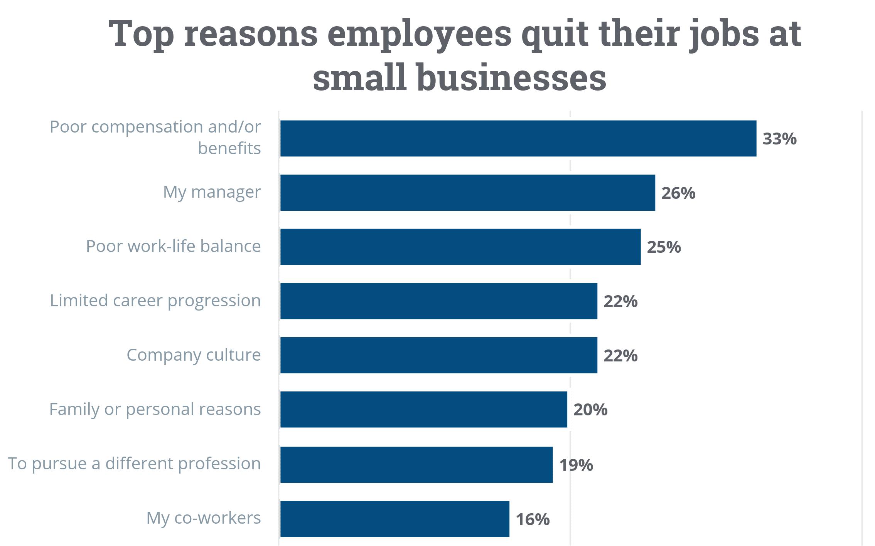
Why employees resign?

Slide 5
Purpose
Performance appraisal process provides a means for discussing, planning and reviewing the performance of each employee.
Hiring is not easy process. It is essential for the organization to retain the valuable employees showing potential.
Assigns overall performance ratings.
Employee retention practices help support an organization’s productivity.
Employee's overall performance and salary level to position responsibilities must be evaluated to determine whether a salary increase is warranted.
Focus not only on salary but also churn prediction of an employee

Slide 6
Literature conclusion
RESPECT is a term that refers to a special regard, or unique treatment. Respect is the cornerstone of keeping your employees, as the pyramid illustrates. If you don't appreciate your employees, RECOGNITION and REWARDS will have minimal impact.
Most of the research papers describes retention factors as job satisfaction, commitment, work-life balance, leadership etc...
Different theoretical research and studies have been conducted to date in order to determine attrition prediction.
The machine learning approach was chosen for creating the predictive model for forecasting employee attrition based on the accuracy calculated by the confusion matrix.

Slide 7
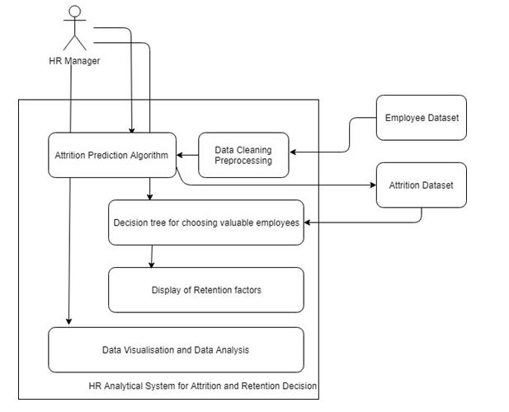
System architecture

Slide 8
Implementation
Method:
Consists of various features to define how the employee performance is measured for future benefits.
Comparing different machine learning algorithms and goal is to make a prediction correctly and calculate accuracy to know which algorithm give better performance.
Dataset consists of : Time spent, n-projects, status, salary etc.
A typical question asked by a beginner, when facing a wide variety of machine learning algorithms, is “which algorithm should I use?” The answer to the question varies depending on many factors, including: (1) The size, quality, and nature of data; (2) The available computational time; and (3) What you want to do with the data.

Slide 9
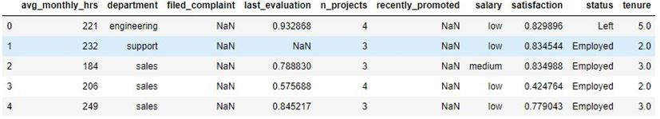
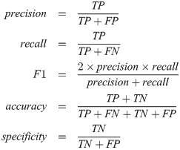
Technical concepts
screenshots
MODELLING :
Train the machine using data which is well labelled
Produces a correct outcome from labelled data.
Regression output is continuous quantity where as in classification we have categorical quantity
Automatically create accurate predictive models
Focus on performance metrics and gives better results.
Figure 1: Dataset for the model
The dataset has 14249 observations for past/present employees.
The observations span 12 different departments.
Each observation includes the employee’s current employment status.
Target variable: 'status' – Current employment status (Employed / Left)
'tenure' – Number of years at the company

Slide 10

Algorithms
screenshots
Logistic Regression:
Transforms data about the binary dependent variable into an unbounded continuous variable and estimates a regular model
Tests the statistical significance of each coefficient.
Why Decision Tree is used:
Tree structure to represent a number of possible decision paths and an outcome for each path.
Handles both categorical and numerical data, and graphically allow you to interpret the data.
Figure 1: Dataset for the model
The dataset has 14249 observations for past/present employees.
The observations span 12 different departments.
Each observation includes the employee’s current employment status.
Target variable: 'status' – Current employment status (Employed / Left)
'tenure' – Number of years at the company

Slide 11
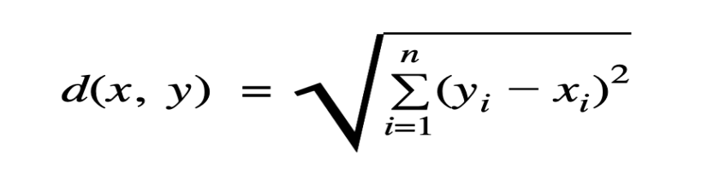
Algorithms
screenshots
Random Forest:
One way of avoiding overfitting that Decision Trees are prone to, is to apply a technique called.
Built multiple decision trees and let them vote on how to classify their inputs which is an ensemble technique
Why k-Nearest Neighbours is used:
Based on mainly two ideas: the notion of a distance metric and that points that are close to one another are similar.
Result of majority voting
Use a Euclidean distance metric.
Figure 1: Dataset for the model
The dataset has 14249 observations for past/present employees.
The observations span 12 different departments.
Each observation includes the employee’s current employment status.
Target variable: 'status' – Current employment status (Employed / Left)
'tenure' – Number of years at the company

Slide 12
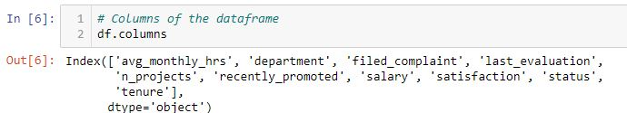
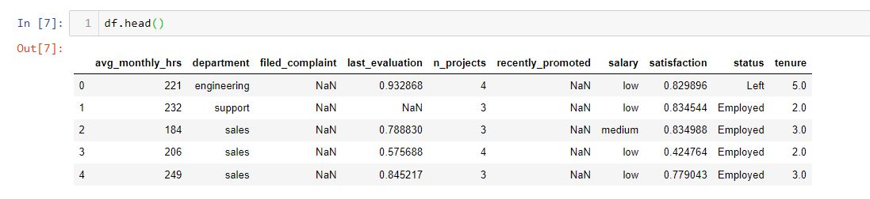
dataset
First figure shows the columns\fields in dataset and next shows in detail values. Total records :1429 and 10 columns

Slide 13
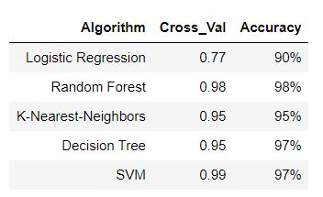
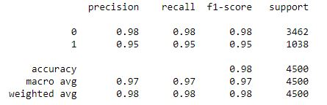
Screenshots
First figure shows the Performance of the Random forest model and the second shows Accuracy of different machine learning algorithm and highest accuracy is achieved by Random Forest as it can handle large files and has embedded feature selection property.

Slide 14
Result & discussions
Employees are dissatisfied with the organization's recognition and performance appraisal. Employees must be properly compensated in order for the company to retain them for a lengthy period of time. Employees are feeling over-worked as a result of the workload. Employees and management must enhance their relationship. Recognize and congratulate them on their accomplishments. People want to enjoy their work, therefore make it enjoyable for them. Recognize that employees need to balance their personal and professional lives, thus provide flexible start times and core hours. To encourage open communication, provide 360-degree feedback surveys and other questionnaires. Allow anonymous questionnaires on occasion so that staff can be more open and honest about their thoughts. Provide opportunities for career advancement and cross-training inside the organization.

Slide 15
conclusion
It is evident that industries cannot survive in the long run if they do not possess predictive analytics skills from the human resource management. Employee attrition is one of the biggest challenges organizations face currently. The cost of the loss of an employee and replacing them with another one can turn the focus away from the organization’s bottom line. Instead, analytics can be used to prevent this in the first place by identifying at-risk employees. By analysing factors such as pay, promotions, company environment, and relationships with managers, predictive analytics can reveal who may be the most likely to leave the organization, serving as a game changer in the personalization of the engagement process for those employees and their retention.

Slide 16
References
1. Mita, M., Aarti K. and Ravneeta, D. (2014) Study on Employee Retention and Commitment. International Journal of Advance Research in Computer Science and Management Studies, 2, 154-164.
2. Kumar, Sanath & Devadas, Udaya & Dhammika, Kas. (2021). Impact of Employee Value Proposition on Employee Retention: A conceptual paper. 10.5281/zenodo.5513384.
3. Reddy Asi, Dr Vasudeva. (2021). Compensation System: Influence on Employee Retention.
4. Gorde, Sangita. (2019). A Study of Employee Retention.
5. Silva, Melissa & Carvalho, Joao & Dias, Álvaro. (2019). Determinants of Employee Retention. 10.4018/978-1-5225-7888-8.ch004.

Slide 17
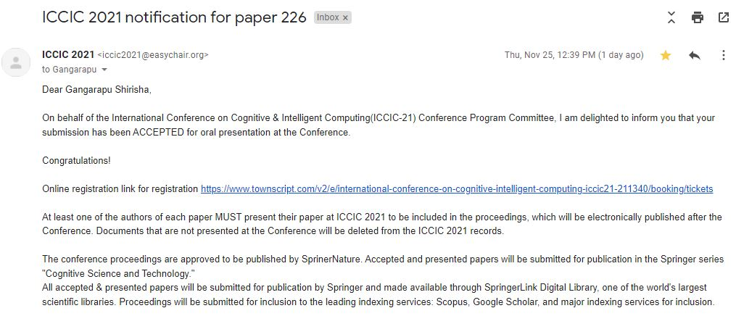
Acceptance letter

Slide 18
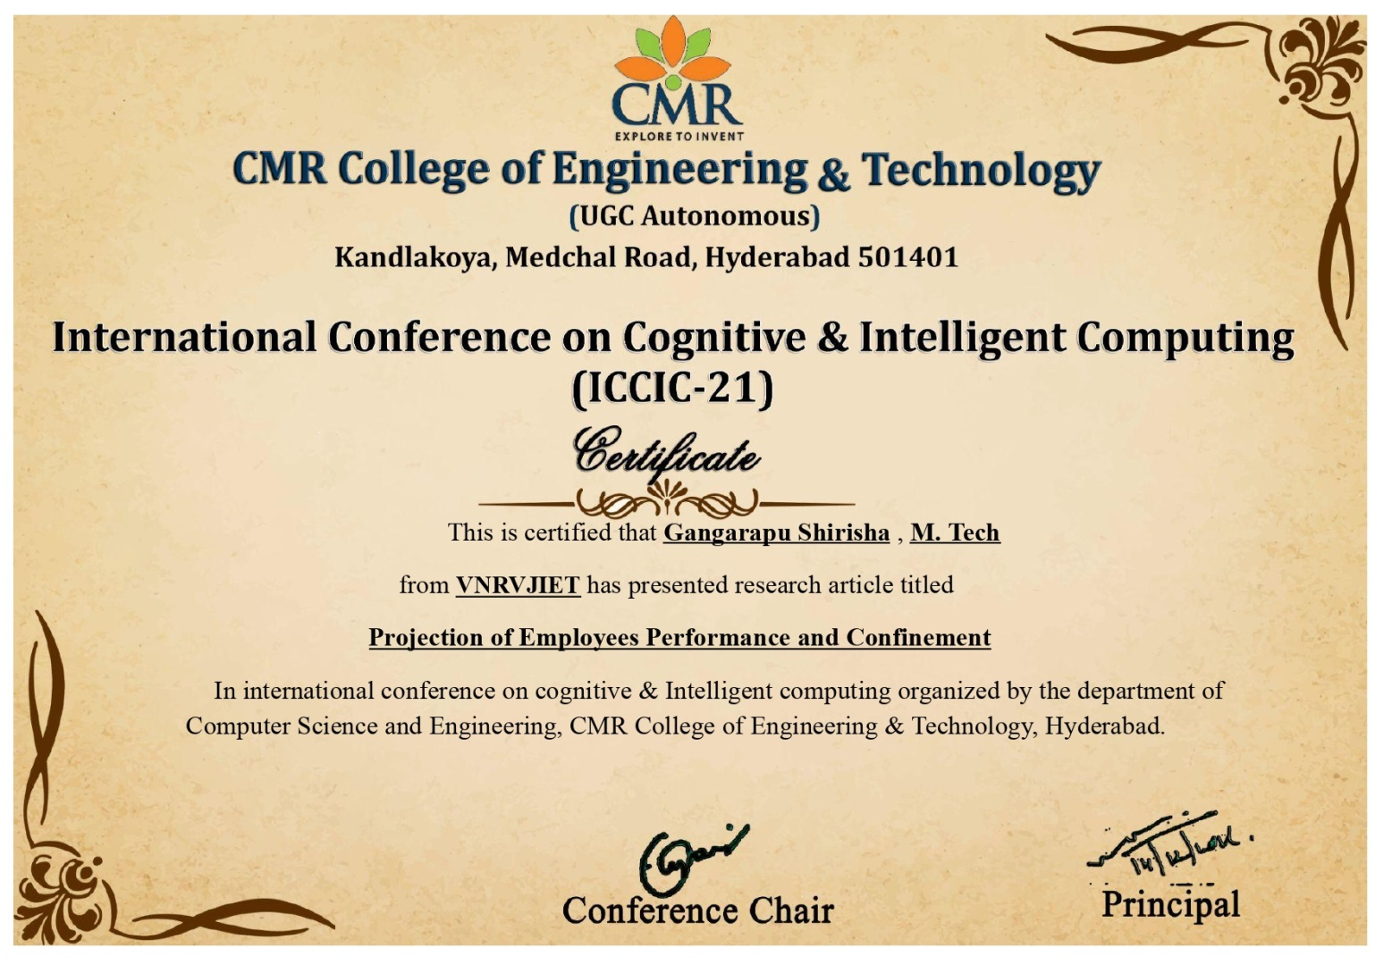
Certificate

