Slide 1
HackZon 2022
OLDSCHOOL
SIRISHA M
SHIVARAJ C M
CHAITANYA BHARADWAJ
GAGAN M

Slide 2
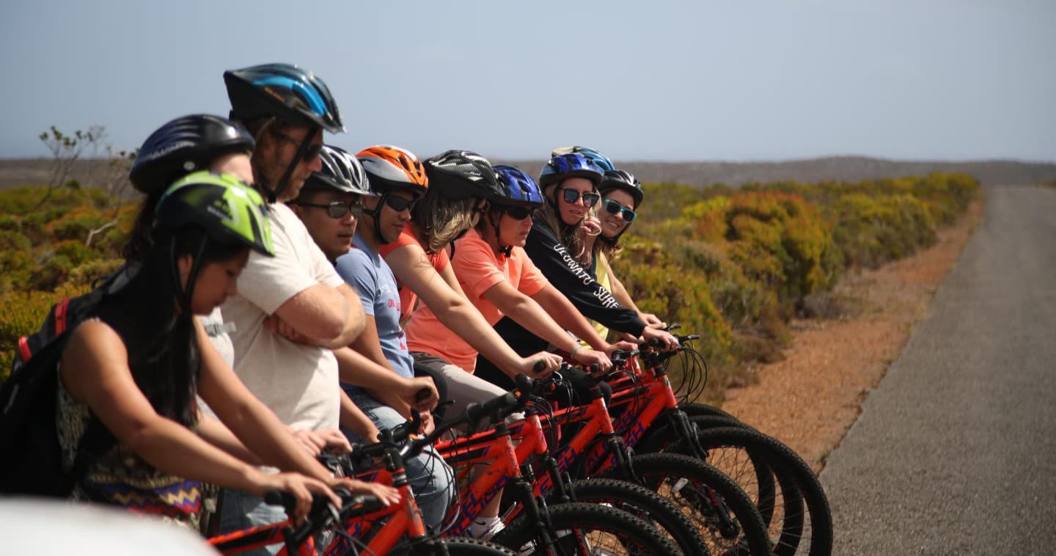
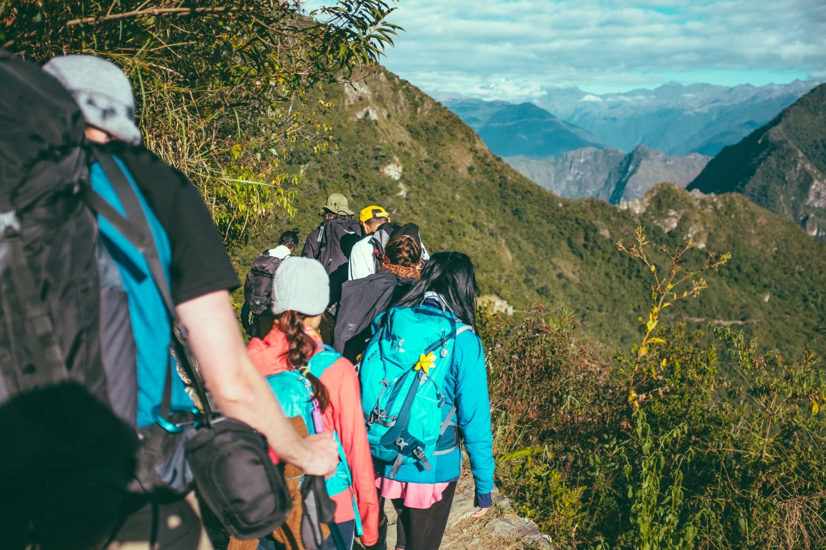
Ever had your group travel plans cancel out because your friends cancel last minute and you don't wanna go solo????

Slide 3
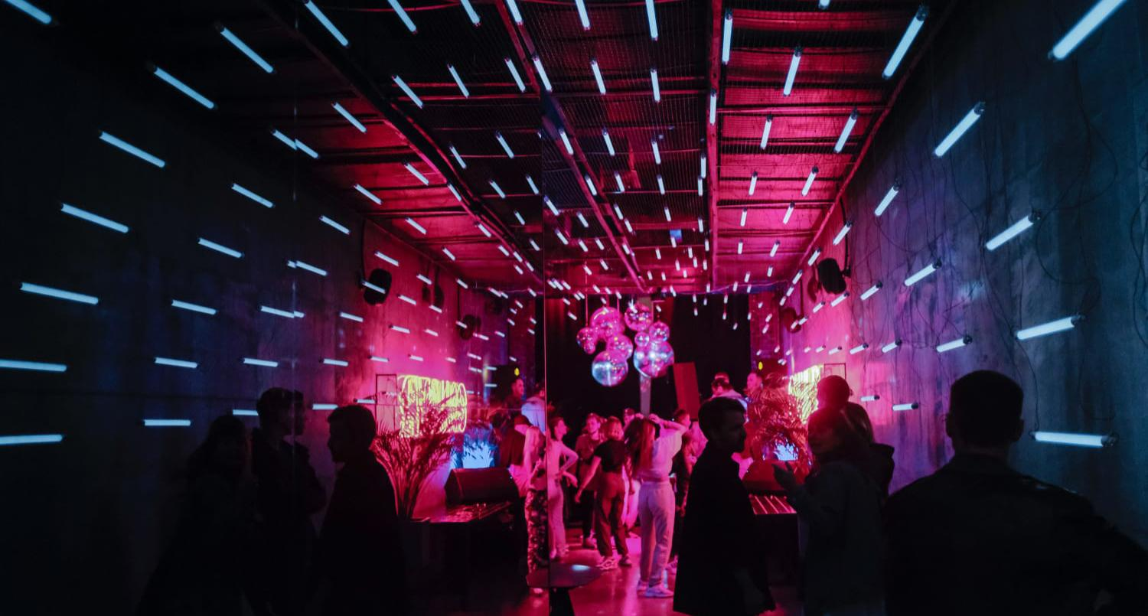
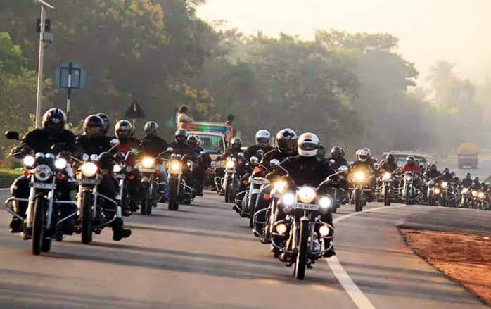
WANDERLUST!!!
Introducing WANDERLUST!!!!!!!With Wanderlust you can find and create a community which vibes with your energy.On this Platform once you register you can get info regarding all the events that are being planned and can join join the said event if it matches you idea of a vacation.
Also, you can host your event and have people of similar frequencies find you and join you on your idea of travel .

Slide 4
Implementation of Idea into the Project
Create a web app in which a user can create his profile to access the events .
The user can host an event such as trek, rides , trips and parties etc.
And the other users can join the events which match their interest.

Slide 5
Functionality of the Project
EXPRESS.JS
JAVASCRIPT
MongoDB
A flexible Nodejs framework for our backend functioning of the platform .
Javascript along with CSS bootstrap for the the front-end web application development
NoSQl Database for the storage and processing of data and accessing of data in a much easier way.

Slide 6
Future scope:
This platform is still in a budding stage and has a plethora of potential .
The developmental additions of new features can only elevate the idea .
We plan on implementing features regarding the – security and secured profiles , users feedbacks and the development of mobile application

Slide 7
Thank You
( OLDSCHOOL )

