Slide 1
Blinkit Sales Analysis Dashboard
Data Analyst Internship – Task 3
SIRISHA D
Tool Used: Power BI

Slide 2
Objective & Dataset
Objective:
The objective of this task is to design an interactive dashboard using Power BI to analyze sales and product performance for Blinkit.
Dataset Source: Blinkit Grocery Sales Dataset
Key Columns: Sales, Item Type, Outlet Type, Location Type, Rating, Fat Content

Slide 3
BUSINESS REQUIREMENT
To conduct a comprehensive analysis of Blinkit's sales performance, customer satisfaction, and inventory distribution to identify key insights and opportunities for optimization using various KPIs and visualizations in Power BI
.
KPI’s Requirements
Total Sales: The overall revenue generated from all items sold.
Average Sales: The average revenue per sale.
Number of Items: The total count of different items sold.
Average Rating: The average customer rating for items sold.

Slide 4
BUSINESS REQUIREMENT
Chart’s Requirements
1. Total Sales by Fat Content: Objective: Analyze the impact of fat content on total sales. Additional KPI Metrics: Assess how other KPIs (Average Sales, Number of Items, Average Rating) vary with fat content. Chart Type: Donut Chart.
2. Total Sales by Item Type: Objective: Identify the performance of different item types in terms of total sales. Additional KPI Metrics: Assess how other KPIs (Average Sales, Number of Items, Average Rating) vary with fat content. Chart Type: Bar Chart.
3. Fat Content by Outlet for Total Sales: Objective: Compare total sales across different outlets segmented by fat content. Additional KPI Metrics: Assess how other KPIs (Average Sales, Number of Items, Average Rating) vary with fat content. Chart Type: Stacked Column Chart.

Slide 5
BUSINESS REQUIREMENT
4. Total Sales by Outlet Establishment: Objective: Evaluate how the age or type of outlet establishment influences total sales. Chart Type: Line Chart
5. Sales by Outlet Size: Objective: Analyze the correlation between outlet size and total sales. Chart Type: Donut/ Pie Chart.
6. Sales by Outlet Location: Objective: Assess the geographic distribution of sales across different locations. Chart Type: Funnel Map.
7. All Metrics by Outlet Type: Objective: Provide a comprehensive view of all key metrics (Total Sales, Average Sales, Number of Items, Average Rating) broken down by different outlet types. Chart Type: Matrix Card.

Slide 6
Dashboard Features:
• Slicers: Filter by Product Type, Outlet Type, Location Tier
• Cards: Summary values
• Visuals: Bar, Pie, Column Charts
• Color Theme: Clean (Yellow and greens)

Slide 7
Dashboard Visuals & Insights
Key Insights:
• Most sales come from Dairy and Snack Foods
• Supermarket Type1 contributes the highest revenue
• Tier 1 cities dominate grocery consumption
• Low Fat items perform better in terms of sales

Slide 8
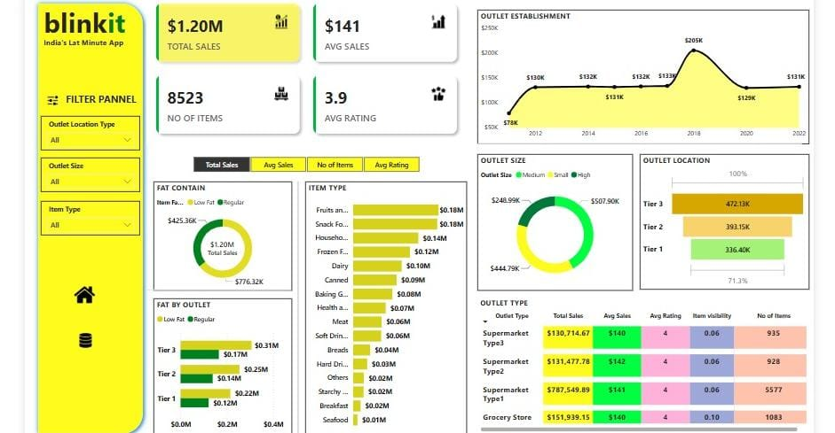
Blinkit Analysis

Slide 9
Conclusion
Summary:
The Blinkit Sales Dashboard provides insights into product performance, outlet trends, and consumer preferences.
Future Scope: • Add time-based trends • Customer segmentation • Predictive analytics

