Slide 1
Project Presentation
Item based Collaborative filtering with User Features
Presented by Krishna Sirisha

Slide 2
Existing Method of Item Based Collaborative Filtering
Creates a user-item matrix with the ratings listed in the dataset
Computes the item-item similarity
Predicted rating is calculated with the similarity measure
Recommendations are done to the user based on the predictions calculated
User/ Item | Item1 | Item2 | Item3
User1 | 4 | ? | 3
User2 | 5 | 4 | 3
User3 | ? | 2 | 1
User/ Item | Item1 | Item2 | Item3
User1 | 4 | ? | 3
User2 | 5 | 4 | 3
User3 | ? | 2 | 1

Slide 3
Issue with the existing method
Takes only the item-item similarity into account
Does not consider the user features
Prediction quality might be low in some cases where predictions are done without considering the user features
Though achieves good performance, likely to present less quality recommendations

Slide 4
User Features for Recommendation
User Features play an important role for making effective recommendations
Knowing user profile helps in increasing the quality of recommended items
The present model takes into account the item similarities without user features
Consider a case where there is a dataset with 80% of users are of age 40-60, so the similar ratings on the movies would make items similar which effects the remaining 20% of users of age 15-25.
As a result, the users who are of different age see recommendations that are not accurate to them

Slide 5
Different approach towards the item based collaborative filtering
This approach is applying the item based collaborative filtering after grouping the users
Users of similar features are grouped together
The item based collaborative filtering is then applied to compute the predictions and generate recommendations for the most similar users within the group.
Age 18-35
Group2
Age 56-85
Group4
Age 3-17
Group1
Age 36-55
Group3

Slide 6
Preparing the dataset
The MovieLens Dataset consists of
1,00,000 ratings (1-5) from 943 users on 1682 movies
Each user has rated atleast 20 movies
Simple demographic info for the users (age, gender, occupation, zip)
The dataset is divided into the training data and test data
75% of the data was used to train the algorithm and 25% of the data was used as the test data to which the algorithm was not exposed.
The training and test data sets are selected randomly.

Slide 7
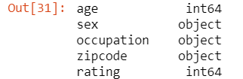
Preparing the dataset
The user features are determined from the dataset
All the object type columns in the dataset are then transformed using Label Encoding technique
Load dataset with user features
Encode categorical values using Label Encoding

Slide 8
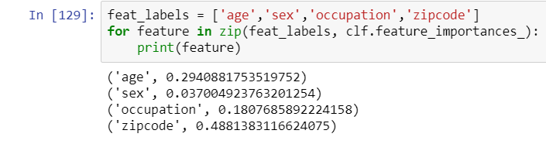
Selecting User Features
Random Forest algorithm was used for feature selection in this project
Trained random forest classifier with user features and target variable
Identify the most important features

Slide 9

Grouping the users
Experimented with grouping of users based on
Occupation
Age
Gender
Though zip code has the highest feature importance, it was not considered for grouping as there were 795 unique values for 943 users
Grouping with zip code results with small number of users per group with zip code

Slide 10
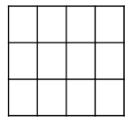
Group users based on user feature
G1
G2
…..
G6
G7
…..
Gn
Calculate User Similarity within each group
IBCF
IBCF
IBCF
IBCF
IBCF
Prediction

Slide 11
Hybrid User Item Collaborative Filtering
Once the grouping is done, a user item matrix is constructed with each group
The user similarity is calculated within the group
Most similar users are selected from the group
Item Based Collaborative Filtering is then applied on the most similar users selected from the group
Prediction is calculated and compared with the original value

Slide 12
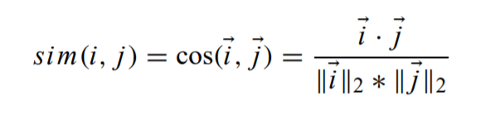
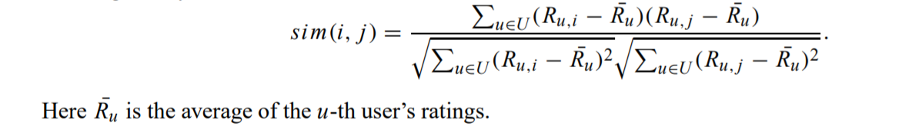
Similarity Measures
Cosine based similarity: Users/Items i and j are thought of as 2 vectors in the m dimensional space. The cosine of the angle between 2 vectors is taken as the similarity measure.
Adjusted Cosine Similarity: The ratings are mean centered before calculating the similarity. Subtracts the user average in order to mean center the ratings

Slide 13
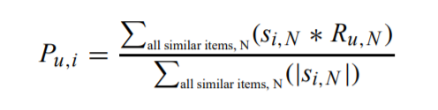
Prediction Computation
Weighted Sum:
Computes the prediction on item i by computing the sum of ratings given by the user on items that are similar to i
Each rating is weighted by the corresponding similarity calculated

Slide 14
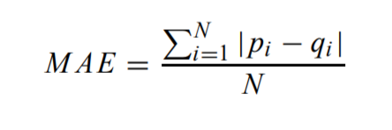
Evaluation Metric
Statistical Accuracy metrics
Compares the numerical predicted score against the actual ratings in the test set
Mean Absolute Error is used to calculate the deviations of predicted values from the true user specified values.
MAE is computed by summing the absolute errors of the corresponding rating-prediction pairs and taking the average of it.

Slide 15
Experimental Results
In order to assess the quality of predicted values, the sensitivity of following parameters were determined
Similarity Measures
Value of training/test ratio
User Neighborhood Size
Item Neighborhood Size

Slide 16
Similarity Measures
The cosine - cosine approach for calculating user and item similarities respectively was performing better.
The cosine - adjusted cosine approach was having high MAE values when compared to that of cosine-cosine
MAE

Slide 17
User Neighborhood Size
The MAE values were recorded by varying the user group size
It can be observed that when 1/8th of the group data was considered, the method is performing better than using 25% or 50% of group user data
Using less user neighbors is increasing the performance
MAE

Slide 18
Value of Training/Test ratio
Experiment was conducted with the cosine-cosine similarity measure by taking different training/test ratios varying by 0.1
Here 0.45 means 45% is taken as training data and 55% is taken as test data
The MAE value is less for training/test ratio at 0.75 and it is considered for all the evaluations.
MAE
Train/Test Ratio

Slide 19
Item Neighborhood Size
The number of neighbors are varied and MAE values are computed
From the below graph, the new approach improves as we increase the neighborhood size and later the curve tends to be flat at 700
No: of neighbors

Slide 20
Experimental Evaluation
From the final evaluation, it can be seen that the proposed approach performs somewhat better than the basic item based collaborative filtering
The MAE values using different neighbors for both algorithms were plotted as follows
MAE
No: of neighbors

Slide 21
Extensions to the Project
Testing the approach with different data sets
Combining groups if there are less number of users in the group with the help of threshold value
Effect of quality with different threshold values
Imputing missing values and testing the approach

Slide 22
Conclusion
Though the collaborative filtering techniques generate good recommendations, it may not be accurate at all times.
Considering the user features would enhance the present technique and results in an accurate prediction, thus improving the recommendations.

Slide 23
Questions

