Slide 1

SREENIDHI INSTITUTE OF SCIENCE & TECHNOLOGY
Bachelor of Technology in
Electronics & Computer Engineering
D1
Major Project on
MULTIPLE DISEASE DETECTION f
By
M.SRAVANI 21311A1920
M.SHIRISHA 21311A1935
D.KATHYAYANI 22315A1901

Slide 2
Contents
Abstract
Introduction
Literature Survey
Block Diagram of the Existing System
Block Diagram of the Proposed System
Tentative Results
Conclusion
References

Slide 3
ABSTRACT
Ensemble learning is a powerful machine learning technique that combines predictions from multiple models to achieve higher accuracy and robustness compared to individual models. This study explores the integration of Support Vector Machines (SVM), Logistic Regression, Random Forest, K-Nearest Neighbors (KNN), and Decision Trees to create an ensemble model using majority voting. The proposed model leverages the strengths of each algorithm to handle diverse data characteristics, resulting in improved classification performance. By aggregating predictions from these classifiers, the ensemble mitigates individual model biases and enhances the overall decision-making process. The effectiveness of this approach is validated through experiments on benchmark datasets, demonstrating its potential for reliable and accurate predictions in real-world applications.

Slide 4
Introduction
The increasing complexity and variability of data in modern applications necessitate machine learning models that are not only accurate but also generalizable. While individual models, such as Logistic Regression or Support Vector Machines (SVM), are effective in specific scenarios, they may fail to capture the diverse patterns present in complex datasets. Ensemble learning addresses this limitation by combining multiple models to produce a single, consolidated prediction.
This project focuses on implementing an ensemble learning approach that integrates five widely-used classification algorithms: Logistic Regression, SVM, Random Forest, K-Nearest Neighbors (KNN), and Decision Trees. Each algorithm brings unique strengths, such as SVM's ability to handle high-dimensional spaces, Random Forest's robustness to overfitting, and KNN's simplicity in capturing local data structures. The ensemble method employs majority voting to aggregate predictions, ensuring that the collective output is more accurate and resilient to noise than any individual model.
The motivation for this project stems from the diverse applications of ensemble learning, ranging from medical diagnosis and financial fraud detection to image recognition and natural language processing. By combining the predictive capabilities of multiple classifiers, the proposed ensemble aims to overcome individual weaknesses and deliver robust, reliable results. This document outlines the architecture, implementation, and evaluation of the ensemble learning framework, along with its performance analysis on a benchmark dataset.

Slide 5
Literature Survey
Disease Prediction System using Support Vector Machine and Multilinear RegressionAuthors: Md. Ehtisham Farooqui, Dr. Jameel Ahmad: This paper explores the combination of Support Vector Machine (SVM) and Multilinear Regression for predicting diseases based on various health indicators like test results, symptoms, and medical history. The hybrid model was found to outperform individual SVM or regression models in prediction accuracy.
The Prediction of Disease Using Machine LearningAuthors: Dr. C.K. Gomathy, Mr. A. Rohith Naidu: The paper compares different machine learning models, including Naive Bayes, Decision Trees, and SVM, on datasets like diabetes, heart disease, and cancer. It suggests ensemble methods like Random Forest as effective but focuses on individual classifiers' merits.
Disease prediction from various symptoms using machine learningAuthors: Rinkal Keniya, Aman Khakharia, Vruddhi Shah, Vrushabh Gada, Ruchi Manjalkar, Tirth Thaker, Mahesh Warang, Ninad Mehendale: The paper focuses on disease prediction based on symptoms using models like K-Nearest Neighbors (KNN), SVM, and Random Forest, while primarily discussing the use of simpler models like KNN for its ease of implementation.
Predicting Disease with Neural NetworksAuthors: Hassan A. Al-Habash, Faisal Iqbal, Nour S. Al-Khathlan: This study focuses on using Artificial Neural Networks (ANNs) for disease prediction, analyzing the benefits of deep learning over traditional algorithms like Decision Trees or SVM.
Disease Prediction Using Naive Bayes and Logistic RegressionAuthors: Anjali Yadav, Arun Kumar, Deepak Sharma: The paper evaluates the use of Naive Bayes and Logistic Regression for disease prediction, demonstrating that while Random Forest may provide better generalization, these simpler models are effective for certain types of diseases, especially when computational resources are limited.

Slide 6
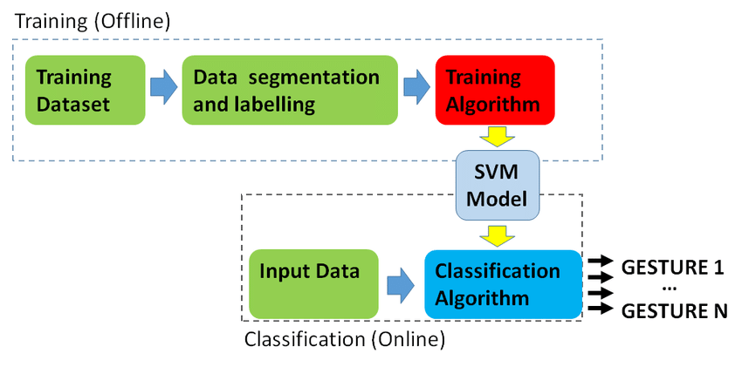
Block Diagram of the Existing System

Slide 7
Block Diagram of Proposed system
Logistic regression
Decision tree
Random Forest
SVM Classifier
KNN Classifier
Aggregation
Final Prediction

Slide 8
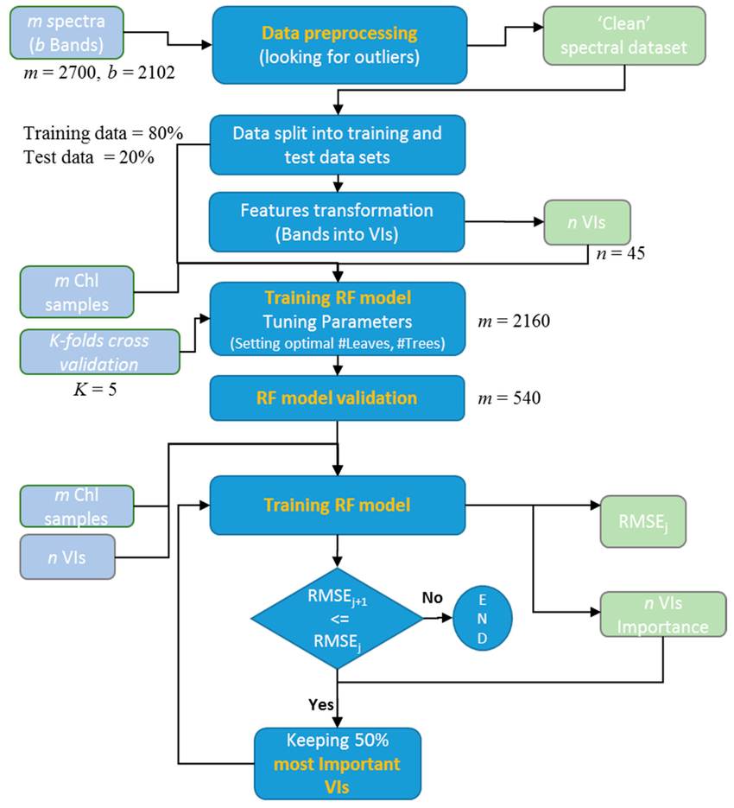
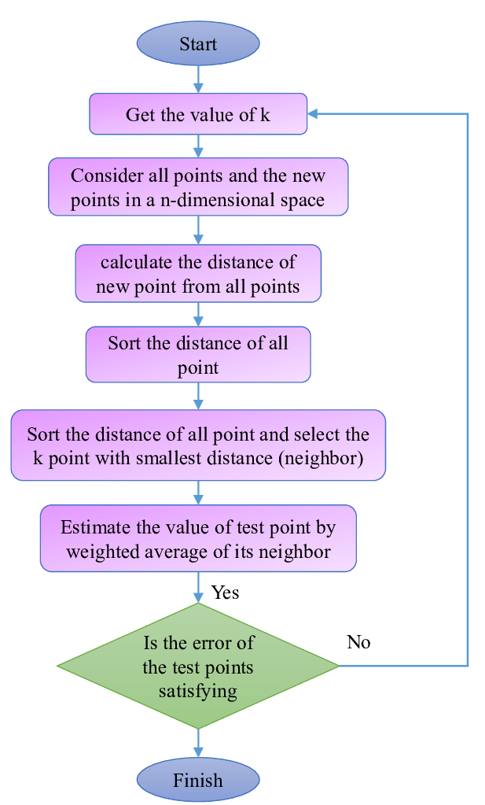
Block Diagram of the Proposed System
Random Forest
KNN

Slide 9
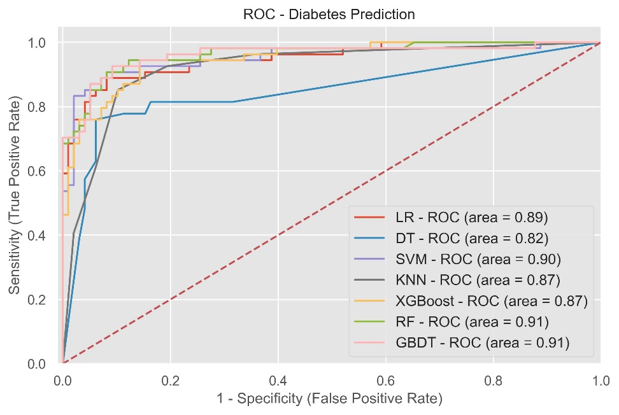
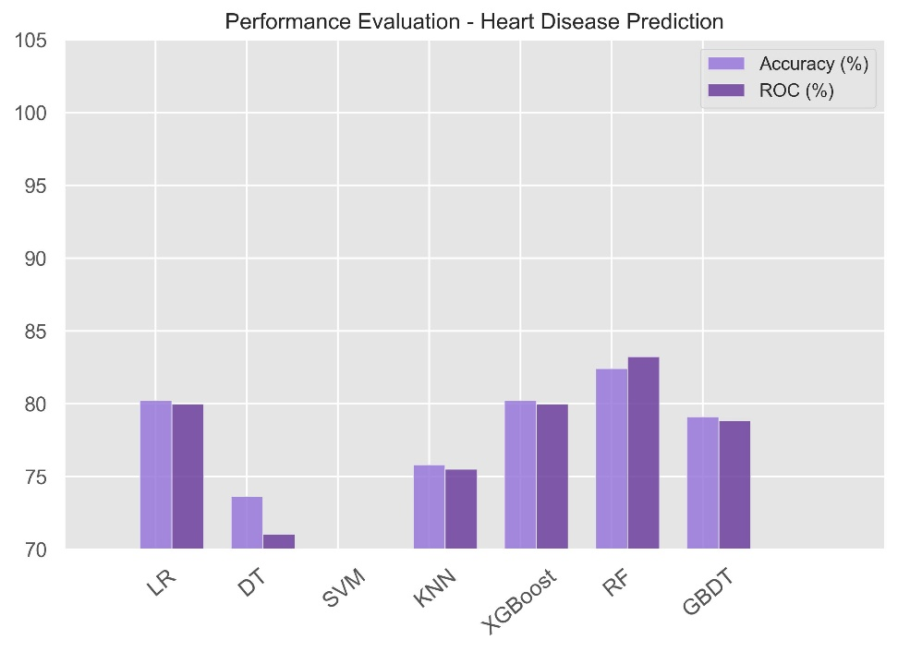
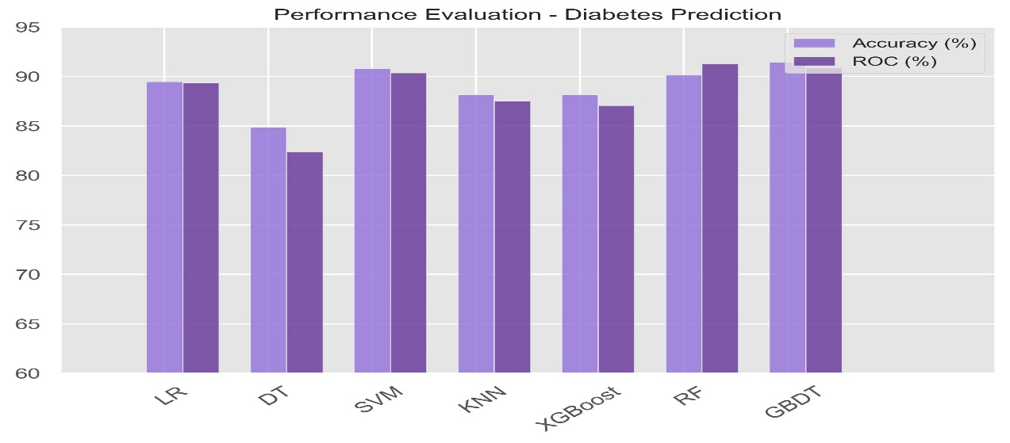
Tentative Results

Slide 10
Conclusion
This project highlights the transformative power of machine learning in healthcare by using the Random Forest algorithm for accurate multi-disease detection. The model efficiently predicts conditions like diabetes, tyroid,skin and heart disease, surpassing traditional methods in accuracy and reliability. With advanced preprocessing and feature selection, it ensures precise results and valuable insights for clinicians.
The success of this system demonstrates its potential to revolutionize diagnostics, making them faster, cost-effective, and scalable. This work serves as a foundation for integrating intelligent models into healthcare, paving the way for improved patient outcomes and a more efficient diagnostic process.

Slide 11
References
[1] Disease Predictor Based on Symptoms Using Machine Learning M Vamshi Krishna Reddy1 , G V P Sai Abhijith2 , K Sai Nath3 , Mangali Sathyanarayana4 1, 2, 3B.Tech IV year Students, 4Assistant Professor, Department of Computer Science and Engineering (CSE), Sreenidhi Institute of Science and Technology, Hyderabad, Telangana, India.
[2] Disease Prediction System using Support Vector Machine and Multilinear Regression Md. Ehtisham Farooqui, Dr. Jameel Ahmad
[3] THE PREDICTION OF DISEASE USING MACHINE LEARNING Dr C K Gomathy, Mr. A. Rohith Naidu Sri Chandrasekharendra Saraswathi Viswa Mahavidyalaya , Kanchipuram
[4] Disease prediction from various symptoms using machine learning Rinkal Keniya · Aman Khakharia · Vruddhi Shah · Vrushabh Gada · Ruchi Manjalkar · Tirth Thaker · Mahesh Warang · Ninad Mehendale ∗
[5] An Approach to detect multiple diseases using machine learning algorithm To cite this article: Indukuri Mohit et al 2021 J. Phys.: Conf. Ser. 2089 012009
[6] Disease prediction from various symptoms using machine learningAuthors: Rinkal Keniya, Aman Khakharia, Vruddhi Shah, Vrushabh Gada, Ruchi Manjalkar, Tirth Thaker, Mahesh Warang, Ninad Mehendale:
[7] Disease Prediction System using Support Vector Machine and Multilinear RegressionAuthors: Md. Ehtisham Farooqui, Dr. Jameel Ahmad

