Slide 1


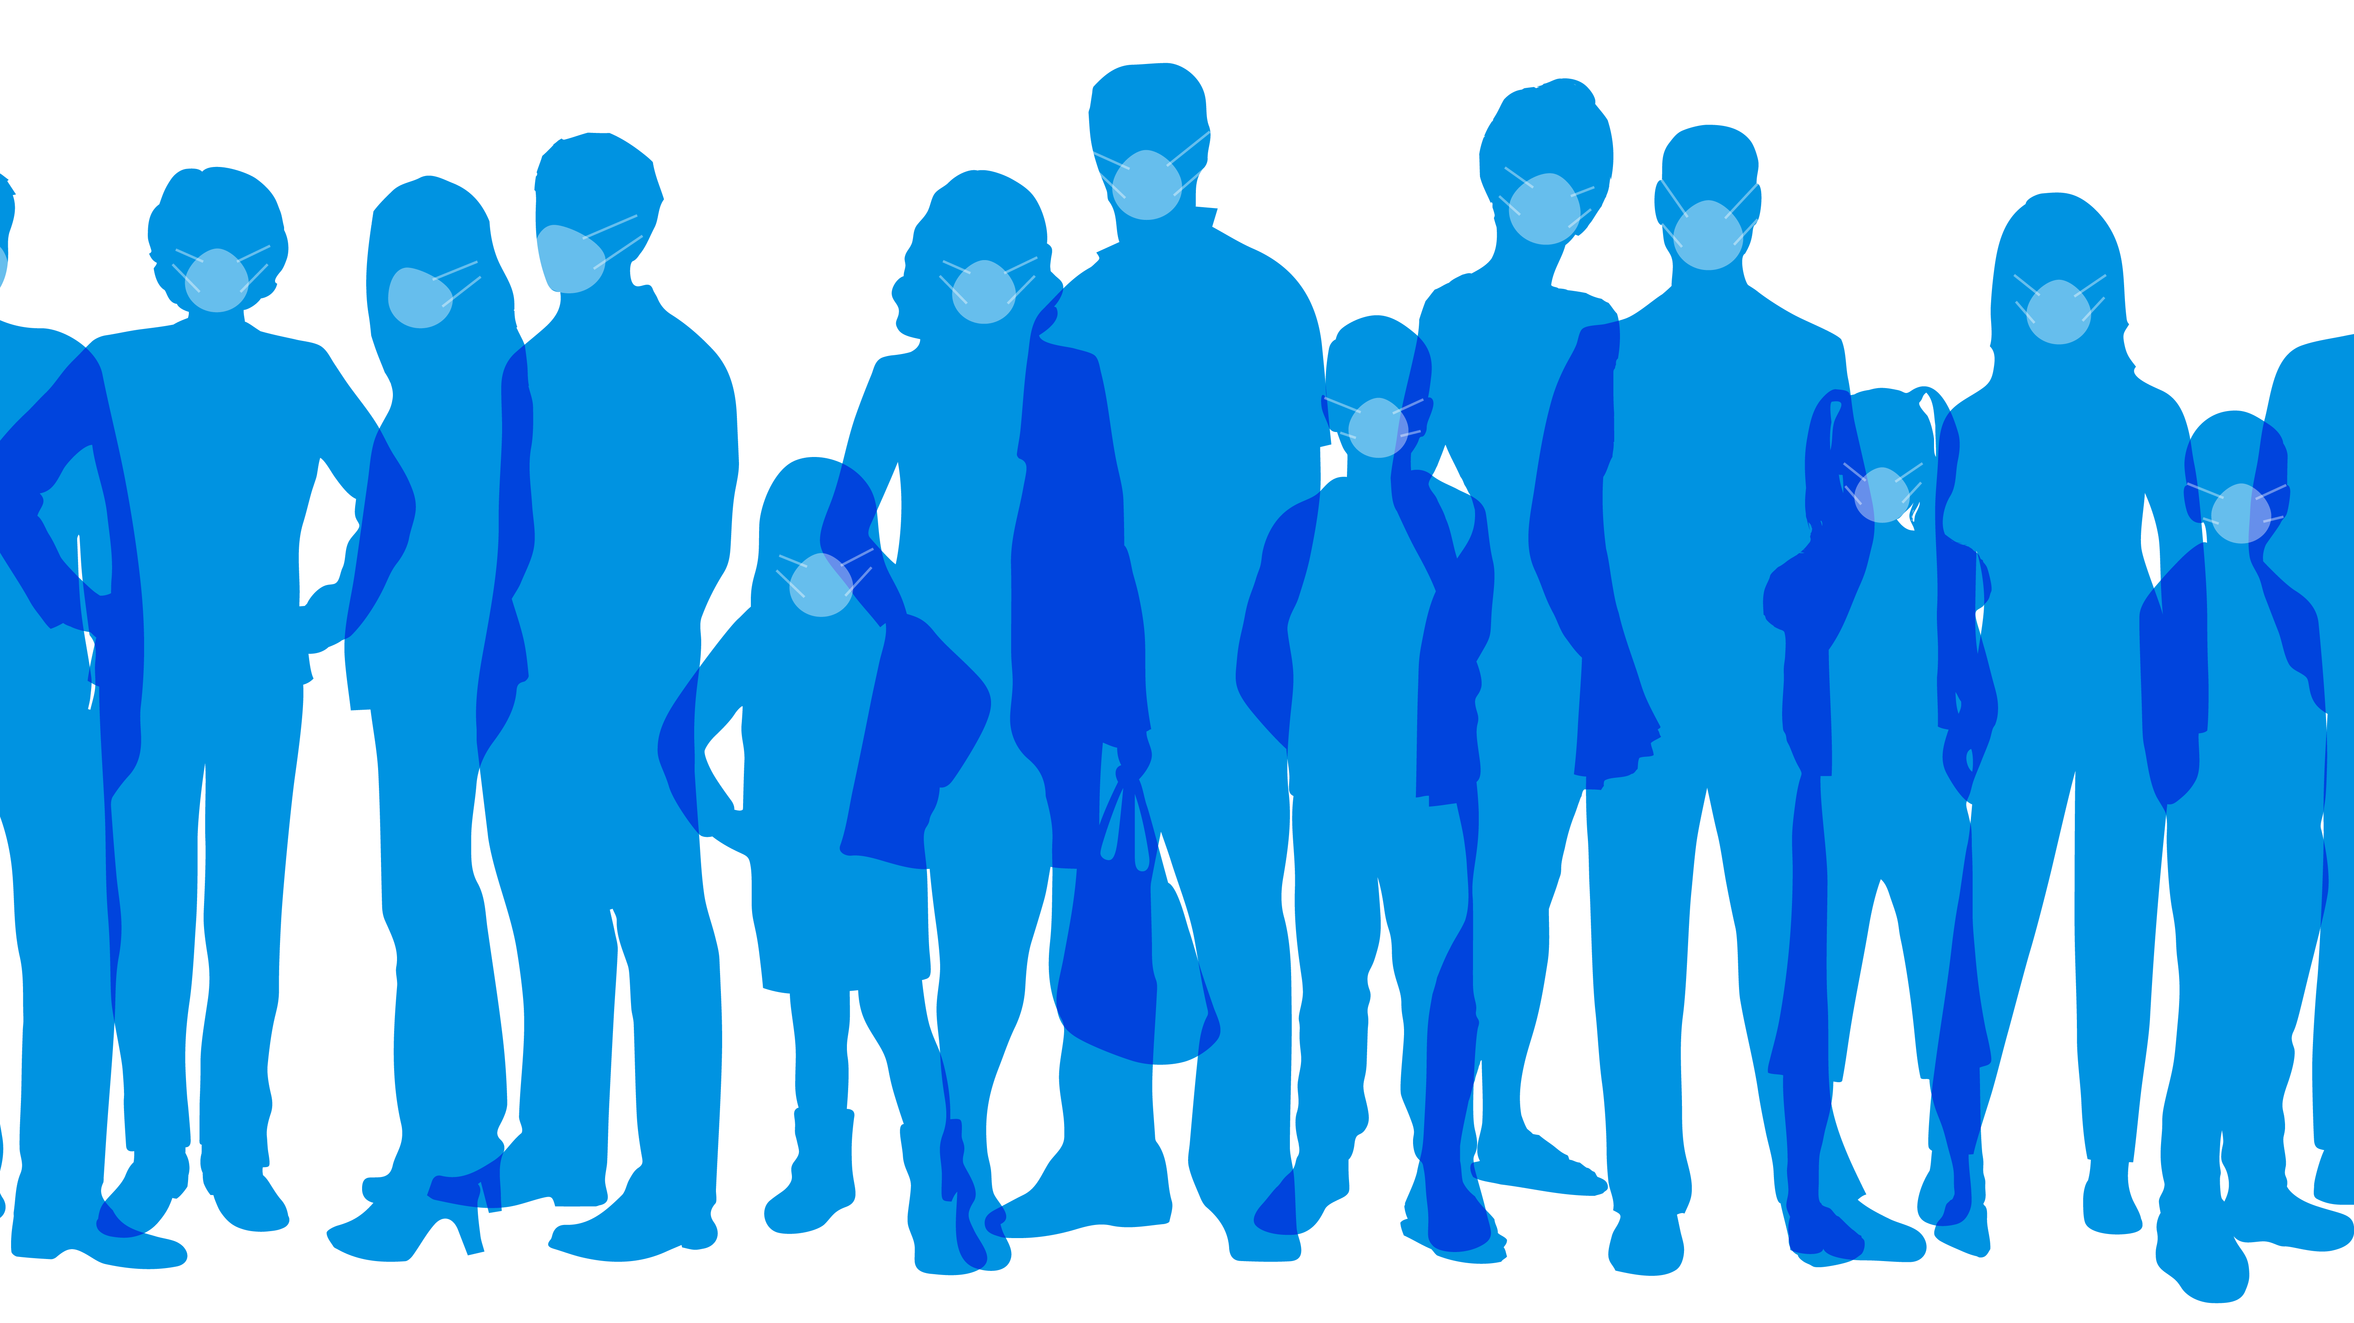
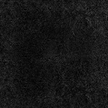
Mask On, Mask Off: The Role of AI in Enforcing Public Health Measures

Slide 2
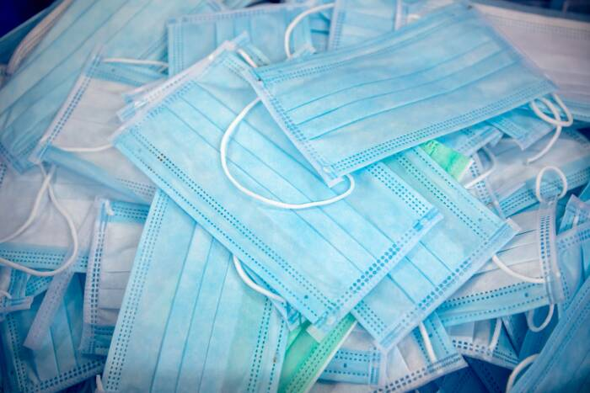
Outline
Introduction
Data Collection
Data pre-processing
Model Architecture
Training the model
Testing and Evaluation
Results

Slide 3
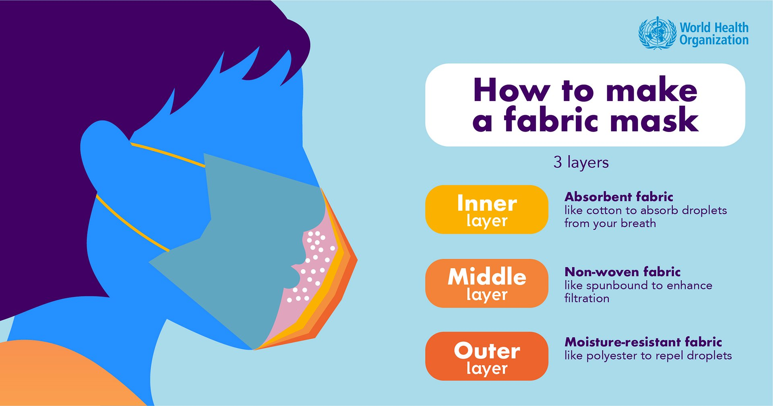
Introduction
COVID-19 pandemic has brought unprecedented challenges to the world
enforcing mask-wearing in public spaces can be difficult.
AI model that can identify individuals who are not wearing masks.
model can be used in various settings
We used deep learning techniques to develop an AI model

Slide 4

Data Collection
extensive collection of images containing individuals wearing and not wearing masks
total 3833 images were collected
Dataset was having two categories With-Mask and Without-Mask
1,915 images were of with Mask
1,918 images were of without mask
20% of the data set is used for testing
80% of the data id used for training

Slide 5
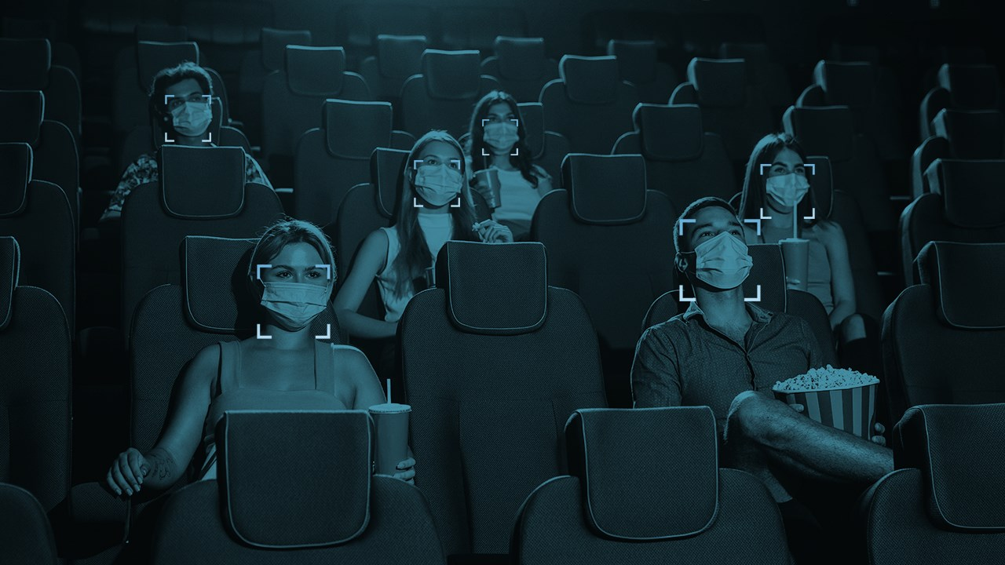
DATA PRE-PROCESSING
loaded the images with the help of python programming(Open CV)
convert those images into arrays(MobileNet)
Image resizing(224*224)
Data augmentation
Data Balancing
data Labelling

Slide 6
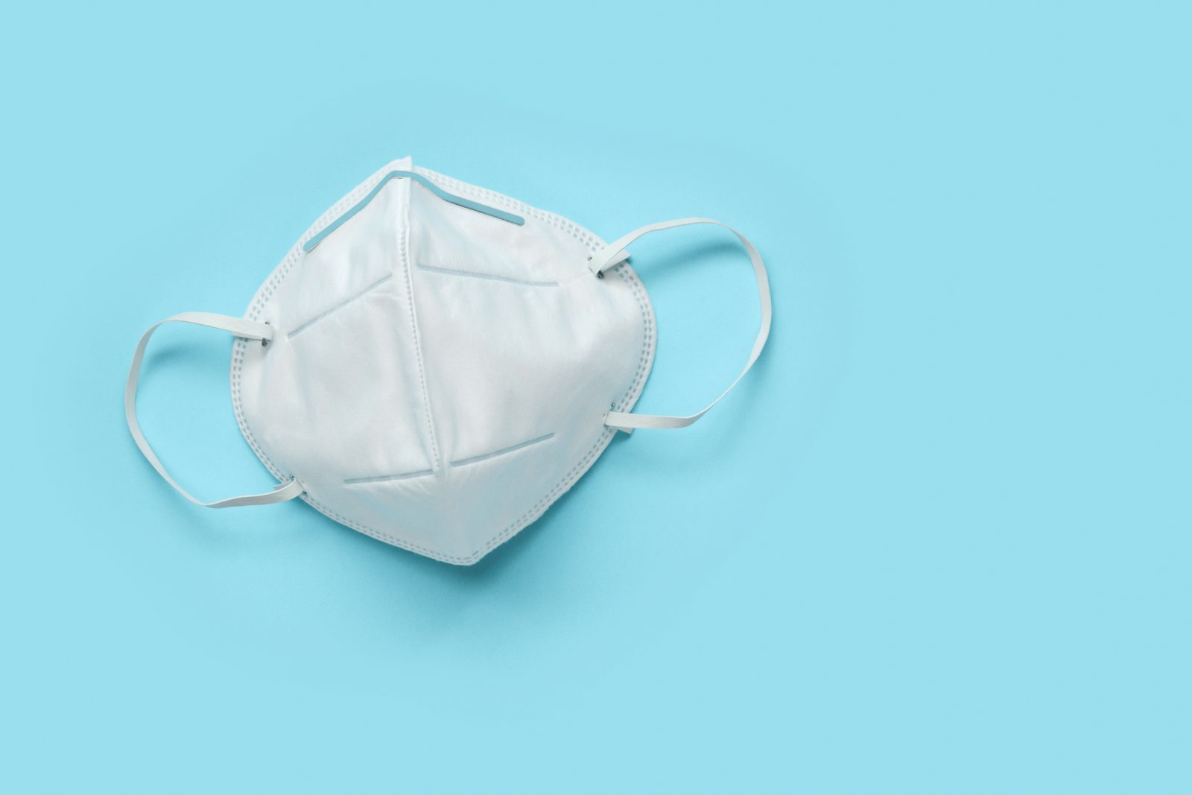
Introduction
Explanation of the importance of public health measures
The current situation of the pandemic
The need for technology to enforce public health measures
Thesis statement

Slide 7

MODEL ARCHITECTURE
MobileNetV2 architecture
basically two models:
Head model (3 layers)
Base Model (155 layers)
model consists of a base convolutional neural network (CNN) architecture
Optimizer used is Adam,
loss function used is Sparse Categorical Crossentropy.

Slide 8
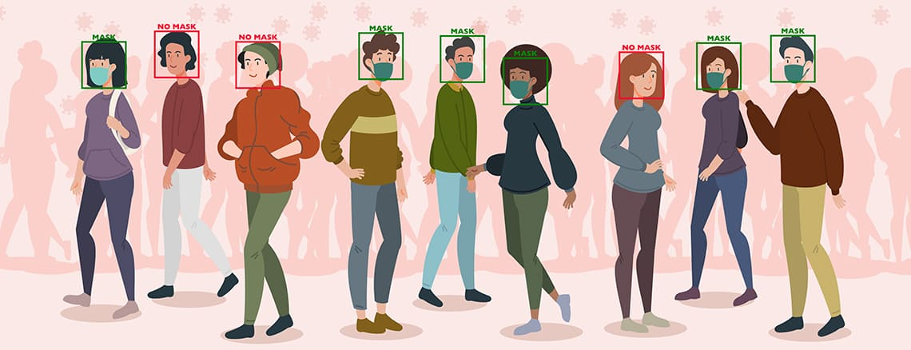
TRAINING THE MODEL

Slide 9

TESTING AND EVALUATION
load the test data
prepare the test data
evalaute the test data
print the test resuts
metrics used
precision,
recall,
f1-score,

Slide 10
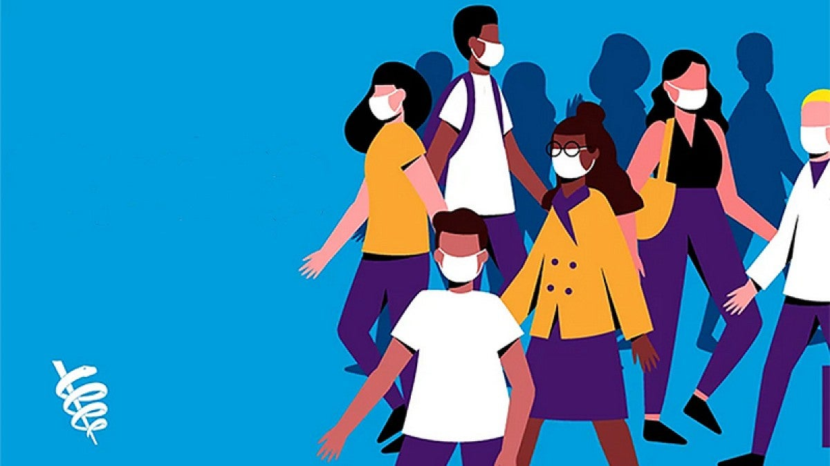
RESULTS
Real time Face detection model
displays the messgae no mask with accuracy when not worn
displays the message with mask when it is there

