Slide 1
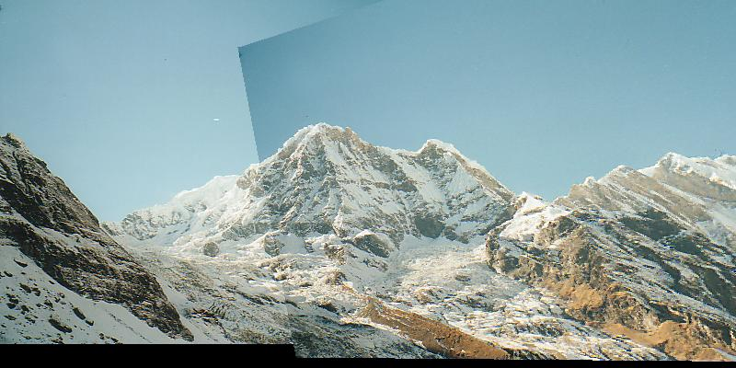
Assignment 2
Creating Panoramas

Slide 2
Step 1: (10 pts) Implement the Harris corner detector.
Part a. void GaussianBlurImage(double *image, int w, int h, double sigma)
Same as your function for Assignment 1, but the input is a floating point array of size
w*h.
You can use the full 2D kernel.
You can index a pixel (c,r) by image[r*w + c] to go with the rest of the code for this
assignment.
c
r

Slide 3
Step 1: (10 pts) Implement the Harris corner detector.
Part b. void HarrisCornerDetector(QImage image, double sigma, double thres,
CIntPt **cornerPts, int &numCornerPts, QImage &imageDisplay)
image is the input image
sigma is the standard deviation for the Gaussian
thres is the threshold for detection corners
cornerPts is an array that will contain the returned corner points
numCornerPts is the number of points returned
imageDisplay – image returned to display for debugging

Slide 4
Step 1: (10 pts) Implement the Harris corner detector.
Part b. void HarrisCornerDetector(QImage image, double sigma, double thres,
CIntPt **cornerPts, int &numCornerPts, QImage &imageDisplay)
To do:
i. Compute x and y derivatives of the image, use them to produce 3 images
(I_x^2, I_y^2, and I_x*I_y)
and smooth each of them with a 5x5 Gaussian.
ii. Compute the Harris matrix H in a 5x5 window around each pixel.
iii. Compute corner response function R = Det(H)/Tr(H), and threshold R.
Try threshold 50 on the UI.
iv. Find local maxima of the response function using nonmaximum suppression.
1
.
i
.
n
cornerPts[i].m_X, cornerPts[i].m_Y . . .

Slide 5
Step 2: (10 pts) Implement MatchCornerPoints.
void MatchCornerPoints(Qimage image1, Cintpt *cornerPts1, int numCornerPts1,
Qimage image2, Cintpt *cornerPts2, int numCornerPts2, CMatches **matches,
int &numMatches, Qimage &image1Display, Qimage &image2Display)
image1 is the first input image
image 2 is the second (match from image 1 to image 2)
cornerPts1 is a vector of interest points found in image1
cornerPts2 is a vector of interest points found in image 2
numCornerPts1 is the number of interest points in image1
numCornerPts2 is the number of interest points in Image 2
matches is a vector of matches; each match has X and Y coordinates from each image
1
.
i
.
n
matches[i].m_X1, matches[i].m_Y1, matches[i].m_X2, matches[i].m_Y2

Slide 6
Step 2: (10 pts) Implement MatchCornerPoints.
void MatchCornerPoints(Qimage image1, Cintpt *cornerPts1, int numCornerPts1,
Qimage image2, Cintpt *cornerPts2, int numCornerPts2, CMatches **matches,
int &numMatches, Qimage &image1Display, Qimage &image2Display)
To do this you'll need to follow these steps:
Compute the descriptors for each interest point.
This code has already been written for you.
b. For each corner point in image 1, find its best match in image 2.
The best match is defined as the closest distance (L1-norm distance. )
c. Add the pair of matching points to "matches".
d. Display the matches using DrawMatches (code is already written. )
Just pass it the required parameters.
You should see many correct and incorrect matches.

Slide 7
Step 3: (10 pts) Compute the homography between the images using RANSAC
(Szeliski, Section 6.1.4). You write the helper functions for ComputeHomography.
Part a. void Project(double x1, double y1, doube &x2, double &y2, double h[3][3])
This should project point (x1, y1) using the homography "h".
Return the projected point (x2, y2).
See the slides for details on how to project using homogeneous coordinates.
Part b. int ComputeInlierCount(double h[3][3], Cmatches *matches, int numMatches,
double inlierThreshold).
This is a helper function for RANSAC to compute thenumber of inlying points for
a homography "h".
Project the first point in each match using the function "Project".
If the projected point is less than the distance "inlierThreshold" from the second
point (in that match), it is an inlier.
Return the total number of inliers.

Slide 8
c. void RANSAC (Cmatches *matches , int numMatches, int numIterations,
double inlierThreshold, double hom[3][3], double homInv[3][3],
Qimage &image1Display, Qimage &image2Display)
matches is a set of numMatches matches
numIterations is the number of times to iterate
inlierThreshold is a real number so that the distance from a projected point to the match
is less than its square
hom is the homography and homInv its inverse
Image1Display and Image2Display hold the matches to display

Slide 9
c. void RANSAC (Cmatches *matches , int numMatches, int numIterations,
double inlierThreshold, double hom[3][3], double homInv[3][3],
Qimage &image1Display, Qimage &image2Display)
a. Iteratively do the following for "numIterations" times:
i. Randomly select 4 pairs of potentially matching points from "matches".
ii. Compute the homography relating the four selected matches with the function
"ComputeHomography. "
iii. Using the computed homography, compute the number of inliers using
"ComputeInlierCount".
iv. If this homography produces the highest number of inliers, store it as the best
homography.
b. i. Given the highest scoring homography, once again find all the inliers.
ii. Compute a new refined homography using all of the inliers (not just using four points
as you did previously. )
iii. Compute an inverse homography as well (the fourth term of
the function ComputeHomography should be false), and return their values
in "hom” and "homInv".
c. Display the inlier matches using "DrawMatches".

Slide 10
Step 4: (10 pts) Stitch the images together using the computed homography.
Following these steps:
a. bool BilinearInterpolation(Qimage *image, double x, double y, double rgb[3]).
This code should be the same as in Assignment 1, but if x and y are out of range,
it should just return false, else fill the rgb and return true.
b. void Stitch(Qimage image1, Qimage image2, double hom[3][3], double homInv[3][3],
Qimage &stitchedImage)
image1 and image 2 are the input images
hom is the homography and homInv its inverse
stitchedImage is the result.
i. Compute the size of "stitchedImage. "
To do this project the four corners of "image2" onto "image1" using
Project and "homInv". Allocate the image.
ii. Copy "image1" onto the "stitchedImage" at the right location.
iii. For each pixel in "stitchedImage", project the point onto "image2".
If it lies within image2's boundaries, add or blend the pixel's value to
"stitchedImage. " When finding the value of image2's pixel use
BilinearInterpolation. (Here’s where the true/false is needed.)

