Slide 1
Image Stitching
Linda Shapiro
CSE 455

Slide 2
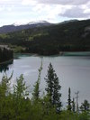
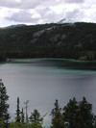
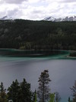
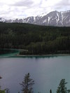
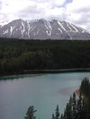
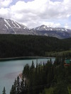
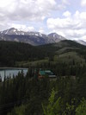
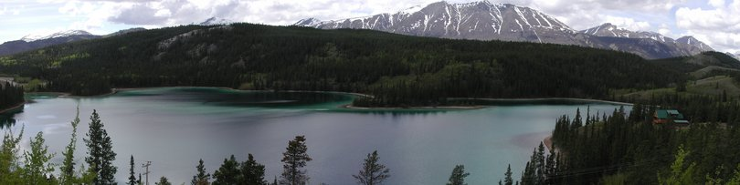
Combine two or more overlapping images to make one larger image
Add example
Slide credit: Vaibhav Vaish

Slide 3
How to do it?
Basic Procedure
Take a sequence of images from the same position
(Rotate the camera about its optical center)
Compute transformation between second image and first
Shift the second image to overlap with the first
Blend the two together to create a mosaic
If there are more images, repeat

Slide 4
1. Take a sequence of images from the same position
Rotate the camera about its optical center

Slide 5
2. Compute transformation between images
Extract interest points
Find Matches
Compute transformation
?

Slide 6
3. Shift the images to overlap

Slide 7
4. Blend the two together to create a mosaic

Slide 8
5. Repeat for all images

Slide 9
How to do it?
Basic Procedure
Take a sequence of images from the same position
Rotate the camera about its optical center
Compute transformation between second image and first
Shift the second image to overlap with the first
Blend the two together to create a mosaic
If there are more images, repeat
✓

Slide 10
Compute Transformations
✓
Extract interest points
Find good matches
Compute transformation
✓
Let’s assume we are given a set of good matching interest points

Slide 11
Image reprojection
mosaic PP
The mosaic has a natural interpretation in 3D
The images are reprojected onto a common plane
The mosaic is formed on this plane

Slide 12
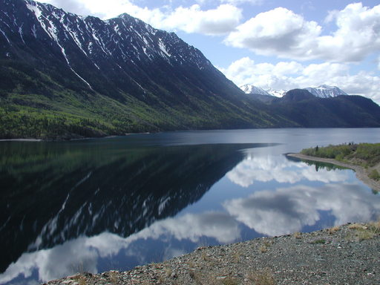
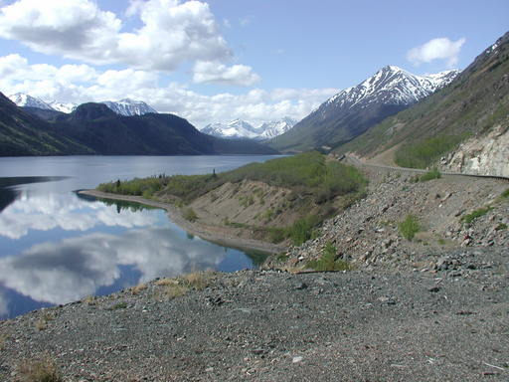
Example
Camera Center

Slide 13
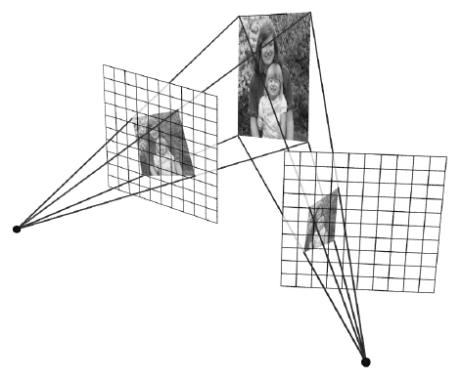
Image reprojection
Observation
Rather than thinking of this as a 3D reprojection, think of it as a 2D image warp from one image to another

Slide 14
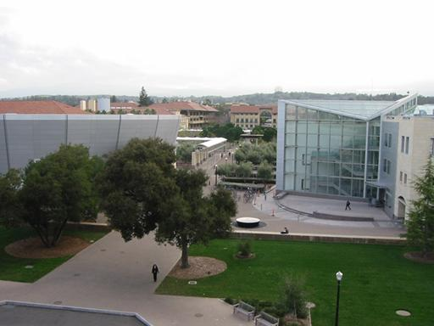
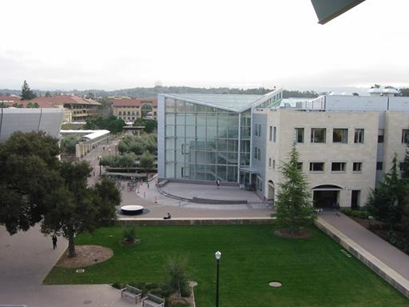
Motion models
What happens when we take two images with a camera and try to align them?
translation?
rotation?
scale?
affine?
Perspective?

Slide 15
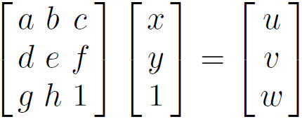




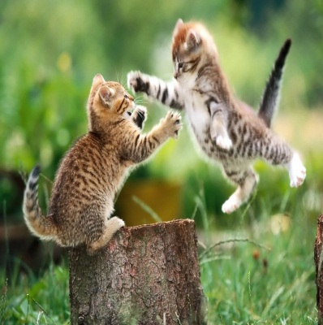
Recall: Projective transformations
(aka homographies)

Slide 16
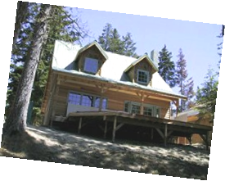
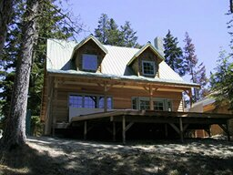
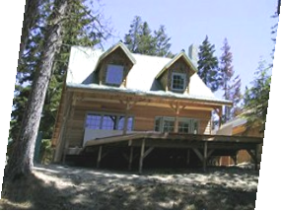
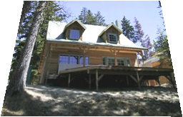
Parametric (global) warping
Examples of parametric warps:
translation
rotation
aspect
perspective
affine

Slide 17
2D coordinate transformations
translation: x’ = x + t x = (x,y)
rotation: x’ = R x + t
similarity: x’ = s R x + t
affine: x’ = A x + t
perspective: x’ ≅ H x x = (x,y,1) (x is a homogeneous coordinate)

Slide 18
Image Warping
Given a coordinate transform x’ = h(x) and a source image f(x), how do we compute a transformed image g(x’) = f(h(x))?
h(x)
x
x’
f(x)
g(x’)

Slide 19
Forward Warping
Send each pixel f(x) to its corresponding location x’ = h(x) in g(x’)
What if pixel lands “between” two pixels?
h(x)
x
x’
f(x)
g(x’)

Slide 20
Forward Warping
Send each pixel f(x) to its corresponding location x’ = h(x) in g(x’)
What if pixel lands “between” two pixels?
Answer: add “contribution” to several pixels, normalize later (splatting)
h(x)
x
x’
f(x)
g(x’)

Slide 21
Inverse Warping
Get each pixel g(x’) from its corresponding location x’ = h(x) in f(x)
What if pixel comes from “between” two pixels?
h⁻¹(x)
x
x’
f(x)
g(x’)

Slide 22
Inverse Warping
Get each pixel g(x’) from its corresponding location x’ = h(x) in f(x)
What if pixel comes from “between” two pixels?
Answer: resample color value from interpolated source image
h⁻¹(x)
x
x’
f(x)
g(x’)

Slide 23
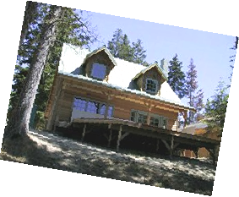
Interpolation
Possible interpolation filters:
nearest neighbor
bilinear
bicubic (interpolating)

Slide 24
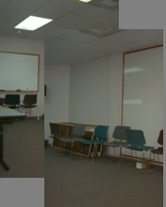
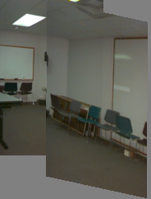
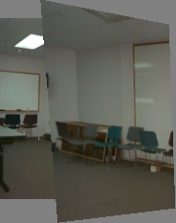
Motion models
Translation
Affine
Perspective
2 unknowns
6 unknowns
8 unknowns

Slide 25
Finding the transformation
Translation = 2 degrees of freedom
Similarity = 4 degrees of freedom
Affine = 6 degrees of freedom
Homography = 8 degrees of freedom
How many corresponding points do we need to solve?

Slide 26
Plane perspective mosaics
8-parameter generalization of affine motion
works for pure rotation or planar surfaces
Limitations:
local minima
slow convergence
difficult to control interactively

Slide 27
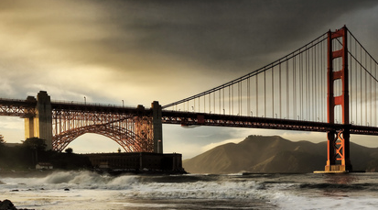


Simple case: translations
How do we solve for
?

Slide 28






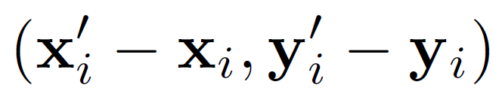
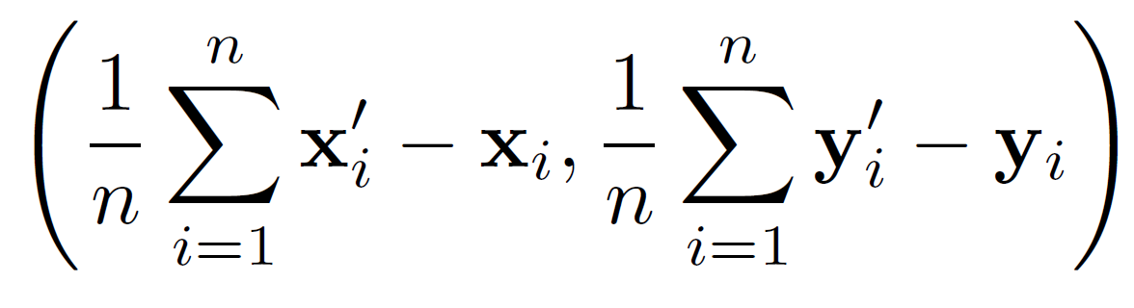
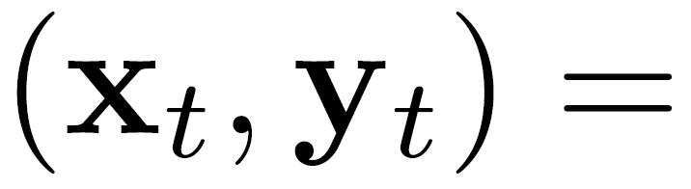
Simple case: translations
Displacement of match i =
Mean displacement =

Slide 29
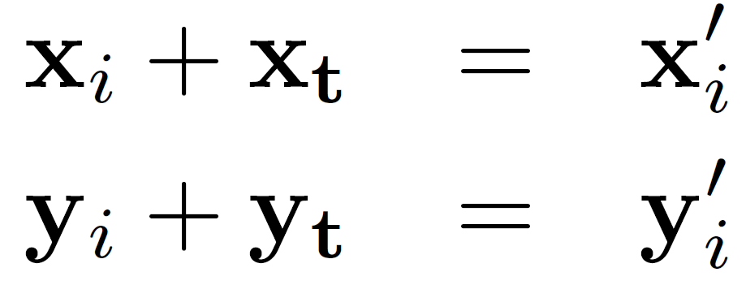
Simple case: translations
System of linear equations
What are the knowns? Unknowns?
How many unknowns? How many equations (per match)?

Slide 30
Simple case: translations
Problem: more equations than unknowns
“Overdetermined” system of equations
We will find the least squares solution

Slide 31
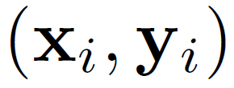
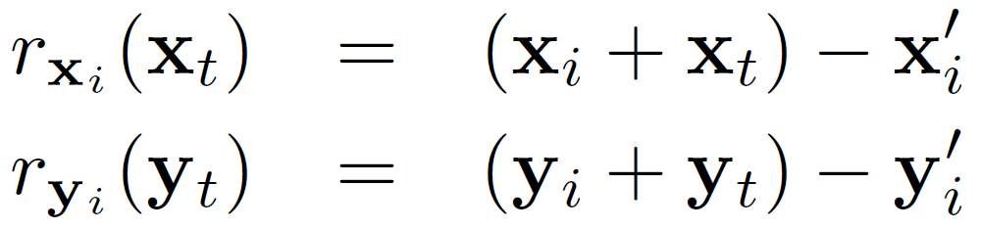
Least squares formulation
For each point
we define the residuals as

Slide 32
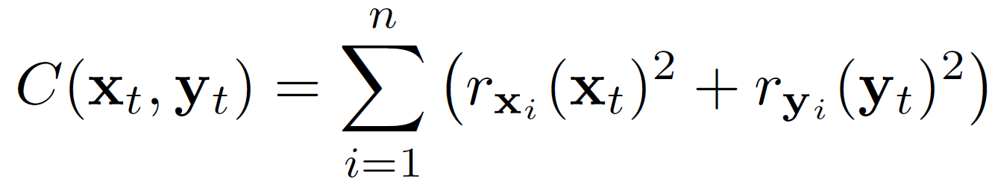
Least squares formulation
Goal: minimize sum of squared residuals
“Least squares” solution
For translations, is equal to mean displacement

Slide 33

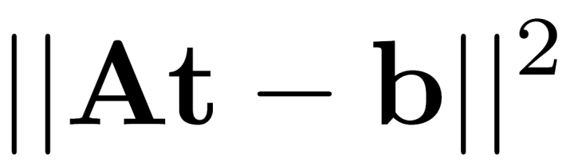
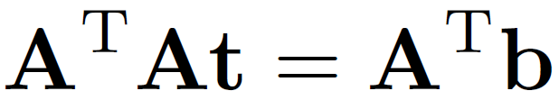
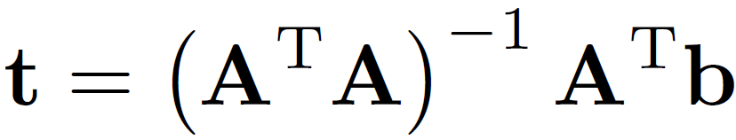
Least squares
Find t that minimizes
To solve, form the normal equations

Slide 34
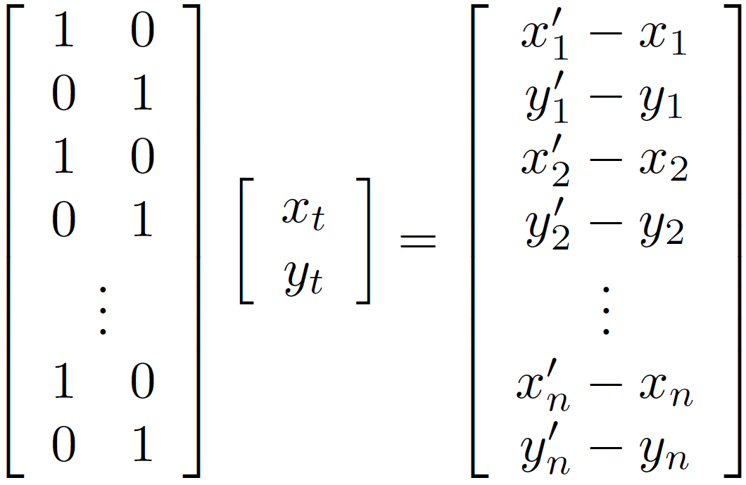




Solving for translations
Using least squares
2n x 2
2 x 1
2n x 1

Slide 35
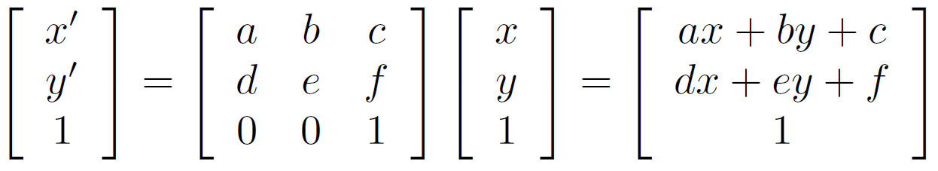
Affine transformations
How many unknowns?
How many equations per match?
x´ = ax + by + c; y´ = dx + ey +f
How many matches do we need?

Slide 36
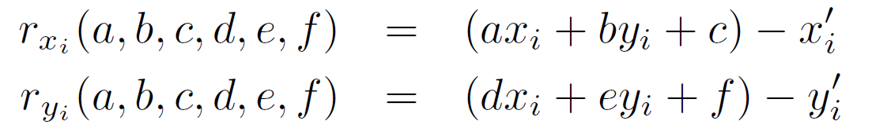

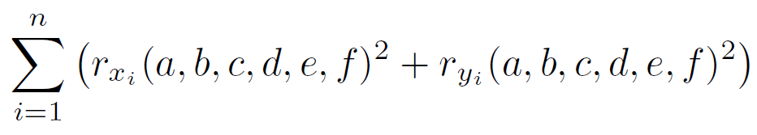
Affine transformations
Residuals:
Cost function:

Slide 37
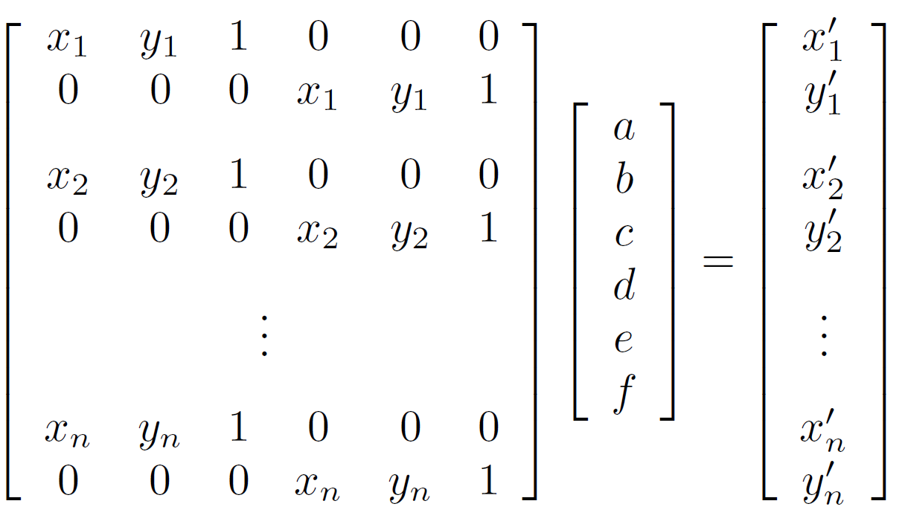
Affine transformations
Matrix form
2n x 6
6 x 1
2n x 1

Slide 38
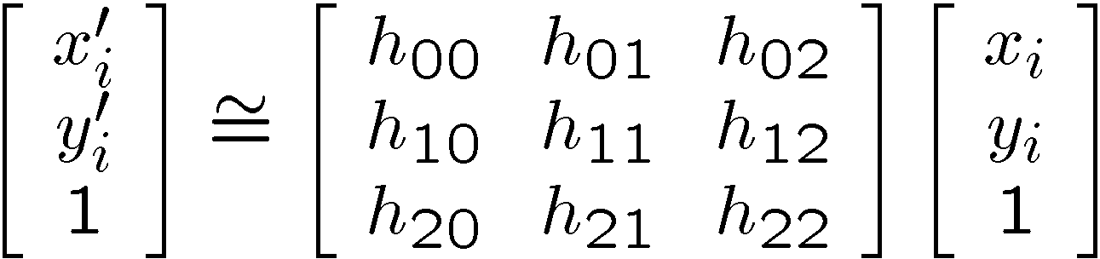
Solving for homographies
Why is this now a variable and not just 1?
A homography is a projective object, in that it has no scale.
It is represented by the above matrix, up to scale.
One way of fixing the scale is to set one of the coordinates to 1,
though that choice is arbitrary.
But that’s what most people do and your assignment code does.

Slide 39
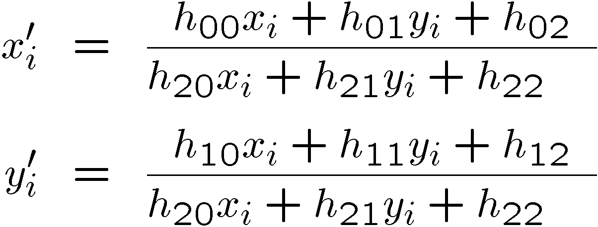
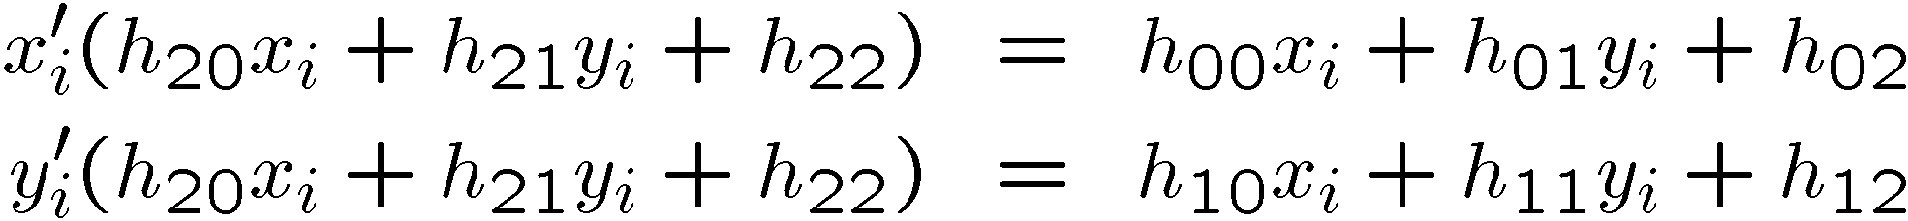
Solving for homographies
Why the division?

Slide 40
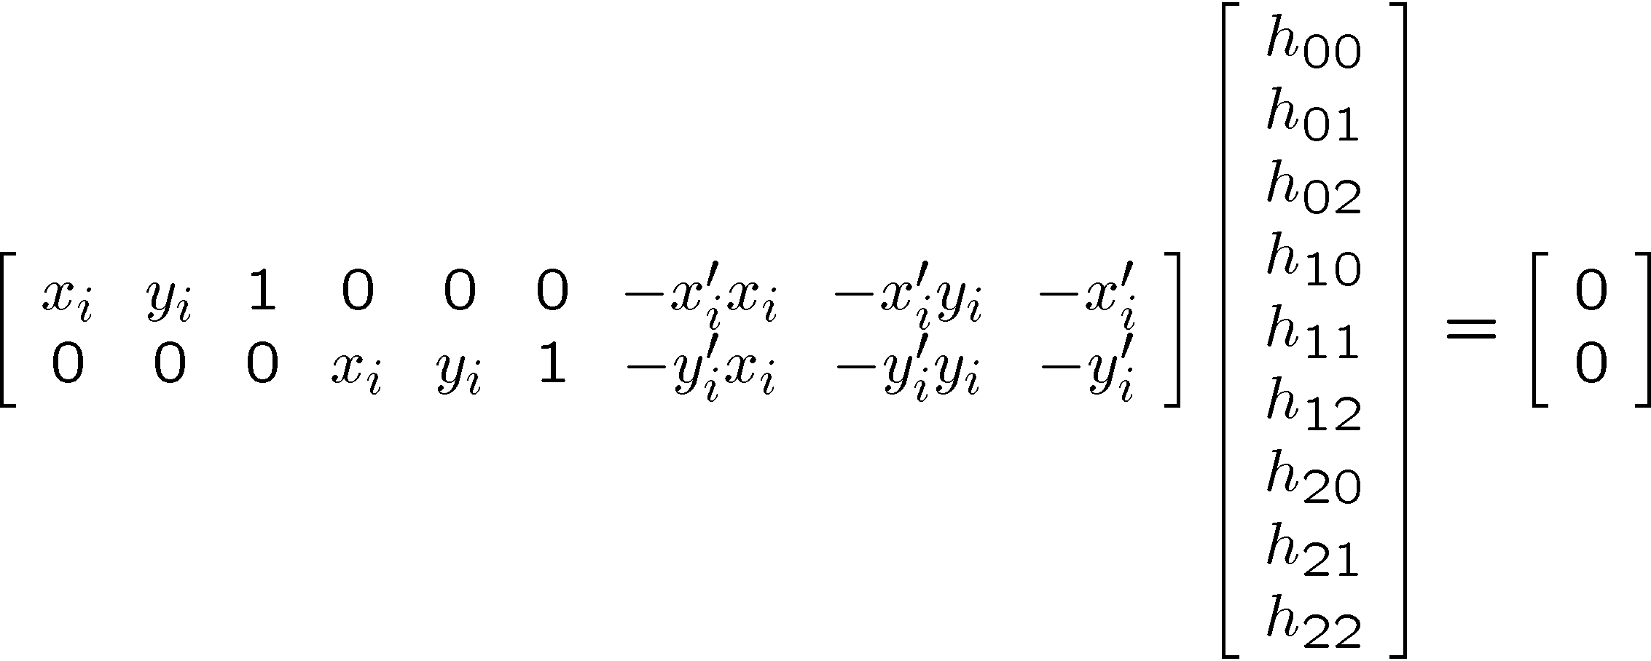
Solving for homographies

Slide 41
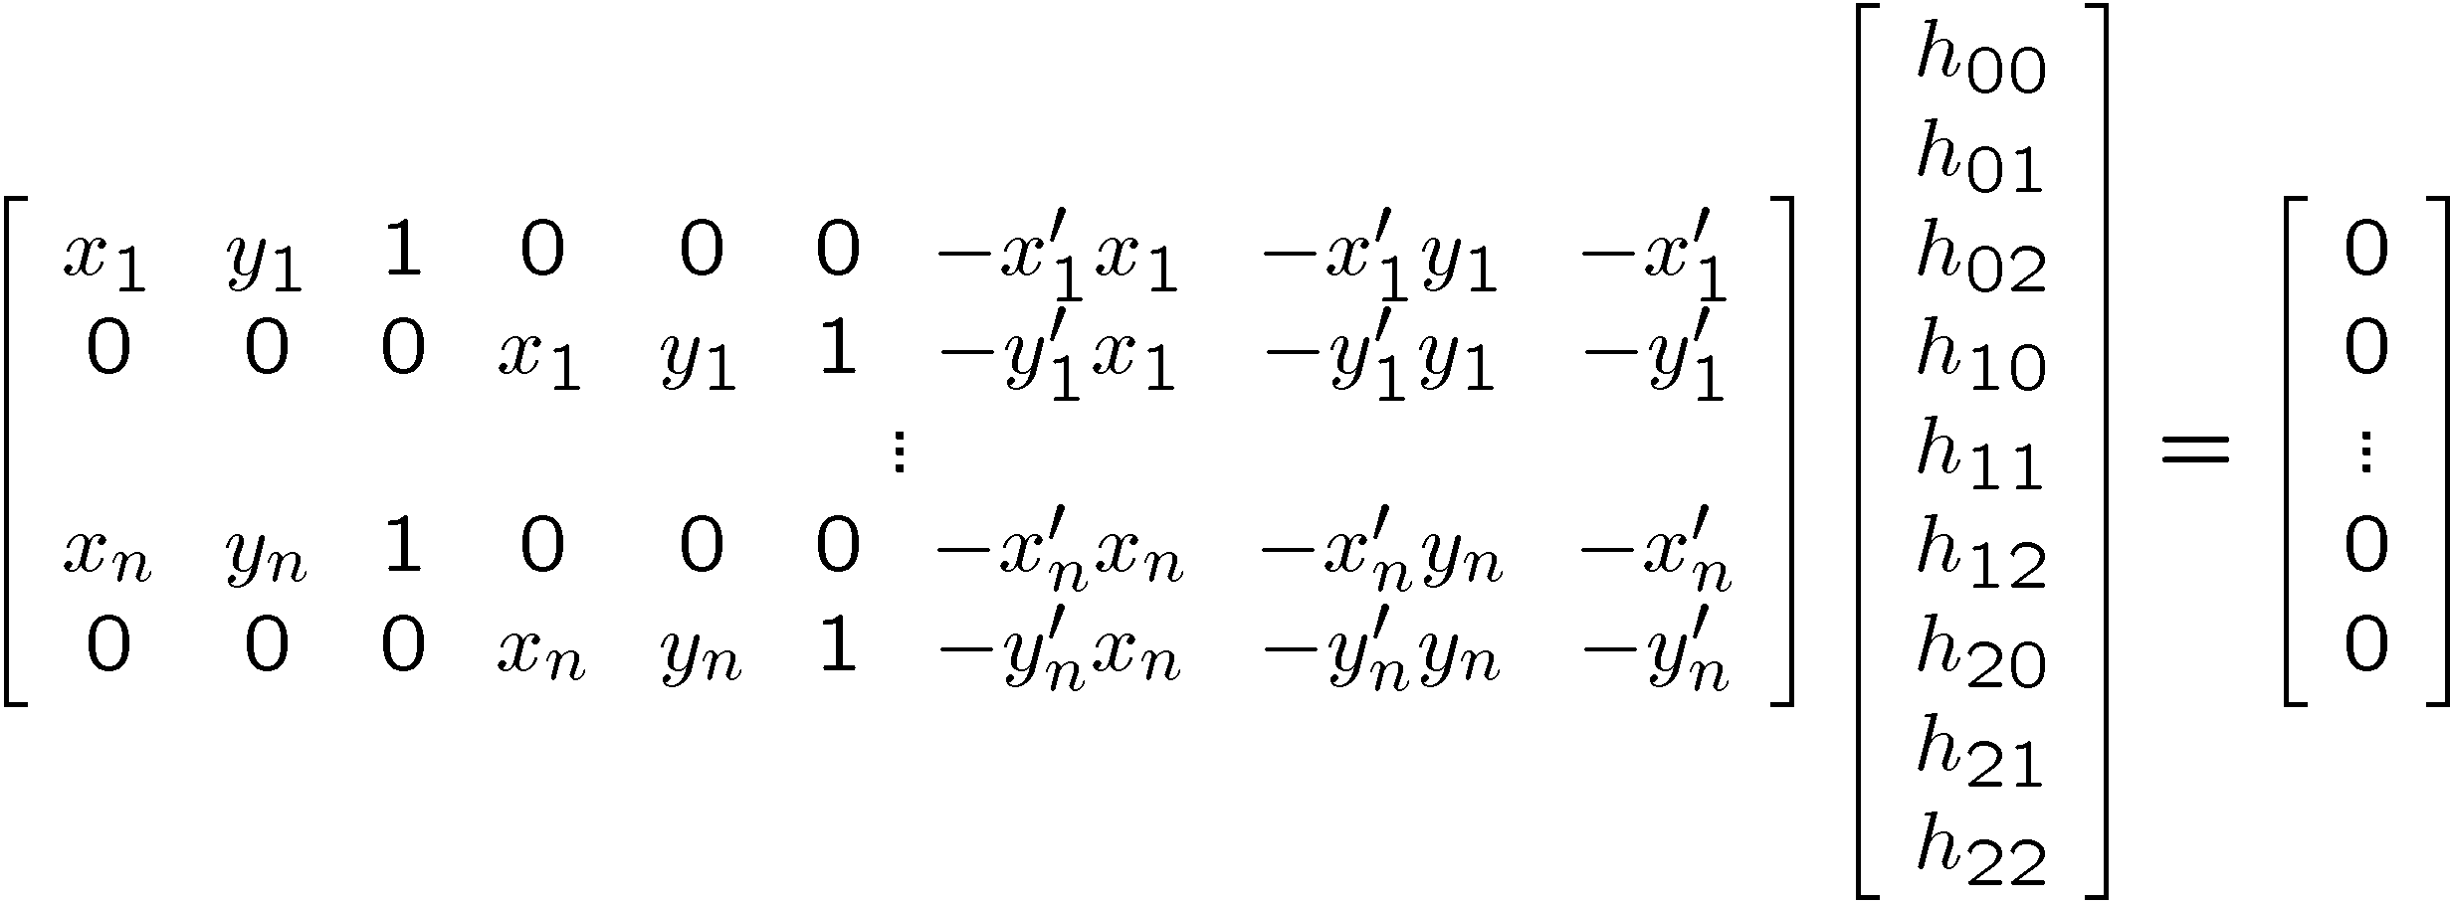





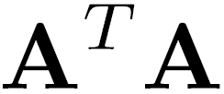
Direct Linear Transforms
2n × 9
9
2n
Defines a least squares problem:
Since is only defined up to scale, solve for unit vector
Solution: = eigenvector of with smallest eigenvalue
Works with 4 or more points

Slide 42
Direct Linear Transforms
Why could we not solve for the homography in exactly the same way we did for the affine transform, ie.

Slide 43
Answer from Sameer
For an affine transform, we have equations of the form Ax_{i} + b = y_{i}, solvable by linear regression.
For the homography, the equation is of the form
Hx̃_{i} ̴ ỹ_{i} (homogeneous coordinates)
and the ̴ means it holds only up to scale. The affine solution does not hold.
To get rid of the scale ambiguity, we can break up the H into 3 row vectors and divide out the third coordinate to make it 1.
[h₁’ x̃_{i} / h₃’ x̃_{i} , h₂’ x̃_{i} / h₃’ x̃_{i} ] = [y_{i1}, y_{i2}] for each i.

Slide 44
Continued
Expanding these out leads to (for each i)
h₁’ x̃_{i} - y_{i1} h₃’ x̃_{i} = 0
h₂’ x̃_{i} - y_{i2} h₃’ x̃_{i} = 0
a system with no constant terms.
The resultant system to be solved is of the form A h = 0
Then this is solved with the eigenvector approach.

Slide 45
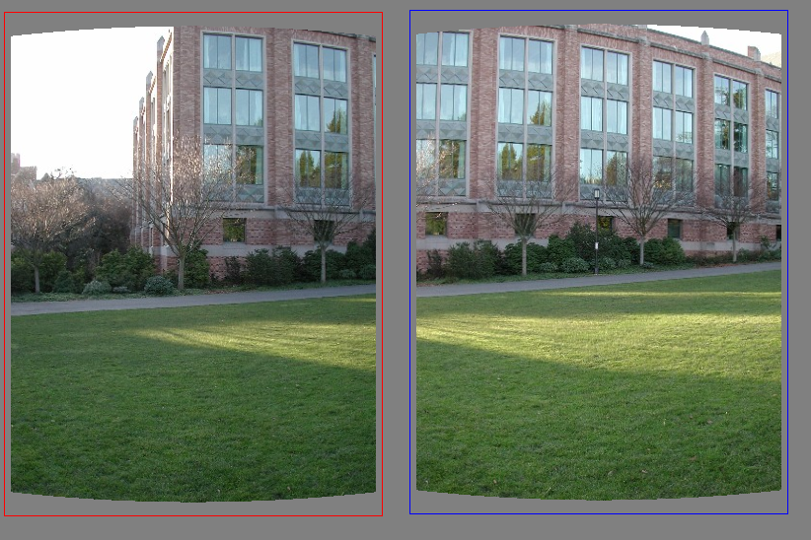
Matching features
What do we do about the “bad” matches?

Slide 46
RAndom SAmple Consensus
Select one match, count inliers

Slide 47
RAndom SAmple Consensus
Select one match, count inliers

Slide 48
Least squares fit (from inliers)
Find “average” translation vector

Slide 49
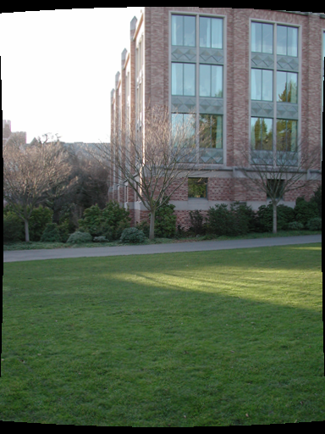
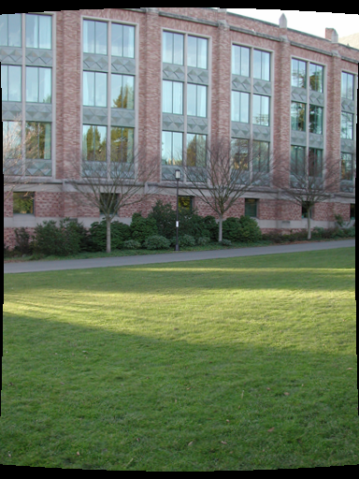

Slide 50
RANSAC for estimating homography
RANSAC loop:
Select four feature pairs (at random)
Compute homography H (exact)
Compute inliers where ||p_{i}´, H p_{i}|| < ε
Keep largest set of inliers
Re-compute least-squares H estimate using all of the inliers

Slide 51
Simple example: fit a line
Rather than homography H (8 numbers) fit y=ax+b (2 numbers a, b) to 2D pairs
51

Slide 52
Simple example: fit a line
Pick 2 points
Fit line
Count inliers
3 inliers
52

Slide 53
Simple example: fit a line
Pick 2 points
Fit line
Count inliers
4 inliers
53

Slide 54
Simple example: fit a line
Pick 2 points
Fit line
Count inliers
9 inliers
54

Slide 55
Simple example: fit a line
Pick 2 points
Fit line
Count inliers
8 inliers
55

Slide 56
Simple example: fit a line
Use biggest set of inliers
Do least-square fit
56

Slide 57
Where are we?
Basic Procedure
Take a sequence of images from the same position
(Rotate the camera about its optical center)
Compute transformation between second image and first
Shift the second image to overlap with the first
Blend the two together to create a mosaic
If there are more images, repeat

