Slide 1
The Effects of the World on AQI.

Slide 2
R Markdown
This is an R Markdown presentation. Markdown is a simple formatting syntax for authoring HTML, PDF, and MS Word documents. For more details on using R Markdown see http://rmarkdown.rstudio.com.
When you click the Knit button a document will be generated that includes both content as well as the output of any embedded R code chunks within the document.

Slide 3
Slide with Bullets
Bullet 1
Bullet 2
Bullet 3

Slide 4
Slide with R Output
summary(cars)
## speed dist ## Min. : 4.0 Min. : 2 ## 1st Qu.:12.0 1st Qu.: 26 ## Median :15.0 Median : 36 ## Mean :15.4 Mean : 43 ## 3rd Qu.:19.0 3rd Qu.: 56 ## Max. :25.0 Max. :120

Slide 5
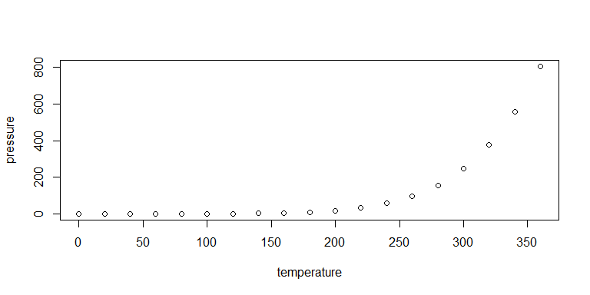
Slide with Plot

