Slide 1
Environmental Legislation and its Effects on Air Quality
Group 2

Slide 2
Introduction
The goal of this study is to examine the impact of certain variables on the climate by examining the AQI of counties across the United States of America using data collected by the EPA.
There are two smaller sub studies in this presentation: One examining the effects of the Climate Alliance legislative program, and another examining the correlation between aspects of counties and the air quality.

Slide 3
Reading the Data and EDA
To begin we read the data in from the EPA datasets.
## `summarise()` has grouped output by 'state'. You can override using the `.groups` argument.

Slide 4
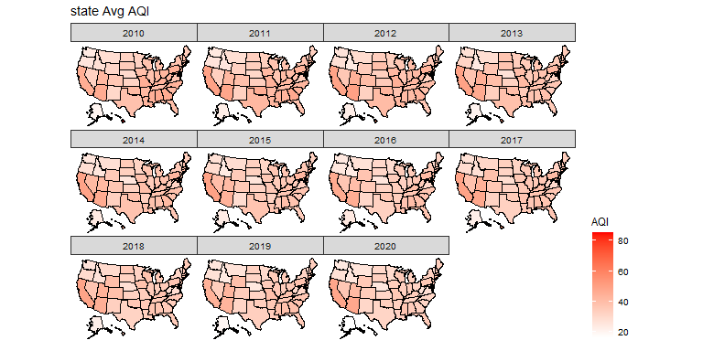

Slide 5
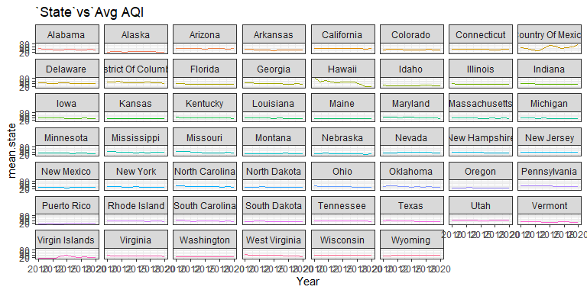

Slide 6
## 'data.frame': 41 obs. of 5 variables: ## $ Year : int 1980 1981 1982 1983 1984 1985 1986 1987 1988 1989 ... ## $ Mean : num 112.9 109.9 110.1 99.5 93.1 ... ## $ Number.of.Trend.Sites: int 20 20 20 20 20 20 20 20 20 20 ... ## $ X10th.Percentile : num 66.5 66.5 66.5 59.5 59.8 ... ## $ X90th.Percentile : num 190 190 190 165 145 ...
## Year Mean Number.of.Trend.Sites X10th.Percentile ## Min. :1980 Min. : 40.5 Min. :20 Min. :29.4 ## 1st Qu.:1990 1st Qu.: 48.3 1st Qu.:20 1st Qu.:37.0 ## Median :2000 Median : 66.6 Median :20 Median :45.0 ## Mean :2000 Mean : 71.3 Mean :20 Mean :46.5 ## 3rd Qu.:2010 3rd Qu.: 94.4 3rd Qu.:20 3rd Qu.:56.0 ## Max. :2020 Max. :112.9 Max. :20 Max. :66.5 ## X90th.Percentile ## Min. : 55 ## 1st Qu.: 65 ## Median :112 ## Mean :116 ## 3rd Qu.:165 ## Max. :190

Slide 7
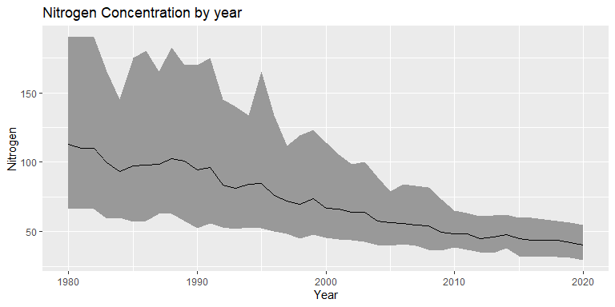

Slide 8
## 'data.frame': 31 obs. of 5 variables: ## $ Year : int 1990 1991 1992 1993 1994 1995 1996 1997 1998 1999 ... ## $ Mean : num 0.0877 0.0882 0.0837 0.0848 0.0851 ... ## $ Number.of.Trend.Sites: int 394 394 394 394 394 394 394 394 394 394 ... ## $ X10th.Percentile : num 0.068 0.067 0.068 0.065 0.069 0.071 0.07 0.068 0.071 0.07 ... ## $ X90th.Percentile : num 0.108 0.11 0.098 0.103 0.099 0.109 0.1 0.102 0.107 0.104 ...
## Year Mean Number.of.Trend.Sites X10th.Percentile ## Min. :1990 Min. :0.0652 Min. :394 Min. :0.0540 ## 1st Qu.:1998 1st Qu.:0.0694 1st Qu.:394 1st Qu.:0.0600 ## Median :2005 Median :0.0787 Median :394 Median :0.0650 ## Mean :2005 Mean :0.0780 Mean :394 Mean :0.0645 ## 3rd Qu.:2012 3rd Qu.:0.0849 3rd Qu.:394 3rd Qu.:0.0680 ## Max. :2020 Max. :0.0896 Max. :394 Max. :0.0710 ## X90th.Percentile ## Min. :0.075 ## 1st Qu.:0.080 ## Median :0.092 ## Mean :0.092 ## 3rd Qu.:0.101 ## Max. :0.110

Slide 9
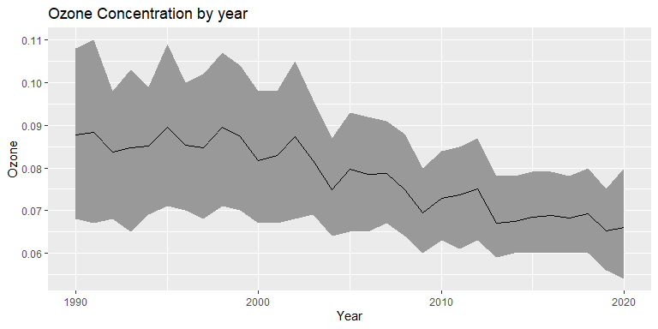

Slide 10
## 'data.frame': 41 obs. of 5 variables: ## $ Year : int 1980 1981 1982 1983 1984 1985 1986 1987 1988 1989 ... ## $ Mean : num 162 154 141 154 142 ... ## $ Number.of.Trend.Sites: int 32 32 32 32 32 32 32 32 32 32 ... ## $ X10th.Percentile : num 50 50 40 37 30 40 30 25 30 30 ... ## $ X90th.Percentile : num 271 251 250 321 280 250 258 242 220 261 ...
## Year Mean Number.of.Trend.Sites X10th.Percentile ## Min. :1980 Min. : 10.3 Min. :32 Min. : 3.0 ## 1st Qu.:1990 1st Qu.: 40.9 1st Qu.:32 1st Qu.:10.9 ## Median :2000 Median : 82.0 Median :32 Median :26.0 ## Mean :2000 Mean : 82.0 Mean :32 Mean :23.2 ## 3rd Qu.:2010 3rd Qu.:118.4 3rd Qu.:32 3rd Qu.:31.0 ## Max. :2020 Max. :162.4 Max. :32 Max. :50.0 ## X90th.Percentile ## Min. : 16 ## 1st Qu.: 84 ## Median :151 ## Mean :150 ## 3rd Qu.:218 ## Max. :321

Slide 11
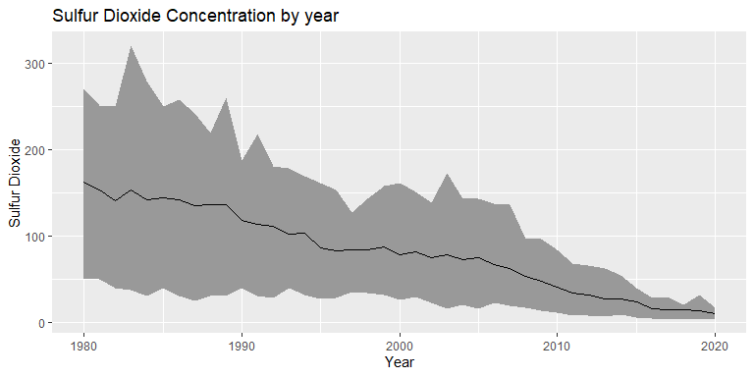

Slide 12
## 'data.frame': 11 obs. of 5 variables: ## $ Year : int 2010 2011 2012 2013 2014 2015 2016 2017 2018 2019 ... ## $ Mean : num 0.2272 0.2277 0.2013 0.1378 0.0776 ... ## $ Number.of.Trend.Sites: int 83 83 83 83 83 83 83 83 83 83 ... ## $ X10th.Percentile : num 0.01 0.01 0.01 0.01 0.01 0.01 0.01 0.01 0 0 ... ## $ X90th.Percentile : num 0.64 0.66 0.51 0.43 0.17 0.11 0.12 0.11 0.11 0.09 ...
## Year Mean Number.of.Trend.Sites X10th.Percentile ## Min. :2010 Min. :0.0320 Min. :83 Min. :0.00000 ## 1st Qu.:2012 1st Qu.:0.0437 1st Qu.:83 1st Qu.:0.00500 ## Median :2015 Median :0.0478 Median :83 Median :0.01000 ## Mean :2015 Mean :0.1017 Mean :83 Mean :0.00727 ## 3rd Qu.:2018 3rd Qu.:0.1696 3rd Qu.:83 3rd Qu.:0.01000 ## Max. :2020 Max. :0.2277 Max. :83 Max. :0.01000 ## X90th.Percentile ## Min. :0.060 ## 1st Qu.:0.110 ## Median :0.120 ## Mean :0.274 ## 3rd Qu.:0.470 ## Max. :0.660

Slide 13
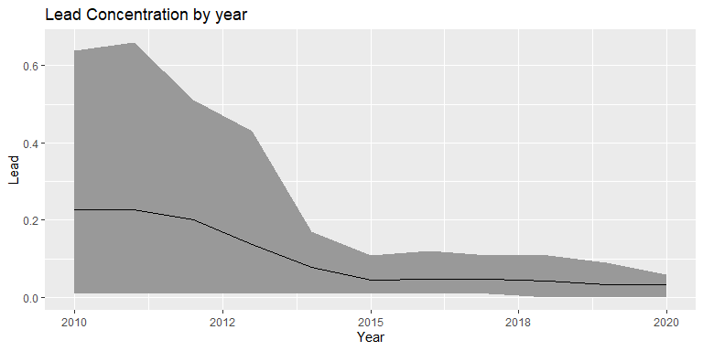

Slide 14
## 'data.frame': 41 obs. of 5 variables: ## $ Year : int 1980 1981 1982 1983 1984 1985 1986 1987 1988 1989 ... ## $ Mean : num 9.46 9.21 8.59 9.11 8.34 ... ## $ Number.of.Trend.Sites: int 36 36 36 36 36 36 36 36 36 36 ... ## $ X10th.Percentile : num 4.6 3.9 4.8 4.5 4.4 3.9 4.5 4.5 4.1 3.6 ... ## $ X90th.Percentile : num 16.8 14.6 13.9 16.2 13.7 12.3 12.6 10.2 10.5 10.4 ...
## Year Mean Number.of.Trend.Sites X10th.Percentile ## Min. :1980 Min. :1.27 Min. :36 Min. :0.70 ## 1st Qu.:1990 1st Qu.:1.76 1st Qu.:36 1st Qu.:0.90 ## Median :2000 Median :3.79 Median :36 Median :2.00 ## Mean :2000 Mean :4.31 Mean :36 Mean :2.33 ## 3rd Qu.:2010 3rd Qu.:6.56 3rd Qu.:36 3rd Qu.:3.60 ## Max. :2020 Max. :9.46 Max. :36 Max. :4.80 ## X90th.Percentile ## Min. : 1.80 ## 1st Qu.: 2.60 ## Median : 5.40 ## Mean : 6.61 ## 3rd Qu.: 9.80 ## Max. :16.80

Slide 15
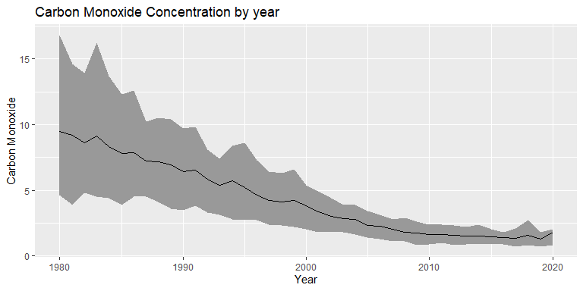

Slide 16
## 'data.frame': 31 obs. of 5 variables: ## $ Year : int 1990 1991 1992 1993 1994 1995 1996 1997 1998 1999 ... ## $ Mean : num 86.2 85.4 73.5 74 72.1 ... ## $ Number.of.Trend.Sites: int 100 100 100 100 100 100 100 100 100 100 ... ## $ X10th.Percentile : num 45 46 39 41 34 37 34 36.5 37 39 ... ## $ X90th.Percentile : num 145 134 112 124 124 ...
## Year Mean Number.of.Trend.Sites X10th.Percentile ## Min. :1990 Min. :46.0 Min. :100 Min. :24.5 ## 1st Qu.:1998 1st Qu.:56.1 1st Qu.:100 1st Qu.:27.5 ## Median :2005 Median :62.5 Median :100 Median :33.0 ## Mean :2005 Mean :62.3 Mean :100 Mean :32.6 ## 3rd Qu.:2012 3rd Qu.:65.7 3rd Qu.:100 3rd Qu.:37.0 ## Max. :2020 Max. :86.2 Max. :100 Max. :46.0 ## X90th.Percentile ## Min. : 73.0 ## 1st Qu.: 90.5 ## Median : 96.5 ## Mean :102.7 ## 3rd Qu.:113.2 ## Max. :145.0

Slide 17
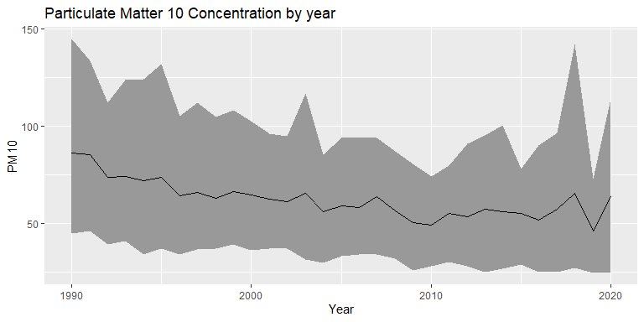

Slide 18
## 'data.frame': 21 obs. of 5 variables: ## $ Year : int 2000 2001 2002 2003 2004 2005 2006 2007 2008 2009 ... ## $ Mean : num 13.5 13.2 12.8 12.3 12 ... ## $ Number.of.Trend.Sites: int 390 390 390 390 390 390 390 390 390 390 ... ## $ X10th.Percentile : num 8.73 8.65 8.61 7.9 7.65 ... ## $ X90th.Percentile : num 18 17.3 16.6 16.2 15.7 ...
## Year Mean Number.of.Trend.Sites X10th.Percentile ## Min. :2000 Min. : 7.63 Min. :390 Min. :5.62 ## 1st Qu.:2005 1st Qu.: 8.54 1st Qu.:390 1st Qu.:6.10 ## Median :2010 Median : 9.88 Median :390 Median :6.68 ## Mean :2010 Mean :10.29 Mean :390 Mean :6.97 ## 3rd Qu.:2015 3rd Qu.:12.02 3rd Qu.:390 3rd Qu.:7.71 ## Max. :2020 Max. :13.50 Max. :390 Max. :8.73 ## X90th.Percentile ## Min. : 9.51 ## 1st Qu.:10.75 ## Median :12.41 ## Mean :13.25 ## 3rd Qu.:15.67 ## Max. :18.04

Slide 19
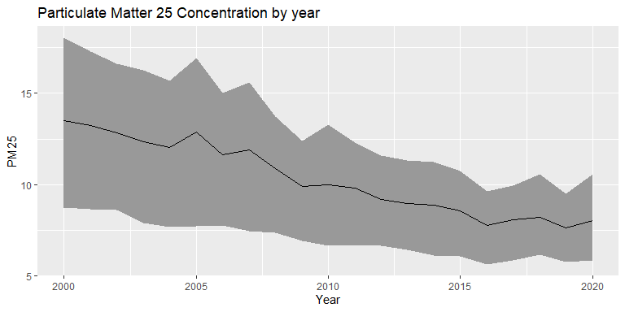

Slide 20
<<<<<<< HEAD =======

Slide 21
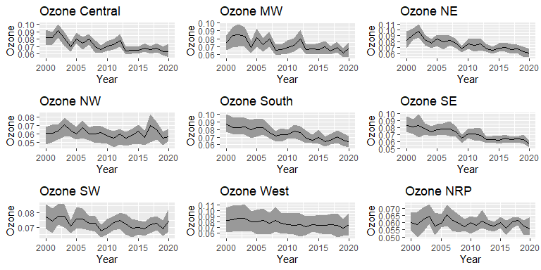

Slide 22
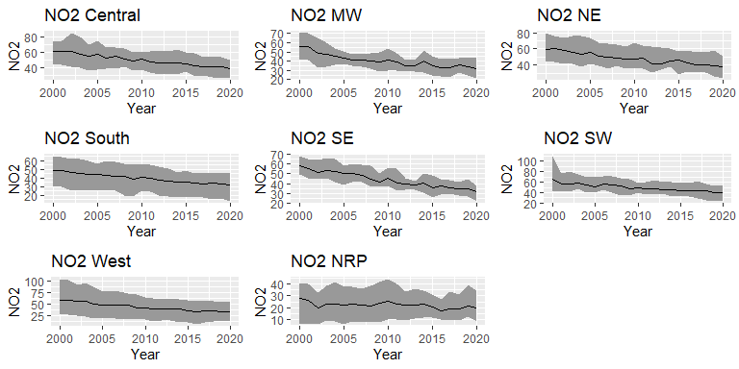

Slide 23
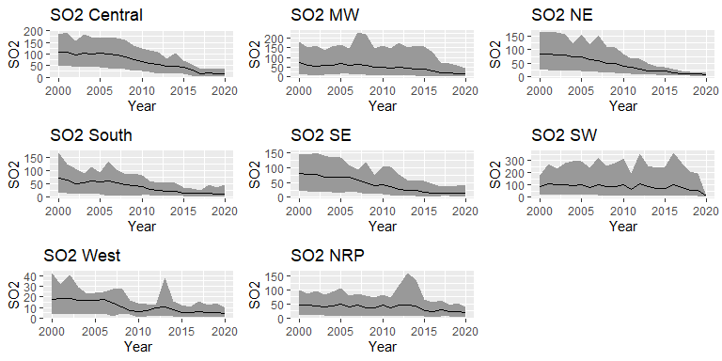

Slide 24
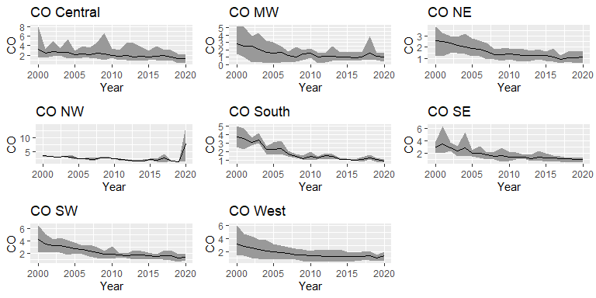

Slide 25
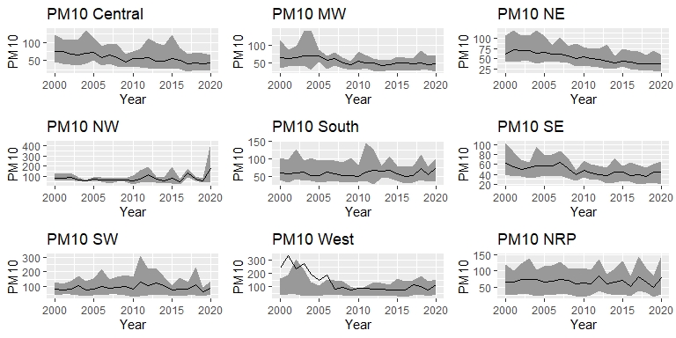

Slide 26
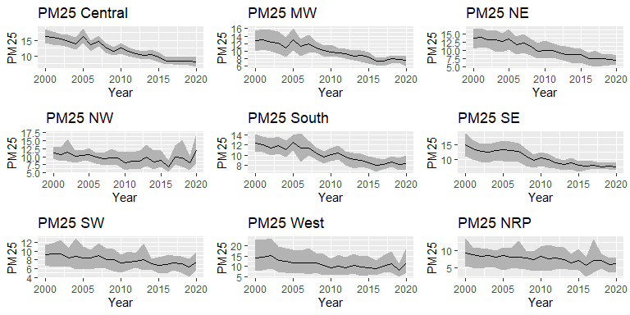

Slide 27
Climate Alliance
## ## Call: ## lm(formula = med.aqi ~ is.climate.alli + state, data = focus_data) ## ## Residuals: ## Min 1Q Median 3Q Max ## -36.82 -3.06 1.36 5.68 94.52 ## ## Coefficients: (1 not defined because of singularities) ## Estimate Std. Error t value Pr(>|t|) ## (Intercept) 37.5294 1.8246 20.57 < 2e-16 *** ## is.climate.alliyes -1.1008 2.3131 -0.48 0.63418 ## stateAlaska -17.0000 3.1602 -5.38 8.3e-08 *** ## stateArizona 6.3167 2.7717 2.28 0.02277 * ## stateArkansas -1.7294 2.8029 -0.62 0.53730 ## stateCalifornia 9.8827 1.7575 5.62 2.1e-08 *** ## stateColorado 0.3419 1.9689 0.17 0.86215 ## stateConnecticut 2.1339 3.0158 0.71 0.47929 ## stateCountry Of Mexico 18.9706 5.6237 3.37 0.00076 *** ## stateDelaware 4.7381 4.5701 1.04 0.29997 ## stateDistrict Of Columbia 6.4706 7.7409 0.84 0.40331 ## stateFlorida -2.3371 2.1864 -1.07 0.28522 ## stateGeorgia -0.8570 2.2979 -0.37 0.70923 ## stateHawaii -8.4286 4.0211 -2.10 0.03620 * ## stateIdaho -12.5294 2.4544 -5.10 3.6e-07 *** ## stateIllinois -1.1323 2.0291 -0.56 0.57689 ## stateIndiana -3.4669 2.1780 -1.59 0.11159 ## stateIowa -1.2169 2.6203 -0.46 0.64240 ## stateKansas -5.2112 2.9110 -1.79 0.07357 . ## stateKentucky 0.5261 2.3292 0.23 0.82131 ## stateLouisiana -2.4068 2.1170 -1.14 0.25571 ## stateMaine -2.0786 2.7714 -0.75 0.45333 ## stateMaryland 1.3950 2.3131 0.60 0.54652 ## stateMassachusetts -0.2986 2.7717 -0.11 0.91421 ## stateMichigan -1.5536 2.0106 -0.77 0.43979 ## stateMinnesota -5.7857 2.1717 -2.66 0.00778 ** ## stateMississippi -0.0056 2.9528 0.00 0.99849 ## stateMissouri -1.0502 2.3847 -0.44 0.65969 ## stateMontana -9.6610 2.5115 -3.85 0.00012 *** ## stateNebraska -11.4739 3.1012 -3.70 0.00022 *** ## stateNevada -0.9286 2.8826 -0.32 0.74739 ## stateNew Hampshire -2.8151 3.3784 -0.83 0.40479 ## stateNew Jersey 2.5089 2.3576 1.06 0.28737 ## stateNew Mexico -4.2411 2.3576 -1.80 0.07218 . ## stateNew York -4.9608 1.9613 -2.53 0.01150 * ## stateNorth Carolina -0.4549 1.8736 -0.24 0.80820 ## stateNorth Dakota -3.2794 2.9981 -1.09 0.27415 ## stateOhio -2.4104 2.1625 -1.11 0.26515 ## stateOklahoma -2.5702 2.3746 -1.08 0.27922 ## stateOregon -8.5350 2.1046 -4.06 5.2e-05 *** ## statePennsylvania 0.9294 1.8489 0.50 0.61523 ## statePuerto Rico -15.4841 2.8826 -5.37 8.7e-08 *** ## stateRhode Island -0.4286 4.5701 -0.09 0.92529 ## stateSouth Carolina -1.5016 2.5442 -0.59 0.55511 ## stateSouth Dakota -5.8794 2.9981 -1.96 0.05000 . ## stateTennessee -1.9425 2.4061 -0.81 0.41959 ## stateTexas -4.8593 2.1204 -2.29 0.02202 * ## stateUtah 5.7039 2.6649 2.14 0.03244 * ## stateVermont -7.0536 4.0211 -1.75 0.07956 . ## stateVirgin Islands -14.8628 4.7110 -3.15 0.00163 ** ## stateVirginia -6.9139 1.9198 -3.60 0.00032 *** ## stateWashington -10.7892 1.9689 -5.48 4.8e-08 *** ## stateWest Virginia -8.3732 2.6203 -3.20 0.00142 ** ## stateWisconsin NA NA NA NA ## stateWyoming 1.6650 2.5442 0.65 0.51290 ## --- ## Signif. codes: 0 '***' 0.001 '**' 0.01 '*' 0.05 '.' 0.1 ' ' 1 ## ## Residual standard error: 10.6 on 2055 degrees of freedom ## Multiple R-squared: 0.187, Adjusted R-squared: 0.166 ## F-statistic: 8.92 on 53 and 2055 DF, p-value: <2e-16

Slide 28
Climate Alliance states tend to have a better AQI on average but it is not significant.
This might be because the Climate Alliance only went into effect 3 years ago in 2017.

Slide 29
County Level Effects on AQI
Using the data found by the USDA’s Economic Research Service, we look for predictors in counties to determine air quality and find correlations. This begins by merging the 2019 AQI with the latest USDA ERS data. We use 2019 data to avoid skewing due to the 2020 West Coast fires.

Slide 30
To begin the analysis, we start by merging county data with AQI data. We start by merging all three sets of ERS county data, and then we merge by county and state.
We only take the data from year 2019 to keep it consistent. We are avoiding using 2020 data due to the fires on the West coast skewing data.

Slide 31
Break the cleaned and merged dataset into X and Y for use with cv.glmnet. We use set.seed(1) for consistency.
## Note: Using an external vector in selections is ambiguous. ## i Use `all_of(select_cols)` instead of `select_cols` to silence this message. ## i See <https://tidyselect.r-lib.org/reference/faq-external-vector.html>. ## This message is displayed once per session.
## Anova Table (Type II tests) ## ## Response: med.aqi ## Sum Sq Df F value Pr(>F) ## state 15670 48 3.44 2.5e-13 *** ## PctEmpAgriculture 109 1 1.15 0.2848 ## PctEmpConstruction 174 1 1.83 0.1761 ## PctEmpFIRE 734 1 7.73 0.0055 ** ## Age65AndOlderPct2010 50 1 0.53 0.4676 ## Ed4AssocDegreePct 774 1 8.16 0.0044 ** ## FemaleHHPct 1681 1 17.71 2.8e-05 *** ## HH65PlusAlonePct 578 1 6.09 0.0138 * ## Ed3SomeCollegeNum 737 1 7.77 0.0054 ** ## ForeignBornMexNum 610 1 6.43 0.0114 * ## NetMigrationNum0010 1698 1 17.90 2.6e-05 *** ## Residuals 89962 948 ## --- ## Signif. codes: 0 '***' 0.001 '**' 0.01 '*' 0.05 '.' 0.1 ' ' 1

Slide 32
From the Anova call above, we see that Age65AndOlderPct2010 is the least relevant, so we remove it.
## Anova Table (Type II tests) ## ## Response: med.aqi ## Sum Sq Df F value Pr(>F) ## state 15623 48 3.43 2.9e-13 *** ## PctEmpAgriculture 92 1 0.97 0.3246 ## PctEmpConstruction 143 1 1.50 0.2205 ## PctEmpFIRE 723 1 7.62 0.0059 ** ## Ed4AssocDegreePct 744 1 7.84 0.0052 ** ## FemaleHHPct 1652 1 17.41 3.3e-05 *** ## HH65PlusAlonePct 950 1 10.01 0.0016 ** ## Ed3SomeCollegeNum 732 1 7.72 0.0056 ** ## ForeignBornMexNum 618 1 6.52 0.0108 * ## NetMigrationNum0010 1683 1 17.74 2.8e-05 *** ## Residuals 90012 949 ## --- ## Signif. codes: 0 '***' 0.001 '**' 0.01 '*' 0.05 '.' 0.1 ' ' 1

Slide 33
From the Anova call above, we see that PctEmpAgriculture is the least relevant, so we remove it.
## Anova Table (Type II tests) ## ## Response: med.aqi ## Sum Sq Df F value Pr(>F) ## state 16002 48 3.51 8.3e-14 *** ## PctEmpConstruction 124 1 1.31 0.25270 ## PctEmpFIRE 1037 1 10.93 0.00098 *** ## Ed4AssocDegreePct 685 1 7.22 0.00732 ** ## FemaleHHPct 1667 1 17.58 3.0e-05 *** ## HH65PlusAlonePct 1046 1 11.03 0.00093 *** ## Ed3SomeCollegeNum 786 1 8.29 0.00408 ** ## ForeignBornMexNum 614 1 6.47 0.01112 * ## NetMigrationNum0010 1704 1 17.96 2.5e-05 *** ## Residuals 90104 950 ## --- ## Signif. codes: 0 '***' 0.001 '**' 0.01 '*' 0.05 '.' 0.1 ' ' 1

Slide 34
From the Anova call above, we see that PctEmpConstruction is the least relevant, so we remove it.
## Anova Table (Type II tests) ## ## Response: med.aqi ## Sum Sq Df F value Pr(>F) ## state 16606 48 3.65 1.1e-14 *** ## PctEmpFIRE 1127 1 11.88 0.00059 *** ## Ed4AssocDegreePct 733 1 7.73 0.00555 ** ## FemaleHHPct 1974 1 20.81 5.7e-06 *** ## HH65PlusAlonePct 1139 1 12.01 0.00055 *** ## Ed3SomeCollegeNum 814 1 8.58 0.00348 ** ## ForeignBornMexNum 582 1 6.13 0.01347 * ## NetMigrationNum0010 1679 1 17.69 2.8e-05 *** ## Residuals 90228 951 ## --- ## Signif. codes: 0 '***' 0.001 '**' 0.01 '*' 0.05 '.' 0.1 ' ' 1

Slide 35
## Estimate Std. Error t value Pr(>|t|) ## PctEmpFIRE 6.13e-01 1.78e-01 3.45 5.91e-04 ## Ed4AssocDegreePct -5.29e-01 1.90e-01 -2.78 5.55e-03 ## FemaleHHPct 5.35e-01 1.17e-01 4.56 5.73e-06 ## HH65PlusAlonePct -4.73e-01 1.36e-01 -3.47 5.53e-04 ## Ed3SomeCollegeNum 1.42e-05 4.86e-06 2.93 3.48e-03 ## ForeignBornMexNum 2.15e-05 8.67e-06 2.48 1.35e-02 ## NetMigrationNum0010 2.78e-05 6.61e-06 4.21 2.84e-05
From the final model, we see that most of the impact on AQI is geographical. For example, the increase from ForeignBornMexNum and NetMigrationNum could signal that states closer to the Mexican border tend to have worse AQIs due to their location. However, the most clear predictors are the states themselves.
The assumptions for linearity appear to hold up until about 1 standard deviation below the mean.

Slide 36
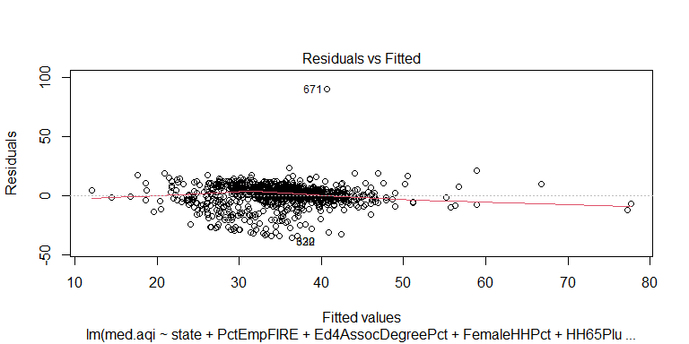

Slide 37
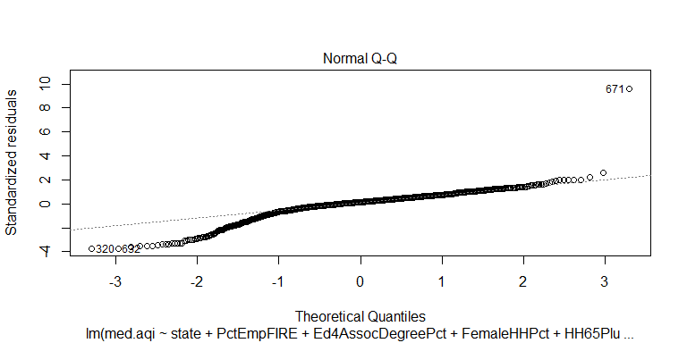

Slide 38
Conclusion
The overall objective of this study was to use the AQI of counties across the USA to determine the impact of variables on the climate. Using data collected by the EPA, we were able to focus on the effect of the Climate Alliance on curbing the deterioration of the AQI across the nation, as well as the correlation between aspects of counties and their air quality.
From this study, we were able to conclude that the Climate Alliance has not had much of an effect yet on the AQI of member states, but do have better AQIs on average compared to other states. We were also able to see that most of the impact on the AQI is geographical based on the significant variables of the model.

