Slide 1

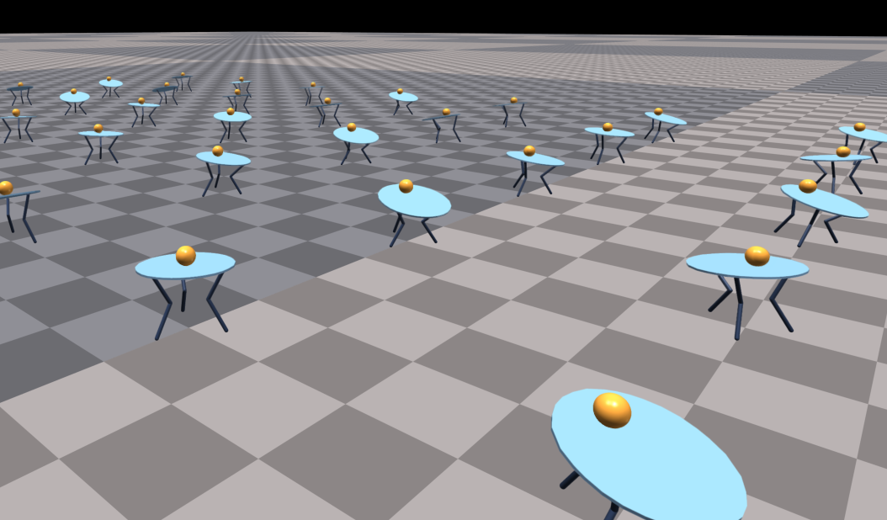
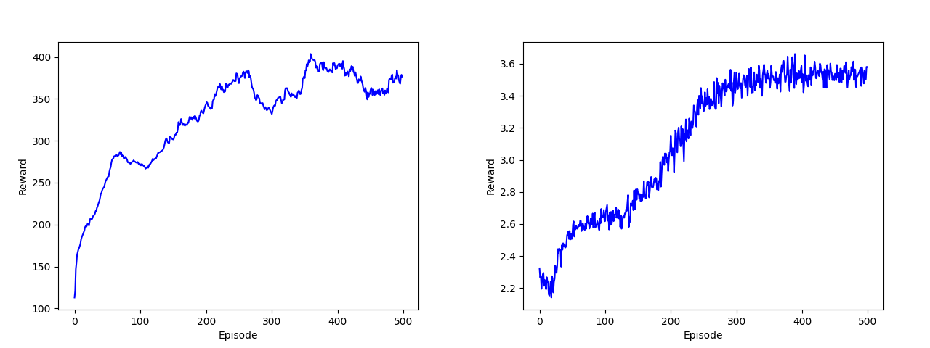
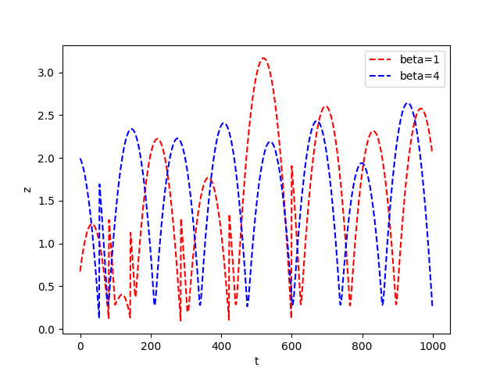
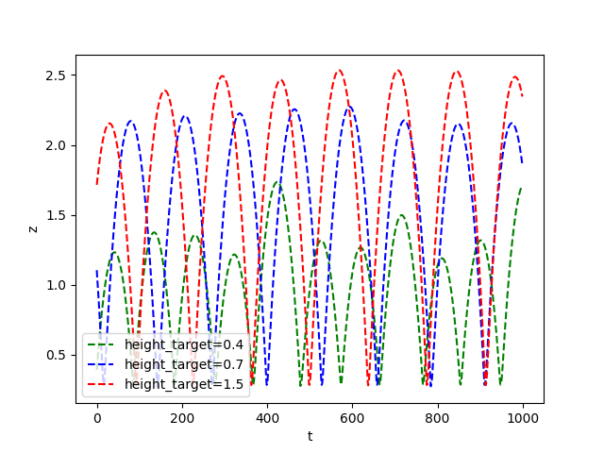
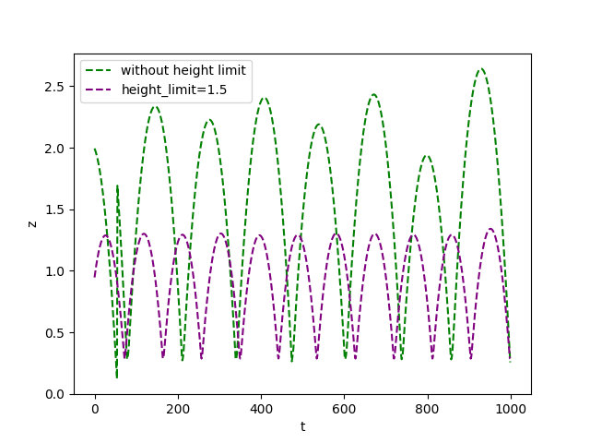
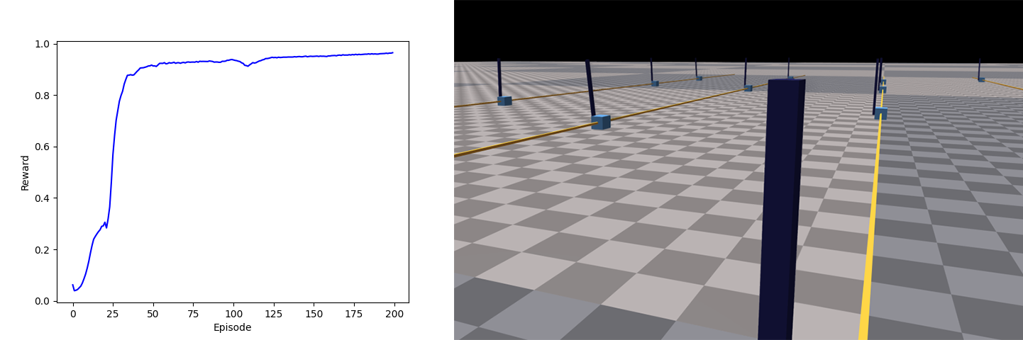
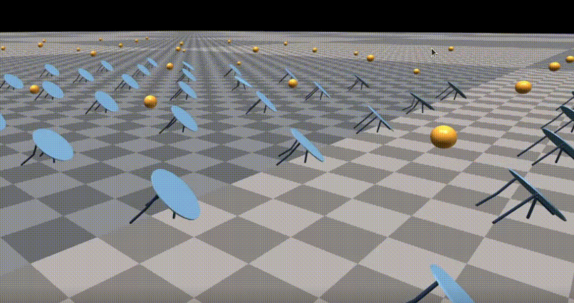
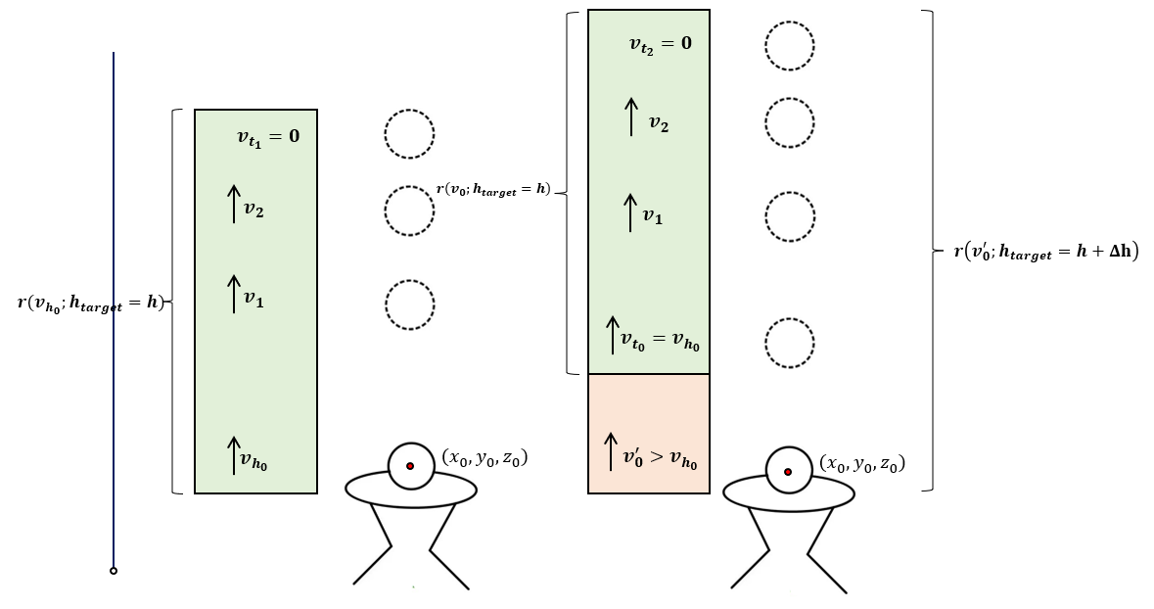
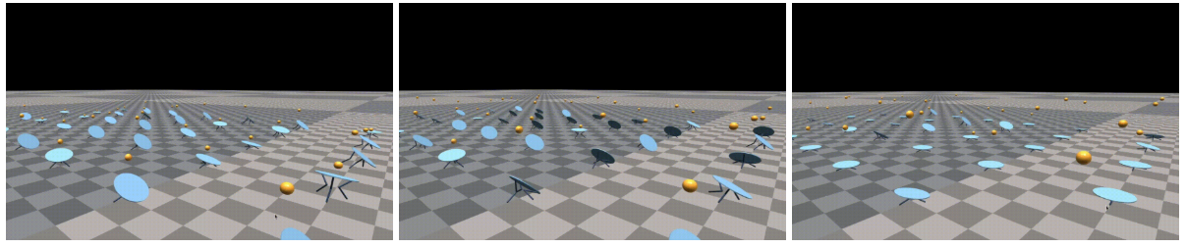
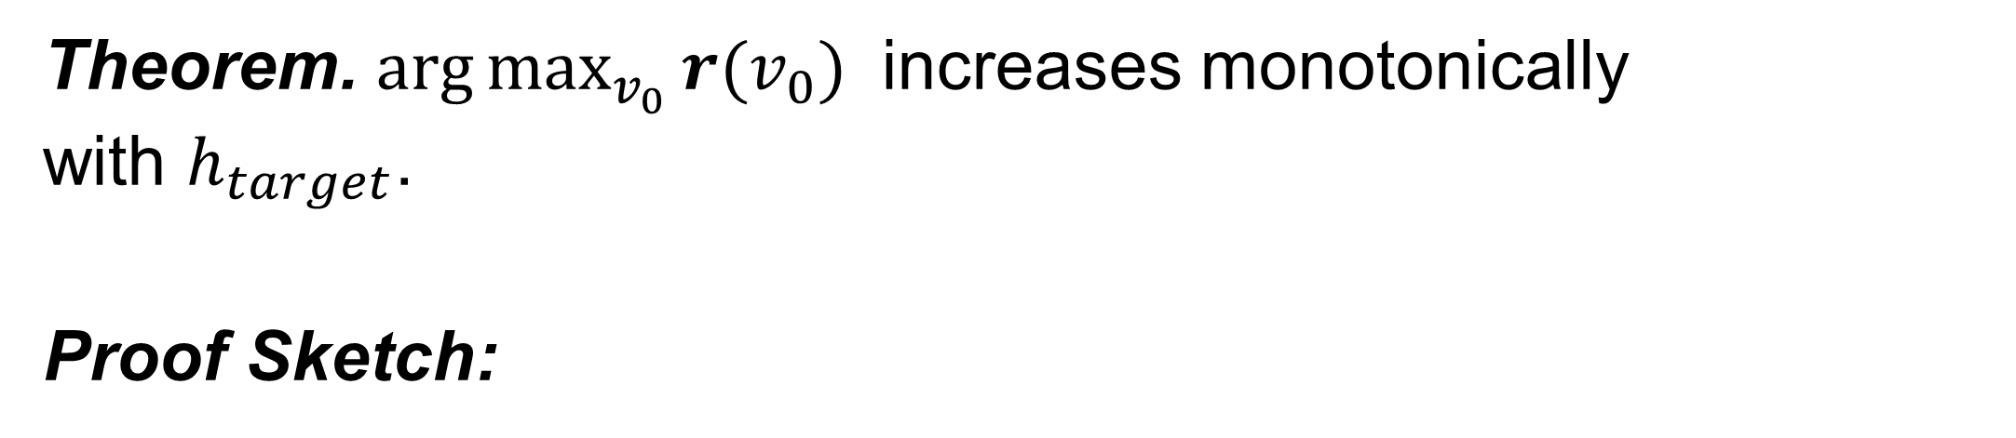
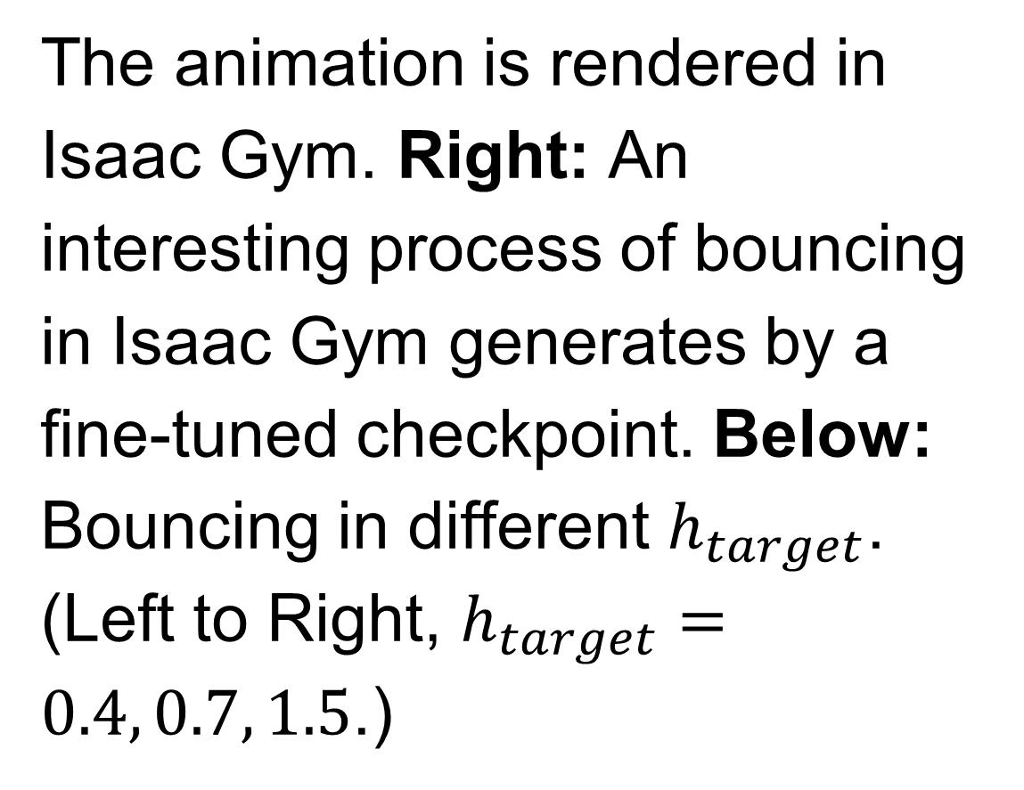
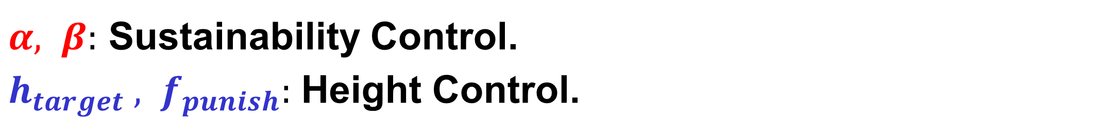
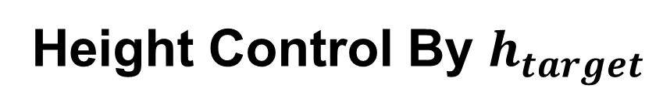
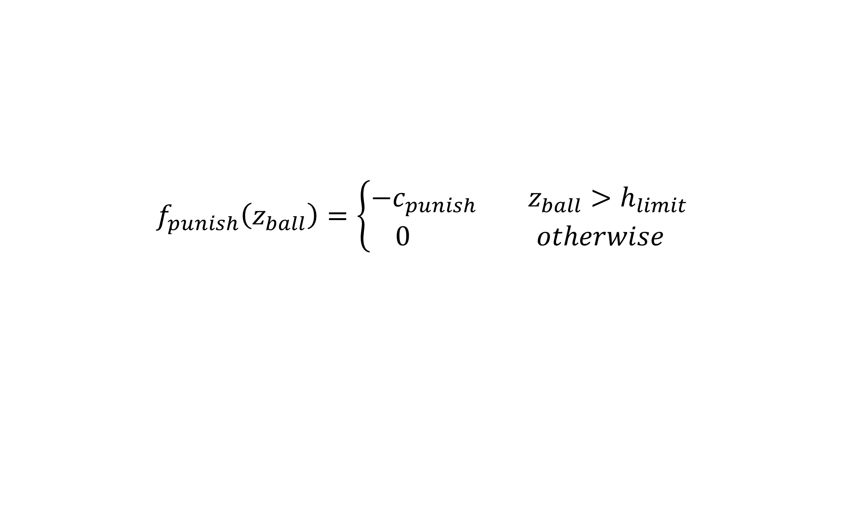
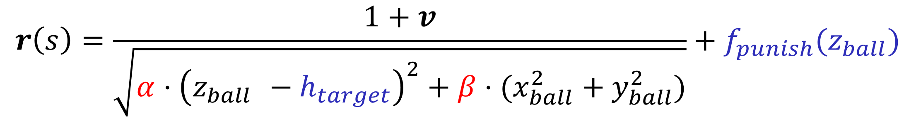
Balancing is Boring, Let’s Try Bouncing: Exploration of Ball Bouncing Task in Isaac Gym
Chaofan Lin
ACM Class, Zhiyuan College, Shanghai Jiao Tong University
Background
PIG Library
Ball Balancing Task in Isaac Gym
PIG
Isaac Gym: A physics simulation environment developed by NVIDIA for end-to-end GPU accelerated reinforcement learning research.
Ball Balancing: The agent controls the table by applying different forces to the legs, trying to keep the ball balanced on the table.
PPO
A-C NN
PPO
Agent
Isaac
Gym Envs
Experiments
Reward Curve
Left: RL Games. Right: PIG.
Motivation
Balancing is boring, let’s try bouncing: Modify the original Ball Balancing task to a new task called Ball Bouncing.
Training tasks in self-implemented RL algorithm is cool: PPO for Isaac Gym (PIG).
Different Sustainability
Height Control By $h_{target}$
Height Punishment
Ball Bouncing Task
Reward Function
Training Cartpole in PIG
$$r\left(s\right)=\frac{1+v}{\sqrt{α⋅{\left(z_{ball }−h_{target}\right)}^{2}+β⋅(x_{ball}^{2}+y_{ball}^{2})}}+f_{punish}(z_{ball})$$
$$f_{punish}\left(z_{ball}\right)=\left\{\begin{aligned}−c_{punish} z_{ball}>h_{limit} \\ 0 otherwise\end{aligned}\right.$$
$α, β:$ Sustainability Control.
$h_{target} , f_{punish}:$ Height Control.
Visualize Bouncing
Height Control Analysis
The animation is rendered in Isaac Gym. Right: An interesting process of bouncing in Isaac Gym generates by a fine-tuned checkpoint. Below: Bouncing in different $h_{target}$. (Left to Right, $h_{target}=0.4, 0.7, 1.5$.)
Theorem. $\arg{\max_{v_{0}}{r(v_{0})} }$ increases monotonically with $h_{target}$.
Proof Sketch:
GIFs: https://github.com/SiriusNEO/GOODBOUNCE
CS3316 - Reinforcement Learning - Course Project
https://acm.sjtu.edu.cn/home

