Slide 1



sim=0.63
sim=0.74
sim=0.12
sim=0.56

Slide 2
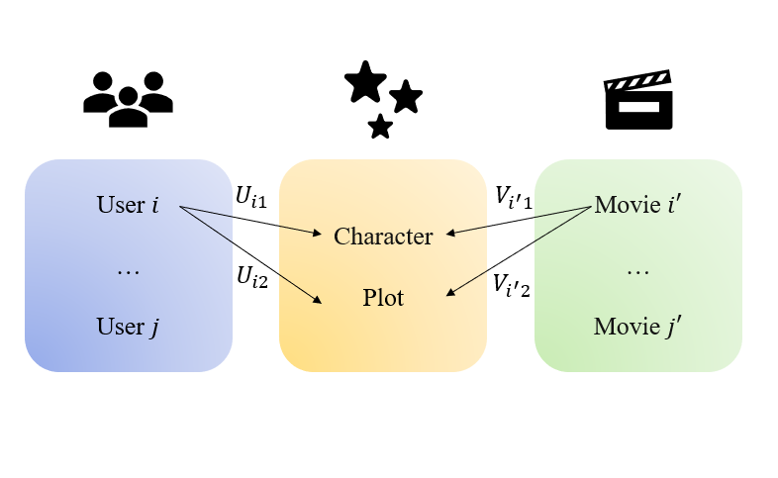

Slide 3







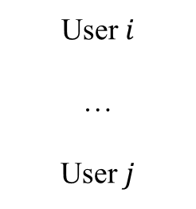
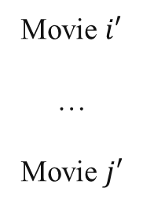
User $i$
…
User $j$
$$U_{i1}$$
$$V_{i^{′}1}$$
Movie $i′$
…
Movie $j′$
Character
Plot
$$U_{i2}$$
$$V_{i^{′}2}$$

